Slide 1
Water Pollution

Slide 2
Water Pollution: Types, Effects, and Sources
What is water pollution?
Major types of pollutants, sources and effects
Point and nonpoint sources
Is the water safe to drink?

Slide 3
Major Categories of Water Pollutants
Infectious Agents
  Bacteria, Viruses, Protozoa, Parasitic Worms
  Source: Human and animal waste
Oxygen-Demanding Waste
  Organic debris & waste + aerobic bacteria
  Source: Sewage, feedlots, paper-mills, food processing
Inorganic Chemicals
  Acids, Metals, Salts
  Sources: Surface runoff, Industrial effluent, household cleansers
Radioactive Materials
  Iodine, radon, uranium, cesium, thorium
  Source: Coal & Nuclear Power plants, mining, weapons production, natural
Plant Nutrients
  Nitrates, Phosphates,
  Source: Sewage, manure, agricultural and landscaping runoff
Organic Chemicals
  Oil, Gasoline, Plastics, Pesticides, Solvents, detergents
  Sources: Industrial effluent, Household cleansers, runoff from farms and yards
Eroded Sediment
  Soil, Silt
Heat/Thermal Pollution
  Source: Power plants, Industrial

Slide 4
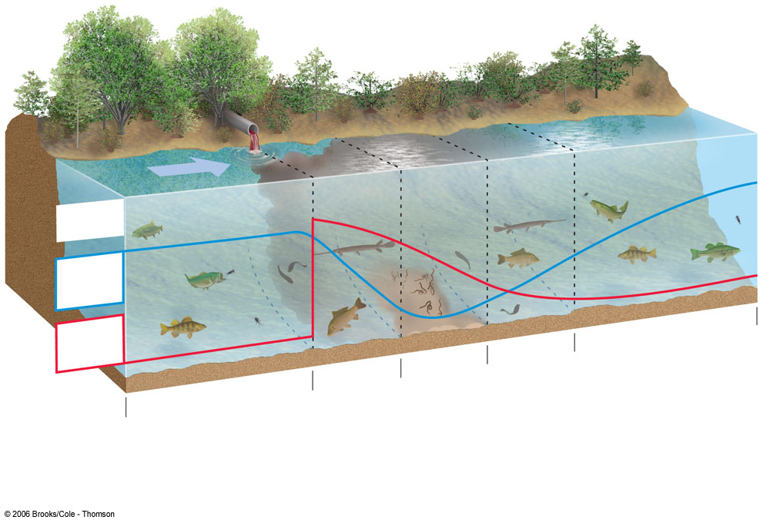
Pollution in Streams
Normal clean water organisms
(trout, perch, bass,
mayfly, stonefly)
Fish absent, fungi,
sludge worms,
bacteria
(anaerobic)
Trash fish
(carp, gar,
leeches)
Normal clean water organisms
(trout, perch, bass,
mayfly, stonefly)
Trash fish
(carp, gar,
leeches)
8 ppm
Types of
organisms
Dissolved oxygen (ppm)
8 ppm
Biological oxygen
demand
Clean Zone
Recovery Zone
Septic Zone
Decomposition
Zone
Clean Zone

Slide 5
Benefits of Floodplains
Highly productive wetlands
Provide natural flood and erosion control
Maintain high water quality
Recharge groundwater
Fertile soils
Nearby rivers for use and recreation
Flatlands for urbanization and farming

Slide 6
Dangers of Floodplains and Floods
Deadly and destructive
Human activities worsen floods
Failing dams and water diversion
Bangladesh

Slide 7
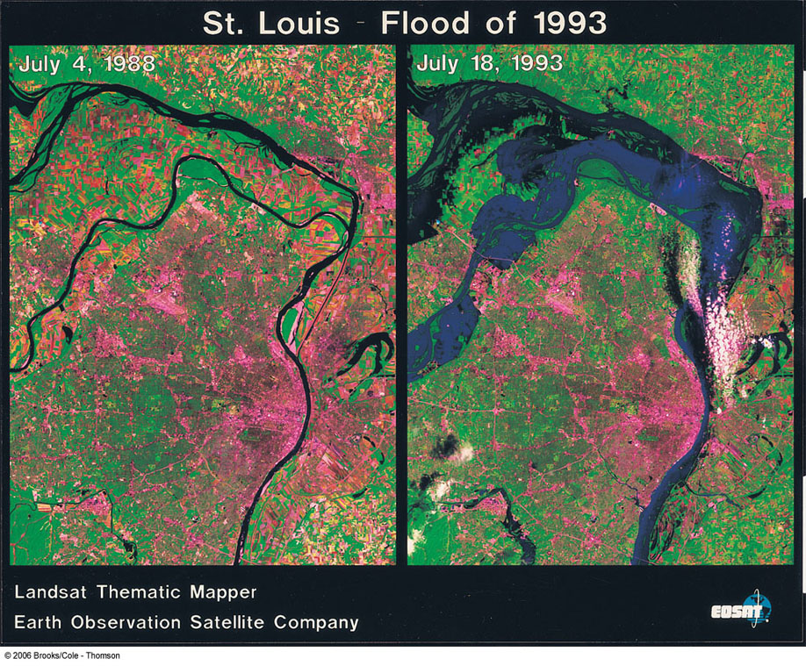
Before and During a Flood in St. Louis, Missouri

Slide 8
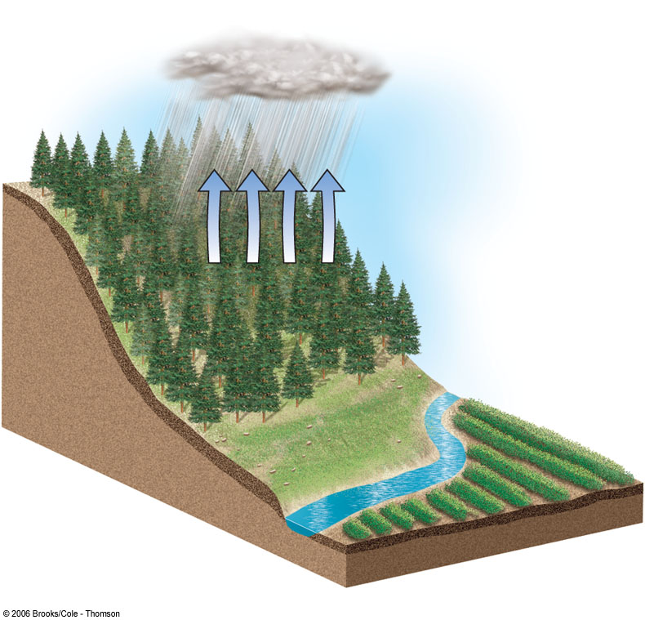
Flooding After Deforestation of a Hillside
Forested Hillside
Oxygen
released by
vegetation
Diverse
ecological
habitat
Evapotranspiration
Trees reduce soil
erosion from heavy
rain and wind
Agricultural
land
Steady
river flow
Leaf litter
improves
soil fertility
Vegetation releases
water slowly and
reduces flooding
Tree roots stabilize soil and aid water flow

Slide 9
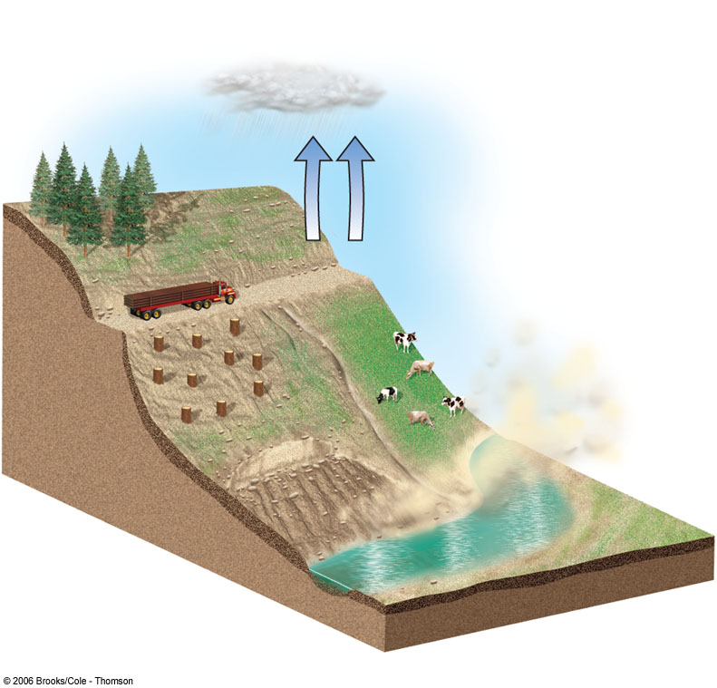
Flooding After Deforestation of a Hillside
After Deforestation
Tree plantation
Evapotranspiration decreases
Roads
destabilize
hillsides
Ranching accelerates soil erosion by water and wind
Winds remove
fragile topsoil
Agriculture land
is flooded and
silted up
Gullies and
landslides
Heavy rain leaches nutrients from soil and erodes topsoil
Rapid runoff
causes flooding
Silt from erosion blocks rivers and
reservoirs and causes flooding downstream

Slide 10
Reducing Flood Risks
Channelization
Levees (floodwalls)
Dams
Protect and restore wetlands
Identify and manage flood-prone areas
Precautionary approach

Slide 11
Lake Pollution
Dilution less effective than with streams
Stratification in lakes and relatively little flow hinder rapid dilution of pollutants
Lakes more vulnerable to pollutants than streams
How pollutants enter lakes
Eutrophication: causes and effects
Oligotrophic and eutrophic lakes
Cultural eutrophication
Preventing or removing eutrophication

Slide 12
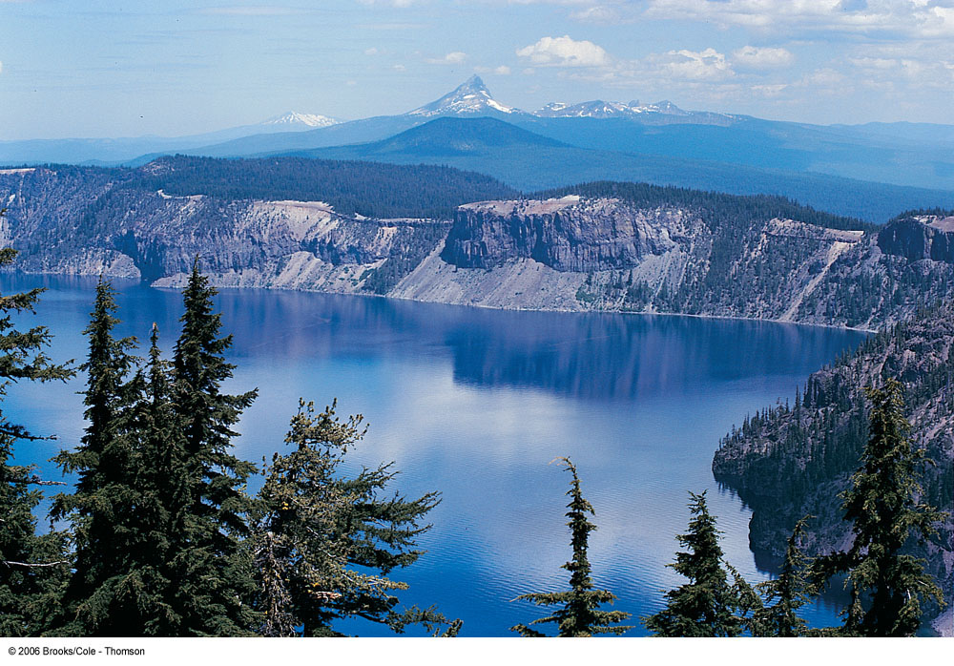
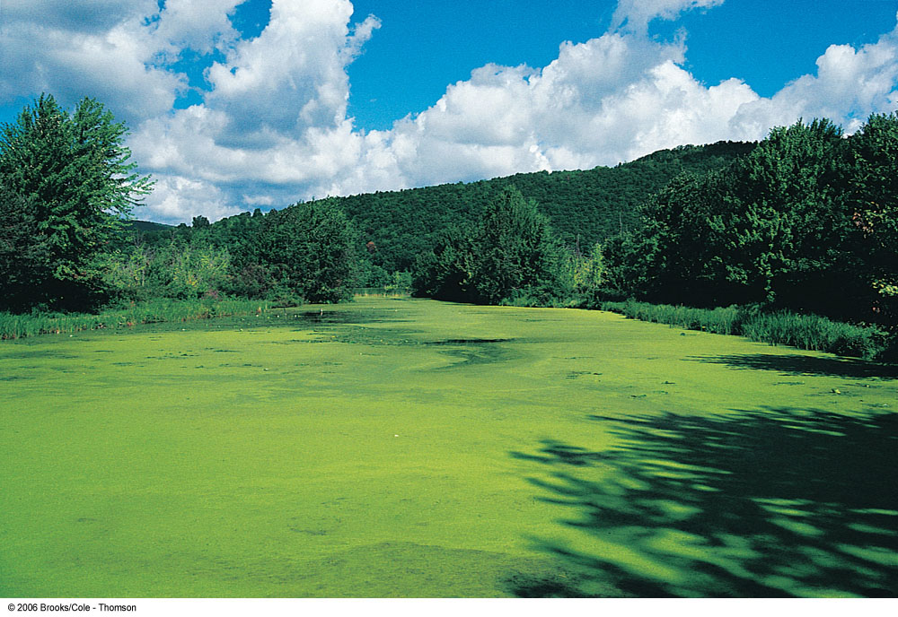
Oligotrophic and Eutrophic Lakes

Slide 13
Groundwater Pollution: Causes and Persistence
Sources of groundwater pollution
Slow flowing: slow dilution and dispersion
Consequences of lower dissolved oxygen
Fewer bacteria to decompose wastes
Cooler temperatures: slow down chemical reactions
“Degradable” and nondegradable wastes in groundwater

Slide 14
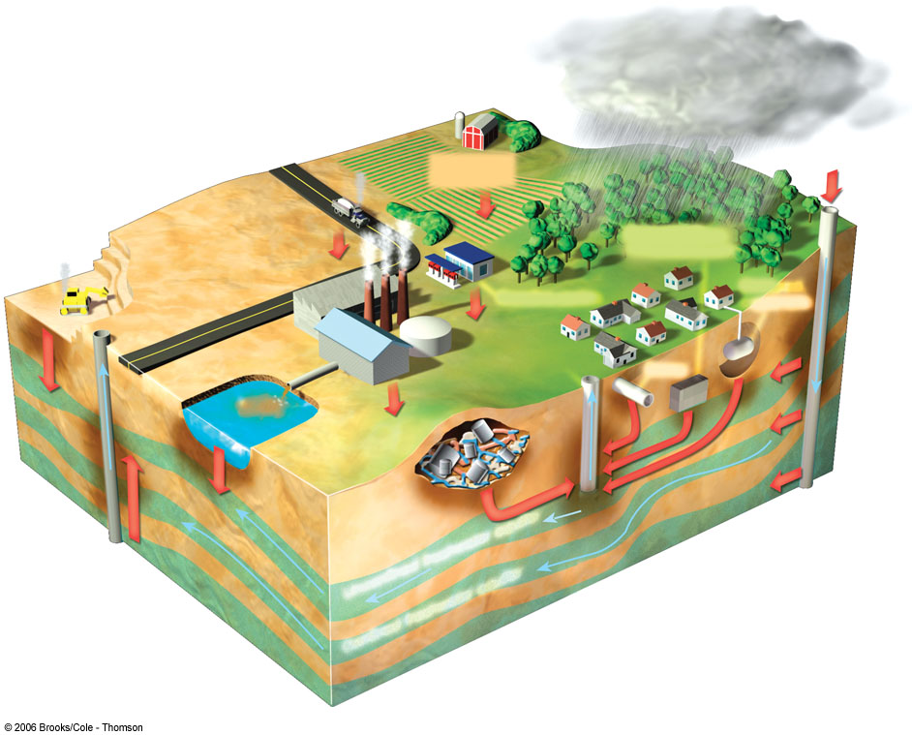
Groundwater Pollution
Polluted air
Hazardous waste injection well
Pesticides
and fertilizers
Coal strip mine runoff
De-icing road salt
Buried gasoline and solvent tank
Pumping well
Gasoline station
Water pumping well
Cesspool septic tank
Waste lagoon
Sewer
Landfill
Leakage from faulty casing
Accidental spills
Discharge
Unconfined freshwater aquifer
Confined aquifer
Confined freshwater aquifer
Groundwater flow

Slide 15
Extent of Groundwater Pollution
Not much is known about groundwater pollution
Organic contaminants, including fuel leaks
Arsenic
Protecting groundwater: Prevention is best

Slide 16
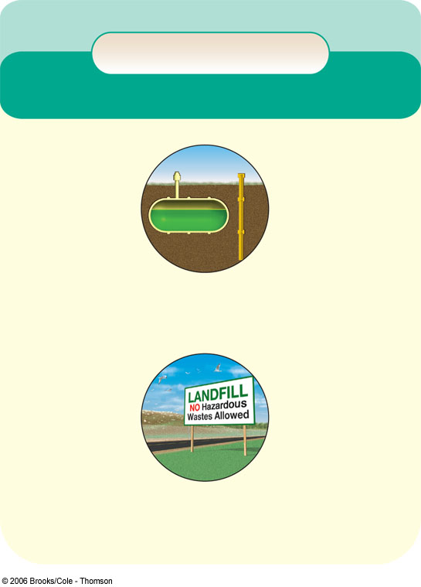
Preventing and Cleaning Up Pollution in Groundwater
Solutions
Groundwater Pollution
Prevention
Cleanup
Find substitutes for toxic chemicals
Pump to surface, clean, and return to aquifer (very expensive)
Keep toxic chemicals out of the environment
Install monitoring wells near
landfills and underground tanks
Inject microorganisms to clean up contamination (less expensive but still costly)
Require leak detectors on underground tanks
Ban hazardous waste disposal
in landfills and injection wells
Pump nanoparticles of inorganic compounds to remove pollutants (may be the cheapest, easiest, and most effective method but is still being developed)
Store harmful liquids in aboveground tanks with leak detection and collection systems

Slide 17
Ocean Pollution
How much pollution can oceans tolerate?
Some pollutants degrade and dilute in oceans
Ocean dumping controversies

Slide 18
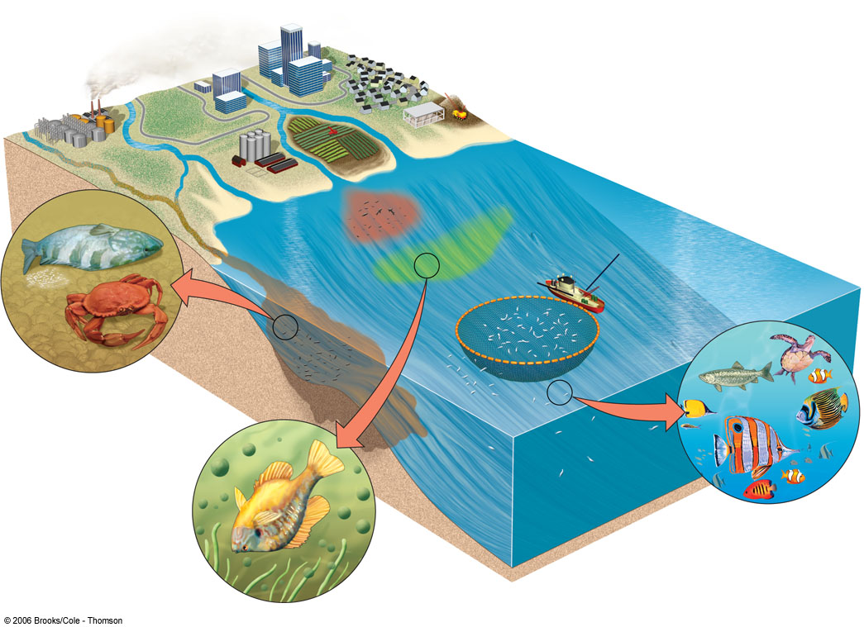
Coastal Water Pollution
Industry
Nitrogen oxides from autos and smokestacks; toxic
chemicals, and heavy
metals in effluents flow into bays and estuaries.
Cities
Toxic metals and
oil from streets and
parking lots pollute
waters; sewage
adds nitrogen and
phosphorus.
Urban sprawl
Bacteria and viruses from sewers and septic tanks contaminate shellfish beds and close beaches; runoff of fertilization from lawns adds nitrogen and phosphorus.
Construction sites
Sediments are washed into waterways,
choking fish and plants, clouding
waters, and blocking sunlight.
Farms
Run off of pesticides, manure, and fertilizers adds toxins and excess nitrogen and phosphorus.
Red tides
Excess nitrogen causes explosive growth of toxic microscopic algae, poisoning fish and marine mammals.
Closed
shellfish beds
Closed
beach
Oxygen-depleted
zone
Toxic sediments
Chemicals and toxic metals
contaminate shellfish beds,
kill spawning fish, and
accumulate in the tissues
of bottom feeders.
Healthy zone
Clear, oxygen-rich waters
promote growth of plankton
and sea grasses, and support fish.
Oxygen-depleted zone
Sedimentation and algae overgrowth reduce sunlight, kill beneficial sea grasses, use up oxygen, and degrade habitat.

Slide 19
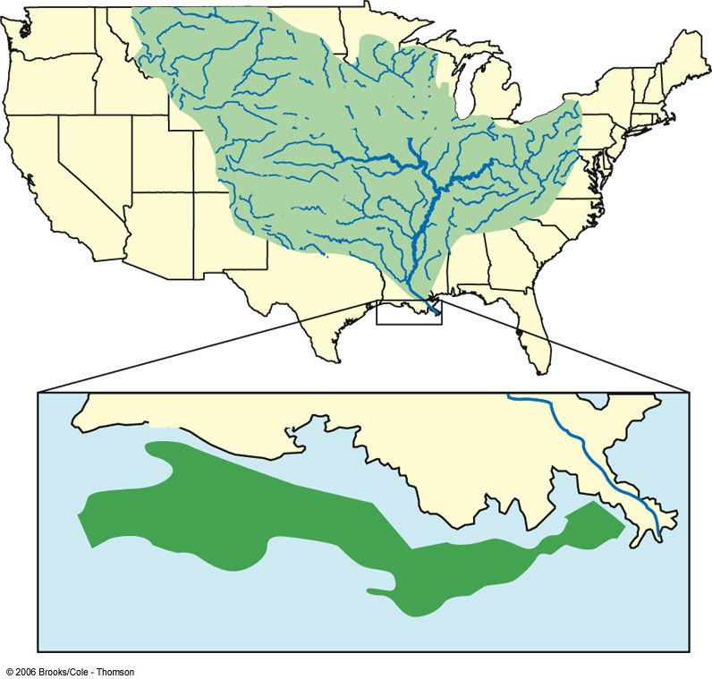
Oxygen-depleted Water in the Gulf of Mexico
Mississippi
River Basin
Ohio
River
Mississippi
River
Missouri
River
LOUISIANA
Mississippi
River
Depleted Oxygen
Gulf of Mexico

Slide 20
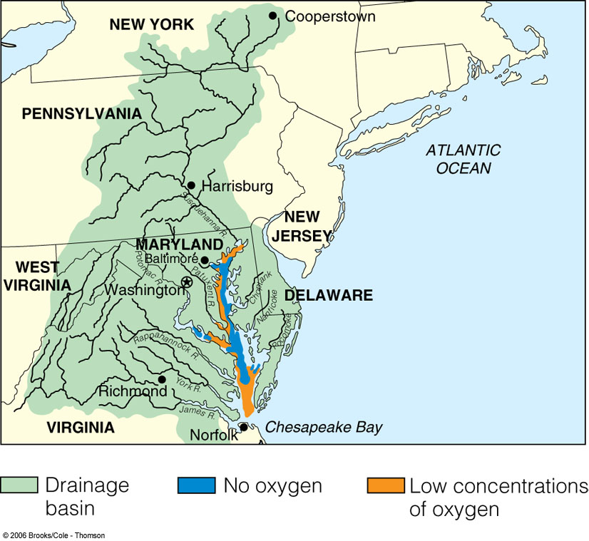
Chesapeake Bay
Largest US estuary
Pollution “sink”
Oxygen depletion
Chesapeake Bay Program

Slide 21
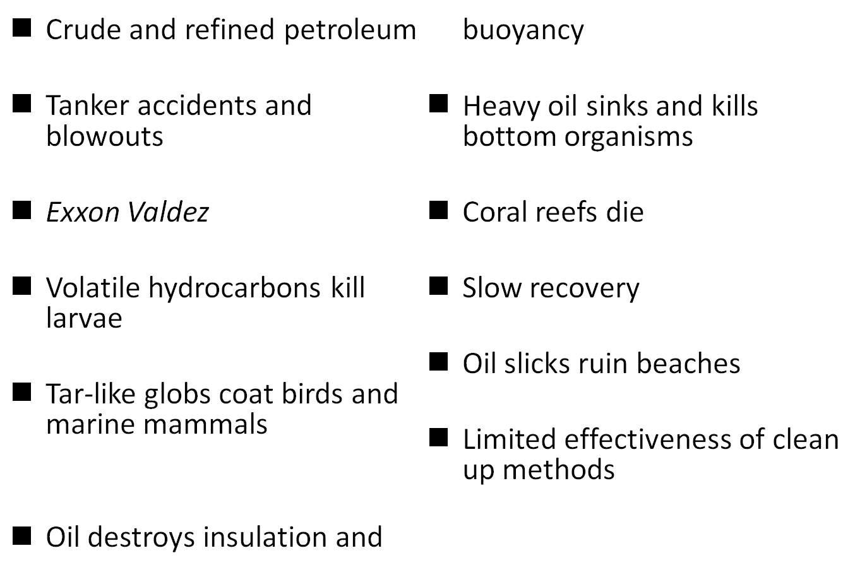
Effects of Oil on Ocean Life

Slide 22
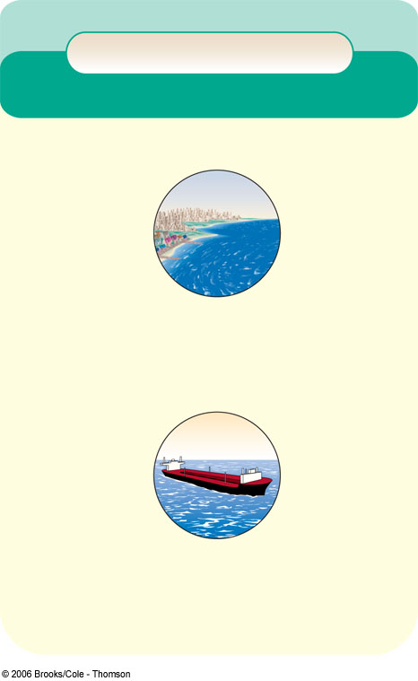
Preventing and Cleaning Up Pollution in Coastal Waters
Solutions
Coastal Water Pollution
Prevention
Cleanup
Reduce input of toxic pollutants
Improve oil-spill cleanup
capabilities
Separate sewage and storm lines
Ban dumping of wastes and sewage by maritime and cruise ships in coastal waters
Sprinkle nanoparticles over an oil or sewage spill to dissolve the oil or sewage without creating harmful byproducts
(still under development)
Ban ocean dumping of sludge and hazardous dredged material
Protect sensitive areas from development, oil drilling, and oil shipping
Require at least secondary
treatment of coastal sewage
Regulate coastal development
Use wetlands, solar-aquatic, or
other methods to treat sewage
Recycle used oil
Require double hulls for oil tankers

Slide 23
Preventing Nonpoint Source Pollution
Mostly agricultural wastes
Use vegetation to reduce soil erosion
Reduce fertilizer use
Use plant buffer zones around fields
Integrated pest management: Only use pesticides when necessary
Use plant buffers around animal feedlots
Keep feedlots away from slopes, surface water and flood zones

Slide 24
Laws for Reducing Point Source Pollution
Clean Water Act
Water Quality Act

Slide 25
Sewage Treatment Systems
Sewage treatment in rural and suburban areas
Septic tanks
Primary (physical) sewage treatment
Secondary (biological) sewage treatment
Urban sewage treatment (Clean Water Act)
Sewage treatment facilities in many cities fail to meet federal standards
Bleaching and disinfection
Disinfectants: chlorine, ozone, and ultraviolet radiation

Slide 26
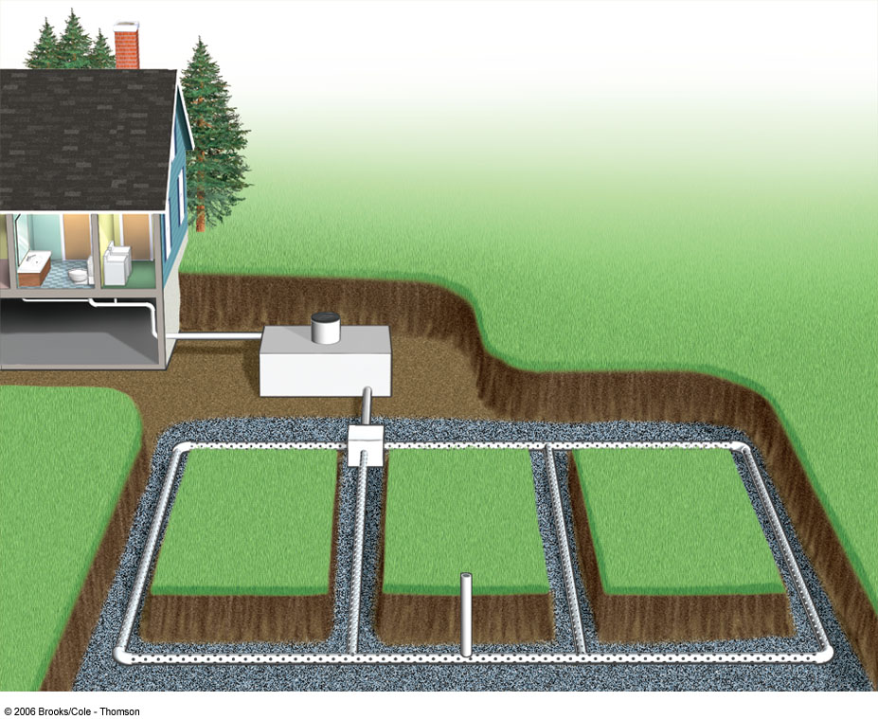
Typical Septic Tank System
Septic tank with manhole (for cleanout)
Household
wastewater
Nonperforated pipe
Distribution box (optional)
Gravel or
crushed
stone
Drain
field
Vent pipe
Perforated pipe

Slide 27
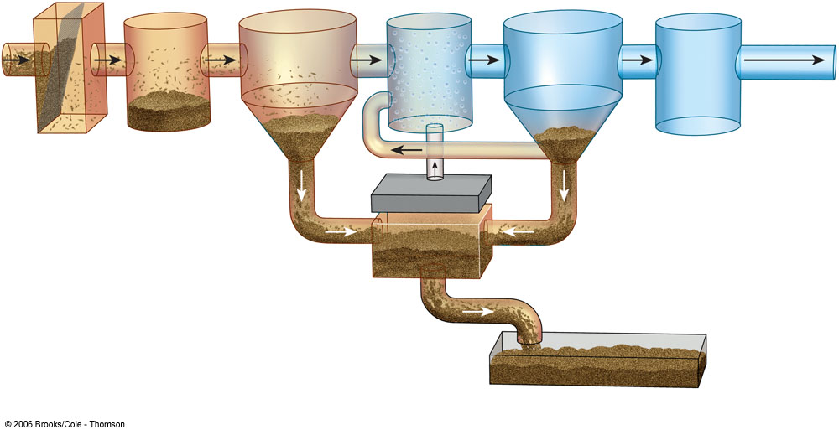
Primary and Secondary Sewage Treatment
Primary
Secondary
Bar screen
Chlorine
disinfection tank
Grit chamber
Settling tank
Aeration tank
Settling tank
To river, lake,
or ocean
Sludge
Activated sludge
(kills bacteria)
Raw sewage
from sewers
Air pump
Sludge digester
Disposed of in landfill or ocean or applied to cropland, pasture, or rangeland
Sludge drying bed

Slide 28
Improving Sewage Treatment
Systems that exclude hazardous wastes
Non-hazardous substitutes
Composting toilet systems
Working with nature to treat sewage
Using wetlands to treat sewage

Slide 29
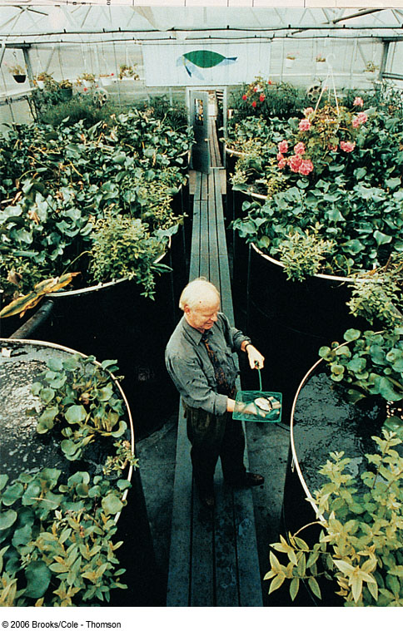
Ecological Wastewater Treatment
Burlington, VT
University of Vermont

Slide 30

Should the Clean Water Act be Strengthened?
State and local officials want more discretion

Slide 31
Drinking Water Quality
Purification of urban drinking water
Purification of drinking water in developing countries
Bottled water

Slide 32


Solutions
What Can You Do?
Water Pollution
Water Pollution
Prevent groundwater contamination
Greatly reduce nonpoint runoff
Reuse treated wastewater for irrigation
Find substitutes for toxic pollutants
Work with nature to treat sewage
Practice four R's of resource use (refuse, reduce, recycle, reuse)
Reduce resource waste
Reduce air pollution
Reduce poverty
Reduce birth rates
Fertilize your garden and yard plants with manure or compost instead of commercial inorganic fertilizer.
Minimize your use of pesticides.
Never apply fertilizer or pesticides near a body of water.
Grow or buy organic foods.
Compost your food wastes.
Do not use water fresheners in toilets.
Do not flush unwanted medicines down the toilet.
Do not pour pesticides, paints, solvents, oil, antifreeze, or other products containing harmful chemicals down the drain or onto the ground.

