Slide 1


Baysten Onboarding Optimization
Reducing User Drop-Off Through AI-Powered Resume Parsing
Team Members: Lakhvir Sohal, Spurthi Jayadeva, Naisha Khera, Yanxi Lu, Himaja Reddy Kandati
Date: April 15th, 2026

Slide 2

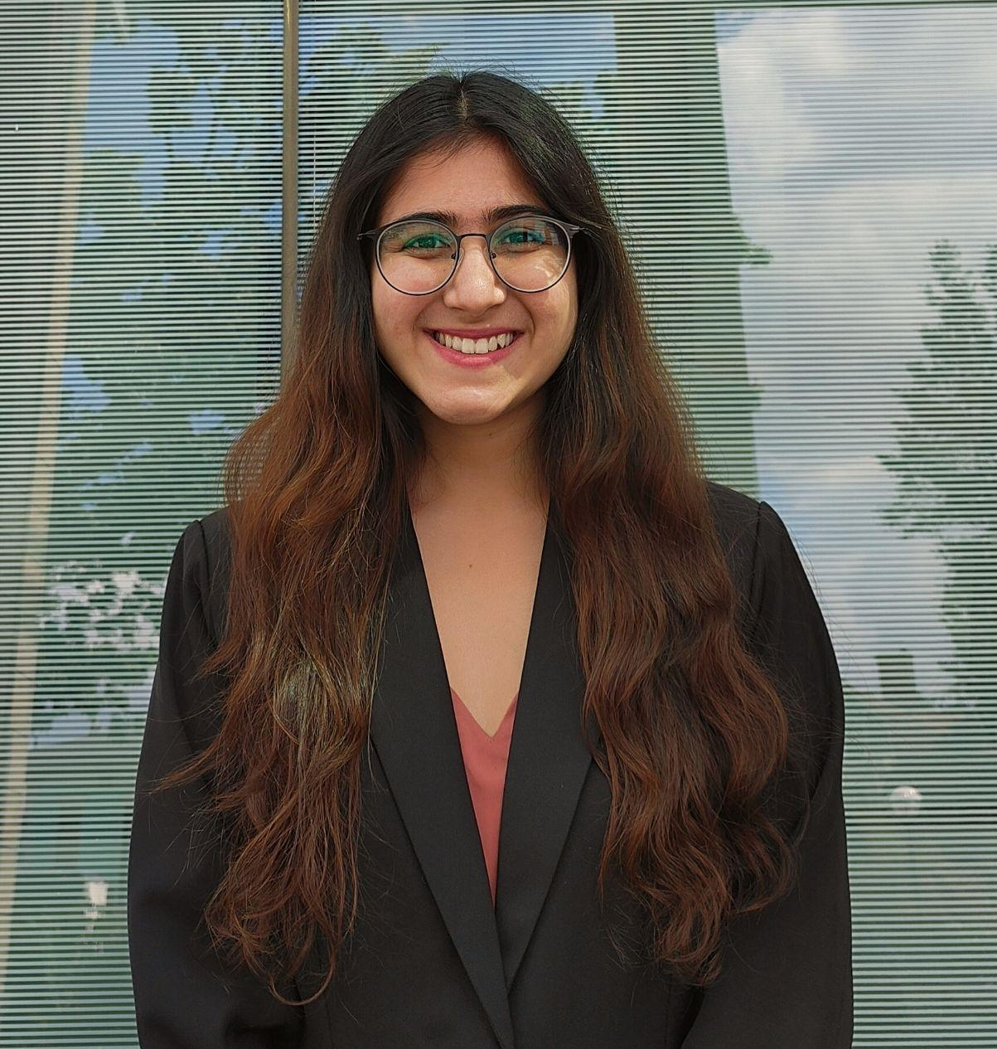



Michigan Ross Team
Lakhvir Sohal
Naisha Khera
Himaja Reddy Kandati
Yanxi Lu
Spurthi Jayadeva
Hometown
Tirupati, India Shenzhen, CN
Mombasa, Kenya
New Delhi, India
Troy, MI
Career Interests
The ability to impact a several lives or organizations
Working at the intersection of data and people
Data-driven strategy and analytics for business impact
Intersection of AI, Fintech, and strategic business growth
Using data, tech, and human behavior for decision-making
B.S. Statistics (Minors: Data Science & QMSS), UMich
BBA in Houston, Texas
Sales & Marketing Analyst at Kaveri Seed Company Limited
B.S. Economics (Minors: Math & Stats), UMich
B.S. Cognitive Science (Minors: CS & QMSS) at UMich
Before Ross
Fun Fact
I support Manchester United so I live a horrible life.
I love spicy food
I actually enjoy cleaning messy data, it’s oddly satisfying
Big fan of horror movies
I climbed part of an active volcano!

Slide 3
Agenda
01
04
02
05
03
06
Problem
Results
Approach
Recommendations
Solution
Q&A

Slide 4

01
The Problem
Why onboarding friction is Baysten's most urgent growth barrier

Slide 5
Onboarding Friction Is Significantly Impacting Conversion
Onboarding is fully manual → no resume upload, no autofill
Users must invest 32 minutes before experiencing any platform value
Every drop-off = a lost match, lost revenue, and weaker search quality
Manual taxonomy checking adds operational burden
32 min
Average profile completion time
13%
Profile completion at sign up

Slide 6

The Current Onboarding Flow Has 7 Key Points
User downloads app
Begins creating account
Enters basic info
Enters work history
Enters education and skills
Enters DOB, hobbies, social links
Submits complete profile
Highest drop-off point
Only a fraction of users who start ever reach this step
What users told us:
"I didn't know how long it would take"
"I wasn't ready to put all this in before I could see how the platform works"
“I skipped sections and planned to come back but never finished”
Key Finding:
Users are reluctant to invest time before experiencing value

Slide 7

02
Our Approach
Three phase roadmap to deliver an AI-powered proof of concept
Notes:
Spurthi
We structured this project as a three-phase roadmap to move from problem identification to a working AI-powered proof of concept. We focused on understanding where and why users were dropping off, built and tested a proof of concept using an LLM-based resume parser, and transitioned that solution into our deliverables.

Slide 8
Three Core Findings Shaped Our Approach
1
2
3
Manual Entry Is the Primary Barrier
Field Design Creates Unnecessary Friction
Competing Platforms Have Solved This
Users averaged 32 minutes to complete onboarding
Drop-off increased sharply after work history
More required fields reduced completion likelihood
Top complaint: “Too much to fill in”
Several required fields are not matching-critical
DOB, hobbies, and extra social links add unnecessary load
Open-ended fields created uncertainty
Some fields felt confusing or inapplicable
Major platforms offer one-click resume import
Resume autofill is now a baseline expectation
Autofill improves profile completion rates
Baysten is behind competitors without it
Notes:
Spurthi
Our approach was driven by three major findings that consistently came up across both our qualitative and quantitative analysis.
First, manual entry is the primary barrier to onboarding completion. On average, users were spending about 32 minutes filling out their profiles before experiencing any real value from the platform. We also saw a sharp increase in drop-off once users reached more complex sections like work history. The most common feedback we heard was simply that there was ‘too much to fill in.’
Second, the way fields are currently designed is creating friction. Many fields, like date of birth, hobbies, or additional social links, don’t directly contribute to matching outcomes, yet they still demand time and effort from users. And adding too many open-ended fields created uncertainty, and some users weren’t even sure how to respond or whether certain fields applied to them.
Third, when we looked externally, it was clear that competing platforms have already addressed this issue. Resume autofill and one-click import are now standard expectations, not differentiators. These features dramatically reduce onboarding time and improve completion rates.
So when we put these three findings together, the takeaway was very clear: the biggest opportunity is removing friction, specifically by reducing manual entry wherever possible.

Slide 9
Project Methodology: 3 Phases
01
Research & Diagnosis
Conducted user interviews, identified drop-off points, and analyzed field-level friction drivers
02
Solution Design, Proof of Concept, and Testing
Developed LLM-based resume parser and validated through alpha and accuracy testing
03
Final Deliverables
Transferred production-ready code and delivered final report and presentation
Notes:
Spurthi
To execute this, we worked in three clearly defined phases.
In Phase 1, Research and Diagnosis, we conducted user interviews and analyzed onboarding data to identify exactly where users were struggling. We didn’t just look at overall drop-off but we went field by field to understand which inputs were causing the most friction and why.
In Phase 2, Solution Design, Proof of Concept, and Testing, we built an LLM-based resume parser designed to automatically extract key information and populate user profiles. We then validated this through resume and alpha testing, focusing on both accuracy and usability to ensure the solution actually improved the onboarding experience.
Finally, in Phase 3, Final Deliverables, we focused on implementation. We delivered production-ready code, along with a comprehensive report and recommendations to help Baysten integrate this into their existing system.
By structuring the project this way, we ensured that every step was aligned and grounded in real user needs. Now I’ll pass it off to Scarlet to talk more about our solution.

Slide 10

03
Our Solution
An LLM-powered resume parser built and tested for Baysten
Notes:
Yanxi
Thanks, Spurthi.
so Building on our research and testing, we focused on one key question: how to reduce onboarding friction without sacrificing data quality?
To address this, we designed a solution centered on an LLM-powered resume parser—making profile creation much faster while still preserving the structured data needed for matching.

Slide 11
We Built and Tested a Three-Part Solution
LLM Resume Parser
Accepts PDF/DOCX/TXT uploads. Claude extracts structured fields across formats via secure backend.
03
Rationalized Field Structure
Only email, password, and five skills required. All other fields optional to maximize completion.
01
02
Redesigned Onboarding Flow
Single-page onboarding with instant resume autofill and edit-based completion.
Notes:
Yanxi
Our solution has three connected parts.
First, the resume parser itself, which accepts PDF, DOCX, and TXT uploads and extracts structured information through a secure backend. This directly reduces the amount of manual entry required from users.
Second, we proposed a rationalized field structure. Instead of requiring users to complete a large number of fields upfront, we recommend that only email, password, and five skills remain required, while the rest become optional. This lowers the burden at sign-up and helps users complete onboarding with much less friction.
Third, we designed a redesigned onboarding flow built around a single-page experience with instant resume autofill and edit-based completion. So rather than asking users to type everything from scratch across multiple steps, it can let them upload, review, and edit—making the process feel much lighter and more intuitive.

Slide 12

Resume Parser Demo
Notes:
Yanxi
To make this more concrete, here’s a short demo of the resume parser in action. As you watch, the key thing to notice is how this shifts onboarding from manual entry to a much faster review-and-edit experience.

Slide 13

04
Results
Testing demonstrates accuracy and measurable improvements in speed

Slide 14
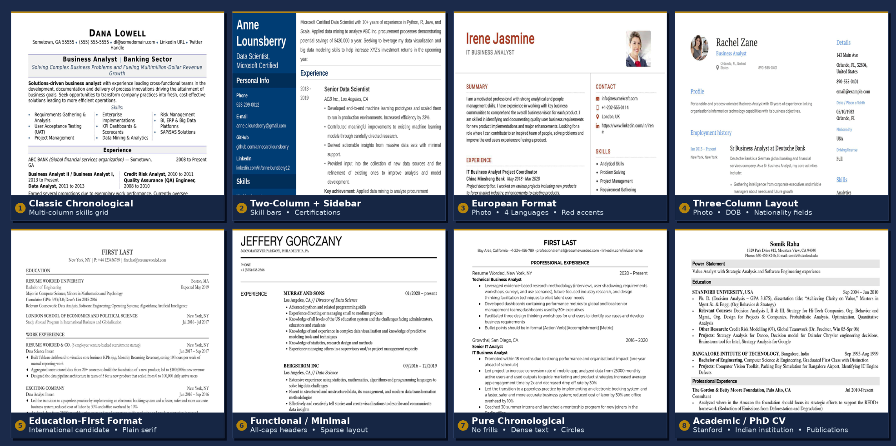
Resume Testing
We tested for accuracy across diverse layouts, languages, and industry backgrounds.

Slide 15
Our Parser Achieved 95.3% Accuracy and Reduced Completion Time by 84.4%
95.3%
Average field-level accuracy across 134 resumes
5 min
Average profile completion time with parser (vs. 32 min manual)
81.3%
Resumes scored 100% accuracy

Slide 16

05
Recommendations
Actionable roadmap to improve conversion

Slide 17
Implementation Roadmap
Now
2-4 Weeks
4-8 Weeks
Ongoing
Phase 1: Deploy Parser
Phase 2: Redesign Onboarding
Phase 3: Field Rationalization
Phase 4: Monitor & Expand
Integrate existing proof of concept into onboarding flow. No new infrastructure needed, as the backend proxy is ready. Begin tracking field acceptance rate and completion rate.
Implement single-page scrolling layout using our prototype. A/B test against current multi-step flow. Measure time-to-completion and drop-off by section.
Apply two-tier required/optional field structure. Remove flagged fields. Show optional fields progressively after profile is submitted.
Track accuracy drift, expand resume corpus, explore multilingual parsing. Use field acceptance rate to identify fields needing parser improvement.

Slide 18
Thank You!
Questions & Discussion

