Slide 1
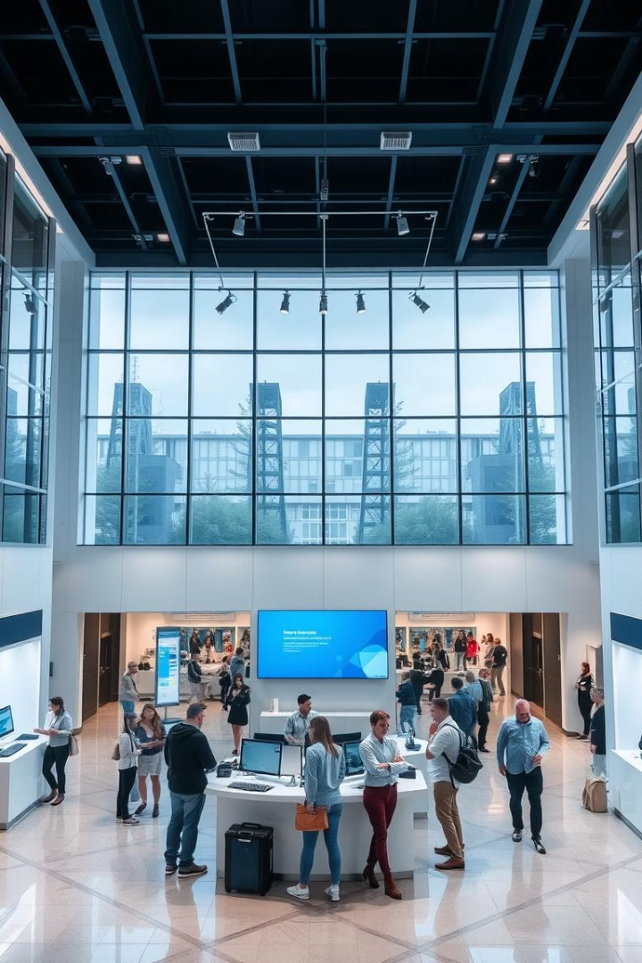
Bank Network Using Cisco
.efficient bank network using Cisco equipment for multiple branches.

Slide 2
Connections
Router
Switch
Computers
A router connects the branch network to the internet and to the central office, providing security and traffic management.
A switch connects computers and other devices within the branch, allowing for high-speed communication within the local network.
Computers are used by employees for banking operations, customer service, and data processing.

Slide 3

Advantages
Scalability
Security
The network can easily scale to accommodate growth in the number of branches and users.
Cisco equipment provides robust security features, protecting the network and sensitive data.
Reliability
Cost-Effectiveness
Cisco devices are known for their reliability and performance, ensuring network uptime and business continuity.
Cisco solutions offer a balance of performance and cost, providing a cost-effective network solution for banks.

Slide 4



Disadvantages
Complexity
1
Setting up and managing a large network can be complex and require specialized skills.
Cost
2
Cisco equipment can be expensive, especially for large deployments.
Maintenance
3
Ongoing maintenance and updates are required to ensure optimal network performance and security.

