Slide 1

AI-driven Hypertension & Diabetes Prevention Mobile App for
sri lankans
25-26J-371

Slide 2
01.
AI-Driven Early Hypertension Risk Prediction & Personalized Recommendation
Components
Owner: IT22178886 | Rathnayaka L.P.N.K.
02.
Early Risk Prediction for Diabetic Management
Owner: IT22178886 | Ravindu S.L
03.
AI-Powered Food Recognition & Nutrient-Driven Dietary Recommendation
Owner: IT22178886 |
04.
Domain-Specific Intelligent AI Agent for Stress Monitoring
Owner: IT22623690 |

Slide 3
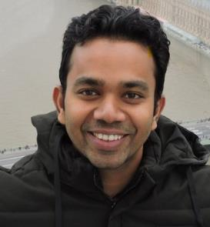
External Supervisor
Professor Lakmal Fonseka
MBBD, MD, MRCP, FRCP,
DPhil (Oxon)Faculty of Medicine,
University of Ruhuna

Slide 4

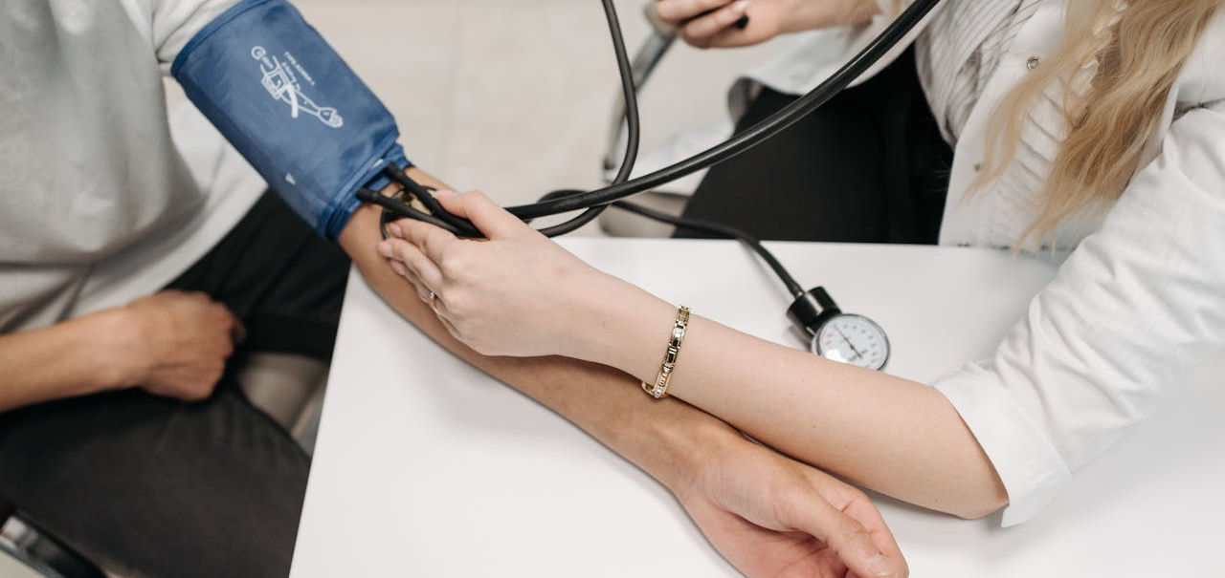
Problem & Motivation
Problem
Hypertension and diabetes are rapidly increasing health issues in Sri Lanka specially among the adults.
Stakeholders
Sri Lankan adults and patients
Healthcare providers and nutritionists
Health organizations and policymakers
Observed Issue
Many individuals detect these diseases only after symptoms appear
Lack of personalized preventive health guidance
Why it Matters
Leads to severe health complications
Increases healthcare costs
Reduces quality of life

Slide 5
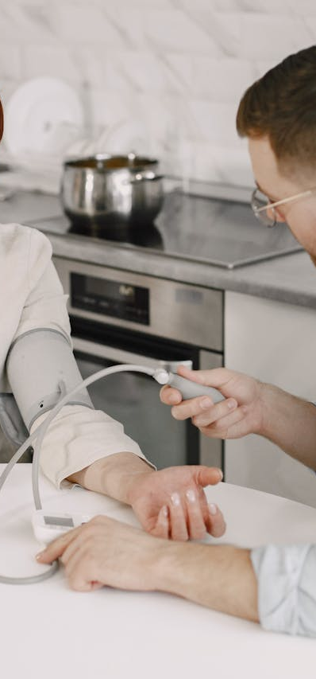


Research Gap & Objectives
Research gap
Most existing systems focus on diagnosis after disease onset rather than early prediction and prevention using integrated AI solutions.
Main Objective
Develop an AI-driven integrated system that:
Predicts early risk of hypertension & diabetes
Provide recommendations to control risk
Provides AI-based dietary recommendations
Monitors stress levels for early hypertension detection

Slide 6
Solution Overview
An AI-powered health monitoring platform that predicts hypertension and diabetes risk and provides personalized lifestyle recommendations..
Key Features
Non-Functional Focus
Usability
FR1-Hypertension Risk Prediction
Model accuracy
Reliability
Data privacy
FR2-Diabetes Risk Prediction model
Current Completion Status
FR3 - AI-powered food recognition with nutrient analysis
•Core ML models implemented •Frontend mobile interfaces completed
•Backend APIs integrate
FR4-Stress Monitoring AI Agent

Slide 7
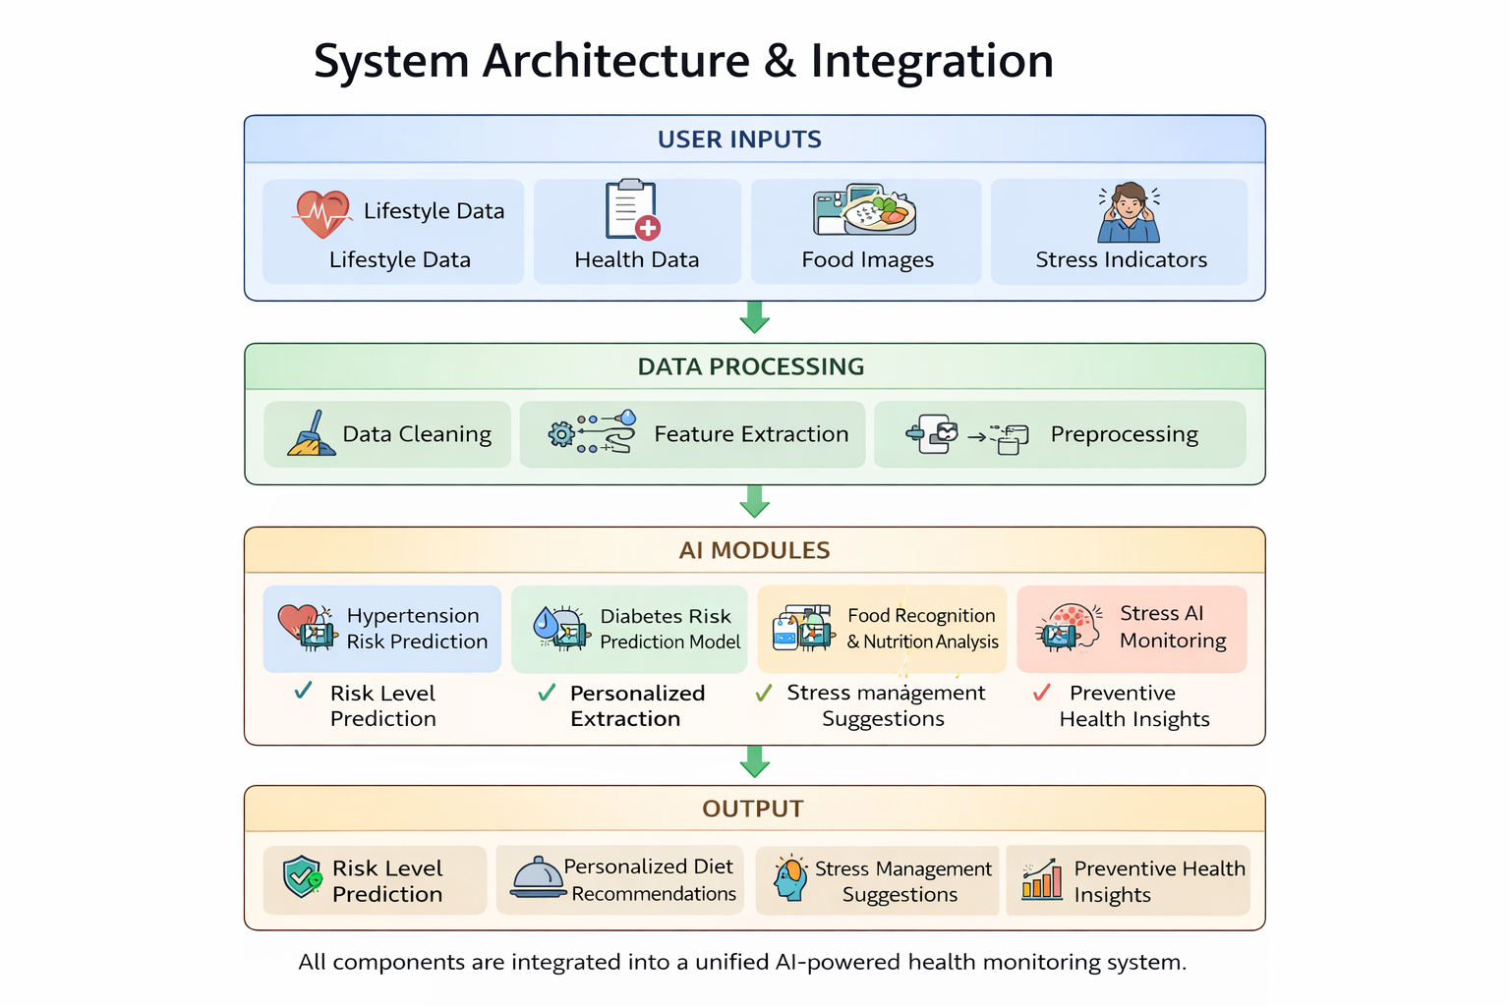
System Architecture & Integration
Backend Integration
• Python Flask backend • REST API communication • JSON data exchange
Data Management
• ChromaDB vector database • Firebase Firestore cloud database

Slide 8

Commercialization
Target Users
Individuals at risk of hypertension or diabetes
Health-conscious users
Healthcare providers
Wellness organizations
Value Proposition
Our solution provides:
Mobile health application
Personalized lifestyle recommendations
AI-based dietary guidance
Continuous stress monitoring

Slide 9
Cost & Feasibility
Estimated Cost Areas
Development Cost (AI models, mobile app development)
Software & API services
Legal and Administrative Expenses
Feasibility
Uses open-source technologies
Can be deployed as a scalable mobile application

Slide 10
Q&A

Slide 11
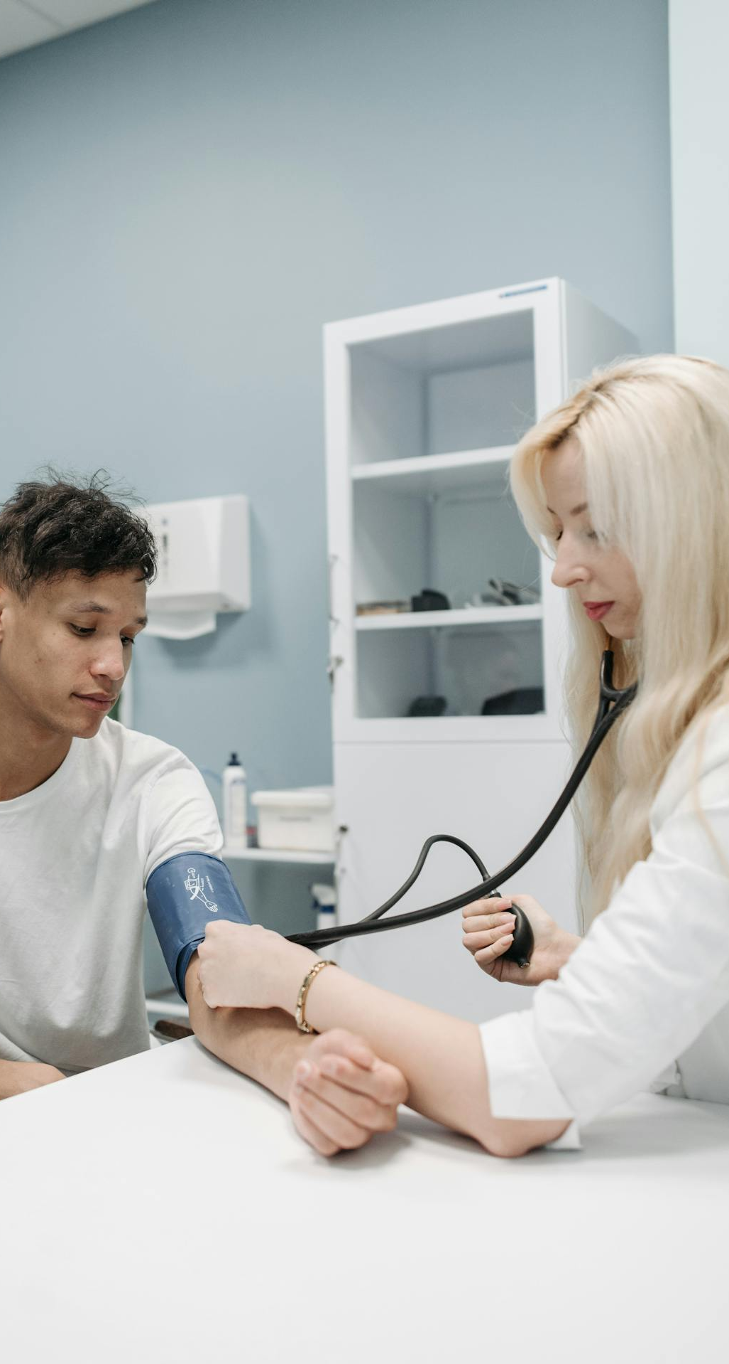
Thank You!

Slide 12
Doctors’ Comments

Slide 13
Recorded Video

Slide 14
Backup Plan

Slide 15
Recorded Video

Slide 16
Screenshots

