Slide 1




AI-Driven-hypertension and Diabetes-prevention-and-wellness-app
Specialization: Information Technology

Slide 3
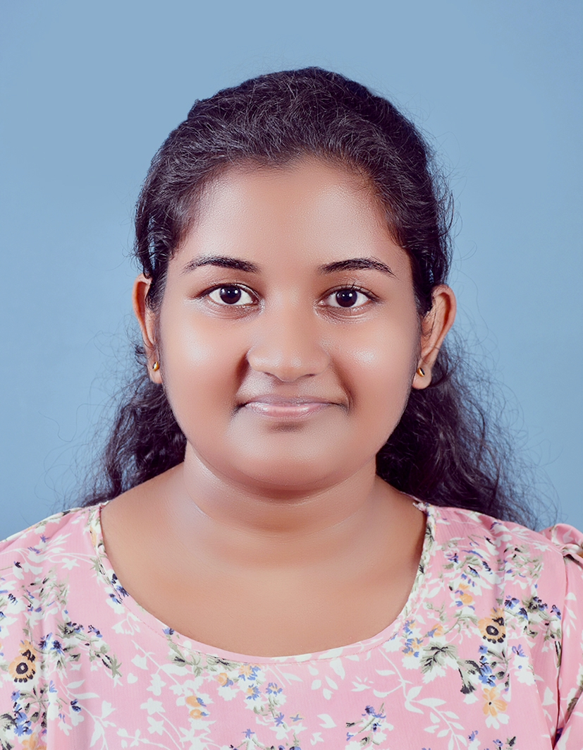
IT22178886 | Rathnayaka L.P.N.K.
AI-Driven Early Hypertension Risk Prediction and Personalized Recommendation System
Specialization: Information Technology
IT22178886 | Rathnayaka L.P.N.K | 25-26J-371

Slide 4



Early Hypertension Risk Prediction and Recommendation
Problem Statement
Hypertension is rapidly increasing among Sri Lankan office workers due to sedentary lifestyles, high stress, and excessive salt intake. Current prediction tools are based on Western clinical datasets and fail to reflect local behavior and diet patterns.
Impact:
Early detection and lifestyle modification can prevent 70% of potential hypertension cases.
Localized, AI-based prediction improves preventive health decisions.
How the Solution Addresses the Sub-Problem
Objective:
Predict early hypertension risk and recommend personalized preventive actions.
Prototype Features:
AI Model: Predicts early hypertension risk (trained using your dataset).
Explainability: Displays key factors contributing to risk.
Recommendation Engine: Provides tailored lifestyle interventions.
IT22178886 | Rathnayaka L.P.N.K | 25-26J-371

Slide 5

Early Hypertension Risk Prediction and Recommendation
User Requirements Addressed by the Solution
Accurate, localized prediction
Personalized wellness recommendations
Simple, web-based interface for accessibility
Design Excellence
Combines AI prediction, explainable insights, and wellness guidance in
one system.
Lightweight and deployable on low-resource environments.
Enables preventive health culture within office environments.
IT22178886 | Rathnayaka L.P.N.K | 25-26J-371

Slide 6
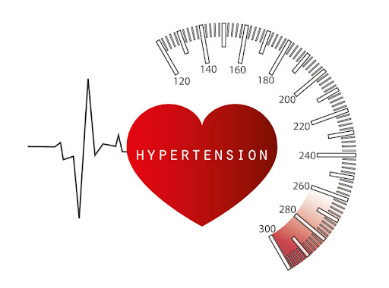
Early Hypertension Risk Prediction and Recommendation
User Feedback on Prototype
“Simple and informative helps understand my personal risk.”
“The recommendations are easy to follow and culturally relevant.”
“Visualization clearly shows why I’m at higher risk.”
IT22178886 | Rathnayaka L.P.N.K | 25-26J-371

Slide 7
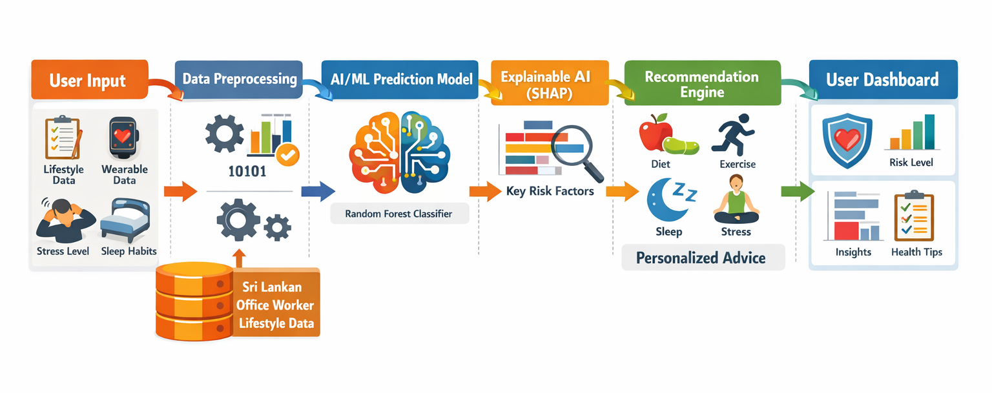
Early Hypertension Risk Prediction and Recommendation
System Overview
IT22178886 | Rathnayaka L.P.N.K | 25-26J-371

Slide 8
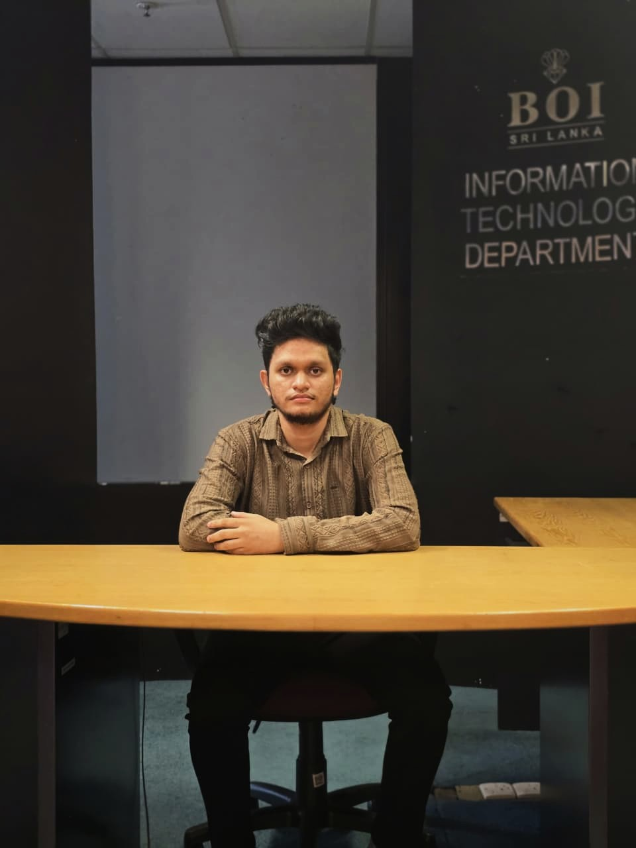
IT22587756 Ravindu S.L
Early Risk Prediction for Diabetic Management
Specialization: Information Technology
IT22587756 | Ravindu S.L | 25-26J-371

Slide 9
Early Risk Prediction for Diabetic Management
Problem Statement
Diabetes is increasing rapidly in Sri Lanka. (adults (23%)
Many people are diagnosed only after complications begin.
People lack timely and guidance to prevent diabetes.
A simple, low-cost solution is needed for early risk identification and prevention.
How the Solution Addresses the Sub-Problem
The solution uses multiple health factors and an XGBoost model to assess diabetes risk without lab tests or medical devices.
This makes screening easy and accessible, supports early detection and provides stage-based guidance for timely prevention.
IT22587756 | Ravindu S.L | 25-26J-371

Slide 10
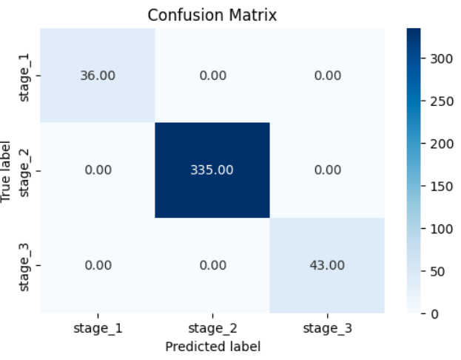
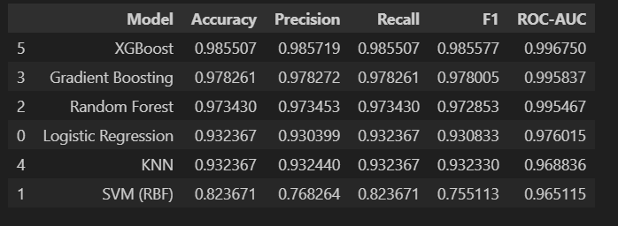
Early Risk Prediction for Diabetic Management
User Requirements Addressed by the Solution
Accessible screening without medical devices or laboratory tests
Clear three-tier risk classification for immediate understanding
Actionable medical recommendations for each stage with next steps
Design Excellence
XGBoost model optimization for max accuracy
Scalable design for adding new clinical variables
Scalable FastAPI backend enabling secure, reliable, and low-latency
IT22587756 | Ravindu S.L | 25-26J-371

Slide 11


IT22587206 | Jayanath M.I.T
AI-Powered Food Recognition & Nutrient-Driven Dietary Recommendation System
Specialization: Information Technology
IT22587206 | Jayanath M.I.T | 25-26J-371

Slide 12
AI-Powered Food Recognition & Nutrient-Driven Dietary Recommendation System
Problem Statement
Users struggle to understand the nutritional content of Sri Lankan meals and lack real-time guidance to manage their sodium, sugar, and overall dietary intake.
How the Solution Addresses the Sub-Problem
Instant nutrient detection by simply taking a photo of the meal.
Immediate alerts for high sodium, high sugar, and high fat levels.
Color-coded health indicators (Good, Caution, Warning) for quick understanding.
Personalized health warnings such as “May increase blood pressure” or “Not recommended for diabetics.”
Automatic tracking of daily sodium, sugar, and calorie intake.
IT22587206 | Jayanath M.I.T | 25-26J-371

Slide 13
.
AI-Powered Food Recognition & Nutrient-Driven Dietary Recommendation System
User Requirements Addressed by the Solution
Ability to instantly identify nutritional content by taking a photo.
Real-time alerts for high sodium, sugar, and fat levels.
Clear, color-coded indicators to understand health risks quickly.
Personalized warnings based on potential health impacts.
Automatic tracking of daily nutrient intake for better diet management.
Design Excellence
Advanced AI integration using YOLOv8 object detection fused with a Sri Lankan nutrition database for highly accurate diabetes- and hypertension-focused assessments.
Precise nutrient calculations powered by a custom health-logic layer that delivers real-time sodium, sugar, and risk-level analysis.
Scalable FastAPI backend enabling secure, reliable, and low-latency food analysis with locally stored nutritional data.
IT22587206 | Jayanath M.I.T | 25-26J-371

Slide 14
AI-Powered Food Recognition & Nutrient-Driven Dietary Recommendation System
User Feedback on Prototype
Quick and easy meal logging via photo.
Real-time alerts for high sodium and sugar.
Color-coded indicators simplify health risk understanding.
IT22587206 | Jayanath M.I.T | 25-26J-371

Slide 15

IT22623690 | Jayawardhana N.S.G
A Domain-Specific AI Health Coach for Stress and Hypertension Awareness in Sri Lankans
Specialization: Information Technology
IT22623690 | Jayawardhana N.S.G | 25-26J-371

Slide 16

A Domain-Specific AI Health Coach for Stress and Hypertension
Problem Statement
People often ignore early stress symptoms
Mental health support is limited
Hypertension is frequently detected at a later stage
There is a need for a simple, interactive, and preventive solution
How the Solution Addresses the Sub-Problem
Enables users to talk naturally about stress and well-being
Detects emotional stress using sentiment analysis
Uses the validated PSS-10 questionnaire for stress assessment
Predicts stress levels early to reduce hypertension risk
Provides culturally relevant Sri Lankan recommendations
IT22623690 | Jayawardhana N.S.G | 25-26J-371

Slide 17
A Domain-Specific AI Health Coach for Stress and Hypertension
User Requirements Addressed by the Solution
Users can express feelings using natural language
Users can check their stress level on demand
Users receive non-medical, preventive guidance
Users can ask hypertension-related questions
Users are guided safely during emotional distress
Design Excellence
Conversational health coach approach
Ethical design with clear non-diagnostic warnings
Crisis keyword detection with emergency guidance
Sri Lankan lifestyle and cultural context integration
Provides a conversational health coach experience
IT22623690 | Jayawardhana N.S.G | 25-26J-371

Slide 18
A Domain-Specific AI Health Coach for Stress and Hypertension
User Feedback on Prototype
Easy to use and understand.
Stress questions are relevant and clear.
Recommendations are practical for daily life.
They encourage early awareness and healthy habits
Testing Summary Table
Test Case | Input | Expected Output | Result
TC - 01 | I feel Stress | Stress detected | Pass
TC - 02 | I feel okay | Low Stress | Pass
TC - 03 | I want to die | Crisis message | Pass
TC - 04 | PDF upload | No Crash | Pass
IT22623690 | Jayawardhana N.S.G | 25-26J-371

Slide 19
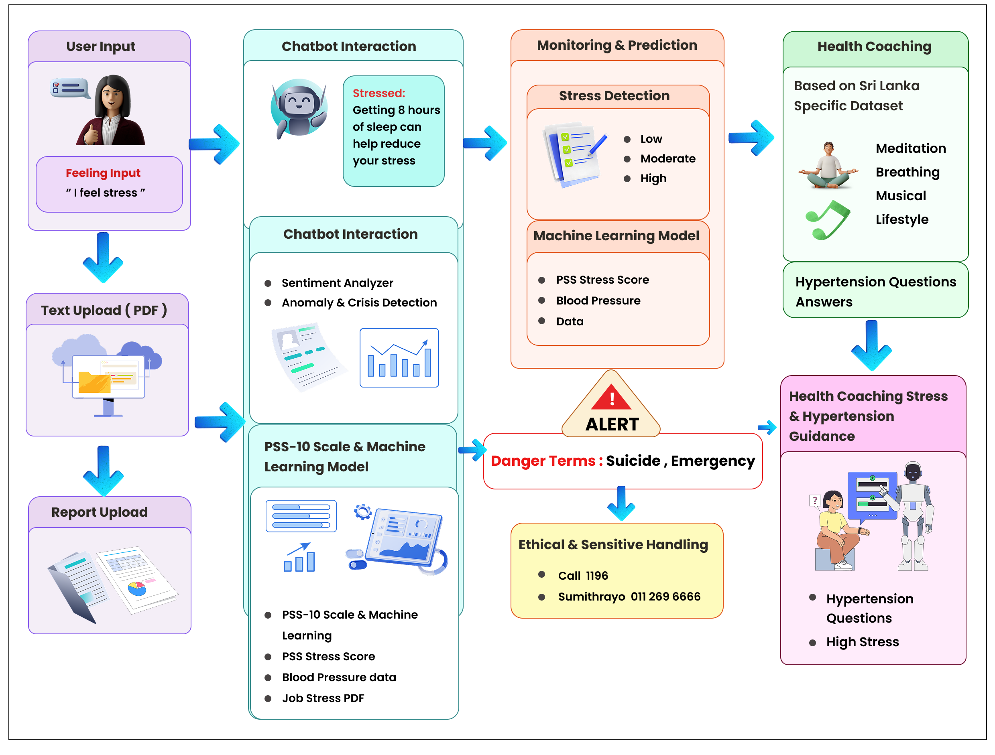
A Domain-Specific AI Health Coach for Stress and Hypertension
System Overview – Domain-Specific AI Health Coach for Stress and Hypertension
IT22623690 | Jayawardhana N.S.G | 25-26J-371

Slide 20
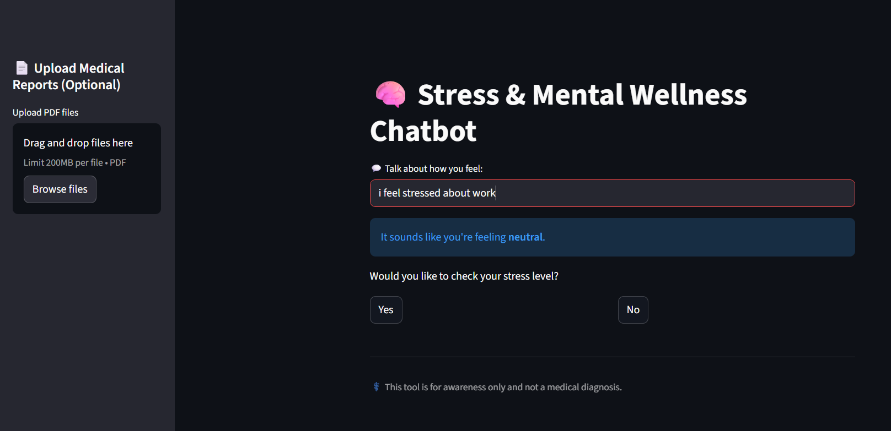
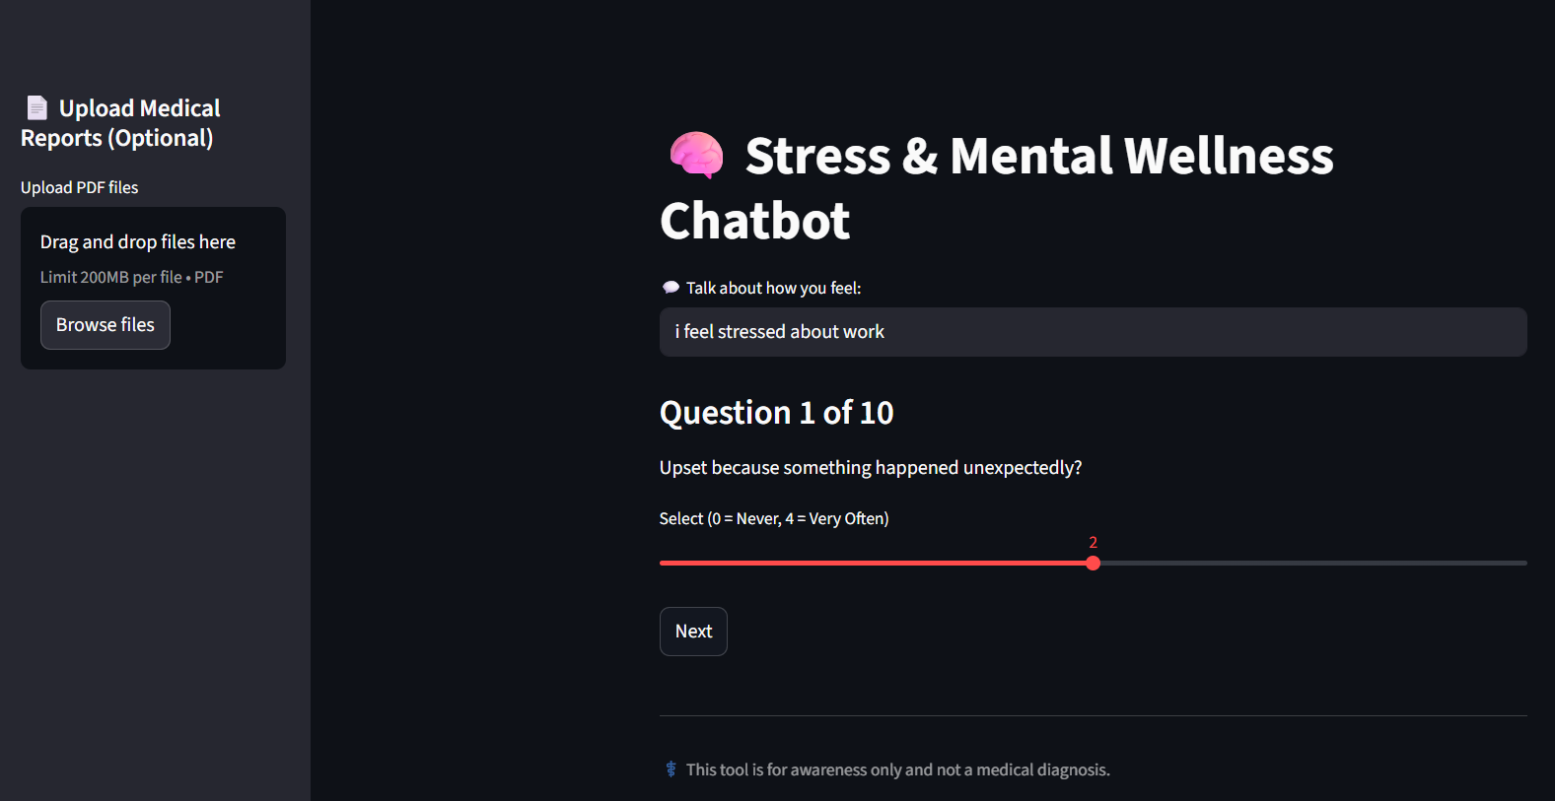
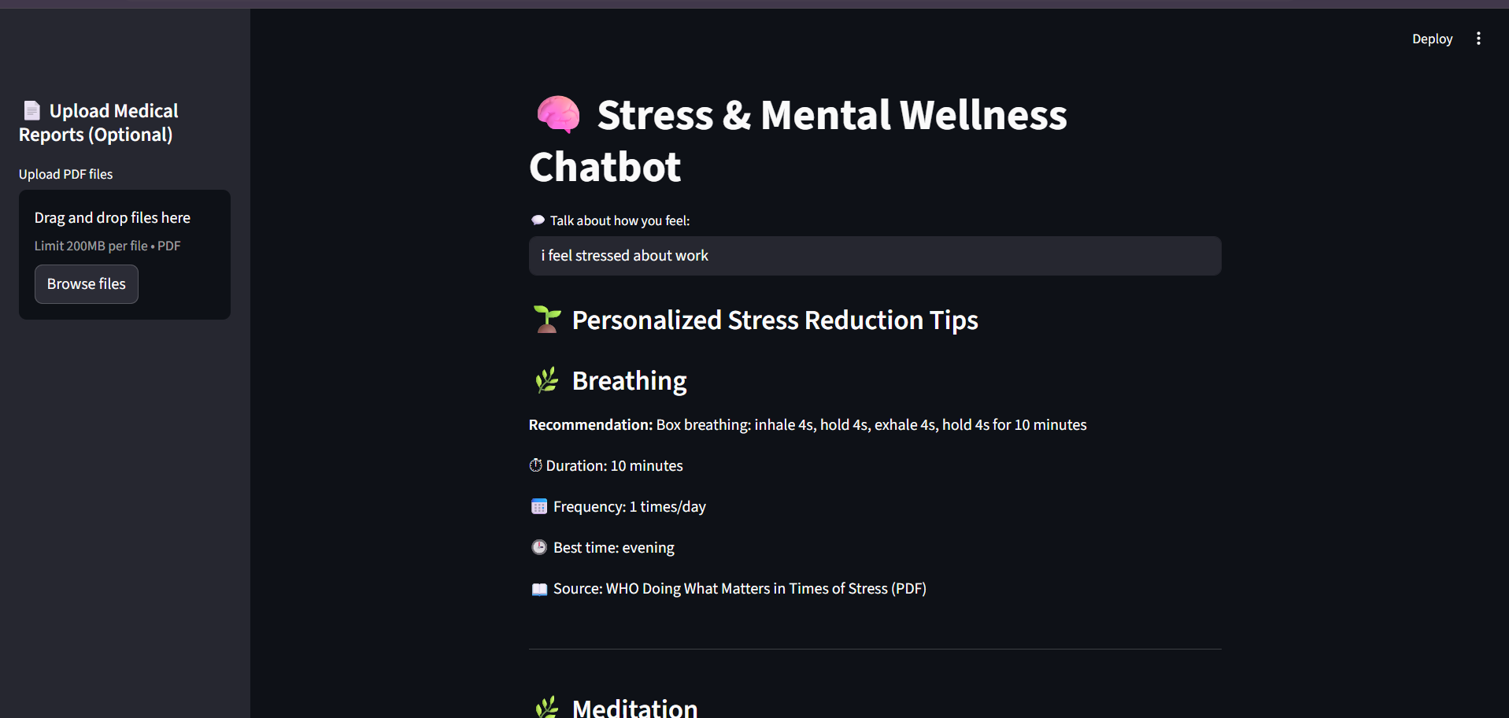
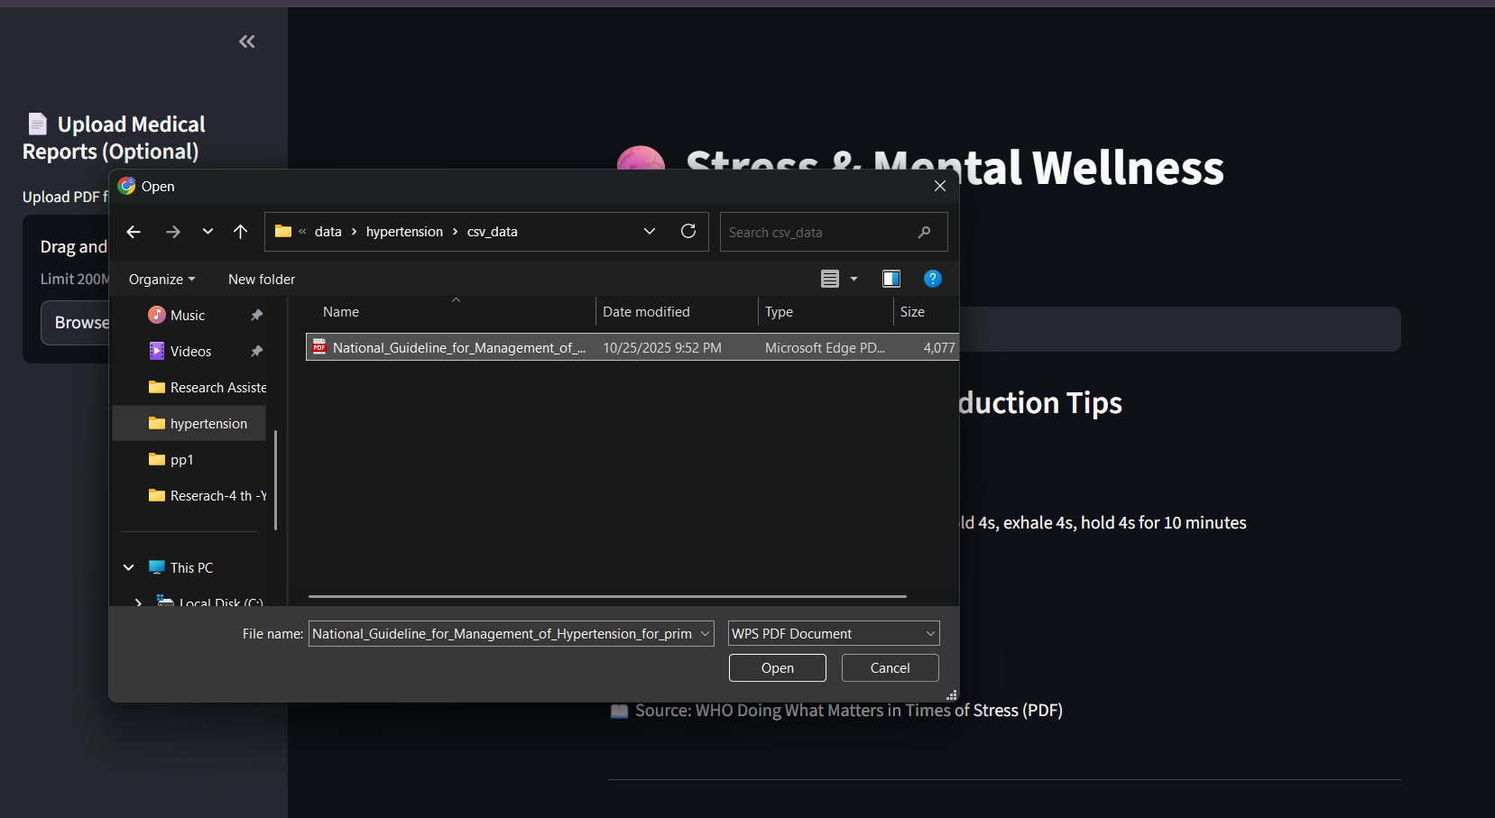

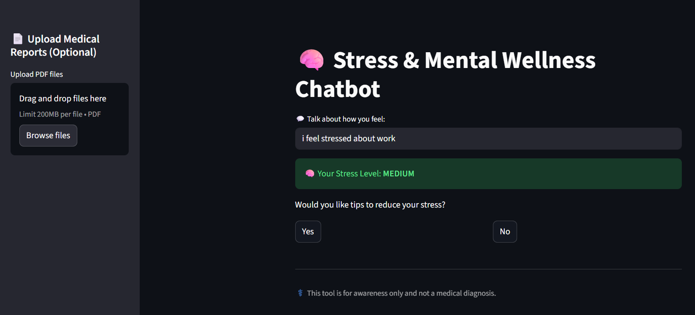
A Domain-Specific AI Health Coach for Stress and Hypertension
Testing Summary
IT22623690 | Jayawardhana N.S.G | 25-26J-371

Slide 21
Sustainability of Solution
Customer Persona
Young Professionals (25 - 40 yrs): Health-conscious, tech-savvy, use health apps.
Middle-Aged Adults (40 - 60 yrs): At risk of hypertension/diabetes, seeking prevention
Market Size (Sri Lanka)
~5 - 7 million potential users (urban & semi-urban adults)
Growing adoption of smartphones & wearable health devices
Cost Recovery
What is Unique?
Freemium + Premium subscription model
B2B corporate wellness partnerships
Collaboration with local health insurers & clinics
AI-driven personalized health insights & alerts
Localized for Sri Lankan diet & lifestyle patterns
Preventive approach targeting early hypertension & diabetes

