Slide 1

SMART INDIA HACKATHON 2026
SCOURGE
Ask the bank, not the paper.
Problem Statement ID – SIH26265
Problem Statement Title – Streamline of Security Deposit / FDR Portal
Theme – Smart Automation
PS Category – Software
Team ID – 199322
Team Name (Registered on portal) – Arnavax#

Slide 2

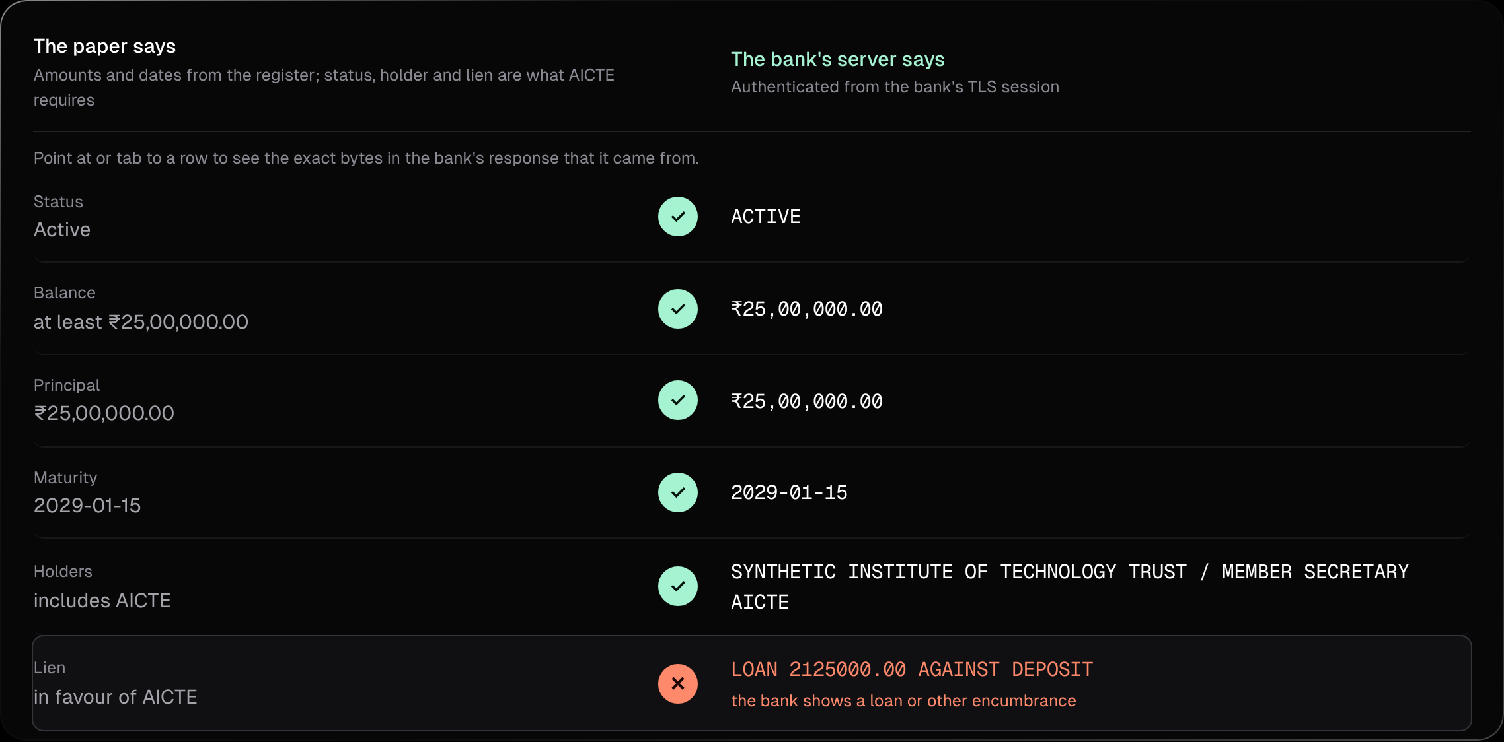


SCOURGE — ASK THE BANK, NOT THE PAPER
SCOURGE
Proposed Solution (Describe your Idea/Solution/Prototype)
The bank's own website proves the FDR: no bank API, no agreement, no paper. AICTE sees only that record.
LIVE PROTOTYPE · SYNTHETIC BANK
The bank's server contradicts the paper.
Detailed explanation of the proposed solution
AICTE sends a single-use challenge for one FDR. The institution opens its own net banking; the connection key is split with AICTE's verifier (MPC-TLS), so nobody can fake the page. Login, OTP and PAN stay with the institution.
How it addresses the problem
Paper is checked once and trusted for 10 years. Scourge re-checks the bank any time and before every release: a loan, early encashment, missing pledge (lien) or fake FDR shows up as a Discrepancy.
Innovation and uniqueness of the solution
Works with banks' existing net banking: no bank API or agreement needed, and API-ready when banks offer one. If a page cannot show a field: bank-signed e-advice, then branch confirmation. Fakes and replays are rejected.
✕ HIDDEN LOAN CAUGHT
Every value traces to the bank's own bytes
The complete FDR lifecycle in one portal (all five stages run in the prototype)
1 FILE
Institution files online; renewals linked
2 PROVE
Bank-session proof on AICTE's challenge
3 MONITOR
T-90/60/30/7 alerts; adequacy; MT940/camt.053 reconcile
4 DECIDE
Verdict + evidence; hash-chained audit
5 PLEDGE RELEASE
Dept reviewers, 2 signers, holds; signed letter → bank ack
Why now: ₹201.42 crore of FDRs "do not appear in IDFC's records" (CBI chargesheet, Oct 2026); AICTE joint FDRs found encashed or loaned against without consent.

Slide 3







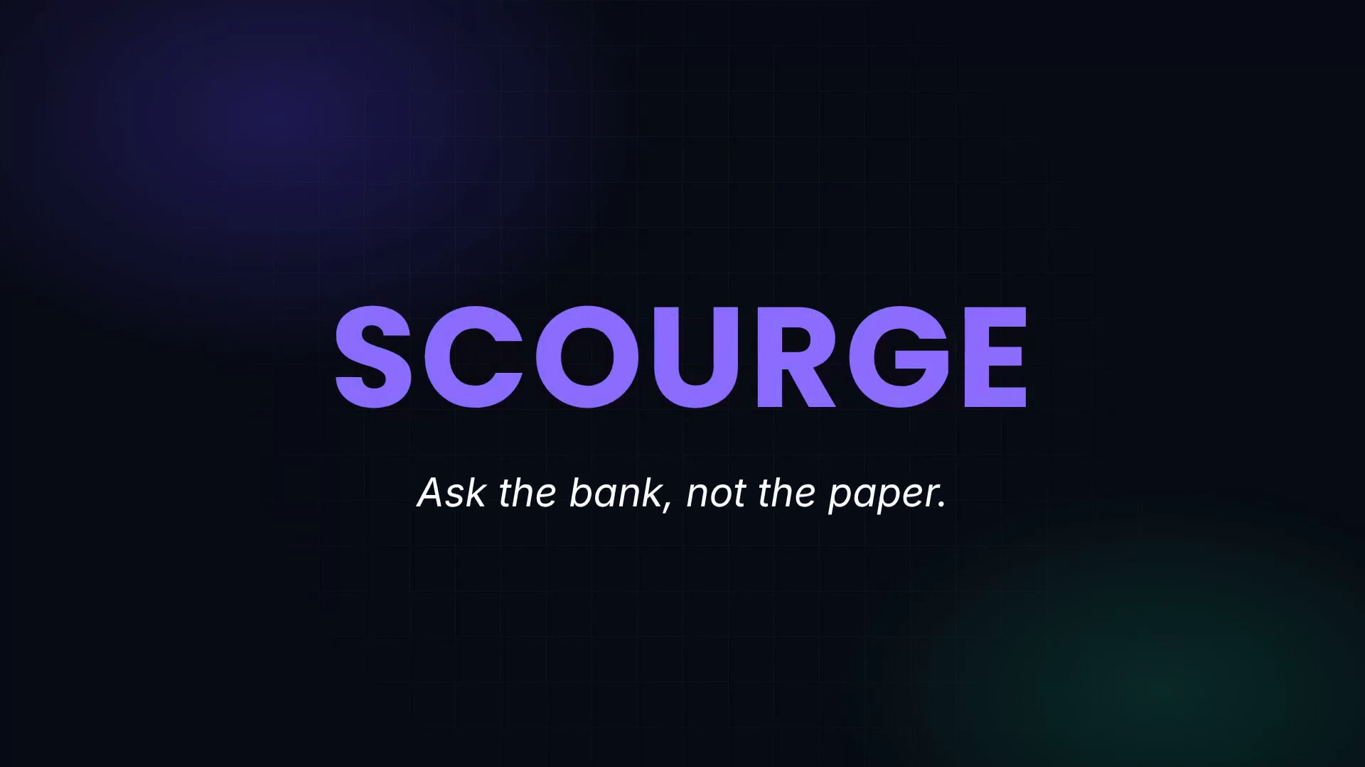


TECHNICAL APPROACH
SCOURGE
Technologies to be used
Proof layer
TLSNotary MPC-TLS · Rust
Selective disclosure · rustls
Backend
Python · FastAPI · SQLite
AES-GCM vault · hash-chained audit
Frontend
Server-rendered HTML · JS
Live 3-party proof view
Ops & QA
Docker · nginx · GitHub CI
266 tests · 2FA · audits
Methodology and process for implementation (Flow Charts/Images/ working prototype)
In plain words: an AICTE "notary" watches the bank page load, sees only the FD line, and nobody can change it.
WATCH THE 3-MINUTE DEMO
Bank's server
sees a normal login
Institution
runs the prover
AICTE verifier
holds half the TLS keys
1 Single-use challenge, consumed first
2 Logs in; TLS keys split with AICTE's verifier
3 Bank sends the FD page, encrypted
4 Proof: only this deposit's record
Click to play here, or scan / click the QR for YouTube
Synthetic bank + live real-bank session
5 Verifier checks certificate, bank host and record → register match
Outcome:
Verified
Discrepancy
Insufficient evidence
Rejected

Slide 4





FEASIBILITY AND VIABILITY
SCOURGE
Analysis of the feasibility of the idea
0.58 s
Real bank
266 / 266
₹0
per bank proof
median of 60 runs · synthetic bank
live split-key session
HTTP 200 in 1.0 s · first bank: SBI
automated tests pass
incl. rollback, forgery, backup-restore
software licences
357 MB/proof · see FEASIBILITY.md
LIVE ON A REAL BANK
First bank tested: SBI · 30 Oct 2026
{"ok":true,"server":"api.onlineyono.sbi.bank.in","status_line":"HTTP/1.1 200 OK","secs":1.0}
Split-key session with a bank's production net-banking API; cert checked against public roots. Log: tools/realbank/RESULTS.md
Potential challenges and risks
Strategies for overcoming these challenges
Bank page can't be proven, or hides the lien
3-tier fallback: bank-signed e-advice, then branch; never a guess
Fake bank site or a replayed old proof
Rejected: bank certificate + single-use, 15-min challenge
Bank terms, consent and data protection
Own login, per-deposit consent, record-only disclosure; legal review
Bank encrypts data inside HTTPS, or ties it to the browser
Browser-extension prover; verifier gets the per-session app key
PILOT PLAN ✓ Prototype, 266 tests → ✓ Live real-bank session → FD pages at 3 large banks → 1 AICTE regional office → National rollout

Slide 5





IMPACT AND BENEFITS
SCOURGE
Potential impact on the target audience
AICTE RB officers
AICTE finance
Institutions
Students
A dated proof from the bank in seconds, not a letter in weeks
The whole FDR book is re-checkable, before every release
One short proof from their own net banking; Hindi or English
29.6 lakh enrolled in 2025-26 (Lok Sabha reply); deposits checked all 10 years
Benefits of the solution (social, economic, environmental, etc.)
TODAY
WITH SCOURGE
TESTED ON 180 FRESH DEPOSITS
Random amounts, dates, formats · real proofs · synthetic bank
Branch letter or uploaded screenshot
The bank's own server, proven
119 / 119
bad deposits the upload portal approved
Checked once, trusted for 10 years
Re-checked any time, before every release
0 / 119
bad deposits Scourge verified
Weeks per confirmation
0.58 s per proof (synthetic); 1.0 s live bank session
Hidden loans found at release, or never
Pledge checked at the bank; two-officer release
0 / 61
honest deposits Scourge accused
Social
students' deposits stay intact
Economic
stops loss before release
Environmental
no paper letters or couriers
Governance
accounts, 2FA, vault, chained audit

Slide 6



RESEARCH AND REFERENCES
SCOURGE
Details / Links of the reference and research work
Scourge vs existing approaches
The problem is real
 | Upload & approve | Bank letter | Account Aggregator | NeSL e-BG | Scourge
Uses the bank's own data | ✕ | ✓ | ✓ | ✓ | ✓
No bank API or agreement | ✓ | ✓ | ✕ | ✕ | ✓
Institution cannot forge it | ✕ | ~ | ✓ | ✓ | ✓
Covers existing FDR book | ✓ | ✓ | ✓ | ✕ | ✓
Re-check in seconds | ✕ | ✕ | ✓ | ✓ | ✓
Shown on a real bank today | ✓ | ✓ | ✓ | ✓ | Live bank session; FD next
CBI: ₹201.42 cr of FDRs not in IDFC's records (ThePrint, 7 Oct 2026)
theprint.in › cbi-says-haryana-pollution-board…
CBI on AICTE: joint FDRs encashed or loaned without consent
deccanherald.com › greater-transparency-aicte…
Regulation
AICTE guidelines 2024-27: cl. 6.2(g) 10-year release; cl. 11.8
indiankanoon.org/doc/173919027
Account Aggregator users must be regulated FIUs (DFS)
financialservices.gov.in › account-aggregator…
Technology
TLSNotary: MPC-TLS proofs of web data, MIT / Apache-2.0
tlsnotary.org
NeSL e-BG for security deposits: new instruments only (WDRA)
wdra.gov.in › ebg_requirement-27-08-2025
PROJECT RESOURCES
Demo video (90 s): youtu.be/8HoplhFOGCg
Prototype: Scourge v1.0.0-rc1 · 266 / 266 tests · synthetic bank
Code + evidence: github.com/Lakki007/Arnavax-Scourge-SIH26265
~ a bank letter can still be forged. Live split-key session with a real bank done (SBI, 30 Oct 2026); FD-page proof is roadmap step 1.

