Slide 1
StudyGenius
AI-Powered Study Tool
Presentation by Laksh and Dishan
Mother Divine Public School

Slide 2
Problem Statement
Students today are overwhelmed with vast amounts of study material — textbooks, PDFs, class notes, and online resources. Manually reading, summarizing, and creating revision tools like flashcards or quizzes is not only time-consuming but also mentally exhausting. This outdated method of learning often results in students skipping proper revision, missing key points, or feeling unmotivated. In an age of intelligent technology, there’s a clear gap in tools that automatically assist in efficient learning and retention.
Key Issues Faced by Students:
Reading and summarizing long texts takes a lot of time
Lack of automated revision tools like flashcards and quizzes
Manual preparation leads to inconsistent understanding
Revision often happens last minute, causing stress
Traditional methods are not personalized or interactive

Slide 3
What is StudyGenius ?
StudyGenius is an AI-powered desktop application designed to make studying smarter and faster. It helps students by automatically transforming raw text — such as notes, articles, or PDFs — into structured, interactive learning tools like summaries, flashcards, and quizzes. Powered by advanced Natural Language Processing (NLP) algorithms, StudyGenius saves time, boosts understanding, and makes revision more engaging. It's like having a personal tutor that reads, analyzes, and prepares study material for you — instantly.
Key Highlights:
Converts PDFs and TXT files into summaries, flashcards, and quizzes
Uses AI algorithms to understand and process text
Offers multiple summarization techniques based on content type
Creates interactive learning materials automatically
Designed for students of all levels to learn more in less time

Slide 4
Core Functionalities
Smart Text Extraction
Extracts clean, readable content from PDF and TXT files
AI-Powered Summarization
Uses 5 advanced algorithms (TextRank, LSA, etc.) to generate summaries
Flashcard Generation
Creates Q&A pairs, keyword definitions, and fill-in-the-blank flashcards
Interactive Quizzes
Auto-generates multiple-choice, true/false, and blank-fill questions
Study Analytics
Shows reading difficulty, word count, and time needed to study
User-Friendly GUI
Clean interface built with PyQt5 for easy navigation and use

Slide 5
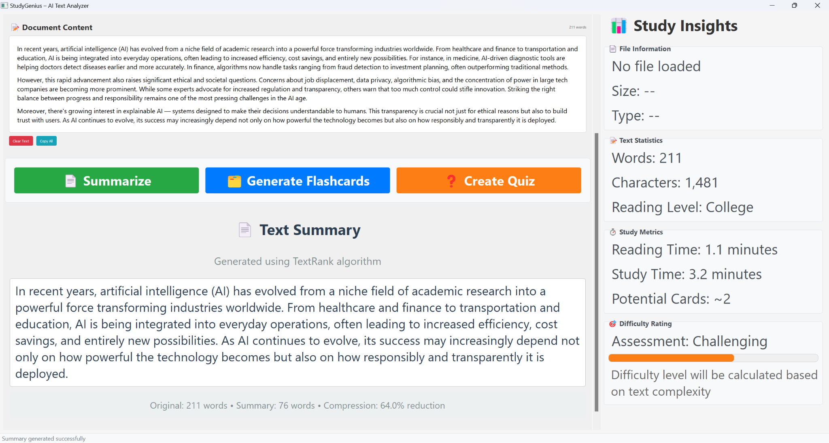
Summarization
StudyGenius allows you to upload any document — like a textbook chapter or class notes — and automatically gives you a short, easy-to-read summary. This helps students revise faster without reading the full text. You can even control how short or long the summary should be, based on your preference.

Slide 6
Flashcard & Quiz
StudyGenius doesn’t just summarize — it also turns your study material into interactive flashcards and quizzes. This makes revision more engaging and helps you test your knowledge instantly. You don’t have to write questions by hand — the app does it all for you automatically.

Slide 7
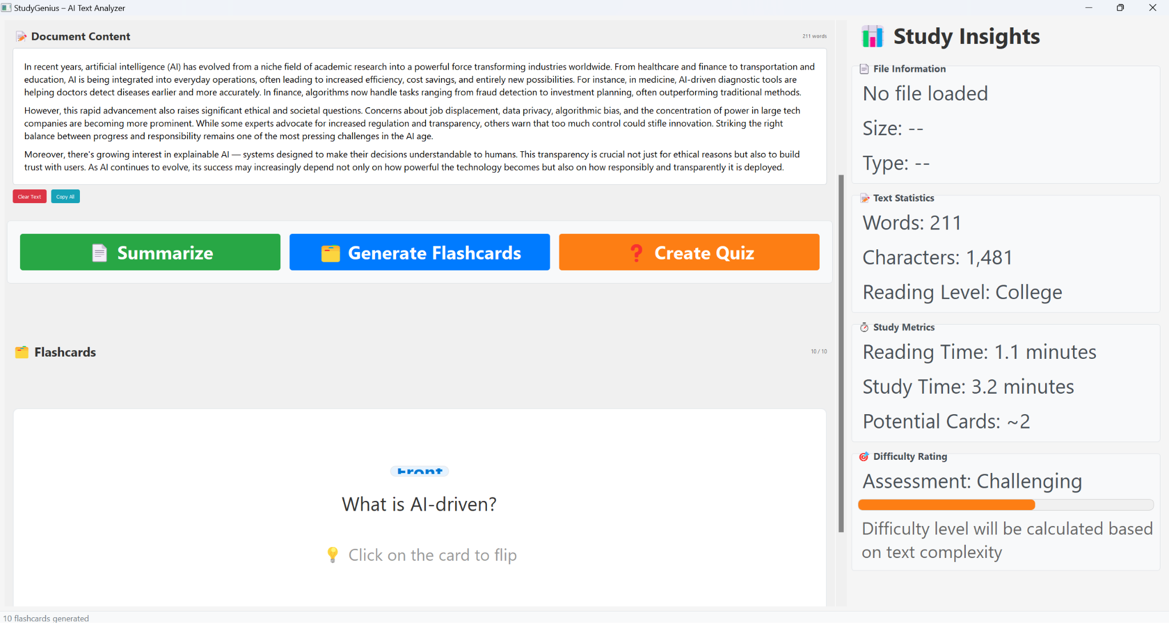

Slide 8
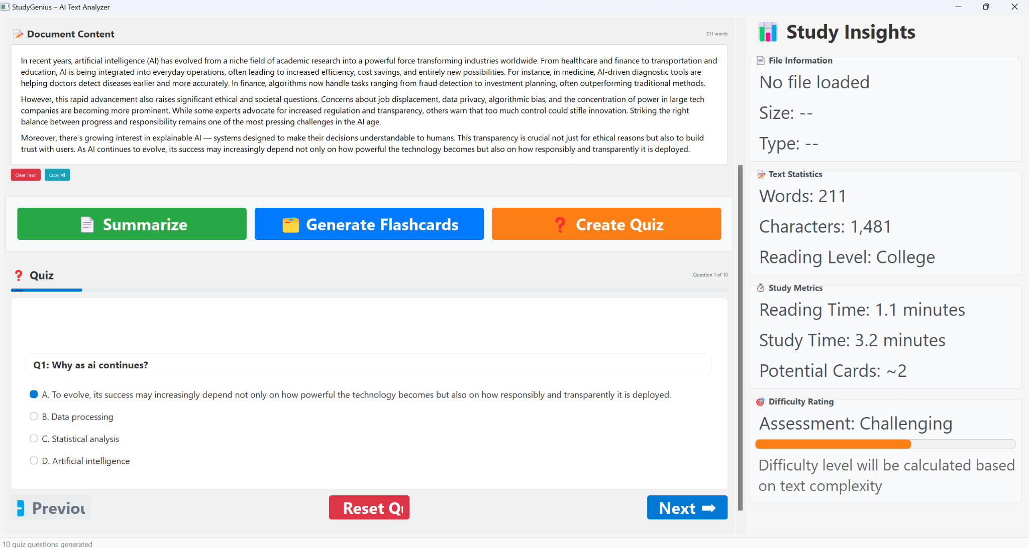

Slide 9
Analytics
StudyGenius also helps students plan their studies better by giving useful analytics. It tells you how long a document might take to read, how difficult it is, and how much content it contains. This helps in managing time and knowing what to focus on first.

Slide 10
How It Works Internally ?
StudyGenius is built using Python and uses PyQt5 to create a clean and user-friendly desktop interface. When a document is uploaded, it goes through a text extraction module that pulls clean text from PDF or TXT files. This text is then processed using various Natural Language Processing (NLP) algorithms to generate summaries, flashcards, and quizzes. Behind the scenes, the app includes different modules — one for summarization, one for flashcard creation, and one for quiz generation — all working together like a pipeline. The system intelligently selects the best algorithm based on the content and uses libraries like NLTK, Sumy, and pdfplumber to perform tasks like keyword extraction, sentence ranking, and question creation.

Slide 11
Screenshots

Slide 12
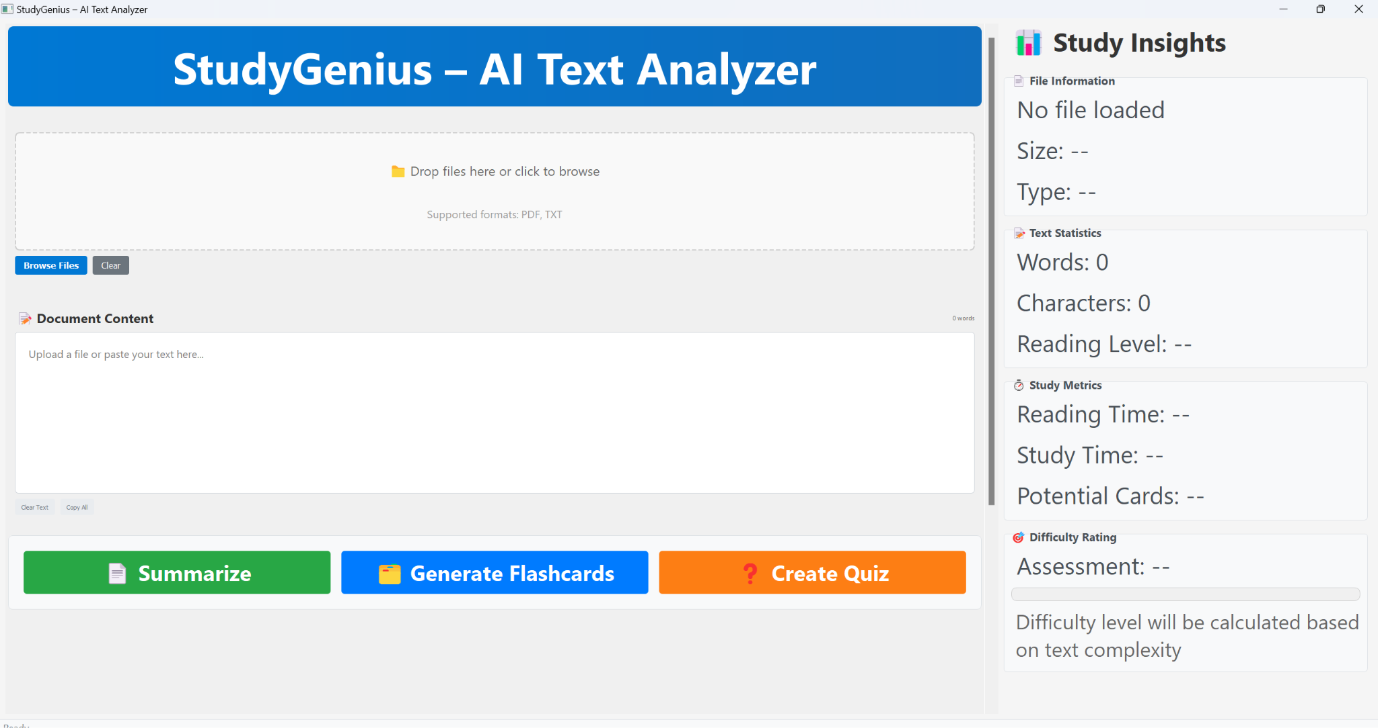
Dashboard

Slide 13
Summary

Slide 16
Conclusion
StudyGenius is more than just a tool — it's a complete AI-powered study assistant that helps students save time, revise better, and learn smarter. By combining text summarization, flashcard generation, quiz creation, and study analytics into one application, it transforms how students interact with their study material. Whether it's preparing for exams or revising last-minute, StudyGenius makes the process faster, easier, and more effective. Our mission is simple: to turn information into understanding — instantly.

Slide 17
Thank You!
Presentation by Laksh and Dishan
Mother Divine Public School

