Slide 1

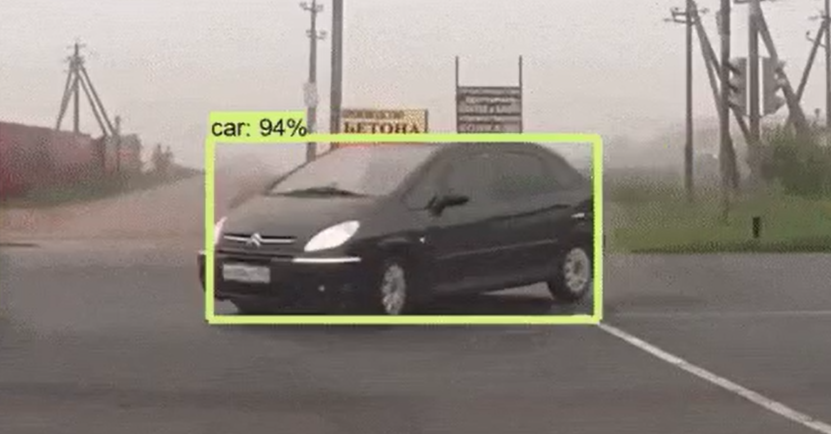
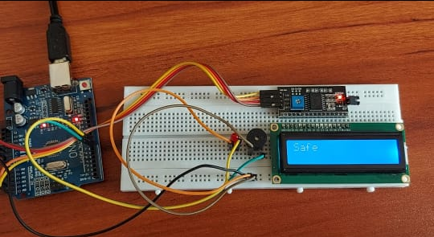
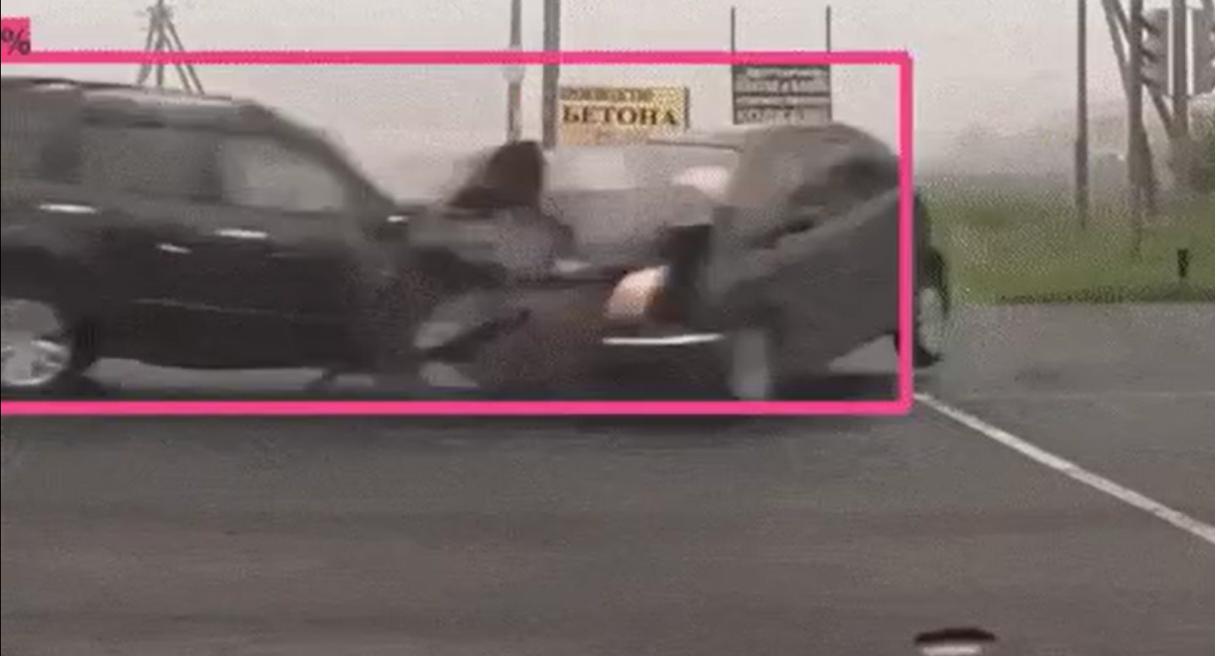
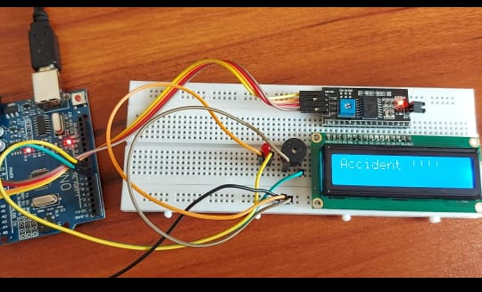
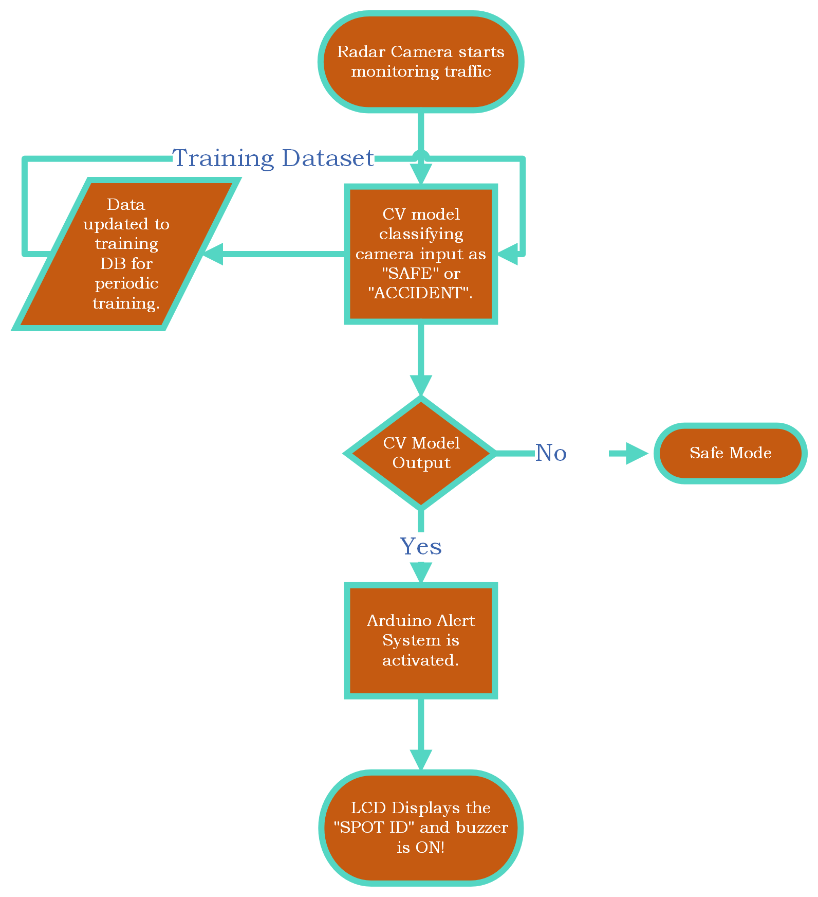
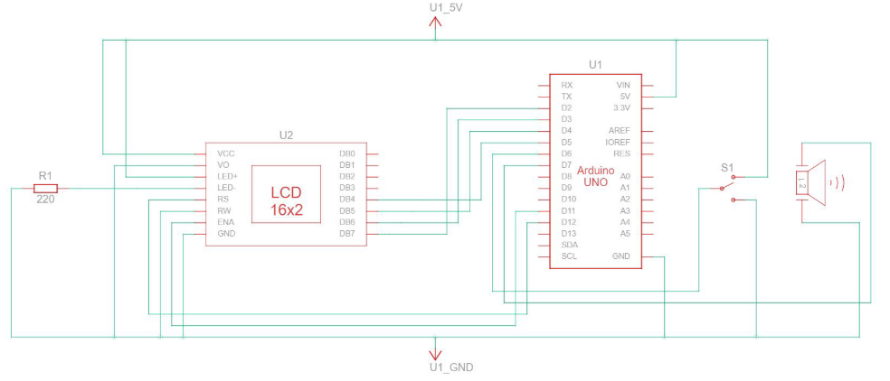
ACCIDENT DETECTION & ALERTING SYSTEM USING IOT
Laksha S (20BAI1186)
Dr. A K Ilavarasi
School of Computer Science and Engineering
INDUSTRY CONCLAVE 2023
INTRODUCTION
An analysis of the accident rate in India is published by the Transport Research Wing (TRW) of the Ministry of Road Transport and Highways (MoRTH) every year. According to the most recent report published for the year 2021, there are 18 deaths per hour of every 47 accidents on average. Even though road accidents have reduced by 8.1%, the fatalities have increased by 1.9 in 2021 corresponding to the same period in 2019.” The number of fatalities shows that India is not doing quite well in terms of “HANDLING ACCIDENT RESPONSE” which is a necessity of the current times.
Objectives
To reduce the number of fatalities due to road accidents
To have safer highway roads by using traffic surveillance
Making emergency accident response accessible on highways
Making emergency accident response accessible in places with no human activity
Automating the process of calling/ dialing the emergency accident response ambulance of 102 or 108 depending on the availability in the states
To reduce the average medical response time for ambulances
SCOPE of the project
It can aid the overall healthcare system in reducing the medical response time for accident victims reducing fatalities.
It could aid in reducing the fatalities that occur due to road accidents where there was no one to alert about the occurrence of the accident.
It could help in improving the overall security of the roadways around the nation
It could be used multi-purpose to find the person causing the accident and bring them to justice.
methodology
Gathering dataset: Collect a database of images or videos depicting the numerous types of road accidents.
Pre-process the data: Normalize the images or videos, remove noise, and resize the images to a consistent size before processing the dataset.
Train the model: The model should classify images or frames as either containing or not containing an accident.
Validate the model: Validate the performance of the model using a separate dataset that was not used during training.
Deploy the model: in a real-time system capable of processing video feeds from traffic cameras or other sources in real-time and notifying authorities or emergency services when an accident is detected.
Architecture
The traffic surveillance camera takes in the input which is relayed to the CV (Computer Vision) model which is trained by Resnet to detect accidents once the accident is detected, the signal is passed to the IoT system and the system starts beeping the buzzer and the LED (in-place of a siren) showing that an accident has happened just like that of a fire engine.
Results and discussion
The below pictures show the working of the accident detection model. The left side pictures show the algorithm working and the right side pictures show the IoT components working during an accident as the LED display shows “ACCIDENT” and when there is no accident AS “SAFE”.
The referred papers suggest implementing a vibration sensor in the car and connecting it to the mobile numbers of the victim’s close relatives which can’t work if the accident happens in a remote location where there is no service for the message to be sent. But in the case of using a centralized system like the model proposed in this paper, it could be more efficient and also could ensure no loss of privacy and reduce user security concerns tremendously.
Conclusion
IoT based Accident detection and alerting system has a lot of scope in terms of implementing in-traffic surveillance since it doesn’t increase the cost of implementation in terms of the consumer/ citizen perspective and car manufacturers’ perspective but helps in improving the overall accessibility to health care too all the citizens of the nation.
References
[1] Mohammadrezaei, M., Fard, H. S., Niaky, R. P., & Dizaj, B. S. T. (2020). Iot-Based Vehicular Accident Detection Systems.
[2] Nasr, E., Kfoury, E., & Khoury, D. (2016, November). An IoT approach to vehicle accident detection, reporting, and navigation. In 2016 IEEE International Multidisciplinary Conference on Engineering Technology (IMCET) (pp. 231-236). IEEE.
The model detecting a car without accident
The model detecting accident

