Slide 1
CS1050 — Computer Organization and Digital Design
Nanoprocessor Design
Group 23
Name | Index No.
Jayathilake P. I. K. | 240288D
Jayawardana Y. G. L. S. | 240294R
Jayawardhana J. A. R. P. | 240297E
Kalpashaka N. G. L. G. | 240312A
Implemented in Vivado · Tested on Basys 3 FPGA · Department of Computer Science and Engineering

Slide 2
Project Overview
Objectives
Key Features
Design and develop a 4-bit nanoprocessor capable of executing arithmetic, logical, and control-flow instructions.
Implement two processor versions: Optimized (resource-efficient) and Extended (feature-rich).
Expand the instruction set from 4 instructions (12-bit, 2-bit opcode) to 11 instructions (14-bit, 4-bit opcode).
Validate all components via VHDL simulation and deploy on the Basys 3 FPGA development board.
12-bit ISA (Optimized)
4 instructions: MOVI, ADD, NEG, JZR — 2-bit opcode
14-bit ISA (Extended)
11 instructions incl. SUB, AND, OR, XOR, NOT, CMP, CMPU, MOVI, ADD, NEG, JZR — 4-bit opcode
FPGA Deployment
Implemented and tested on Basys 3 (Artix-7 XC7A35T)
Real-time Output
4-bit result displayed via seven-segment display
Modular Architecture
ROM, PC, Decoder, Register Bank, ALU, Flags — all as separate VHDL modules

Slide 3
Instruction Set Architecture — Optimized Version (12-bit)
Optimized Version
4 instructions · 2-bit opcode · 12-bit instruction word
Instruction | Description | Opcode | Format (12-bit)
MOVI R, d | Move immediate d → R (R ∈ [0,7], d ∈ [0,15]) | 10 | 1 0 R R R 0 0 0 d d d d
ADD Ra, Rb | Ra ← Ra + Rb | 00 | 0 0 Ra Ra Ra Rb Rb Rb 0 0 0 0
NEG R | R ← −R (2's complement) (R ∈ [0,7]) | 01 | 0 1 R R R 0 0 0 0 0 0 0
JZR R, d | If R=0 → PC←d; else PC←PC+1 (d ∈ [0,7]) | 11 | 1 1 R R R 0 0 0 0 d d d

Slide 4
Instruction Set Architecture — Extended Version
(14-bit)
Extended Version
11 instructions · 4-bit opcode · 14-bit instruction word
Instruction | Description | Opcode (4-bit) | Format (14-bit)
MOVI R, d | Move immediate d → R | 1000 | 1 0 0 0 R R R 0 0 0 d d d d
NEG R | R ← −R (2's complement) | 1001 | 1 0 0 1 R R R 0 0 0 0 0 0 0
JZR R, d | If R=0 → PC←d; else PC←PC+1 (d ∈ [−8,7]) | 1010 | 1 0 1 0 R R R 0 0 0 d d d d
ADD Ra, Rb | Ra ← Ra + Rb | 0000 | 0 0 0 0 Ra Ra Ra Rb Rb Rb 0 0 0 0
SUB Ra, Rb | Ra ← Ra − Rb | 0001 | 0 0 0 1 Ra Ra Ra Rb Rb Rb 0 0 0 0
CMPU Ra, Rb | Unsigned comparison; updates GT/EQ/LT flags | 0010 | 0 0 1 0 Ra Ra Ra Rb Rb Rb 0 0 0 0
CMP Ra, Rb | Signed comparison; updates GT/EQ/LT flags | 0011 | 0 0 1 1 Ra Ra Ra Rb Rb Rb 0 0 0 0
OR Ra, Rb | Ra ← Ra ∨ Rb (bitwise OR) | 0100 | 0 1 0 0 Ra Ra Ra Rb Rb Rb 0 0 0 0
AND Ra, Rb | Ra ← Ra ∧ Rb (bitwise AND) | 0101 | 0 1 0 1 Ra Ra Ra Rb Rb Rb 0 0 0 0
XOR Ra, Rb | Ra ← Ra ⊕ Rb (bitwise XOR) | 0110 | 0 1 1 0 Ra Ra Ra Rb Rb Rb 0 0 0 0
NOT Ra | Ra ← ~Ra (bitwise complement) | 0111 | 0 1 1 1 Ra Ra Ra Rb Rb Rb 0 0 0 0

Slide 5
Opcode Encoding — Original vs. Extended
Optimized Version — 2-bit Opcode
Extended Version — 4-bit Opcode
Instruction | Opcode
ADD / SUB | 00
NEG | 01
MOVI | 10
JZR | 11
Instruction | Opcode
ADD | 0000
SUB | 0001
CMPU | 0010
CMP | 0011
OR | 0100
AND | 0101
XOR | 0110
NOT | 0111
MOVI | 1000
NEG | 1001
JZR | 1010

Slide 6
Opcode Encoding — Original vs. Extended
Key Architectural Differences
Feature | Optimized | Extended
Instruction Width | 12 bits | 14 bits
Opcode Width | 2 bits | 4 bits
No. of Instructions | 4 | 11
ALU Operations | ADD / NEG only | ADD, SUB, AND, OR, XOR, NOT, CMP, CMPU
Output Flags | Zero, Overflow | Zero, Overflow, GT, EQ, LT

Slide 7
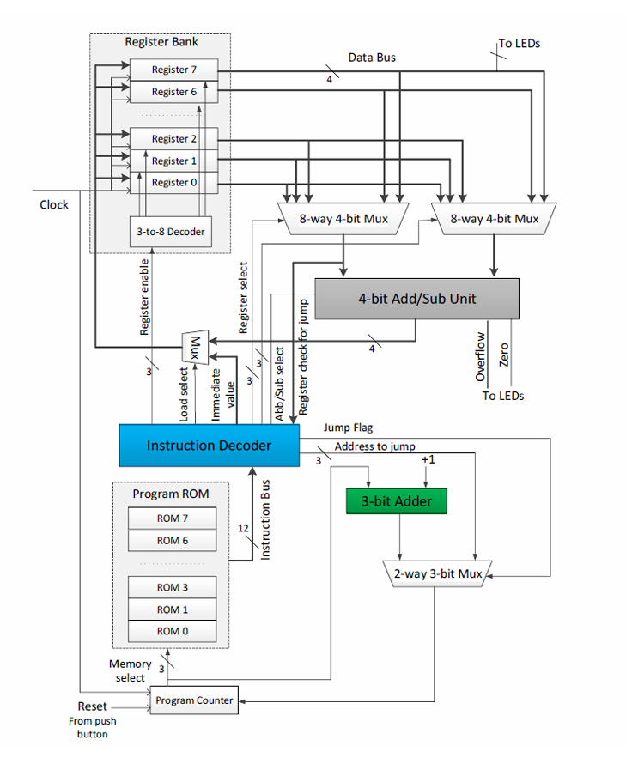
System Architecture Overview

Slide 8
Top Module — Optimized Version
Optimized
Entity Interface
Sub-Modules Instantiated
entity Nanoprocessor is
Port (
Clk_100MHz : in STD_LOGIC;
reset : in std_logic;
result : out std_logic_vector(3 downto 0);
zero : out std_logic;
overflow : out std_logic
);
end Nanoprocessor;
program_rom
8×12-bit ROM; addressed by 3-bit PC
instruction_decoder
Decodes 12-bit instruction; issues control signals
ADD_SUB_4bit
4-bit ALU with ADD/NEG; produces zero & overflow flags
register_bank
Eight 4-bit registers (R0–R7) with sync write
Signal Flow Summary
flags
Registers zero/overflow flags on clock edge
PC → ROM → 12-bit instruction word
Decoder issues reg_write_en, alu_sub, wb_sel_imm, pc_load
ALU output or immediate data written back to register bank
Zero flag → decoder for JZR conditional branch
slow_clock
Divides 100 MHz → ~0.5 Hz for visible stepping
mux2_4bit (×2)
Writeback selector (ALU vs immediate); PC mux
mux8_4bit
Selects one of eight 4-bit inputs based on 3-bit select line

Slide 9
Top Module — Extended Version
Key Differences from Optimized
Extended Entity Interface
Feature | Optimized | Extended
Instruction width | 12-bit | 14-bit
Opcode | 2-bit | 4-bit
ALU top module | None | top_alu (new)
Comparator | Not present | Used inside top_alu
Logic unit (binOp) | Not present | AND/OR/XOR/NOT support
Flags out | zero, overflow | zero, overflow, GT, EQ, LT
Flag logic location | ADD_SUB_4bit | top_alu mux
entity Nanoprocessor is
Port (
Clk_100MHz : in STD_LOGIC;
reset : in std_logic;
mode_sel : in std_logic;
sw_inst : in std_logic_vector(13 downto 0);
btn_step : in std_logic;
result : out std_logic_vector(3 downto 0);
zero : out std_logic;
overflow : out std_logic;
greater : out std_logic;
equal : out std_logic;
lower : out std_logic
);
end Nanoprocessor;

Slide 10
Top Module — Extended Version
New Components Added in Extended Version
top_alu
Wrapper module combining ADD_SUB_4bit, Comparator, and Logic Unit. Selects output via 3-bit alu_op control signal.
Comparator
Performs signed and unsigned 4-bit comparison; generates GT, EQ, and LT flag signals.
Logic Unit (binOp)
Implements bitwise AND, OR, XOR, and NOT operations on 4-bit operands.

Slide 11
Core Components — Overview
Program ROM
Program Counter
Slow Clock
8-location ROM (12-bit optimized / 14-bit extended) driven by 3-bit PC address bus.
3-bit counter tracking the current instruction address; supports conditional load for JZR branches.
Frequency divider reducing 100 MHz system clock to ~0.5 Hz for observable hardware stepping.
Instruction Decoder
Register Bank
ALU / Top ALU
Decodes the instruction word and asserts control signals: reg_write_en, alu_sub, wb_sel_imm, pc_load, alu_op.
Eight 4-bit registers (R0–R7) with synchronous write enable, 3-to-8 decoder for write selection, and two concurrent read ports.
Optimized: standalone ADD_SUB_4bit. Extended: top_alu integrating arithmetic, logic, and comparison sub-units.
Seven-Segment Display
Load Selector MUX
Flags Unit
Converts the 4-bit ALU result into BCD for real-time display on the Basys 3 seven-segment output.
2-way 4-bit mux selecting between the ALU output and the immediate data field for register writeback.
Clocked register capturing zero, overflow, and (in extended) GT/EQ/LT comparison flags from the ALU.

Slide 12
Program ROM
Design Specification
VHDL Implementation Approach
Parameter | Value
Type | ROM (read-only memory)
Depth | 8 locations (8 instructions)
Width (Optimized) | 12 bits
Width (Extended) | 14 bits
Address input | 3-bit (from Program Counter)
Data output | 12 / 14-bit instruction word
Access type | Asynchronous (combinational)
entity program_rom is
Port ( addr : in STD_LOGIC_VECTOR (2 downto 0);
data : out STD_LOGIC_VECTOR (11 downto 0));
end program_rom;
architecture Behavioral of program_rom is
type rom_array is array (0 to 7) of std_logic_vector(11 downto 0);
constant ROM : rom_array := (
0 => "101110000000", -- MOVI R7, 0 (R7 = 0)
1 => "100010000001", -- MOVI R1, 1 (R1 = 1)
...
others => (others => '0’)
);
Role in Processor Datapath
Program ROM stores the hardcoded instruction sequence loaded at synthesis time.
The 3-bit PC address selects which of the 8 instruction words is presented to the instruction decoder on each clock cycle.
The Extended version widens the data bus to 14 bits to accommodate the 4-bit opcode and larger instruction fields.

Slide 13
Program Counter & Address Control Logic
Program Counter
PC Multiplexer & Jump Logic
3-bit register tracking the current instruction address (0–7).
On each slow-clock rising edge: if pc_load='1' and zero flag set, loads jump target d; otherwise increments by 1.
Synchronous reset (btnC) returns PC to '000'.
Driven by the slow clock (~0.5 Hz) so execution is observable on hardware.
2-way MUX selects between PC+1 (sequential) and jump address d (branch taken).
Select signal: pc_load AND zero_flag — only JZR with R=0 triggers a branch.
Jump address d is encoded directly in the instruction word (bits [2:0] for optimized).
3-bit Adder (PC Increment)
PC Control Signal Summary
Combinational 3-bit adder computes PC + 1 for the next sequential instruction.
Built from a chain of full adders, consistent with the structural VHDL approach used throughout.
Output fed to the PC register and to the MUX for jump target selection.
Condition | pc_load | Zero flag | PC next
Normal execution | 0 | X | PC + 1
JZR, R ≠ 0 | 1 | 0 | PC + 1
JZR, R = 0 | 1 | 1 | d (jump target)
Reset | X | X | 000

Slide 14
Slow Clock — Frequency Division
Purpose & Design
Frequency Division Parameters
The Basys 3 oscillator generates a 100 MHz system clock. Direct use at this frequency would make register transitions invisible to the human eye.
The slow_clock module uses a counter-based frequency divider to reduce the processor's operating clock to approximately 0.5 Hz.
The enable input allows the top module to gate the slow clock output.
A 28-bit counter counts to 50,000,000 (half-period) and toggles the output, yielding ~1 Hz → ~0.5 Hz toggle rate.
Parameter | Value
Input clock | 100 MHz (Basys 3)
Counter width | 28 bits
Half-period count | 50,000,000
Output frequency | ~1 Hz
Effective processor step | ~0.5 Hz (one instruction per 2 s)
Purpose | Human-observable FPGA execution
Entity Interface
entity slow_clock is
Port (
clk_in : in STD_LOGIC;
enable : in STD_LOGIC
);
end slow_clock;
Signal Flow
Clk_100MHz → slow_clock → divided clock signal → PC register clock input.
The divided clock governs all synchronous state transitions in the processor.

Slide 15
Instruction Decoder — Optimized Version
Decoder Inputs & Outputs
Port | Direction | Width | Purpose
instruction | in | 12-bit | Full instruction word from ROM
zero_flag | in | 1-bit | Zero flag from flags unit
reg_write_en | out | 1-bit | Enable write to register bank
reg_write_sel | out | 3-bit | Destination register address
read_sel_a | out | 3-bit | Source register Ra address
read_sel_b | out | 3-bit | Source register Rb address
alu_sub | out | 1-bit | ALU operation: 0=ADD, 1=NEG
wb_sel_imm | out | 1-bit | Writeback: 0=ALU result, 1=immediate d
pc_load | out | 1-bit | Enable PC jump (JZR)
Decoding Logic (2-bit Opcode)
Opcode = instruction[11:10] selects instruction type.
00 → ADD: reg_write_en=1, alu_sub=0, wb_sel_imm=0
01 → NEG: reg_write_en=1, alu_sub=1, wb_sel_imm=0
10 → MOVI: reg_write_en=1, wb_sel_imm=1 (immediate d = inst[3:0])
11 → JZR: pc_load=1 (branch if zero_flag=1), reg_write_en=0
Register fields: Ra/R = inst[9:7], Rb = inst[6:4]
Optimized
Verification
Verified via Vivado simulation with all four instruction opcodes as stimuli; timing diagram confirmed correct control signal assertion on each instruction word.

Slide 16
Instruction Decoder — Extended Version
Extended
Changes from Optimized Decoder
Feature | Optimized | Extended
Instruction width | 12-bit input bus | 14-bit input bus
Opcode field | inst[11:10] — 2 bits | inst[13:10] — 4 bits
Sub-opcode | Not applicable | inst[5:3] — 3 bits for alu_op
alu_op signal | 1-bit alu_sub | 3-bit alu_op for top_alu selection
New instructions | — | SUB, CMPU, CMP, OR, AND, XOR, NOT
Flag enable (flag_en) | Not present | Added to control flag register write
JZR range | d ∈ [0,7] | d ∈ [−8,7] (signed, 4 bits)

Slide 17
Instruction Decoder — Extended Version
Extended
Extended Decoding Logic — alu_op Mapping
Opcode | Instruction | top_alu routing
0000 | ADD | ADD_SUB_4bit, alu_sel=0
0001 | SUB | ADD_SUB_4bit, alu_sel=1
0010 | CMPU | Comparator (unsigned)
0011 | CMP | Comparator (signed)
0100 | OR | Logic unit, binop_sel=00
0101 | AND | Logic unit, binop_sel=01
0110 | XOR | Logic unit, binop_sel=10
0111 | NOT | Logic unit, binop_sel=11

Slide 18
Register Bank
Design Specification
Internal Architecture
Eight 4-bit general-purpose registers, R0 through R7.
R0 is hardwired to '0000' (read as zero; writes ignored).
Synchronous write: data written on rising clock edge when write_en='1'.
3-to-8 decoder selects the destination register using the 3-bit write_sel signal.
Two simultaneous read ports provide operands Ra and Rb to the ALU.
Eight instances of 4-bit D flip-flop registers, each with synchronous enable.
3-to-8 decoder converts write_sel to one-hot register enable.
Two 8-to-1 multiplexers (4-bit) select Ra and Rb read outputs.
Register Map
Register | Purpose
R0 | Hardwired zero (read-only)
R1–R6 | General-purpose arithmetic / logic
R7 | Primary result output (driven to LEDs)
Entity Interface
entity register_bank is
Port (
clk, reset, enable : in std_logic;
write_en : in std_logic;
write_sel : in std_logic_vector(2 downto 0);
data_in : in std_logic_vector(3 downto 0);
read_sel_a: in std_logic_vector(2 downto 0);
read_sel_b: in std_logic_vector(2 downto 0);
data_a : out std_logic_vector(3 downto 0);
data_b : out std_logic_vector(3 downto 0)
);
end register_bank;

Slide 19
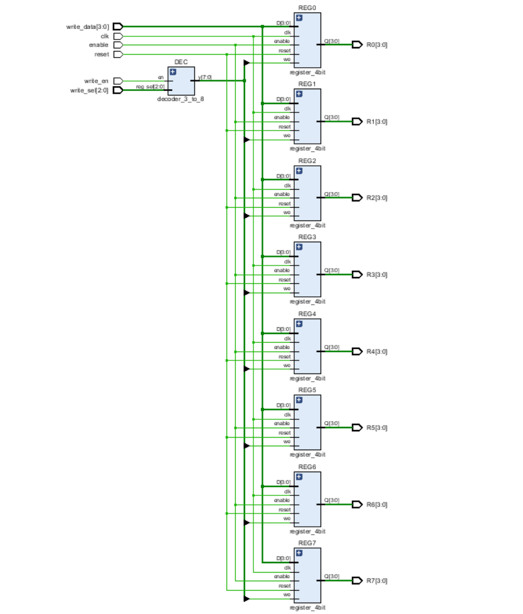
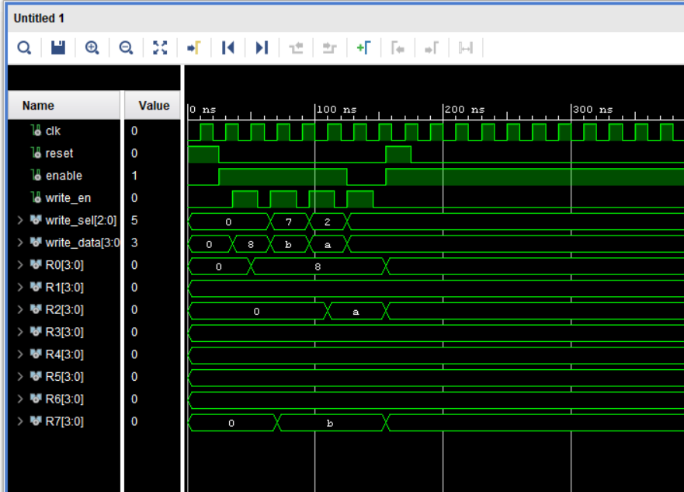
Register Bank
Verification
Schematic
The timing diagram confirmed correct write-on-enable behavior.
Eight 4-bit registers

Slide 20
Arithmetic Logic Unit — Overview
ALU Comparison: Optimized vs. Extended
Aspect | Optimized Version | Extended Version
Top-level entity | ADD_SUB_4bit (direct) | top_alu (new wrapper module)
ADD / SUB | ADD_SUB_4bit | ADD_SUB_4bit (sub-module inside top_alu)
Bitwise ops | Not present | Logic Unit: AND, OR, XOR, NOT
Comparison | Not present | Comparator: signed & unsigned CMP, CMPU
Output selection | Single result | 3-bit alu_op mux selects among sub-units
Zero flag source | ADD_SUB_4bit directly | top_alu output mux
Flags produced | zero, overflow | zero, overflow, GT, EQ, LT

Slide 21
Arithmetic Logic Unit — Overview
Sub-Unit Roles in Extended ALU
ADD_SUB_4bit
4-bit ripple carry adder/subtractor. ADD: B unchanged; SUB: B negated (2's complement). Generates carry, overflow, and zero flags.
Comparator
Performs unsigned (CMPU) and signed (CMP) 4-bit comparison. Generates one-hot GT, EQ, LT flag outputs. Used only for flag updates — does not write to registers.
Logic Unit (binOp)
Implements AND, OR, XOR, and NOT on 4-bit operands. Selected via 2-bit binop_sel from decoder. Result stored in Ra.

Slide 22
ADD / SUB Unit — ADD_SUB_4bit
Design Overview
Flag Generation Logic
4-bit adder/subtractor built on a 4-bit Ripple Carry Adder (RCA_4bit).
alu_sel=0: standard addition (Y = A + B).
alu_sel=1: subtraction via 2's complement (Y = A + ~B + 1).
Overflow detected by XOR of carry-in and carry-out at MSB.
Zero flag asserted when all result bits are '0' (NOR of Y[3:0]).
Flag | Logic | Condition
zero | NOR(Y[3:0]) | Result = 0000
overflow | C_in XOR C_out (MSB) | Signed overflow
carry | C_out of bit 3 | Unsigned overflow
Entity Interface
2's Complement Subtraction
entity ADD_SUB_4bit is
Port (
A : in STD_LOGIC_VECTOR(3 downto 0);
B : in STD_LOGIC_VECTOR(3 downto 0);
alu_sel : in STD_LOGIC;
Y : out STD_LOGIC_VECTOR(3 downto 0);
carry : out STD_LOGIC;
overflow: out STD_LOGIC;
zero : out STD_LOGIC
);
end ADD_SUB_4bit;
When alu_sel=1, B is bitwise inverted and Cin=1 is injected at bit 0 of the RCA.
This implements A − B = A + (~B + 1) via the standard 2's complement technique.
Verification
Simulation confirmed overflow detection, zero flag, and correct subtraction across boundary cases (e.g., 0000 − 0001, signed overflow at 0111 + 0001).

Slide 23
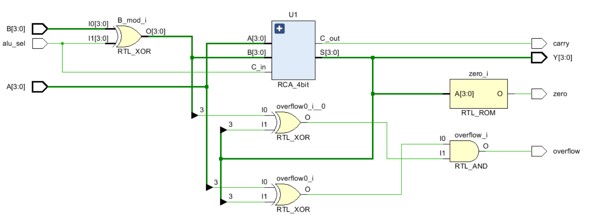
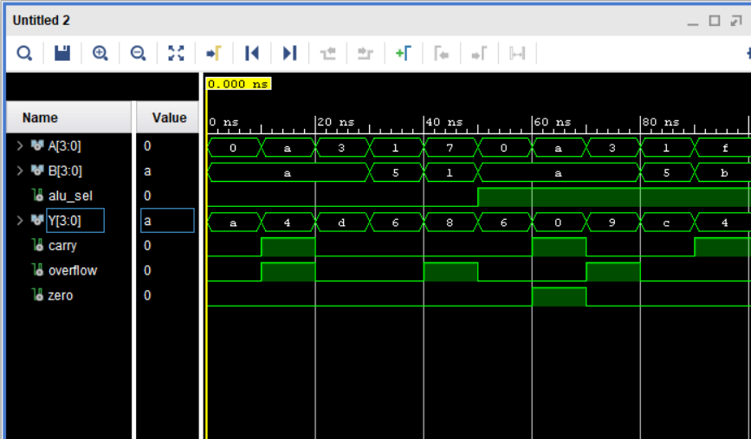
ADD / SUB Unit — ADD_SUB_4bit
Verification
Schematic
Simulation confirmed overflow detection, zero flag, and correct subtraction across boundary cases (e.g., 0000 − 0001, signed overflow at 0111 + 0001).
U1 -> 4-bit Ripple Carry Adder unit

Slide 24
Comparator Unit (Extended Version)
Design Overview
Flag Truth Table
The comparator supports both unsigned (CMPU) and signed (CMP) 4-bit comparison.
Generates three one-hot flags: GT (greater than), EQ (equal), LT (less than).
Comparison is flag-only — no result is written to the register bank.
Unsigned comparison: direct binary comparison of 4-bit values (range 0–15).
Signed comparison: interprets operands as 2's complement integers (range −8 to +7).
Condition | GT | EQ | LT
A > B (unsigned or signed) | 1 | 0 | 0
A = B | 0 | 1 | 0
A < B (unsigned or signed) | 0 | 0 | 1
Integration in top_alu
Comparator is a sub-module of top_alu, selected when alu_op = CMPU (0010) or CMP (0011).
GT/EQ/LT outputs are registered in the flags unit alongside zero and overflow.
Enables conditional program flow beyond the basic JZR zero-check.
Entity Interface
entity comparator is
Port (
A, B : in STD_LOGIC_VECTOR(3 downto 0);
mode : in STD_LOGIC; -- 0=unsigned, 1=signed
GT, EQ, LT : out STD_LOGIC
);
end comparator;
Verification
Elaborated schematic and Vivado simulation confirmed correct flag assertion for boundary cases in both signed and unsigned modes.

Slide 25
Logic Unit — Bitwise Operations (Extended Version)
Supported Operations
Instruction | Operation | Expression | alu_op
AND Ra, Rb | Bitwise AND | Ra ← Ra ∧ Rb | 0101
OR Ra, Rb | Bitwise OR | Ra ← Ra ∨ Rb | 0100
XOR Ra, Rb | Bitwise XOR | Ra ← Ra ⊕ Rb | 0110
NOT Ra | Bitwise NOT | Ra ← ~Ra | 0111
Implementation Notes
Implemented as a purely combinational circuit using concurrent signal assignments.
A 2-bit selection input (binop_sel) routes through a case statement to produce the correct output.
For NOT, operand B is ignored; Ra is complemented bit by bit.
Result is presented to the top_alu output mux, which selects it when alu_op indicates a logical operation.
Entity Interface
Integration
entity logic_unit is
Port (
A, B : in STD_LOGIC_VECTOR(3 downto 0);
binop_sel: in STD_LOGIC_VECTOR(1 downto 0);
result : out STD_LOGIC_VECTOR(3 downto 0)
);
end logic_unit;
-- binop_sel: 00=OR, 01=AND, 10=XOR, 11=NOT
Logic unit operates as a sub-module of top_alu alongside ADD_SUB_4bit and the Comparator.
The decoder asserts the appropriate alu_op (3-bit) and binop_sel (2-bit) based on the 4-bit opcode field.
Elaborated design schematic verified in Vivado; logic operations confirmed via simulation.

Slide 26
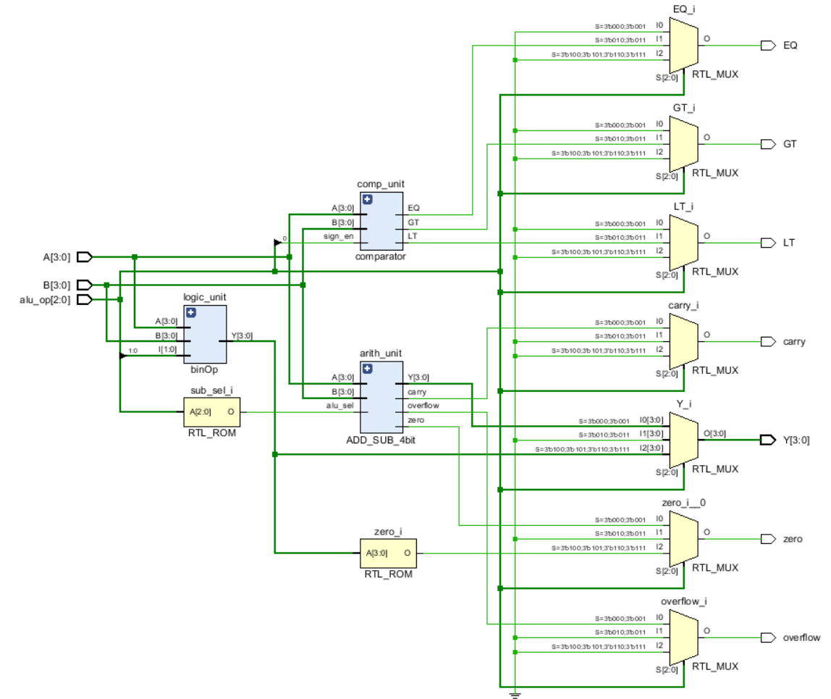
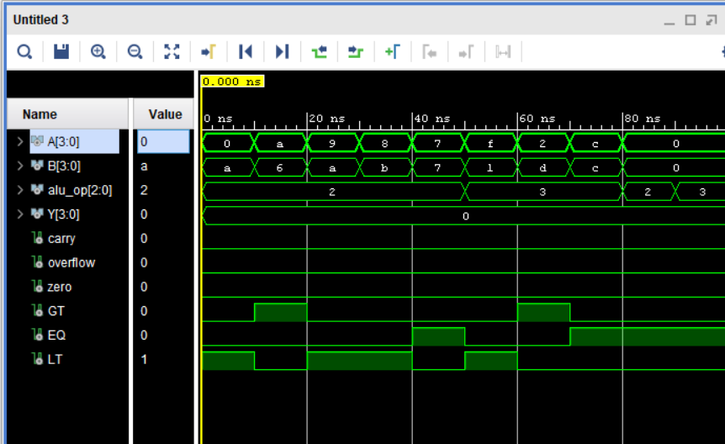
Comparator Unit , Logic Unit

Slide 27
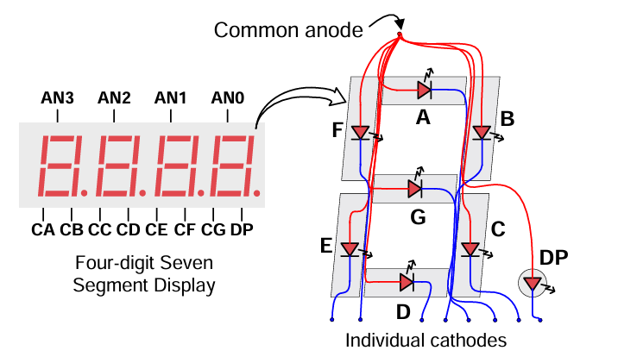
Seven-Segment Display
Design Overview
Converts the 4-bit ALU result (0–15) into the appropriate seven-segment encoding for the Basys 3 display.
Implemented as a combinational lookup using a case statement (with select in VHDL).
Active-low segment outputs drive segments a–g of the display.
Extended version additionally uses flag LEDs (zero, overflow, GT, EQ, LT).
Entity Interface
entity seven_seg is
Port (
data_in : in STD_LOGIC_VECTOR(3 downto 0);
seg_out : out STD_LOGIC_VECTOR(6 downto 0)
);
end seven_seg;

Slide 28
Seven-Segment Display
Segment Encoding (Hex 0–F)
FPGA Pin Assignments (Basys 3)
Value | Decimal | Segments (a–g, active low)
0000 | 0 | 1000000
0001 | 1 | 1111001
0010 | 2 | 0100100
0011 | 3 | 0110000
0100 | 4 | 0011001
0101 | 5 | 0010010
0110 | 6 | 0000010
0111 | 7 | 1111000
Signal | Pin
seg[0] | W7
seg[1] | W6
seg[2] | U8
seg[3] | V8
seg[4] | U5
seg[5] | V5
seg[6] | U7
an[0] | U2
an[1] | U4

Slide 29
Fundamental Building Blocks — Half Adder & Full Adder
Half Adder
Full Adder
Adds two single-bit inputs A and B.
Sum S = A XOR B; Carry C = A AND B.
No carry-in input; used as the first stage in full adder construction.
Adds three bits: A, B, and carry-in C_in.
Built from two Half Adders: HA_0 sums A+B; HA_1 adds result to C_in.
S = A XOR B XOR C_in; C_out = (A AND B) OR (C_in AND (A XOR B)).
entity HA is
Port ( A, B : in STD_LOGIC;
C, S : out STD_LOGIC );
end HA;
-- S <= A xor B; C <= A and B;
entity FA is
Port ( A, B, C_in : in STD_LOGIC;
S, C_out : out STD_LOGIC );
end FA;
-- Two HA instances:
-- HA_0: A+B -> HA0_S, HA0_C
-- HA_1: HA0_S + C_in -> S, HA1_C
-- C_out <= HA0_C or HA1_C;
Half Adder Truth Table
A | B | S (Sum) | C (Carry)
0 | 0 | 0 | 0
0 | 1 | 1 | 0
1 | 0 | 1 | 0
1 | 1 | 0 | 1
Role in Processor
Full adders are chained to form the 4-bit Ripple Carry Adder used in ADD_SUB_4bit and the 3-bit PC incrementer.

Slide 30
Fundamental Building Blocks — Overview
4-bit Ripple Carry Adder (RCA_4bit)
3-bit Adder (PC Increment)
3-to-8 Decoder
Chains four Full Adders in series to perform 4-bit addition. Carry propagates from LSB to MSB. Used inside ADD_SUB_4bit for both ADD and SUB operations.
Specialized 3-bit RCA that computes PC + 1 for sequential instruction fetch. Hardwired to add binary '001' to the current PC value. Output fed to the PC multiplexer.
Converts a 3-bit write_sel address into one-hot write-enable signals for the register bank. Ensures only one register is written per clock cycle. Gated with write_en to prevent accidental writes.
2-way 3-bit Multiplexer
8-way 4-bit Multiplexer
2-way 4-bit Multiplexer (Writeback)
Selects the next Program Counter value: either PC + 1 for sequential execution or jump address d when a JZR branch is taken. Select signal driven by pc_load AND zero_flag.
Reads one of eight 4-bit register outputs from the register bank. Two instances provide operands Ra and Rb to the ALU simultaneously. Select driven by read_sel_a and read_sel_b from the decoder.
Selects between ALU result and immediate data field d for register bank writeback. Controlled by wb_sel_imm from the instruction decoder; set high for MOVI, low for all ALU operations.
4-bit Register (D Flip-Flop)
3-bit PC Register
Flags Unit
4-bit D flip-flop with synchronous reset and write enable. Eight instances form the register bank; one instance serves as the PC register; another stores the slow-clock counter.
3-bit variant of the D flip-flop register used to hold the current program counter address. D input driven by the PC MUX. Enable tied to the slow clock; reset tied to the centre button (btnC) on Basys 3.
Clocked register capturing output flags from the ALU. Optimized version stores zero (Z) and overflow (V) from ADD_SUB_4bit. Extended version additionally stores GT, EQ, and LT comparison flags from the Comparator. flag_en input (extended only) prevents MOVI and JZR from inadvertently overwriting flag values between operations.

Slide 31
Fundamental Building Blocks — Adders
4-bit Ripple Carry Adder (RCA_4bit)
3-bit Adder (PC Increment)
The RCA_4bit is the core arithmetic unit responsible for the ADD and SUB operations. It is constructed from four 1-bit Full Adders.
A specialised version of the RCA designed to compute the next sequential instruction address (PC + 1).
Computes PC + 1 combinational on every clock cycle.
Output passed to the 2-way 3-bit MUX alongside the jump target address d.
MUX selects PC + 1 for normal sequential execution; selects d when JZR branch is taken (pc_load AND zero_flag = 1).
Implemented structurally using three cascaded Full Adder instances consistent with the rest of the datapath.
ADD (ctrl=0): S = A + B with carry-out.
SUB (ctrl=1): S = A + ~B + 1 via 2's complement; Cout used as borrow indicator.
Carry ripples bit-by-bit: simple and area-efficient at low clock speeds.
Forms the foundation of ADD_SUB_4bit and the 3-bit PC adder.
entity Adder_3bit is
Port ( A : in STD_LOGIC_VECTOR (2 downto 0);
Y : out STD_LOGIC_VECTOR (2 downto 0));
end Adder_3bit;
architecture Behavioral of Adder_3bit is
begin
Y <= std_logic_vector(unsigned(A)+1);
end Behavioral;
entity RCA_4bit is
Port ( A : in STD_LOGIC_VECTOR (3 downto 0);
B : in STD_LOGIC_VECTOR (3 downto 0);
C_in : in STD_LOGIC;
S : out STD_LOGIC_VECTOR (3 downto 0);
C_out : out STD_LOGIC);
end RCA_4bit;

Slide 32
Fundamental Building Blocks — Decoders
3-to-8 Decoder (Register Select)
Address to Output Mapping
Maps a 3-bit register address to 8 unique 'Write Enable' signals for the register bank.
Address (reg_sel) | Output Bit High | Register Enabled
000 | Bit 0 | R0
001 | Bit 1 | R1
010 | Bit 2 | R2
011 | Bit 3 | R3
100 | Bit 4 | R4
101 | Bit 5 | R5
110 | Bit 6 | R6
111 | Bit 7 | R7
Integrated with the write_en signal to prevent accidental writes.
Ensures only one register is active at any time.
if (en = '1') then
case reg_sel is
when "000" => y <= "00000001";
when "001" => y <= "00000010";
when "010" => y <= "00000100";
when "011" => y <= "00001000";
when "100" => y <= "00010000";
when "101" => y <= "00100000";
when "110" => y <= "01000000";
when "111" => y <= "10000000";
when others => y <= "00000000";
end case;
else
y <= "00000000";
end if;

Slide 33
Fundamental Building Blocks — Multiplexers
8-way 4-bit Multiplexer
2-way 3-bit Multiplexer (Jump Select)
Determines the next source for the Program Counter (PC).
Acts as the reading interface for the Register Bank, allowing the processor to access Ra and Rb values simultaneously.
Path A : PC + 1 (normal sequential execution).
Path B : Jump Address d extracted from instruction bits [2:0].
Control ; Driven by pc_load signal from the instruction decoder.
Two independent 8-to-1 mux instances share the same register bank outputs but use different select signals (read_sel_a and read_sel_b).
Ra feeds ALU input A; Rb feeds ALU input B — both driven in the same clock cycle.
Implemented using a with-select concurrent signal assignment for purely combinational operation.
No latency: register values appear at ALU inputs within the same clock period as the decode stage.
2-way 4-bit Multiplexer (Writeback)
Selects the source of data to be written back into the Register Bank.
Input 0 : ALU Result (for arithmetic / logic instructions).
Input 1 : Immediate Value d (for MOVI instruction).
Select : wb_sel_imm signal from the instruction decoder.

Slide 34
Fundamental Building Blocks — Registers
4-bit Register (D Flip-Flop)
3-bit PC Register
4-bit D flip-flop with synchronous reset and enable.
On rising clock edge: if reset='1' → Q ← 0000; else if enable='1' → Q ← D.
Eight instances form the register bank; one instance is the PC register.
Additional instance stores the slow-clock counter for frequency division.
Identical design to the 4-bit register but 3 bits wide to address 8 ROM locations.
D input driven by PC MUX output (either PC+1 or jump target d).
Enable tied to slow clock; reset tied to the centre button (btnC) on Basys 3.
entity pc_register is
Port ( clk : in STD_LOGIC;
enable : in STD_LOGIC;
reset : in STD_LOGIC;
D : in STD_LOGIC_VECTOR (2 downto 0);
Q : out STD_LOGIC_VECTOR (2 downto 0));
end pc_register;
entity register_4bit is
Port ( clk : in STD_LOGIC;
reset : in STD_LOGIC;
enable : in STD_LOGIC;
we : in STD_LOGIC;
D : in STD_LOGIC_VECTOR (3 downto 0);
Q : out STD_LOGIC_VECTOR (3 downto 0));
end register_4bit;
Common Register Behaviour
Condition | clk edge | Q output
reset = '1' | Rising | 0000 / 000 (cleared)
enable = '1', reset = '0' | Rising | D (data loaded)
enable = '0', reset = '0' | Rising | Q unchanged (hold)

Slide 35
Fundamental Building Blocks — Flags
Flags Unit Optimized / Extended
Flags Entity (Extended)
Clocked register capturing output flags from the ALU.
Optimized: stores zero (Z) and overflow (V) from ADD_SUB_4bit.
Extended: additionally stores GT, EQ, LT from the Comparator.
flag_en input (extended only) controls when flags are updated — prevents MOVI/JZR from inadvertently overwriting flags.
Flags held stable between updates, available to the decoder each cycle.
entity flags is
Port (
clk : in STD_LOGIC;
enable : in STD_LOGIC;
reset : in STD_LOGIC;
flag_en : in STD_LOGIC;
cmp_en : in STD_LOGIC;
alu_zero : in STD_LOGIC;
alu_overflow : in STD_LOGIC;
alu_GT : in STD_LOGIC;
alu_EQ : in STD_LOGIC;
alu_LT : in STD_LOGIC;
Z : out STD_LOGIC;
V : out STD_LOGIC;
GT : out STD_LOGIC;
EQ : out STD_LOGIC;
LT : out STD_LOGIC );
end flags;
Flags Entity (Optimized)
entity flags is
Port (
clk, enable, reset : in STD_LOGIC;
flag_en : in STD_LOGIC;
alu_zero : in STD_LOGIC;
alu_overflow : in STD_LOGIC;
Z : out STD_LOGIC;
V : out STD_LOGIC
);
end flags;

Slide 36
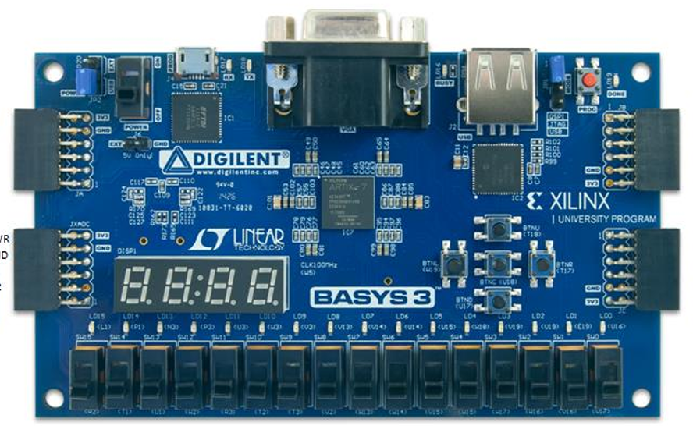
FPGA Pin Mappings — Basys 3
Optimized Version
Signal | Pin | Direction | Function
Clk_100MHz | W5 | in | 100 MHz system clock
reset (btnC) | U18 | in | Synchronous processor reset
led[0] | U16 | out | Result bit 0 (R7[0])
led[1] | E19 | out | Result bit 1 (R7[1])
led[2] | U19 | out | Result bit 2 (R7[2])
led[3] | V19 | out | Result bit 3 (R7[3])
led[4] | P1 | out | Zero flag
led[5] | L1 | out | Overflow flag
seg[0–6] | W7–U7 | out | Seven-segment a–g
an[0–3] | U2–W4 | out | Seven-segment anodes
overflow
zero
Reset button
R7[3] R7[2] R7[1] R7[0]
Seven segment display

Slide 37
FPGA Pin Mappings — Basys 3
Extended Version — Additional Pins
equal
zero
Instruction push
Signal | Pin | Direction | Function
Clk_100MHz | W5 | in | 100 MHz system clock
reset (btnC) | U18 | in | Synchronous processor reset
btnU | T18 | in | Auxiliary button (extended)
sw[0–13] and sw[15] | V17–U1 and R2 | in | 15 input switches for extended ops
led[0–3] | U16–V19 | out | Result bits [3:0]
led[4] | P1 | out | Zero flag
led[5] | L1 | out | Overflow flag
led[6] | N3 | out | GT flag
led[7] | P3 | out | EQ flag
led[8] | U3 | out | LT flag
seg[0–6] / an[0–3] | W7–W4 | out | Seven-segment display
overflow
greater
lower
reset
Manual instructions
mode
R7[3] R7[2] R7[1] R7[0]

Slide 38
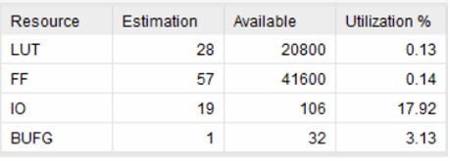
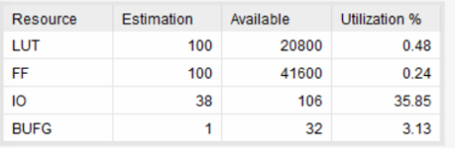
Resource Utilization — Basys 3
Optimized Version
Extended Version
Comparison & Analysis
Metric | Optimized | Extended | Increase
LUTs | 28 | 100 | X3.57 - due to top_alu, comparator, and logic unit
Flip-Flops | 57 | 100 | X1.75 - additional flag registers (GT/EQ/LT)
I/O Buffers | 19 | 38 | x2 - switches + extra flag LEDs

Slide 39
Conclusion
This project involved the successful design, simulation, and FPGA deployment of a 4-bit nanoprocessor in VHDL, progressing from a resource-optimized baseline to an extended feature-rich implementation.
Hardware Mastery
ISA Design
Gained hands-on understanding of all key processor components — ALU, instruction decoder, program counter, register bank, and flag handling — through structural VHDL implementation.
Designed and validated a complete instruction set architecture in both optimized (12-bit/2-bit opcode) and extended (14-bit/4-bit opcode) forms, covering arithmetic, logical, and control-flow operations.
VHDL Proficiency
FPGA Deployment
Implemented and simulated all sub-modules in Vivado; timing diagrams confirmed correct functional behaviour for each component under all tested stimuli.
All components passed physical integration testing on the Basys 3 development board, with real-time results observable via LEDs and the seven-segment display.
Design Trade-offs
Collaborative Engineering
Demonstrated quantified trade-offs: the Extended version approximately doubles LUT usage over the Optimized version, directly attributable to the three additional ALU sub-modules.
Effectively partitioned a complex multi-module system across four team members, integrating independently verified sub-modules into a fully functional processor.

Slide 40
Team Contributions
Name | Index No. | Contributions | Hours
Jayathilake P. I. K. | 240288D | ALU, Seven-Segment Display, Top Module, Presentation, Report | 24
Jayawardana Y. G. L. S. | 240294R | Program ROM, Instruction Decoder, Presentation, Report | 22
Jayawardhana J. A. R. P. | 240297E | Program Counter, 3-bit Adder, Multiplexers, Report | 20
Kalpashaka N. G. L. G. | 240312A | Register Bank, 3-to-8 Decoder, Flags Unit, Report | 20
CS1050 · Group 23 · Department of Computer Science and Engineering · University of Moratuwa

Slide 41
Thank You
Nanoprocessor Design · CS1050 · Group 23
Implemented in Vivado and tested on Basys 3 FPGA

