Slide 1
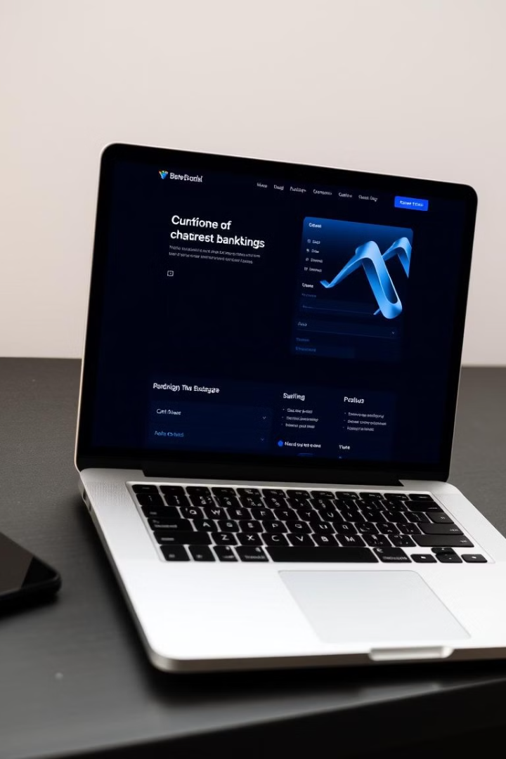
Online Banking System
EAD Course Work
A Microservices-Based Web Application

Slide 2
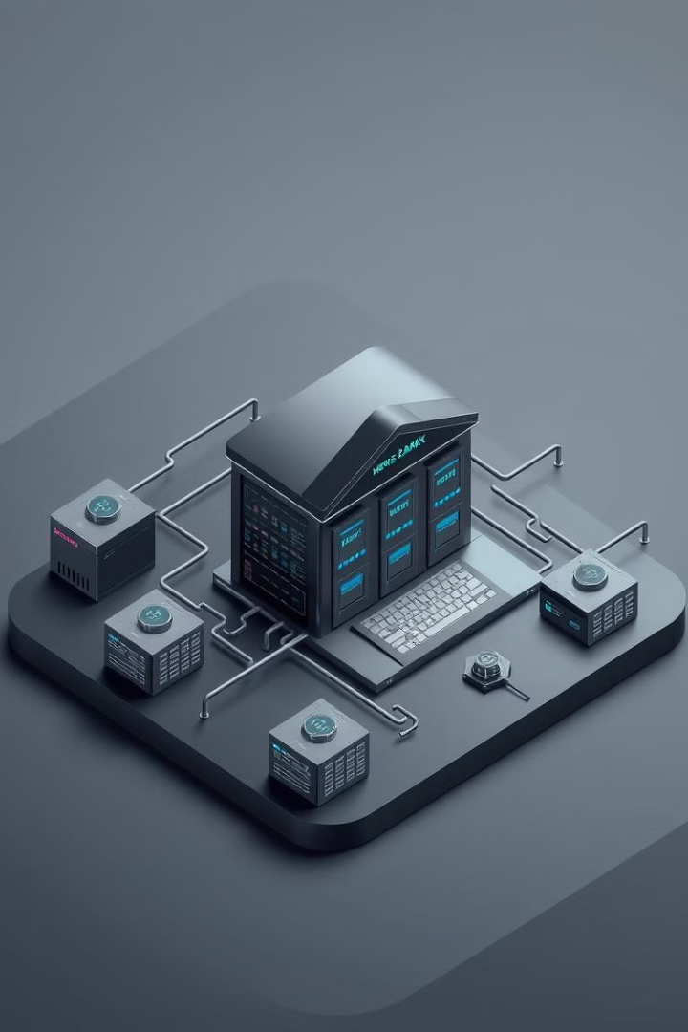



Introduction
Scalability
Security
Traditional systems lack scalability.
Leverage Spring Boot for secure banking.
Modularity
Modular architecture.

Slide 3
Microservices Overview
Loan Service 💰
Account Service 🏦
Transaction Service 🔄
User Service 👥
Apply loan
Create account (Admin)
Login/Register
Update status (Admin)
Deposit/Withdraw
Update Profile
Calculate EMI
View/Update/Delete account
Transfer funds
Manage Users (Admin)
Delete Applications
View history

Slide 4
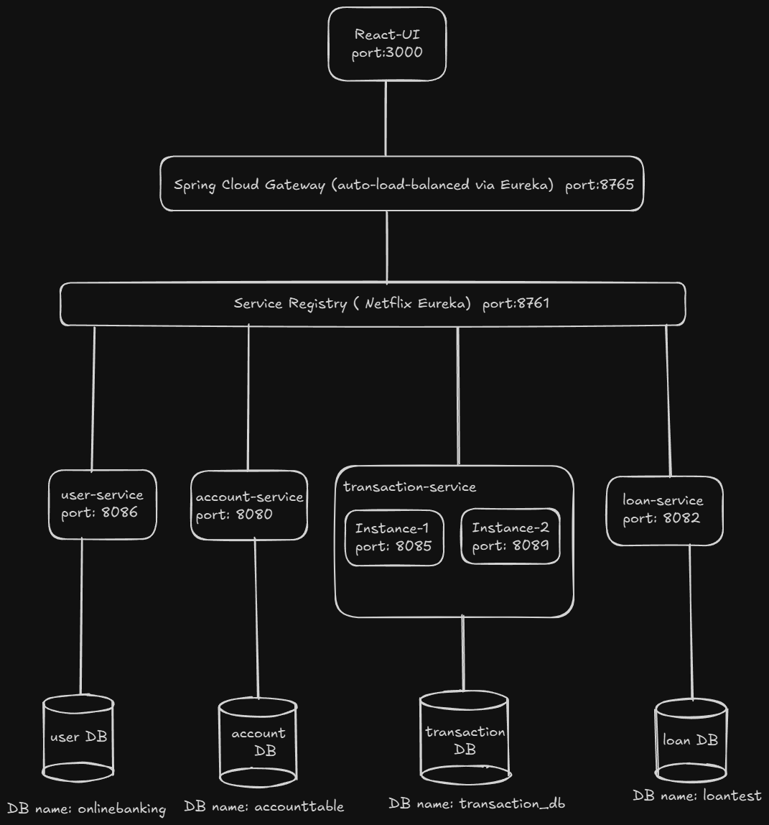
Microservices Architecture

Slide 5

Thank You
Questions?

