Slide 1

By Lakshana, Kanchan, Tamara

Slide 2
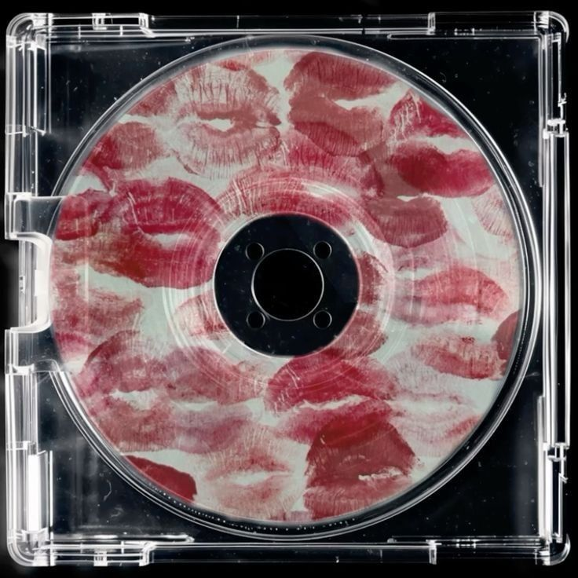
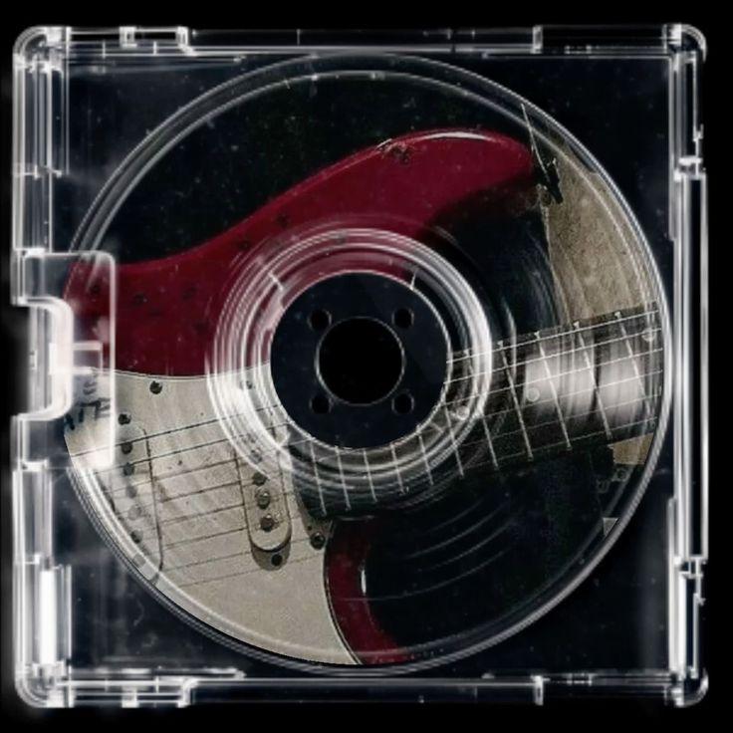
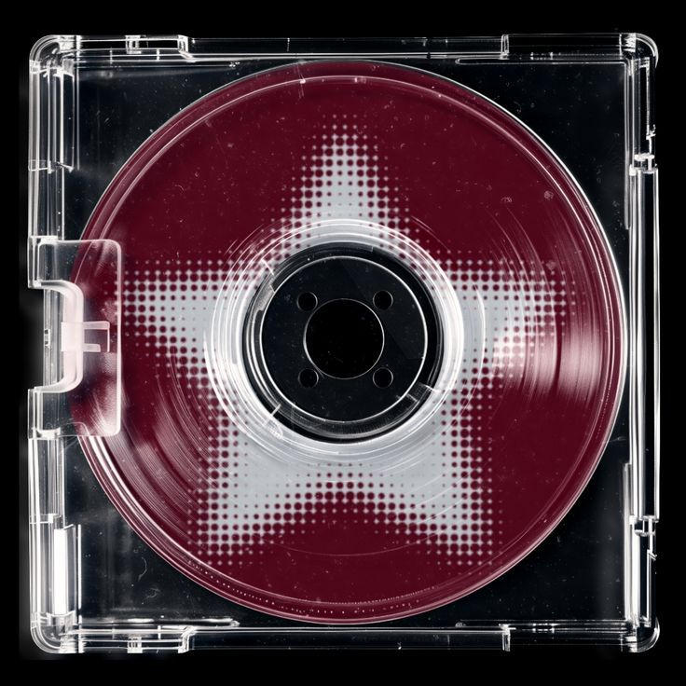
TABLE OF CONTENTS
Introduction
Timeline
Growth
Problem
Collapse
Cloud
Lessons
Legacy
References

Slide 3

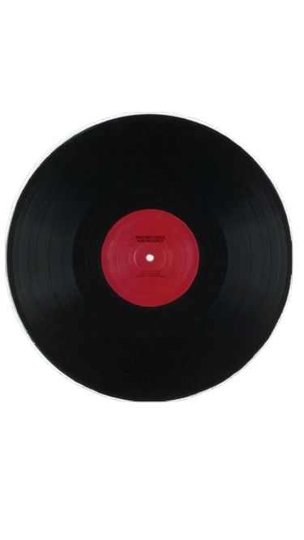
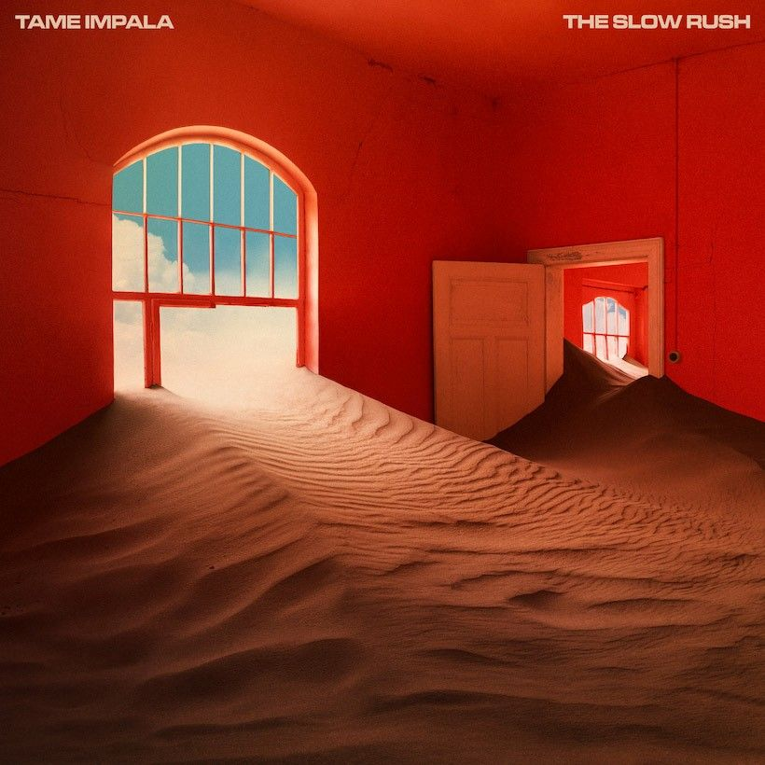
INTRODUCTION
Grooveshark was an online music streaming service that launched in March 2006,long before Spotify and Apple Music became household names. It offered millions of tracks that users could search, stream, and share freely, making it a favorite hangout spot for music lovers around the world.
Grooveshark was founded by three University of Florida students: Sam Tarantino, Josh Greenberg , Andres Barreto
The founders wanted to make music more accessible to everyone. At a time when piracy was rampant and legal options were limited, they dreamed of creating a community-driven platform where people could upload, share, and enjoy music freely. Their bigger goal was to bridge the gap between listeners and artists in a fairer way than traditional record labels. In essence: music without barriers.

Slide 4

TIMELINE
Founded in Florida as a peer-to-peer music sharing site.
2006-2007
Shifted into a streaming platform with search, playlists, and community features.
2007–2008
Gained popularity- Reached 30M+ users but faced first lawsuits from record labels.
2009–2010
Hit peak with 35M users, 15M+ songs. Legal pressure grew; apps removed from Apple & Google stores.
2011-2012
Tried artist-upload model, but lawsuits intensified. Courts ruled executives uploaded copyrighted songs.
2012–2014
Grooveshark shut down in settlement with Universal, Sony, and Warner.
April 2015

Slide 5
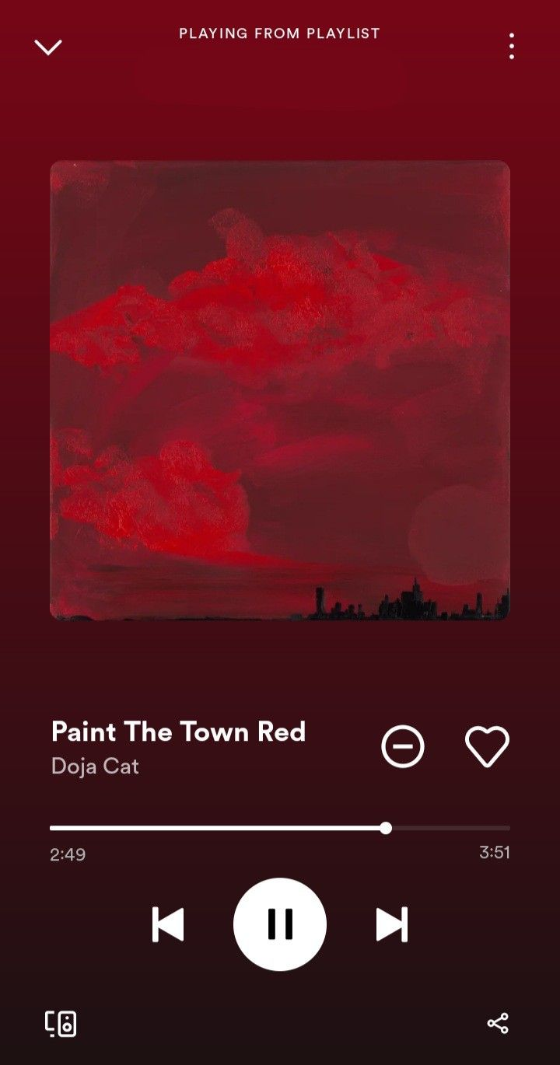
GROWTH
Grooveshark worked as a peer-to-peer network,letting users upload MP3s for others to listen to. It later transformed into a sleek web-based music streaming site.
Gained traction quickly because it offered free, on-demand music at a time when few services did Features like search, playlists, and community sharing made it stand out.
Expanded with mobile apps, drawing comparisons to Spotify. By 2011, it had around 35 million users worldwide and a catalog of 15 million+ songs.
Users could follow friends, share playlists, and even discover new artists, giving it a “music community” vibe.
Accessible in over 150 countries, making it one of the most widely used streaming platforms before Spotify took over.

Slide 6
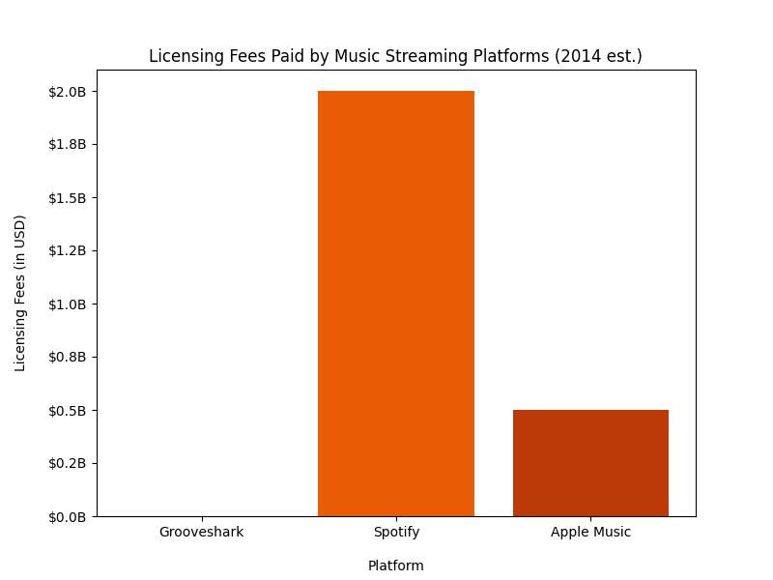
PROBLEM
LEGAL FALLOUT
FEES COMPARISION
Lack of Licensing - The model relied on user-uploaded content, allowing copyrighted music, uploading without permission and operating in a legally gray area compared to Spotify or Apple Music
Legal Actions - In 2011, Universal Music Group, Sony Music, Entertainment and Warner Music Group sued Grooveshark for copyright infringement, alleging it ignored takedown notices and deleted the metadata to hide the original uploaders
Court Rulings and Penalties - In 2015, a federal judge deemed Grooveshark's actions willful and in bad faith, resulting in potential $700 million in damages and financial hardship for the company

Slide 7

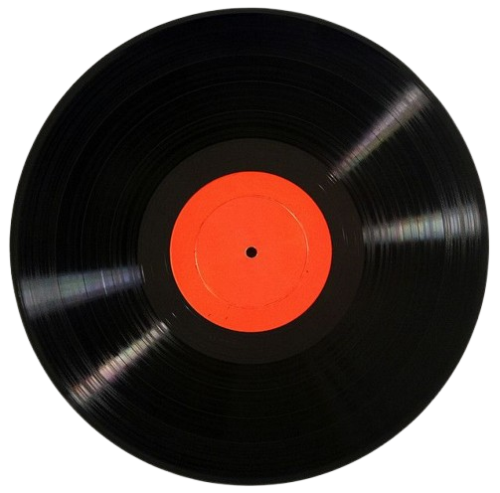

COLLAPSE
Settlement Agreement
In April 2015, Grooveshark reached a settlement with Universal, Sony and Warner, requiring immediate cessation of operations, removal of copyrighted music and the transfer of intellectual property to record labels
Shutdown & Public Apology
Grooveshark announced a sudden shutdown, causing users to lose access to playlists and uploaded music. Their apology targeted the artists, songwriters, labels, fans and displaced employees
Impact on the Industry
Millions of consumers were harmed by Grooveshark's forced switch to licensed services such as Spotify and Apple Music, as many lost their favorite tracks and the streaming model they were used to.

Slide 8
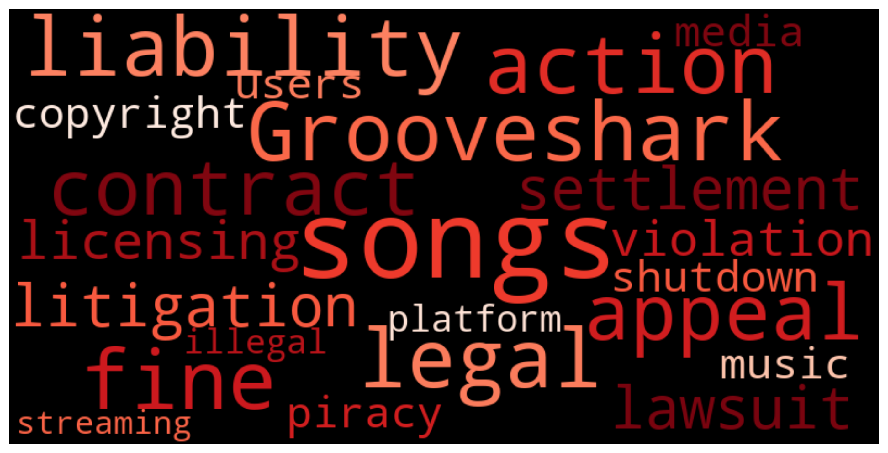
A CLOUD OF CONTROVERSY

Slide 9
LESSONS LEARNT
Despite Grooveshark being an innovative music-sharing platform, it faced challenges in three areas:
Legal Risks
Ethical Concerns
Sustainability
♥ ⏮ ⏯ ⏭ ⊕
♥ ⏮ ⏯ ⏭ ⊕
♥ ⏮ ⏯ ⏭ ⊕
Allowing users to upload and stream music without proper licenses created significant legal risks.
Although the platform claimed to follow DMCA rules, artists were not paid, raising ethical concerns.
The shutdown highlights that tech innovation must align with ethics and legal requirements to be sustainable.

Slide 10
LEGACY
~Influence on Modern Platforms~
Many features like playlist sharing and music discovery are now common on platforms like Spotify and Youtube music. ​Its user-upload model influenced SoundCloud’s community-driven platform​. Became a cautionary tale, proving that long-term success requires proper licensing and artist support
Feature | Grooveshark | Spotify | YouTube Music | SoundCloud
Playlist Sharing | ✓ | ✓ | ✓ | ✓
User Uploads | ✓ | ✗ | ✗ | ✓
Recommendations | ✓ | ✓ | ✓ | ✓
Licensed Content | ✗ | ✓ | ✓ | ✓ (partial)
Artist Payout | ✗ | ✓ | ✓ | ✓ (limited)

Slide 11

REFERENCES
https://www.bbc.com/news/technology-32547376
1
https://www.rollingstone.com/music/music-news/grooveshark-shuts-down-after-eight-years-74101/
2
https://www.cinchsolution.com/what-happened-to-grooveshark-com/
3
https://www.wired.com/story/grooveshark-is-dead/
4

