Slide 1


Slide 2

Agenda
Introduction
Entities & Attributes
ER Diagram
Mapping Relationships
Database Creation
Data Inserting
Data Retrieve
Conclusion

Slide 3

INTRODUCTION
Brief Description
To streamline inventory management for a retail company.
Centralized database for product details, supplier information, and order histories.
Supplier management, shipment tracking, automated purchase orders, real-time inventory updates.
Benefits:
Improved order fulfillment procedures.
Prevention of stockouts and overstocking.
Enhanced inventory accuracy.
Optimization of supply chain management for increased profitability and customer satisfaction.

Slide 4

Entity & Attributes
Regular Entities
supplier(supplie_id, name, contact_person, email, address)
physical_product(product_id,type , name, description, total_stock, available_stock, color, weight, size, supplier_id)
digital_product(product_id, lisenskey, name, description, total_stock, available_stock, supplier_id)

Slide 5
Entity & Attributes
Regular Entities
customer(customer_id, first_name, last_name,email,address) order(order_id, date,status,total_amount, available_stock, customer_id)
order_details(order_detail_id, quantity,unit_price,total_price,order_id)
Multivalued attributes
• supplier_contract(supplier_id, contact_no)
• customer_contract(customer_id, contact_no)

Slide 6
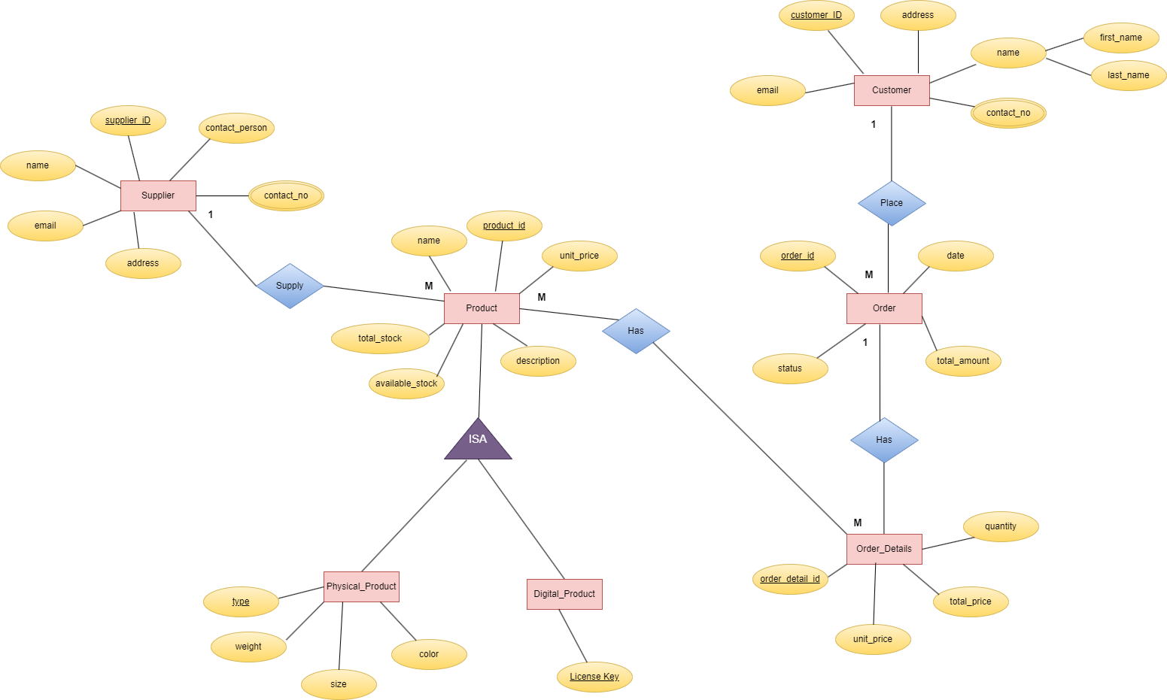

Slide 7
Mapping Relationships
One-to-Many (1 : M) Relationships:
Physical Product - Supplier
Description: Each physical product is associated with one supplier, while a supplier can supply multiple physical products.
Relationship: One supplier can supply many physical products.
Entities:
Physical_Product (Supplier_ID - Foreign Key)
Supplier (Supplier_ID - Primary Key)
Digital Product - Supplier
Description: Similar to physical products, each digital product is associated with one supplier, and a supplier can supply multiple digital products.
Relationship: One supplier can supply many digital products.
Entities:
Digital_Product (Supplier_ID - Foreign Key)
Supplier (Supplier_ID - Primary Key)

Slide 8
One-to-Many (1 : M) Relationships:
Order - Customer
Description: Each order is placed by one customer, but a customer can place multiple orders.
Relationship: One customer can place many orders.
Entities:
Order (Customer_ID - Foreign Key)
Customer (Customer_ID - Primary Key)
Mapping Relationships

Slide 9
Mapping Relationship
Many-to-Many (M : N) Relationships:
Digital Product - Order Details
Description: Multiple digital products can be included in an order, and a digital product can be part of multiple order details.
Relationship: Many digital products can be associated with many order details.
DigitalProduct_OrderDetails (Product_ID_Type, Order_Detail_ID)
Physical Product - Order Details
Description: Similarly, multiple physical products can be included in an order, and a physical product can be part of multiple order details.
Relationship: Many physical products can be associated with many order details.
PhysicalProduct_OrderDetails (Product_ID_Type, Order_Detail_ID)
Mapping Relationships

Slide 10
Create Database Tables
CREATE TABLE Supplier (
Supplier_ID INT PRIMARY KEY,
Name VARCHAR(100),
Contact_Person VARCHAR(100),
Email VARCHAR(100),
Address VARCHAR(255)
);
CREATE TABLE Customer (
Customer_ID INT PRIMARY KEY,
First_Name VARCHAR(50),
Last_Name VARCHAR(50),
Email VARCHAR(100),
Address VARCHAR(255)
);
CREATE TABLE Physical_Product (
Product_ID INT PRIMARY KEY,
Type VARCHAR(50),
Name VARCHAR(100),
Description TEXT,
Total_Stock INT,
Available_Stock INT,
Color VARCHAR(50),
Weight DECIMAL(10,2),
Size VARCHAR(50),
Supplier_ID INT,
FOREIGN KEY (Supplier_ID) REFERENCES Supplier(Supplier_ID)
);

Slide 11
CREATE TABLE Order (
Order_ID INT PRIMARY KEY,
Date DATE,
Status VARCHAR(50),
Total_Amount DECIMAL(10,2),
Customer_ID INT,
FOREIGN KEY (Customer_ID) REFERENCES Customer(Customer_ID)
);
CREATE TABLE Customer (
Customer_ID INT PRIMARY KEY,
First_Name VARCHAR(50),
Last_Name VARCHAR(50),
Email VARCHAR(100),
Address VARCHAR(255)
);
CREATE TABLE Digital_Product (
Product_ID INT PRIMARY KEY,
License_Key VARCHAR(100),
Name VARCHAR(100),
Description TEXT,
Total_Stock INT,
Available_Stock INT,
Supplier_ID INT,
FOREIGN KEY (Supplier_ID) REFERENCES Supplier(Supplier_ID)
);
Create Database Tables

Slide 12
Data Inserting
INSERT INTO supplier (supplier_id, name, contact_person, email, address)
VALUES
('Sup001', 'John Abrhum', 'John Doe', 'john.doe@gamil.com', '123 Main Street’),
('Sup002', 'Nikesh Nithil', 'Jane Smith', 'jane.smith@gamil.com', '456 Elm Street’),
('Sup003', 'Kamal Anirudh', 'Michael Johnson', 'michael.johnson@gamil.com', '789 Oak Street'), ('Sup004', 'Patrick Jane', 'Emily Brown', 'emily.brown@gamil.com', '101 Pine Street’),
('Sup005', 'Jane hightower', 'David Wilson', 'david.wilson@gamil.com', '202 Maple Street'), ('Sup006', 'Brad Smith', 'Sarah Lee', 'sarah.lee@gamil.com', '303 Cedar Street’),
('Sup007', 'Kevin Fernando', 'Kevin Miller', 'kevin.miller@gamil.com', '404 Birch Street'), ('Sup008', 'Adam Martinez', 'Amanda Davis', 'amanda.davis@gamil.com', '505 Walnut Street'), ('Sup009', 'Rebeca Silvester', 'Robert Taylor', 'robert.taylor@gamil.com', '606 Ash Street'), ('Sup010', 'Anne Sebestian', 'Jessica Martinez', 'jessica.martinez@gamil.com', '707 Oakwood Avenue');

Slide 13
Data Inserting
INSERT INTO digital_product (product_id, licenskey, name, description, unit_price, available_stock, total_stock, supplier_id)
VALUES
('Dig001', 'ABC123', 'Software', 'Digital software product', 49.99, 200, 300, 'Sup001'), ('Dig002', 'DEF456', 'E-book', 'Digital book in PDF format', 9.99, 500, 600, 'Sup002’),
('Dig003', 'GHI789', 'Online Course', 'Digital course with video lectures', 79.99, 100, 150, 'Sup003’),
('Dig004', 'JKL012', 'Subscription', 'Digital subscription service', 19.99, 300, 400, 'Sup004’),
('Dig005', 'MNO345', 'Music Album', 'Digital music album in MP3 format', 14.99, 150, 200, 'Sup005’),
('Dig006', 'PQR678', 'Movie', 'Digital movie download', 9.99, 200, 250, 'Sup006’),
('Dig007', 'STU901', 'Game', 'Digital video game', 39.99, 100, 150, 'Sup007'), ('Dig008', 'VWX234', 'Audio Book', 'Digital audio book', 29.99, 80, 120, 'Sup008’),
('Dig009', 'YZA567', 'Software Tool', 'Digital software tool', 69.99, 150, 200, 'Sup009’),
('Dig010', 'BCD890', 'E-magazine', 'Digital magazine subscription', 4.99, 300, 400, 'Sup010');

Slide 14
Data Inserting
INSERT INTO customer (customer_id, first_name, last_name, email, address)
VALUES
('Cus001', 'Alice', 'Johnson', 'alice.johnson@example.com', '123 Pine Street'), ('Cus002', 'Bob', 'Smith', 'bob.smith@example.com', '456 Oak Street'), ('Cus003', 'Charlie', 'Williams', 'charlie.williams@example.com', '789 Maple Street’),
('Cus004', 'David', 'Brown', 'david.brown@example.com', '101 Elm Street'), ('Cus005', 'Emma', 'Jones', 'emma.jones@example.com', '202 Cedar Street'), ('Cus006', 'Frank', 'Taylor', 'frank.taylor@example.com', '303 Birch Street'), ('Cus007', 'Grace', 'Anderson', 'grace.anderson@example.com', '404 Walnut Street’),
('Cus008', 'Henry', 'Martinez', 'henry.martinez@example.com', '505 Ash Street’),
('Cus009', 'Ivy', 'Garcia', 'ivy.garcia@example.com', '606 Oakwood Avenue'), ('Cus010', 'Jack', 'Lopez', 'jack.lopez@example.com', '707 Elmwood Drive');

Slide 15
Data Inserting
INSERT INTO order (order_id, date, customer_id, total_amount, status) VALUES
('Ord001', '2024-04-01', 'Cus001', 299.99, 'Shipped’),
('Ord002', '2024-04-02', 'Cus002', 199.99, 'Delivered’),
('Ord003', '2024-04-03', 'Cus003', 399.99, 'Pending’),
('Ord004', '2024-04-04', 'Cus004', 599.99, 'Shipped’),
('Ord005', '2024-04-05', 'Cus005', 499.99, 'Delivered’),
('Ord006', '2024-04-06', 'Cus006', 99.99, 'Shipped’),
('Ord007', '2024-04-07', 'Cus007', 199.99, 'Delivered’),
('Ord008', '2024-04-08', 'Cus008', 149.99, 'Pending’),
('Ord009', '2024-04-09', 'Cus009', 799.99, 'Shipped’),
('Ord010', '2024-04-10', 'Cus010', 349.99, 'Delivered');

Slide 16
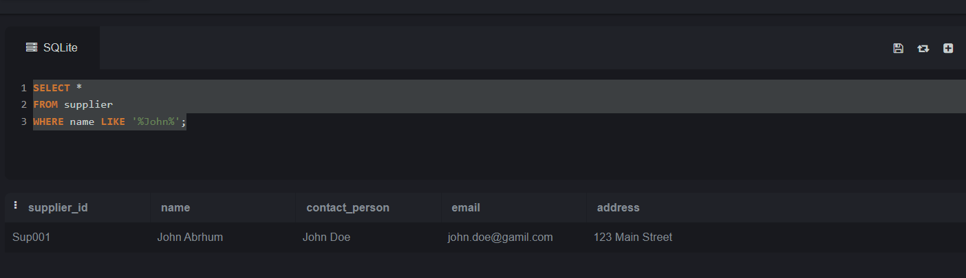
Data Retrieve
SELECT * FROM supplier WHERE name LIKE '%John%’;

Slide 17
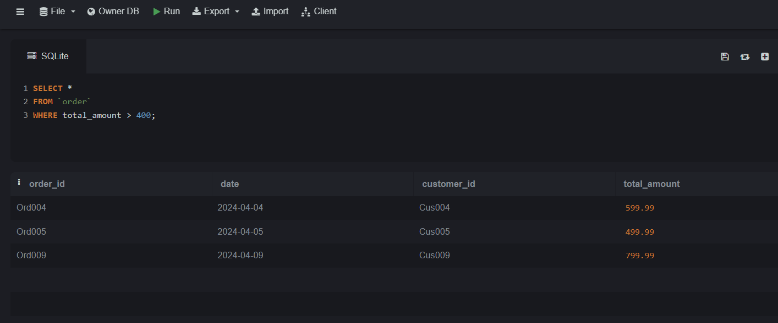
Data Retrieve
SELECT * FROM order WHERE total_amount > 400;

Slide 18
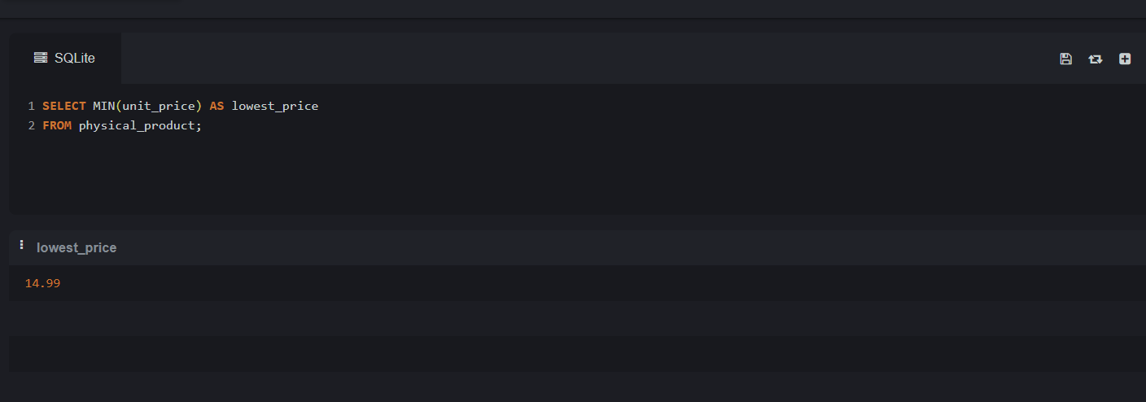
Data Retrieve
SELECT MIN(unit_price) AS lowest_price FROM physical_product;

Slide 19
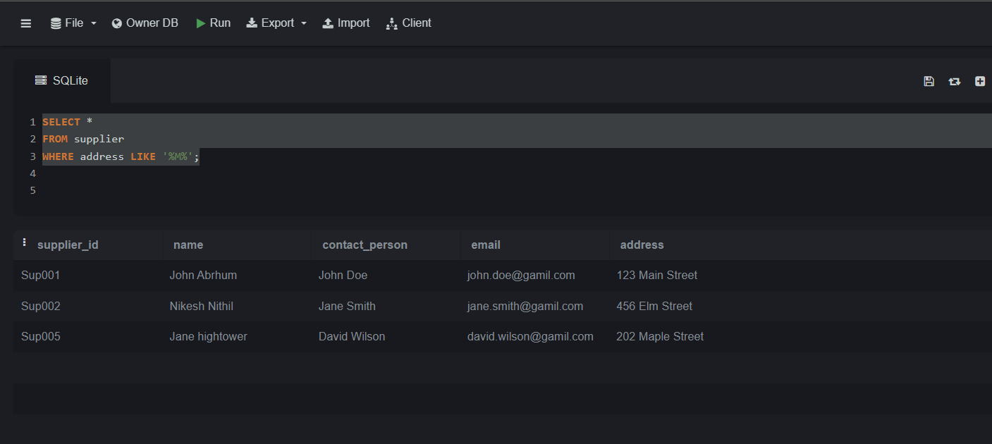
Data Retrieve
SELECT * FROM supplier WHERE address LIKE '%M%';

Slide 20
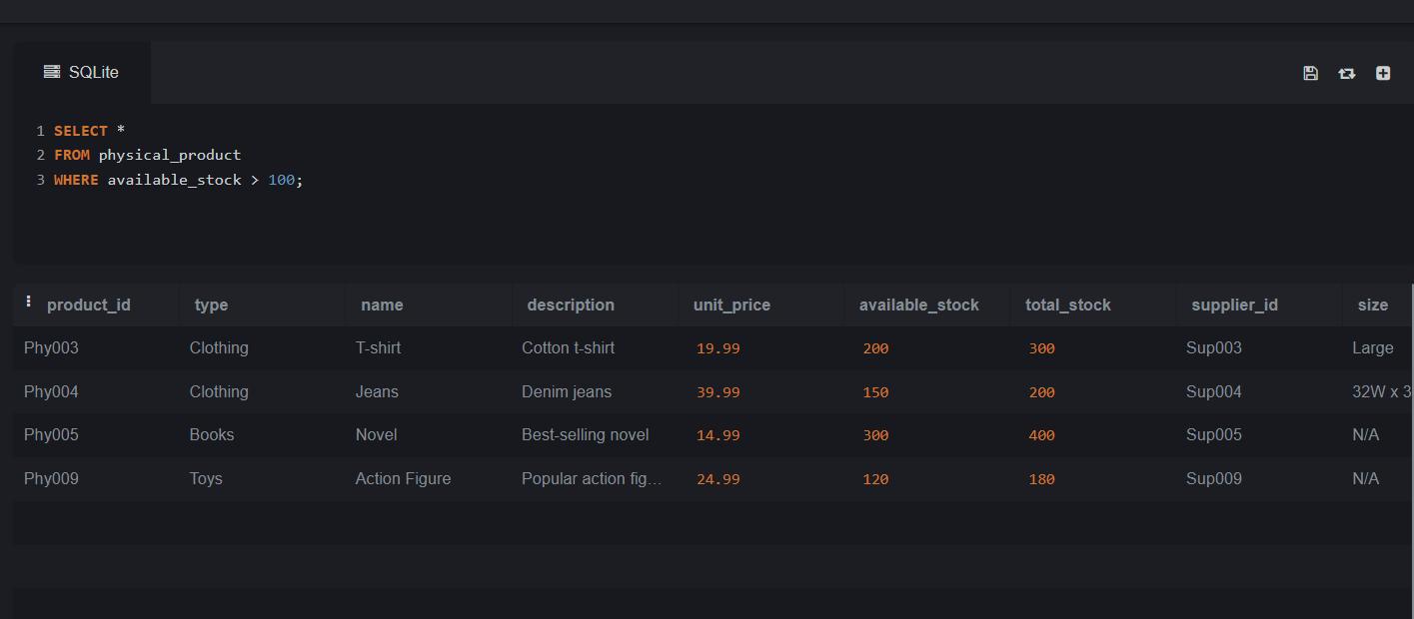
Data Retrieve
SELECT * FROM physical_product WHERE quantity_on_hand > 100;

Slide 21
Conclution
In conclusion, our retail company's inventory management requirements are well-served by the sophisticated Inventory Management System (IMS) we've designed. Through the centralization of supplier, product, customer, and order data, the IMS improves efficiency and simplifies operations.
Relational databases and SQL have helped us lay a strong basis for automated workflows, real-time updates, and well-informed decision-making. Better supply chain management and more seamless connectivity between entities are made possible by the integration of one-to-many and many-to-many links.
All things considered, the IMS makes it possible for us to maximize order fulfillment, reduce stockouts, increase inventory accuracy, and ultimately raise customer satisfaction and profitability. We appreciate your time and are enthusiastic about the beneficial effects our IMS will bring to our company.

Slide 22


