Slide 1
DRISHTI
Predictive Crime Hotspot Mapping Assistant
IBM Bob AI Hackathon 2026
Track 4 • AI & Predictive
Turning historical crime records into explainable, time-aware patrol intelligence.
TEAM ANANTA
Lakshay Sunil Jatawat • Kunj Buddhdev • Deeksha • Jiya Joshi
District-level decision support for proactive patrol planning
01

Slide 2
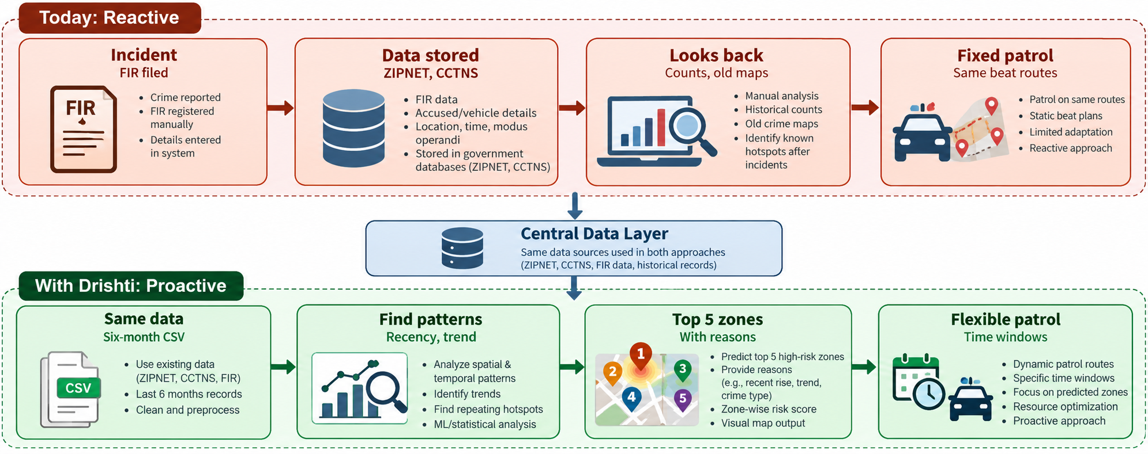
01 / PROBLEM
The gap is not data — it is predictive use of data
Police stations may already hold years of geo-tagged crime records, while patrol plans can remain static and reactive.
CURRENT STATE
Reactive workflow
Incident is recorded after the event.
Historical data is stored, but often looked at retrospectively.
Beat routes can remain fixed despite changing spatial-temporal patterns.
Drishti adds a predictive decision layer on top of existing records.
Source basis: project README problem statement and solution description.

Slide 3
02 / SOLUTION
Drishti converts historical records into an actionable weekly brief
The system is designed around explainability and human approval — not black-box automation.
1
2
3
4
1 Detect patterns
2 Predict Top 5
3 Simulate events
4 Redeploy patrols
Spatial + temporal analysis
Ranked risk + reasons
What-if analysis
Time-window guidance
Find near-repeat patterns, recency effects, and recurring hotspots across micro-zones.
Score areas for the coming week and explain what is driving each high-risk flag.
Model shows how festivals, markets, or rallies could shift area-level risk.
Suggest patrol windows and package findings in a one-page SHO intelligence brief.
Key product promise:
Top-5 risk areas + the “why” + event impact + patrol timing — in one decision flow.

Slide 4
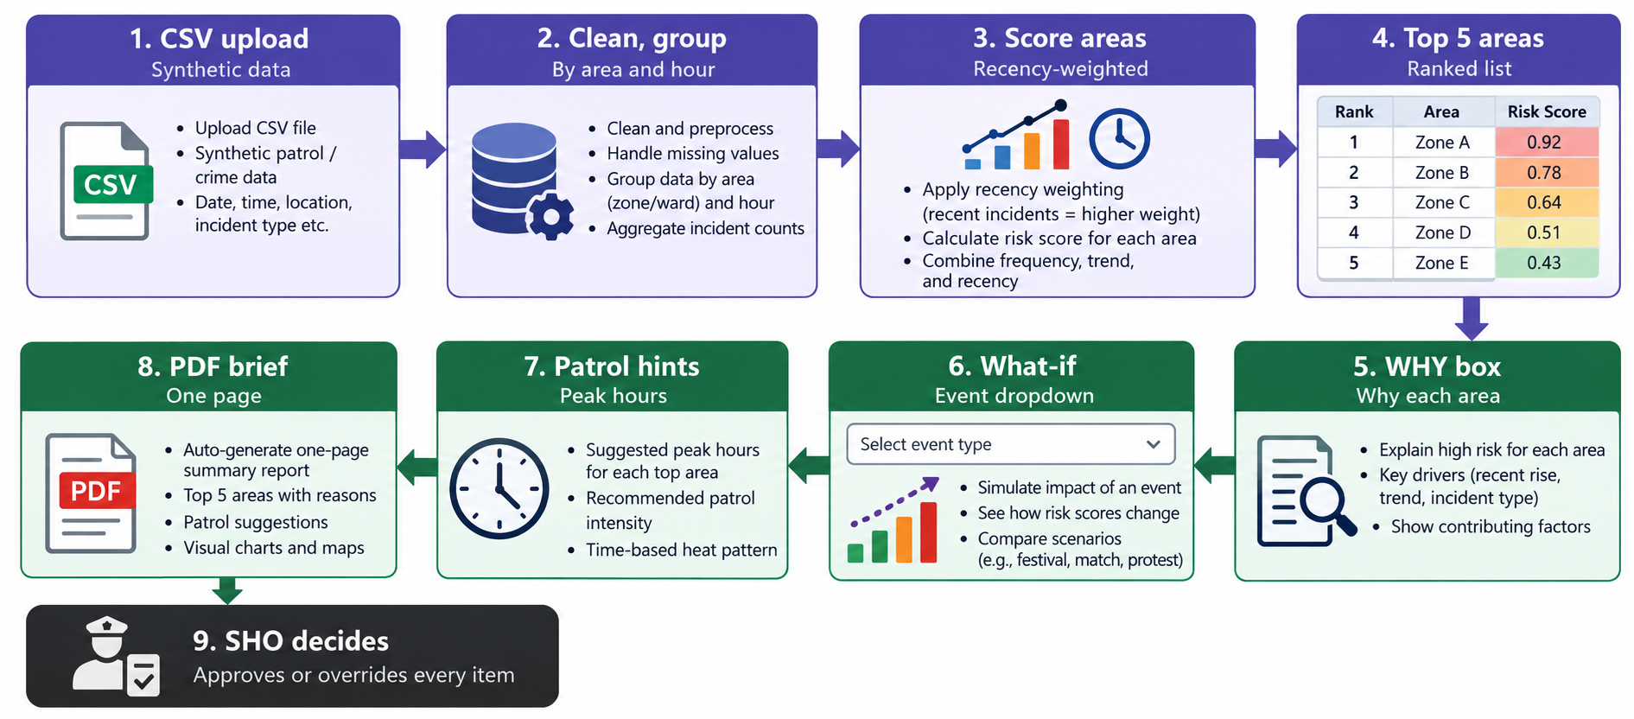
03 / SYSTEM ARCHITECTURE
From CSV upload to an approved patrol decision
Human-in-the-loop: the SHO approves or overrides every recommendation.

Slide 5
04 / DECISION SUPPORT
The recommendation is explainable at every step
Drishti does not stop at a risk score; it exposes the reasoning and turns it into a usable operational brief.
TOP 5 AREAS
Ranked list of the highest-scoring areas
OFFICER EXPERIENCE
What an SHO actually gets
WHY BOX
Recent rise • trend • incident type • contributing factors
Readable
Plain-language explanation instead of only a model score.
WHAT-IF
Compare risk under an upcoming event scenario
Scenario-aware
Event assumptions can be tested before deployment changes.
PATROL HINTS
Suggested peak hours and time-based intensity
Operational
Peak-hour guidance translates analysis into patrol timing.
Controllable
Final approval stays with the SHO.
PDF BRIEF
One-page summary with reasons, charts and map output
Decision support, not autonomous policing.

Slide 6
05 / TECHNOLOGY
A lightweight stack built for a fast, explainable MVP
IBM Bob is the build accelerator; the application layer stays transparent and easy to inspect.
IBM TECHNOLOGY
APP
Streamlit
Interactive district dashboard and workflow
IBM Bob
Used as the hackathon build environment / AI development layer.
DATA
Pandas • NumPy
Cleaning, grouping, aggregation and scoring inputs
VISUALIZATION
Plotly
Interactive maps / charts and scenario visuals
Track 4: AI & Predictive
Rapid iteration + clear, auditable application logic
REPORTING
ReportLab • Matplotlib
One-page intelligence brief generation and charts
Repository modules include app.py, analytics.py, simulator.py, report_generator.py and generate_data.py.

Slide 7
06 / MVP STATUS
What is implemented — and what is still a limitation
The current submission demonstrates the end-to-end intelligence workflow; it does not claim a field-validated forecasting model.
IMPLEMENTED
LIMITATIONS
1000+ generated mock crime records for the MVP
Synthetic data
Uses generated mock records instead of real police records.
Spatial-temporal / near-repeat pattern analysis
Heuristic scoring
Weighted heuristic demo, not a calibrated probabilistic forecast.
Recency-weighted top-5 area scoring
Explainable “WHY” rationale for each area
Grid mapping
Grid-based map rather than real GIS / H3 spatial indexing.
What-if event simulation
Access control
SHO vs Beat Officer role separation is not implemented.
Patrol hints + one-page PDF brief
Next validation step: real data + calibrated forecasting + real GIS.

Slide 8
07 / TEAM & NEXT STEP
Team Ananta — building a decision layer for proactive patrol planning
The MVP is intentionally small: demonstrate the decision flow first, then harden it with real data and operational controls.
TEAM
NEXT STEP
Lakshay Sunil Jatawat
From prototype → deployable intelligence layer
Team Lead
Replace synthetic records with governed real police data
1
Kunj Buddhdev
Calibrate and validate the risk model on held-out / real-world data
2
Deeksha
Move from grid maps to real GIS / H3 spatial indexing
3
Jiya Joshi
Add role-based access control and deployment hardening
Built as Team Ananta for the IBM Bob AI Hackathon 2026.
Live demo is not deployed yet; repository includes demo artifacts.

