Slide 1
WEEK 3 - CYBER SECURITY TASK
BUSINESS SECURITY & DIGITAL RISK ANALYSIS
Digital presence assessment, vulnerability scan, and cyber risk scoring of 50 businesses identified via Google Maps across major Indian cities.
Prepared by: Cyber Security Consultant | Assessment Scope: Pan-India Market Audit

Slide 2
Project Scope & Assessment Areas
Target Region: India Local Market Analysis (50 Businesses)
PAN-INDIA DIGITAL SECURITY AUDIT • 2026
01 | Data Sourcing
Google Maps Sourcing
• Mapped 50 Indian businesses. • Mumbai, Bangalore, Chennai, Kolkata. • Delhi, Hyderabad, Pune, Jaipur, Goa.
Security Audits
• Scanned target websites. • Checked SSL & admin page flags.
02 | Industry Scope
Sectors Evaluated
• Restaurants & Cafes (10 checked) • Healthcare & Clinics (10 checked) • Retail & Shops (10 checked) • Professional Services (10 checked) • Hospitality & Hotels (10 checked)
03 | Security Parameters
Protocols & SSL Checks
• Checked HTTPS redirect. • Checked SSL certificate validity. • Scanned admin login exposure.
Asset Exposures
• Scanned open directory indexes. • Tested contact forms protection.

Slide 3
Executive Summary
Key Findings and Performance Metrics
PAN-INDIA DIGITAL SECURITY AUDIT • 2026
50
TOTAL CHECKED
3.44
AVERAGE SCORE
64%
SECURE RATE
36%
AT RISK RATE
High-Level Cybersecurity Posture Analysis
• Security Divide: 64% Secure rate is driven by corporate hotels/hospitals, but 36% At-Risk rate exposes local small businesses. • Protocol Gaps: Plaintext transmissions and exposed CMS panels (6 sites) are the largest source of website vulnerability. • Sabotage Risks: 9 Google Maps business profiles remain unclaimed, presenting an active hijacking risk for information edits.

Slide 4
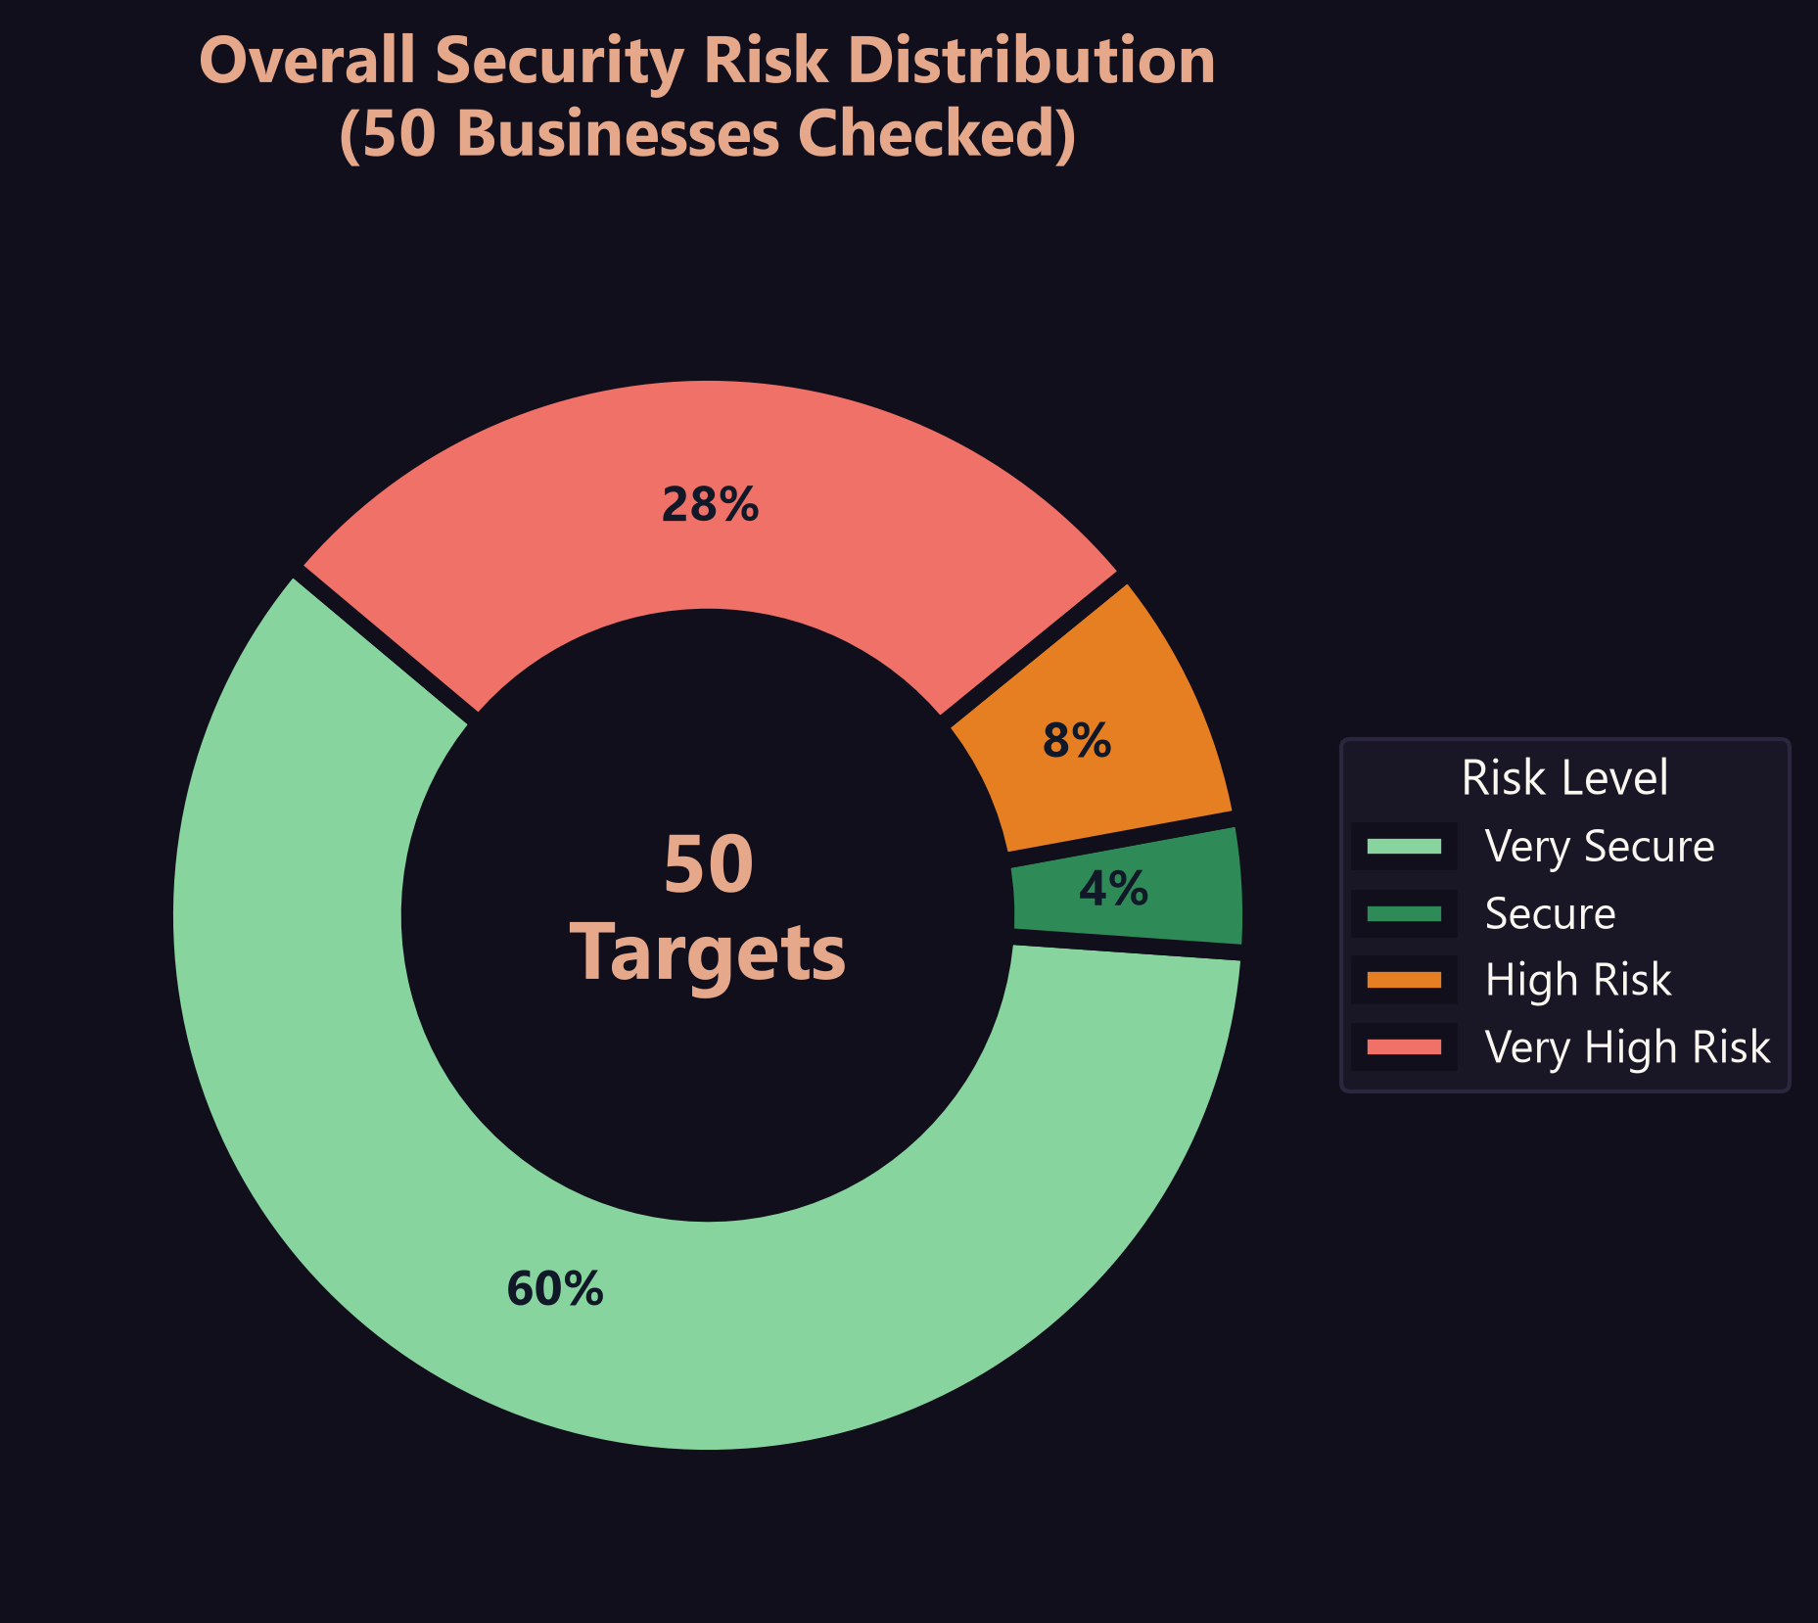
Security Risk & Score Distribution
Proportion of overall secure vs. vulnerable businesses
PAN-INDIA DIGITAL SECURITY AUDIT • 2026
Risk Tier Analysis
Very Secure (Score 5) — 30 Businesses
Fully secure websites with active HTTPS redirections, valid SSL certificates, and hidden CMS login pages.
Secure (Score 4) — 2 Businesses
Minor vulnerabilities detected (missing CSP or HSTS headers), but user input forms are secure.
Vulnerable (Score 0-3) — 18 Businesses
Critical protocol exposures or complete digital absence (no website) with unclaimed business profiles.

Slide 5
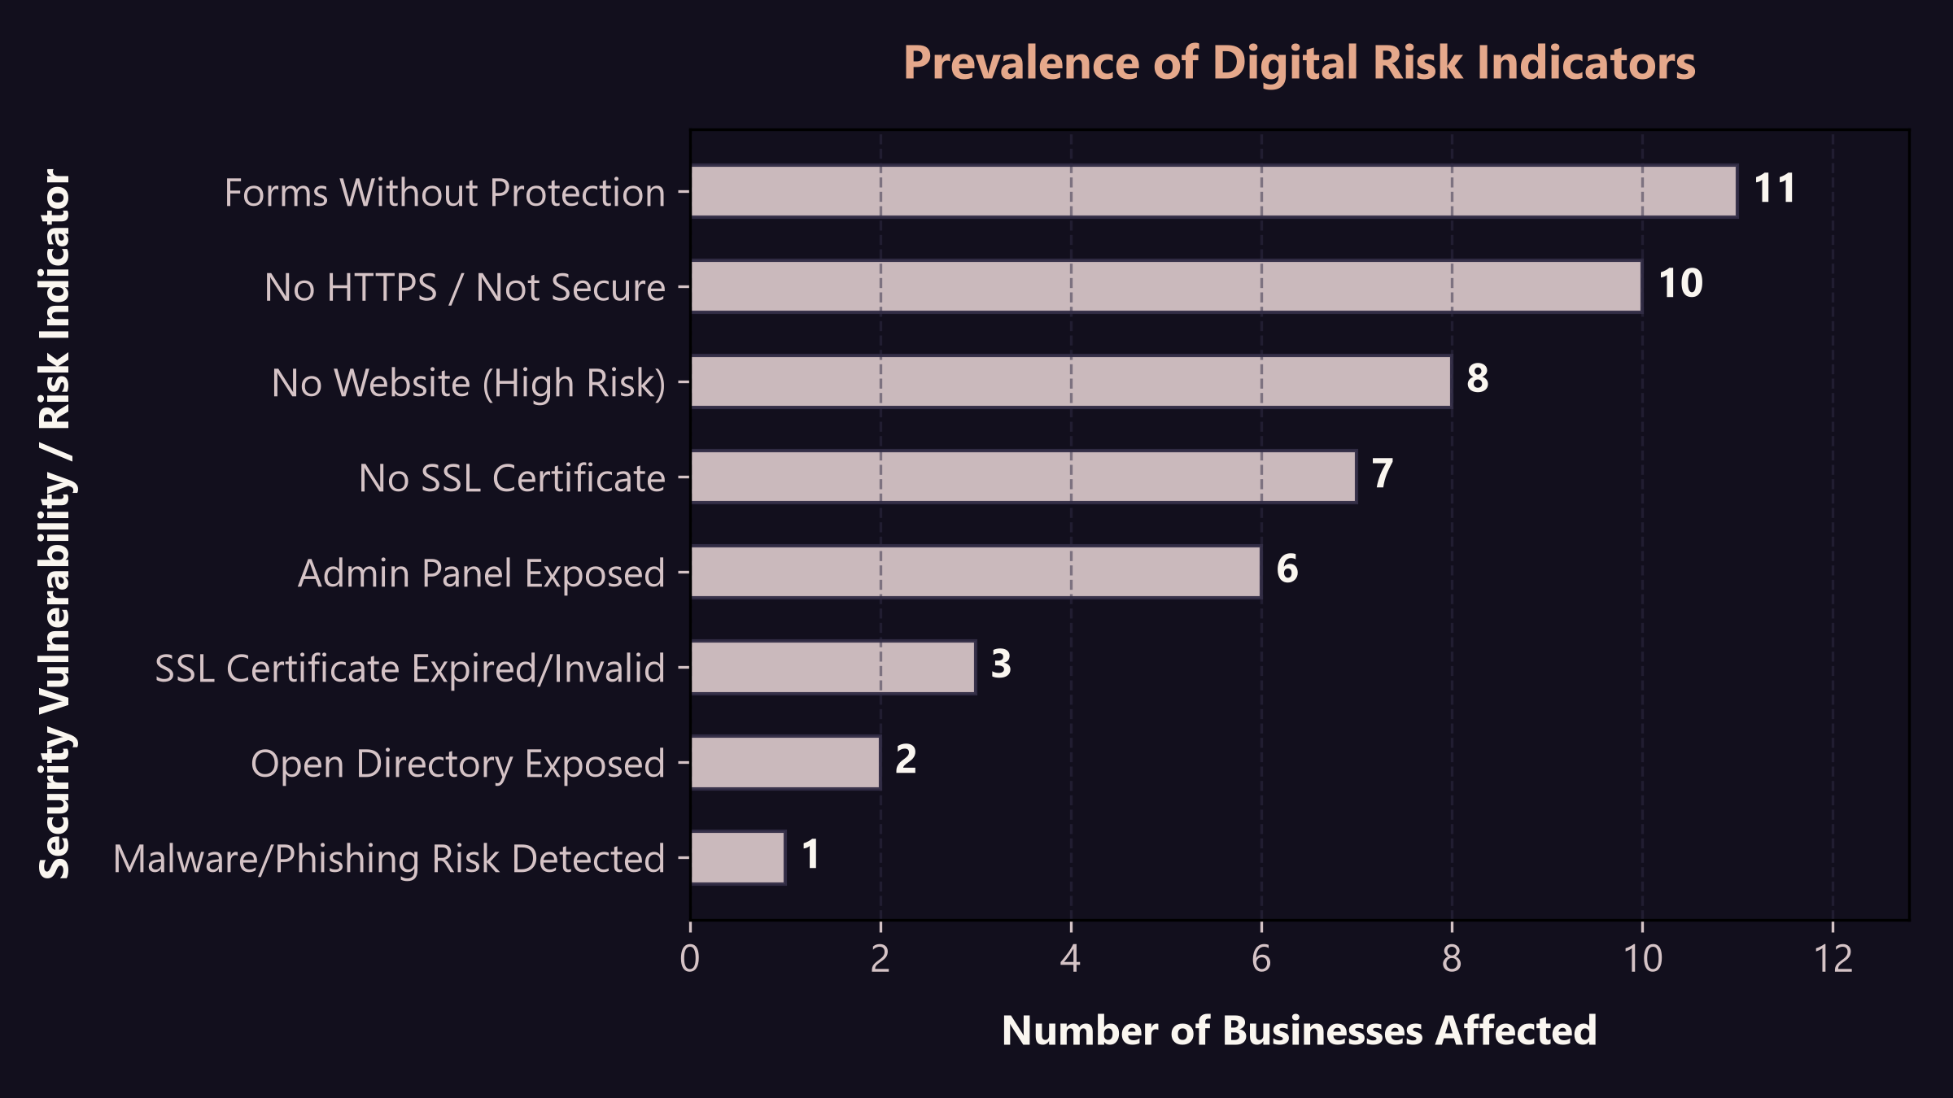
Vulnerability & Risk Indicators
Prevalence of specific digital risks across the assessed group
PAN-INDIA DIGITAL SECURITY AUDIT • 2026
Vulnerability Breakdown
Insecure Protocols (10 Sites)
Transmitting booking and user details in plaintext over HTTP. Vulnerable to interception.
Exposed Admin Panels (6 Sites)
WordPress login directories are exposed, allowing hackers to run automated brute-force scans.
Open Directories (2 Sites)
Folder indexing is active, exposing backend assets and file directories to public view.

Slide 6
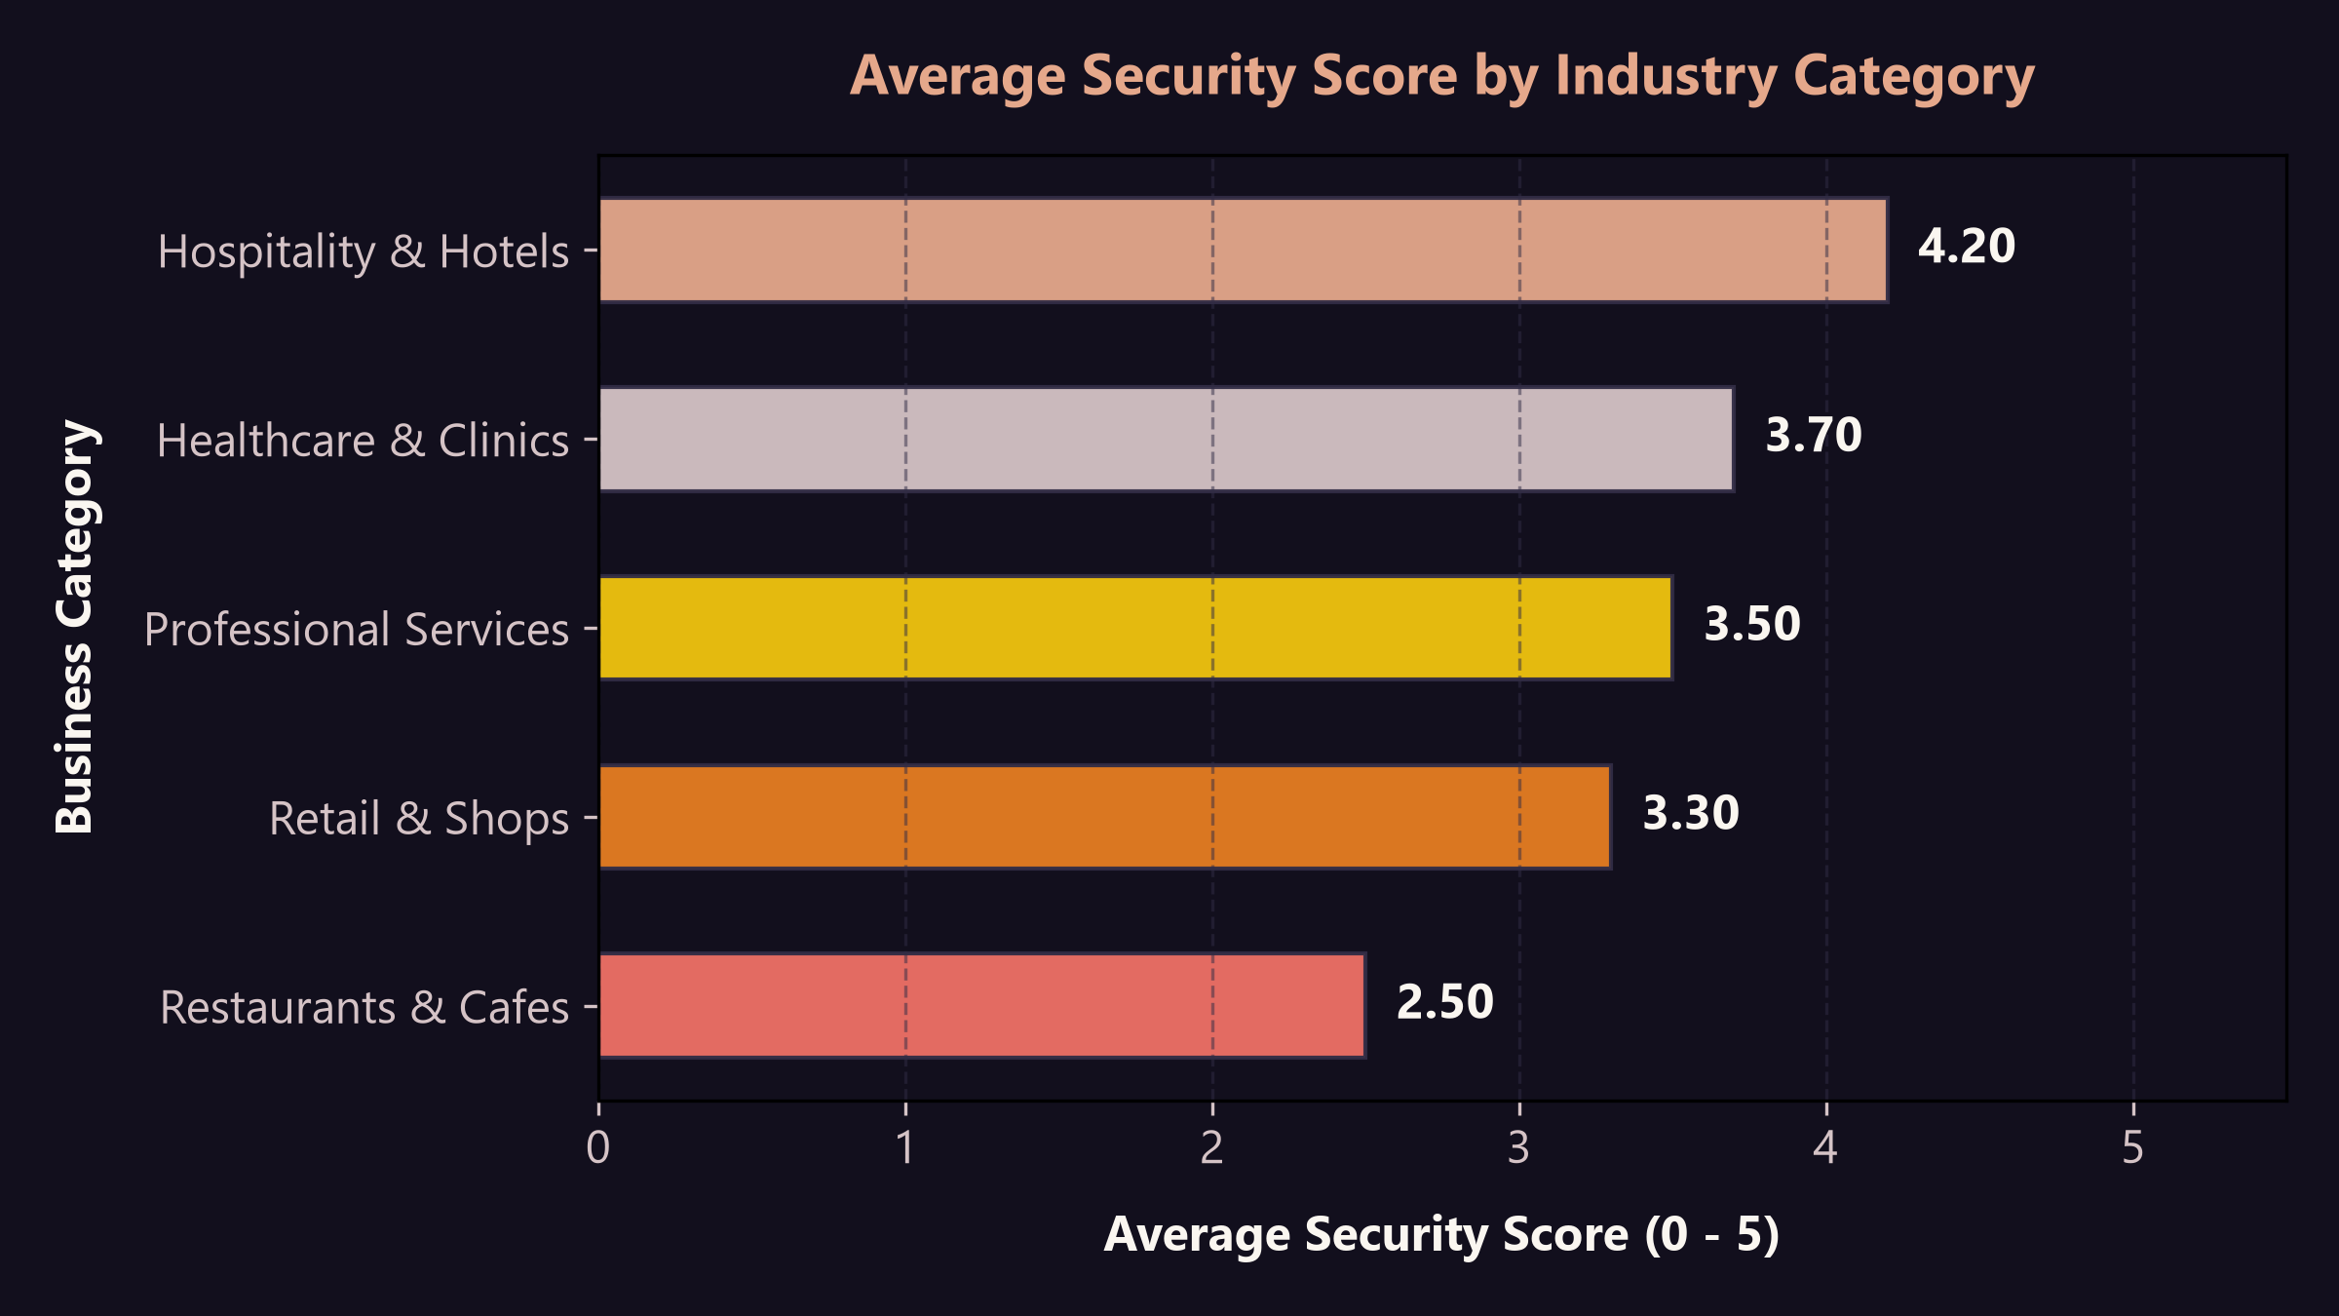
Industry Category & Location Analysis
Comparing security standards across sectors and areas
PAN-INDIA DIGITAL SECURITY AUDIT • 2026
Industry & Geography Risks
Industry Security Scorecard
Hospitality and Healthcare lead in security standards due to compliance regulations. Professional Services and Retail lag behind due to high rates of digital absence and unencrypted sites.
Geographical Analysis
Major metropolitan centers show stark contrasts: premium corporate entities in Mumbai and Bengaluru exhibit high security postures, while smaller regional firms represent high-vulnerability clusters.

Slide 7
Top 10 Risky Businesses
Identified targets requiring immediate intervention
PAN-INDIA DIGITAL SECURITY AUDIT • 2026
Business Name | Category | Location | Security Score | Primary Security Gaps
Cafe Goodluck | Restaurants & Cafes | Pune | 0 / 5 | No Website, Unclaimed Profile
City Dental Clinic & Implant Center | Healthcare & Clinics | Ahmedabad | 0 / 5 | No Website, Unclaimed Profile
Sarojini Saree House | Retail & Shops | Jaipur | 0 / 5 | No Website, Unclaimed Profile
Shimla Residency Guest House | Hospitality & Hotels | Shimla | 0 / 5 | No Website, Unclaimed Profile
Coimbatore Grocery Mart | Retail & Shops | Coimbatore | 0 / 5 | No Website, Unclaimed Profile
Mehta Tax Advisors | Professional Services | Mumbai | 0 / 5 | No Website, Unclaimed Profile
Gupta Chartered Accountants | Professional Services | Pune | 0 / 5 | No Website, Unclaimed Profile
Sharma Real Estate Consultants | Professional Services | Jaipur | 0 / 5 | No Website, Unclaimed Profile
Peter Cat | Restaurants & Cafes | Kolkata | 1 / 5 | HTTP Only (No HTTPS), Expired SSL, Exposed Admin Page, Unprotected Forms
Leopold Cafe & Bar | Restaurants & Cafes | Mumbai | 1 / 5 | HTTP Only (No HTTPS), No SSL, Exposed Admin Page, Unprotected Forms

Slide 8
Strategic Cybersecurity Roadmap
Actionable recommendations for businesses and service providers
PAN-INDIA DIGITAL SECURITY AUDIT • 2026
1. Immediate Remediation (At-Risk Sites)
• Install SSL Certificates: Force HTTP to HTTPS redirects.
• Cloak Admin Panels: Restrict access to /wp-admin.
• Secure Forms: Deploy anti-CSRF tokens on forms.
2. Google Maps Profile Hardening
• Profile Claiming: Verify unclaimed profiles on Maps.
• Access Audits: Enforce MFA on associated accounts.
• Monitor Edits: Set alerts for Google Maps suggestions.
3. Ongoing Security Management
• Header Hardening: Enable CSP & X-Frame-Options.
• Auto updates: Configure automatic CMS updates.
• Scanning: Run monthly scans for directory leaks.
4. Lead Generation & Client Acquisition
• Lead Gen: Pitch audit reports to low-scoring sites.
• Quick Wins: Offer free SSL & GBP verification setups.
• Bundles: Package security audits for CA/clinics.

Slide 9
Lead Conversion & Outreach Playbook
Commercial strategy for IT consulting & cybersecurity agencies
PAN-INDIA DIGITAL SECURITY AUDIT • 2026
01 | Lead Prioritization
Vulnerability Value
• Target critical risks (score 0-2). • Focus on high-review businesses. • High reputation = high leverage.
Sabotage Risks
• Highlight unclaimed Maps listings. • Stress unauthorized edit risk.
02 | Conversion Hooks
Active Visual Warning
• Show 'Not Secure' browser flags. • Demo exposed login directories. • Highlight SSL expiry warnings.
Trust Builder Offer
• Offer free Google Profile claim. • Charge low entry-fee for SSL setup.
03 | Upsell Strategy
Compliance Focus
• Pitch compliance audits to clinics. • Pitch secure bookings to hotels.
Retainer Packages
• Bundle weekly scanner audits. • Offer monthly backups & updates.

