Slide 1


BLUETOOTH STEREO AUDIO SYSTEM WITH ACTIVE NOISE CANCELATION
Active Noise cancellation
The need for stronger signal-to-noise ratios drives the study of noise cancellation. Signals are stronger without noise, leading to better signal-to-noise ratios.
Two main techniques are passive noise reduction and active noise cancellation.
Headphones employing passive noise reduction use materials to block certain sound waves from entering the user's ears.
Active noise cancellation involves taking the noise signal, inverting it, and adding it to the input signal to cancel out noise deconstructively.
The typical method for estimating a damaged additive noise signal involves passing it through a filter aimed at removing the noise while preserving the original signal as much as possible. This process is known as direct filtering.
figures :google

Slide 2
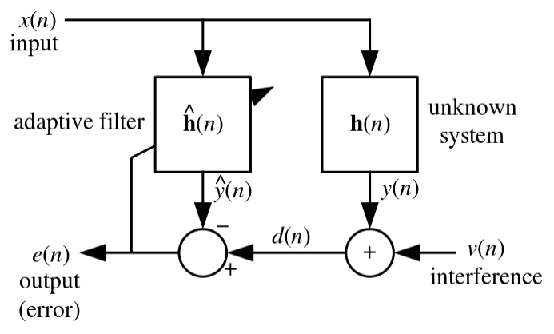

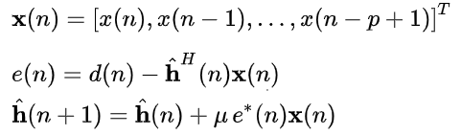
Least Mean Square Algorithm
The LMS algorithm for a pth order filter can be summarized as:
Parameters:
p = filter order
u = step size
n = length of desired signal
Initialisation:
Computation: For n=0,1,2,...
figures:google

Slide 3
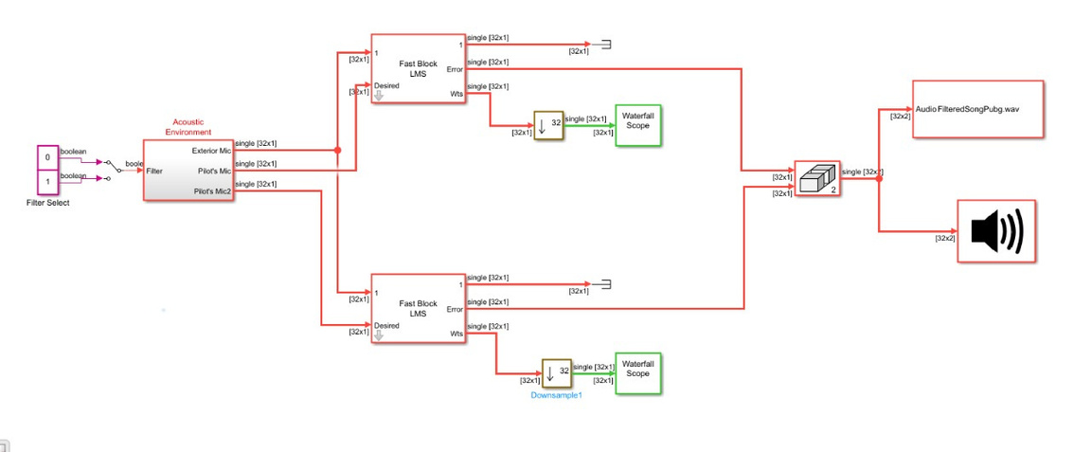
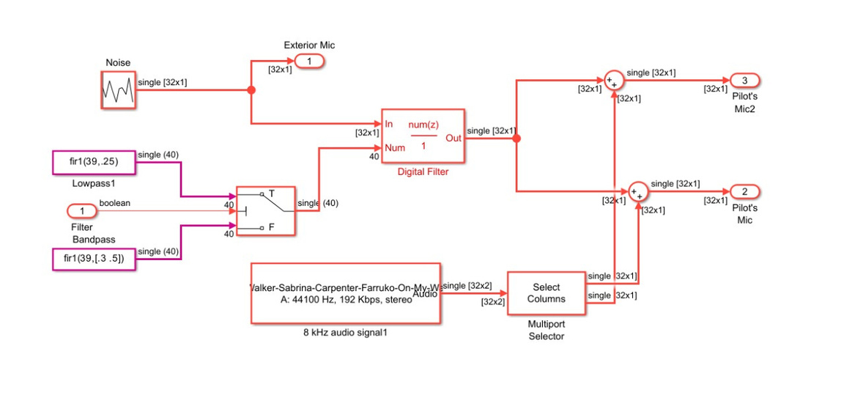
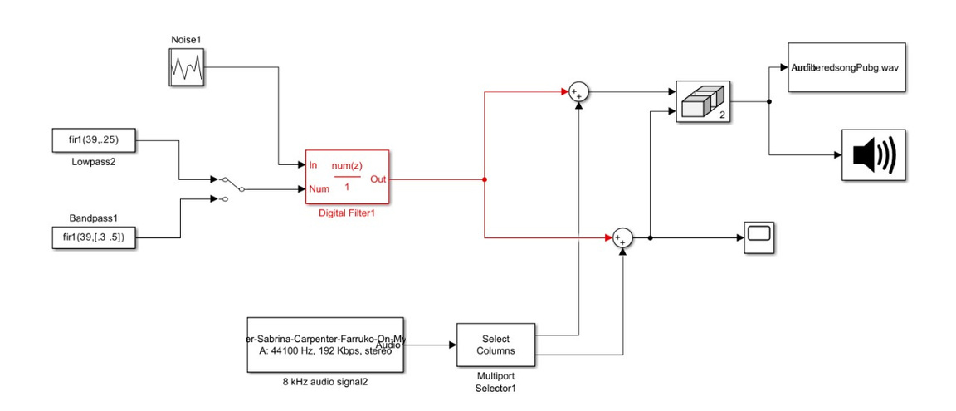
Simulations
ANC System
Audio Signal with Noise
Acoustic Environment (filter)

Slide 4
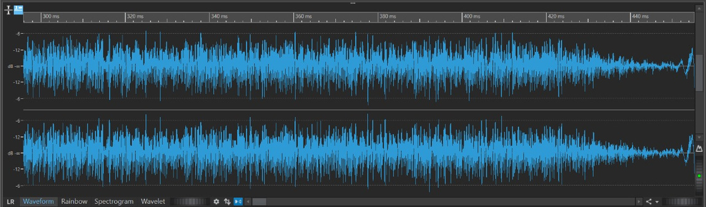
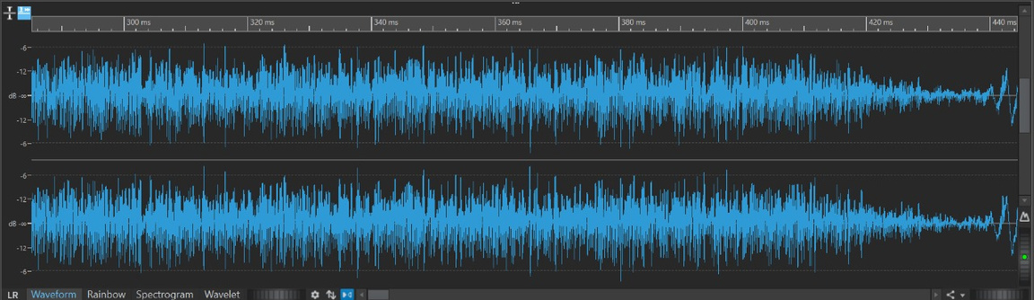
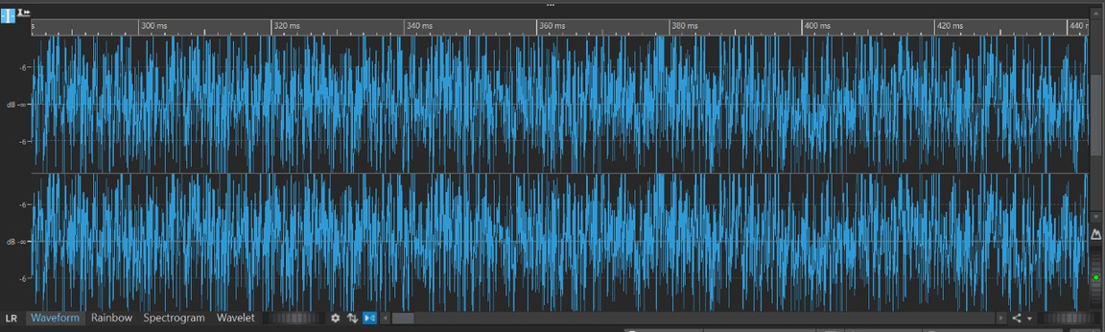
Outputs
Original Audio Signal
Filtered Audio Signal
Audio Signal with Noise

Slide 5
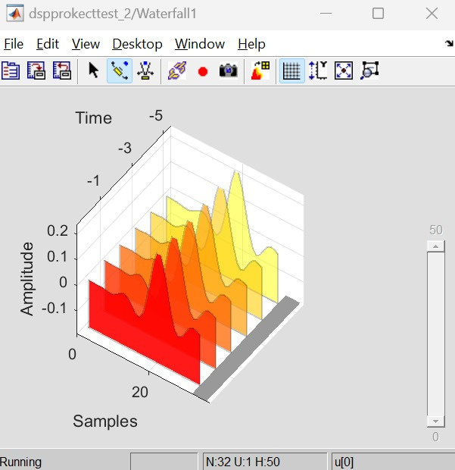
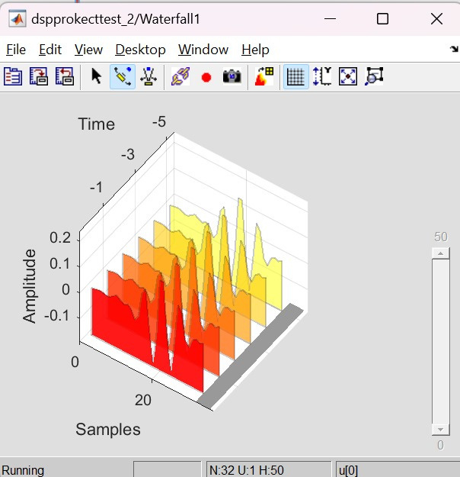
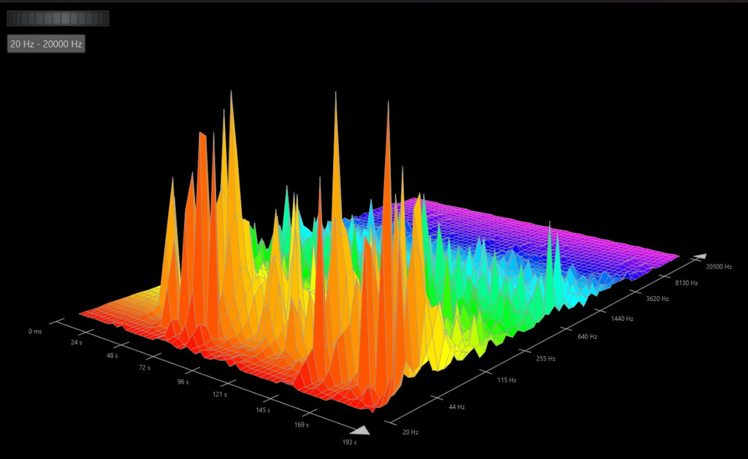
Outputs
ANC simulation’s Waterfall plot (LPF)
ANC simulation’s Waterfall plot (BPF)
3-D frequency analysis plot
By :
Abhinn Tari(210002002)
Lakshay(210002050)
Rajesh Yadav(210002060)
Reference : https://ieeexplore.ieee.org/document/9405901

