Slide 1

School of information communication and technology
Project presentation on :
A TaxiCo Company
Mentor- Submitted By-
Ms. Jyoti Kurav Lakshay Chauhan
(20/BCA/007)

Slide 2
Table of Contents-
Introduction
Technologies
Tools
Objective
Reviews
Website view
Interactive user interface
Price fare
Different login portals
Opportunities
Limitations
Scope
Conclusion
Reference

Slide 3
Problem Introduction-
Cab booking is a common kind of transportation provided by several transportation companies in a given city. The majority of individuals rely on cab services for their everyday transportation requirements. The firm must be registered and meet all of the transportation department's criteria and security standards. Here TaxiCo is the application that is built to provide the best taxi service to the people who love to travel whether it is a small as well as Long Tour at a low-cost price. There are many Applications which are already running in the market after that also I have seen that people are facing Many problems such as taxi is cancelled at the last moment, may be driver is telling lie to us i.e. he is about to reach at your location or he is stuck in the traffic jam, and cab does not go for long distance such as someone has to go Sri Nagar from Noida, it is impossible to get a single taxi from which the client can reach own his/her location. By Keeping all such problems in the mind, we have made this Application to resolve such types of problems.

Slide 4
Technologies
HTML
CSS
JavaScript
Bootstrap
Java
Servlet
JSP
JDBC
MYSQL
XML

Slide 5
Tools
Windows 10
Visual Studio Code
JDK 18
Eclipse
Apache Tomcat Server
MySQL Database
Drivers(Connecting API)

Slide 6
Objectives-
The purpose is to make this TaxiCo application to resolve the problems which are currently faced by the people right now occurring at the time of traveling. This TaxiCo service provides us good environment, safety, security and comfortability to our every customer. Every type and size of taxi will be available to our customers like Hatchback, Sedan, SUV, and luxury cars. That’s why the User can book according to their requirement. Here the best thing is that the service which is not provided by another taxi company is provided here, suppose any user is going anywhere and coming back within an hour then only one side rent will be charged to customer.

Slide 7
Reviews
TaxiCo is an application which is open for all the user who loves to travel and those to enjoy their traveling jobs.
Every taxi owner, their cars, taxi Driver are verified by the Admin.
Without registration, users can search for their service taxi at the home page.
Every type of taxi is available here.
Users can search for their taxi by their current location.
After booking a taxi users can communicate with their driver.
After booking the taxi user can see the status of the taxi.
The status of taxi service is automatically updated when we drop the customer at their destination.
The taxi owner can easily deactivate their id without any problem.
If Admin found any misbehaving or feel insecurity then he/she can reject their taxi services

Slide 8
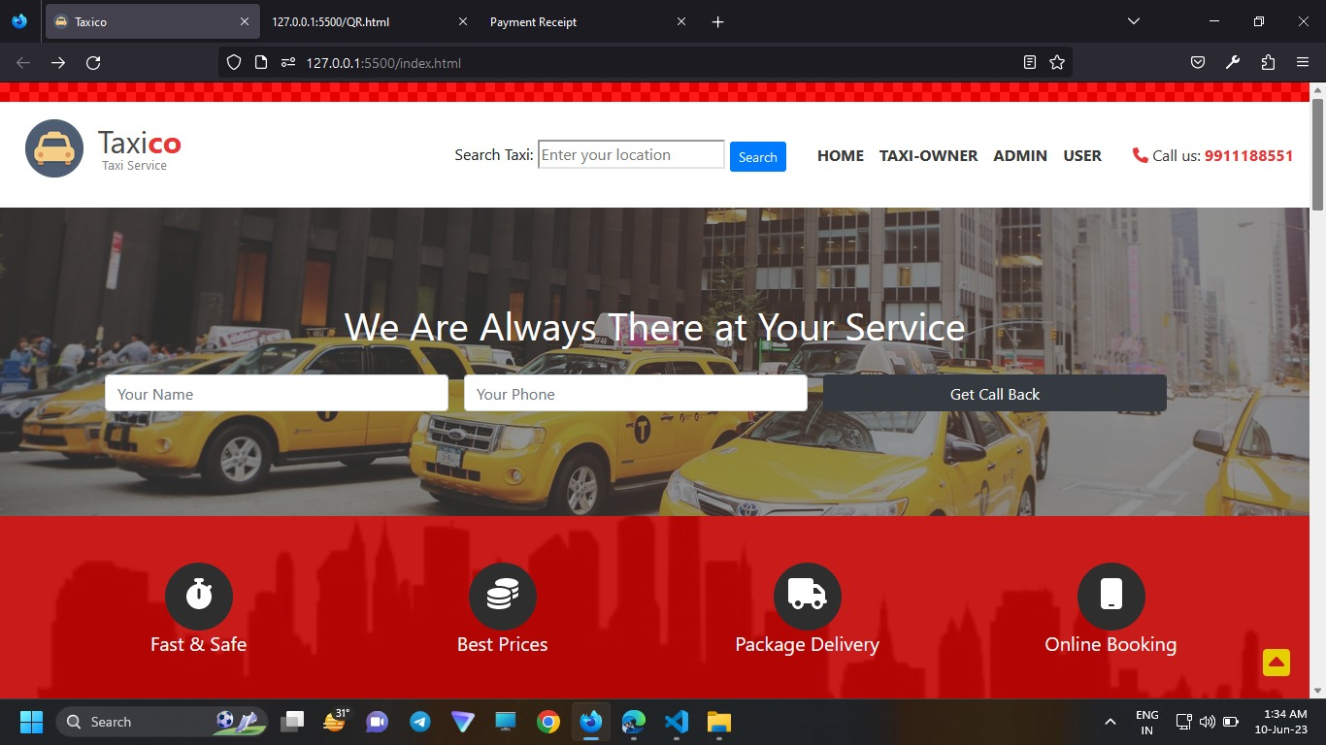
Website View

Slide 9
Interactive User Interface
An interactive user interface (UI) is a key component of a website that enables users to interact with the site's content, features, and functionality. It includes various visual elements and interactive elements that enhance the user experience and facilitate navigation, information retrieval, and task completion. Here are some common interactive UI elements found on websites:

Slide 10
Navigation Menu: A menu typically located at the top or side of a website, containing links to different pages or sections within the site. It allows users to easily navigate and access different areas of the website. Buttons: Interactive elements that users can click or tap to trigger an action, such as submitting a form, making a purchase, or expanding/collapsing content. Forms: Input fields and checkboxes that allow users to enter or select data, such as contact information, login credentials, or search queries. Forms typically include submit buttons for users to send their input. Interactive Maps: Maps that users can interact with, such as zooming, panning, and clicking on specific locations to view more details.

Slide 11
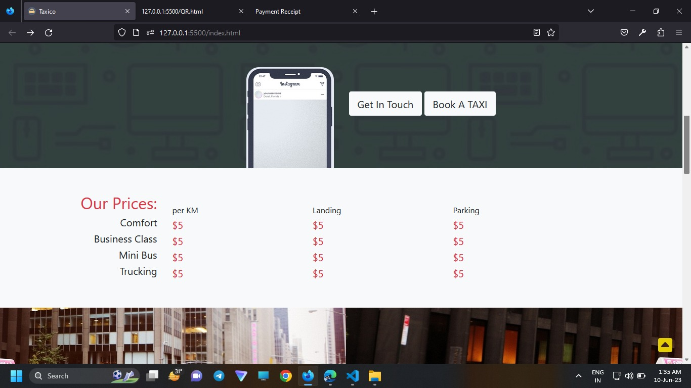
Price Fare

Slide 12
Price Fare The fare for a taxi can vary depending on several factors, including the city or region, distance traveled, time of day, and any additional charges or surcharges. Without specific information about your location, it is challenging to provide an accurate estimate. However, I can give you a general idea of what factors contribute to the pricing structure of a taxi fare.

Slide 13
Base fare: Taxis usually have a fixed initial charge, which covers a certain distance or duration. This is the starting point for the fare calculation. Distance traveled: Most taxi fares are determined by the distance traveled. The fare per mile or kilometer varies by location and can be influenced by factors such as fuel prices and local regulations. Time-based charges: In some areas, taxis may charge an additional fee for time spent in traffic or waiting time, especially during peak hours or in congested areas. Additional fees: Extra charges may apply for specific circumstances such as airport pickups, tolls, luggage handling, or late-night services. These additional fees should be clearly communicated by the taxi company.

Slide 14
Different Login Portals

Slide 15
Log in Portals
Log-in portals are commonly used in various applications, including taxi applications, to provide secure access to users. Here are a few types of log-in portals that can be implemented:
Passenger log-in portal: This allows passengers to create an account and log in to access the taxi application. Passengers can book rides, track their ride history, manage payment methods, and access other features specific to their needs.
Driver log-in portal: This portal is for drivers who want to register with the taxi service. They can create a profile, submit necessary documents, manage their availability, and access features related to accepting and completing ride requests.
Administrator log-in portal: This portal is designed for administrators or staff members who manage and monitor the taxi application. It provides access to administrative functions such as user management, driver verification, payment reconciliation, and analytics.

Slide 16
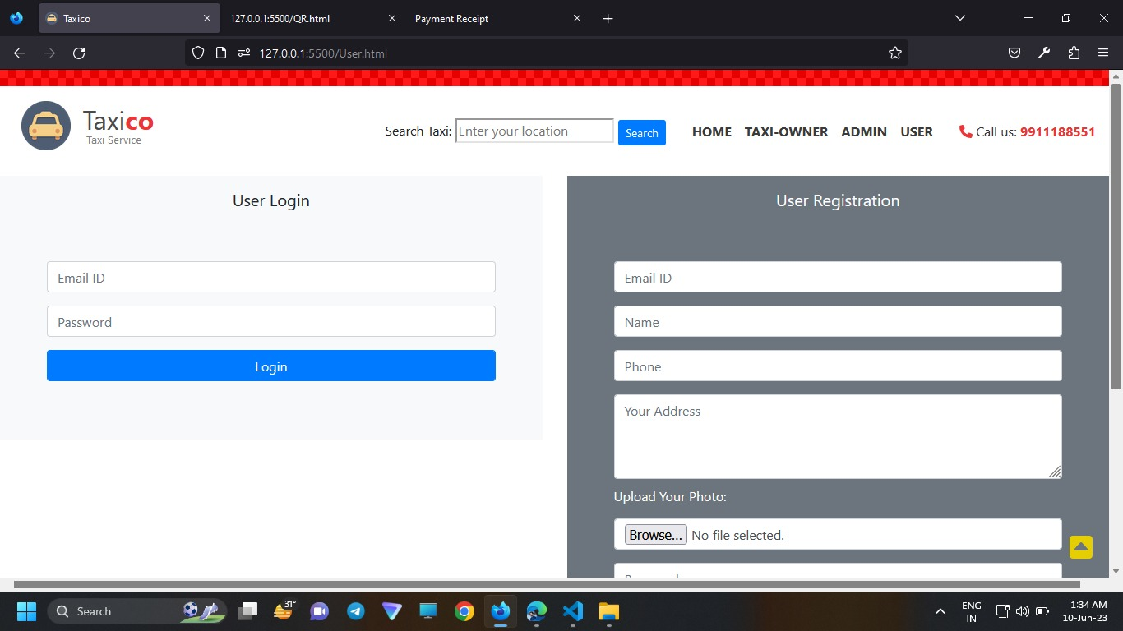
User Login and User Registration

Slide 17
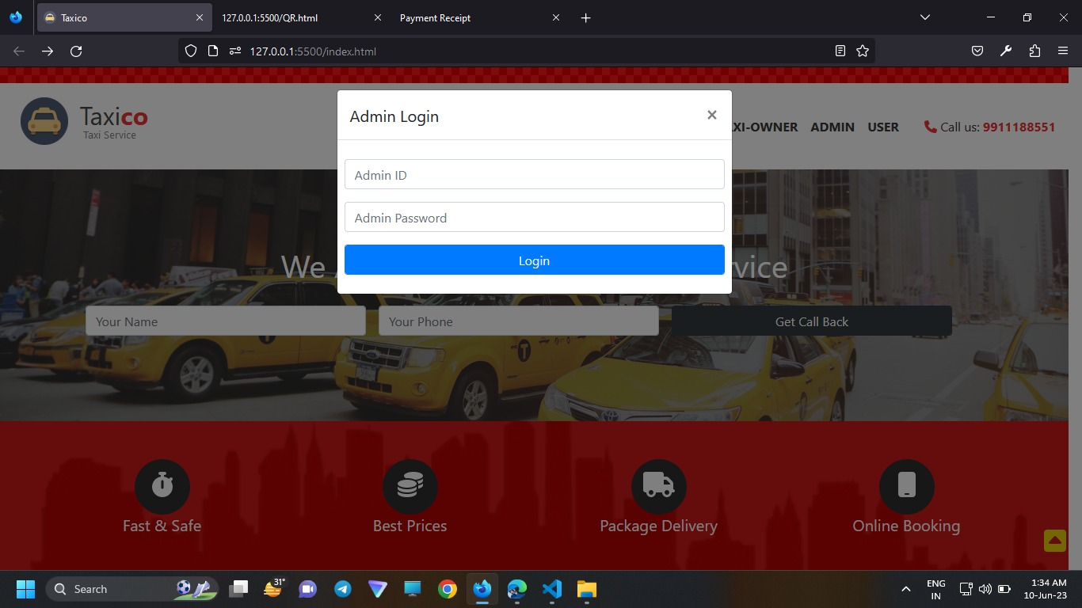
Admin Login

Slide 18
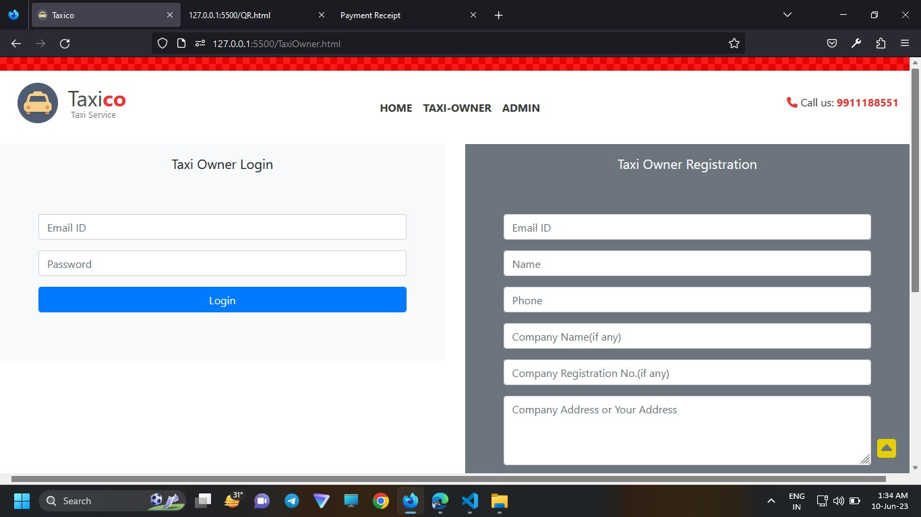
Taxi Owner Login

Slide 19
Opportunities
Platforms like Uber, Lyft, and other ride-hailing apps provide opportunities for taxi drivers to connect with passengers and offer on-demand transportation services. These services often have a large customer base and can provide a steady stream of ride requests.
Many taxi drivers have expanded their services beyond passenger transportation and have started offering delivery services. This can include food delivery, package delivery, or even courier services. Delivery services have experienced significant growth, especially with the rise of online shopping and app-based delivery platforms.
Airports are bustling hubs with a constant flow of passengers in need of transportation. Offering specialized airport transfer services can be a lucrative opportunity for taxi drivers. You can target frequent flyers, business travelers, or tourists who need reliable transportation to and from the airport.

Slide 20
Ride-hailing services: Apps like Uber and Lyft have revolutionized the taxi industry by connecting passengers directly with nearby drivers. These platforms provide convenience and flexibility for both passengers and drivers, allowing them to request and provide rides on-demand. Taxi dispatch and management: Taxi applications can streamline the dispatch and management processes for traditional taxi companies. These apps can handle booking requests, track driver locations, manage payments, and provide real-time analytics for better operational efficiency. Carpooling and ride-sharing: Taxi applications can incorporate features that facilitate carpooling or ride-sharing. This allows multiple passengers traveling in the same direction to share a ride, reducing costs for passengers and easing traffic congestion. Accessibility and special services: Taxi apps can include features to accommodate passengers with disabilities, such as wheelchair-accessible vehicles or specialized transportation services. Additionally, apps can offer options for luxury or executive services, catering to specific customer segments. Integration with other services: Taxi applications can integrate with other services, such as public transportation, to provide a seamless travel experience. This could include offering combined itineraries, ticketing integration, or last-mile transportation solutions.

Slide 21
Limitations
At the time of writing limitations in my project, we focus on that particular area that we can't summarize till now but will try to resolve in the future as soon as possible.
1. Google Maps: Basically, used for tracking and updating taxi driver locations. This app helps to reduce a lot of burden for the user, whether for booking a taxi or to track driver and customer location.
2. Payment gateway: nowadays, digital payments are very beneficial and time-saving to the user for the people. After adding this benefit to our platform will give an estimated figure for travel charges. For future accept, if we get an opportunity to cover our limitations, we can blast into the market as a tough competitor and provide one of the best cars booking websites.

Slide 22
Scope
The TaxiCo app offers mobility solutions by connecting customers to drivers and a wide range of vehicles across bikes, auto-rickshaws, metered taxis, and cabs, enabling convenience and transparency for hundreds of millions of consumers and over 1.5 million driver-partners. Taxi business has been an ancient business in India. Starting from horse carts to ambassador cars to now lots and lots of Indicas. Before the smartphones came in Taxi business used to thrive in select pockets within big cities like Mumbai, Calcutta, Bangalore, Madras, Pune, Hyderabad, etc. With the advent of cheap internet and smartphones, taxi business in India has gained the much needed penetration into the cities that otherwise would have been a very costly affair.

Slide 23
Conclusion
TaxiCo services are increasingly accurate and useful, and their benefits are extending widely across the economy. Every user can get various benefits from our taxi services like safety, cheap rate, security, easy to track and cancel etc. Here each and every steps is take care with our guidance.
The operation which most of the consumer find most difficult is getting refund from the company.
Tracking the cab and find or mark location is also difficult for consumer.
Many people find it difficult to cancel a cab.
Most easiest and convenient operation is inbuilt payment option.
Major thing upon which consumers look while looking for a cab is fare rates, followed by safety and then service.

Slide 24
Reference
1. Create Servlet in eclipse
https://www.geeksforgeeks.org/creating-servlet-example-in-eclipse/
Packages
https://www.w3schools.com/java/java_packages.asp
JSP
https://www.tutorialspoint.com/jsp/jsp_syntax.html
4. Download JQuery
https://jquery.com/download/
Finally Keyword https://docs.oracle.com/javase/tutorial/essential/exceptions/finally.html

Slide 25
THANK YOU

