Slide 1

Harnessing Predictive Analytics: Reducing Customer Churn and Enhancing Retention Strategies
Presented by: Group 4

Slide 2

Project Goal: Reducing Customer Churn through Predictive Analytics
Our project aims to leverage predictive analytics to identify key factors contributing to customer churn in e-commerce. By analyzing historical data, we will develop a predictive model using a Random Forest Classifier to forecast the likelihood of churn. This model will help us understand the critical drivers behind customer decisions to discontinue services. Insights gained will inform targeted intervention strategies to enhance customer retention rates. Ultimately, this project seeks to transform raw data into actionable insights, enabling the formulation of effective retention strategies that improve customer satisfaction and loyalty.

Slide 3
EDA

Slide 4
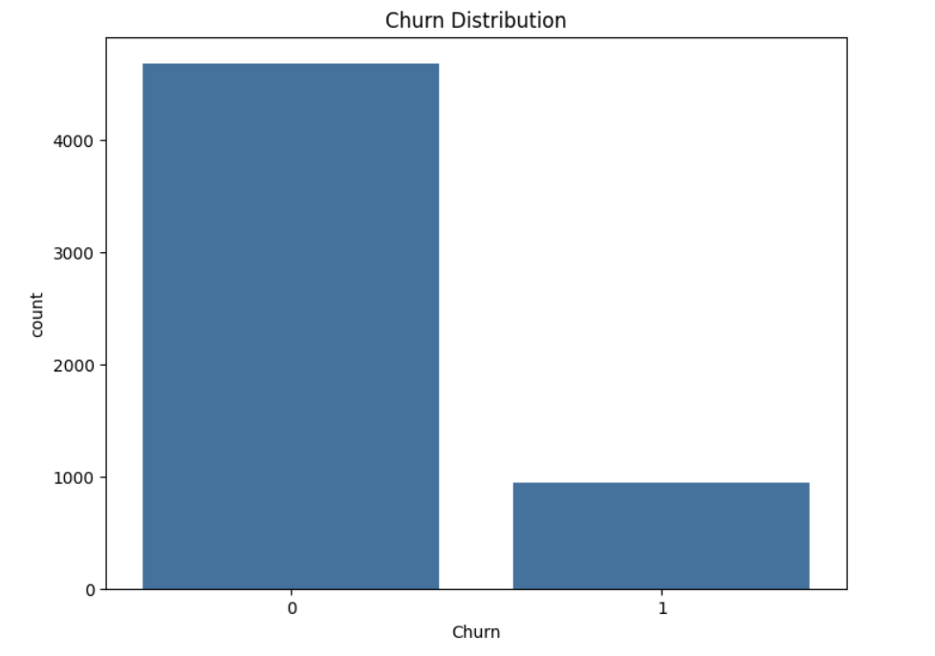
1. Churn Distribution (Count Plot)
This count plot illustrates the distribution of the 'Churn' variable, categorizing customers into churned and retained.

Slide 5
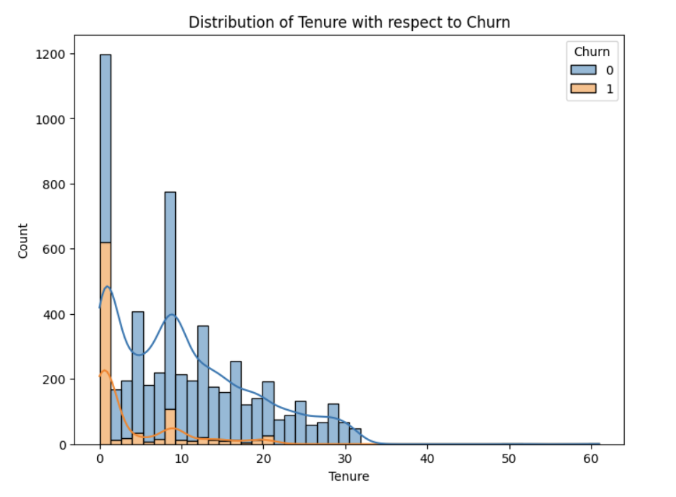
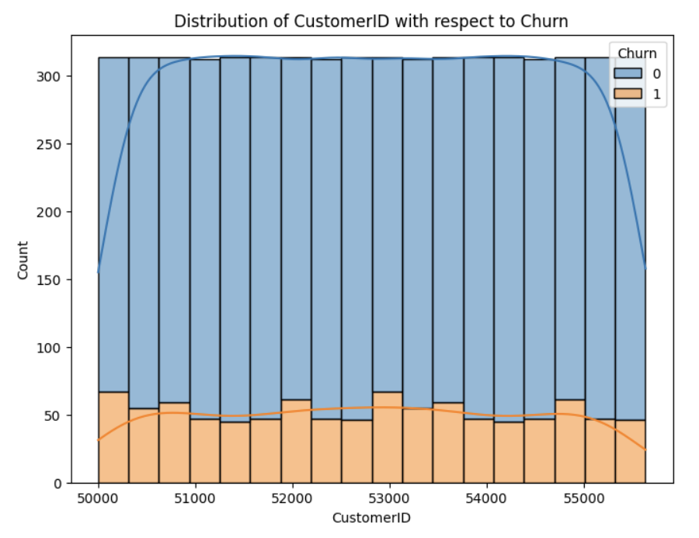
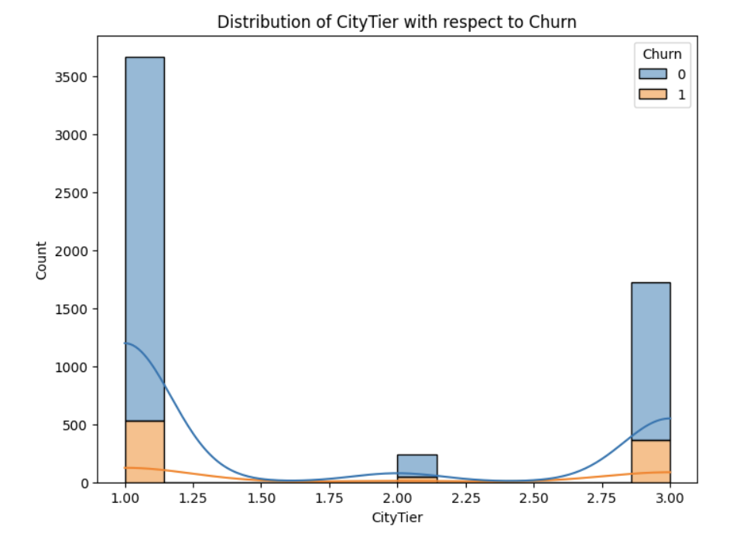
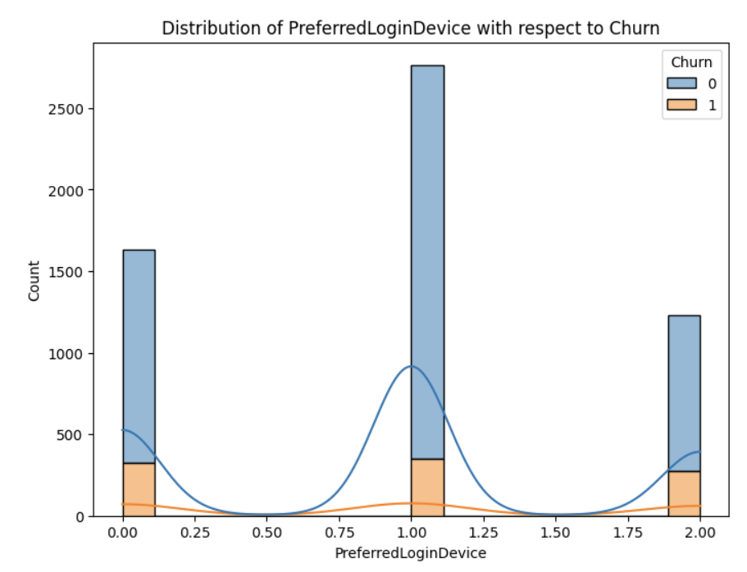
2. Feature Distributions with Respect to Churn (Histograms)

Slide 6
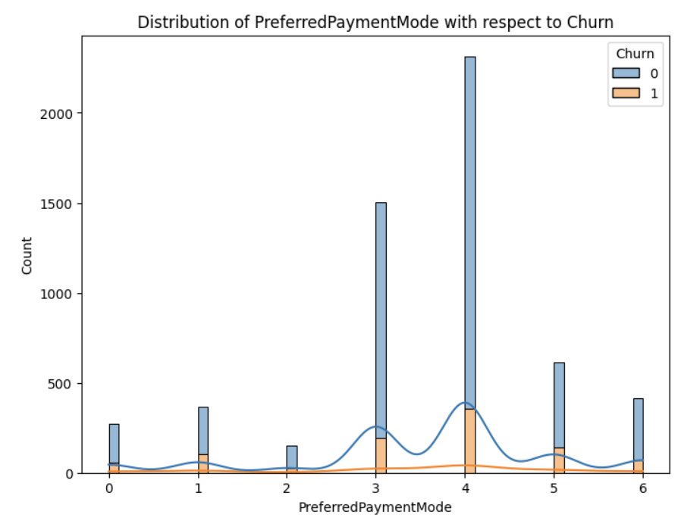
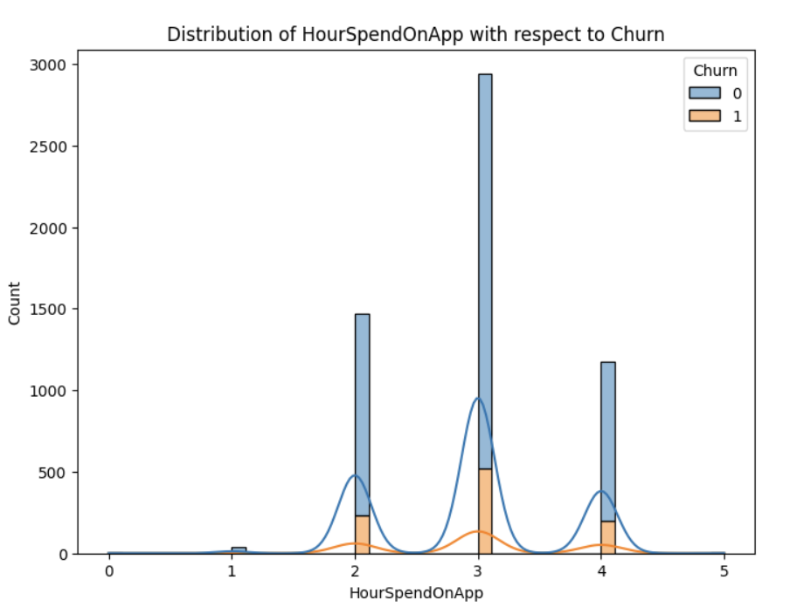
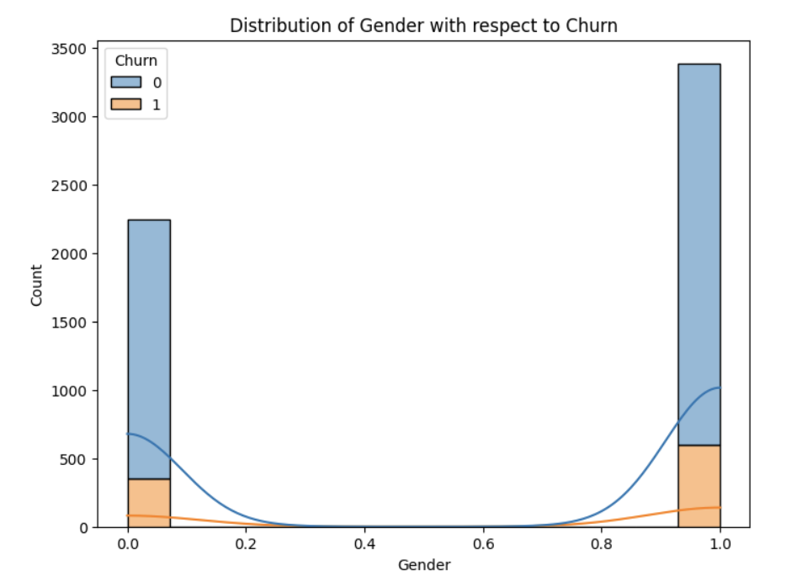
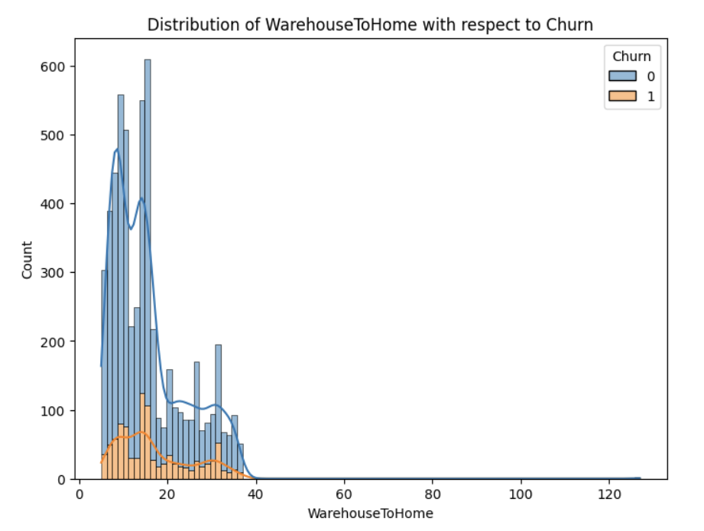
2. Feature Distributions with Respect to Churn (Histograms)

Slide 7
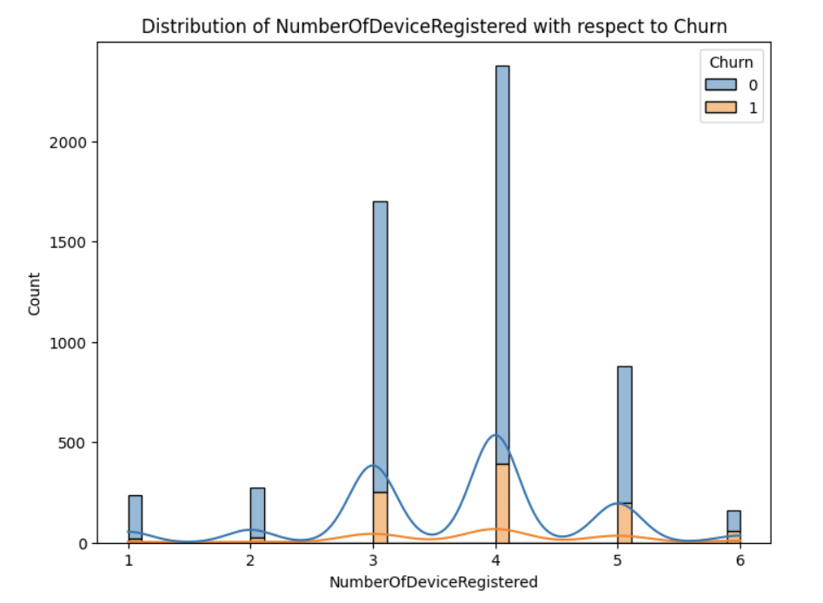
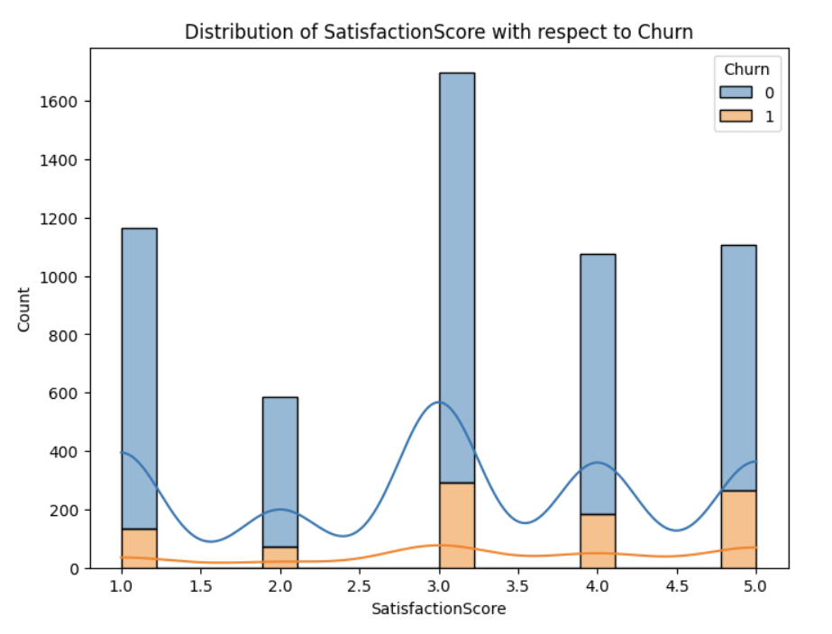
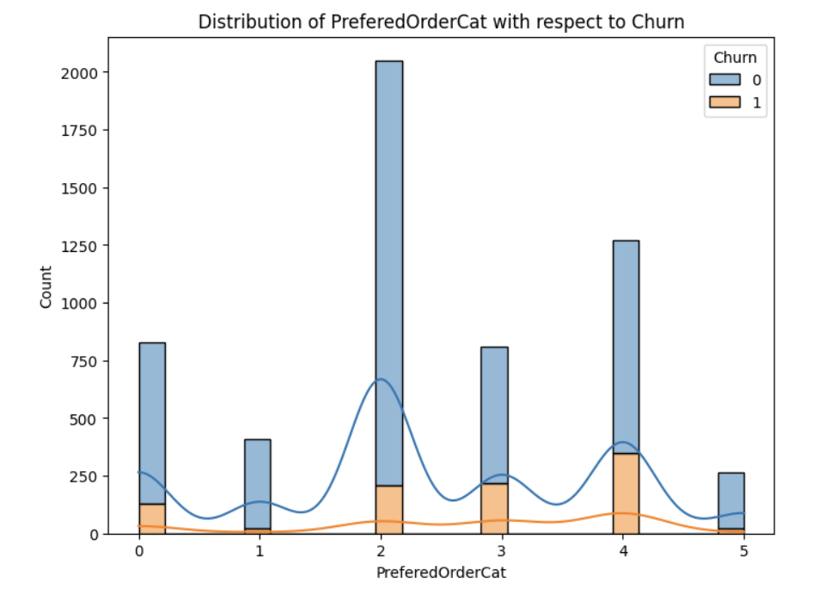
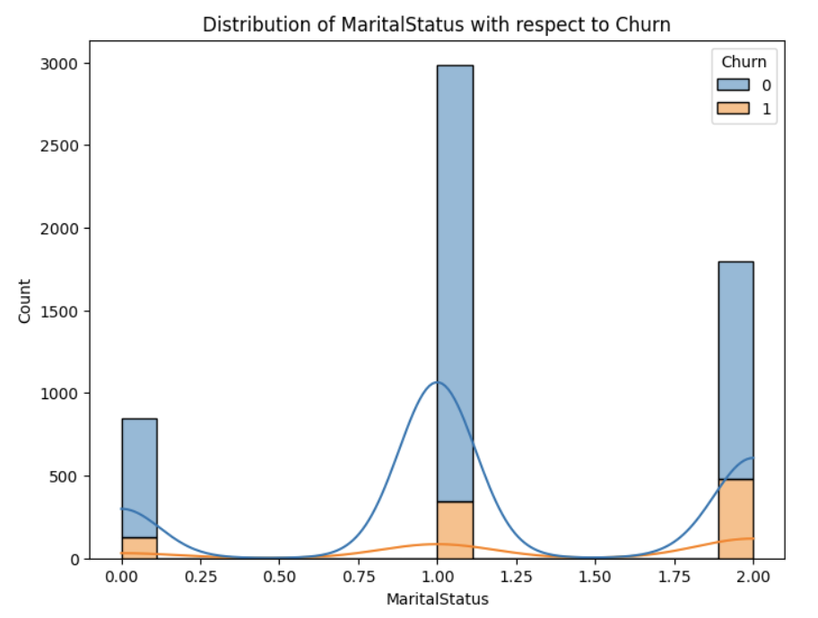
2. Feature Distributions with Respect to Churn (Histograms)

Slide 8
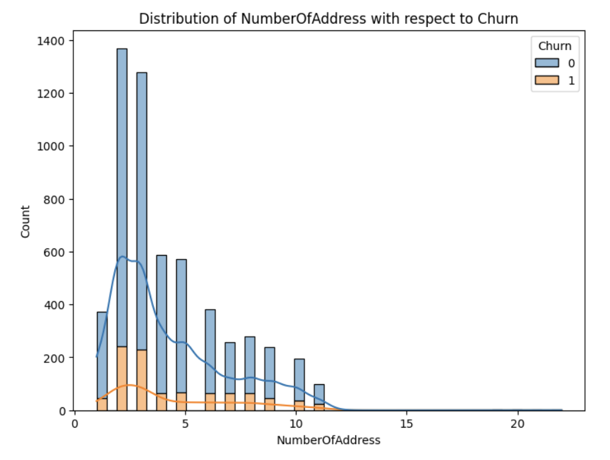
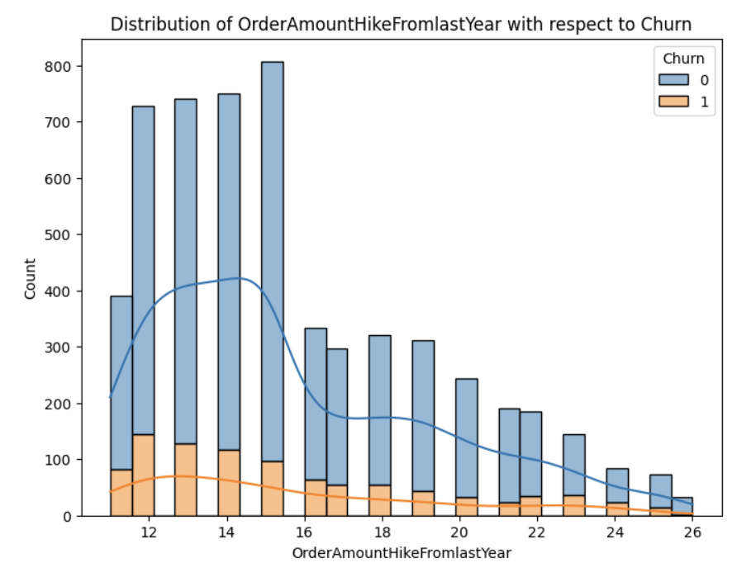
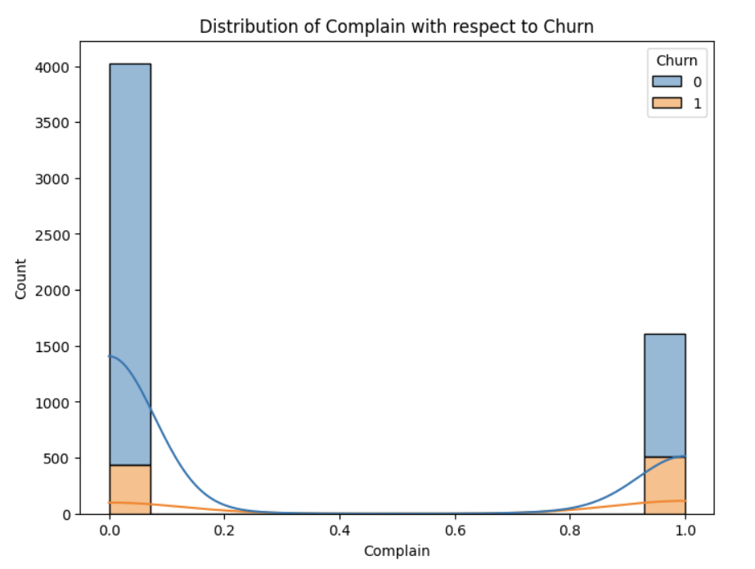
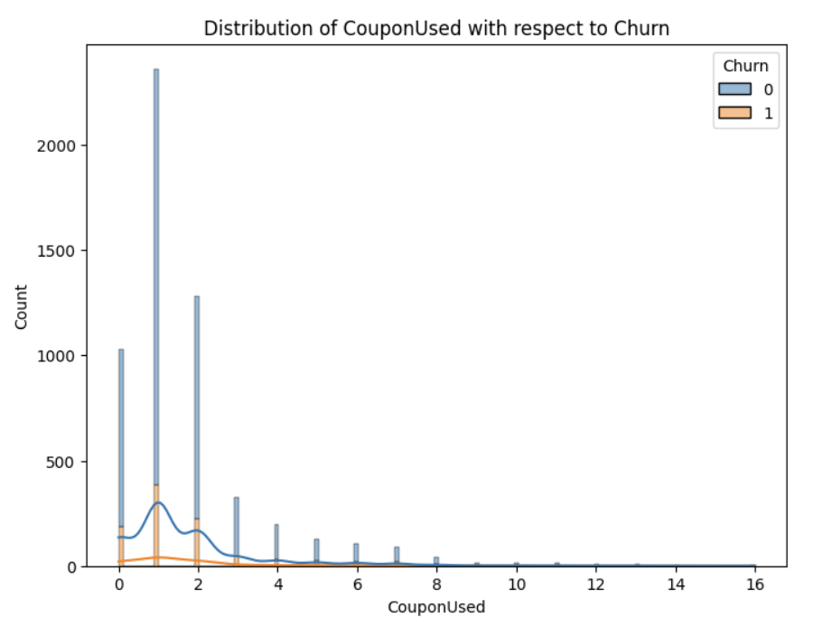
2. Feature Distributions with Respect to Churn (Histograms)

Slide 9
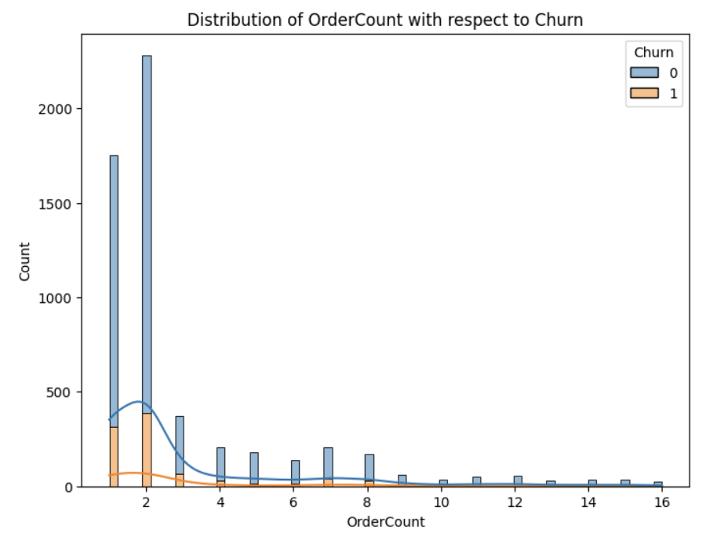
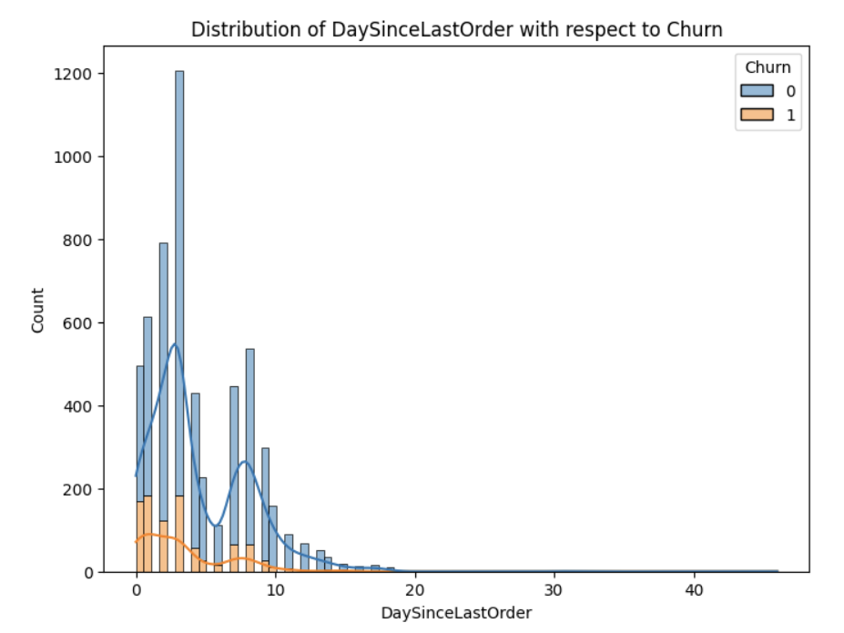
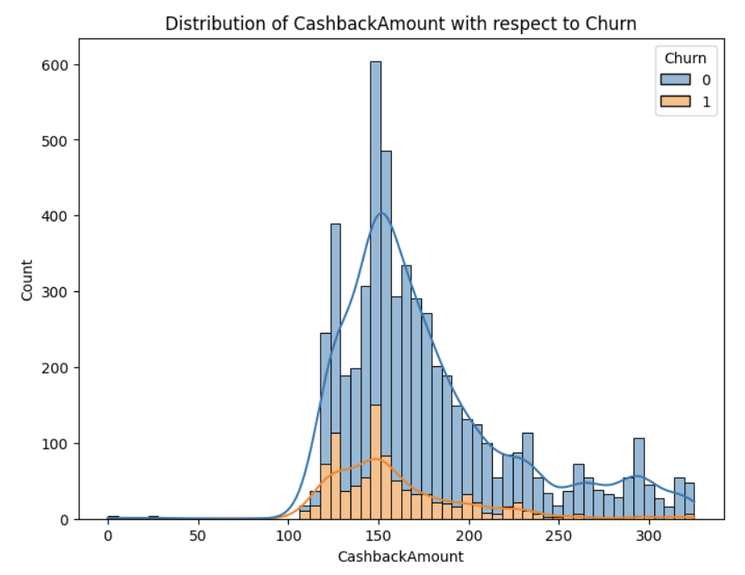
2. Feature Distributions with Respect to Churn (Histograms)

Slide 10
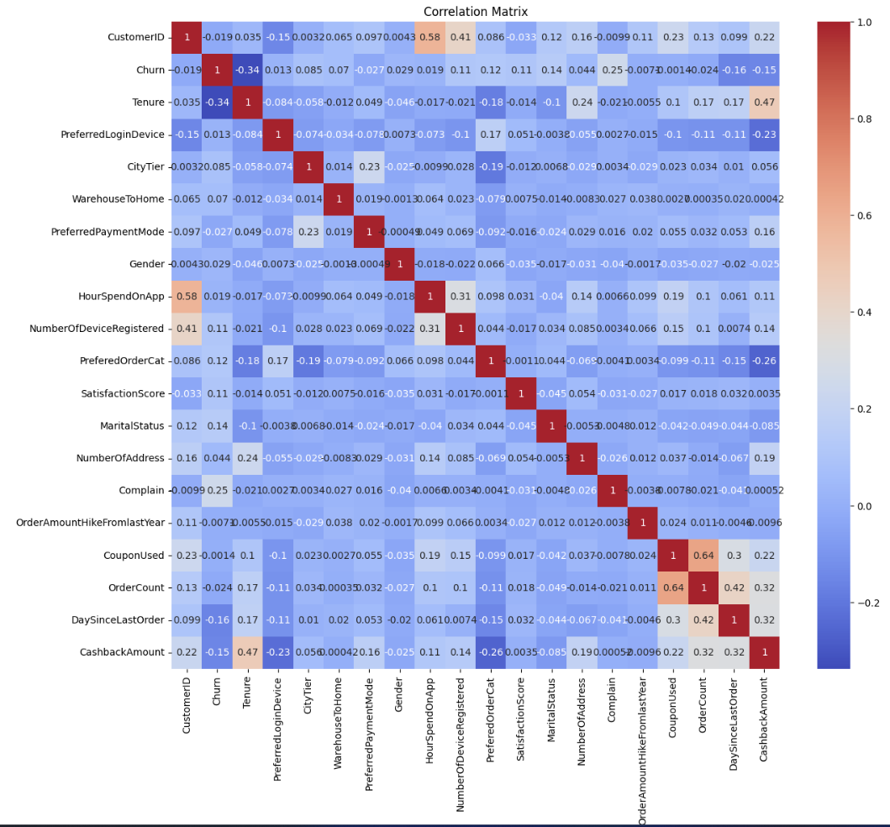
3. Correlation Matrix (Heatmap)
These correlations aids in identifying predictors of churn and refining our predictive model, ensuring robust feature selection and mitigating multicollinearity.

Slide 11
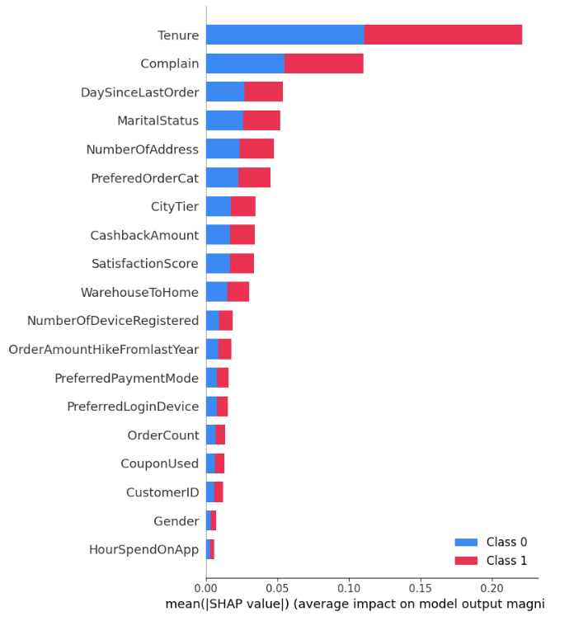
5. SHAP Summary Plot
The SHAP summary plot reveals the impact of various features on customer churn prediction. Key variables like usage frequency, account age, and customer service interactions show strong predictive power. Features with higher SHAP values push the model towards predicting churn, indicating areas where targeted interventions could reduce churn. Understanding these influences helps in tailoring personalized retention strategies, optimizing resource allocation, and enhancing overall customer experience.

Slide 12
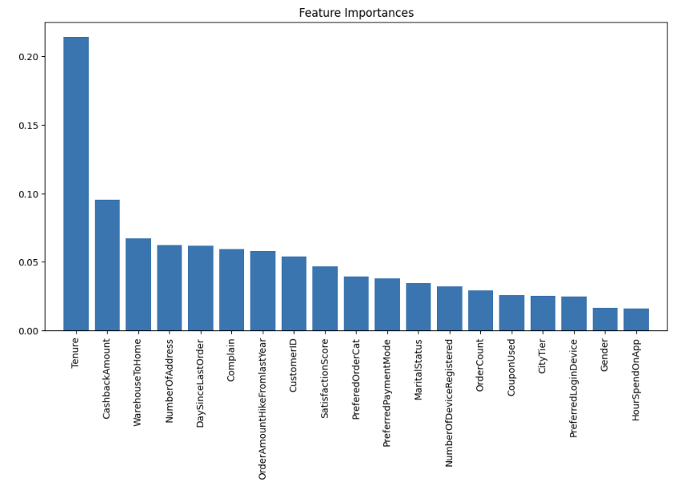
6. Feature Importances (Bar Chart)
The feature importance graph highlights key predictors of customer churn, with usage frequency being the most significant. Demographics, account age, and recent activity are also crucial, emphasizing the need for personalized engagement and long-term relationship nurturing. Improving service quality and ensuring timely payments can further enhance retention. These insights are vital for developing effective strategies to reduce churn and improve customer satisfaction.

Slide 13
Conclusion: Insights and Implications
Our analysis revealed significant predictors of customer churn, including usage patterns and customer demographics. The predictive model highlighted critical areas for intervention. Implementing targeted strategies based on these insights can significantly enhance customer retention. Ongoing monitoring and model refinement will ensure the effectiveness of our retention strategies, ultimately boosting customer satisfaction and loyalty.

Slide 14
Thank You

