Slide 1
Lakshay Soni
Data Analyst

Slide 2
About me
Hello! I’m Lakshay Soni, a passionate and detail-oriented Data Analyst with a strong foundation in statistical analysis, data visualization, and machine learning. I am about to graduate with a diploma in Artificial Intelligence and Machine Learning from Conestoga College, where I honed my skills in analyzing and interpreting complex data to drive actionable insights.

Slide 3
Skills & expertise
Database Management
CRM Systems
&
Ads Platform
Statistical Analysis
Programming Languages

Slide 4
Portfolio samples

Slide 5
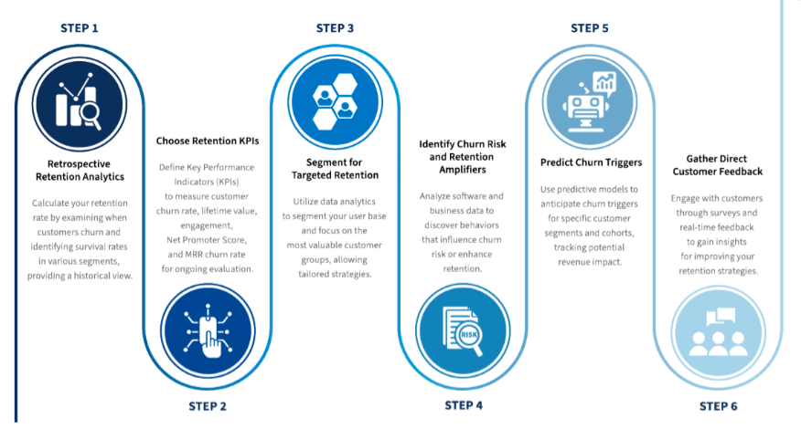


GOODLIFE FITNESS
PREDECTIVE ANALYSIS
HARNESSING PREDICTIVE ANALYTICS: REDUCING CUSTOMER CHURN AND ENHANCING RETENTION STRATEGIES PREDICTIVE ANALYTICS: REDUCING CUSTOMER CHURN AND ENHANCING RETENTION STRATEGIES ANALYTICS: REDUCING CUSTOMER CHURN AND ENHANCING RETENTION STRATEGIES.
Our project aims to harness the power of artificial intelligence to optimize gym utilization and enhance client satisfaction at GoodLife fitness clubs across Canada. By employing predictive analytics and AI-driven personalization, the initiative seeks to improve resource management, reduce overcrowding, and tailor fitness experiences to individual member preferences, thereby increasing both client retention and profitability.

Slide 6

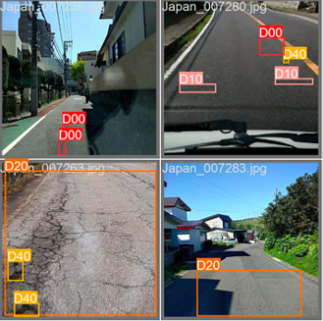
HEALTH INSURANCE
ROAD SENSE
The health insurance sector protects individuals from excessive medical expenses by assessing risk factors like age, sex, BMI, and smoking status to set rates. However, challenges such as complex underwriting guidelines and regulatory compliance persist, requiring insurers to strike a balance between profitability and customer needs.
The introduction of the project "RoadSense" highlights the significant financial burden of poor-quality roads on Canadian drivers, estimated at $3 billion annually. The project aims to enhance road inspection efficiency through real-time damage detection and severity assessment using artificial intelligence, addressing the limitations of traditional methods.

Slide 7


Atari Game "Assault"
This project focuses on developing and optimizing reinforcement learning (RL) algorithms for the Atari game "Assault" using the Gymnasium environment. In "Assault," players control a vehicle to destroy enemy drones while avoiding attacks from a larger mothership. The goal is to enhance the agent's performance by leveraging and comparing different RL algorithms, namely Deep Q-Networks (DQN), and Advantage Actor-Critic (A2C).
Deep Q-Networks (DQN)
Actor-Critic (A2C).

Slide 8
Career highlights
Dept Manager
Walmart, Ottawa,ON
August 2024 - Present
Marketing Strategist
ICT KIKKAWA, Toronto,ON
September 2023 - December 2023
Technical Administrator
Code Pulse, Gurgram,IN
December 2020 - October 2022

Slide 9

Thank You

