Slide 1


SMART INDIA HACKATHON 2024
Problem Statement ID – 1629
Problem Statement Title – Freelancing Platform
Theme – Smart Education
PS Category- Software
Team ID- 42501
Team Name - SyntaxSavants

Slide 2
IDEA TITLE
SyntaxSavants
Problem Resolution :
Personalization elevates user experience by offering virtual try-ons using AI and custom designs, ensuring an engaging shopping journey with reduced returns.
Empowering users with custom, culturally authentic clothing while promoting access to artisan designers, fostering unique, high-quality creations.
IDEA / SOLUTION :
Implementation of a custom design and SaaS personalization platform that allows users to customize and visualize traditional outfits, submit personalized designs, sell and connect with designers for bespoke creations.
E-commerce Platform for Traditional Clothing
User-Based Personalization and Visualization
SaaS with Customization Features using NextJS
Connecting Users with Designers and Boutiques
Unique Value Propositions (UVP) :
Cultural Authenticity with Modern Convenience
Seamless Personalization and Customization
Designer Access and Collaboration
Quad Level Custom Encryption Algorithm
Advanced Visualization and User Experience

Slide 3
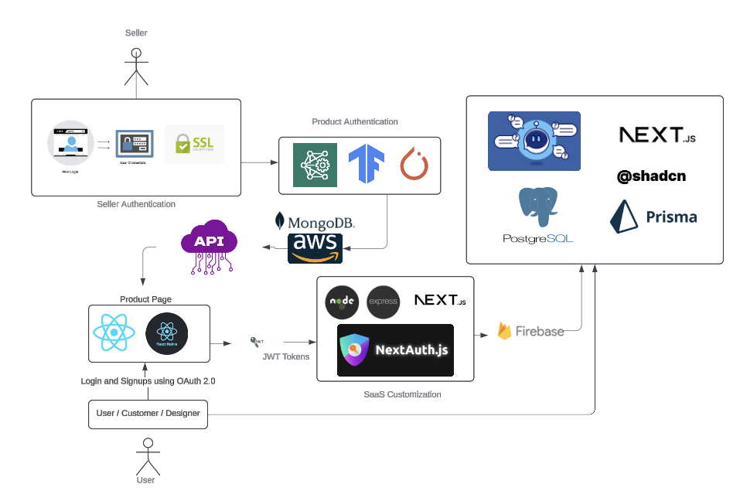
TECHNICAL APPROACH
SyntaxSavants
PROCESS FLOW ARCHITECTURE
Algorithm Development:
Next.js & Express.js - Core technologies used for developing SaaS-based customization platforms.
OpenCV, TensorFlow, and AI Image Manipulation API - For image processing and building AI models that overlay virtual try-ons.
Mobile Application Development:
React Native – The framework for building the mobile application ensures cross-platform compatibility.
Encryption and Security: JWT and OAuth for authentication and authorization. Implement AES-256 encryption to secure sensitive customer information.
Cloud Services and Database: Using PostgreSQL for managing data on artisan designers and their clothing inventory. AWS S3 and Firebase for Cloud Storage
Product Status: 80% product build is completed and further build is in progress. Testing and validation processes are next to be undergone.

Slide 4
FEASIBILITY AND VIABILITY
SyntaxSavants
ANALYSIS OF FEASIBILITY :
With modern Technology, building a site that supports customization, collaboration between designers and manufacturers, and seamless e-commerce functionality is achievable.
Only verified designers can make the designs, ensuring quality and exclusivity for tailored, avoiding overloading of data.
Collaborating with different brands and manufacturers.
Freelancing companies can approach designers based on design reviews.
Introducing a feature where designers can track the status of their requests to manufacturers in real-time.
POTENTIAL CHALLENGES AND RISKS:
Coordinating seamless interaction between designers, manufacturers, and customers requires a sophisticated platform.
Convincing designers and manufacturers to join and actively engage on the platform could be difficult.
Relying on advance payments for customization might be difficult to manage.
STRATEGIES TO OVERCOME THESE CHALLENGES:
Creating a centralized dashboard with integrated tools for smooth coordination.
Emphasize streamlined production and potential earnings through freelancing opportunities.
Implement a flexible payment structure with partial advance payments and milestone-based payments to manage financial risk and customer confidence.

Slide 5

IMPACT AND BENEFITS
SyntaxSavants
Exclusive Ethnic Wear: Our platform will offer a unique selection of ethnic clothing, featuring designs from a diverse pool of global freelancers, ensuring each item is distinct and stands out.
Customer Engaging : We will engage customers by allowing them to create and display their own designs, fostering a stronger connection and sense of involvement with our brand.
Creating an expansive ecommerce hub : By incorporating freelance designers, our inventory will continuously feature fresh and diverse designs, keeping our offerings dynamic and aligned with the latest trends.
Dual Revenue Streams: Our business model includes revenue from both the sale of ethnic clothing and commissions from freelance designers, providing multiple income sources and enhancing financial stability.
Custom Fashion: Customers will have the opportunity to commission bespoke clothing designs, delivering a personalized shopping experience and catering to individual preferences.

Slide 6
RESEARCH AND REFERENCES
SyntaxSavants
https://www.sciencedirect.com/topics/computer-science/e-commerce
https://www.sciencedirect.com/science/article/abs/pii/S0957417407006525
https://www.elsevier.com/en-in/solutions/research-analytics-and-evaluation
https://www.researchgate.net/publication/349651858_Analysis_of_Customization_Strategy_for_E-Commerce_Operation_Based_on_Big_Data
https://int-jecse.net/article/Investigating+the+Role+of+Personalization+in+E-commerce%253A+A+Study+of+Customer+Satisfaction+and+Purchase+Behaviour_5462/?download=true&format=pdf

