Slide 1
S&P GLOBAL & CRISIL CAMPUS HACKATHON 2026
Financial Risk Intelligence Platform
Real-time AI/NLP risk signals from news and social media, driving tactical index rebalancing and event-driven portfolio stress testing
Sentiment macro-F1 0.80
Both modules built
49 automated tests
Lakshay Gupta
Indraprastha Institute of Information Technology Delhi (IIIT-Delhi)
lakshay24318@iiitd.ac.in
Notes:
Introduce yourself and the one-line pitch: the system reads financial news as it arrives, turns each headline into a structured risk signal, and acts on it twice: rebalancing an index and stress-testing a bank portfolio.

Slide 2
Risk moves at headline speed; risk reports don't
The problem
The approach
Market-moving events arrive as unstructured text: news, filings, social posts
Analysts cannot read everything, and keyword alerts are noisy
Stress tests run on a quarterly calendar, not when the event happens
Goal: turn text into structured, explainable risk signals and act on them in seconds
1
Ingest
10 live RSS feeds + social stream; freshness filter and de-dup
2
Understand
Fine-tuned FinBERT sentiment, event class (keywords → NLI), tickers
3
Score
Explainable 1–10 impact: severity, novelty, breadth, source
4
Act
Module A rebalances an index; Module B stress-tests a $100M book
Notes:
Frame the business problem in your own words. Then walk the four steps: ingest, understand, score, act. Mention both downstream modules are implemented, not just one.

Slide 3
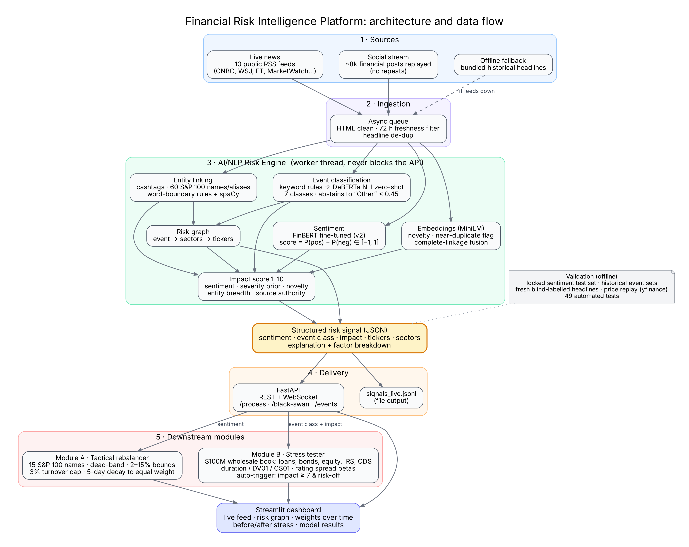
System design: one engine, two consumers
Non-blocking
Models run in a worker thread with an inference lock; the API and dashboard stay responsive
Two outputs
Every signal goes to REST + WebSocket and to a JSONL file, as the brief allows either
Fails safe
No feeds? Bundled headlines replay. Fine-tuned model missing? Falls back to base FinBERT
Duplicates suppressed
Near-identical headlines (cosine ≥ 0.80) never move weights or trigger a second stress test
Notes:
Point at the flow: sources, ingestion, the NLP engine, the structured JSON signal, delivery, then Module A and Module B feeding the dashboard. Then the four engineering choices on the right.

Slide 4
Implementation highlights and why
1
2
3
Fine-tuned FinBERT
Trained on 8,111 finance posts; locked test set never used for checkpoint selection; score = P(pos) − P(neg)
Classifier that abstains
Precise regex rules first, DeBERTa NLI for the rest; below 0.45 confidence it says “Other” instead of guessing
Explainable impact
Five transparent factors with fixed weights; every signal shows its point-by-point breakdown
4
5
6
Module A controls
Dead-band, 2–15% bounds, 3% turnover cap, 5-day decay to equal weight, 5 bp costs
Module B realism
Duration, DV01/CS01, rating spread betas; rates hit the whole book; trigger needs impact ≥ 7 and risk-off
Engineering
49 offline tests incl. end-to-end API; pinned dependencies; one script regenerates every result
Notes:
Pick two or three to explain: abstention ('Other') is what makes the live feed trustworthy; Module B reprices with real fixed-income sensitivities; the evaluation never touches the locked test set.

Slide 5
Results: +0.16 macro-F1 over FinBERT, 2× baseline on events
Event classification accuracy vs always-guess-majority
64.9%
vs 32.4%
Fresh live headlines, labelled blind (n=37)
77.8%
vs 50.0%
Historical holdout (n=18)
74.1%
vs 51.9%
Historical tuning (n=27)
100% recall on Geopolitical and Credit Event (the classes that trigger stress tests) · ticker recall 75%
Accuracy 48.2% → 69.0% → 83.5% (majority class 64.7%)
Notes:
Lead with the sentiment gain: same locked test set for all three models, never used in training. Then event classification: the blind-labelled live headlines are the most credible number because nothing was tuned on them.

Slide 6
Domain impact: from headline to stress test in seconds
Live example
1
Early warning
Every headline scored in about a second, with a factor breakdown an analyst can audit
“China blockade of Taiwan Strait sparks military standoff; TSMC, NVIDIA and Apple shares plunge as sanctions loom”
Geopolitical · impact ≈ 8/10 · TSM, NVDA, AAPL
Stress test triggered automatically
2
Event-driven stress testing
Scenarios run when the event happens, not on a quarterly calendar; attributed by sector, asset and position
≈ −6%
of a $100M wholesale book: about $6M
3
Trustworthy by design
Abstains when unsure, suppresses duplicates, never stresses on good news, keeps working offline
Technology 64% of gross loss · bonds 53%
CDS protection offsets part of it · loss explained per position
Notes:
This is the domain slide, and it decides ties. Explain who uses it: a market-risk or credit-risk desk at a bank. The example is what the live demo shows.

Slide 7
Market evidence, limits and next steps
What the market evidence shows
Next steps
Tweets (8,364 scored, 916 stock-days, 2017–18): weak but consistent contrarian signal, IC −0.06 to −0.09 over 1–3 days, negative in both halves; TextBlob agrees
So a momentum tilt is the wrong sign for social data: Module A replay ties the benchmark (+0.11 pp)
News headlines: direction 51% on 45 events, a coin flip at this n; impact score is triage, not a forecast
Module B uses first-order sensitivities; social feed is a replay, not a live API
1
Test a contrarian tilt for social sources
On later, unseen data (2019+), with news signals kept separate
2
Calibrate impact on a larger archive
Fit impact weights to thousands of dated headlines and realised moves
3
Credit losses, not just mark-to-market
Add PD/LGD and rating migration to Module B; connect a live social API
Everything above is reproducible: bash scripts/reproduce_results.sh
Notes:
Say this plainly; it builds credibility. The tweet study is the interesting finding: positive social chatter tended to precede slightly weaker returns, consistently across both halves of the data and with a second method. We did not change Module A after seeing it, because that would be fitting to the result; it is the first thing to test on new data.

