Slide 1
AIR QUALITY REGRESSION ANALYSIS DELHI
Lakshay Trehan Karanjeet Singh
Shrey Yadav
Yash Singh
Sahil

Slide 2
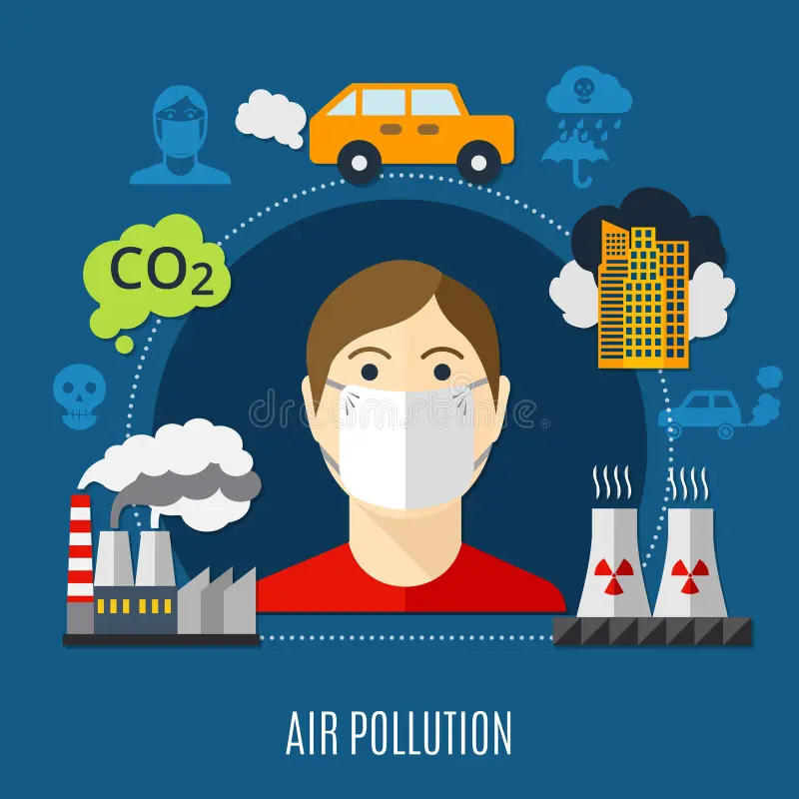
ABSTRACT
The alarming rise in air pollution levels in Delhi
presents a severe public health challenge. This project focuses
on analyzing air quality through a sophisticated regression
model that forecasts concentrations of major pollutants
including PM2.5, PM10, NO, NO2, NH3, SO2, and
CO. By investigating the relationships between these pollutants
and various environmental factors, our goal is to provide
actionable insights to support effective policy-making
and intervention strategies.

Slide 3
MOTIVATION
Delhi, one of the world's most populous cities, faces severe air pollution due to industrial emissions, vehicular traffic, and seasonal agricultural burning. This project aims to tackle these challenges by developing a regression model to predict pollutant concentrations (PM2.5, PM10, NO, NO2, NH3, SO2, and CO) based on comprehensive historical data and environmental variables.
Public Health Impact: Severe health problems due to air pollution in Delhi lead to respiratory and cardiovascular diseases, hence need for strict monitoring and intervention.
Environmental Degradation: Ecosystem damage and loss of biodiversity by high-level pollutants have thus made proper control of pollution more vital for the protection of the environment.

Slide 4
MOTIVATION
Data Driven Policies: Accurate predictions of pollutant concentrations using Regression Techniques allows the government to create and implement data driven policies. This will help in formulating the regulations that can address specific pollutants, like NH3 and NO, and mitigate their sources more effectively.
Technological Innovation: By Applying Advanced Regression Techniques on the historical data on pollutants such as PM2.5, NO2, and SO2 can leverage technological innovations for predicting how pollutants function in complex ways. This fosters smarter urban management strategies in regard to monitoring in real time and anti-pollution efforts.
Economic Burden: The Economic Costs of Treating Pollution Related Health problems and lost of productivity due to poor air quality are significant. Regression models can help predict future pollution trends thus enabling proactive measures that reduce healthcare strain and making pollution control economically advantageous.

Slide 5
LITERATURE REVIEW
Recent advancements in air quality prediction have increasingly leveraged regression-based models to improve forecasting accuracy. Kumar and Goyal (2011) made significant contributions by exploring advanced regression techniques for air quality forecasting in Delhi. Their study utilized principal component regression, showcasing the potential of these methodologies to enhance prediction accuracy. By incorporating their forecasting techniques into our model, we aim to bolster its predictive capabilities, ensuring more reliable assessments of air quality in urban environments.
In a subsequent study in 2017, researchers examined the "Forecasting Air Quality Index Using Regression Models" in the context of Delhi and Houston. This paper evaluated various regression models, including Support Vector Regression (SVR) and multiple linear regression approaches, such as gradient descent methods. The findings underscored the relationship between the Air Quality Index (AQI) and pollutant concentrations of NO₂, CO, O₃, PM₂.5, PM₁₀, and SO₂, with SVR demonstrating superior performance. Incorporating insights from this research will further enhance our AQI prediction framework, particularly for cities analogous to Delhi and Houston.

Slide 6
LITERATURE REVIEW
Further advancements were made in 2019 when Mahanta et al. presented their work on "Urban Air Quality Prediction Using Regression Analysis." This study highlighted the critical role of regression analysis in understanding air quality dynamics, emphasizing the importance of meteorological factors in influencing pollutant levels. By integrating their findings, we can refine our AQI prediction framework, focusing on the interplay between pollution and meteorological variables, which is vital for developing accurate predictive models.
Lastly, Shukla et al. (2021) introduced flexible regression models to tackle the complexities of photochemical air pollutants in Delhi, emphasizing the necessity of capturing pollutant interactions for improved predictive performance. Alongside traditional regression techniques, machine learning approaches have emerged as powerful tools for predicting air quality indices. Gupta et al. (2023) conducted a comprehensive analysis of various machine learning techniques, providing valuable insights into algorithm selection and optimization for AQI prediction. This synthesis of existing literature will guide our research, helping us develop an effective air quality prediction framework that integrates both regression and machine learning methodologies.

Slide 7
DataSet Description
The dataset used for predicting the Air Quality Index (AQI) of Delhi contains data merged from multiple sources like Kaggle and Delhi Pollution Control Committee (DPCC) , Department of Environment Govt NCT of Delhi , including air quality measurements, weather conditions, and pollutant concentrations such as PM2.5, PM10, NO2, CO, SO2, and O3. This data helps monitor air pollution levels in Delhi, a city facing severe pollution challenges due to traffic, industrial activities, and weather patterns. We bring this data to analyze the impact of various pollutants on AQI and predict future trends, helping authorities and citizens take timely actions. The data is collected continuously at different times of the day to capture pollution variations based on daily activities and weather shifts.
Drive Link for DataSet : -
https://drive.google.com/drive/folders/1hMIOSkI-7jrlenNSyriost1Jd5zM8BGy?usp=sharing

Slide 8
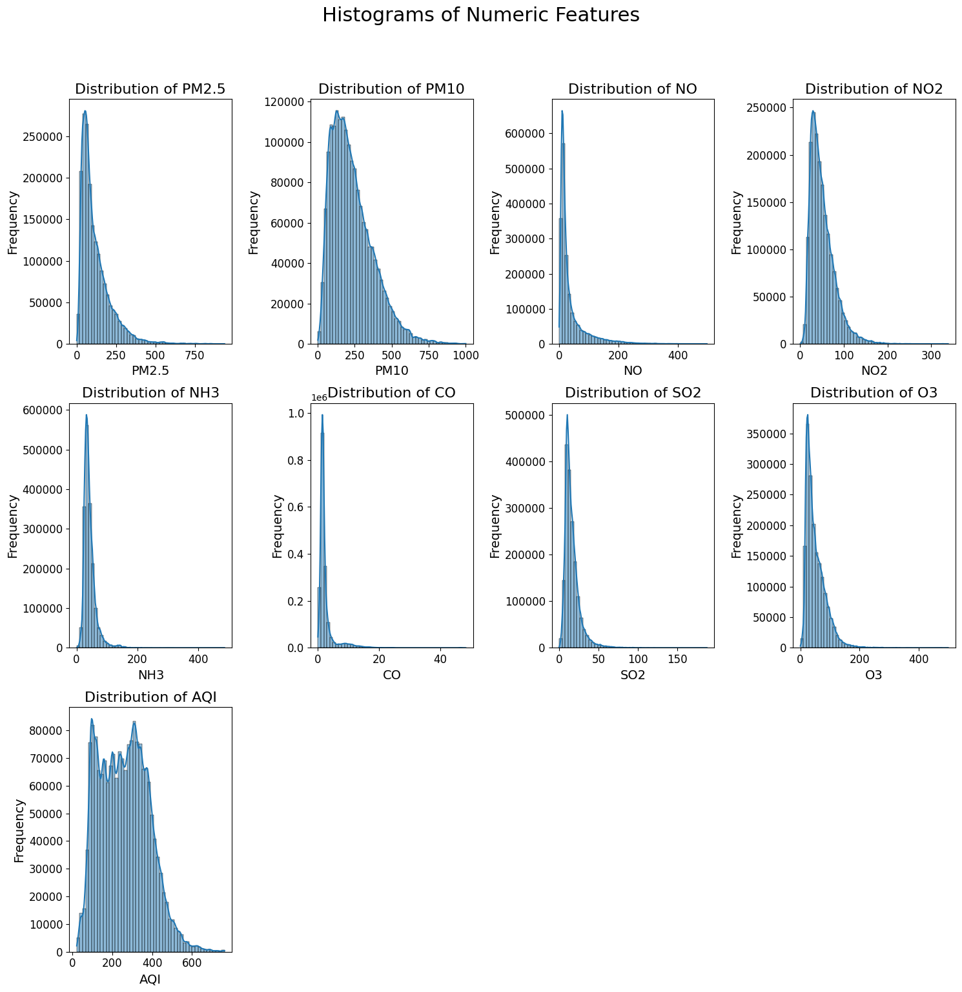
DATASET VISUALISATION AND EDA
Observations
1. Right-skewed distributions are found in most the vari-
ables PM2.5, PM10, NO, NO2, NH3, SO2, O3 and AQI.
2. The major data points have shifted into the lower end
with long tails that indicate higher values.
3. AQI shows bimodal behavior. This is the appearance
of different clusters in air quality measurements.
4. PM10 and PM2.5 have wider distributions indicating
fluctuations that are influenced by various factors.
5. The CO has sharp peak near zero showing that most
values are concentrated in low ranges

Slide 9
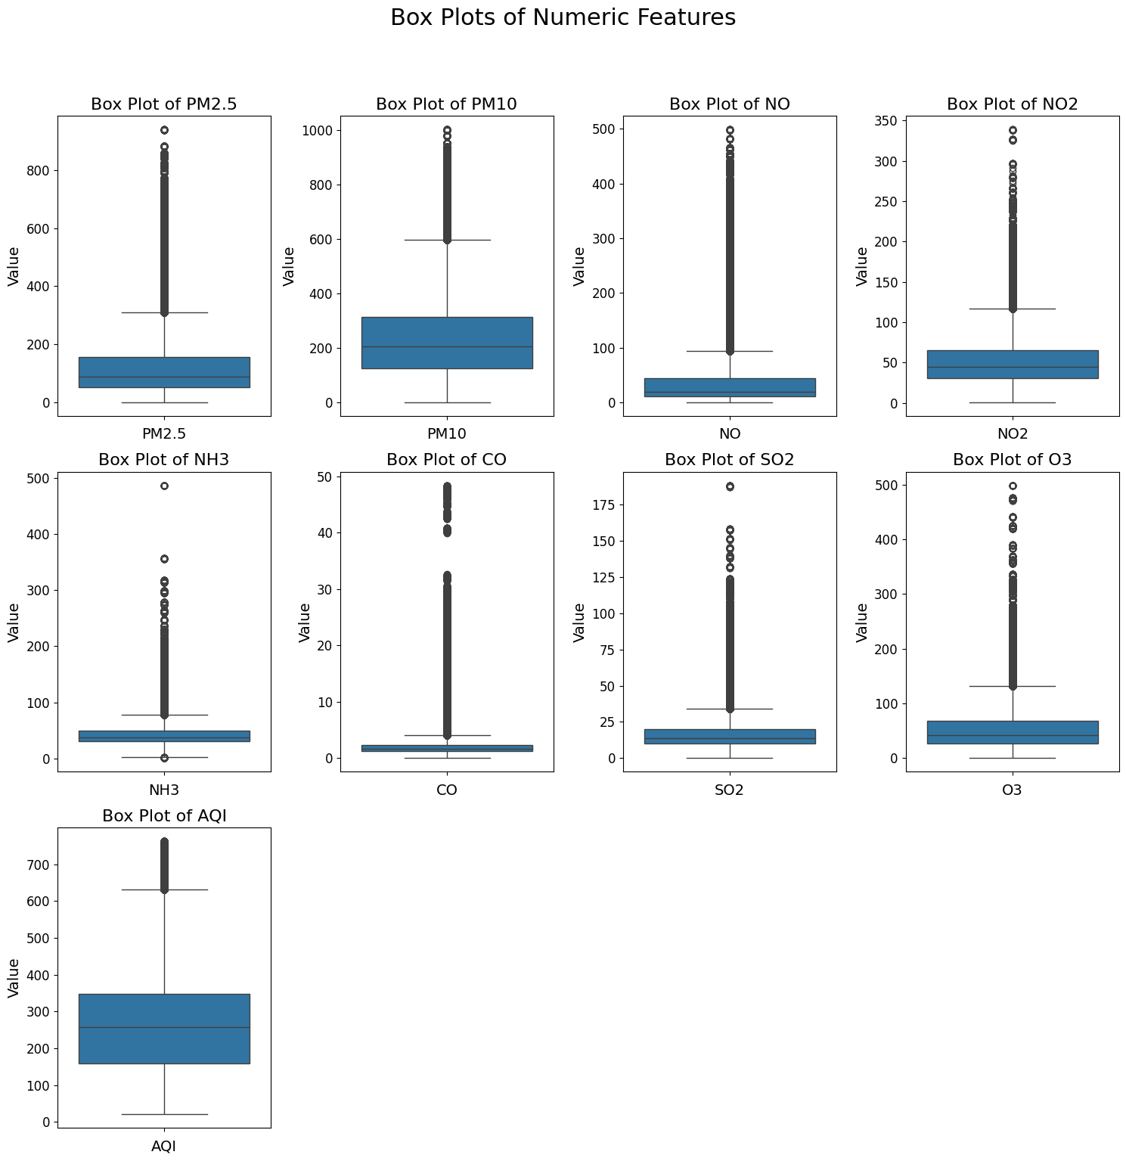
DATASET VISUALISATION AND EDA
Observations
1. The box plots show presence of outliers in many fea-
tures, with higher number in PM10 and NO2.
2. PM2.5 shows a higher median compared to others in-
dicating worse air quality.
3. Features represents higher IQR’s, indicating greater
variability in pollution levels.
4. CO , NH3 , SO2 , O3 , NO , PM2.5 , PM10 , NO2 has
higher number of outliers representing greater variabil-
ity.
5. AQI’s has lower outliers as compare to others and its
central tendency aligns with higher pollution levels.

Slide 10
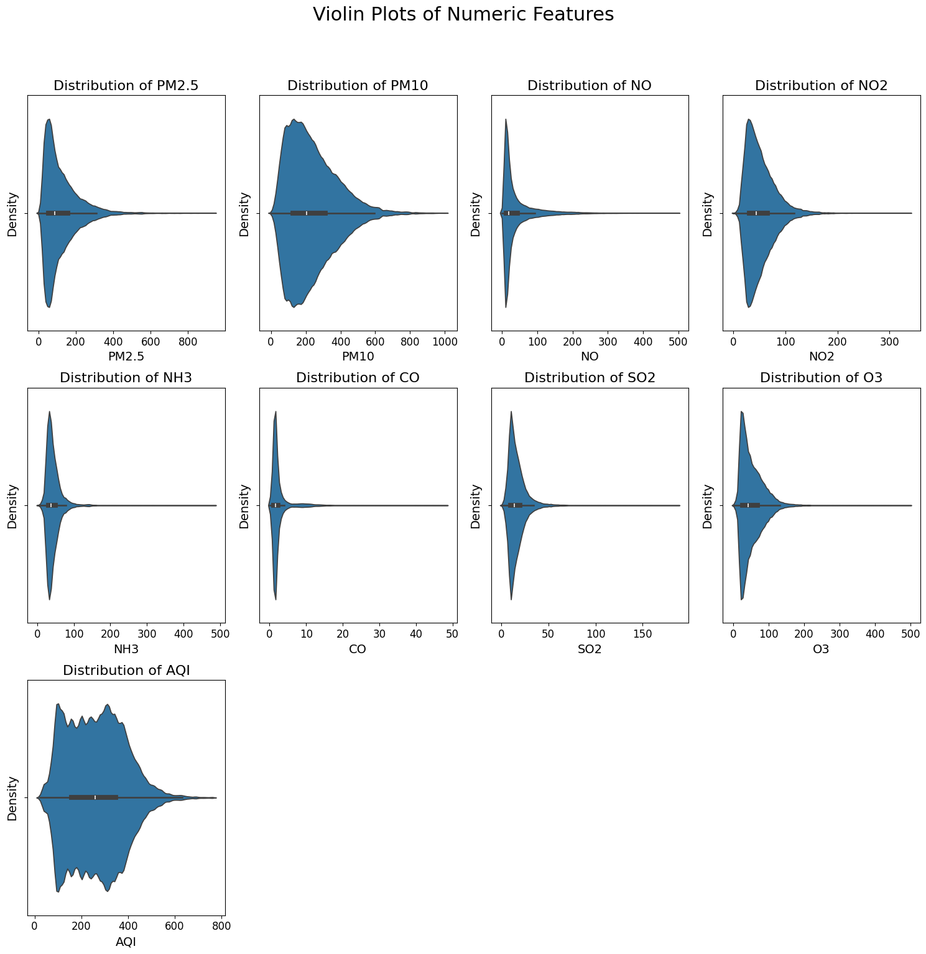
DATASET VISUALISATION AND EDA
Observations
1. Many features like PM2.5 and PM10 has right-skewed
distributions with higher densities at lower values.
2. The AQI plot indicates bimodal behavior suggesting
distinct air quality clusters.
3. CO feature has narrow distribution centered around
zero indicating low carbon monoxide levels.
4. There are Wider distributions for PM10 and PM2.5
suggesting significant variability in pollution levels.
5. Outlier are visible in many features , extending the density tails and emphasizing pollution spikes.

Slide 11
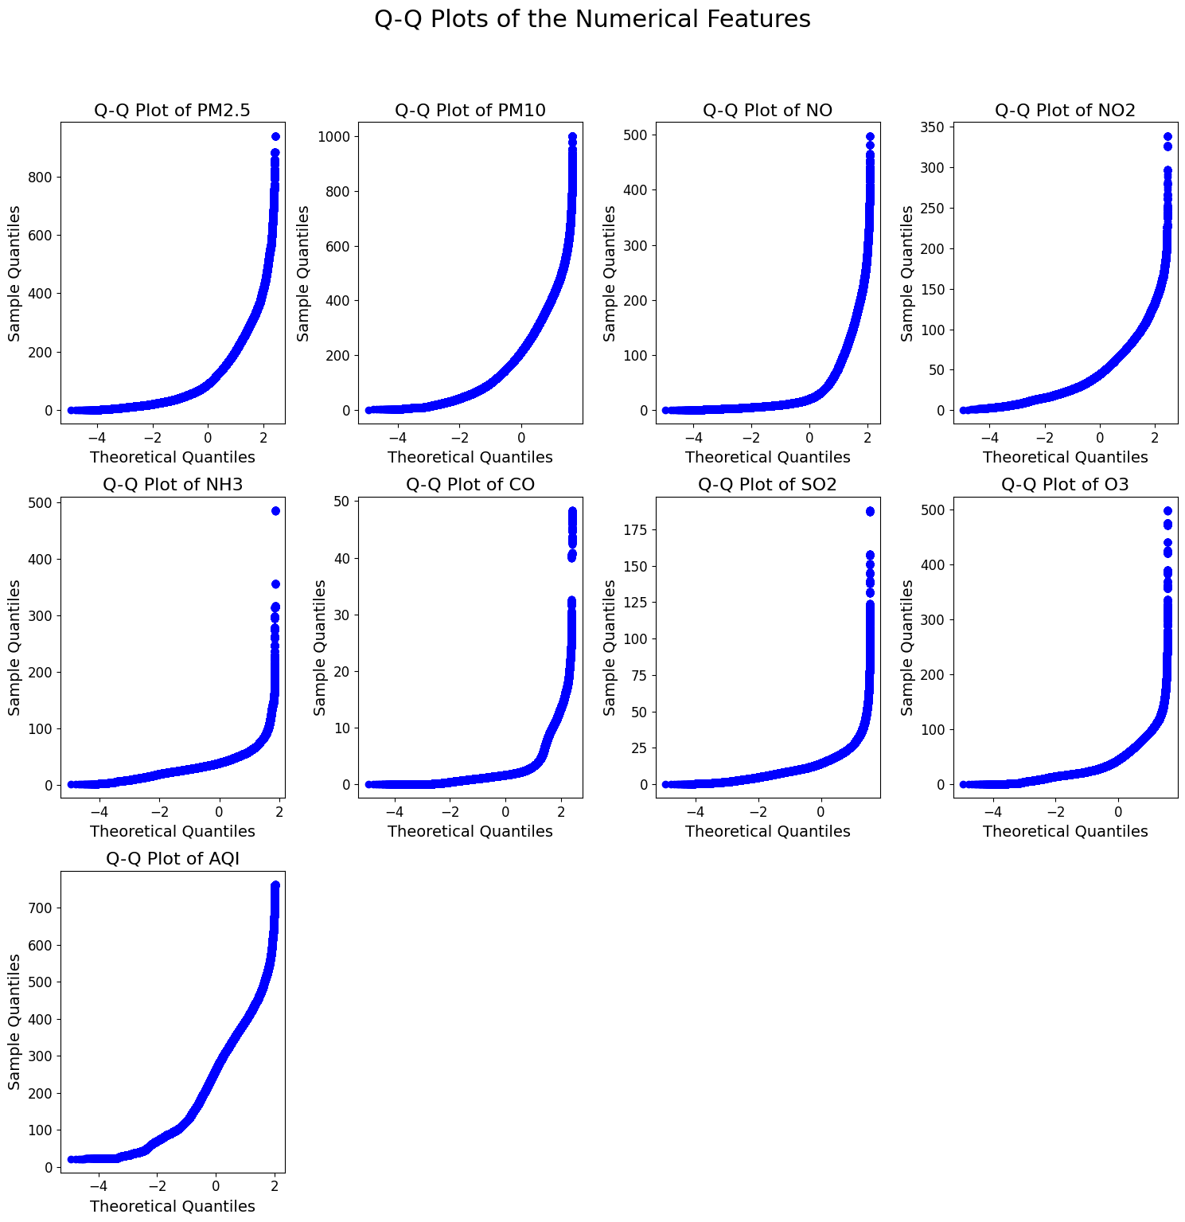
DATASET VISUALISATION AND EDA
Observations
1. The Q-Q plots also show that all features are right-
skewed as they have upward curvature in the Q-Q
plots.
2. Features like PM2.5, PM10, CO, and AQI have heavy
tails indicating extreme values and deviations from
normality.
3. No features follow Gaussian distribution all features
deviate from the normal quantiles.
4. Q-Q Plots show that the outliers are present in all the
features.
5. O3 has relatively less skewness but still deviates from
normal in the tails.

Slide 12
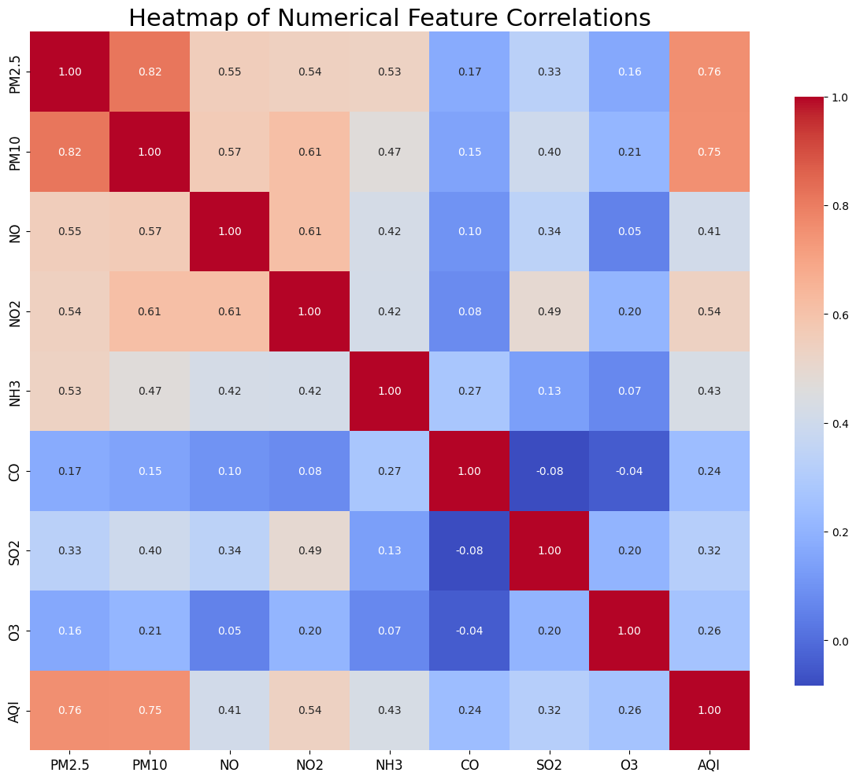
DATASET VISUALISATION AND EDA
Observations
1. PM2.5 and PM10 have a strong positive correlation of 0.82, indicating a
close relationship.
2. Nitric oxide and nitrogen dioxide show a positive correlation of 0.57, likely due to combustion processes.
3. Ammonia and sulfur dioxide have a
moderate positive correlation of 0.54, possibly due to agricultural and industrial activities.
4. The Air Quality Index (AQI) is strongly correlated with PM2.5 (0.72) and PM10 (0.75) but has weaker correlations with other pollutants like NH3, CO, SO2, NO, and NO2.

Slide 13
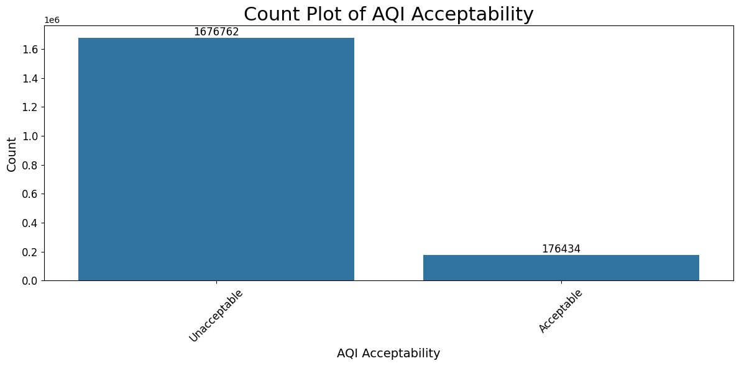
DATASET VISUALISATION AND EDA
Observations
Acceptability Distribution: The ”Unacceptable” category has a significantly higher count 1.6 million while the ”Acceptable” category has a much lower count approx 2,00,000. This indicates that a large proportion of air quality measurements fall into the ”Unacceptable” range, highlighting need to control the pollution.

Slide 14
PREPROCESSING

Slide 15
HANDLING MISSING VALUES
Mean/Mode Imputation: Replaces missing values in
specified pollutant columns with the mean or mode
of those columns, ensuring that the imputed values
are representative of the data distribution.
Interpolation: Utilizes interpolation techniques to estimate and
fill in missing values based on existing data, allowing
for a smoother representation of data trends over time.

Slide 16
FEATURE ENGINEERING

Slide 17
LABEL ENCODING
Label encoding is used to convert categorical
variables into numerical values. This is neces-
sary for algorithms that require numerical inputs.
The method systematically replaces each category
with a unique integer. For example, a column
with values like ’Good’, ’Moderate’, ’Unhealthy’
might be converted to 0, 1, 2, respectively.

Slide 18
EXTRACTING DATETIME FEATURES
Extracting datetime features involves converting a
datetime column into separate components, such
as year, month, day, hour, and day of the week.
These features enable analyses that consider time-
based patterns and seasonal effects in air quality
data. For example, certain pollutants might have
higher concentrations during specific months or
times of day due to environmental factors or human
activities.

Slide 19
CYCLIC ENCODING
Cyclic encoding is applied to features that have a
periodic nature, such as month or day of the week.
Instead of treating these features as linear (where
December would be next to January, creating an
artificial gap), cyclic encoding transforms them
into sine and cosine values. This allows the model
to understand the cyclical relationship, preserving
the continuity of these time-related features.

Slide 20
LOG TRANSFORMATION
Log transformation is a common technique used
to handle skewed data. By applying the natural
logarithm to pollutant measurements, this method
helps stabilize variance, reduces the impact of
outliers, and can make the distribution of the data
more normal. This is particularly useful for pol-
lutants that may have exponential growth patterns
or are heavily right-skewed.

Slide 21
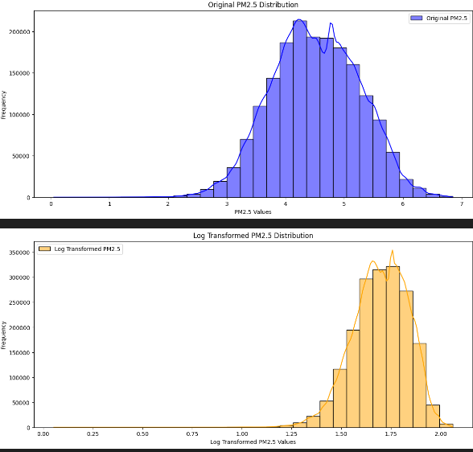
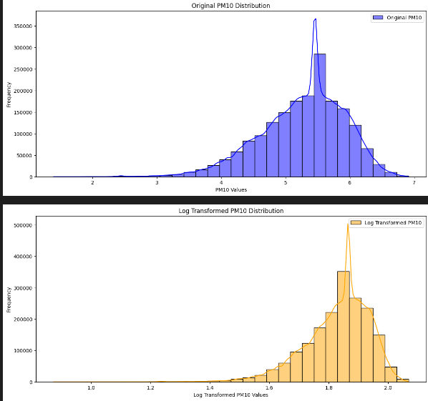
LOG TRANSFORMATION GRAPHS

Slide 22
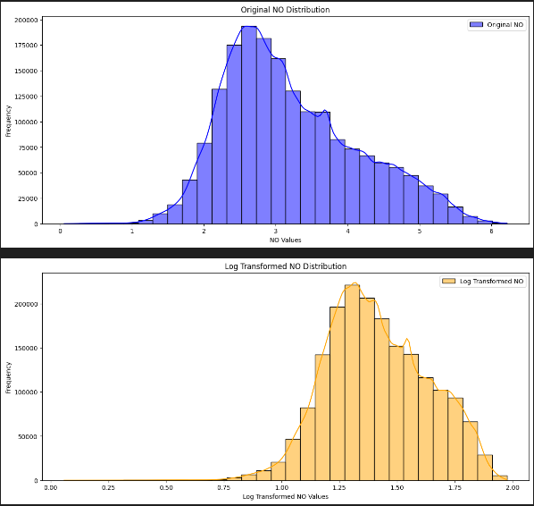
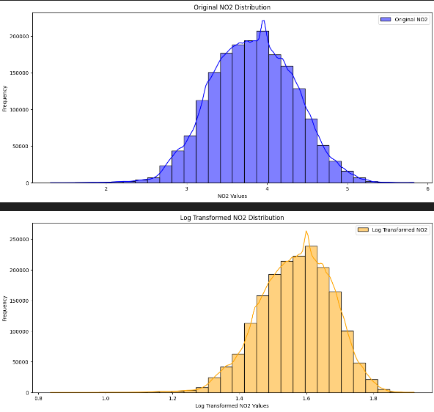
LOG TRANSFORMATION GRAPHS

Slide 23
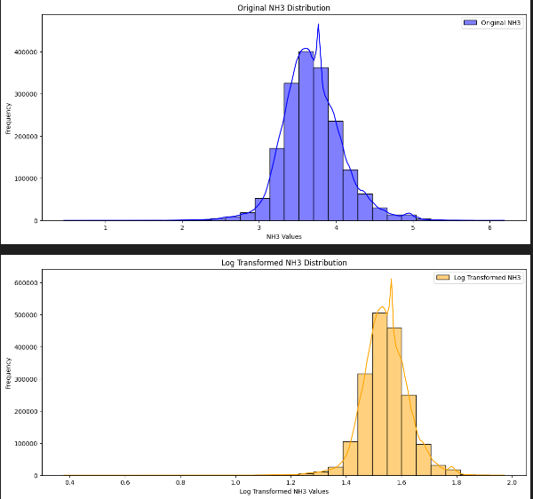
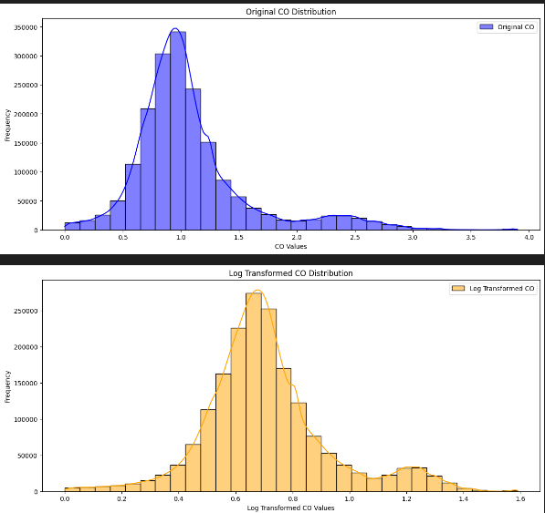
LOG TRANSFORMATION GRAPHS

Slide 24
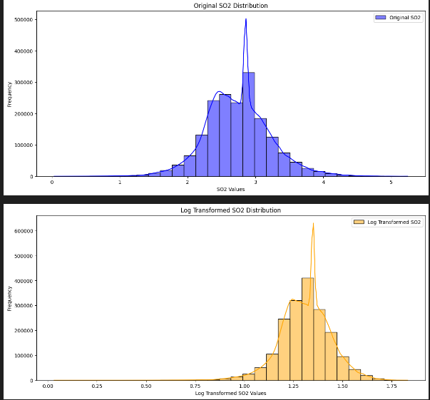
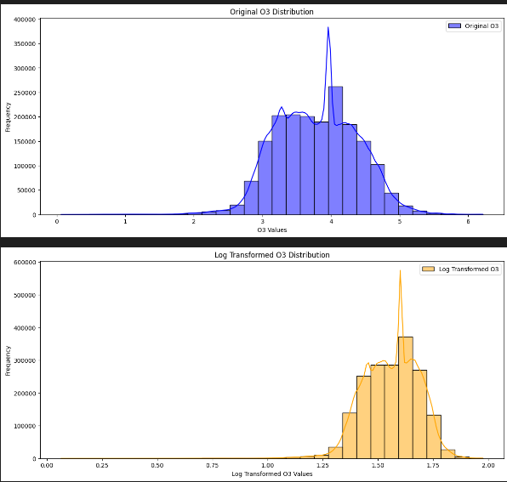
LOG TRANSFORMATION GRAPHS

Slide 25
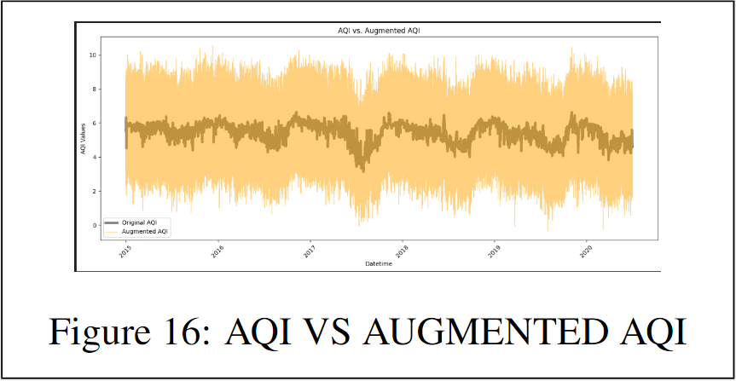
ADDING NOISE IN AQI
The method that compares AQI with augmented noise
generates an ’Augmented AQI’ by adding random
noise to the original AQI values. This comparison
helps to understand how noise impacts the measure-
ments and can serve as a sensitivity analysis. Visualiz-
ing both original and augmented AQI values over time
can reveal trends and fluctuations that might not be ap-
parent with the original data alone.

Slide 26
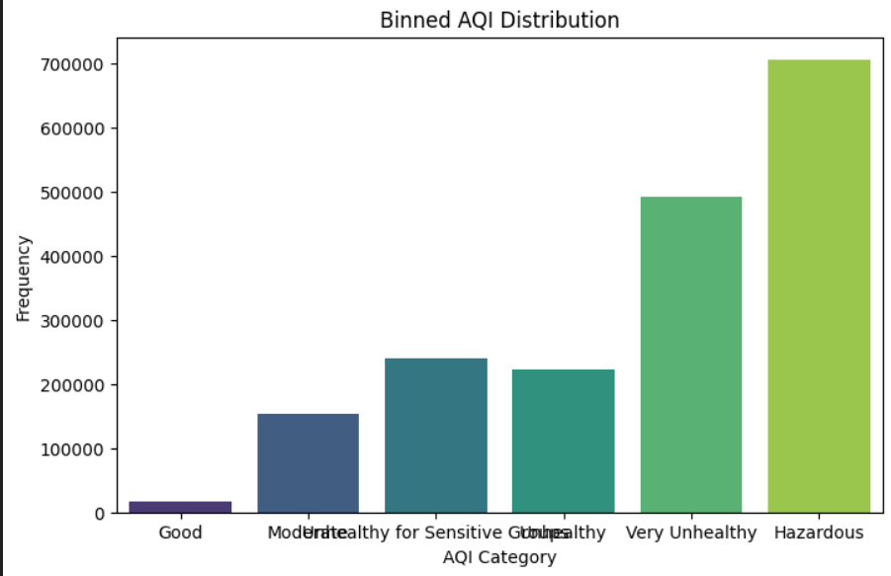
BINNING
Categorizing the AQI involves defining thresholds to
classify the AQI values into meaningful categories,
such as Good, Moderate, Unhealthy, etc. This catego-
rization enhances interpretability and allows for easier
analysis of air quality data. It also facilitates visual-
ization, such as plotting the frequency of different AQI
categories, providing insights into the distribution of
air quality levels.

Slide 27
SCALING

Slide 28
STANDARD SCALER
The StandardScaler standardizes features by re-
moving the mean and scaling to unit variance. This
results in a distribution with a mean of 0 and a stan-
dard deviation of 1. Standard scaling is useful when
the features follow a Gaussian distribution

Slide 29
ROBUST SCALER
The Robust Scaler uses the median and the
interquartile range for scaling, making it robust to out-
liers. This technique is particularly beneficial when the
dataset contains outliers that may skew the scaling of
other techniques.

Slide 30
MIN MAX SCALER
The MinMaxScaler scales the features to a fixed
range, typically [0, 1]. It does this by subtracting the
minimum value and then dividing by the range of the
data. This technique is useful for ensuring that all
features contribute equally to the distance calculations
used in many machine learning algorithms.

Slide 31
OBSERVATIONS

Slide 32
MEAN
The mean values for each scaling technique provide an
understanding of the average transformed values for each
pollutant.
• StandardScaler: The mean values are approxi-
mately close to zero, indicating a standard normal
distribution.
RobustScaler: The mean values are relatively small,
suggesting that it effectively mitigates the influence
of outliers on the average.
• MinMaxScaler: The mean values are significantly
higher, as it scales the data to a [0, 1] range.

Slide 33
STD. DEVIATION
The standard deviation measures the spread of the scaled
data around the mean.
• StandardScaler: The standard deviation is exactly
1, as this method scales data to have unit variance.
• RobustScaler: The standard deviation is lower (ap-
proximately 0.79), indicating a tighter clustering of
data around the median.
• MinMaxScaler: The standard deviation is minimal
(approximately 0.115), reflecting the nature of data
being rescaled to a defined range.

Slide 34
MIN AND MAX VALUES
The minimum and maximum values for each scaling
method indicate the transformed range of the pollutants.
• StandardScaler: The minimum and maximum val-
ues vary significantly, reflecting the original data dis-
tribution post-standardization.
• RobustScaler: Similar to StandardScaler, it shows
varied minimum and maximum values, capturing the
distribution effectively while minimizing outlier in-
fluence.
• MinMaxScaler: The minimum values are all 0, and
the maximum values are close to 1, as expected from
this scaling method, which compresses data into a
specific range.

Slide 35
MAD
Mean Absolute Deviation (MAD) quantifies the average
distance between each data point and the mean.
• StandardScaler: Shows higher MAD values, sug-
gesting greater variability in data.
• RobustScaler: The MAD is lower than that of Stan-
dardScaler, reflecting less variability due to its outlier
resistance.
• MinMaxScaler: The MAD values are minimal, in-
dicating that the data is tightly clustered around the
mean.

Slide 36
BEST SCALING TECHNIQUE
The analysis identifies the MinMaxScaler as the best
scaling technique, evidenced by its low standard devia-
tion and range. The insights indicate that it provides a
more uniform representation of the data, which is bene-
ficial for certain types of machine learning models that
require input data within a fixed range.

Slide 37
BEST SCALER INSIGHTS
Mean: The mean values for pollutants are consis-
tently scaled, showing that the MinMaxScaler main-
tains relative proportions.
• Standard Deviation: A low standard deviation sug-
gests reduced variability.
• Minimum: All minimum values are set to zero.
• Maximum: Values are rescaled to approach one,
highlighting the effectiveness of this method in nor-
malizing data

Slide 38
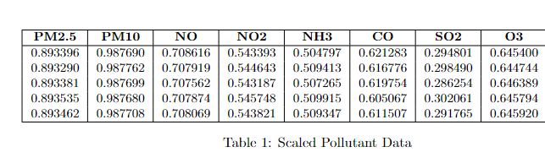
BEST SCALED DATA
These scaled values are essential for ensuring that different pollutants are compared on the same scale, facilitating more effective analysis and machine learning modeling.

Slide 39
GRAPHS FOR COMPARISON OF SCALING TECHNIQUES

Slide 40
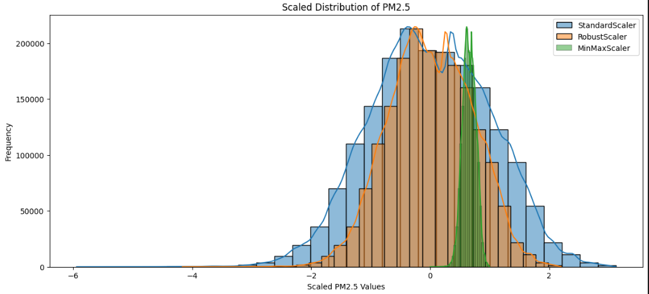
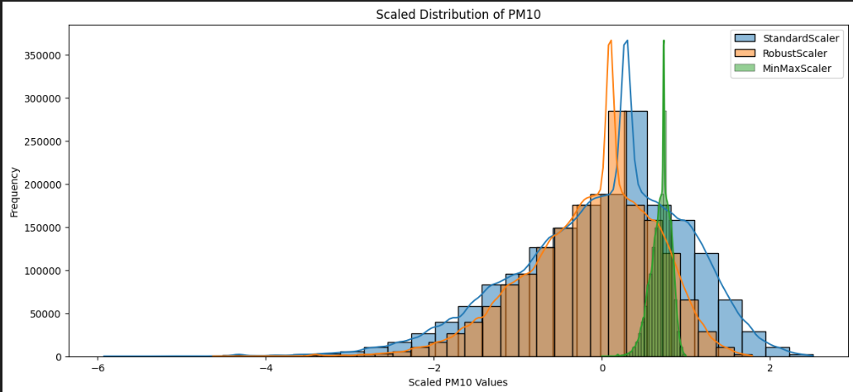

Slide 41
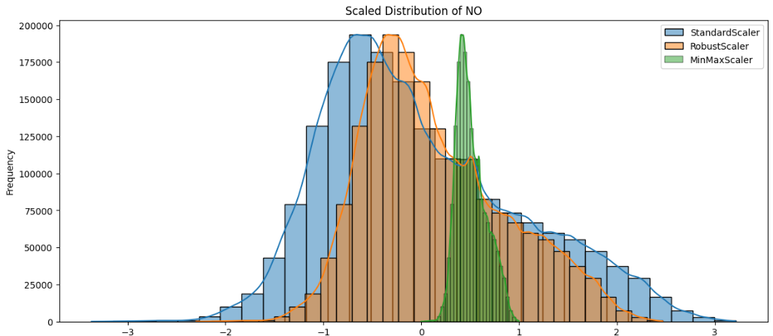
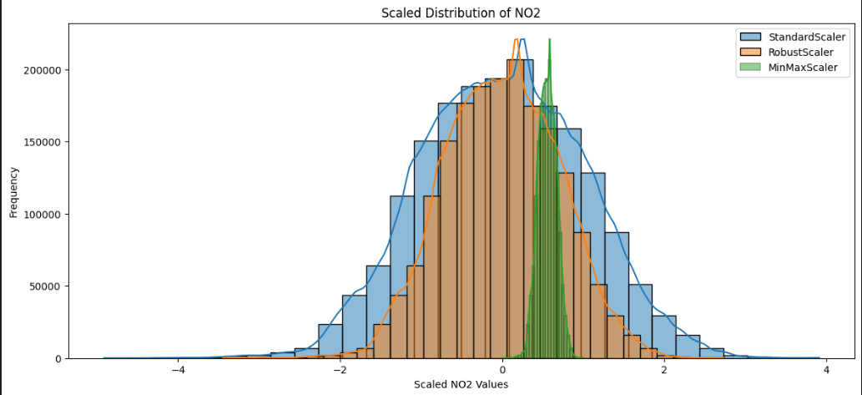

Slide 42
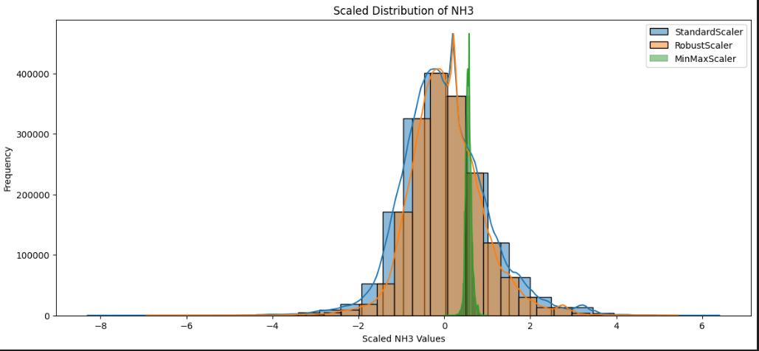
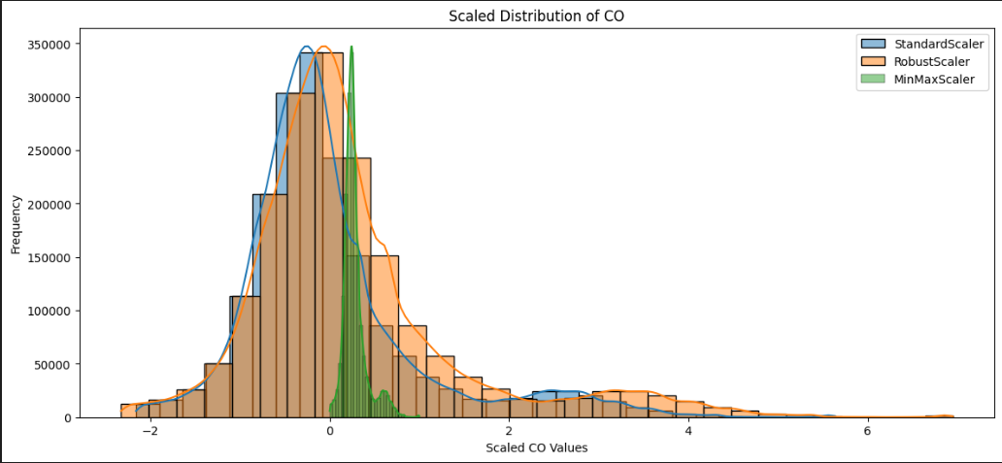

Slide 43
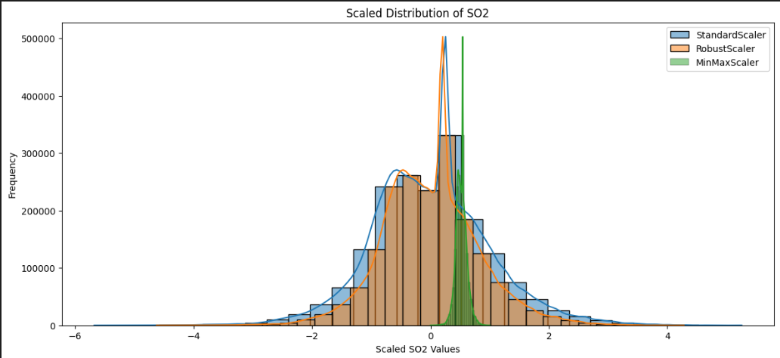
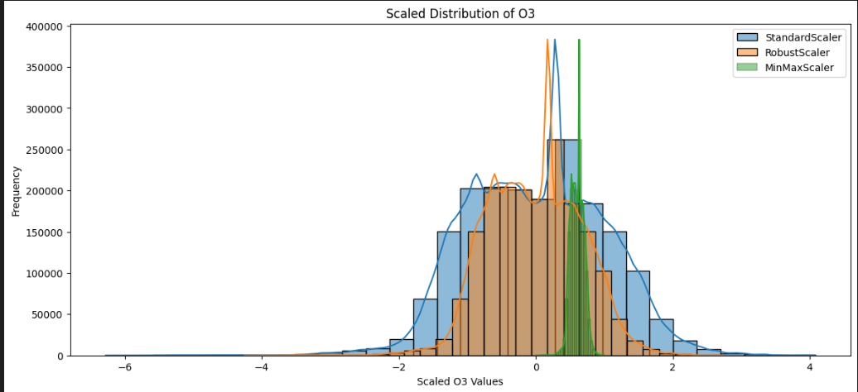

Slide 44
OUTLIER DETECTION

Slide 45
IQR METHOD
The IQR method identifies outliers based on the quar-
tiles of the data.
• First, the first quartile (Q1) and third quartile
(Q3) are computed.
• The IQR is calculated as IQR = Q3 − Q1.
• Lower and upper bounds are established using
the formulas:
Lower Bound = Q1 − 1.5 × IQR
Upper Bound = Q3 + 1.5 × IQR
• Outliers are defined as any data points outside
these bounds.

Slide 46
Z-SCORE
The Z-Score method measures how many standard de-
viations a data point is from the mean.
• Z-Scores are calculated for each value in the
dataset.
• A threshold (commonly set at 3) is used to iden-
tify outliers, defined as:
|z| > 3
where z is the Z-Score.

Slide 47
FOREST ISOLATION
The Isolation Forest is an ensemble learning method
used for anomaly detection.
• It works by isolating observations in the dataset.
The idea is that anomalies are easier to isolate
than normal points.
• A contamination parameter is specified to define
the expected proportion of outliers in the dataset.
• The model predicts outliers, with a prediction
value of -1 indicating an outlier.

Slide 48
OBSERVATIONS
.1 Analysis for PM2.5
• IQR Outliers Detected: 5168
• Z-Score Outliers Detected: 2946
• Isolation Forest Outliers Detected: 182659
2 Outlier Comparison for PM2.5
Technique Count
IQR 5168
Z-Score 2946
Isolation Forest 182659

Slide 49
GRAPHS FOR IQR VS Z SCORE

Slide 50
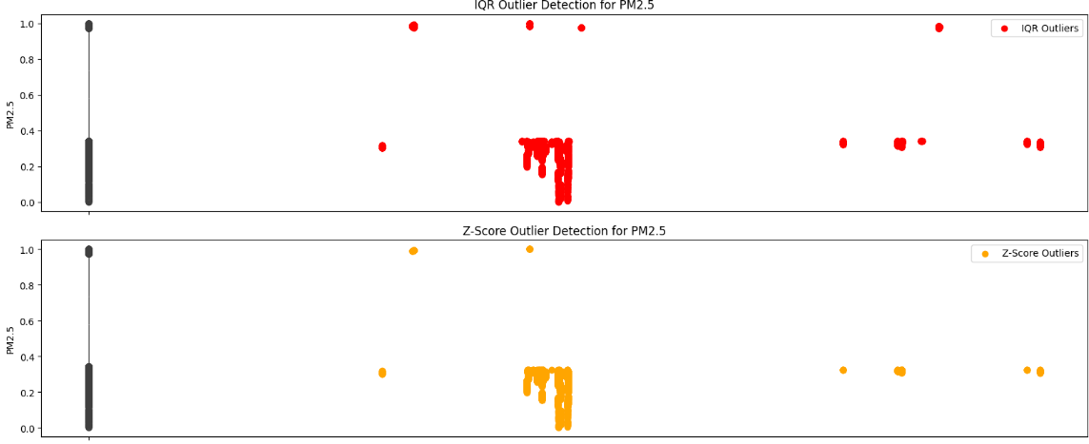
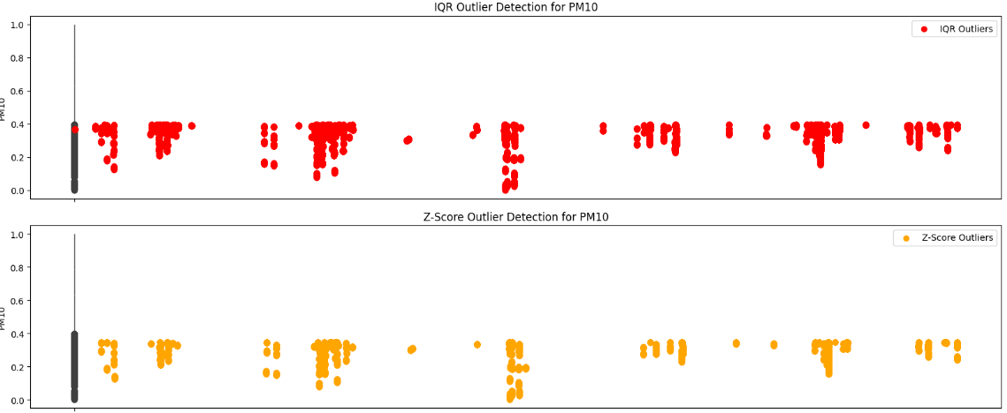

Slide 51
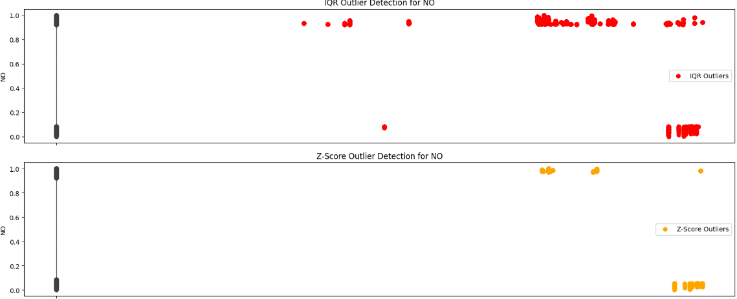
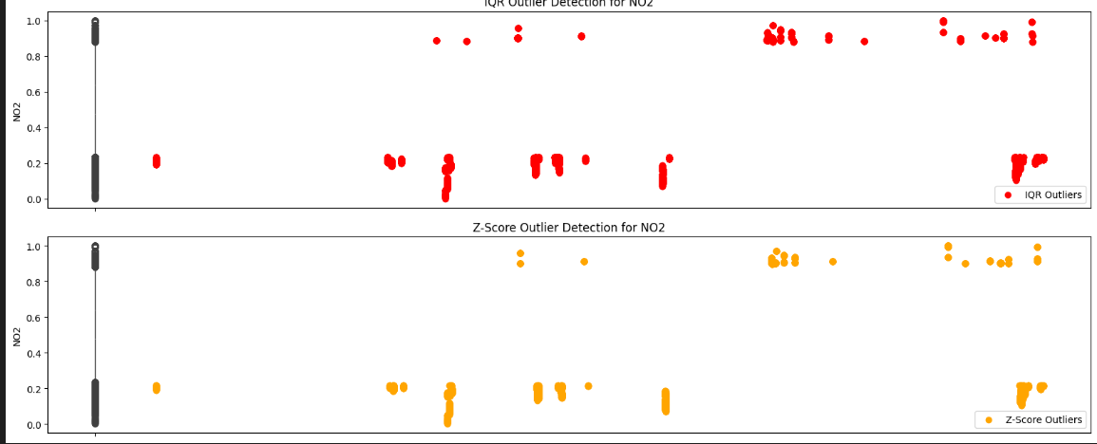

Slide 52
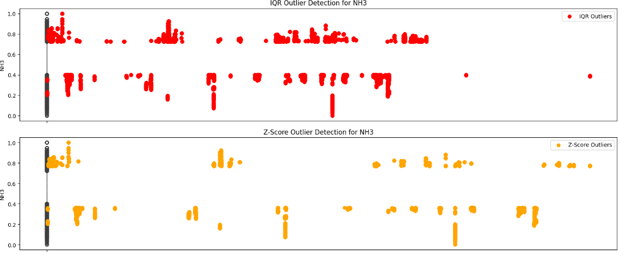
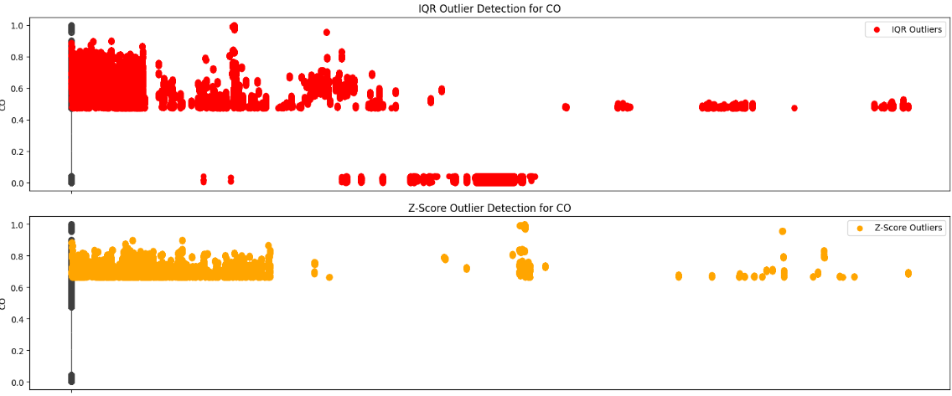

Slide 53
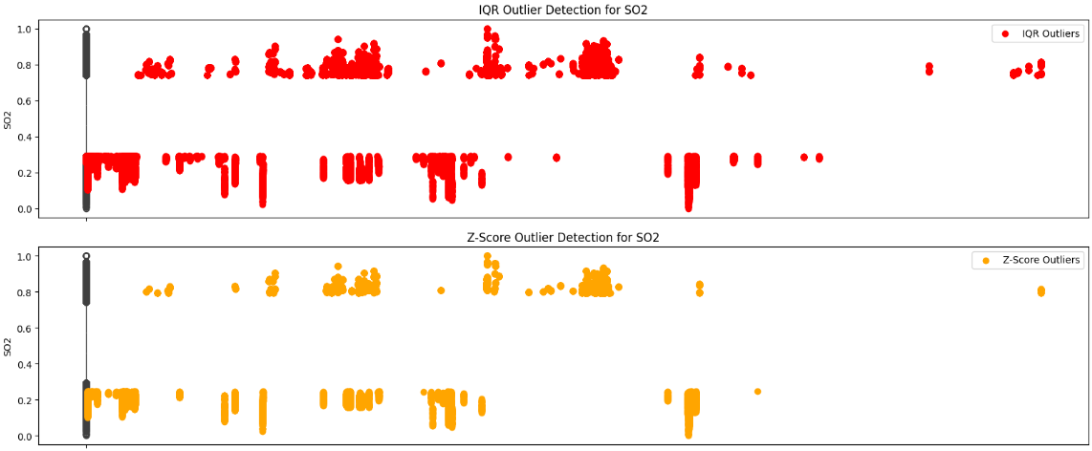
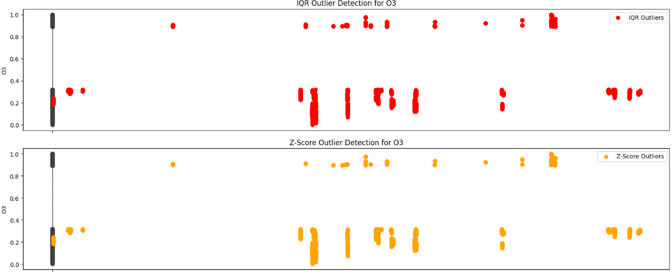

Slide 54
GRAPHS FOR ISOLATION

Slide 55
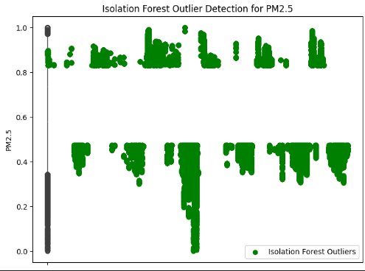
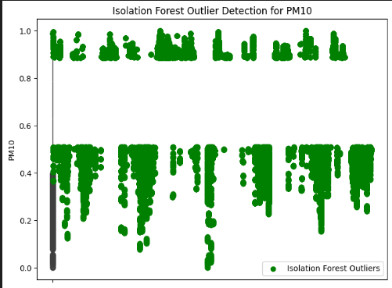
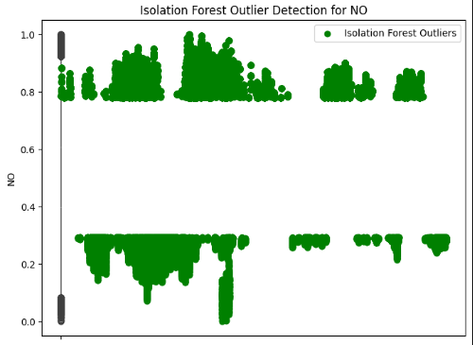
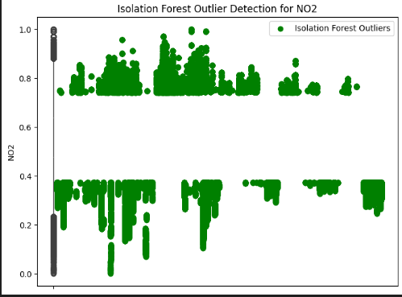

Slide 56
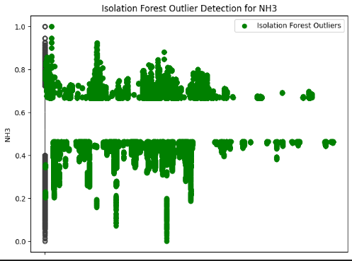
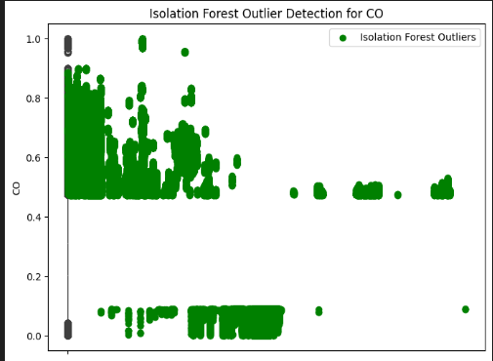
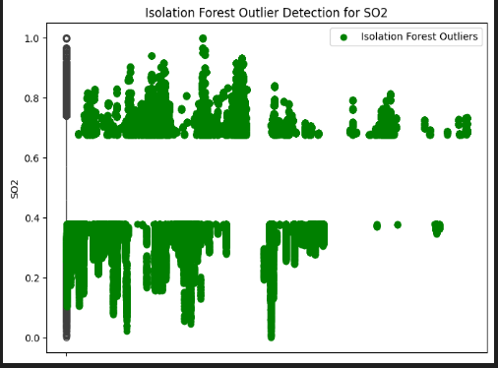
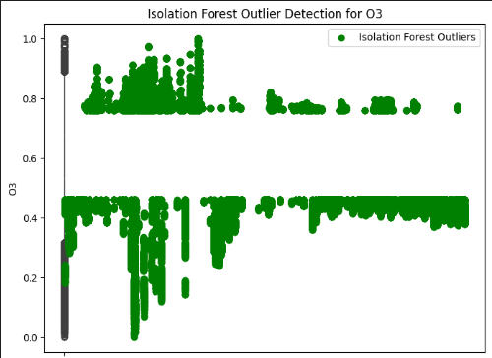

Slide 57
FEATURE SELECTION

Slide 58
FEATURE SELECTION
Feature selection is a critical step in the machine learning
pipeline that helps improve model performance by identi-
fying the most relevant features in the dataset. This analy-
sis employs various methods to assess and select features
that are significant predictors of the target variable, Air
Quality Index (AQI).

Slide 59
RECURSIVE FEATURE ELIMINATION
Recursive Feature Elimination is a method that selects
features by recursively considering smaller sets of fea-
tures. The process involves the following steps:
• A model (in this case, Linear Regression) is
trained on the entire set of features.
• The least important features are removed iter-
atively until the desired number of features is
reached.
• The selected features are returned for further
analysis.
Results: The selected features using RFE are:
• Selected Features: [’PM2.5’, ’NO’,
’NO2’, ’CO’, ’O3’]

Slide 60
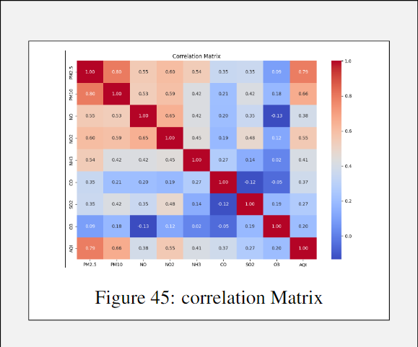
CORRELATIONAL ANALYSIS
Correlation analysis helps in understanding the linear
relationships between the features and the target vari-
able. The key steps include:
• A correlation matrix is generated to visualize the
strength of relationships.
• Features that exhibit a high absolute correlation
(greater than a predefined threshold, e.g., 0.5)
with the target variable are identified.
Results: The features highly correlated with the target
(AQI) are:
• Highly Correlated Features: [’PM2.5’,
’PM10’, ’NO2’, ’AQI’]

Slide 61
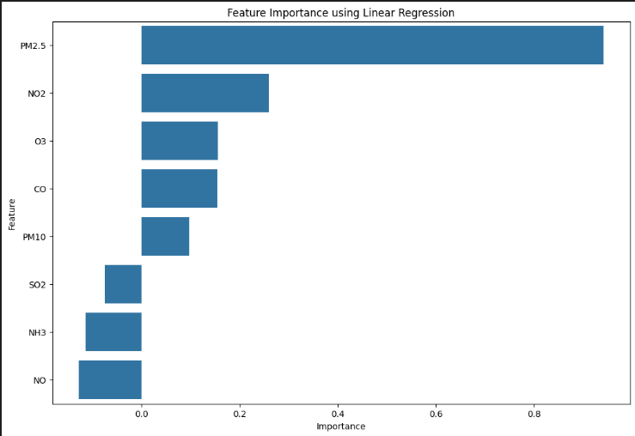
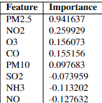
LINEAR REGRESSION
Feature importance can also be derived from the coef-
ficients of a fitted linear regression model:
• The linear regression model is trained using the
features and the target variable.
• The coefficients of the model indicate the impor-
tance of each feature, with larger absolute values
suggesting a greater influence on the target vari-
able.
• A bar plot is generated to visualize the feature
importances

Slide 62
Methodology
To predict the Air Quality Index (AQI), we employed several regression models, each with distinct advantages for handling complex environmental data:
1. AdaBoostRegressor: Chosen for its capability to boost weak learners by focusing on difficult-to-predict AQI values. This makes it useful when AQI fluctuations are driven by subtle, nonlinear factors.
2. Bayesian Ridge Regression: Selected for its strength in managing high-dimensional AQI datasets that involve many potential predictors (e.g., pollutant levels, weather conditions). Its probabilistic approach helps avoid overfitting when dealing with uncertain or noisy AQI data.

Slide 63
TO BE CONTINUED ..
3) CatBoost: Used for its efficiency in handling categorical features, such as pollutant source types or day classifications, without the need for extensive preprocessing. Its fast training and ability to model complex relationships between features ensure accurate AQI predictions
4)Elastic Net Regression: This model was employed due to its combination of L1 and L2 regularization, making it adept at handling AQI datasets with correlated features (such as pollutant concentrations that often co-occur). This regularization helps in making more robust predictions.
5) Lasso Regression: Used for its feature selection capabilities, allowing us to eliminate irrelevant features in AQI prediction, such as potentially redundant or low-impact variables, thus focusing on the most critical environmental factors influencing air quality.

Slide 64
6. MLP Regressor (Multi-Layer Perceptron): Applied for its ability to capture non-linear relationships in AQI data, such as the nonlinear effect of weather conditions (temperature, humidity) on air quality. However, its performance can vary depending on hyperparameter tuning. 7. Ridge Regression: Chosen for its ability to handle multicollinearity among AQI-related variables (e.g., multiple pollutants). By penalizing large coefficients, it helps create more stable models, which is crucial when predicting air quality influenced by interdependent factors.
8. XGBoost: This model was selected for its exceptional speed and ability to handle large, complex datasets, such as those used in AQI prediction. Its capacity for fine-tuning allows it to model intricate interactions between various AQI contributors, making it ideal for high-performance AQI forecasting.

Slide 65
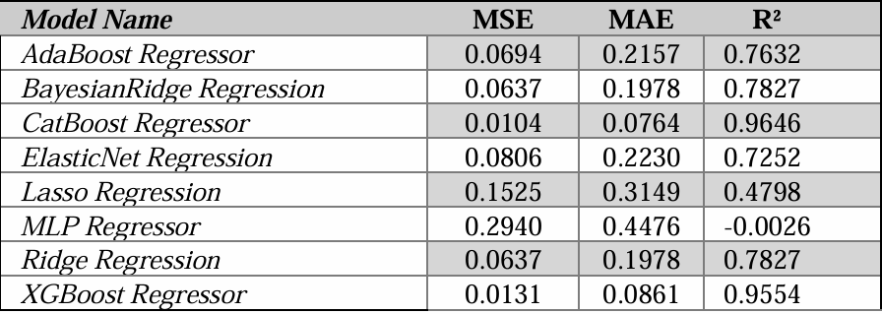

Results and Analysis
The performance metrics for each regression model on the test set are summarized in Table 1. These metrics—Mean Squared Error (MSE), Mean Absolute Error (MAE), and the coefficient of determination (R²)—provide insights into the models' effectiveness in predicting the Air Quality Index (AQI).

Slide 66
Comparative Analysis
The analysis of regression models for predicting Air Quality Index (AQI) highlights the CatBoost Regressor as the top performer, achieving the lowest Mean Squared Error (MSE) of 0.0104 and a high R² value of 0.9646. Its effectiveness is attributed to its advanced boosting mechanism and robust handling of categorical variables, allowing it to efficiently capture intricate patterns in the AQI data.
The XGBoost Regressor follows closely with an MSE of 0.0131 and an R² of 0.9554, demonstrating strong capabilities in uncovering complex relationships within the data. Both Bayesian Ridge and Ridge Regression provide competitive performance, with similar MSE values around 0.0637, showcasing their effectiveness in balancing bias and variance, although they do not match the accuracy of the boosting methods.

Slide 67
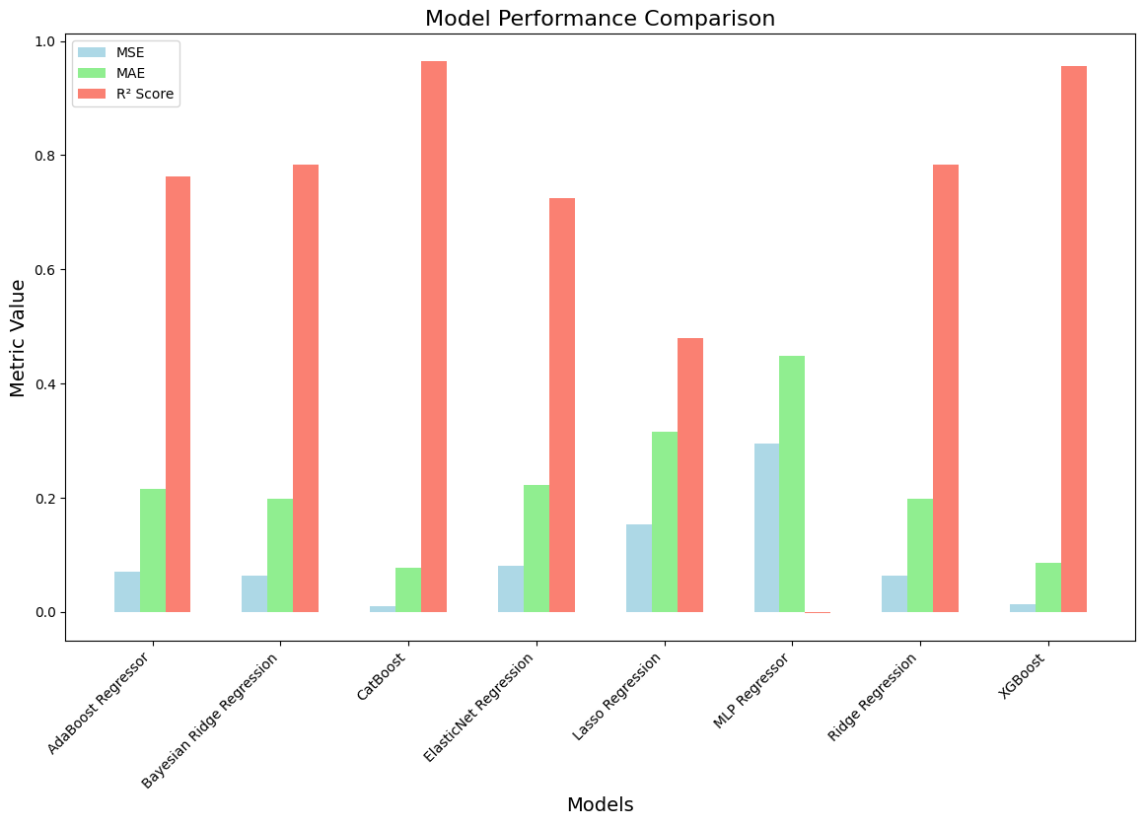

Slide 68
Conclusion and Timelines, Work to do …
Learnings : We collectively learned about the severe impact of air pollution and the potential for machine learning to provide solutions. We explored various preprocessing techniques, regression methods, and their practical applications in environmental science.
Work Left : Currently, we are on track with our timeline and are now focusing on tuning ensemble models to enhance our analysis and improve predictive accuracy
Timeline : Currently, we are on track with our timeline and are now focusing on tuning ensemble models to enhance our analysis and improve MSE.

Slide 69
Contributions
1. Shrey Yadav: Responsible for dataset acquisition and combination, ensuring that we had a robust dataset to work with. 2. Lakshay Trehan: Conducted exploratory data analysis (EDA), which allowed us to understand the data better and identify patterns. 3. Karanjeet Singh & Lakshay Trehan: Focused on preprocessing, ensuring the data was clean and well-prepared for modelling. 4. Yash Singh & Sahil: Handled model methodology and model training, along with result analysis, providing insights into model performance and areas for improvement.

Slide 70
REFERENCES
[1] Mahanta, S., Ramakrishnudu, T., Jha, R. R., & Tailor, N. (2019). Urban Air Quality Prediction Using Regression Analysis. TENCON 2019 - 2019 IEEE Region 10 Conference, Kochi, India, 1118-1123. doi: [10.1109/TENCON.2019.8929517](https://doi.org/10.1109/TENCON.2019.8929517).
[2] Shukla, K., Dadheech, N., Kumar, P., & Khare, M. (2021). Regression-based flexible models for photochemical air pollutants in the national capital territory of megacity Delhi. Chemosphere, 272, 129611. ISSN 0045-6535. doi: [10.1016/j.chemosphere.2021.129611](https://doi.org/10.1016/j.chemosphere.2021.129611).
[3] Kumar, A., & Goyal, P. (2011). Forecasting of air quality in Delhi using principal component regression technique. Atmospheric Pollution Research, 2(4), 436-444. ISSN 1309-1042. doi: [10.5094/APR.2011.050](https://doi.org/10.5094/APR.2011.050).
[4]Gupta, N. S., Mohta, Y., Heda, K., Armaan, R., Valarmathi, B., & Arulkumaran, G. (2023). Prediction of Air Quality Index Using Machine Learning Techniques: A Comparative Analysis. Journal of Environmental and Public Health, 2023, Article ID 4916267. ISSN 1687-9805. doi: [10.1155/2023/4916267](https://doi.org/10.1155/2023/4916267).
[5] S. S. Ganesh, S. H. Modali, S. R. Palreddy and P. Arulmozhivarman, "Forecasting air quality index using regression models: A case study on Delhi and Houston," 2017 International Conference on Trends in Electronics and Informatics (ICEI), Tirunelveli, India, 2017, pp. 248-254, doi:10.1109/ICOEI.2017.8300926. https://ieeexplore.ieee.org/document/8300926

