Slide 1
People Sight
What the April and October 2026 data say about sentiment and hiring at Porter
For the CHRO
For the TA Head
The eNPS fall is not company-wide. It sits in the Intercity teams reorganised in June and in new joiners; if those groups scored like their same-manager colleagues, October eNPS would be +13.1 instead of +3.3.
Hiring loses candidates to slow R1 feedback (13 of 37 candidates of the two slowest interviewers withdrew) and to low offers (42.7% of offers below 0.90× expectation declined); senior roles lose time before anyone applies.
For the CHRO and TA Head · data as of 31-Oct-2026 (synthetic case data) · every number shows its base n in the slides that follow
Notes:
Two one-line answers. CHRO: the counterfactual replaces each changed-manager and new-joiner respondent's score with the October same-manager average in their own thread and recomputes eNPS (an upper bound). TA Head: withdrawals are candidate status 'Withdrawn' among R1-interviewed candidates; the decline rate is declined / (accepted + declined) for offers below 0.90 of the candidate's expected CTC.

Slide 2
Two fixable groups explain the eNPS fall, and three process gaps cost hiring speed and candidates
Company eNPS +11.0 → +3.3 (n = 866 / 799); the same 526 people: +20.2 → +13.1. Not significant company-wide (p = 0.06) — the fall sits in specific groups.
Sentiment
Hiring
Top three asks
Manager change: eNPS -59.1 (n = 44) vs +13.0 with the same manager (n = 629); all 62 Intercity changes came in one June reorganisation.
Onboarding: 9.4% of under-6-month staff rate it favourably (n = 139) vs 47.3% of everyone else (n = 660).
Detractors leave: 27.8% of April detractors left voluntarily (n = 245) vs 5.0% of promoters (n = 340).
Slow R1 feedback: 13 of 37 candidates of the two slowest interviewers withdrew vs 0 of 1124 for everyone else.
Low offers: 42.7% of offers below 0.90× expectation declined (n = 75) vs 8.6% (n = 221); 59 of 75 had budget headroom.
Senior roles: 54.2% of G6+ fills breached SLA (n = 24); the eventual hire applies 40 days after the req is raised vs 5 overall.
CHRO: manager-transition playbook for the reorganised Intercity teams (up to +3.7 pts company eNPS).
CHRO: 90-day onboarding standard for every new joiner.
TA Head: 48-hour R1 feedback rule and a 0.90× offer floor where budget allows (about 19 fewer declines).
People Sight · Porter People Analytics · data as of 31-Oct-2026 (synthetic case data)
2 / 12
Notes:
Executive summary. eNPS = % promoters (9-10) minus % detractors (0-6) on Q1. The panel is the people who answered both waves (salted respondent key). Significance: z-test on the per-person +1/0/-1 score and Wilcoxon on the panel's Q1 change. Each line points to the slide with the evidence; asks are on slide 11.

Slide 3
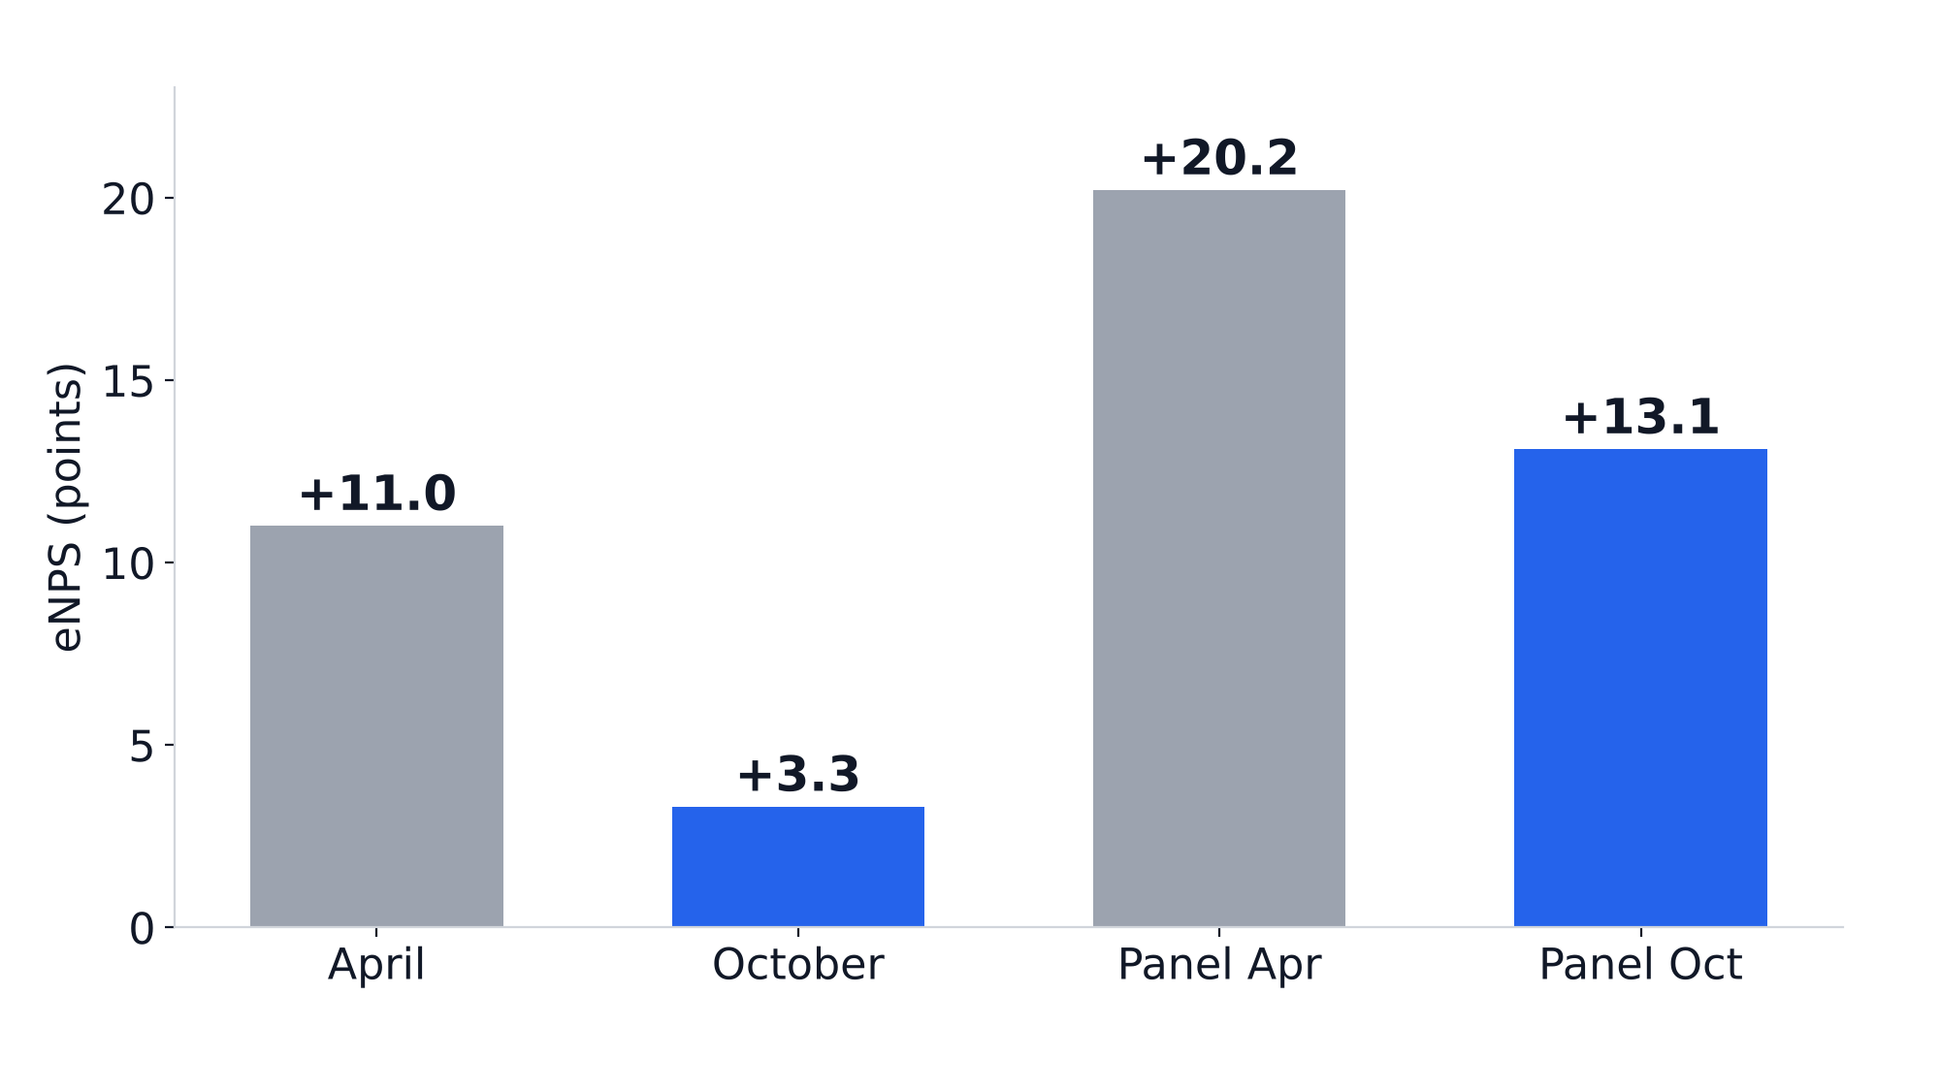
eNPS fell 7.7 points, also for the same people — but company-wide the fall is not statistically significant; it sits in specific groups
+11.0 → +3.3
Company eNPS, n = 866 / 799
+20.2 → +13.1
Same 526 people (panel)
p = 0.06
Company-wide change: not significant at 5%
So what
Do not run a company-wide programme. The next slides show the fall sits in two groups that can be fixed directly.
n — April n = 866 · October n = 799 · Panel Apr n = 526 · Panel Oct n = 526
People Sight · Porter People Analytics · data as of 31-Oct-2026 (synthetic case data)
3 / 12
Notes:
eNPS per wave from all valid responses (Q1 blank or outside 0-10 excluded). Panel = respondents in both waves, matched on a salted key; no IDs or names are stored with survey answers. The z-test treats the two waves as independent, which overlapping respondents make conservative; the Wilcoxon test on the panel is the cleaner check. Neither reaches p < 0.05.

Slide 4
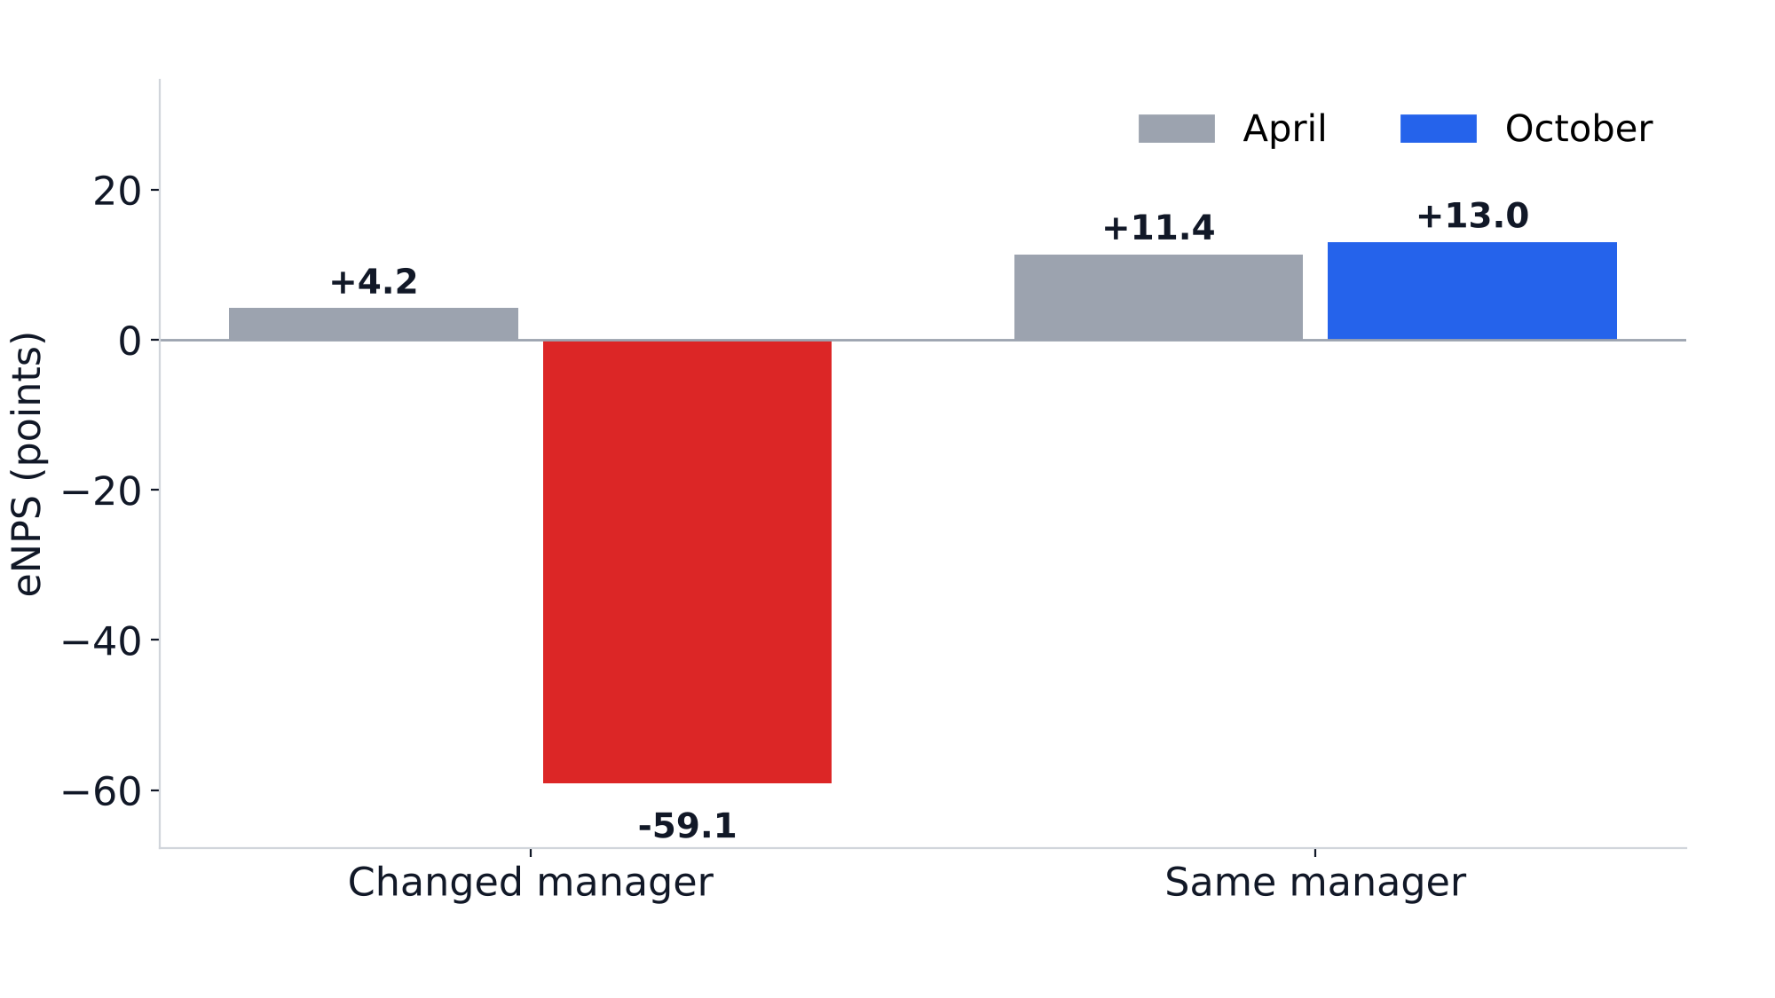
People who changed manager are far less positive — within the same thread and grade
-59.1
Changed manager, October (n = 44); +4.2 in April (n = 48)
62 in June
Intercity manager changes, 61 onto two managers
+9.6
Intercity, same manager (n = 104) vs +13.7 elsewhere — no real gap
So what
Closing the changed-manager gap alone would lift October eNPS to +7.0 company-wide and -3.1 in Intercity.
n — April: Changed manager 48, Same manager 818 | October: Changed manager 44, Same manager 629
People Sight · Porter People Analytics · data as of 31-Oct-2026 (synthetic case data)
4 / 12
Notes:
Changed manager = Manager Effective From between 18-Apr and 04-Oct-2026 and after the joining date. Within the same thread and grade the gap holds (permutation test, manager status shuffled within thread x grade 5,000 times, p < 0.001). The April baseline shows no gap before the change. Manager changes are counted from HRMS (no survey join); the two receiving managers are not named.

Slide 5
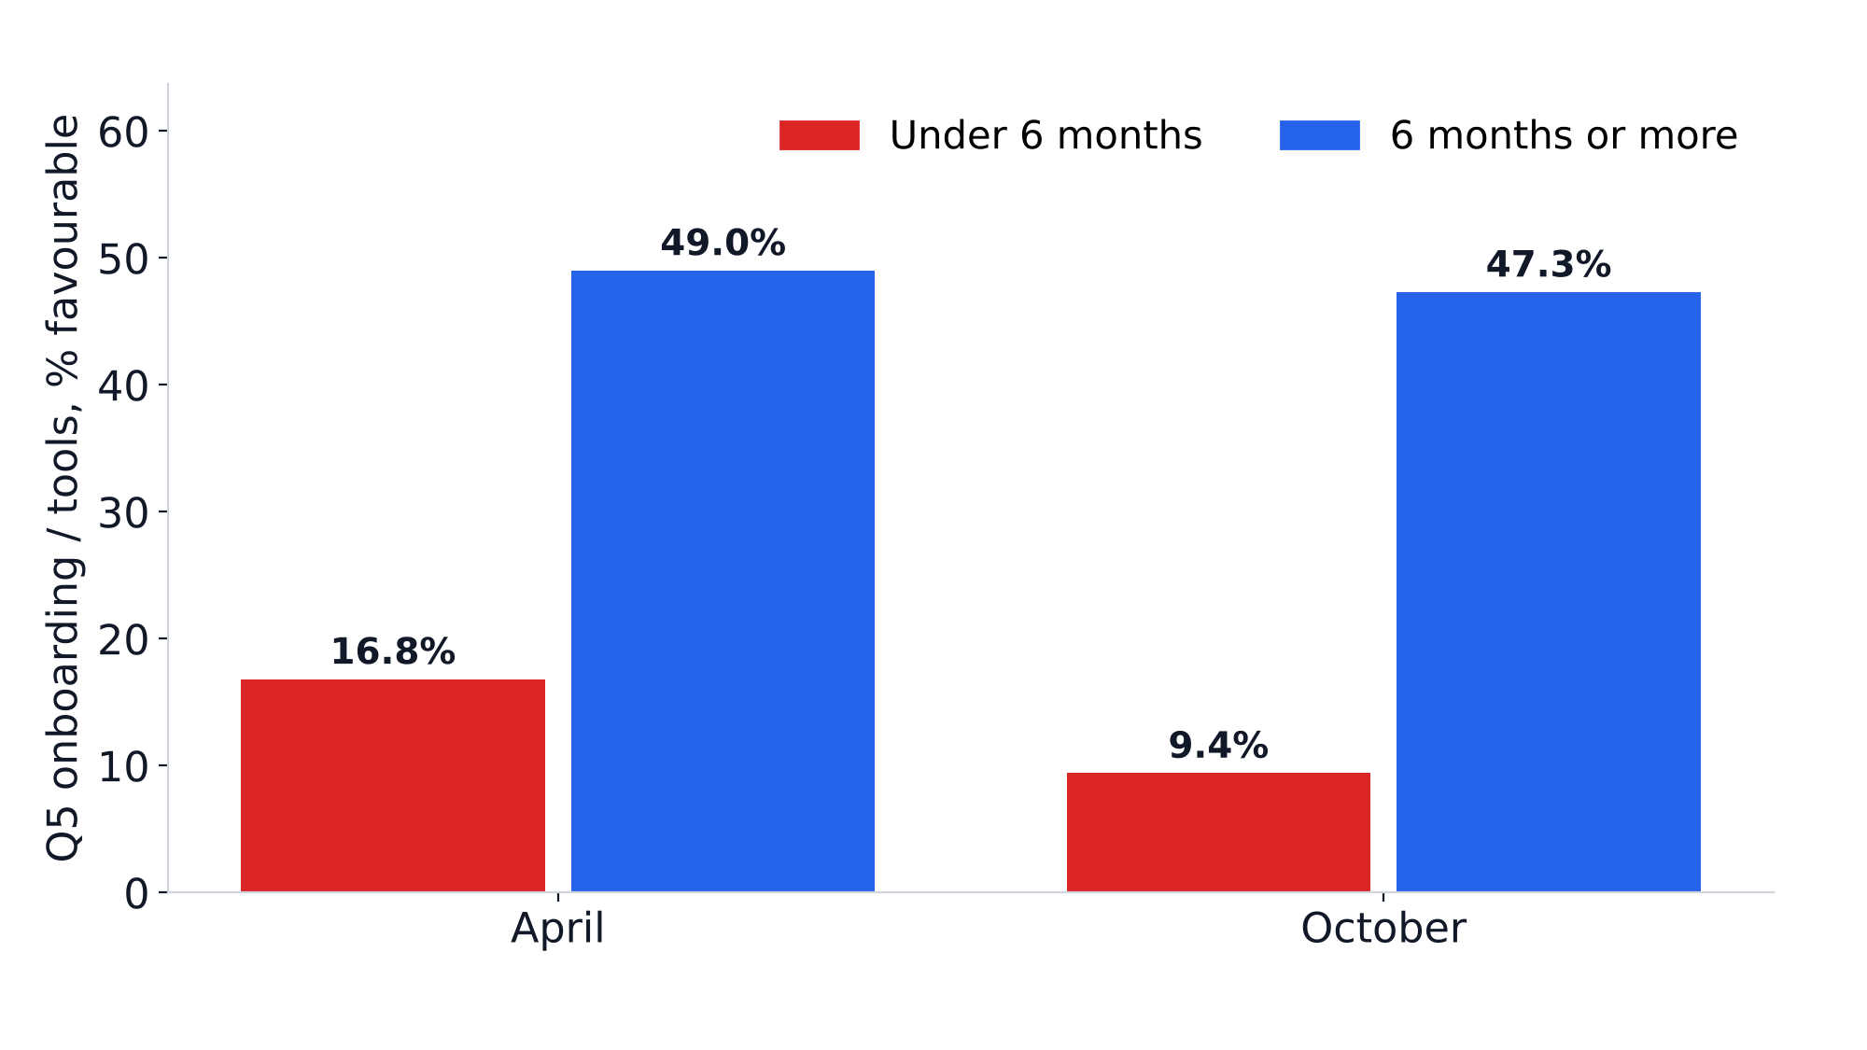
Under-6-month employees rate onboarding lowest — in both waves
-27.3
eNPS, tenure under 6 months (n = 139)
-23.8
eNPS, new joiners on their first manager (n = 126)
-19.4
Intercity, weakest thread (n = 186); below-band pay -7.7 (n = 207)
So what
The gap was already there in April, so it is the onboarding process, not one cohort. Closing the new-joiner gap adds up to +6.1 pts company eNPS.
n — Under 6 months: April 137, October 139 | 6 months or more: April 729, October 660
People Sight · Porter People Analytics · data as of 31-Oct-2026 (synthetic case data)
5 / 12
Notes:
Q5 = onboarding / tools, favourable = 4 or 5 on the 1-5 scale. Tenure band is computed at each wave's open date, so the under-6-month groups are different people in April and October. New joiners overlap heavily with the under-6-month group; they are one signal, counted once.

Slide 6
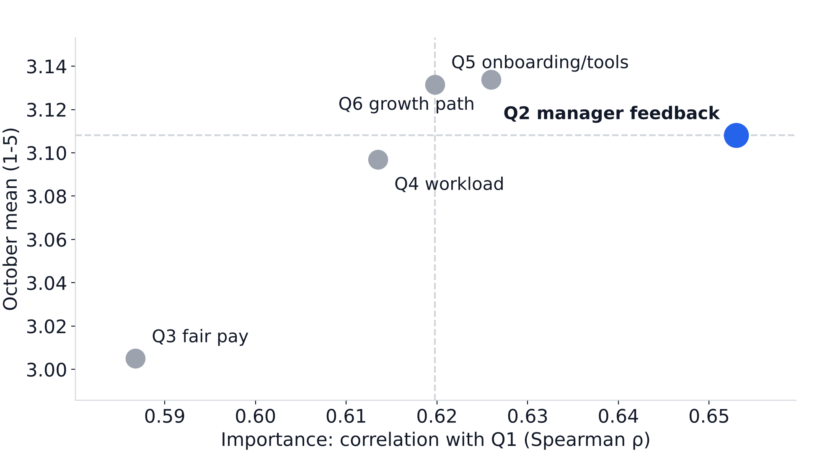
Fix manager feedback first: it matters most among the low-scoring drivers
ρ = 0.65
Q2 manager feedback: link with recommending Porter (n = 796)
9.6% → 16.7%
Comments about Manager (n = 271 / 233)
17.0% vs 42.3%
Fair pay favourable: below band (n = 207) vs at or above (n = 585)
So what
Train managers on regular feedback and 1:1s first; comments about onboarding also rose from 10.7% to 17.6%. Prioritise below-band staff in the next pay review.
n = 796 October respondents; dashed lines = medians; bottom-right = important but low-scoring
People Sight · Porter People Analytics · data as of 31-Oct-2026 (synthetic case data)
6 / 12
Notes:
Importance = Spearman correlation of each driver (Q2-Q6) with Q1 in October; the chart plots it against the October mean, with medians as dashed lines. Correlation is a ranking aid, not proof of cause. Comment shares are each theme's share of themed comments per wave. Compa band uses the 2026-04-01 pay bands.

Slide 7
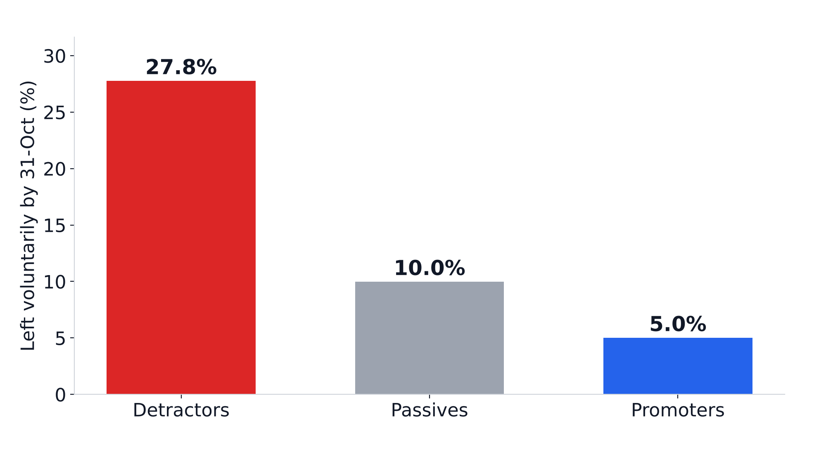
April detractors left voluntarily at 6 times the rate of promoters
27.8% vs 5.0%
Left voluntarily: detractors (n = 245) vs promoters (n = 340)
21.2% vs 4.1%
Regrettable exits, same groups
16 days
Median exit → replacement req (n = 99); 67% replace regrettable exits
So what
Use eNPS as an early warning: stay interviews in teams with many detractors after each wave, and start backfills at resignation rather than at exit.
n — Detractors n = 245 · Passives n = 281 · Promoters n = 340 · Backfill (F16): replacement reqs raised a median 16 days after the exit (n = 99); 67% replace regrettable exits
People Sight · Porter People Analytics · data as of 31-Oct-2026 (synthetic case data)
7 / 12
Notes:
Exit outcome by 31-Oct-2026 is attached to each April survey row before IDs are dropped, so the analysis stays anonymous. Voluntary and regrettable flags come from HRMS. Backfill lag = replacement req raised date minus the replaced employee's exit date, for replacement reqs whose employee has an exit date.

Slide 8
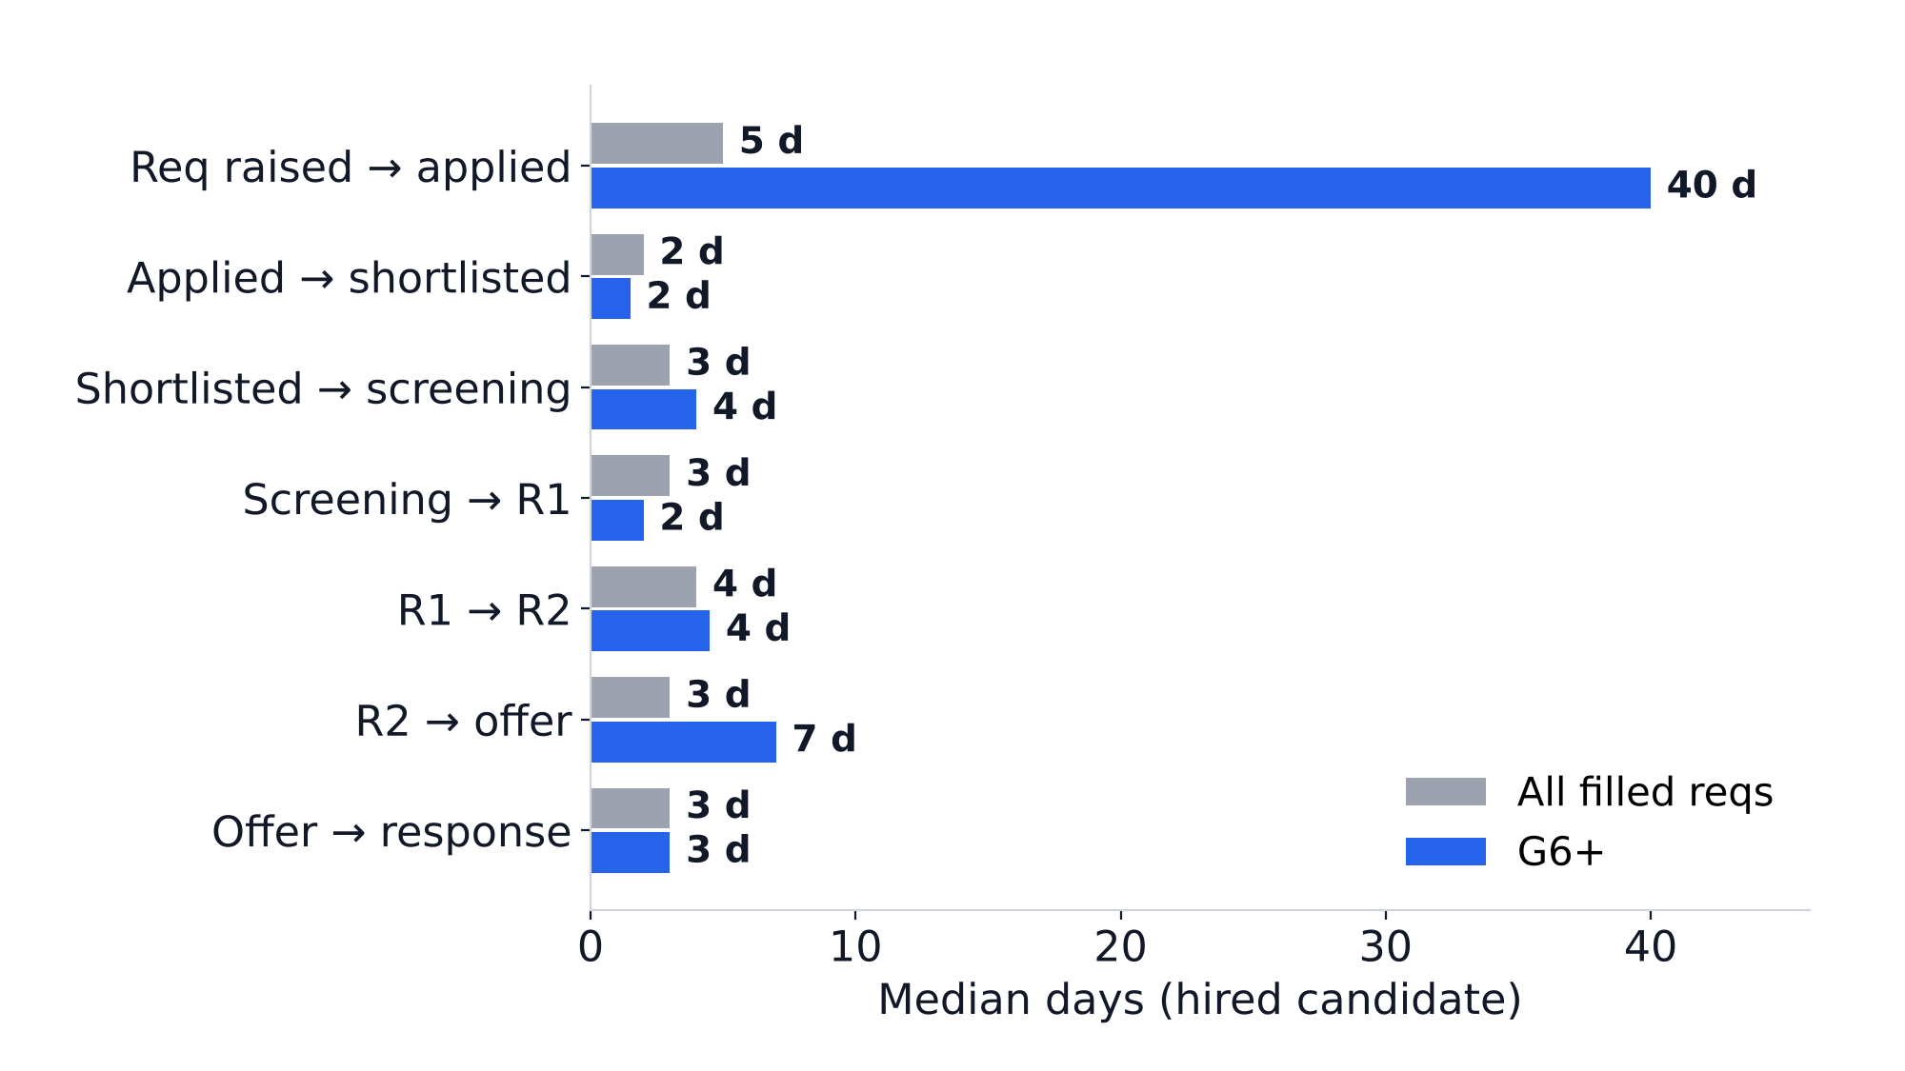
Where the days go: for G6+ roles the eventual hire applies 40 days after the req is raised (vs 5 overall); interviews take only days
54.2% vs 20.8%
Fills breaching SLA: G6+ (n = 24) vs G2-G5 (n = 207)
68 vs 24 days
Median time to fill, G6+ vs G2-G5 (n = 24 / 207)
14 reqs
Marked 'Within SLA' in the ATS but breached by dates
So what
Interviews take days, not weeks. For G6+ start the search before the req is approved and pre-agree offer ranges; fix the ATS SLA rule so reports match the dates.
n (hires with both stage dates) — All filled reqs: 229-231 | G6+: 24-24
People Sight · Porter People Analytics · data as of 31-Oct-2026 (synthetic case data)
8 / 12
Notes:
Time to fill = hired candidate's offer response date minus req raised date. SLA: 30 days up to G2, 45 for G3-G5, 60 for G6+. Stage times use the hired candidate's dated stages; 'req raised to applied' is when the eventual hire applied. Medians of stages do not add up to the median time to fill.

Slide 9
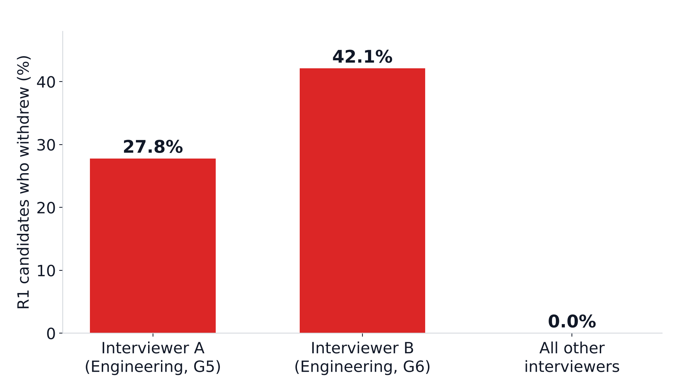
Two slow R1 interviewers lose candidates: every post-R1 withdrawal sits with them
12 and 10 days
Median R1 feedback, Interviewer A and B (n = 13 and 11); company 1 day
7 waiting
Candidates on 5 open reqs still waiting for their feedback
35% of reqs
Held by one recruiter (106 of 300); time to fill 23 vs 26 days — no slowdown
So what
Set a 48-hour R1 feedback rule and reassign the waiting candidates now. Faster feedback would have saved 39 days on 4 filled reqs; keeping candidates matters more.
n — Interviewer A (Engineering, G5) n = 18 · Interviewer B (Engineering, G6) n = 19 · All other interviewers n = 1124 · median R1 feedback: Interviewer A 12 d, Interviewer B 10 d; company 1 d
People Sight · Porter People Analytics · data as of 31-Oct-2026 (synthetic case data)
9 / 12
Notes:
R1 feedback turnaround = feedback submitted date minus R1 interview date, per interviewer with at least 5 interviews. Withdrawals = candidate status 'Withdrawn' among R1-interviewed candidates (Fisher exact test, p < 0.001). Interviewers are labelled by function and grade; names stay on the dashboard Hiring page. Recruiter load is a continuity risk, not a performance issue.

Slide 10
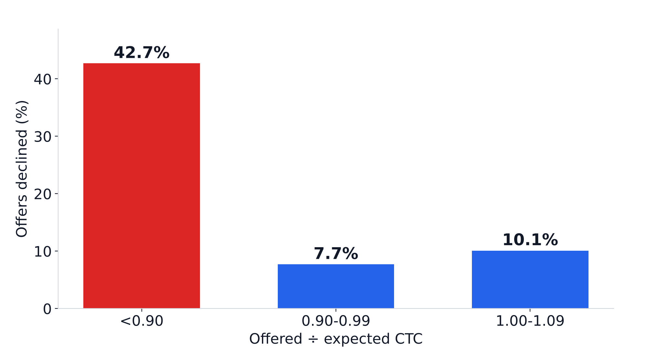
Offers below 0.90× the candidate's expectation are declined 5 times as often — and 59 of 75 had budget headroom
59 of 75
Low offers that fit the budget at 0.90×; ₹8.87 lakh extra annual CTC in total
64.0% vs 86.6%
Offer acceptance: agency (n = 50) vs all other sources (n = 246)
₹44,839
Agency fee per joiner; referrals convert 10.85% of applicants vs 1.68%
So what
Set an offer floor of 0.90× expected CTC when the budget allows — about 19 fewer declines — and grow referrals and internal moves before using agencies.
n — <0.90 n = 75 · 0.90-0.99 n = 142 · 1.00-1.09 n = 79
People Sight · Porter People Analytics · data as of 31-Oct-2026 (synthetic case data)
10 / 12
Notes:
Decline rate = declined / (accepted + declined) by offered / expected CTC band. Headroom = 0.90 x expected CTC is within the req's budgeted maximum. Declines avoided assume the 0.90-0.99 band's decline rate. Agency fee = 8.33% of offered CTC for agency joiners. Role mix by source is not controlled.

Slide 11
Five actions, in priority order, each tied to its evidence and measurable in the next wave
Action | Owner | Expected impact | Measure next wave | Evidence
Manager-transition playbook for the June Intercity reorganisation and any future team move | CHRO | Up to +3.7 pts company eNPS, +16.3 pts Intercity | eNPS and Q2 for changed-manager staff (panel) | Slide 4
90-day onboarding standard: tools on day 1, buddy, 30/60/90 check-ins | CHRO | Q5 for joiners up from 11.2% favourable; up to +6.1 pts company eNPS | Q5 and eNPS for tenure under 6 months | Slide 5
48-hour R1 feedback rule with reminders and escalation | TA Head | Post-R1 withdrawals near zero (now 13 of 37) | Share of R1 feedback within 2 days | Slide 9
Offer floor of 0.90× expected CTC when the req budget allows | TA Head | About 19 fewer declines for ₹8.87 lakh annual CTC | Decline rate for offers below 0.90× | Slide 10
Senior-hiring track for G6+ and a fixed ATS SLA rule | TA Head | G6+ within SLA up from 45.8%; accurate SLA reports | G6+ within-SLA %; ATS mismatches | Slide 8
People Sight · Porter People Analytics · data as of 31-Oct-2026 (synthetic case data)
11 / 12
Notes:
Priority = size of the effect, sample size and how directly the owner can act (the ranking in insights.md). Expected impacts are counterfactual upper bounds: eNPS impacts replace the affected groups' scores with same-manager colleagues in their thread; declines avoided use the 0.90-0.99 band's decline rate. Each measure can be read from the dashboard after the next wave.

Slide 12
Every cleaning step is logged (116 rules), and the known gaps are stated, not hidden
1,726 → 1,665
1,322 → 1,310
5,815 → 5,757
Limitations
Survey responses in → valid
Employee records in → unique
Candidates in → kept
HRMS keeps only current attributes and the current manager: no history of thread, grade, rating or earlier manager moves.
Survey answers are anonymous (salted key, groups of 5 or more), so individual follow-up is impossible by design.
Synthetic data covering one half-year; the ATS SLA rule and the orphan candidates' requisitions are outside the extract.
36
14
3
Orphan candidates (requisition not in the extract) excluded
ATS 'Within SLA' reqs that breached by dates
Exited employees without an exit date (left before October)
Definition used throughout
manager_status: Changed manager = Manager Effective From between 18-Apr and 04-Oct-2026 and after joining; New joiner (first manager) = in that window and equal to the joining date; Same manager = everyone else.
People Sight · Porter People Analytics · data as of 31-Oct-2026 (synthetic case data)
12 / 12
Notes:
Counts come from data/clean/dq_log.csv and reconciliation.csv (also on the dashboard's Data quality page and in dq_note.md). Raw workbooks are never modified; recomputed SLA status is used everywhere and the ATS disagreement is reported as a finding.

