Slide 1

Indian Weather Repository: Visualizing India's Climate
Welcome to our presentation on the Indian Weather Repository, a comprehensive platform for visualizing and analyzing India's climate data.

Slide 2
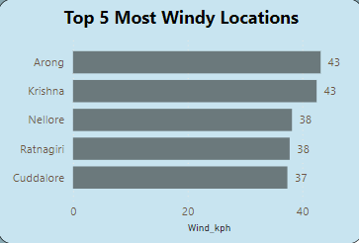
Top 5 Most Windy Locations
This bar chart highlights the top 5 locations in India with the highest average wind speeds, providing a clear visual representation of windy areas.
Data Insights
Analyzing wind patterns in these top 5 locations is crucial for various sectors. Industries like aviation, wind energy, and outdoor activities rely on accurate wind data for planning and safety.

Slide 3
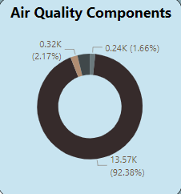
Air Quality Components
Donut Chart
This donut chart provides a comprehensive overview of air quality components across India, highlighting their relative concentrations of Ozon(1.66%), SO2(3.79),NO2(2.17) & CO(92.38%)
Data Analysis
Analyzing these components helps identify areas with potential air pollution concerns and informs public health initiatives.

Slide 4
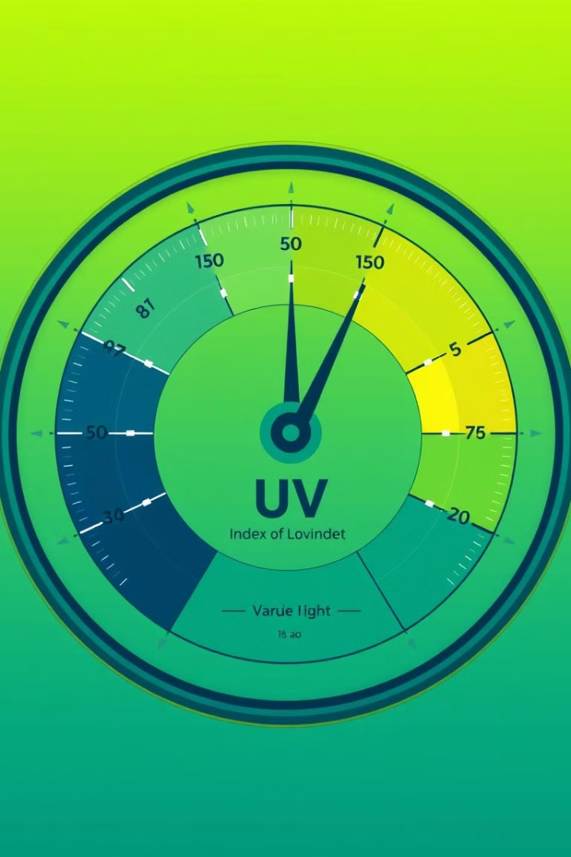
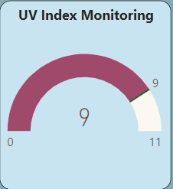

UV Index Monitoring
UV Index
This gauge chart provides real-time monitoring of the UV index levels across India, enabling people to take precautions against harmful UV radiation.

Slide 5
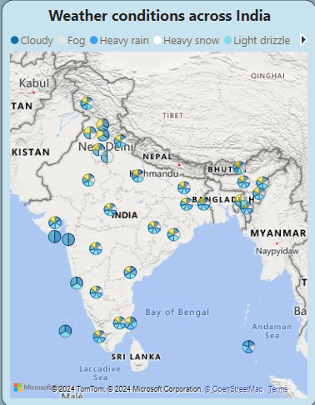
Weather Conditions Across India
1
Interactive Map
This map visualizes weather conditions across India, allowing users to explore the weather patterns.
2
Data Insights
Analyzing these conditions is valuable for agriculture, tourism, and disaster preparedness.

Slide 6
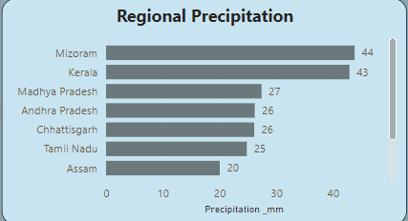


Regional Precipitation
Bar Chart
This bar chart highlights the Max precipitation levels across different regions in India, showcasing regional variations in rainfall.
Data Insights
Analyzing these patterns can help understand the impact of climate change and inform water management strategies.

Slide 7
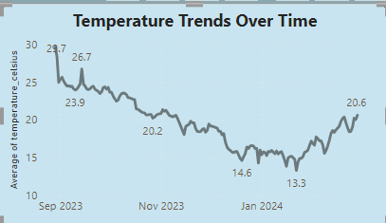
Temperature Trends Over Time
Line Chart
This line chart visualizes the temperature trends over time across month of year in India, showcasing seasonal patterns and long-term changes.
Data Analysis
Analyzing these trends can help identify climate change impacts and inform adaptation strategies.

Slide 8
Leveraging Data for Informed Decision-Making
1
Agriculture
Weather data helps farmers make informed decisions about planting, irrigation, and crop management.
2
Disaster Management
Accurate weather forecasts are crucial for disaster preparedness and mitigation efforts.
Tourism
Weather data enables tourism agencies to provide accurate weather forecasts for travelers.
3
4
Energy
Weather data helps energy companies optimize energy production and distribution.

Slide 9

Conclusion: Unlocking the Power of Weather Data
This Power BI project demonstrates the potential of leveraging weather data to gain valuable insights, inform decision-making, and ultimately contribute to a better understanding of weather patterns and their impact on various sectors.

Slide 10
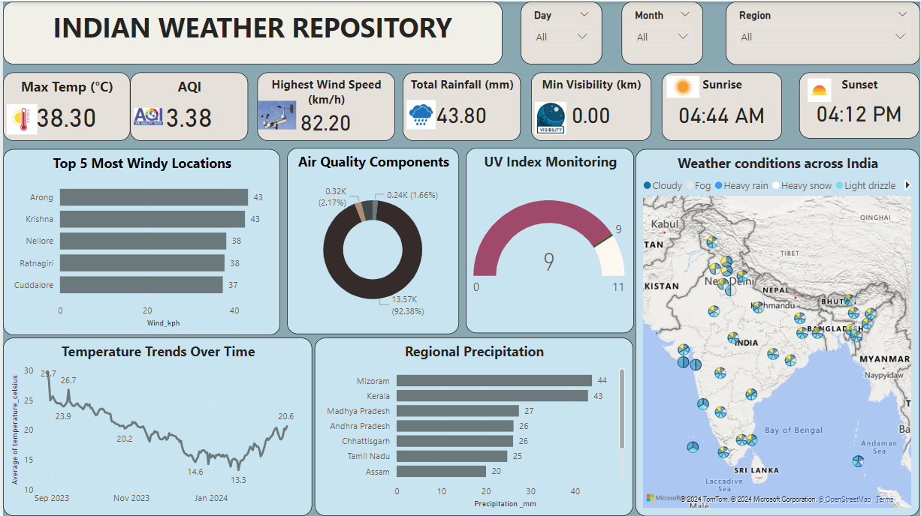

Slide 11
THANK YOU

