Slide 1
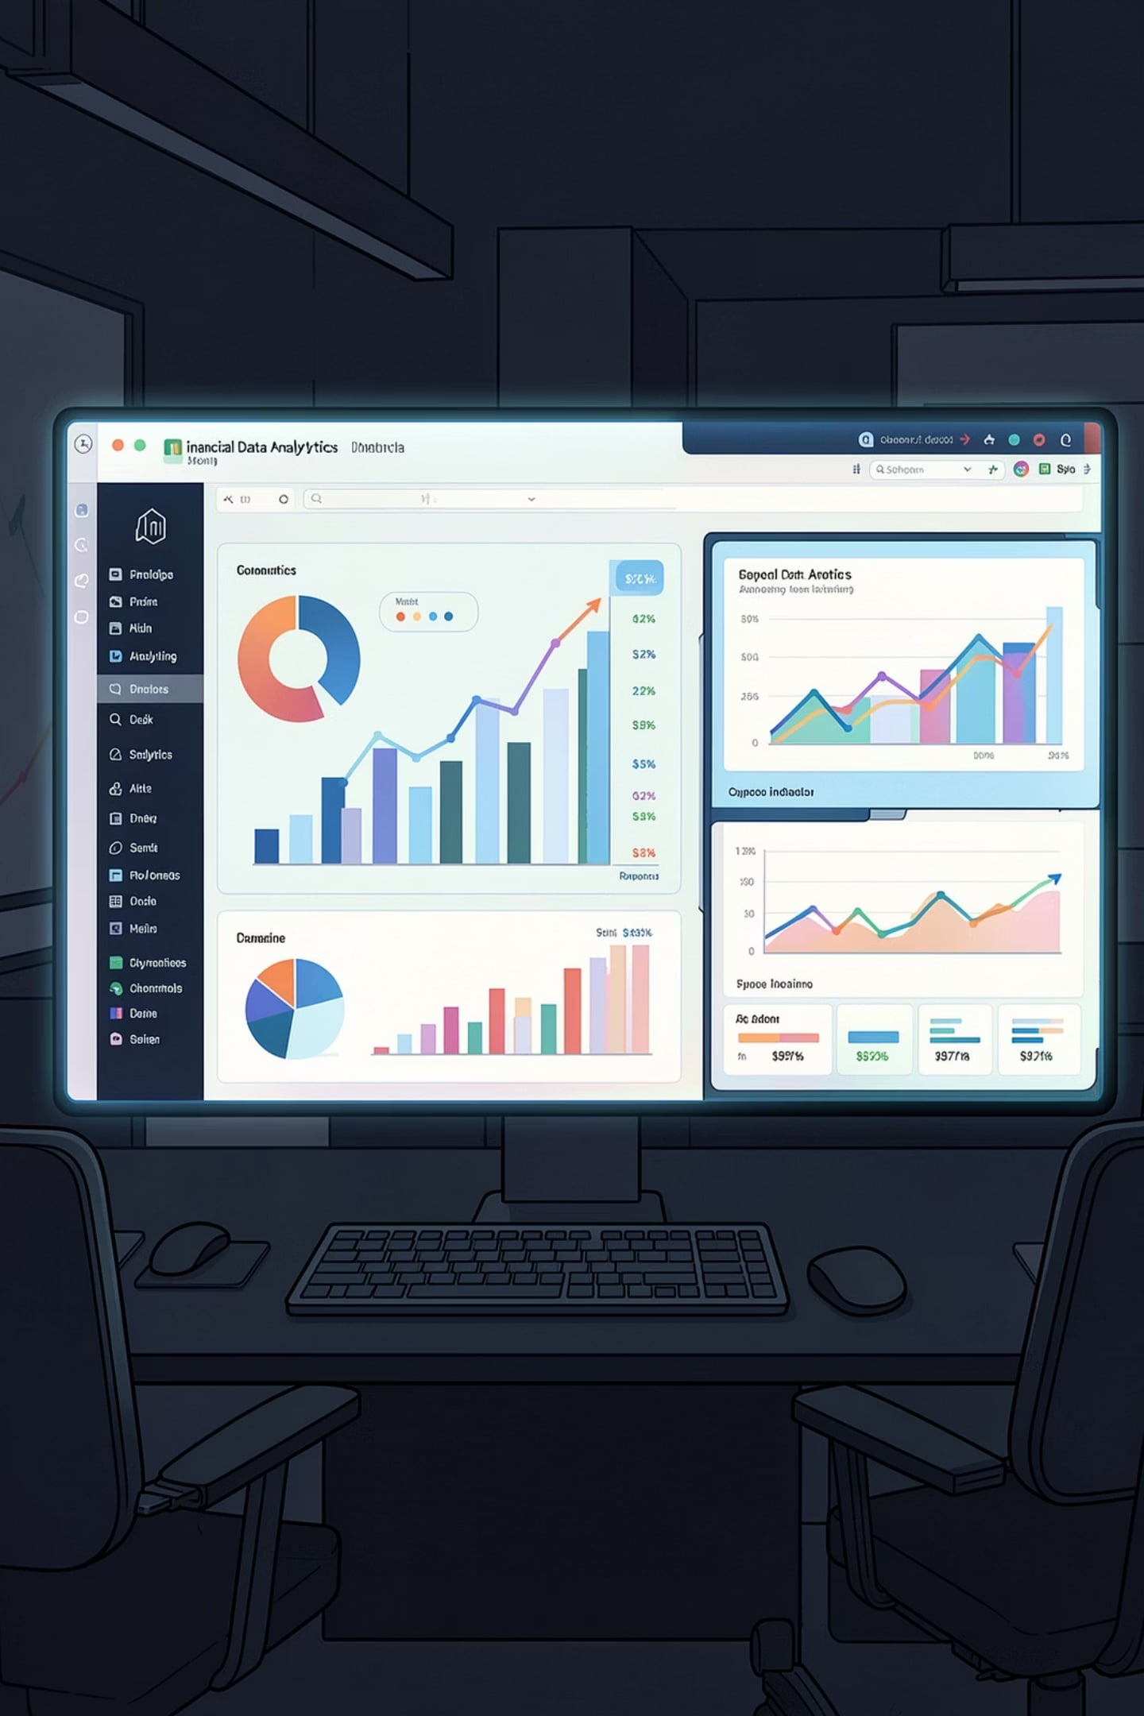
Mutual Fund Analytics Capstone Project
Bluestock Fintech Internship
Presented by Lakshit Sharma · Data Analytics Capstone
DATA ANALYTICS
FINTECH
CAPSTONE PROJECT

Slide 2
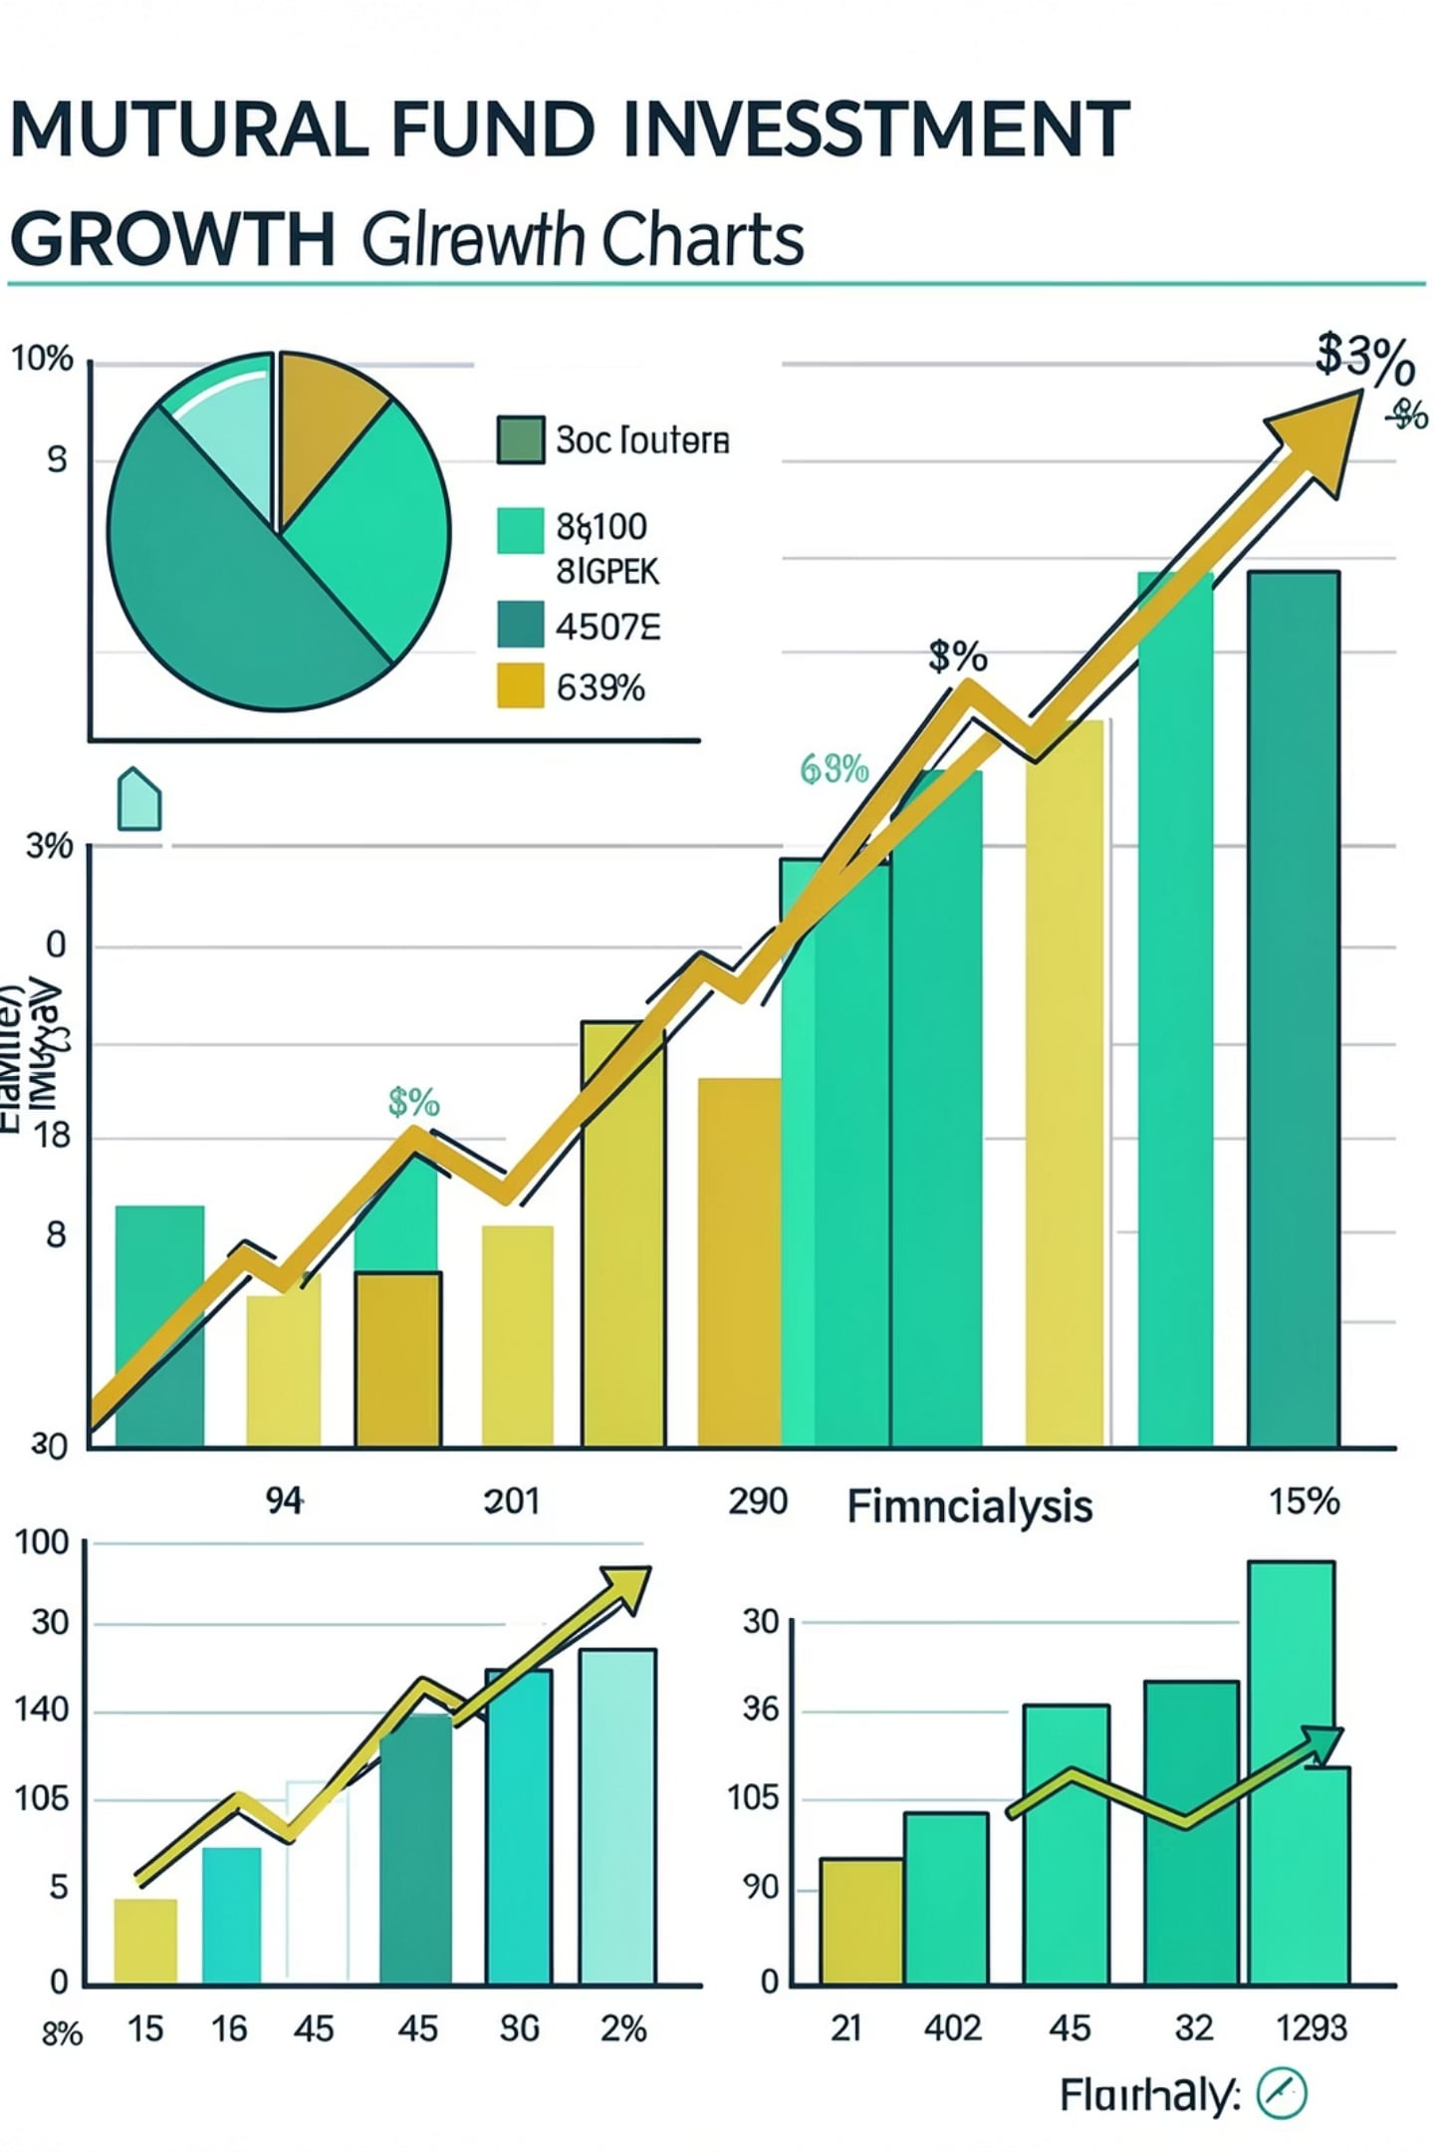


Project Overview
What is Mutual Fund Analytics?
A data-driven system that ingests, processes, and visualizes mutual fund performance metrics — enabling investors and analysts to make informed, evidence-based decisions.
Business Problem
Investors lack centralized, automated tools to track fund performance, compare risk-adjusted returns, and optimize portfolios — leading to suboptimal financial decisions.
Project Goals
Build an end-to-end analytics pipeline — from raw data extraction to an interactive dashboard — delivering actionable financial insights at scale.

Slide 3






Project Objectives
Six core objectives span the full data analytics lifecycle — from ingestion to deployment.
ETL Pipeline
Database Design
Automate extraction, transformation, and loading of fund data
Model a normalized schema for fund, NAV, and performance data
Data Cleaning
Financial Analytics
Handle nulls, duplicates, and inconsistencies at scale
Compute Sharpe, Sortino, Alpha, Beta, and drawdown metrics
Dashboard Development
Deployment
Build an interactive Streamlit app for real-time insights
Automate scheduling and deploy for continuous updates

Slide 4
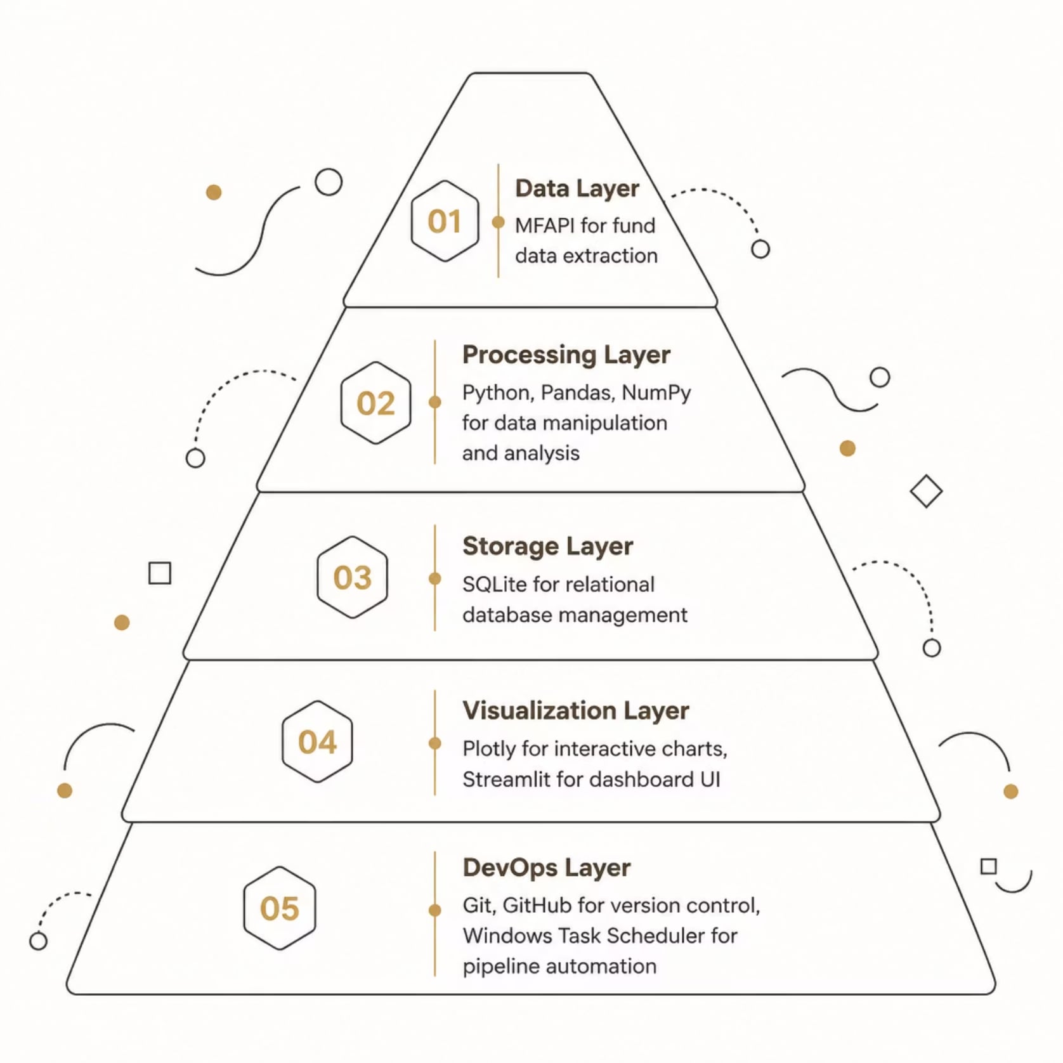
Technology Stack
End-to-End Toolchain
Each layer of the stack serves a distinct purpose — from raw data ingestion via MFAPI to automated scheduling with Windows Task Scheduler. Python anchors the processing layer with Pandas and NumPy, while SQLite provides lightweight relational storage. Plotly and Streamlit power the interactive front end, and Git/GitHub ensures full version control and reproducibility throughout the project.
PYTHON
PANDAS
NUMPY
SQLITE
PLOTLY
STREAMLIT
GIT
GITHUB
WINDOWS TASK SCHEDULER
MFAPI

Slide 5

Project Architecture
A fully automated, end-to-end pipeline — from live API data to an interactive, deployed dashboard.
MFAPI Extract
Raw Ingestion
ETL Pipeline
Processed Data
The pipeline runs on a scheduled basis via Windows Task Scheduler, ensuring the dashboard always reflects the most current fund data without manual intervention.

Slide 6

Project Folder Structure
A clean, modular directory structure enforces separation of concerns — making the project maintainable, scalable, and collaboration-ready for team environments.
📁 data/
📁 db/
📁 scripts/
📁 sql/
raw/ · processed/ — staged and cleaned datasets
SQLite database files and schema migrations
ETL automation, data processing, and metric calculation scripts
DDL and DML queries for database management
📁 streamlit_app/
📄 README · requirements.txt
Dashboard Python app, layout, and visualization modules
Project documentation and dependency management

Slide 7





ETL Pipeline
Extraction
Transformation
Loading
Pull live fund data via MFAPI — NAV, AUM, and holdings
Clean, normalize, and compute derived financial metrics
Write validated records into SQLite dimensional schema
Validation
Automation
Automated quality checks — nulls, duplicates, range bounds
Scheduled via Windows Task Scheduler for zero-touch runs

Slide 8
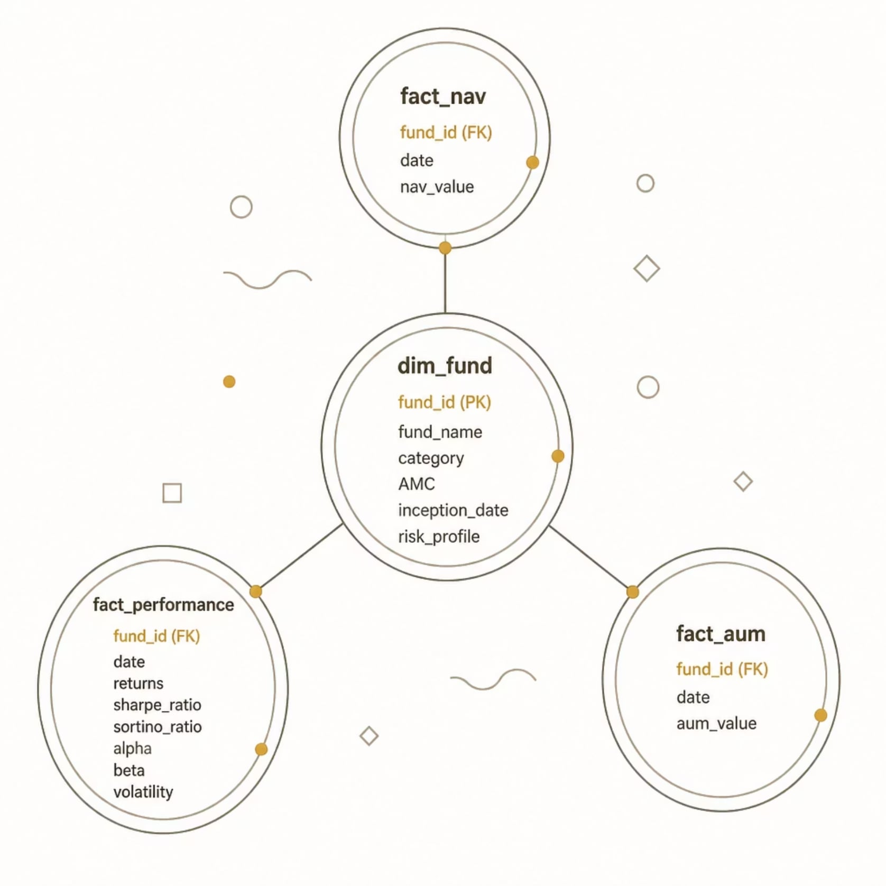
Database Design
Star Schema Model
A normalized star schema separates dimensions from facts — enabling efficient queries, referential integrity, and scalable analytics across fund performance data.
dim_fund
fact_nav
fact_performance
fact_aum
Fund name, category, AMC, inception date, risk profile
Daily NAV values indexed by fund_id and date
Returns, Sharpe, Sortino, Alpha, Beta, volatility
Assets under management tracked over time

Slide 9
Financial Metrics
Core KPIs computed across all funds — enabling rigorous, apples-to-apples performance comparison.
Return
Sharpe Ratio
Absolute and annualized fund returns
Risk-adjusted return per unit of total volatility
Sortino Ratio
Alpha & Beta
Downside risk-adjusted return metric
Outperformance vs. benchmark and market sensitivity
Volatility
Max Drawdown
Standard deviation of fund returns
Largest peak-to-trough decline in fund value
Expense Ratio
AUM
Annual cost as a percentage of AUM
Total assets under management

Slide 10
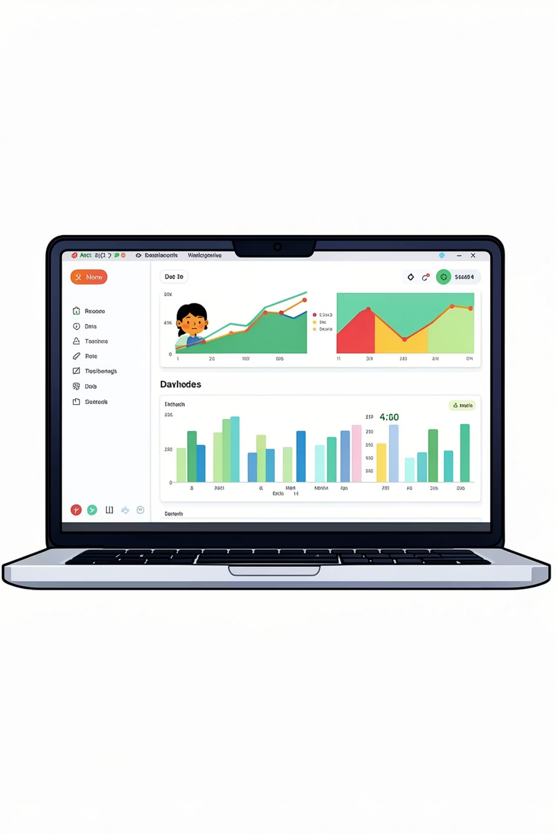




Dashboard & Key Insights
The Streamlit dashboard transforms complex fund data into clear, actionable visuals — enabling rapid comparison and confident investment decisions.
Fund Performance Comparison
Interactive charts comparing returns, risk metrics, and AUM across funds and categories
Ranking & Selection
Dynamic fund rankings by Sharpe Ratio, Alpha, and risk profile for targeted selection
Portfolio Allocation
Visual breakdown of optimal fund allocation based on performance and risk tolerance
Live Deployment
Automated pipeline ensures the dashboard reflects the most current fund data at all times

