Slide 1
LIGO
Laser Interferometer Gravitational-wave Observatory
Submitted to:
Dr. Rajnish Kurchania
Professor & Head
Submitted By:
Lakshita Jain
24205001113

Slide 2
Content
Introduction of Gravitational- Waves(GWs)
Detection Principle
Introduction of LIGO
Key Components
Source of Noise & Mitigation
How it works
Major Discoveries by LIGO
Future of LIGO and GW Astronomy
Conclusion

Slide 3

Introduction of GWs
“An accelerated charged particle generates electromagnetic waves, as described by Maxwell's equations, while an accelerated mass produces gravitational waves, governed by Einstein's equations.”
Einstein Equation: $G_{μν}=8πGT_{μν}$
Where:
$G_{μν}$ is The Einstein Tensor, which describes the curvature of Space-time
$T_{μν}$ The Stress-energy tensor, which describes the matter and energy density
The Equation implies that spacetime curvature tells matter how to move, and matter tells spacetime how to curve.
GW carry crucial and unaltered information of the source like mass, acceleration, type, distance etc.
Frequency Range: EM- Hz- ${10}^{25}Hz$ GW-${10}^{−17}Hz− {10}^{3}Hz$
Ref.1,2

Slide 4
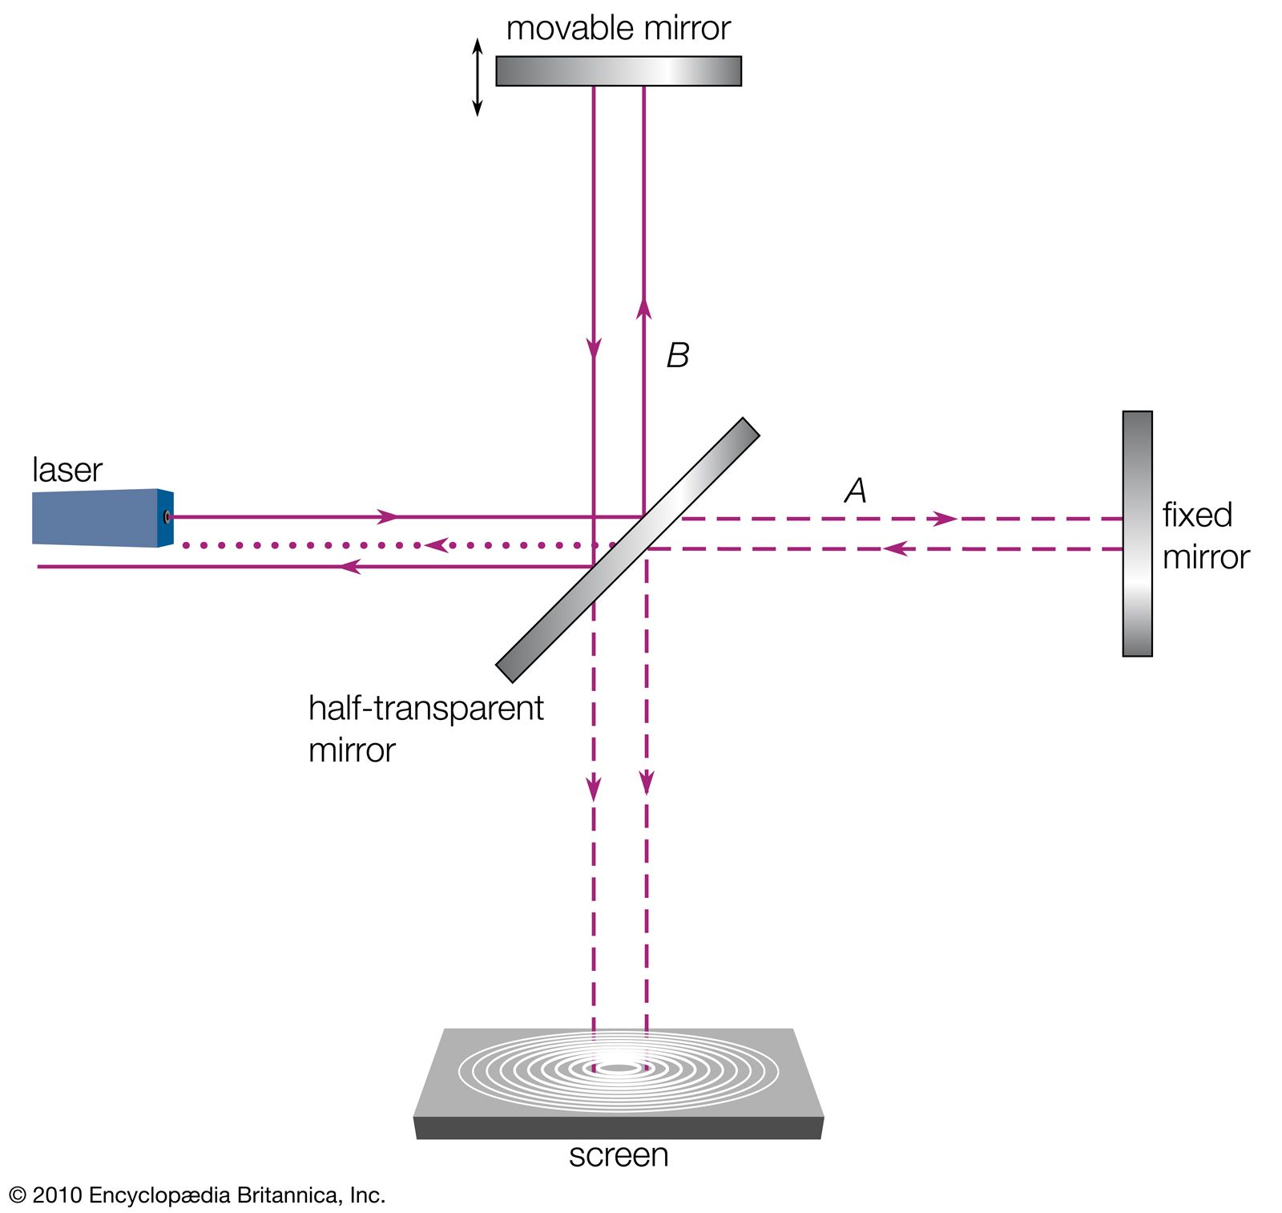
Detection Principle
When Gravitational Wave passes through the space it will elongate or contract unit of space time.
Michelson Interferometer (MI)
Ref.1,2

Slide 5
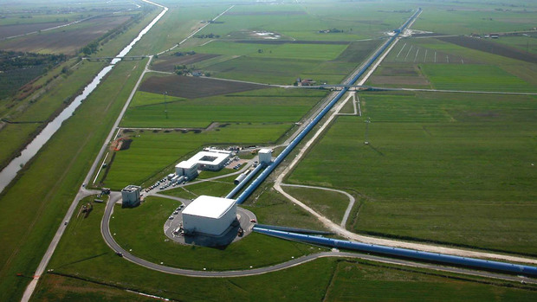

Introduction of LIGO
Ground Based Observatory.
It measures change in space coordinate.
Frequency Range: Hz- few thousands Hz
Uses laser interferometry to measure tiny distortions in spacetime caused by passing gravitational waves.
LIGO allows us to observe cosmic events (like black hole and neutron star collisions) in a completely new way.
Path Difference $∆L\left(t\right)=δL_{x}−δL_{y}=h\left(t\right)L$ ; $L_{x}$ $=L_{y}$= L=4Km
Ref.1,2,3

Slide 6
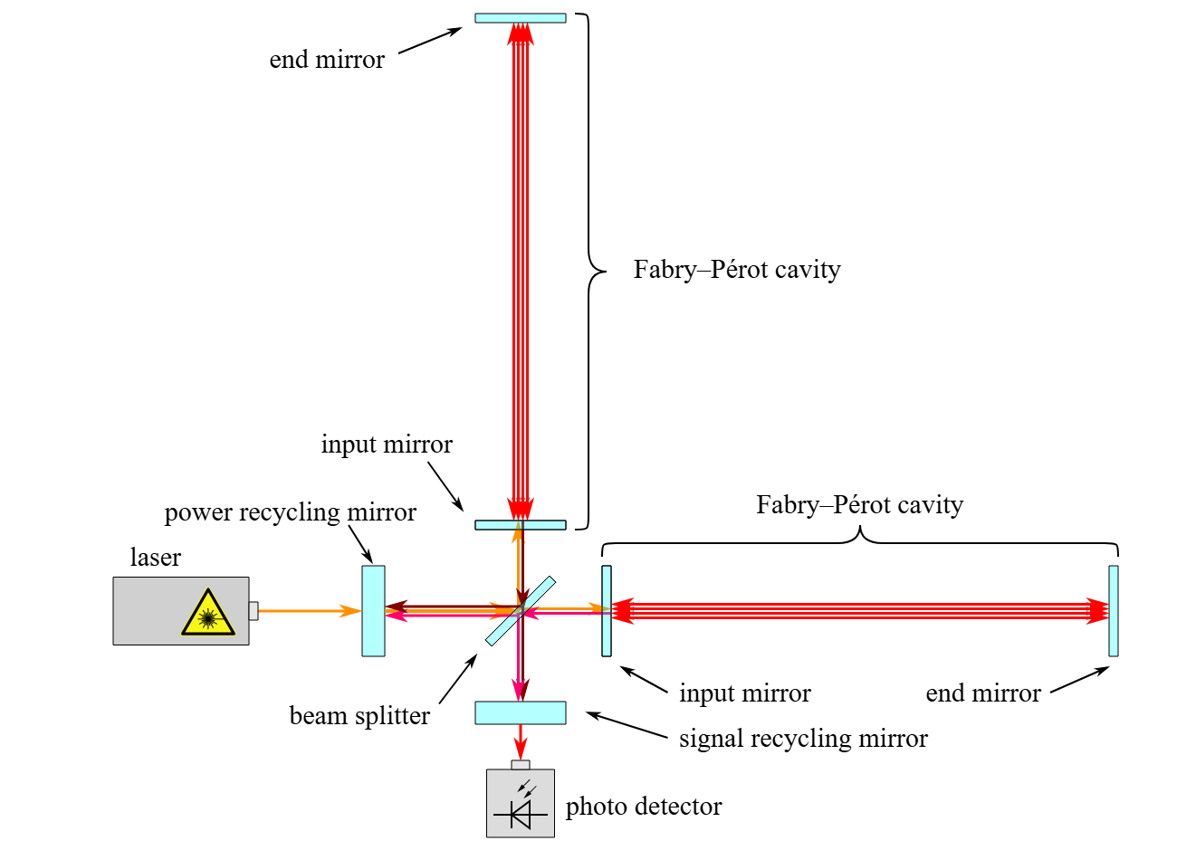
LIGO with Fabry–Pérot Cavities

Slide 7
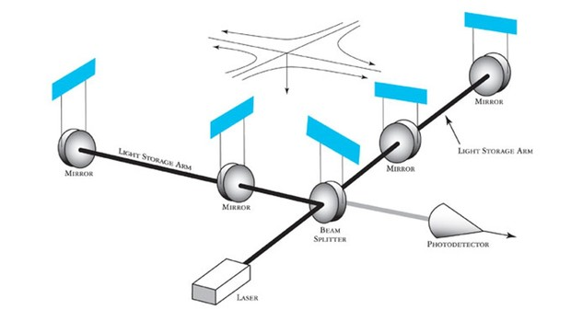
Key Components
Laser Source- Nd:YAG laser 1064-nm 20W
Produces a highly stable, monochromatic laser beam.
Acts as the main light source for the interferometer.
Power Recycling Mirror- 700W
Placed between the laser and the beam splitter
Reflects unused laser light back into the interferometer, increases circulating power, boosting signal sensitivity without needing a stronger laser.(A)
Beam Splitter- Symmetric and Antisymmetric port
Splits the laser beam into two perpendicular beams, sending each down one of LIGO’s 4-km-long arms.
It also recombines them at the end, enabling interference.(A)
Interferometer Arms (4 km each)- Light House
Two ultra-high vacuum tubes.
The laser beams travel back and forth down these arms, reflecting between mirrors.
Fabry–Pérot Cavities- 300-time length
Each arm contains two mirrors that create an optical cavity.
Light bounces back and forth hundreds of times, increasing the effective path length and sensitivity to gravitational waves.(A)
Test Masses / Mirrors- Proton/1000
High-purity, ultra-reflective mirrors suspended in vacuum.
They are suspended by fine wires and isolated from vibrations.
Act as “free” test masses if a gravitational wave passes, their relative positions shift ever so slightly.
Ref.1,3

Slide 8
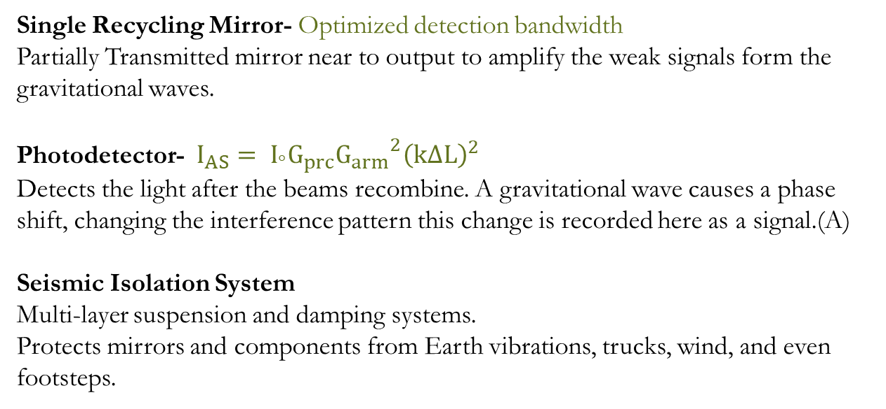
Key Components
Laser Source- Nd:YAG laser 1064-nm 20W
Produces a highly stable, monochromatic laser beam.
Acts as the main light source for the interferometer.
Power Recycling Mirror- 700W
Placed between the laser and the beam splitter
Reflects unused laser light back into the interferometer, increases circulating power, boosting signal sensitivity without needing a stronger laser.(A)
Beam Splitter- Symmetric and Antisymmetric port
Splits the laser beam into two perpendicular beams, sending each down one of LIGO’s 4-km-long arms.
It also recombines them at the end, enabling interference.(A)
Interferometer Arms (4 km each)- Light House
Two ultra-high vacuum tubes.
The laser beams travel back and forth down these arms, reflecting between mirrors.
Fabry–Pérot Cavities- 300-time length
Each arm contains two mirrors that create an optical cavity.
Light bounces back and forth hundreds of times, increasing the effective path length and sensitivity to gravitational waves.(A)
Test Masses / Mirrors- Proton/1000
High-purity, ultra-reflective mirrors suspended in vacuum.
They are suspended by fine wires and isolated from vibrations.
Act as “free” test masses if a gravitational wave passes, their relative positions shift ever so slightly.
Single Recycling Mirror- Optimized detection bandwidth
Partially Transmitted mirror near to output to amplify the weak signals form the gravitational waves.
Photodetector- $I_{AS}= I_{°}G_{prc}{G_{arm}}^{2}{\left(k∆L\right)}^{2}$
Detects the light after the beams recombine. A gravitational wave causes a phase shift, changing the interference pattern this change is recorded here as a signal.(A)
Seismic Isolation System
Multi-layer suspension and damping systems.
Protects mirrors and components from Earth vibrations, trucks, wind, and even footsteps.
Ref.1,3

Slide 9

Key Components
Interferometer Arms (4 km each)- Light House
Two ultra-high vacuum tubes.
The laser beams travel back and forth down these arms, reflecting between mirrors.
Fabry–Pérot Cavities- 300-time length
Each arm contains two mirrors that create an optical cavity.
Light bounces back and forth hundreds of times, increasing the effective path length and sensitivity to gravitational waves.(A)
Test Masses / Mirrors- Proton/1000
High-purity, ultra-reflective mirrors suspended in vacuum.
They are suspended by fine wires and isolated from vibrations.
Act as “free” test masses if a gravitational wave passes, their relative positions shift ever so slightly.
Single Recycling Mirror- Optimized detection bandwidth
Partially Transmitted mirror near to output to amplify the weak signals form the gravitational waves.
Photodetector- $I_{AS}= I_{°}G_{prc}{G_{arm}}^{2}{\left(k∆L\right)}^{2}$
Detects the light after the beams recombine. A gravitational wave causes a phase shift, changing the interference pattern this change is recorded here as a signal.(A)
Seismic Isolation System
Multi-layer suspension and damping systems.
Protects mirrors and components from Earth vibrations, trucks, wind, and even footsteps.
Ref.1,3

Slide 10
Source of Noise & Mitigation
Noise | Source | Mitigation
Seismic Noise | Ground motion (earthquakes, traffic etc.) | Active seismic isolation & Suspension System
Thermal Noise | Thermal Vibration of mirror and suspension | Vacuum chamber, thermal control
Photon shot noise | Quantum uncertainty in the number of photon detected | Increasing laser power and optimizing interferometer design
Environmental noise | Magnetic field, acoustic vibration, electric interference | Monitored using arrays of sensors (e.g., microphones, magnetometer)
Quantum noise | Shot noise, radiation pressure noise and intrinsic quantum nature of light | Squeezing light, heavier test mass , cryogenic mirror
Ref. 1,3

Slide 11
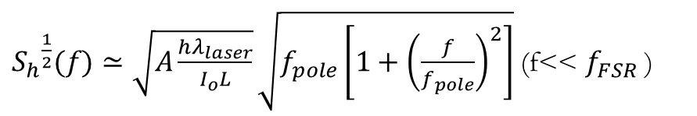
How it works
A laser beam is split into two perpendicular arms (each 4 km long).
Light bounces between mirrors in each arm and recombines.
A gravitational wave slightly stretches one arm and compresses the other
Changing the interference pattern of the recombined light.
Amplitude Strain:
${S_{h}}^{\frac{1}{2}}(f)≃\sqrt{A\frac{hλ_{laser}}{I_{ο}L}}\sqrt{f_{pole}\left[1+{\left(\frac{f}{f_{pole}}\right)}^{2}\right]}$ (f<< $f_{FSR}$ )
(A)
Ref. 1,3

Slide 12
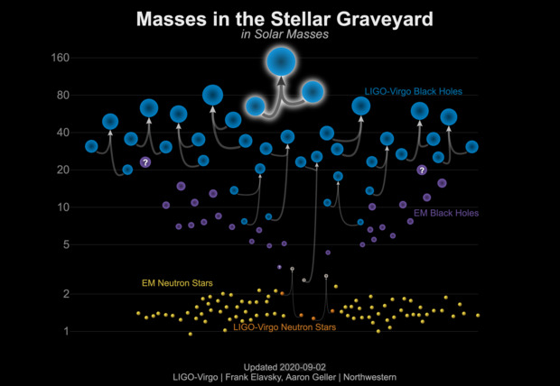
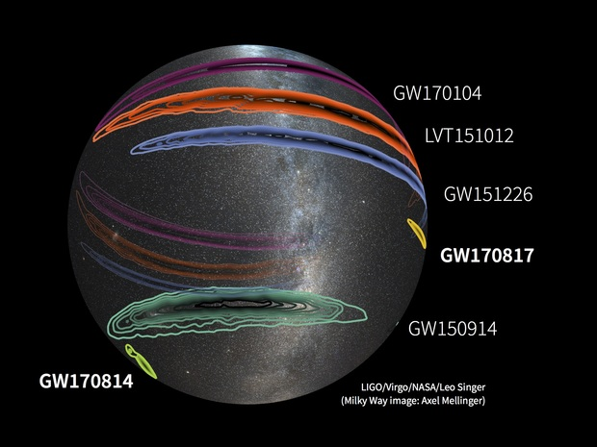
Major Discoveries by LIGO
Masses of the black hole binaries before and after colliding are shown in Graveyard
On the simulation get the information spin, distance, and their previous source.
Sky mapping gives a approximate direction of the source
Provide opportunity to look dipper in the space and also find unknown celestial object
Ref. 3,4

Slide 13
Future of LIGO and GW Astronomy
• Advanced LIGO upgrades improve sensitivity.
• Planned projects: LIGO-India, Einstein Telescope (EU), Cosmic Explorer (US).
• Space-based detector LISA will target low-frequency waves.
Ref. 3,4

Slide 14
Conclusion
• LIGO has opened a new era in astronomy.
• It allows us to observe the invisible universe.
• Gravitational wave detection is transforming our understanding of black holes, neutron stars, and the fabric of spacetime.

Slide 15

Appendix A
Arm cavity Gain $G_{arm}=\frac{1+r_{ITM}}{1−r_{ITM}}=\frac{{t_{ITM}}^{2}}{{(1−r_{ITM})}^{2}}$ ; for initial LIGO${t_{ITM}}^{2}=2.8\%$, $G_{arm}$=140
Amount of time that any photon remain with in the cavity $τ_{s}≈\frac{1}{2}\frac{L}{c}G_{arm}$
An average no of round trips of a photon in the cavity $\left\langle N_{round−trip}\right\rangle ≈\frac{G_{arm}}{4}$
$E_{SYMM}=\frac{1}{2}E_{MICH}[r_{2}e^{−2ikl_{2}}+r_{1}e^{−2ikl_{1}}]$
$E_{ANTI}=\frac{1}{2}E_{MICH}\left[r_{2}e^{−2ikl_{2}}−r_{1}e^{−2ikl_{1}}\right]$
The Recycling Gain $G_{prc}=\frac{1−{r^{2}}_{PRM}}{{(1+r_{PRM}r_{FPMI})}^{2}}=\frac{1}{A_{FPMI}}$ ; for inItial LIGO $G_{prc}≈50$
The Photocurrent $I_{AS∝}{\left|E_{ANTI}\right|}^{2}$; $I_{AS}= I_{ο}G_{prc}{G_{arm}}^{2}{\left(k∆L\right)}^{2}$
Ref:1

Slide 16
References
Jolien D. E. Creighton and Warren G. Anderson; Gravitational-Wave Physics and Astronomy; 2011; published by Wiley-VCH
Bernard Schutz; A first course in general relativity; second edition, 2009; Cambridge University Press
B.P. Abbott et al. ; Observation of Gravitational Waves from a Binary Black Hole Merger; 2016; http://dx.doi.org/10.1103/PhysRevLett.116.061102
LIGO Caltech https://www.ligo.caltech.edu/page/ligo-gw-interferometer

Slide 17
Thank You!

