Slide 1
Maulana Azad National Institute of Technology, Bhopal
Department of Physics
Seminar
MICROGRAVITY
Submitted to:
Dr. Rajnish Kurchania
Professor & Head
Submitted by:
Lakshita Jain
(24205001113)

Slide 2
Content:
Gravity
Microgravity
Creating Microgravity
Need of microgravity
Effects on human body
Challenges and future scopes
References

Slide 3
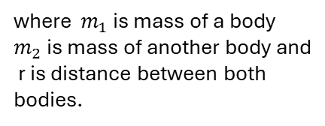
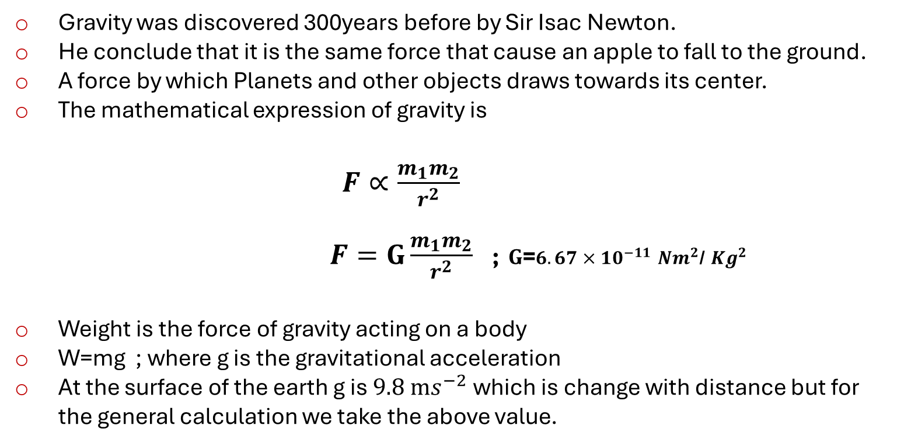
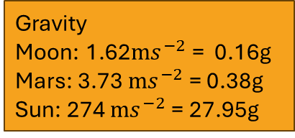
Gravity
Gravity was discovered 300years before by Sir Isac Newton.
He conclude that it is the same force that cause an apple to fall to the ground.
A force by which Planets and other objects draws towards its center.
The mathematical expression of gravity is
$F∝\frac{m_{1}m_{2}}{r^{2}}$
$F=G\frac{m_{1}m_{2}}{r^{2}}$ ;$G$=${6.67×10}^{−11}$ ${Nm}^{2}$/ ${Kg}^{2}$
Weight is the force of gravity acting on a body
W=mg ; where g is the gravitational acceleration
At the surface of the earth g is $9.8$ ${ms}^{−2}$ which is change with distance but for the general calculation we take the above value.
Gravity
Moon: 1.62${ms}^{−2}$ = 0.16g
Mars: 3.73 ${ms}^{−2}$ = 0.38g
Sun: 274 ${ms}^{−2}$ = 27.95g
where $m_{1}$ is mass of a body
$m_{2}$ is mass of another body and
r is distance between both bodies.
Ref. 1,5
Page 1/6

Slide 4
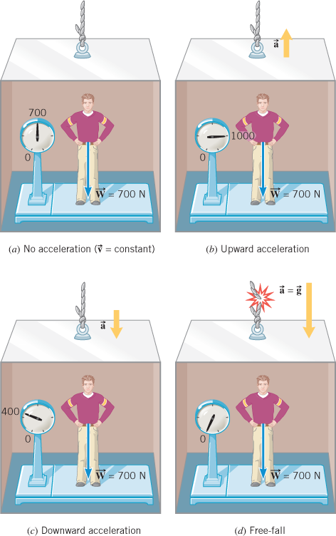
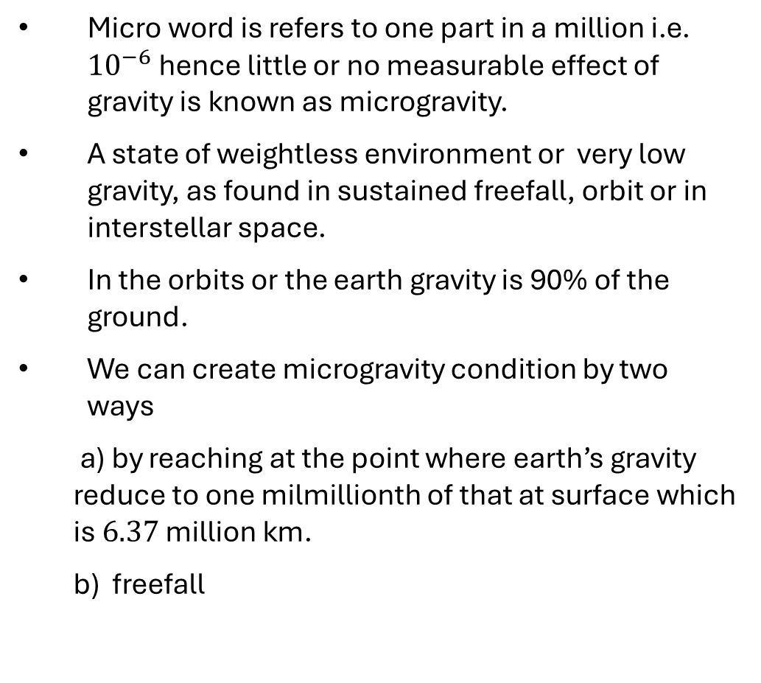
microgravity
Micro word is refers to one part in a million i.e. ${10}^{−6}$ hence little or no measurable effect of gravity is known as microgravity.
A state of weightless environment or very low gravity, as found in sustained freefall, orbit or in interstellar space.
In the orbits or the earth gravity is 90% of the ground.
We can create microgravity condition by two ways
a) by reaching at the point where earth’s gravity reduce to one milmillionth of that at surface which is $6.37$ million km.
b) freefall
Ref. 1,2
Page 2/6

Slide 5
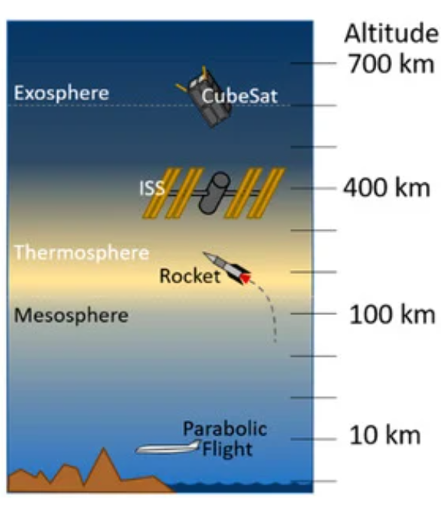
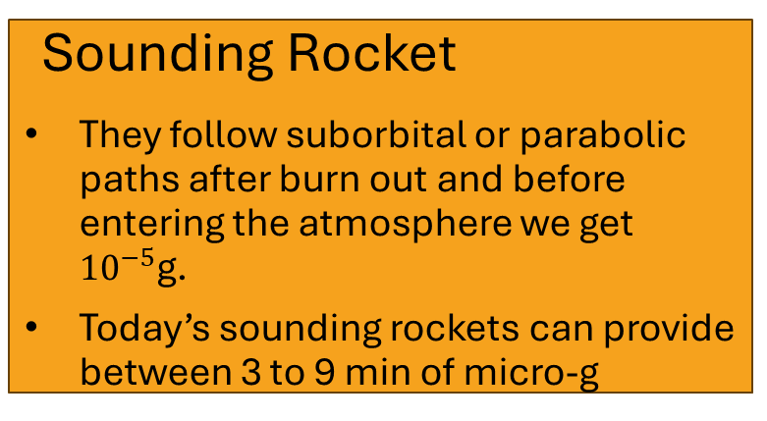
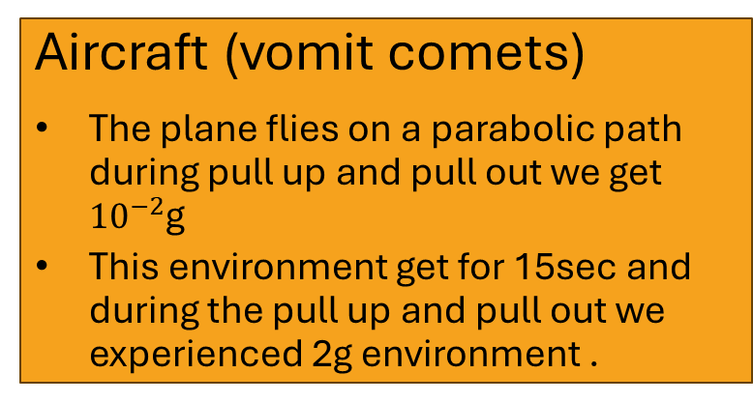
CREATING MICROGRAVITY
Drop facility
The payload dropped off the top of the tower allowed to fall.
In general it gives micro-g for 2.2 seconds from the fall of 24m and maximum we can achieve for 10sec of the fall of 490m
Aircraft (vomit comets)
The plane flies on a parabolic path during pull up and pull out we get ${10}^{−2}$g
This environment get for 15sec and during the pull up and pull out we experienced 2g environment .
Sounding Rocket
They follow suborbital or parabolic paths after burn out and before entering the atmosphere we get ${10}^{−5}$g.
Today’s sounding rockets can provide between 3 to 9 min of micro-g
Orbiting spacecraft
Microgravity in spacecraft is achieved through orbital fall, where the spacecraft continuously falls towards earth while moving forward at a high speed.
It gets for servals days
Ref. 1,3,4,6
Page 3/6

Slide 6
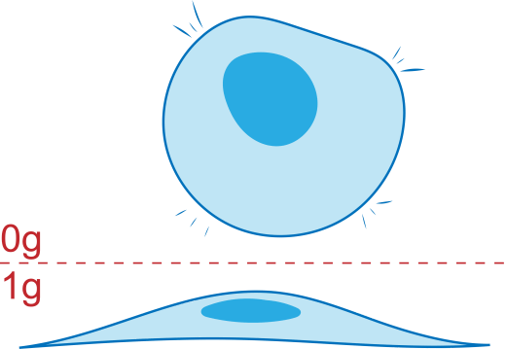
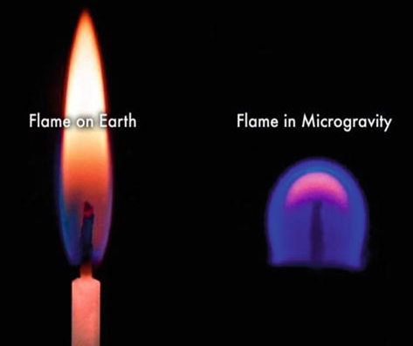
Need of microgravity
Physical Phenomena
Material Science
Combustion Science
Biotechnology
Drop Dynamic
Fluid Physics
Innovation
Astrophysics
Proof of Theories
Making Great Understanding Towards Gravity
Ref. 1,3,5,6
Page 4/6

Slide 7
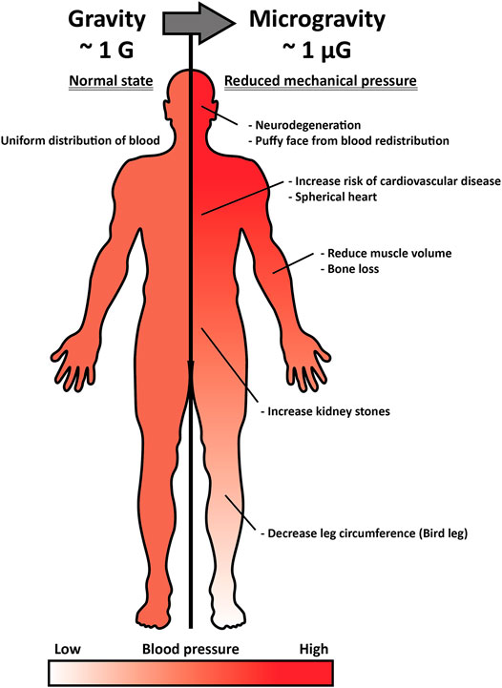
Effects on human body
Short Term Effect
Long Term Effects
Bone loss
Loss in strength
Fluid shift
Muscles atrophy
Space adaption syndrome
Hormonal changes
Shape of eyes
Cardiac arrest
Insulin level
Decrease in Cognitive performance
Ref. 2,4
Page 5/6

Slide 8
Challenges
Future scopes
Creating the microgravity environment for a significant time on the ground itself a challenge.
Cost is high only for creating microgravity like in for sounding rocket 0.16 million rupees per kg(weight of payload), in space shuttle it goes to 17 million rupees per kg to get it there on the space shuttle.
In creating microgravity environment in space shuttle make difficult to survive human being in space shuttle.
Due to short time at ground based microgravity executing the experiment at exact point needs highly precision
Microgravity research will play a crucial role in enabling humans to explore and live in deep space.
It offers unique opportunities for materials science and manufacturing, such as creating novel materials and crystals like ZBLAN
The design of improved drugs, fire protection and detection systems, spacecraft system, high-precision clock, and semiconductor materials.
In addition this research allow us to create outposts on the moon where we can build habitats and research facilities.
Ref. 1,3,5
Page 6/6

Slide 9
References :-
Melissa J.B. Rogers, Gregory L. Vogt, Michael J. Wargo; Microgravity: A Teacher's Guide with Activities in Science, Mathematics, and Technology; Feb 1997 https://www.researchgate.net/publication/24322726_Microgravity_A_Teacher's_Guide_with_Activities_in_Science_Mathematics_and_Technology/citations
Dr. K.G. Sreejalkshmi; IIRS ISRO DIGITAL LEARNING; Microgravity and Biology of Living System https://www.youtube.com/watch?v=0MW301tweMw&t=1555s&ab_channel=IIRSISRODigitalLearningProgramme
Christopher N. Nguyen, Emmanuel Urquieta ; Life Science In Space Research ; Vol 36 ,Feb 2023, Page 147-156 ; https://doi.org/10.1016/j.lssr.2022.10.004
Alexander J. Dontre; Life Science in Space research; vol 40, Feb 2024, page 51-61 ; https://doi.org/10.1016/j.lssr.2023.12.003
Dennis Tucker, Edwin Ethridge Guy A.Smith and Gary Workman; Annals new York academy of science; Dec 2004; DOI:10.1196/annals.1324.012
H. Koch, S. Hurner, T. Sorgenfrei, M. Hainke C. Kranert, J. Friedrich; Journal of Crystal Growth ; vol 607 April 2023; https://doi.org/10.1016/j.jcrysgro.2023.127127
Francesca Ferranti, Mart DEL Bianca, Claudia Pacelli; applied science; vol 11, dec 2021; https://doi.org/10.3390/app11010068

Slide 10
THANK YOU

