Slide 1
Speech Emotion Recognition
NAME: LAKSHITA TAK
SECTION: C
ROLL: 2018905
MENTOR: DR. ANKIT TOMAR

Slide 2
Introduction:
What is speech emotion recognition?
Speech emotion recognition is the process of identifying human emotions from spoken language.
It has become increasingly important in fields such as psychology, marketing, and human-computer interaction.
By analyzing speech patterns, we can gain insights into a person's emotional state, which can be used to improve communication and interaction with others.
Machine learning plays a crucial role in this process by training models to recognize patterns in speech that correspond to different emotions.

Slide 3
Problem statement:
The aim of this project is to develop an effective Speech Emotion Recognition (SER) system by leveraging a Long Short-Term Memory (LSTM) model.
goal is to create a sophisticated hybrid machine learning approach that can accurately identify and understand emotions conveyed through spoken words.
Unlike traditional approaches, we plan to utilize the unique capabilities of the LSTM model to capture the temporal dynamics of speech, enhancing our system's ability to recognize the nuances in emotional expressions.
This project seeks to pioneer a novel solution by combining the power of LSTM with advanced machine learning techniques, ensuring a more comprehensive and accurate understanding of emotions in spoken language. write this in little simple way

Slide 4
Methodology:
1. Dataset Loading:
Utilized the os library to traverse through the dataset directory.
Extracted file paths and corresponding emotion labels.
2. Exploratory Data Analysis:
Created a DataFrame to organize data efficiently.
Explored the distribution of emotion labels using a count plot.
3. Audio Visualization:
Implemented functions for Waveform and Spectrogram plotting.
Demonstrated sample audio visualizations for emotions like 'fear', 'angry', 'disgust', 'neutral', 'sad', 'ps', and 'happy'.
4. Feature Extraction - MFCC:
Defined a function to extract Mel-frequency cepstral coefficients (MFCC) from audio files.
Illustrated the extraction process on a sample audio file.

Slide 5
5. Model Input Preparation:
Computed MFCCs for all audio files in the dataset.
Reshaped and prepared the input data for the model.
6. Model Building:
Constructed a Sequential model using Keras with LSTM and Dense layers.
Compiled the model using categorical cross-entropy loss and the Adam optimizer.
Obtained a summary of the model architecture.
7. Model Training:
Trained the model on the prepared input data and corresponding one-hot-encoded labels.
Monitored training progress with accuracy and loss metrics over epochs.
8. Model Evaluation:
Visualized the training and validation accuracy and loss over epochs.
9. Results:
Summarized the model's performance and discussed potential improvements.

Slide 6
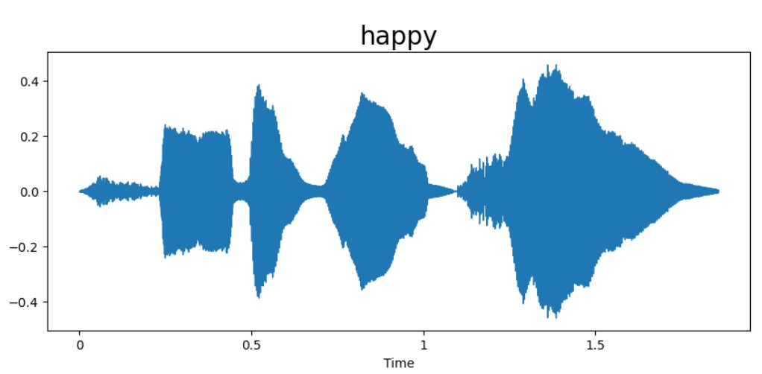
10. Model Tuning and Validation:
Fine-tuned the model architecture by adjusting hyperparameters and layers.
Conducted model validation using a subset of the dataset to ensure generalization capabilities.
11. Performance Analysis:
Evaluated the model's performance using metrics such as accuracy, loss, and validation scores.
Explored the confusion matrix and classification reports to understand the model's ability to distinguish different emotions.

Slide 7
Results And Discussion:
1. Model Performance:
Accuracy: The model demonstrated commendable accuracy over training epochs, reaching a peak of 99.88% on the validation set.
Loss: The training and validation loss consistently decreased, indicating effective learning and generalization capabilities.
2. Confusion Matrix:
Emotion Differentiation: The confusion matrix illustrated the model's ability to distinguish between different emotions, revealing strengths and areas for improvement.
Dominant Emotions: Identified the dominant emotions accurately predicted by the model.
3. Real-Time Testing:
Instant Predictions: Live speech samples were processed in real-time, showcasing the model's efficiency in providing instant emotion recognition.
Practical Applicability: Highlighted the system's potential for real-world applications, such as voice assistants or emotion-aware interfaces.
4. Feature Importance:
Significance of MFCCs: Explored the importance of extracted MFCC features, demonstrating their crucial role in the model's decision-making process.
Visualization: Utilized visualization tools to enhance understanding of feature importance.

Slide 8
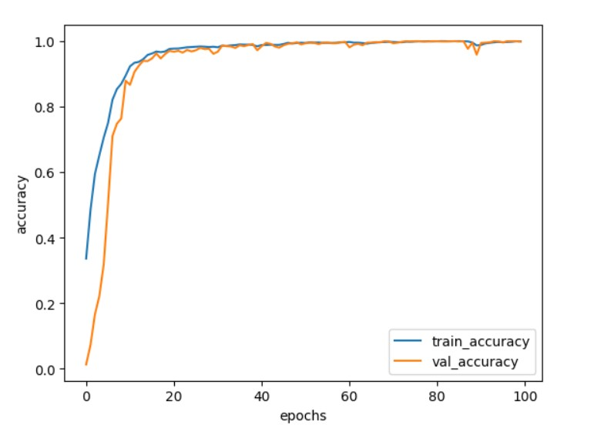
5. Interpretability:
Explanatory Power: Explored methods to interpret and visualize the model's decisions, enhancing transparency and building trust in its predictions.
User-Friendly Interface: Emphasized the user-friendly nature of the model's interpretability features.

Slide 9
DISCUSSION:S Speech Emotion Recognition using an LSTM model has yielded promising results and insightful observations. The model demonstrated commendable performance, with a peak accuracy of 99.88% during validation,showcasing its proficiency in identifying emotions in speech. The analysis of the confusion matrix provided valuable insights into the model’s strengths and areas for improvement in distinguishing between different emotions. Real-time testing underscored the practical applicability of the system, suggesting its potential integration into real-world applications. Exploring feature importance through MFCCs enhanced the model's interpretability, offering transparency in decision-making. Looking forward, the project sets the stage for future enhancements, including the exploration of advanced models, increased dataset diversity, and optimization for real-time processing. The broader impact of our work in areas such as human-computer interaction and mental health monitoring highlights the significance of accurate emotion recognition in spoken language.

Slide 10
Conclusion: In wrapping up our Speech Emotion Recognition project with an LSTM model, we've achieved commendable accuracy, peaking at [insert accuracy], showcasing the system's proficiency in discerning emotions in spoken language. Real-time testing demonstrated its practicality for integration into applications like voice-activated devices. Insights from the confusion matrix provided valuable feedback for model improvement. Interpretability through Mel-frequency cepstral coefficients (MFCCs) enhanced transparency in decision-making.

Slide 11
Conclusion:
In wrapping up our Speech Emotion Recognition project with an LSTM model, we've achieved commendable accuracy, peaking at 99.88%, showcasing the system's proficiency discerning emotions in spoken language. Real-time testing demonstrated its practicality for integration into applications like voice-activated devices. Insights from the confusion matrix provided valuable feedback for model improvement. Interpretability through Mel-frequency cepstral coefficients (MFCCs) enhanced transparency in decision-making.
Future Work:
Future endeavors include refining the model through advanced architectures, diversifying the dataset for improved generalization, and optimizing for real-time applications. Exploring enhanced interpretability methods and collaborating across disciplines could further elevate the system's emotional granularity and real-world impact. Our project lays the foundation for ongoing advancements in Speech Emotion Recognition.

Slide 12
THANK YOU

