Slide 1
STUDENT SUCCESS INTELLIGENCE PLATFORM
BIB InsightIQ
Turning campus data
into student success.
07
Connected sources
300
Fictional student records
Challenge, solution, feature walkthrough,
analytics patterns and requirements coverage
02
Explainable risk flags
BIB InsightIQ / TEAM BIB
01
Notes:
Documentation of the implemented analytics demo and private-portal foundations. Dataset uploaded by the user contains 300 fictional students. This is not a claim of full production readiness.
Evidence: supplied challenge prompt and requirements PDFs; current source and preview screenshots. Fictional dataset; illustrative UI activity is not measured institutional behaviour.

Slide 2
PROJECT DOCUMENTATION
A guide to the complete student story
01 Challenge & design
02 How it works
Why fragmented campus data delays support.
Linked records, weighted scoring and dual flags.
03 Feature tour
04 Evidence & gaps
Student, faculty, admin and guided entry.
Tests, requirement mapping and next phases.
BIB InsightIQ / TEAM BIB
02
Notes:
The main presentation explains the product, with rule tables and requirements matrices later for technical reviewers.
Evidence: supplied challenge prompt and requirements PDFs; current source and preview screenshots. Fictional dataset; illustrative UI activity is not measured institutional behaviour.

Slide 3
CHALLENGE
The challenge: connect signals before support is late
Disconnected records
A misleading single number
No clear next step
Grades, attendance, learning activity and placement preparation live in different systems.
Strong marks can conceal weak attendance or readiness. A score alone is not a diagnosis.
Mentors need evidence, ownership and follow-up—not another dashboard of unexplained alerts.
BIB InsightIQ / TEAM BIB
03
Notes:
Challenge brief: integrate seven campus sources and identify students needing support. No actual campus API integration is claimed.
Evidence: supplied challenge prompt and requirements PDFs; current source and preview screenshots. Fictional dataset; illustrative UI activity is not measured institutional behaviour.

Slide 4
SOLUTION
Three questions become one support workflow
Who needs help?
Why are they at risk?
What should faculty do next?
Use the Success Score, both risk flags and missing-data warnings to prioritize review.
Show the measured value, threshold and points behind every triggered rule.
Turn evidence into a reason, action, owner, priority and follow-up date.
BIB InsightIQ / TEAM BIB
04
Notes:
The flags are deterministic rule-based signals, not diagnoses or predictive machine-learning probabilities.
Evidence: supplied challenge prompt and requirements PDFs; current source and preview screenshots. Fictional dataset; illustrative UI activity is not measured institutional behaviour.

Slide 5
CHALLENGE ALIGNMENT
How the implementation maps to the judging focus
30% Data integration
25% Scoring & risk
25% Dashboards
Shared student ID; seven sources; quality overview; cross-source patterns.
Weighted available-data score; Academic and Placement flags; visible drivers.
Role-oriented views; charts, comparisons, filters and branch × flag heatmap.
Presentation/demo is listed as 10% in the supplied prompt; the three principal categories total 80%.
BIB InsightIQ / TEAM BIB
05
Notes:
Do not invent the unlisted balance of judging weights. These percentages reproduce the supplied implementation prompt.
Evidence: supplied challenge prompt and requirements PDFs; current source and preview screenshots. Fictional dataset; illustrative UI activity is not measured institutional behaviour.

Slide 6
HOW IT WORKS
Seven sources → one student identity
Academics
Attendance
LMS
Skills
Engagement
Placement
Feedback
1. Link & normalize
2. Derive & explain
3. Act & follow up
The student ID connects source records. The uploaded dataset becomes a unified seed used by all three dashboards.
Compute component values, available-weight score, flag points, risk drivers and support segments.
Students see next steps. Mentors triage and create interventions. Administrators monitor aggregate risk.
BIB InsightIQ / TEAM BIB
06
Notes:
Dataset preparation incorporated messy raw sources and the clean reference answer key. The in-app CSV screen handles unified rows; it is not a live connector for seven independent raw feeds.
Evidence: supplied challenge prompt and requirements PDFs; current source and preview screenshots. Fictional dataset; illustrative UI activity is not measured institutional behaviour.

Slide 7
DATA INTEGRATION
Data quality is part of the result—not an afterthought
300
96%
72
Student records
Six-component coverage
Missing component values
Separate absent from zero
Do not over-read coverage
A missing source is excluded from its score denominator. A genuine zero remains a real observed value.
Coverage measures available component values, not accuracy, integration freshness or confidence in an outcome.
BIB InsightIQ / TEAM BIB
07
Notes:
Numbers captured in the current admin/data dashboards. Data coverage differs from seven-source coverage because feedback is not a weighted component. Missing inputs in flag evaluation add no points.
Evidence: supplied challenge prompt and requirements PDFs; current source and preview screenshots. Fictional dataset; illustrative UI activity is not measured institutional behaviour.

Slide 8
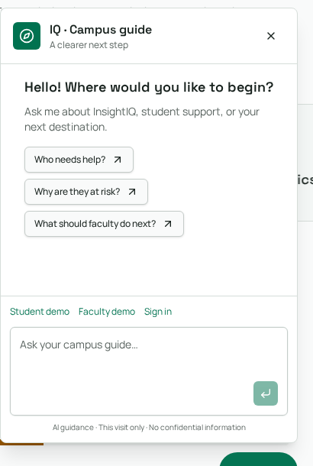
FEATURE WALKTHROUGH
A professional public entry point
Explain the purpose
The landing page introduces the three questions, connected sources and user benefits.
Guided navigation
Ask IQ offers suggested questions and links to the next destination.
Clear boundaries
The assistant is guidance, not a private-record retrieval or decision-making tool.
Actual preview: public website and campus-guide panel.
BIB InsightIQ / TEAM BIB
08
Notes:
The full site also includes role benefits, trust/privacy messaging and Connect with us. Assistant history is visit-only; provider calls stay server-side.
Evidence: supplied challenge prompt and requirements PDFs; current source and preview screenshots. Fictional dataset; illustrative UI activity is not measured institutional behaviour.

Slide 9
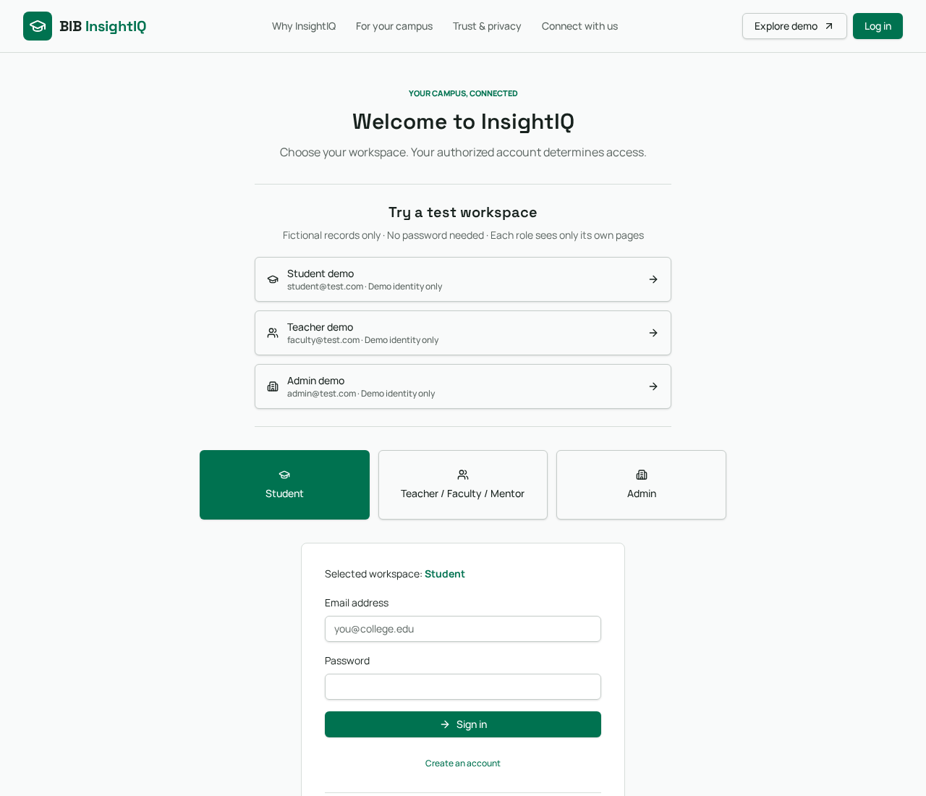
FEATURE WALKTHROUGH
Access: separate fictional demos from private accounts
Password-free demos
Student, Teacher and Admin entry points demonstrate different perspectives.
Role-oriented workspace
Student demo shows its own profile only; other role dashboards are restricted.
Private account layer
Authenticated routes are separate; production access needs verified role and record assignment.
Demo identity is not authorization; fictional records are not private institutional data.
BIB InsightIQ / TEAM BIB
09
Notes:
The private portal has server-side authentication and permission-related source paths. Hosted sign-in/signup configuration and full authenticated workflows were not verified in this documentation capture. Public role isolation is a UI/demo safeguard, not protection for public seed data.
Evidence: supplied challenge prompt and requirements PDFs; current source and preview screenshots. Fictional dataset; illustrative UI activity is not measured institutional behaviour.

Slide 10
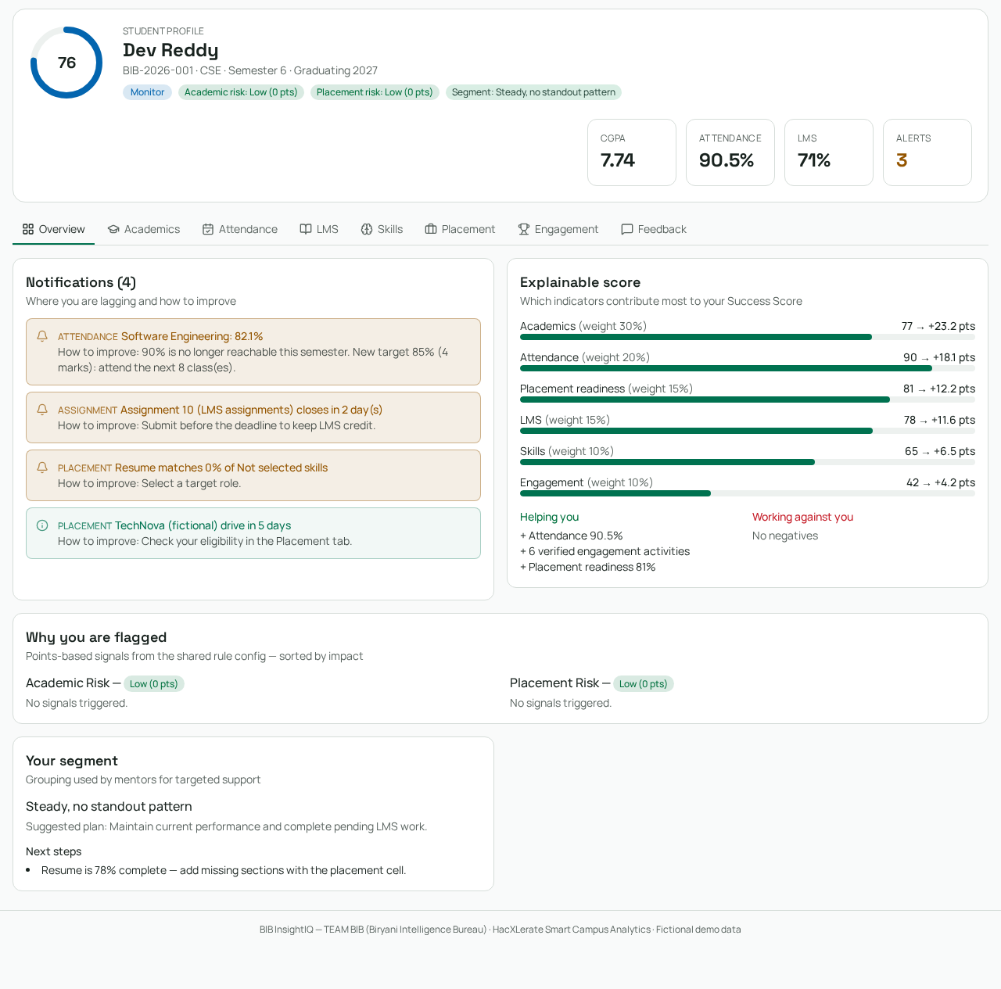
FEATURE WALKTHROUGH
Student overview: evidence before generic advice
One unified header
Success Score, CGPA, attendance, LMS, risk badges and segment.
Visible contributors
Each available component shows its weight and contribution.
Prioritized next steps
Attendance, assignments and placement notifications identify what needs attention.
Eight tabs: Overview · Academics · Attendance · LMS · Skills · Placement · Engagement · Feedback.
BIB InsightIQ / TEAM BIB
10
Notes:
Eight tabs: Overview · Academics · Attendance · LMS · Skills · Placement · Engagement · Feedback.
Evidence: supplied challenge prompt and requirements PDFs; current source and preview screenshots. Fictional dataset; illustrative UI activity is not measured institutional behaviour.

Slide 11
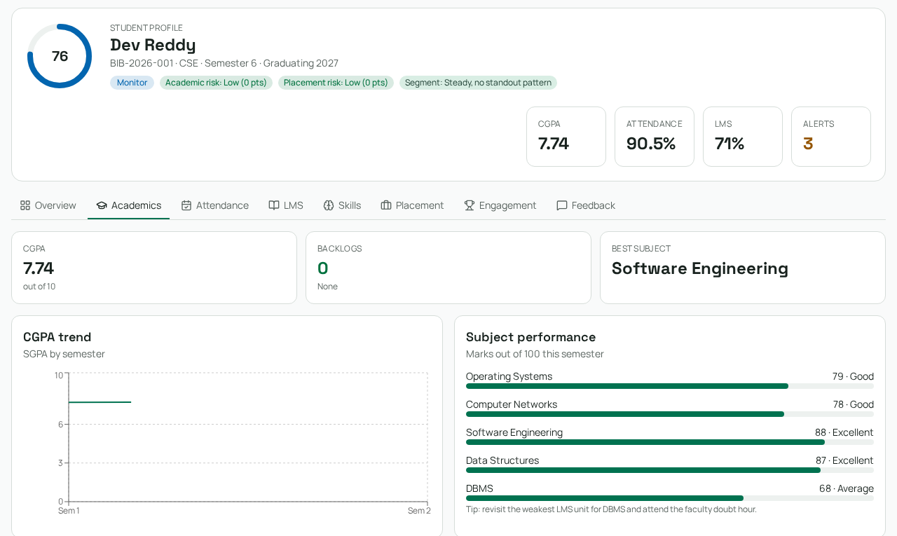
FEATURE WALKTHROUGH
Academics: see strengths, gaps and direction
Academic snapshot
CGPA, active backlogs, strongest subject and subject marks.
Trend view
Semester-grade chart where recorded history is available.
Interpret responsibly
A sparse chart is not proof of a long-term improvement or decline.
Subject outcomes and history are derived from the current student record.
BIB InsightIQ / TEAM BIB
11
Notes:
The full vision includes internal assessment breakdown, exams and backlog remedial content. Detailed calendars and complete assessment workflows require verified source data; do not infer them from this screenshot.
Evidence: supplied challenge prompt and requirements PDFs; current source and preview screenshots. Fictional dataset; illustrative UI activity is not measured institutional behaviour.

Slide 12
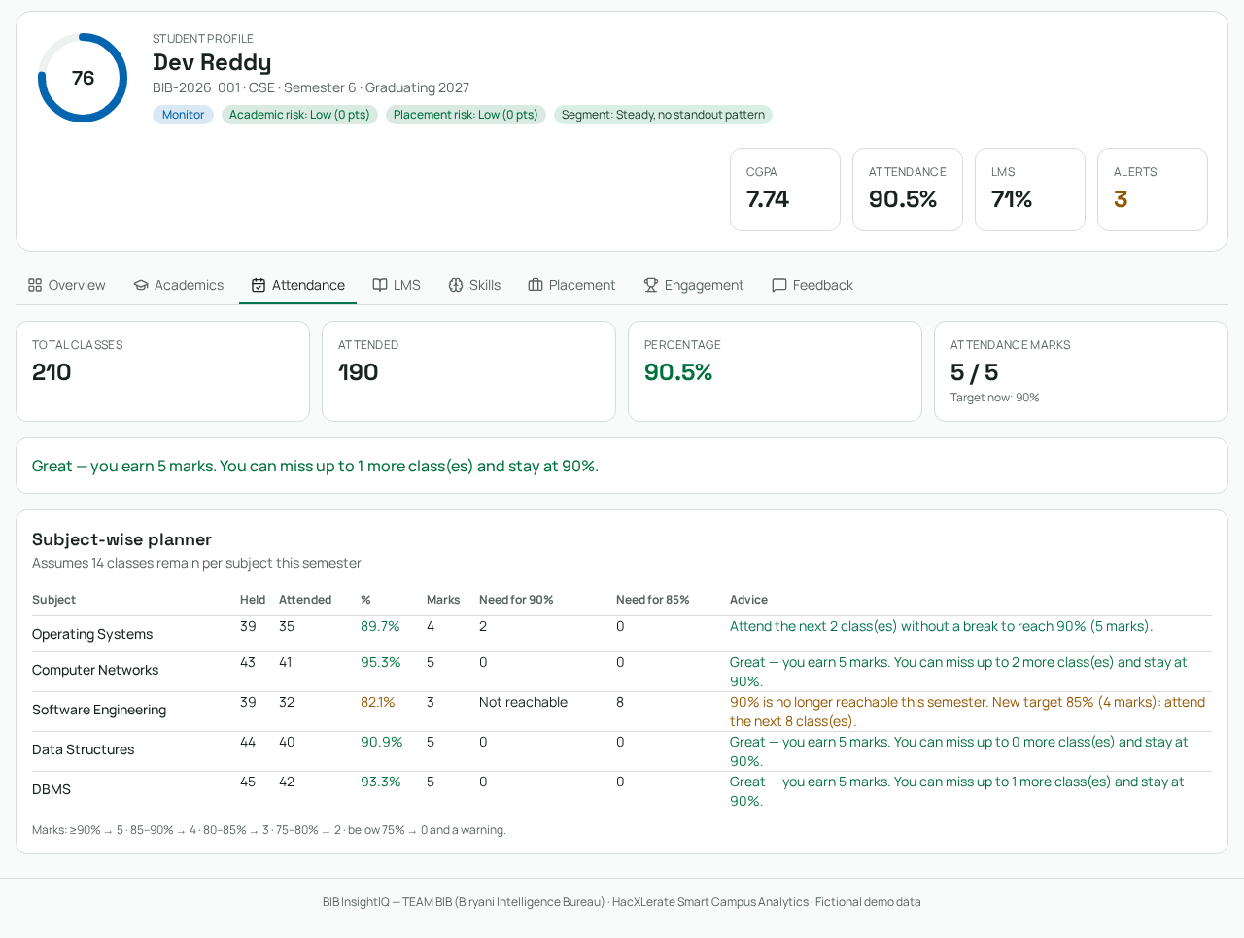
FEATURE WALKTHROUGH
Attendance: a calculator, not just a percentage
Source of truth
Classes attended ÷ classes held, calculated per subject and overall.
Marks & targets
Proposed 90/85/80/75% bands map to 5/4/3/2 marks.
Recovery planning
Additional attended classes, safe-to-miss estimate and warning messages.
Remaining classes are a fixed demo assumption of 14 per subject—not a live timetable.
BIB InsightIQ / TEAM BIB
12
Notes:
Remaining classes are a fixed demo assumption of 14 per subject—not a live timetable.
Evidence: supplied challenge prompt and requirements PDFs; current source and preview screenshots. Fictional dataset; illustrative UI activity is not measured institutional behaviour.

Slide 13
CALCULATION PATTERN
Attendance mathematics: explicit assumptions
Attendance percentage
Reach a target
Safe-to-miss estimate
A / H × 100
A = attended; H = held
No held classes → insufficient data.
max(0, ceil((T × H − A) / (1 − T)))
Assumes every future class is attended; 0 < T < 1.
max(0, floor(A / T − H))
Assumes no future attendance. Timetable changes can alter the estimate.
Example: 32/40 = 80%; to reach 85%, attend 14 consecutive classes → 46/54 = 85.19%.
BIB InsightIQ / TEAM BIB
13
Notes:
The requirements PDF contains an inconsistent example. This presentation uses the exact formula: ceiling((.85*40-32)/.15)=14, not 8. Targets are prototype rules, not asserted university policy.
Evidence: supplied challenge prompt and requirements PDFs; current source and preview screenshots. Fictional dataset; illustrative UI activity is not measured institutional behaviour.

Slide 14
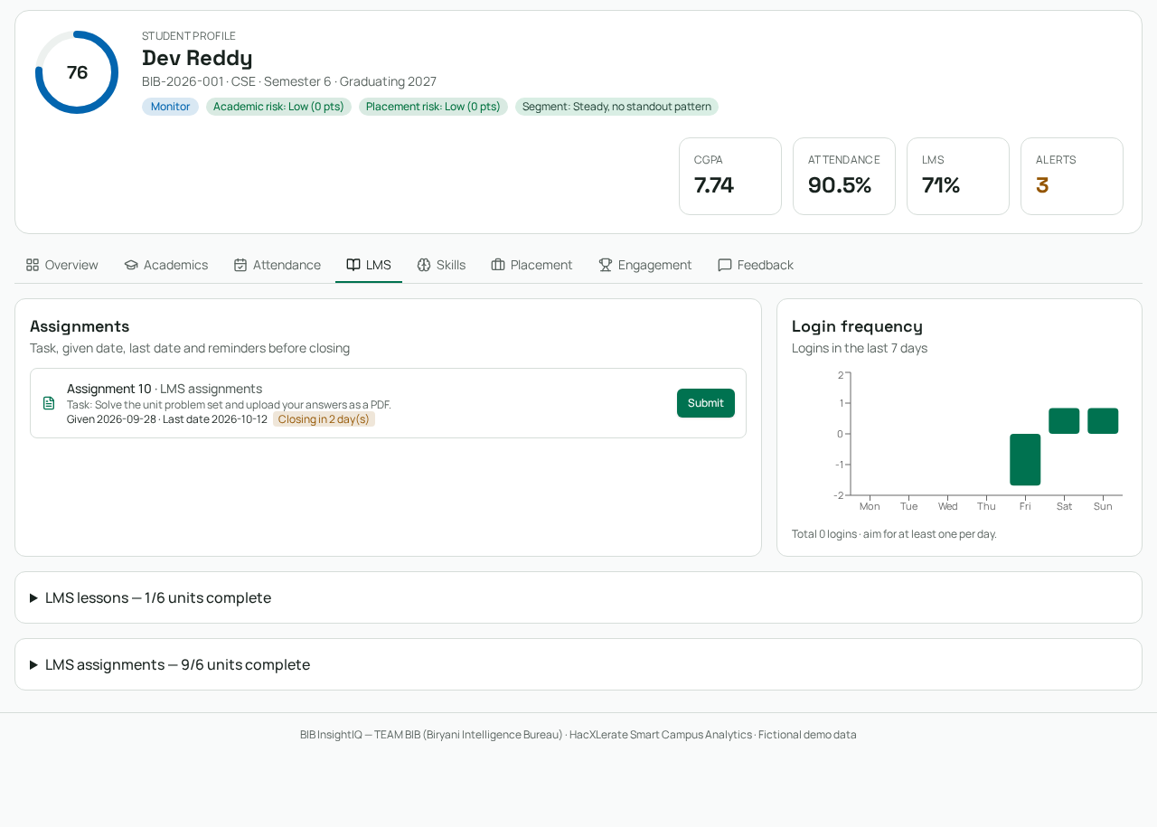
FEATURE WALKTHROUGH
LMS: connect learning progress to pending work
Completion & tasks
Show lesson and assignment completion plus a dated task board.
Activity context
Login-frequency visualization and unit/resource cards aid the demo narrative.
Dataset limitation
Uploaded records preserve aggregate LMS completion; unit details may be illustrative.
Notes, video metadata, task dates and login activity in the demo are not verified live LMS records.
BIB InsightIQ / TEAM BIB
14
Notes:
Seed conversion uses lesson-only and assignment-only containers to preserve official percentages. The expanded syllabus/resources are deterministic demo content. Do not claim teacher uploads or submissions are connected merely because resource cards render.
Evidence: supplied challenge prompt and requirements PDFs; current source and preview screenshots. Fictional dataset; illustrative UI activity is not measured institutional behaviour.

Slide 15
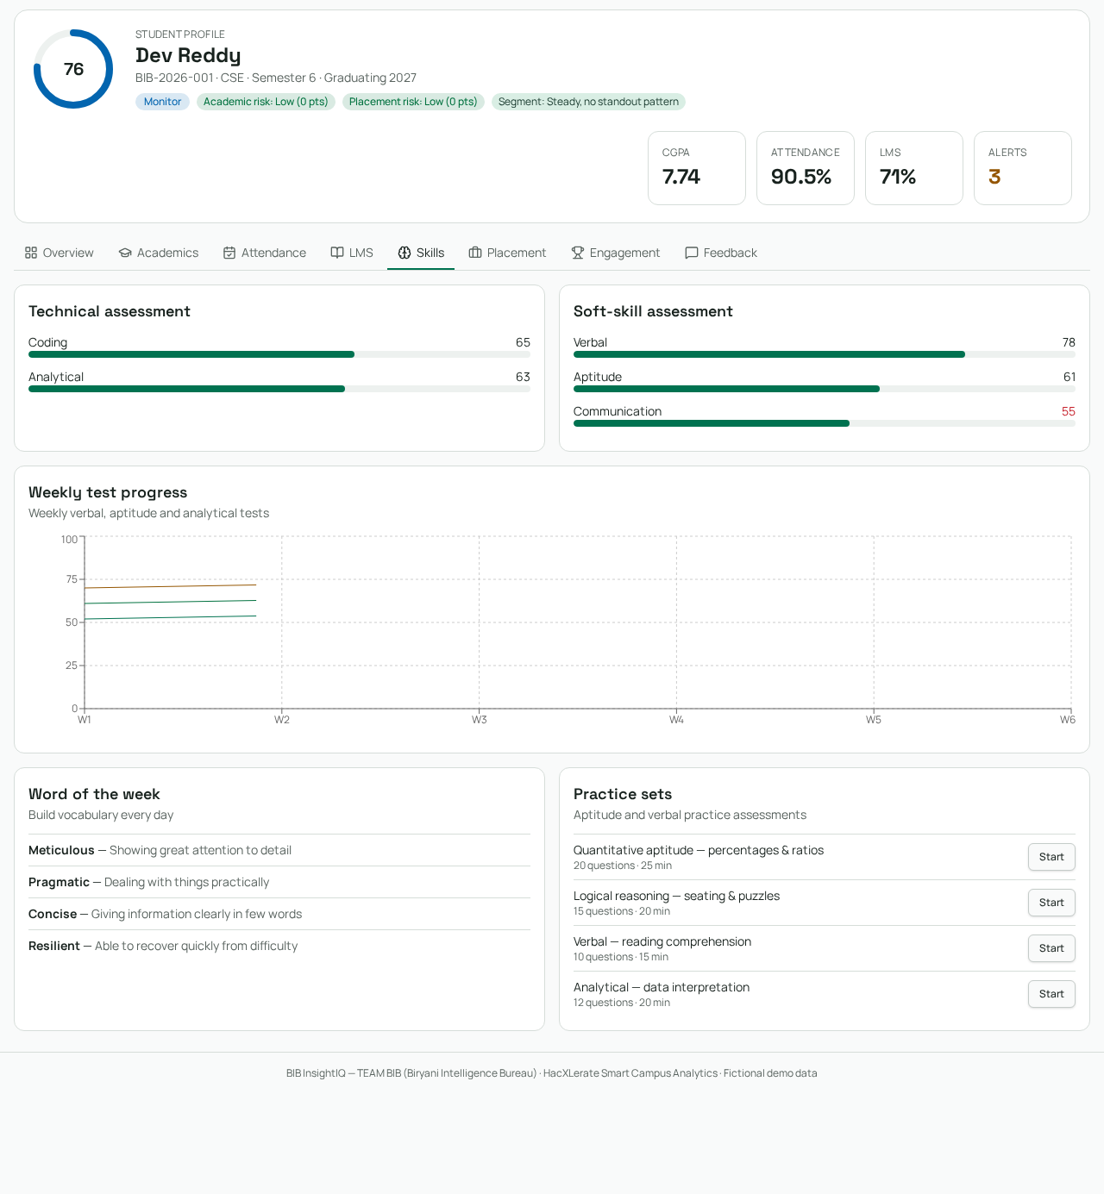
FEATURE WALKTHROUGH
Skills: practice areas and progress cues
Technical & soft skills
Coding, aptitude, verbal/communication and other visible skill indicators.
Practice discovery
Vocabulary, reasoning and coding/aptitude practice-set cards.
Preparation gaps
Highlight where a student should practice before the selected placement goal.
Weekly test curves and practice cards are illustrative; they are not scored live attempts.
BIB InsightIQ / TEAM BIB
15
Notes:
Weekly test curves and practice cards are illustrative; they are not scored live attempts.
Evidence: supplied challenge prompt and requirements PDFs; current source and preview screenshots. Fictional dataset; illustrative UI activity is not measured institutional behaviour.

Slide 16
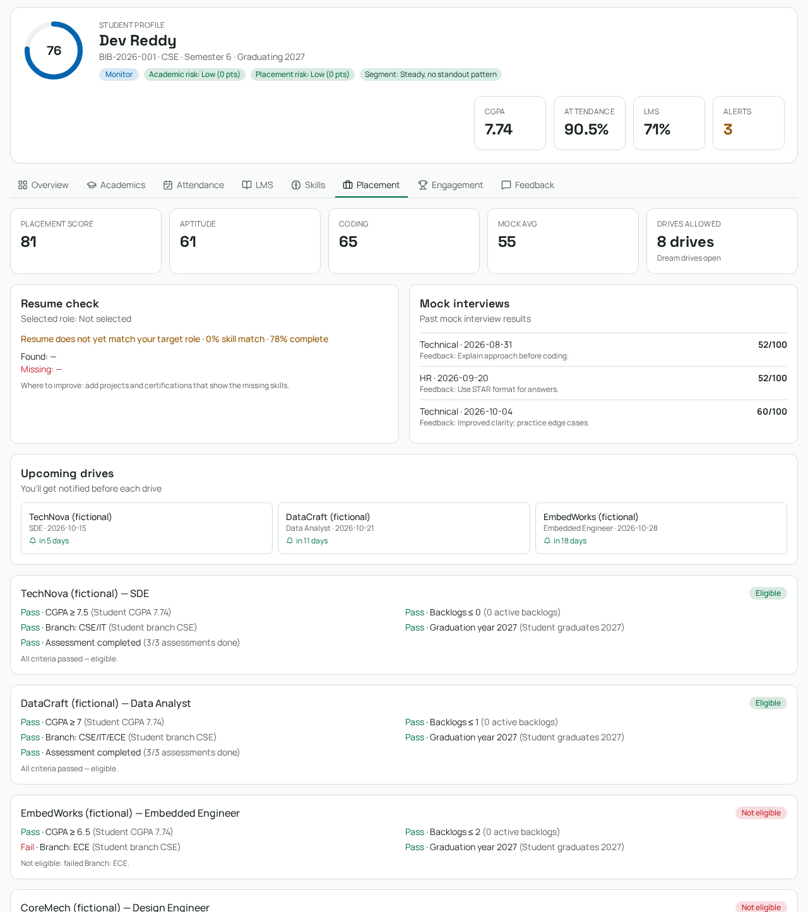
FEATURE WALKTHROUGH
Placement: readiness is different from eligibility
Readiness score
Resume, assessments and mock interviews form a preparation indicator.
Criteria checklist
CGPA, branch, graduation year, backlogs and required assessments produce Pass/Fail/Unknown.
Explain the gap
Upcoming fictional drives and resume-role feedback guide preparation.
Unknown criteria cannot produce an eligible result; demo drives are fictional.
BIB InsightIQ / TEAM BIB
16
Notes:
Drive allowance by CGPA and resume-role matching are prototype rules and heuristics, not employer guarantees. The eligibility function rejects eligibility when required data is missing. Readiness is weighted separately from hard drive criteria.
Evidence: supplied challenge prompt and requirements PDFs; current source and preview screenshots. Fictional dataset; illustrative UI activity is not measured institutional behaviour.

Slide 17
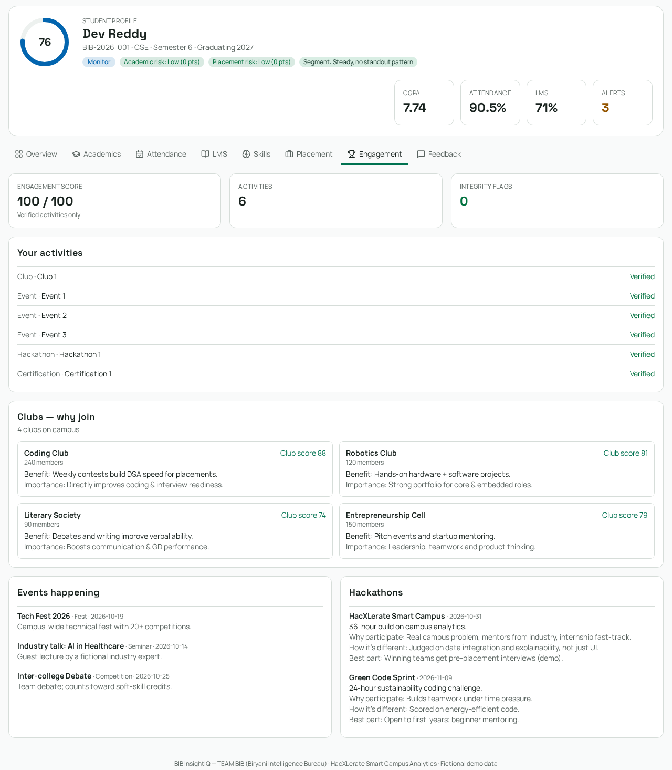
FEATURE WALKTHROUGH
Engagement: opportunities with a purpose
Participation overview
Clubs, events, hackathons and certifications contribute to the record.
Relevant opportunities
Cards explain potential benefits and deadlines for campus activities.
Responsible interpretation
Low participation can reflect unequal opportunity; it is not a measure of student worth.
Event and club recommendations are demo content; real evidence verification needs a connected review workflow.
BIB InsightIQ / TEAM BIB
17
Notes:
Event and club recommendations are demo content; real evidence verification needs a connected review workflow.
Evidence: supplied challenge prompt and requirements PDFs; current source and preview screenshots. Fictional dataset; illustrative UI activity is not measured institutional behaviour.

Slide 18
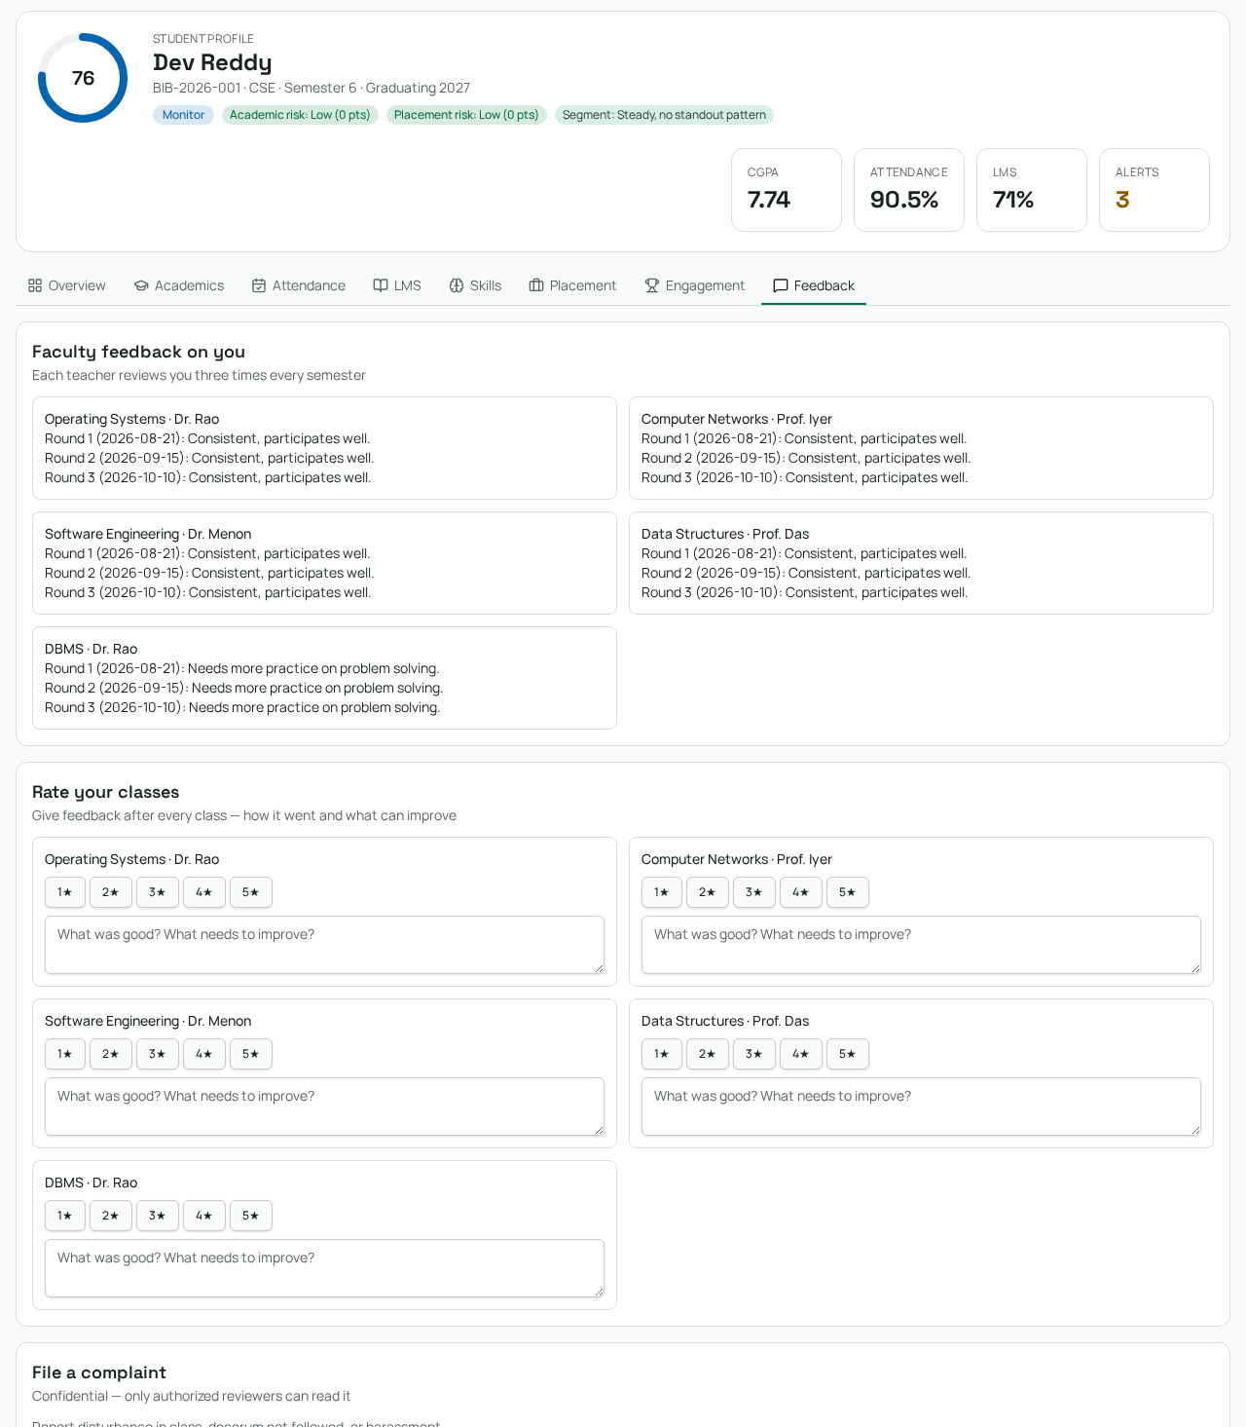
FEATURE WALKTHROUGH
Feedback & support: improve without exposing complaints
Feedback context
Faculty feedback rounds and student feedback prompts.
Support channel
Students can enter a confidential complaint in the demo workflow.
Restricted review
The admin review surface hides complaint content until an authorized review action.
Browser-only demo complaints must never contain sensitive real information.
BIB InsightIQ / TEAM BIB
18
Notes:
The source has a private feedback route and server operations; authenticated submission/review was not tested here. Demo confidentiality is presentation isolation, not production-grade storage security.
Evidence: supplied challenge prompt and requirements PDFs; current source and preview screenshots. Fictional dataset; illustrative UI activity is not measured institutional behaviour.

Slide 19
SCORING MODEL
The Success Score: transparent and available-data aware
Academics
30%
Weighted mean
Attendance
20%
Score = Σ(component × weight) / Σ(present weights)
Missing components are disclosed and excluded—not assigned zero.
LMS
15%
Placement
15%
Skills
10%
Engagement
10%
BIB InsightIQ / TEAM BIB
19
Notes:
The score is rounded to one decimal. Feedback is integrated in the student story but not included in the six weighted components. Component weights are configurable in code; a versioned administrator policy UI is a separate requirement.
Evidence: supplied challenge prompt and requirements PDFs; current source and preview screenshots. Fictional dataset; illustrative UI activity is not measured institutional behaviour.

Slide 20
MODEL & REQUIREMENTS
How each component becomes a 0–100 value
Component | Formula / present-data handling
Academics | CGPA × 10
Attendance | Total attended / total held × 100
LMS | Mean of lesson % and assignment % when present
Skills | Mean of coding, aptitude, verbal and communication
Engagement | min(100, clubs×8 + events×4 + hackathons×12 + certs×10)
Placement | Available-weight mean: resume 40%, assessments 30%, mocks 30%
BIB InsightIQ / TEAM BIB
20
Notes:
Mock contribution = min(100, completed mocks / 3 × 100). Assessment contribution uses completed/required when required > 0. Skills omit missing sentinels; engagement distinguishes a missing source from a true zero. Exact official reference formulas are in the scoring source.
Evidence: supplied challenge prompt and requirements PDFs; current source and preview screenshots. Fictional dataset; illustrative UI activity is not measured institutional behaviour.

Slide 21
RISK MODEL
Bands and flags answer different questions
≥ 80
65–<80
50–<65
< 50
On Track
Monitor
Needs Attention
High Priority
Safety override
Requirements reconciliation
If either Academic or Placement Risk is High, an On Track base band becomes Monitor.
The earlier prompt used 40 as the lower boundary. The uploaded dataset uses 50; this demo follows the dataset.
BIB InsightIQ / TEAM BIB
21
Notes:
This is an explicit variation from the initial prompt, not a claim of exact compliance with conflicting thresholds. Scores, risk points and bands are checked against the uploaded reference. Rules are support heuristics, not official university policy.
Evidence: supplied challenge prompt and requirements PDFs; current source and preview screenshots. Fictional dataset; illustrative UI activity is not measured institutional behaviour.

Slide 22
MODEL & REQUIREMENTS
Academic Risk: shared points-based rules
Signal | Threshold | Points
Active backlogs | ≥ 1 | 3
CGPA | < 6.0 | 3
SGPA drop | ≥ 1.0 | 2
Overall attendance | < 75% | 3
Subjects under 75% | ≥ 1 subject | 1 each; cap 3
Lesson completion / assignment completion | < 50% / < 60% | 2 / 1
BIB InsightIQ / TEAM BIB
22
Notes:
Level: High ≥5, Medium ≥2, otherwise Low. Driver lists contain signal, actual value, threshold and points, sorted highest impact first. Missing evaluators return null and add no points; all missing gives Insufficient data. Shared file: src/lib/risk-flags.js.
Evidence: supplied challenge prompt and requirements PDFs; current source and preview screenshots. Fictional dataset; illustrative UI activity is not measured institutional behaviour.

Slide 23
MODEL & REQUIREMENTS
Placement Risk: shared points-based rules
Signal | Threshold | Points
Readiness | < 60% | 3
Aptitude / coding | < 50 / < 50 | 2 / 2
Resume completeness | < 70% | 1
Mock interviews | 0 completed | 2
Assessments completed | < 50% | 1
Certifications + hackathons | 0 total | 1
BIB InsightIQ / TEAM BIB
23
Notes:
Level: High ≥6, Medium ≥3, otherwise Low. Same shared config as Academic Risk. Missing inputs produce no points and an Insufficient data disclosure. The aggregate score does not replace these separate flags.
Evidence: supplied challenge prompt and requirements PDFs; current source and preview screenshots. Fictional dataset; illustrative UI activity is not measured institutional behaviour.

Slide 24
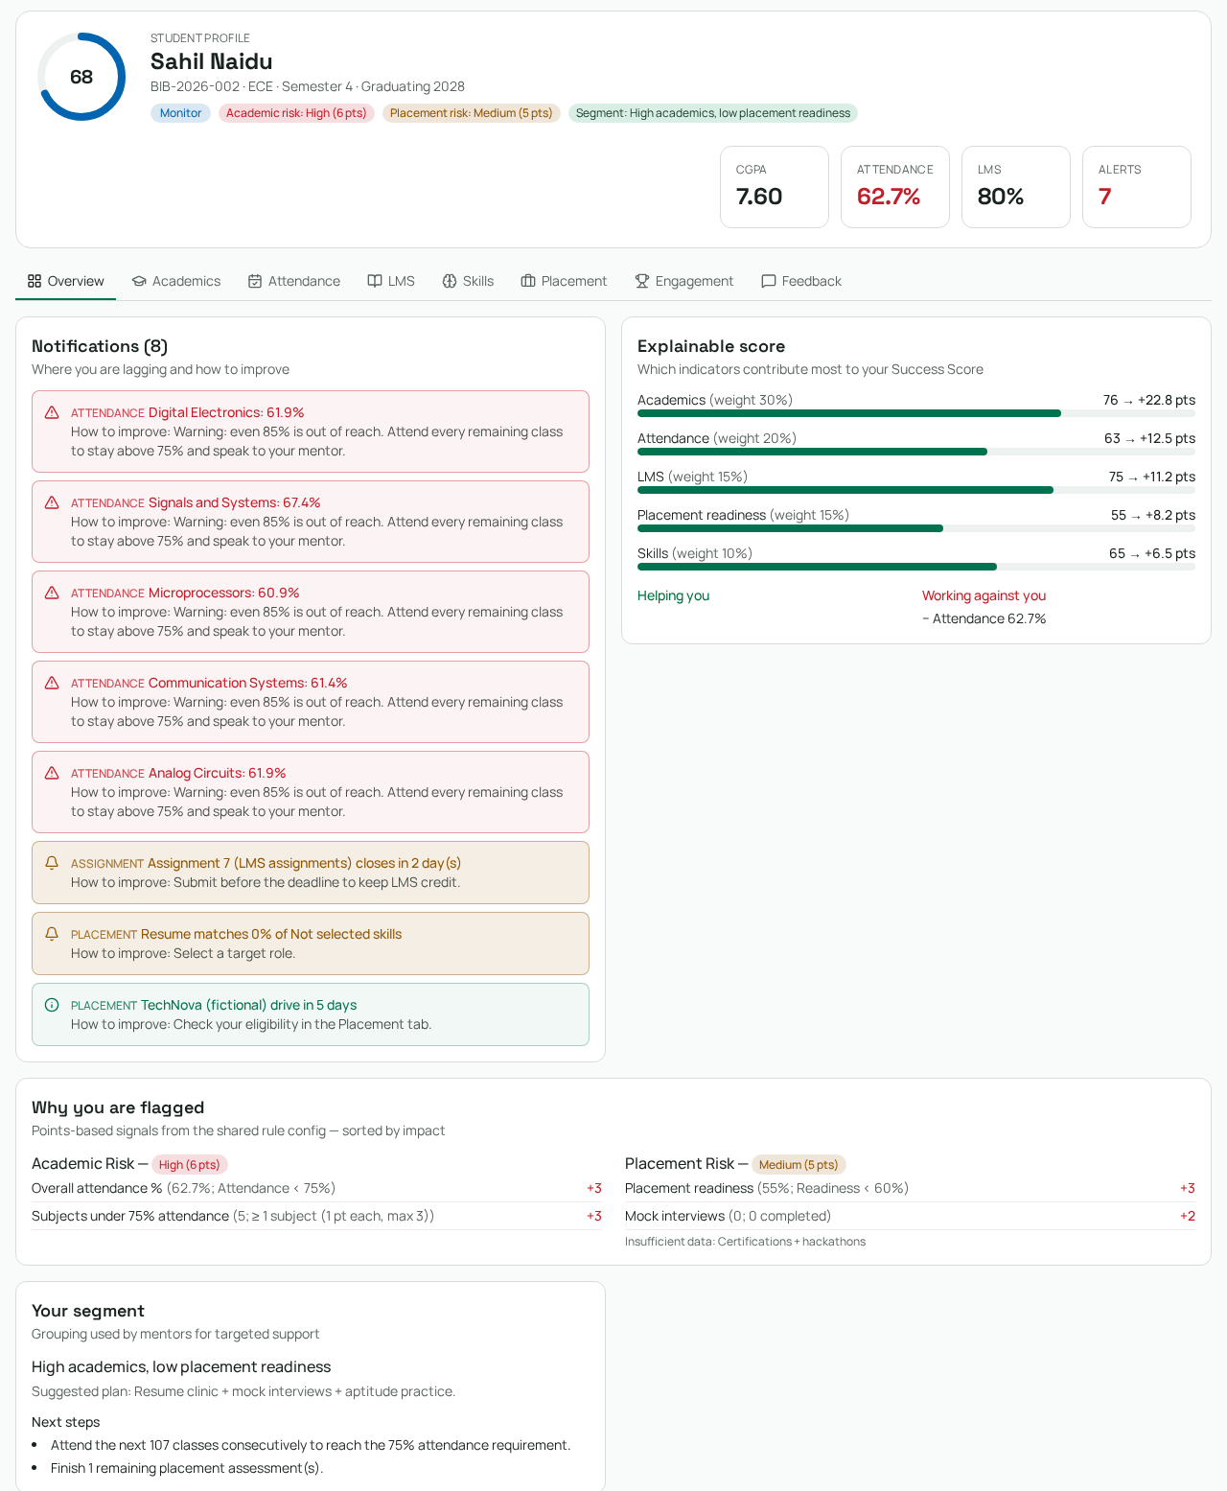
FEATURE WALKTHROUGH
Worked example: good CGPA, serious attendance risk
Academic: High · 6 pts
62.7% attendance adds 3; five subjects below 75% add the capped 3.
Placement: Medium · 5 pts
55% readiness adds 3; zero completed mock interviews add 2.
Overall: Monitor
Score 68.0 and CGPA 7.60 do not erase the two distinct preparation concerns.
Sahil Naidu · BIB-2026-002 · Actual fictional dataset record.
BIB InsightIQ / TEAM BIB
24
Notes:
Missing certifications/hackathons are explicitly disclosed as insufficient data. A mentor should check schedule feasibility and discuss attendance support, then resume/assessment/mock interview preparation. The profile recommendation reports 107 classes to recover the aggregate 75% target, which is not a timetable guarantee.
Evidence: supplied challenge prompt and requirements PDFs; current source and preview screenshots. Fictional dataset; illustrative UI activity is not measured institutional behaviour.

Slide 25
ANALYSIS PATTERNS
Cross-source patterns: explanations, not causal claims
Good CGPA + poor attendance
High attendance + declining grades
Attendance support—not a generic academic weakness label.
Discuss learning barriers despite consistent class attendance.
Good marks + incomplete LMS
Strong coding + weak aptitude
Check pending learning tasks and submission evidence.
Target quantitative-reasoning practice.
High CGPA + low placement readiness
Multiple simultaneous signals
Resume, assessment and mock-interview support.
Prioritize mentor review across sources.
BIB InsightIQ / TEAM BIB
25
Notes:
Cross-source rules are implemented in src/lib/scoring.js. Some insight thresholds and LMS calculations are legacy heuristics distinct from the official risk-rule table. A production system should consolidate policy versions and include dates and data provenance; correlation is never proof of cause.
Evidence: supplied challenge prompt and requirements PDFs; current source and preview screenshots. Fictional dataset; illustrative UI activity is not measured institutional behaviour.

Slide 26
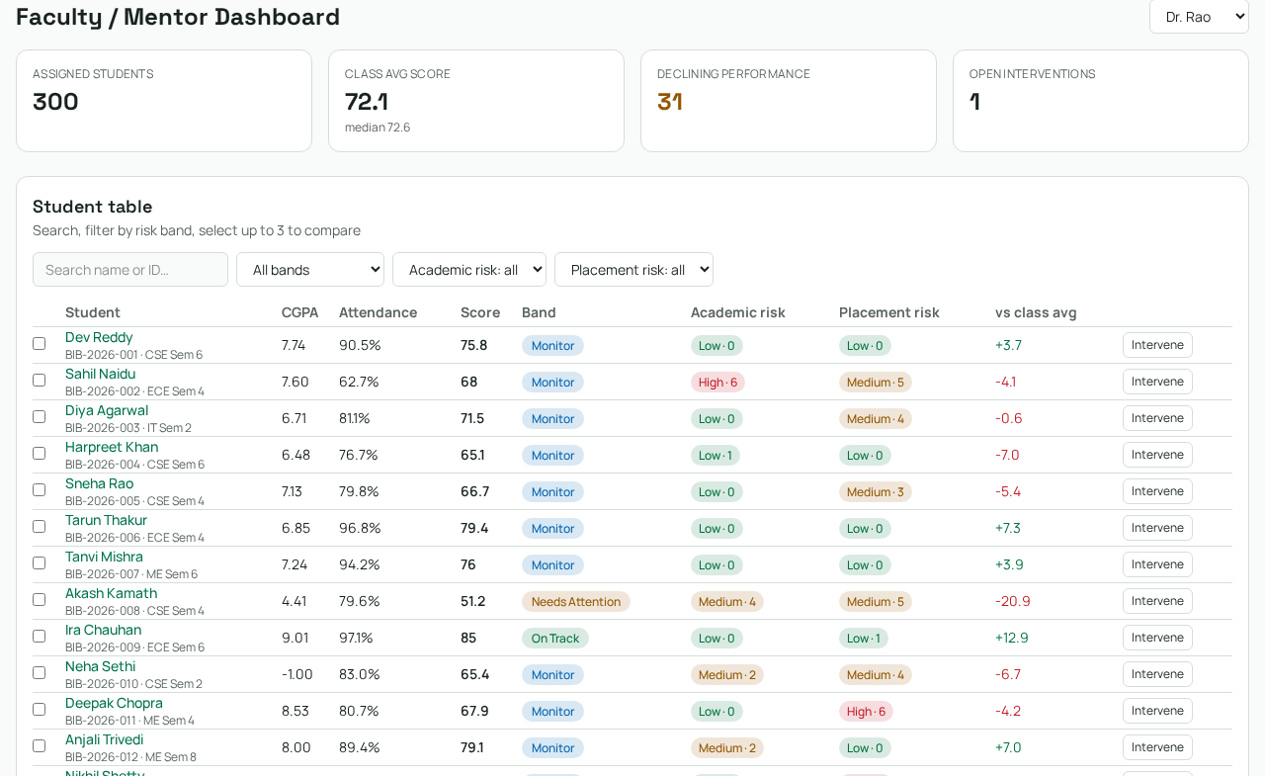
FEATURE WALKTHROUGH
Faculty: filter both risks, then open the evidence
Cohort overview
Assigned count, class mean/median, declining profiles and open interventions.
Search & dual filters
Search name/ID; filter the overall band and each flag independently.
Compare & intervene
Select up to three students, drill into profiles or create a support action.
Demo cohort access is illustrative; private mentor assignment must be enforced server-side.
BIB InsightIQ / TEAM BIB
26
Notes:
The current demo screenshot shows 300 assigned students for Dr. Rao. Do not claim all advanced addendum filters such as missing data, subject, overdue tasks or timestamped urgency sorting exist from these controls.
Evidence: supplied challenge prompt and requirements PDFs; current source and preview screenshots. Fictional dataset; illustrative UI activity is not measured institutional behaviour.

Slide 27
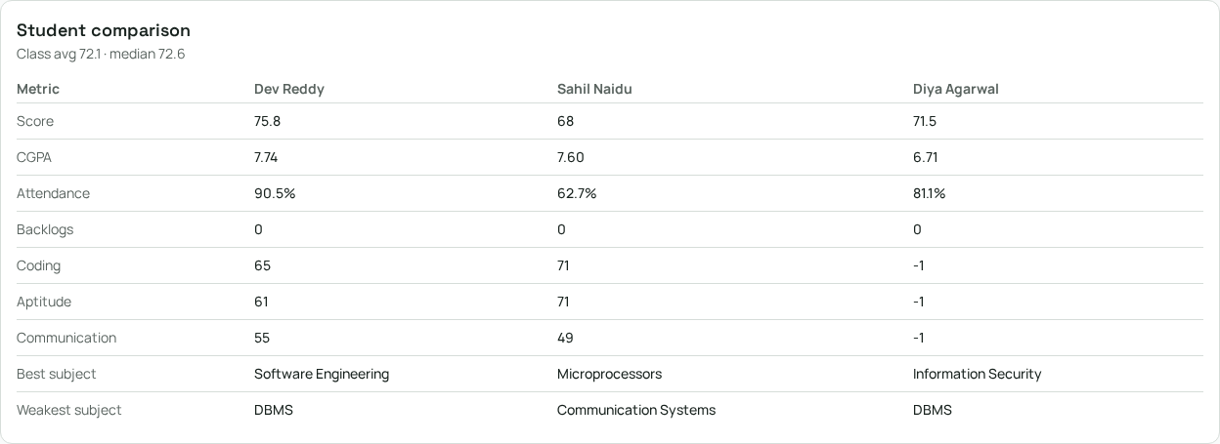
COMPARISON PATTERN
Faculty comparison: label the baseline
What is implemented
Compare up to three students across score, attendance, skills and subject strengths.
What needs more context
Class mean/median are shown. Dates, sample sizes and anonymous peer modes need expansion.
BIB InsightIQ / TEAM BIB
27
Notes:
Missing skill sentinels (-1) currently appear in this public comparison: a known presentation gap; these must become Unknown before real use. The comparison panel appears below the long cohort table. Private peer feedback, resumes and complaints should never be included. Demo fictional peer records are public; do not infer production authorization from their availability.
Evidence: supplied challenge prompt and requirements PDFs; current source and preview screenshots. Fictional dataset; illustrative UI activity is not measured institutional behaviour.

Slide 28
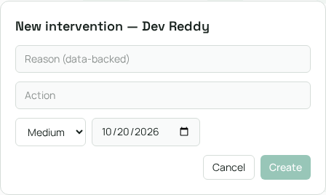
ACTION WORKFLOW
Mentor intervention: turn a flag into ownership
1 Record evidence
Reason, proposed action and priority.
2 Assign follow-up
Owner and follow-up date make the plan reviewable.
3 Track state
Open → in-progress → resolved. Demo changes persist in this browser.
BIB InsightIQ / TEAM BIB
28
Notes:
Public demo store persists interventions to localStorage. The private portal has an interventions route and server-backed operation paths; account-level end-to-end persistence/outcome checks were not performed for this deck. A resolved state does not prove the intervention caused a metric improvement.
Evidence: supplied challenge prompt and requirements PDFs; current source and preview screenshots. Fictional dataset; illustrative UI activity is not measured institutional behaviour.

Slide 29
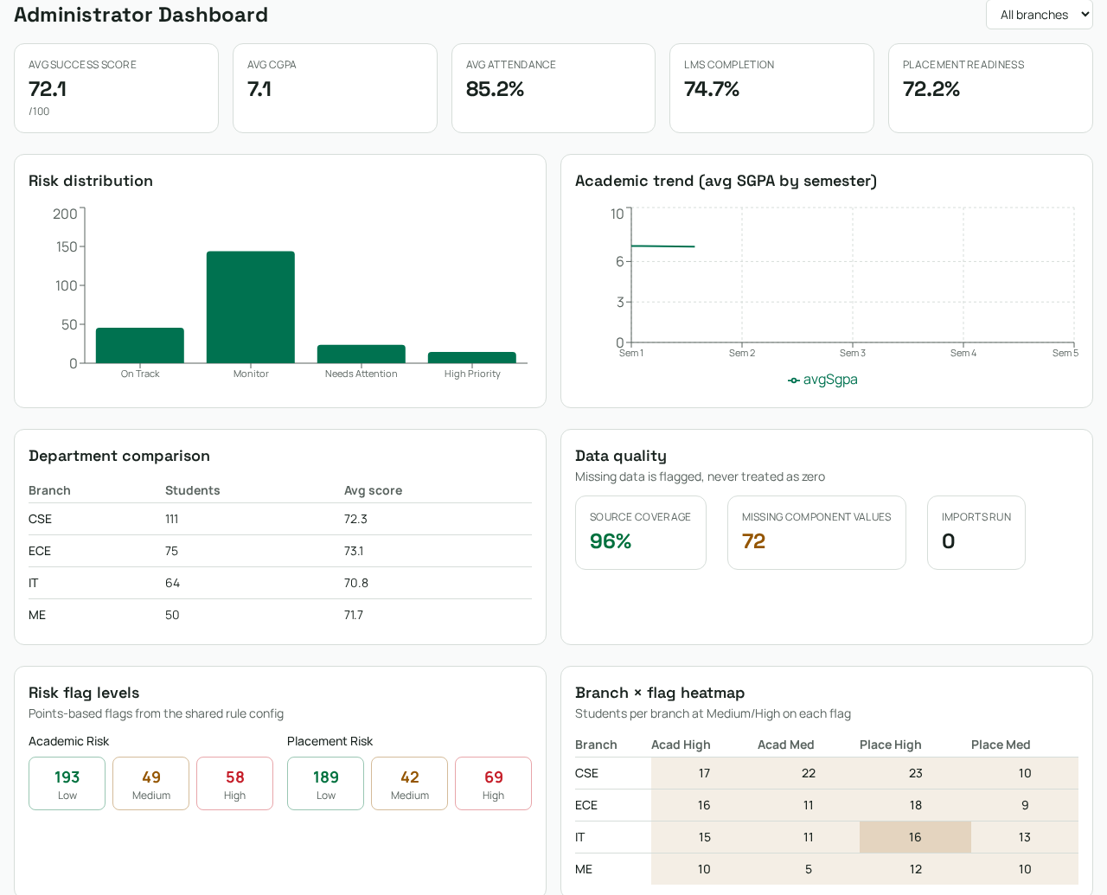
FEATURE WALKTHROUGH
Administrator: patterns at campus scale
Shared campus metrics
Mean Success Score, CGPA, attendance, LMS and readiness.
Two flag distributions
Academic: 193 Low / 49 Medium / 58 High. Placement: 189 / 42 / 69.
Branch × flag heatmap
Counts of Medium/High flags support branch-level review, alongside branch size.
Heatmap values are counts, not rates; compare with each branch’s student count.
BIB InsightIQ / TEAM BIB
29
Notes:
Counts captured from current dashboard: CSE111, ECE75, IT64, ME50. Academic high CSE17/ECE16/IT15/ME10; placement high23/18/16/12. High flags can overlap; do not add 58+69 to infer unique high-risk students.
Evidence: supplied challenge prompt and requirements PDFs; current source and preview screenshots. Fictional dataset; illustrative UI activity is not measured institutional behaviour.

Slide 30
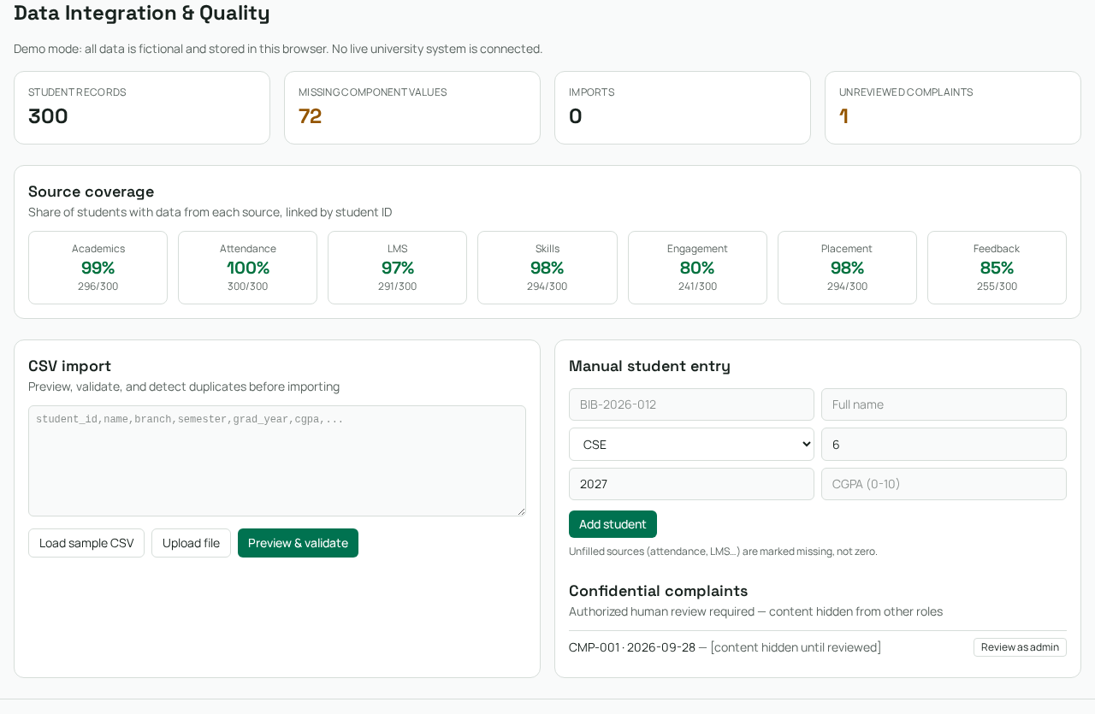
FEATURE WALKTHROUGH
Operations: inspect coverage, validate, then import
Source visibility
Seven source-coverage tiles and missing-component totals.
Unified CSV & manual entry
Preview, validation, duplicate reporting and a basic student-entry form.
Review surfaces
Import log/counts and admin-only complaint review. Demo state stays local.
The manual-entry form is implemented; live ingestion of seven separate raw feeds is a different requirement.
BIB InsightIQ / TEAM BIB
30
Notes:
The audit was corrected by the actual preview and source: manualSchema validates basic fields and addStudents persists the demo record. Unified CSV import is not equivalent to complete seven-feed cleaning/provenance or institutional integration.
Evidence: supplied challenge prompt and requirements PDFs; current source and preview screenshots. Fictional dataset; illustrative UI activity is not measured institutional behaviour.

Slide 31
MODEL & REQUIREMENTS
Requirements followed: core analytics and demo
Requirement | Current evidence | Scope / remaining limitation
Seven-source unified identity | 300-student seed; shared ID | Offline prepared data; no live campus feed
Explainable score & missing handling | Components, weights, data gaps | Admin policy versioning not verified
Separate Academic / Placement Risk | Rules, points, sorted drivers | Dates/provenance need expansion
Three linked dashboards | Student, faculty, admin screenshots | Private role E2E not verified
CSV + manual student entry | Data page; preview/validation | Unified input, not seven-feed ingestion
Intervention create/status | Faculty form and local state | Private persistence needs E2E checks
BIB InsightIQ / TEAM BIB
31
Notes:
Implemented means demonstrable in the public fictional workspace or directly identified in source; it does not mean fully production accepted. Requirements sources: main PDF sections1–18, addendum19.1–19.6 and pasted implementation prompt.
Evidence: supplied challenge prompt and requirements PDFs; current source and preview screenshots. Fictional dataset; illustrative UI activity is not measured institutional behaviour.

Slide 32
MODEL & REQUIREMENTS
Requirements followed: student feature depth
Area | Available feature | Not established by the demo
Academics & attendance | Marks, trends, backlogs, target planner | Full exam/timetable & audited corrections
LMS & tasks | Completion, unit/task/resource UI | Real uploads, submissions, live activity
Skills & placement | Skill cards, practice UI, eligibility | Live scored attempts, real recruiter feeds
Engagement & support | Opportunities, feedback, complaint entry | Real evidence approval and outcomes
Comparison & fairness | Faculty metric comparison; role demo guards | Dated aggregate peer modes, full policy QA
Notifications | Evidence-based in-app demo alerts | Scheduled email/push delivery
BIB InsightIQ / TEAM BIB
32
Notes:
The source includes additional authenticated portal pages for learning, skills, engagement, feedback, messages and audit. Their presence alone does not verify full secure end-to-end workflows. Distinguish deterministic UI examples from actual imported records.
Evidence: supplied challenge prompt and requirements PDFs; current source and preview screenshots. Fictional dataset; illustrative UI activity is not measured institutional behaviour.

Slide 33
TECHNICAL OVERVIEW
Architecture: two data paths with different promises
Public fictional workspace
Authenticated portal foundations
React 19 + TanStack Start
Tailwind / shadcn/ui / Recharts
Shared seed + local browser state
Score and risk-rule utilities
Server-side account and role checks
PostgreSQL-backed record operations
Assigned/private portal routes
Server-side assistant transport
Public demo data is inspectable. Protect real records in server/database policy—not with navigation checks alone.
BIB InsightIQ / TEAM BIB
33
Notes:
Current package/source includes PostgreSQL pg, bcryptjs/jose and server-backed campus modules. Avoid promising a specific hosted auth implementation from stale docs. This deck presents the public demo and source-level private foundation; hosted deployment settings and authenticated user journeys remain unverified.
Evidence: supplied challenge prompt and requirements PDFs; current source and preview screenshots. Fictional dataset; illustrative UI activity is not measured institutional behaviour.

Slide 34
QUALITY & ACCEPTANCE
Verification: what the evidence actually proves
33 Tests passed
300 Reference records checked
08 Student tabs captured
6 test files: scoring, flags, dataset, routing and live-profile derivation.
Risk points/levels and bands match; score test permits ±1.5 for LMS rounding.
Current preview screenshots document the visible features and role dashboards.
Still to verify: signed-in role isolation, real saves, resource/evidence flows, mobile layouts and complete policy acceptance.
BIB InsightIQ / TEAM BIB
34
Notes:
Test log: /tmp/bib-ppt/tests.log, all33 passed in6 files. Dataset test checks score parity within ±1.5, not exact decimal equality; flag points/levels and effective bands have exact checks. Screenshots are 1280×1800 preview captures with crops for readability. Automated tests are not a security audit.
Evidence: supplied challenge prompt and requirements PDFs; current source and preview screenshots. Fictional dataset; illustrative UI activity is not measured institutional behaviour.

Slide 35
DEMO RUNBOOK
A repeatable demo that follows the student journey
01 Explain the problem
02 Open student demo
Landing → three questions → seven sources.
Overview → attendance → skills/placement.
03 Explain two flags
04 Mentor response
Use Sahil’s profile to show values, rules and points.
Faculty filters → compare → create intervention.
05 Campus perspective
06 Close honestly
Admin flag counts → branch heatmap → data quality.
Show tested calculations and the production-readiness roadmap.
BIB InsightIQ / TEAM BIB
35
Notes:
Start in a fresh demo session. Choose Teacher/Admin demo at the access page to change roles; do not try to bypass a Student demo restriction. Sahil profile can be opened from the faculty/admin fictional cohort. Reset changes only in the demo, not production.
Evidence: supplied challenge prompt and requirements PDFs; current source and preview screenshots. Fictional dataset; illustrative UI activity is not measured institutional behaviour.

Slide 36
ROADMAP
Next phase: make evidence durable, secure and auditable
Data trust
Secure workflows
Live seven-feed ingestion, cleaning/provenance report, freshness and dated snapshots.
Verify private role journeys, assignments, uploads, evidence approval and durable support actions.
Fair analytics
Measured follow-up
Dated baseline comparisons, sample sizes, missing-data effects and versioned scoring policies.
Scheduled notifications and before/after reporting without unsupported causal claims.
BIB InsightIQ / TEAM BIB
36
Notes:
Priorities reflect requirements not fully demonstrated. The deck does not request or perform any application changes. Scope should be validated through authenticated tests and institution-authorized data before deployment to real students.
Evidence: supplied challenge prompt and requirements PDFs; current source and preview screenshots. Fictional dataset; illustrative UI activity is not measured institutional behaviour.

Slide 37
THE TAKEAWAY
Explainable insights. Human-led support.
Who needs help?
Why are they at risk?
What should faculty do next?
BIB InsightIQ connects the evidence—
so support can be specific, timely and accountable.
BIB InsightIQ / TEAM BIB
37
Notes:
TEAM BIB — Biryani Intelligence Bureau. References: BIB_InsightIQ_Project_Requirements_1.pdf; BIB_InsightIQ_Project_Requirements_v2.pdf; Final Implementation Prompt; uploaded bib_insightiq_dataset.zip and current application source, tests and screenshots. This project uses a fictional dataset, deterministic rules and illustrative activity content.
Evidence: supplied challenge prompt and requirements PDFs; current source and preview screenshots. Fictional dataset; illustrative UI activity is not measured institutional behaviour.

