Slide 1


Cloud-Based Disaster Recovery
An Automated System for Resilient Infrastructure (CDRAS)
Presented by:
Perineni Lakshith

Slide 2


Problem & Motivation
The Problem
The Solution
System downtime is costly. Manual recovery is slow, error-prone, and inefficient, leading to significant business disruption.
An automated system to detect failures, manage backups, and orchestrate recovery instantly, ensuring compliance and business continuity.

Slide 3
Stakeholders & Objectives
Stakeholder Role | Priority | Key Interests
Cloud Administrator | High | Reliability, automation
IT Manager | High | Fast recovery, compliance
Application Developer | Medium | Continuous uptime
Compliance Officer | Low | Legal and audit logs

Slide 4


Core Requirements
Functional
Non-Functional
✓
Real-time failure monitoring
✓
Availability: 99.99% uptime
✓
Cloud-based data backup & replication
✓
Durability: 11 9's for backups
✓
Automated recovery workflows (runbooks)
✓
Latency: < 200 ms monitoring
✓
Automatic failover to secondary region
✓
Security: End-to-end encryption
✓
Admin notifications & audit logs
✓
Scalability: Scales with monitored systems

Slide 5
Constraints & Assumptions
»
Connectivity: Internet connectivity is required for all cloud operations.
»
Infrastructure: Solution is constrained to AWS or Azure environments.
»
Regions: Recovery regions must be pre configured before deployment.
»
Backups: Backup size is limited to ≤ 5 TB for initial free-tier testing.

Slide 6
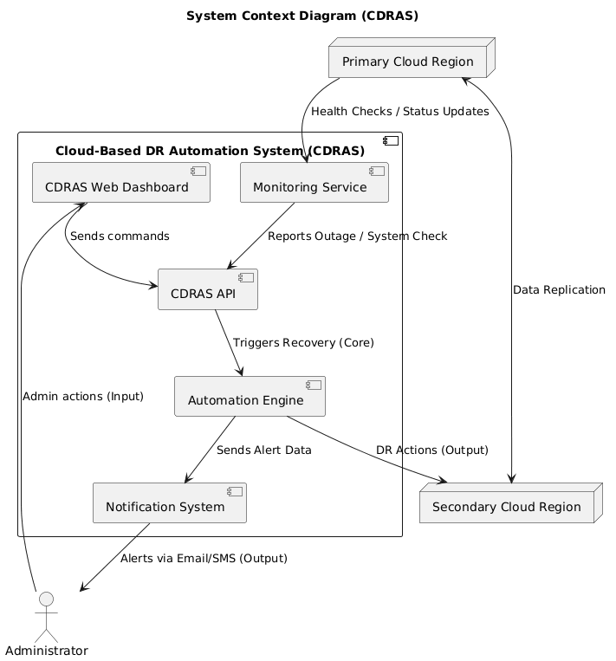

System Context Diagram
CDRAS sits between the Administrator and the physical Cloud Regions, orchestrating Monitoring, Automation, and Notifications.
→
Admin : interfaces via the Web Dashboard.
→
Monitoring Service : checks Primary Cloud Region health.
→
Automation Engine : manages failover to the Secondary Region.

Slide 7


Use Cases & User Stories
Key Use Cases
User Stories
✓
Monitor Systems : (System Monitor)
✓
Admin : "I want to receive alerts if a primary server goes down so I can verify the failover."
✓
Trigger Backup : (Admin, System)
✓
Failover Recovery : (Automation Engine)
✓
Developer : "I want to test recovery drills automatically every week."
✓
Notify Admin : (Notification System)
✓
Auditor : "I want to see logs of every recovery action."

Slide 8
Core Sequence Diagram (Failover Example)
»
System Monitor : detects outage and alerts CDRAS API.
»
CDRAS API : triggers the Automation Engine recovery script.
»
Automation Engine : instructs Cloud Provider to spin up backup instance.
»
Cloud Provider : updates DNS Service for traffic rerouting.
»
Automation Engine : sends alert to Notification System .
»
Notification System : informs Admin that recovery is completed.

Slide 9






High-Level Architecture: Backend Services
Frontend
Orchestration
Monitoring & Notif.
Web Dashboard (React / Flask) for administrative control.
Recovery Orchestrator handles runbooks and state machines.
Dedicated Monitoring and Notification services for real-time awareness.

Slide 10




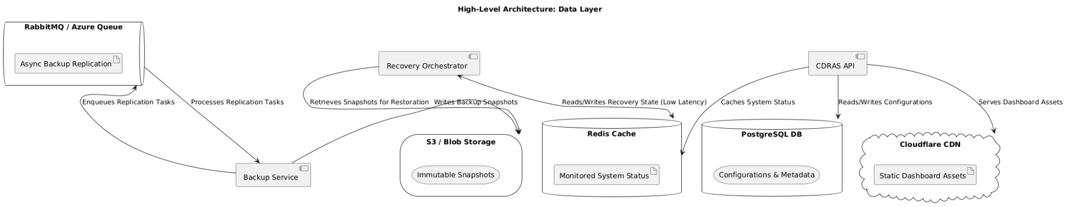
High-Level Architecture: Data Layer
Data Stores
Queues & Cache
Content Delivery
PostgreSQL for configurations. S3/Blob Storage for snapshots.
RabbitMQ / Azure Queue for async tasks. Redis to store rapid recovery state.
Cloudflare (or similar CDN) used for efficient distribution of static dashboard content.

Slide 11


Engineering: Capacity Planning & Sizing
Key Metrics
Back-of-the-Envelope Sizing
✓
✓
Monitoring Load : 100 systems × 10 checks/min = 1000 API calls/min
RTO (Recovery Time Objective) :Target < 5 min
✓
Storage Load : 1 GB avg backup/system/day → 100 GB/day total storage
✓
RPO (Recovery Point Objective) : Target < 1 min data loss

Slide 12


Engineering: API Specification & Data Model
API Specification (Recovery Endpoint)
Core Data Model Schemas
POST /api/v1/recover BODY: { "region": "east-us", "system_id": "srv-101" } RESPONSE: { "status": "recovered", "time": "2025-10-30T12:00:00Z" }
System(system_id, name, region, status) Backup(backup_id, system_id, timestamp, storage_path) RecoveryLog(log_id, system_id, event, timestamp) User(user_id, role, email)

Slide 13
Engineering: Consistency Choices & Caching
»
Strong Consistency : Required for recovery status and backup confirmations (critical operations).
»
Eventual Consistency : Acceptable for reporting dashboards and non-critical data visualization.
»
Caching : Redis cache is utilized for storing recently monitored system status for low-latency dashboard viewing.
»
Indexing : Mandatory indexing on key lookup fields: `system_id` and `timestamp`.

Slide 14
Engineering: Resilience Mechanisms
»
Retries : 3 attempts maximum with exponential backoff for external cloud API calls.
»
Timeouts :Critical cloud API calls are enforced with a strict 5-second timeout.
»
Circuit Breaker : Logic opens the circuit after 3 consecutive failures to prevent cascading downstream overload.

Slide 15


Engineering: Rate Limiting Policy
User-Based Limits
System-Wide Limits
✓
100 monitoring requests/min per individual user (Admin/Developer).
✓
5000 API calls/min maximum system-wide throughput limit.

Slide 16


Engineering: Observability Stack
Logs
Metrics
Traces
Stored in ELK (Elastic Stack) for centralized search and analysis.
Prometheus + Grafana for monitoring RTO, RPO, CPU, and backup frequency.
Open Telemetry is used for distributed tracing across all microservices.

Slide 17


Engineering: Maintenance & DR Drill Plan
Routine Maintenance
Disaster Recovery Drills
✓
Weekly backup integrity verification.
✓
Monthly automated failover drills (testing RTO/RPO).
✓
Automated patch deployment schedule.
✓
Quarterly comprehensive scalability tests.

Slide 18







Quality Targets: Service Level Objectives (SLOs)
Availability: ≥ 99.99%
Latency: < 200 ms
RTO: < 5 Minutes
RPO: < 1 Minute

Slide 19
Scalability Plan
Trade-Off Discussion
Scalability Plan
»
Horizontal Scaling : Utilizing Kubernetes or Azure AKS for auto-scaling stateless services.
**Horizontal Scaling:** Utilizing Kubernetes or Azure AKS for auto-scaling stateless services.
»
»
**Multi-region Backup:** Benefit (Higher reliability) vs. Drawback (Higher cost).
»
Partitioning : Backup data will be partitioned (sharded) by region or customer identifier.
**Partitioning:** Backup data will be partitioned (sharded) by region or customer identifier.
»
»
**Eventual Consistency:** Benefit (Better scalability) vs. Drawback (Possible stale data on dashboards).
»
CDN : Leveraging a Content Delivery Network (Cloudflare) for highly performant delivery of dashboard assets.
**CDN:** Leveraging a Content Delivery Network (Cloudflare) for highly performant delivery of dashboard assets.
»
»
**Serverless Recovery:** Benefit (Fast auto-scaling) vs. Drawback (Cold start delays).

Slide 20
Trade-Off Discussion
Trade-Off Discussion
»
Multi-region Backup : Benefit (Higher reliability) vs. Drawback (Higher cost).
»
**Multi-region Backup:** Benefit (Higher reliability) vs. Drawback (Higher cost).
»
Eventual Consistency : Benefit (Better scalability) vs. Drawback (Possible stale data on dashboards).
»
**Eventual Consistency:** Benefit (Better scalability) vs. Drawback (Possible stale data on dashboards).
»
Serverless Recovery : Benefit (Fast auto-scaling) vs. Drawback (Cold start delays).
»
**Serverless Recovery:** Benefit (Fast auto-scaling) vs. Drawback (Cold start delays).

Slide 21
Questions?
Thank you for your time.

