Slide 1
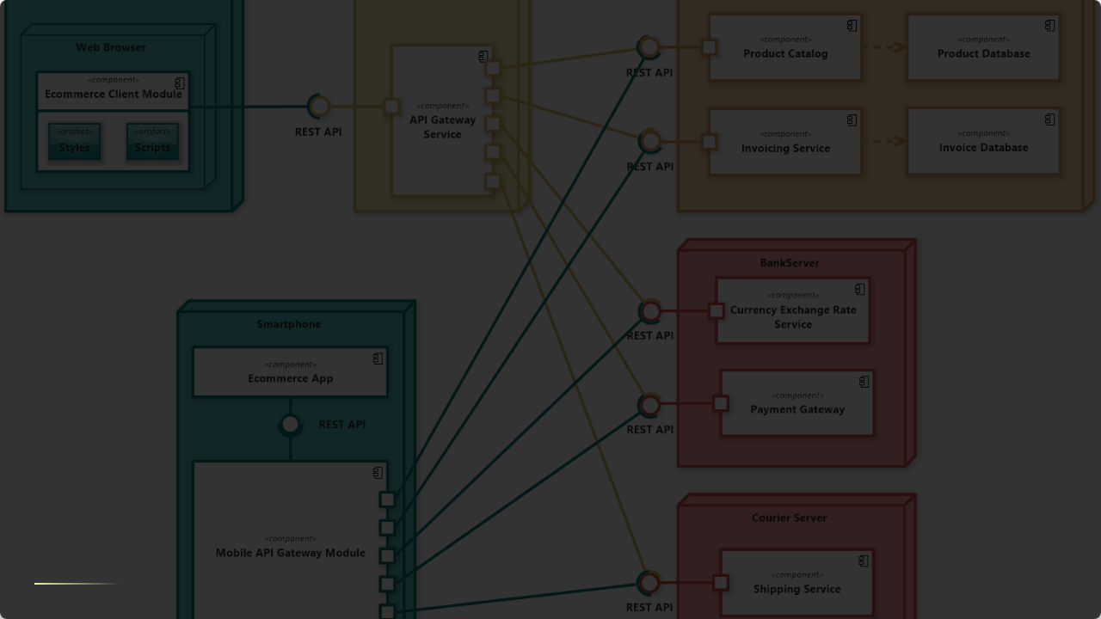
MULTI-TENANT E-COMMERCE MARKETPLACE
Comprehensive Architecture, Design, and Requirements Specification

Slide 2



Requirements Pack: Stakeholders & Stories
Key Stakeholders
Core User Stories
•
Sellers (Tenants): Need storefront customization, inventory mgmt, order processing, and sales analytics.
•
As a Seller: I want to upload bulk inventory via CSV to quickly populate my catalog.
•
Buyers (End Users): Need personalized search, seamless checkout, order tracking, and history.
•
As a Buyer: I want search results to prioritize items based on my browsing history for faster discovery.
•
Admins: Need tenant oversight, billing management, platform configs.
•
As an Admin: I want to disable a tenant's storefront immediately if they violate policy.
•
Developers: Need CI/CD pipelines, monitoring, and easy scalability.

Slide 3
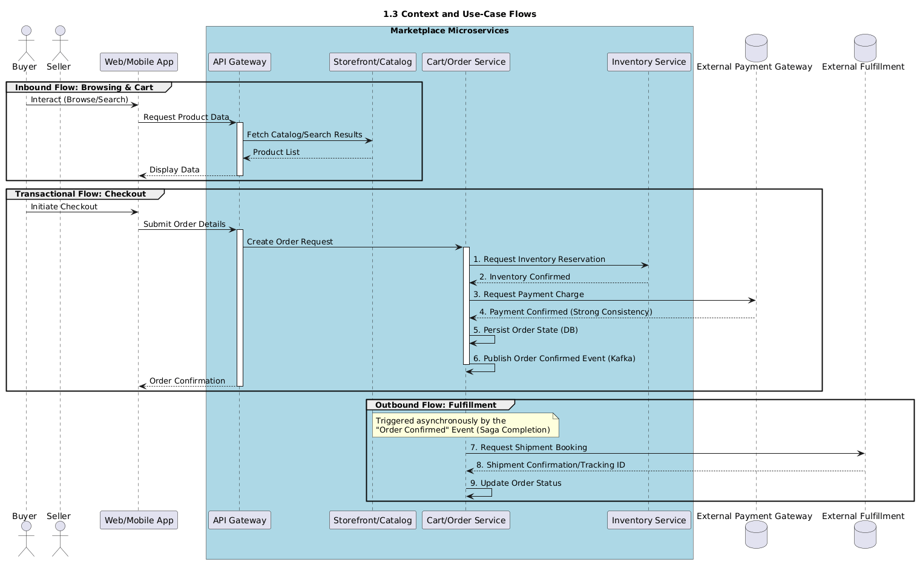
Context Diagram & System Constraints
System Context
•
Inbound: Buyers -> Web/Mobile App -> API Gateway -> Storefront Service.
•
Outbound: Order Service -> Payment Gateway (Stripe/PayPal) -> Shipping (FedEx).
Non-Functional Goals
•
Elastic Scale: Must handle Black Friday traffic spikes without degradation.
•
Strong Consistency: Required for payments and inventory reservation (ACID).
•
Data Privacy: Strict PII protection per tenant (GDPR/CCPA compliance).

Slide 4
Architecture Style Trade-off Analysis
Style | Pros | Cons | Verdict
Monolith | Simple deployment, easy debugging, low latency (local calls). | Single point of failure, tight coupling, hard to scale components individually. | Rejected
Microservices | Elastic scaling (Search vs Checkout), polyglot persistence, fault isolation. | Distributed complexity, eventual consistency challenges, higher ops overhead. | Selected
Serverless | No ops, pay-per-execution, auto-scaling. | Cold starts, vendor lock-in, complex orchestration for long transactions. | Hybrid Use

Slide 5
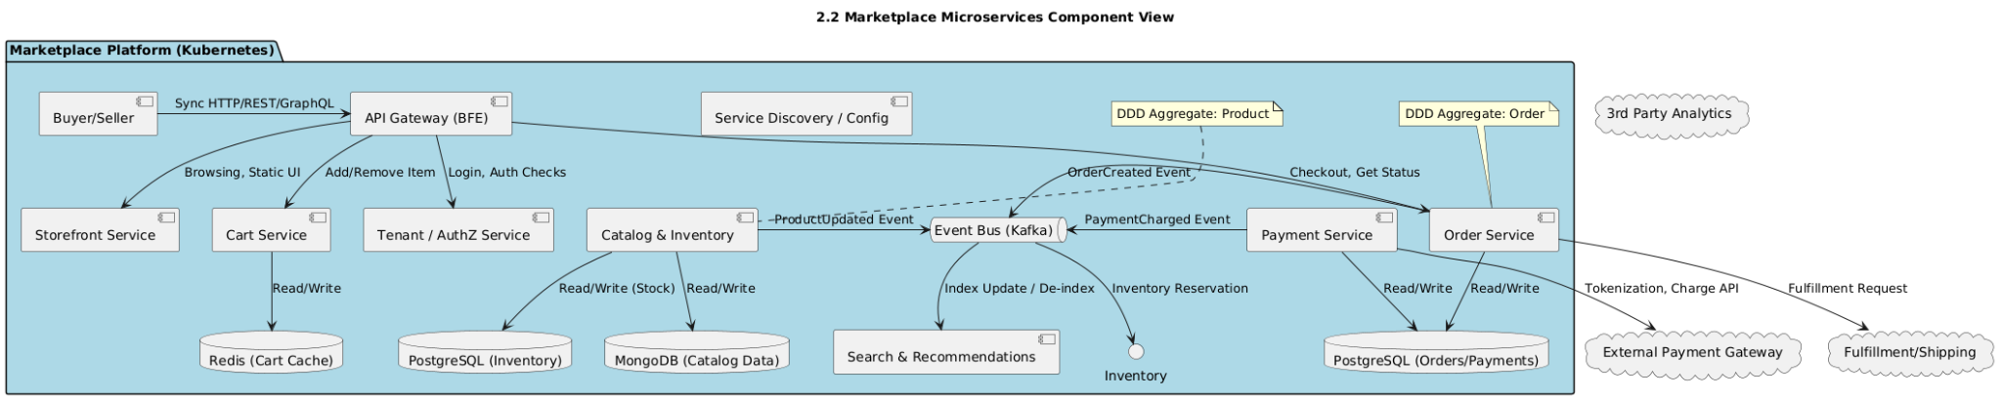
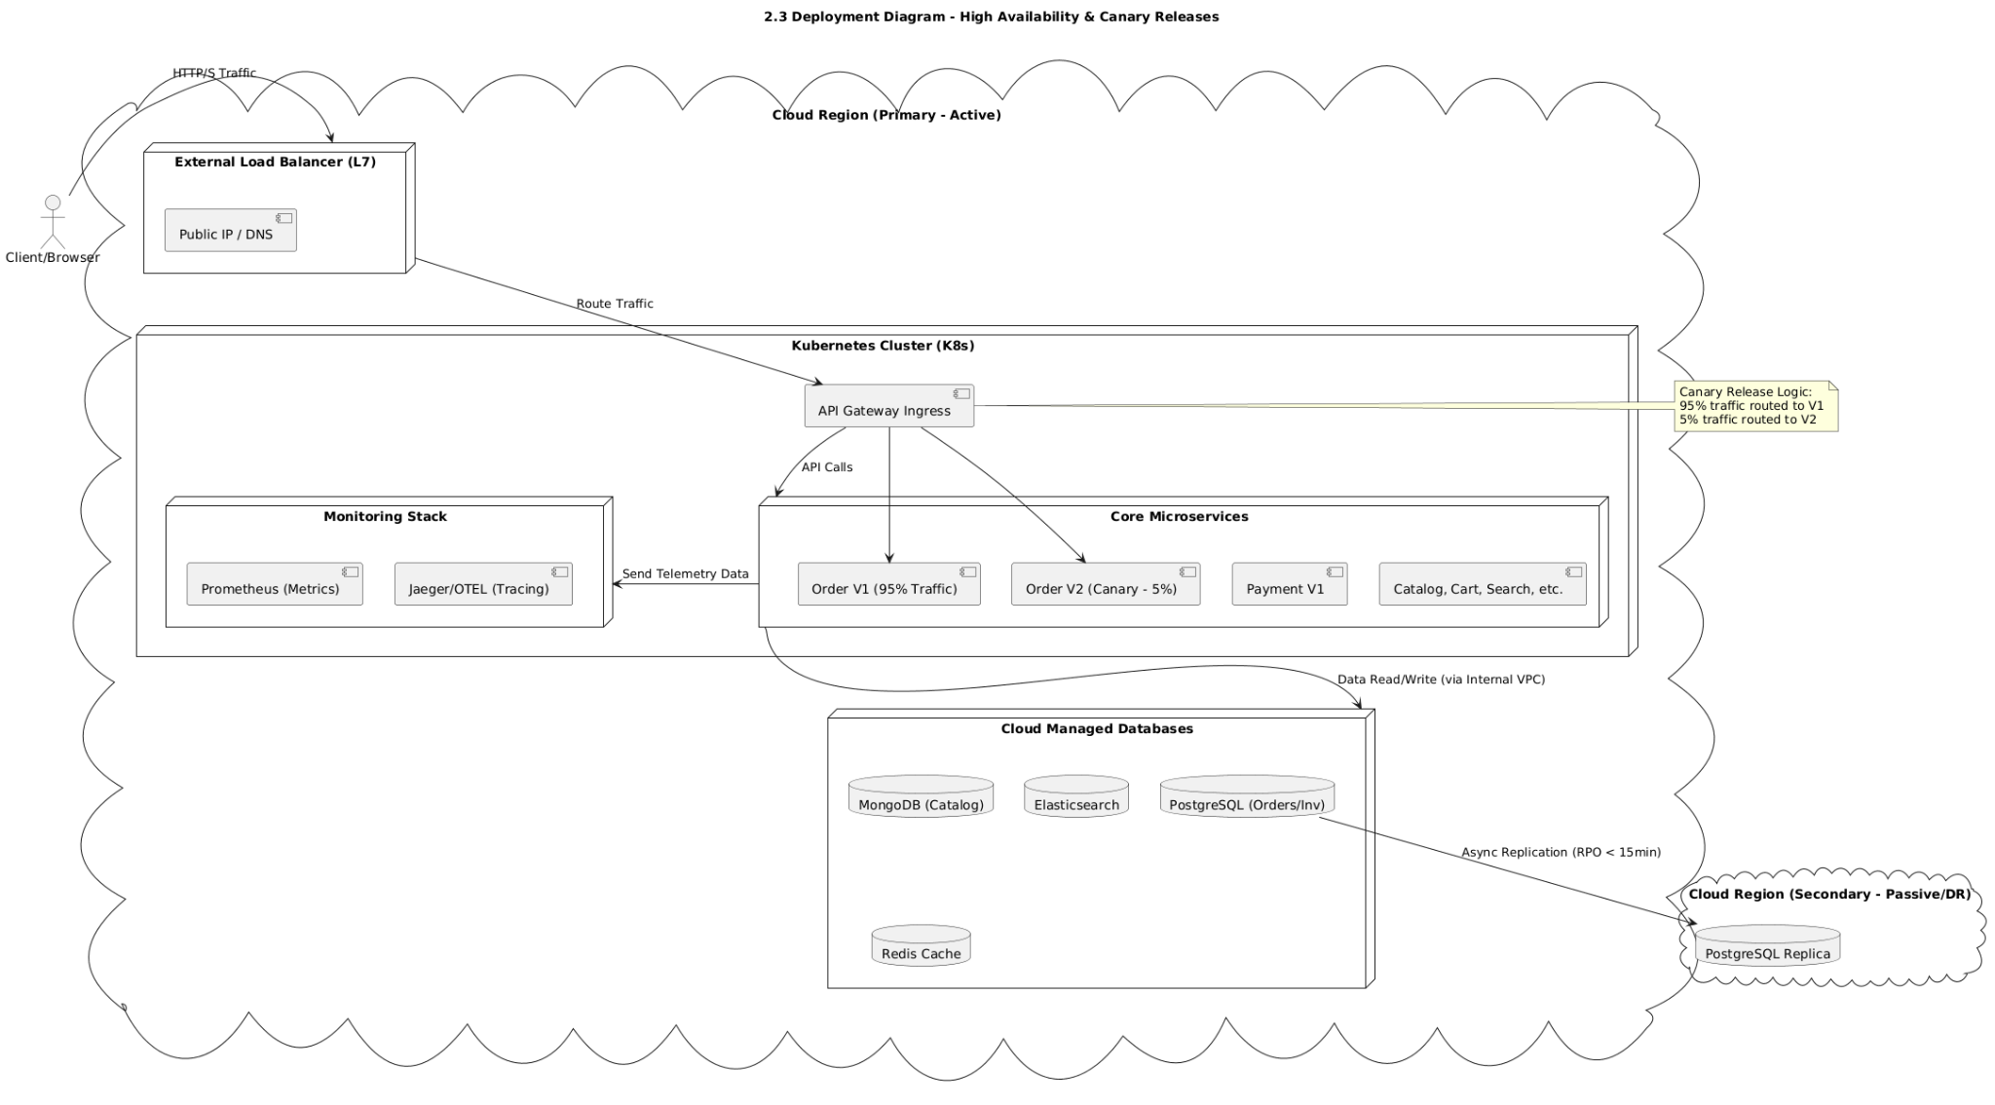
Component & Deployment
Core Components
•
API Gateway: Request aggregation, routing, and rate limiting.
•
Domain Services: Order, Inventory, User, Catalog, Search.
•
Event Bus (Kafka): Asynchronous messaging for decoupling.
Deployment Strategy
•
Orchestration: Kubernetes (K8s) for container management.
•
Config Mgmt: Helm Charts for reproducible deployments.
•
High Availability: Multi-region deployment for disaster recovery.

Slide 6






Selected Design Patterns
Creational
Structural
Behavioral
Factory Pattern: Used to instantiate the correct Payment Provider (e.g., StripeFactory, PayPalFactory) dynamically based on user selection.
Facade: "Search Service" hides complexity of Elasticsearch.
Adapter: Standardizes 3rd-party APIs (Shipping/Payment) into a common interface.
Saga (Orchestration): Manages distributed transactions (Order->Pay->Inventory).
Outbox: Ensures atomic DB update + Event publish.

Slide 7
Anti-Patterns Avoided
Distributed Monolith
Chatty I/O
Problem: Microservices sharing a single database schema, leading to tight coupling and fear of schema changes.
Problem: Frontend making N+1 calls to fetch data (e.g., 1 call for Order, 10 calls for Product details).
Solution: Database-per-service pattern. Each service owns its data and exposes it only via APIs.
Solution: API Gateway (Backend-for-Frontend) aggregates multiple downstream calls into a single response.

Slide 8
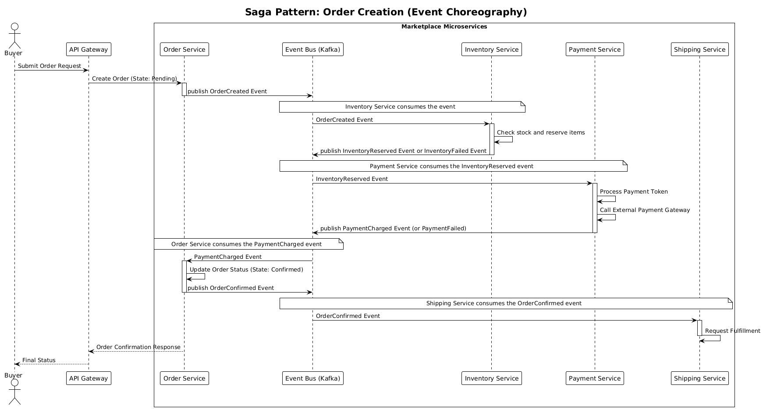
Polyglot Persistence Strategy
Technology Selection
•
PostgreSQL (Relational): Orders, Payments, Users. Chosen for ACID compliance and transactional integrity.
•
MongoDB (Doc Store): Product Catalog. Chosen for flexible schema to support varied product attributes.
•
Elasticsearch: Search Index. Chosen for fuzzy matching, faceting, and high-performance read queries.
Multi-Tenancy
Shared Database, Separate Schema: Balanced cost/isolation. `tenant_id` used in every table with RLS policies.

Slide 9
DB Normalization & Partitioning
Normalization Rationale
Partitioning & Indexing
•
Normalized (SQL): Order/Payment data is highly normalized (3NF) to ensure consistency and reduce redundancy.
•
Sharding Plan: Shard high-volume tables (Orders, Logs) by `tenant_id` for isolation or `order_id` for load distribution.
•
Denormalized (NoSQL): Product data is denormalized (embedded documents) to optimize for read-heavy catalog browsing.
•
Indexing: Composite indexes on `(tenant_id, created_at)` for fast tenant-scoped reporting.

Slide 10


Performance & Scalability Strategies
Caching Strategy
Load Balancing
Backpressure
L1 (In-Memory): Local cache for static configs.
L2 (Redis): Distributed cache for sessions/carts.
CDN: Edge caching for images/assets.
Layer 7: NGINX/ALB routing based on URL path or Tenant Subdomain.
Algorithm: Least connections or Round Robin.
Rate Limiting: Token Bucket algorithm applied per tenant at the API Gateway to prevent "Noisy Neighbor" issues.

Slide 11
Security: Defense in Depth
Threat Model & Auth
OWASP Top 10 Defenses
•
Threat: Tenant Data Leakage. Defense: Row-Level Security (RLS) enforced via `tenant_id`.
•
Injection: Use ORM/Prepared Statements.
•
Broken Access Control: Enforce checks at API Gateway & Service level.
•
Threat: DDoS. Defense: WAF & Rate Limiting.
•
AuthN: OIDC with centralized IdP (Keycloak/Auth0).
•
Sensitive Data Exposure: TLS 1.3 in transit, AES-256 at rest.
•
AuthZ: RBAC using JWT scopes.
•
XSS: Input sanitization and Content Security Policy (CSP).

Slide 12
Reliability & Disaster Recovery
Resilience Patterns
Disaster Recovery (DR)
•
Circuit Breakers: Fail fast if downstream service (e.g., Reviews) is down, preventing cascading failure.
•
Strategy: Active-Passive Multi-region.
•
RPO (Recovery Point Objective): 15 minutes (Async DB replication).
•
Retries: Exponential backoff with jitter for transient errors (e.g., network blips).
•
RTO (Recovery Time Objective): 1 hour (Automated failover scripts).
•
Bulkheads: Isolate connection pools per service.
•
Backups: Hourly incremental snapshots to S3.

Slide 13
API Specification & Standards
Aspect | Standard/Implementation
Protocol | REST: Standard CRUD (Orders, Products). GraphQL: Storefront (fetching complex product graphs).
Versioning | URI Versioning (e.g., `/api/v1/orders`) for explicit client contracts.
Idempotency | `Idempotency-Key` header required for `POST` (Create) and `PATCH` (Pay) to prevent duplicates.
Error Codes | Standard HTTP: 200 (OK), 400 (Bad Request), 401 (Unauth), 403 (Forbidden), 429 (Rate Limit), 500 (Internal).

Slide 14
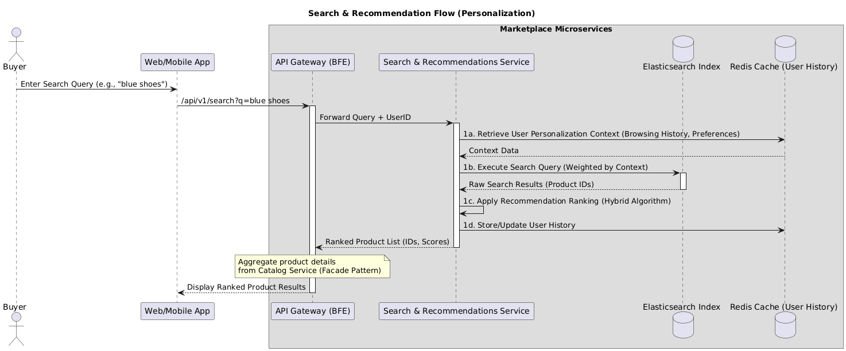
Observability Stack
The Three Pillars
•
Logs: Structured JSON logs aggregated in ELK/Datadog.
•
Metrics: Prometheus collecting RED (Rate, Errors, Duration).
•
Traces: OpenTelemetry (Trace ID propagated across
gateway -> service).
SLOs & Alerting
•
SLO: 99.9% Availability, P99 Latency < 200ms.
•
Alerting: PagerDuty for critical breaches.
•
Runbooks: Automated links in alerts to remediation steps.

Slide 15
Technology Stack Selection
Tier | Selected | Alternatives | Rationale
Backend | Go & Java | Node.js, Python | Go for high-throughput (Checkout); Java for complex domain logic (Order Orchestration).
Frontend | React | Vue, Angular | Component-based, rich ecosystem, large talent pool.
Database | Postgres, Mongo | MySQL, Couchbase | Postgres for robust ACID compliance; Mongo for flexible product attributes.
Infra | Kubernetes | Serverless | Standard for orchestrating containerized microservices; avoids vendor lock-in.

Slide 16
Thank you for your attention

