Slide 1

Basic Details of the Team and Problem Statement
MINISTRY OF ENVIRONMENT
PS Code: SIH1392
Problem Statement Title: E-waste facility locator
Team Name: XORVIANZ
Institute Code (AISHE): C-37028
Institute Name: SONA COLLEGE OF TECHNOLOGY
Theme Name: SMART AUTOMATION

Slide 2
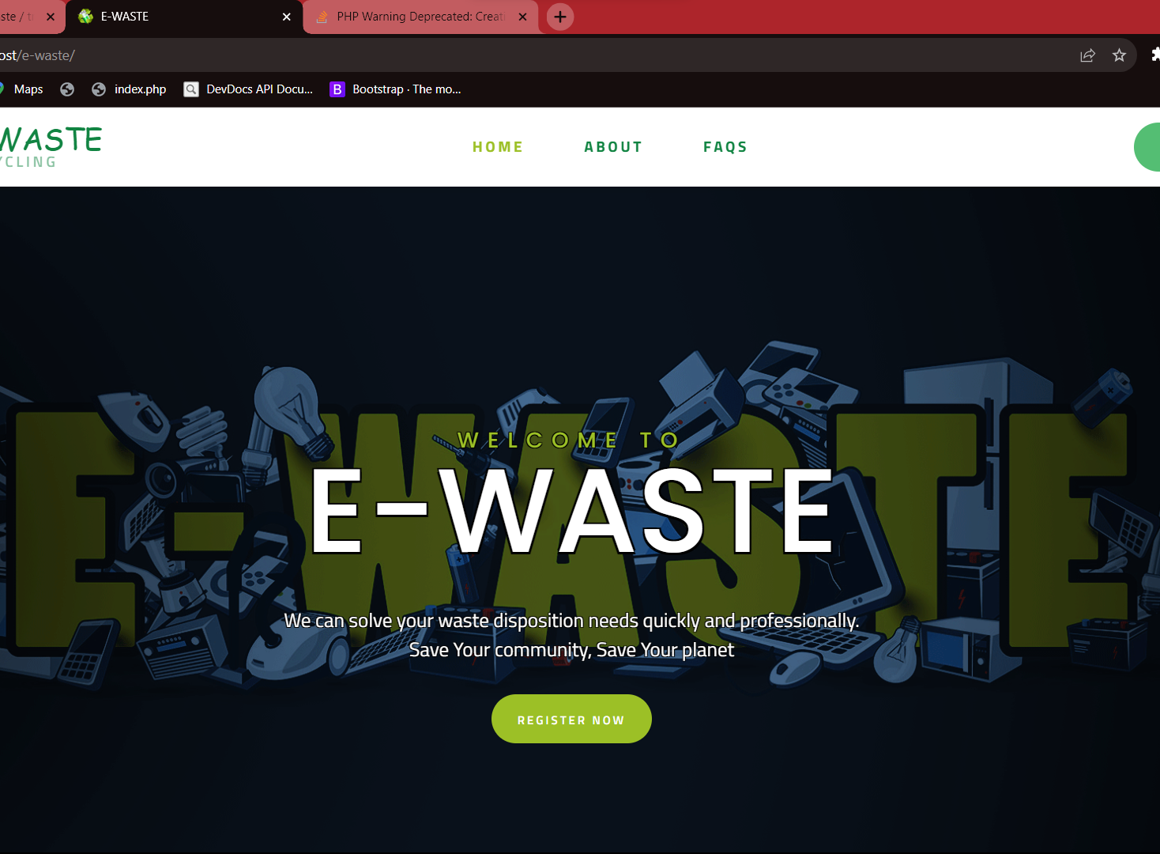
Idea/Approach Details
idea/Solution/Prototype here:
To reduce the e waste in the environment
Recycle the e waste in proper manner
Creating e waste hub to collect the waste
Collect the details of the component need to recycle
Describe your Technology stack here:
Visual Studio Code
XAMPP
SQL
CODE IGNITER
FIGMA

Slide 3
Idea/Approach Details
Use Cases:
Dependencies / Show stopper
User Views Facility Details
User Filters E-waste Facilities
User Receives Sustainability Metrics
Facility Manager Updates Facility Information
User Searches for Special Recycling Events:
Dependencies:
> Data Availability
> Mapping and Geolocation Services:
> API Integration
> User Authentication and Data Security
> Mobile and Web Development Frameworks
Stoppers:
> Lack of Data
> Legal and Privacy Issue
> Technical Challenges
> Lack of User Engagement
>Security Vulnerabilities

Slide 4
Team Member Details
Team Leader Name: LAKSHITHA B
Branch : BE Stream : CSE Year : III
Team Member 1 Name: KISHORE KUMAR A
Branch : BE Stream : CSE Year : III
Team Member 2 Name: HARSHINI S
Branch : BE Stream : CSE Year : III
Team Member 3 Name: JANAGAN A
Branch : BE Stream : CSE Year : III
Team Member 4 Name: KANISHKA S
Branch : BE Stream : CSE Year : III
Team Member 5 Name: KRTHIGHA V
Branch : BE Stream : CSE Year : III
Team Mentor Name: BHUVANESWARI P
Category : Academic Expertise : ML Domain Experience (in years): 5 YEARS

