Slide 1



Name- Vansh Bargotra, Prachi Sharma, Riya Warikoo, Lakshiyta Bhatti
Roll no – 2022a1r095, 2022a1r093, 2022a1r179, 2022a1r106
Department – CSE
Topic – Sorting Techniques: Quick Sort & Merge Sort
Date of presentation- 05-08-2025
Model Institute of Engineering & Technology
Notes:
Presentation slide for courses, classes, lectures et al.

Slide 2
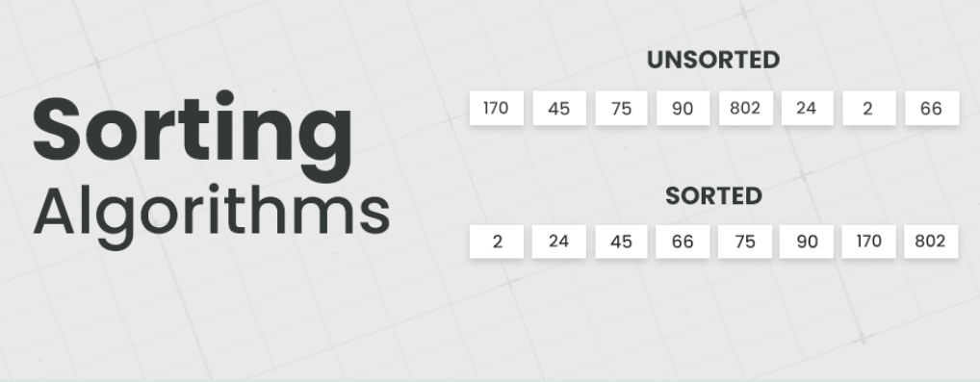
Introduction to Sorting:
Sorting refers to the systematic arrangement of data in a particular sequence, typically in ascending or descending order.
It plays a vital role in optimizing the efficiency of other operations such as searching, merging, and data processing.
Sorting techniques are extensively applied in real-world scenarios, including contact management, e-commerce product filtering, and ranking systems.

Slide 3
Quick Sort:
Quick sort is a divide and conquer algorithm which relies on a partition operation:– to partition an array an element called a pivot is selected.
All elements smaller than the pivot are moved before it and all greater elements are moved after it
The lesser and greater sublists are then recursively sorted- One of the most popular sorting algorithms and is available in many standard programming libraries.
Time Complexity of Quick Sort: O(n log n) (average case)

Slide 4
Algorithm:
If array has 0 or 1 element → return (already sorted).
Choose a pivot (like last element).
Put smaller elements than pivot on left, larger elements on right.
Repeat the same steps for left and right parts (recursively).
When all parts are sorted → final array is sorted.

Slide 5
Examples:
1. Tech Example:
Sorting database query results by a chosen column
Reason: The pivot acts like a chosen reference value; results less than pivot go left, greater go right, and each subset is sorted recursively.
This is exactly how in-memory quick sort in many DB engines works.
2. Non-Tech Example:
Arranging students in a line by height
Reason: Choose one student as a pivot (reference height), send shorter students to the left and taller students to the right, then repeat the same for each side until the line is sorted.

Slide 6
Merge Sort:
Merge sort is a divide and conquer algorithm which recursively divides an array into two halves
Each half is further split until sublists contain only a single element.
The sublists are then merged in sorted order to create larger sorted sublists, ultimately resulting in a single sorted array.
The merging step is where sorted sublists are combined by comparing elements and arranging them in order.
Known for being a stable sorting algorithm, meaning equal elements keep their original order after sorting.
Widely used and available in many standard programming libraries.
Time Complexity of Merge Sort: O(n log n) (average, worst, and best case)

Slide 7
Algorithm:
If array has 0 or 1 element → return (already sorted).
Divide the array into two equal halves.
Recursively apply merge sort on both halves.
Merge the two sorted halves into one sorted array.
When all merging is done → final array is sorted.

Slide 8
Examples:
1. Tech Example:
Sorting very big files (like logs or databases)
Reason: Because Merge Sort works well even when the data is too big to fit in memory.
2. Non-Tech Example:
Sorting books in a library
Reason: Each shelf is sorted separately, then all shelves are merged together.

Slide 9

Thank You

