Slide 1



UIDAI HACKATHON
Team Reference ID : sy8mffJN3v
Team Name: Codesploit

Slide 2
TEAM DETAILS
S.NO | NAME | EMAIL
1 | M.KARTIK | muralikartik01@gmail.com
2 | S.LAKSHMAN | slakshman664@gmail.com
3 | R.KARTHIK RAJA | karthikraja220302@gmail.com
4 | JOAN JEREMIAH | joanjeremiah04@gmail.com
5 | B.MITHUN | mithunb986@gmail.com

Slide 3
PROBLEM STATEMENT !
Theme : Address Update/Authentication Reimagined
Problem Statement:
a)Address Update Challenge in Urban Areas

Slide 4
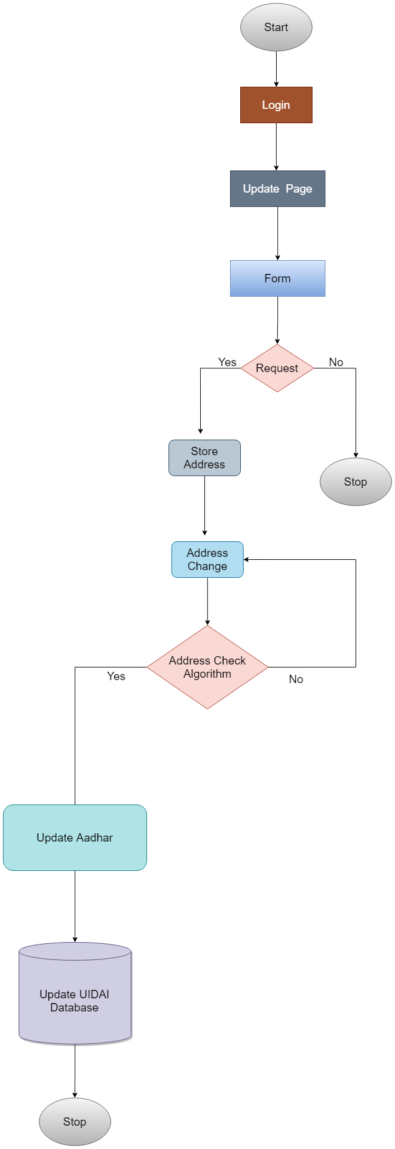
ARCHITECTURAL DIAGRAM .

Slide 5
API USAGE .
- OFFLINE EKYC API
-OTP API
-GEO LOCATION API

Slide 6
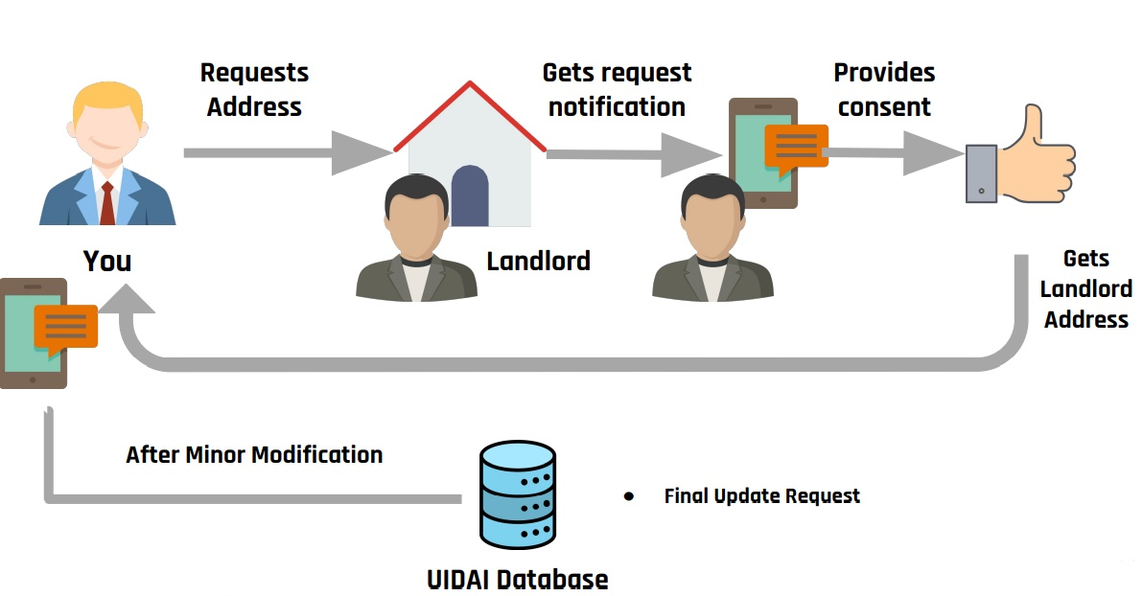
PROCESS FLOW .

Slide 7
PROCESS FLOW FOR USER
user clicks the change of address button
User gets to enter his aadhar number and captcha
User gets an otp to the phone linked with the aadhaar to ensure security
and when the houseowner accepted his request he is directed to the change of address page and process is completed
now he is directed to the status page of his application

Slide 8
PROCESS FLOW FOR USER
User gets to enter this aadhar number and captcha
user clicks the change of address button
now he is directed to the status page of his application
address changing process is initiated by the user
User gets an otp to the phone linked with the aadhaar to ensure security
and when the houseowner accepted his request he is directed to the change of address page and process is completed

Slide 9
PROCESS FLOW FOR HOUSEOWNER/LANDLORD
clicks the link in the message inorder to see the request form
if he accepts the request, then he need to enter the aadhaar number and a passcode
enters the otp sent to his phone and complets the process

Slide 10
FEATURES
Easy user interface, every low end and high end user can access our webapp
A
Each and every data that the user enters in is encrypted and then it is decrypted again when fetched
B
User is notified at each and every step of the process
C

Slide 11
EASY UI
MAXIMUM SECURITY
NOTIFICATION
MULTILANGUAGE FEATURES

Slide 12
WHY OUR WEBAPP? .......
END-TO-END ENCRYPTION
NOTIFICATION FOR EVERY PROCESS
EASY USER UI
MULTILANGUAGE FEATURE
CONTAINS LOG DATA FOR WHOLE PROCESS
EASY PROCESS WITH LOW USER INTERACTION

Slide 13
HOW LOGS WORKS ON OUR WEBAPP
1
2
3
4
5
Once the user login into the webapp , the details of the user is stored
when the user request for the change of address his request is logged
The status of the application is added to log
houseowner/landlords response is added to log
Final status of the address of the user is loged in the final process

Slide 14
HOW NOTIFICATION WORKS ON OUR WEBAPP
01
02
03
04
User gets the notification when he request to change/update the address
houseowner/landlord gets the notification message having the details of the request and a link
user gets the notification regaring the status of his application
landlord gets the notification when the user address is succesfully changed/updated

Slide 15
HOW OUR ENCRYPTION WORK
User/houseowner enters their details to change/update the address
user/houseowner is requesting the date to check its correctness
Insert
fetch
the data is encryted with sha256 encryption process and stored
the data is decryted again with sha256 and displayed to the user/houseowner

Slide 16
THANKS

