Slide 1
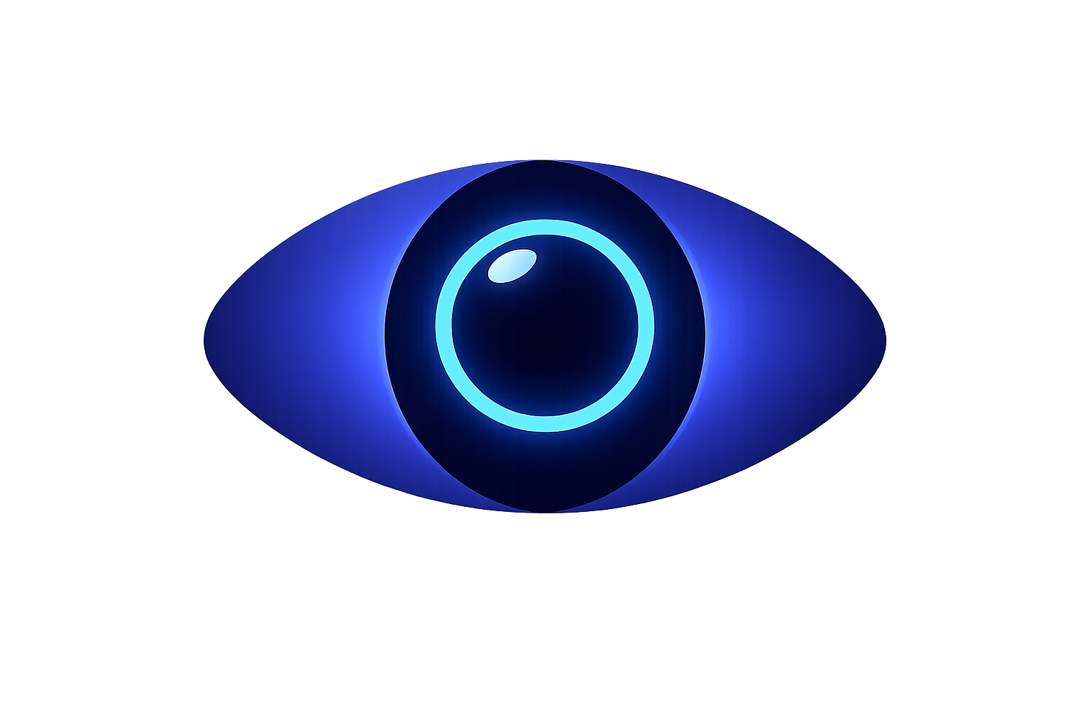
Vigilo
A developer-first monitoring agent.
Latin: "I watch." — Watches your code so you don't have to.
Lakshman Prabhu — Junior AI Understander

Slide 2
You hit run.
You walk away.
Then what?
Every developer who has trained a model, compiled a large project, or run
a long script knows this feeling. The anxiety of not knowing.
THE PROBLEM
● ○ ○ ○ ○ ○ ○
2 / 22

Slide 3
What ACTUALLY happens.
10:00 PM
You start a training run. Everything looks fine.
10:45 PM
You close your laptop. Head to bed.
2:14 AM
RAM spikes to 97%. Silent. No one watching.
2:16 AM
OOM. Kernel kill. 4 hours of training — gone.
7:00 AM
You open your laptop. Empty terminal. No logs. No checkpoint.
"I didn't even know it crashed." — Every developer, at least once.
THE PROBLEM
● ○ ○ ○ ○ ○ ○
3 / 22

Slide 4



This isn't a minor inconvenience.
4–8 hrs
$2.50/hr
67%
of lost training per incident
average Colab Pro GPU cost wasted
of Kaggle users have lost progress to OOM
The real cost isn't just compute. It's momentum. It's the context you lose
when you have to restart a session from scratch.
THE PROBLEM
● ○ ○ ○ ○ ○ ○
4 / 22

Slide 5


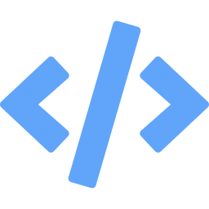
This happens every day.
47.2M
23.3M
36.5M
software developers
worldwide
registered on
Kaggle alone
professional developers
up 70% since 2022
Millions are running resource-intensive workloads on hardware that can barely keep up.
Students. Self-taught practitioners. Early-career developers. People just like us.
Sources: SlashData Developer Nation Survey, Q1 2025 | Kaggle / Wikipedia, Apr 2025 | SlashData, Q1 2025
MARKET
○ ● ○ ○ ○ ○ ○
5 / 22

Slide 6


Who is this for.
Real people with real pain — not theoretical customers.
ML / Data Science
Practitioners
CS Students &
Bootcamp Learners
General Developers
Running Long Tasks
5–8M globally
5–6M globally
2–3M globally
Training models on laptops and free-tier notebooks. Kaggle competitors, Colab users, self-taught practitioners.
Running heavy coursework on the cheapest hardware they can afford. Capstone projects, assignments, portfolio builds.
Game devs compiling, backend engineers running test suites, anyone with scripts over 10 minutes.
Sources: SlashData Developer Nation Survey, Q1 2025 | Kaggle / Wikipedia, Apr 2025 | SlashData, Q1 2025
MARKET
○ ● ○ ○ ○ ○ ○
6 / 22

Slide 7

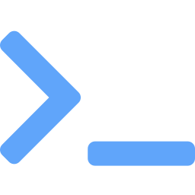


What already exists.
Every existing tool was built for infrastructure teams, not individual developers.
Datadog / Grafana
Enterprise. $15–$23/host/month. Requires infrastructure.
htop / Activity Monitor
Requires you to be at your machine. No predictions. No mobile.
W&B / MLflow
Tracks experiments, not system health. No OOM prediction. No push alerts.
OpenClaw process-watch
General-purpose. No ML-specific intelligence. No phone integration.
The gap: NO ONE is building a purpose-built monitoring agent for individual developers
that predicts failures and reaches you on your phone.
LANDSCAPE
○ ○ ● ○ ○ ○ ○
7 / 22

Slide 8


Vigilo is not just a phone app.
It's a developer-first monitoring agent
that lives on your machine.
The phone is one way to talk to it. Your terminal is another.
Claude Code asking, "how's my training?" through MCP is another.
The agent is the product. Everything else is a window into it.
CLI
MCP
Phone
vigilo status
AI IDE integration
Push + action
THE PLATFORM
○ ○ ○ ● ○ ○ ○
8 / 22

Slide 9



Four levels of intelligence.
Most monitoring tools stop at L0. Vigilo is designed to reach L3.
From watching to acting — each level builds on the last.
L0
Observe
"CPU at 85%, RAM at 72%"
L1
Alert
"Warning: RAM at 92%. OOM in ~12 min."
L2
Recommend
"Suggest: checkpoint now, reduce batch size"
L3
Act
"Auto-checkpointed at epoch 7. Batch size reduced."
THE PLATFORM
○ ○ ○ ● ○ ○ ○
9 / 22

Slide 10

The agent — the core product.
pip install vigilo. That's it. You're monitoring.
System Metrics
Predictive OOM Alerts
CPU, RAM, GPU, disk — via psutil and pynvml. Apple Silicon via macmon.
Tracks memory growth rate. Warns before crash: "OOM in ~18 min."
Progress Detection
Intelligent Actions
Intercepts tqdm, parses stdout. Estimates completion time.
Checkpoint, pause, kill, resize batch — from your phone or AI IDE.
THE PLATFORM
○ ○ ○ ● ○ ○ ○
10 / 22

Slide 11
MCP — the distribution strategy.
Model Context Protocol is a universal standard (by Anthropic) for connecting
AI tools to external data. Vigilo becomes an MCP server.
AI Tool
→
Vigilo MCP
→
Your Machine
Claude Code, Cursor
Windsurf, OpenClaw
get_metrics, predict_oom
checkpoint, adjust_batch
Agent running
locally
Example: Claude Code + Vigilo MCP
You:
"How's my training run going?"
Claude:
tool_call("vigilo.get_training_status")
Vigilo:
{ cpu: 87%, ram: 92%, gpu: 78%, eta: "~2h 14m", risk: "OOM in ~18 min" }
Claude:
"Your run is 78% through but RAM is critical. I'd recommend checkpointing now."
HOW IT WORKS
○ ○ ○ ○ ● ○ ○
11 / 22

Slide 12
Architecture.
THE AGENT (Python)
RELAY
INTERFACES
psutil / pynvml / macmon
Node.js
Auth (email)
Run History
Push Dispatch
CLI
vigilo status
Phone App
push + actions
MCP Clients
Claude, Cursor
OpenClaw
skill plugin
OOM Prediction Engine
→
→
Progress Parser (tqdm)
Action Engine
WebSocket
Local API :8420
MCP Server
One agent. Many windows. Build the engine once — let the ecosystem build on top.
HOW IT WORKS
○ ○ ○ ○ ● ○ ○
12 / 22

Slide 13


Cross-platform from day one.
macOS + Apple Silicon
Windows + Linux
psutil for CPU/RAM
macmon for GPU, ANE, thermals
powermetrics for deep hardware health
IOKit for chip-level telemetry
psutil for CPU/RAM/disk
pynvml for NVIDIA GPU monitoring
torch.cuda for PyTorch CUDA memory
Linux: daemon mode for headless servers
Apple Silicon GPU + Neural Engine
monitoring is a genuine differentiator.
NVIDIA GPU monitoring covers 90%+
of ML practitioners on these platforms.
HOW IT WORKS
○ ○ ○ ○ ● ○ ○
13 / 22

Slide 14
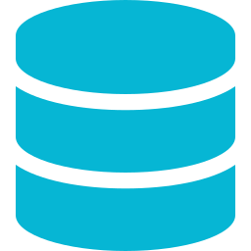
The phone — thin and focused.
Not a dashboard you sit in. A 5-second emergency interface.
Push Alerts
Action Buttons
Run History
OOM warning, crash notification, training complete — reaches you anywhere.
Tap "Checkpoint", "Pause", or "Kill" — command goes back to the agent.
Every run logged: duration, peak metrics, outcome. Compare runs over time.
The 3 AM OOM alert that saves 6 hours of lost training —
that's the story users tell their friends.
HOW IT WORKS
○ ○ ○ ○ ● ○ ○
14 / 22

Slide 15
How developers use it.
Install
Python API
$ pip install vigilo
$ vigilo start
$ vigilo status
import vigilo
with vigilo.watch():
train_model()
MCP (Claude Code)
Phone Notification
> "How's my training going?"
Claude: "78% done. RAM critical.
I recommend checkpointing."
⚠️ Vigilo Alert
RAM at 93%. OOM in ~14 min.
[Checkpoint] [Pause] [Kill]
Zero friction. Works with the tools developers already use.
HOW IT WORKS
○ ○ ○ ○ ● ○ ○
15 / 22

Slide 16
12-month roadmap.
Part-time, alongside full-time work. Under $30/month to run.
Q1
Q2
Q3
Q4
The Agent
The Protocol
Intelligence
Launch
Month 1–3
Month 4–6
Month 7–9
Month 10–12
pip install vigilo
psutil + pynvml metrics
OOM prediction engine
WebSocket relay + push alerts
CLI: start, status, stop
MCP server implementation
Thin phone app (React Native)
macmon (Apple Silicon)
OpenClaw skill publication
Rule-based recommendations
Agent policy system
LLM-powered recommendations
Action buttons (phone)
Multi-machine view
Beta testing
Documentation site
App Store + Google Play
PyPI stable release
Community launch
Iterate on feedback
BUILD PLAN
○ ○ ○ ○ ○ ● ○
16 / 22

Slide 17
What it costs to build.
A passion project, not a funding round.
VPS (relay server)
$10–15/mo
DigitalOcean or Railway
Firebase (push + auth)
$0
Free tier handles thousands
Apple Developer Account
$8.25/mo
$99/year
Google Play Developer
$2.08/mo
$25 one-time
LLM API (recommendations)
$5–15/mo
Scales with users
Domain name
~$1/mo
vigilo.dev
12-month total
< $400
Bootstrapped by design
BUILD PLAN
○ ○ ○ ○ ○ ● ○
17 / 22

Slide 18

Three layers of defensibility.
The agent is the moat.
Anyone can build a dashboard. Building an agent that reliably predicts OOM, intercepts tqdm, and hooks into PyTorch's training loop takes real engineering. That intelligence compounds.
MCP is the distribution.
Every Claude Code user, every Cursor user, every OpenClaw user is a potential Vigilo user. The ecosystem brings users to you — you don't need marketing.
The phone is the differentiator.
Every other tool requires you to be at your computer. Vigilo reaches you in your pocket. That 3 AM OOM alert — that's the story users tell.
Build the agent. Expose it through MCP. Alert through the phone. That's Vigilo.
BUILD PLAN
○ ○ ○ ○ ○ ● ○
18 / 22

Slide 19
What I'm not building. Yet.
Scope discipline is how solo builders' ship.
✗
Full web dashboard
✗
VS Code extension
✗
Team / enterprise features
✗
Monetisation (users first, money later)
✗
.NET agent
✗
Colab / Kaggle notebook integration
Each of these becomes a v2 feature — if real users ask for it.
BUILD PLAN
○ ○ ○ ○ ○ ● ○
19 / 22

Slide 20
Why this exists.
This is a tool I wish existed when I started learning ML and training models.
I lost work. I wasted GPU hours. I sat refreshing terminals at 2 AM.
Every developer in this space would have experienced the same story and with the digital age that we are heading towards with AI-assisted complex code generation, this would become even MORE applicable.
Vigilo exists to help people who are
where I was.
BUILD PLAN
○ ○ ○ ○ ○ ● ○
20 / 22

Slide 21
Questions for discussion.
Architecture
MCP Integration
WebSocket + relay server — or would MQTT / gRPC be more efficient at scale?
Best practices for building a robust MCP server? Security model for system-level access?
Agent Actions
Mac Implementation
How far should autonomous action go? Where's the line between helpful and dangerous?
macmon for Apple Silicon — production-viable, or should I abstract further?
User Feedback Loop
Distribution
How to design early beta feedback without overwhelming solo capacity?
MCP directories, Kaggle forums, OpenClaw skills — where to focus first?
DISCUSSION
○ ○ ○ ○ ○ ○ ●
21 / 22
Notes:
Api across system for task manager
Start with email to access data
Consider using packages and integrating with first python packages
Consider .net and try to check with javascript so it can run across systems
On mac consider progress and explore mac miniOS and how it tracks and observes runs
Health on chip (mac chips) trackers
Agents to interact with system level to make decision based on resource usage and limits
Openclaw (check internal status of running processes)
MCP (model context protocol(do more research))
MCP Integration

Slide 22
Thank you.
Vigilo — I watch, so you don't have to.
Lakshman Prabhu — Junior AI Understander

