Slide 1

Invisible Shield Turning Ordinary Images into Tamper-Proof Vaults for Secure File Sharing
CSA5107-Cryptography and Network Security
Presented By:
K. KARTHIKEYA SRINIVASULU(192312112)
U.JAYAKRISHNA(192324060)
G. LAKSHMAN VENKATESH(192324069)
L. DATTU KUMAR(192324141)
Professor
Dr.P. Jesu Jayarin
Saveetha School of Engineering

Slide 2



INTRODUCTION
Invisible Shield: a security system that protects a file and also hides the fact that a secret file is being sent.
Ordinary Images: a normal-looking PNG photo is used as the carrier; LSB steganography hides data in its pixels without visible change.
Tamper-Proof Vaults: AES-256-GCM and SHA-256 checks catch any change, even 1 bit, or a wrong key, and raise a tamper alert.
Secure File Sharing: login with hashed passwords and the receiver’s public key ensure only the intended person can open the file.
Why it matters: three layers of defence, confidentiality, secrecy and integrity, for files such as patient reports and bank statements.

Slide 3

OBJECTIVES
To let users log in securely with hashed passwords and safe key management.
To protect files with AES-256-GCM and the receiver’s public key (hybrid cryptography).
To hide the encrypted file inside a lossless PNG image using LSB steganography.
To detect tampering or a wrong key using AES-GCM and SHA-256 checks.
To measure file size, processing time and recovery results.

Slide 4
LITERATURE REVIEW
S. No | Author(s) & Year | Name of Journal | Model / Technique | Dataset | Features | Strengths | Limitations
1 | Wahab et al., 2021 | IEEE Access | RSA + compression | Cover images | RSA with compressed hiding | Better quality and capacity | RSA slow for large files
2 | Awadh et al., 2022 | IJECE | DWT + AES + LSB | 40 cover images | Compress, encrypt, hide | PSNR 47.8 dB, SSIM 0.92 | Shared AES key needed
3 | Alanzy et al., 2023 | Applied Sciences | AES + Blowfish | Cover images | Pixel randomization | High PSNR, low MSE | No public-key exchange
4 | Tanu et al., 2023 | IEEE SIN Conference | AES + LSB layers | Text and images | Multi-layer concealment | Hides larger data | Shared secret key needed
5 | Umm e Amara, 2025 | COMSATS Univ. thesis | RSA + XOR + LSB | Digital images | Capacity vs quality study | 1-2 bit LSB is balanced | Deeper LSB distorts image

Slide 5

PROBLEM STATEMENT
Private files like patient reports and bank statements are often sent over public networks, where hackers can intercept them.
Encryption hides the content, but not the fact that a secret file is being sent, which can attract attackers.
Sharing one password is risky, and users cannot always tell if the file was changed on the way.
So we need one system that locks the file, hides it, and proves it was not modified.

Slide 6
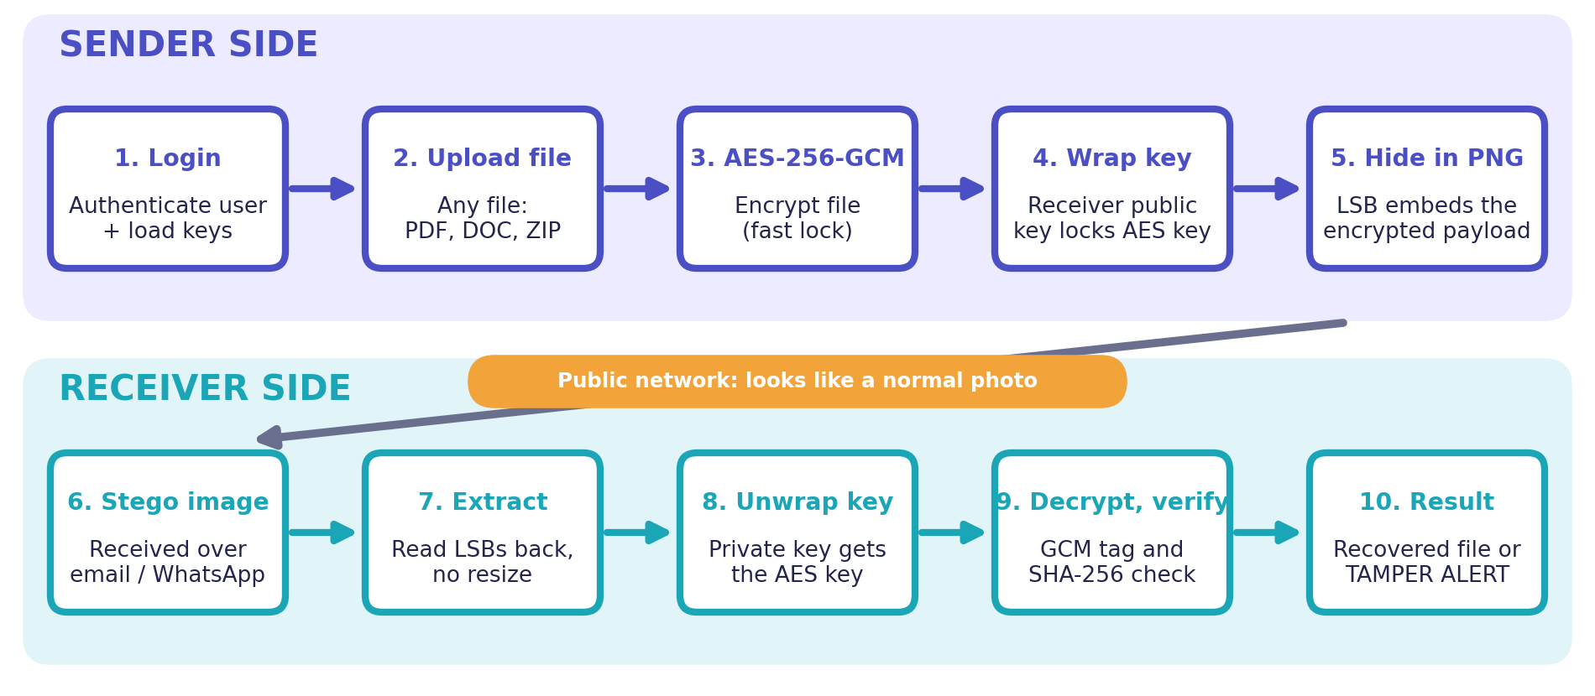
ARCHITECTURE DIAGRAM

Slide 7
MODULES
Module 1: User Authentication and Key Management
Module 2: Hybrid Cryptography for File Protection
Module 3: Image Steganography
Module 4: Integrity Verification and Security Analysis

Slide 8
TECHNIQUES AND TOOLS USED
Technique | Tool / Library | Module | Purpose
AES-256-GCM encryption | Python cryptography | 2 | Locks the file; GCM tag proves it is authentic
Hybrid key wrapping (RSA public key) | Python cryptography | 2 | Receiver's public key protects the AES key
LSB steganography | Pillow, NumPy | 3 | Hides the encrypted file inside a PNG image
SHA-256 hashing | Python hashlib | 4 | Compares original and recovered file
Salted password hashing | Python, SQLite | 1 | Safe login; no plain-text passwords
Web browser interface and key storage | Web browser, Streamlit, SQLite | 1 | User login, upload, download, key management
Performance analysis | Matplotlib | 4 | Graphs of file size and processing time

Slide 9
NETWORK LAYERS AND SECURITY
Layer (OSI) | Role in our project | Technique / Tool
Application (7) | User opens the web app in a browser to log in, upload and download | Web browser, Streamlit, SQLite
Presentation (6) | Encrypts the file and encodes it into the image | AES-256-GCM, RSA, LSB (Pillow)
Session (5) | Only logged-in users start a sharing session | Salted password hashing
Transport (4) | Browser and server exchange data reliably | HTTP over TCP
Network (3) | Data is routed over public Wi-Fi, where a hacker can intercept it | Protected by the layers above
End-to-end protection: the file is secured at the upper layers, so it stays safe even when the lower network layers are untrusted.
Browser-based: the whole system runs in a web browser, so no extra software is needed.

Slide 10
REAL-TIME EXAMPLE
Sender: Anita, hospital lab technician
Receiver: Dr. Ravi, consulting doctor
File: report.pdf, a patient blood-test report (about 50 KB)
Carrier: a normal hospital photo saved as PNG
Risk: a hacker on public Wi-Fi can read or edit the report
Goal: Dr. Ravi gets the exact report; nobody else can read or secretly change it

Slide 11
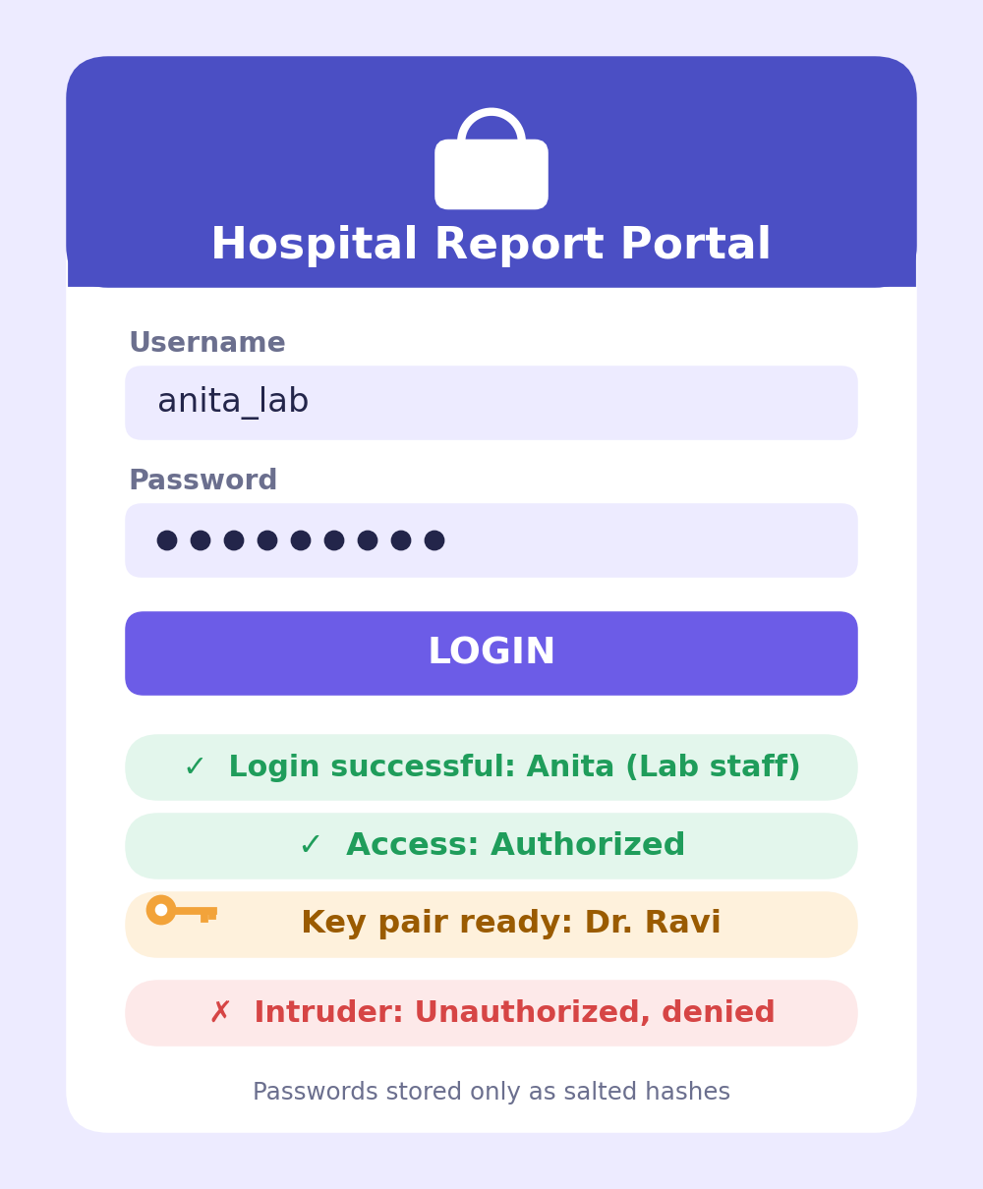
Module 1: User Authentication and Key Management
Implementation:
Python login page with user registration (Streamlit)
Passwords stored as salted hashes, never plain text
Encryption keys created and managed safely (SQLite)
Expected Output (hospital example):
Anita logs in: Login successful
Intruder tries: Unauthorized, access denied
Dr. Ravi’s key pair: created / retrieved
Tools: Streamlit, SQLite, Python cryptography libraries
In our example: Anita logs in and selects Dr. Ravi as the receiver.

Slide 12
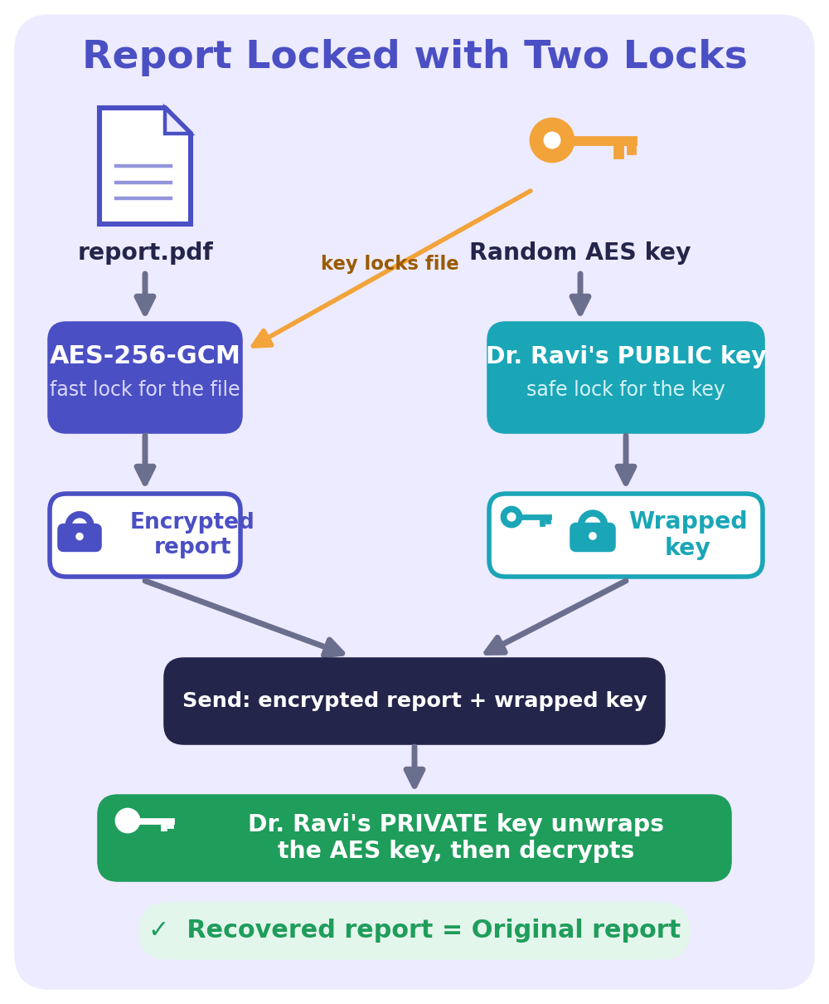
Module 2: Hybrid Cryptography for File Protection
Implementation:
AES-256-GCM encrypts the uploaded file quickly
Receiver’s public key wraps the AES key (hybrid design)
Only the receiver’s private key can unwrap it
Expected Output (hospital example):
report.pdf and its encrypted version
Encryption and decryption status
Recovered report matches the original
Tools: Python cryptography package (optional ML-KEM)
In our example: Anita’s report is locked; only Dr. Ravi’s private key opens it.

Slide 13
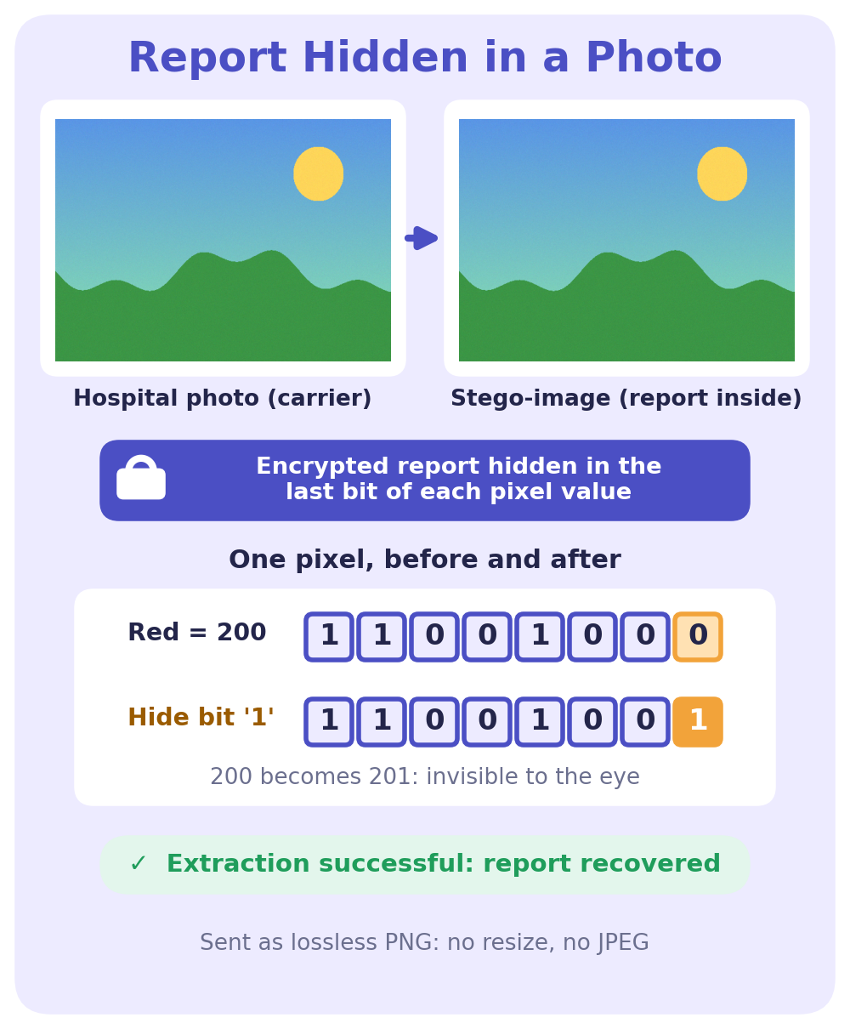
Module 3: Image Steganography
Implementation:
Embed the encrypted payload into a lossless PNG (LSB)
Pixel changes are tiny, so the image looks the same
Extract later without resizing or recompressing
Expected Output (hospital example):
Hospital photo (original carrier image)
Stego-image carrying the encrypted report
Extracted payload: success / failure
Tools: Pillow, NumPy
In our example: Anita emails a normal-looking hospital photo to Dr. Ravi.

Slide 14
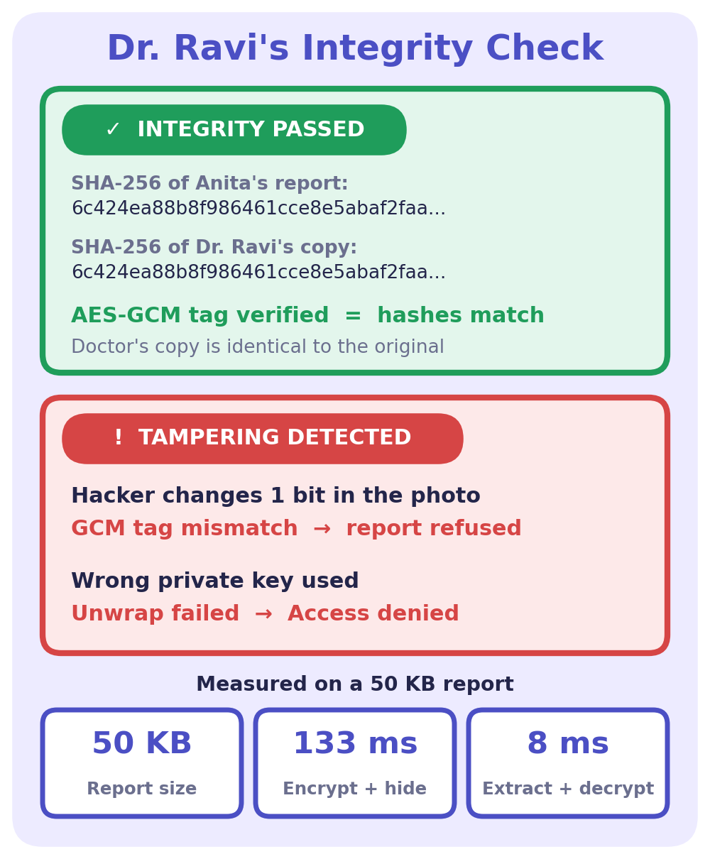
Module 4: Integrity Verification and Security Analysis
Implementation:
AES-GCM tag proves the ciphertext is authentic
SHA-256 compares original and recovered files
Test modified files and incorrect keys
Expected Output (hospital example):
Integrity passed for Dr. Ravi’s copy
Tamper alert if even 1 bit is changed
File size, processing time, recovery result
Tools: Python hashlib, cryptography, Matplotlib
In our example: A hacker edits the photo, so Dr. Ravi sees a TAMPER ALERT.

Slide 15
SECURITY TESTING TOOLS
Tool | Test Type | Module | What It Proves
Wireshark | Network traffic capture | 4 | Traffic captured on public Wi-Fi shows no readable report text
zsteg | LSB steganalysis | 4 | Searches the stego PNG for hidden text or file signatures
StegExpose | Statistical steganalysis | 4 | RS, Sample Pairs and Chi-square tests rate how detectable the hiding is
Bit-flip and wrong-key test | Tamper test | 4 | GCM tag fails and a TAMPER ALERT is raised
Why test: a security system is trusted only after we try to break it. Wireshark shows the network view of an attacker.
Image view: zsteg and StegExpose show whether the stego image can be detected, so we know how well the secret is hidden.

Slide 16
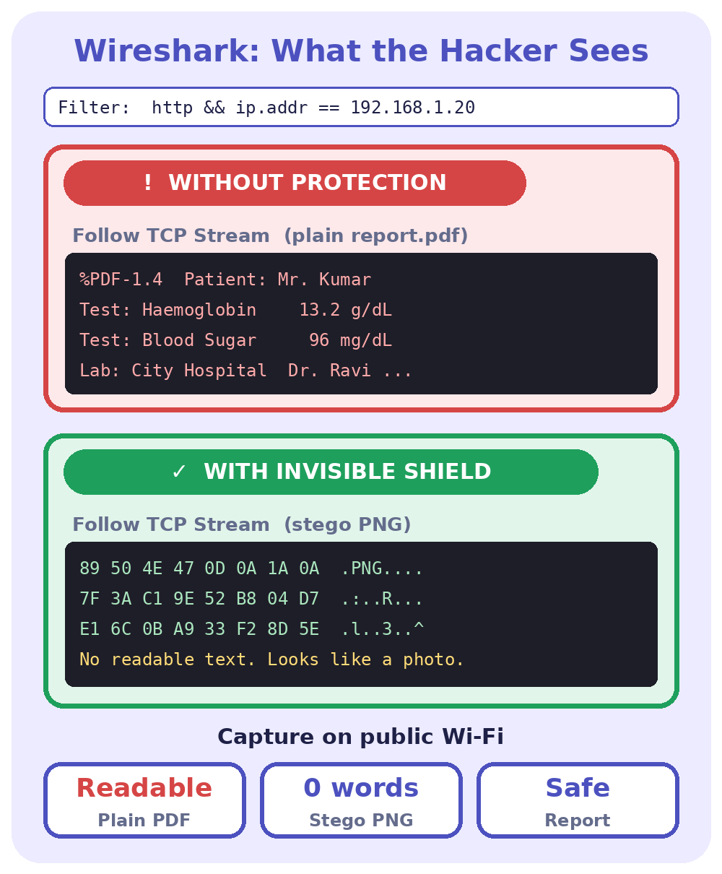
Security Testing: Wireshark Traffic Analysis
Implementation:
Capture packets on public Wi-Fi while the file is shared
Apply the http filter and use Follow TCP Stream
Compare a plain report.pdf with the stego PNG
Expected Output (hospital example):
Plain PDF: patient name and test values are readable
Stego PNG: only image bytes, no readable text
A hacker sees a normal photo, not a report
Tools: Wireshark (packet analyser), Streamlit app over HTTP
In our example: A hacker on public Wi-Fi captures Anita’s upload but cannot read the report.

Slide 17
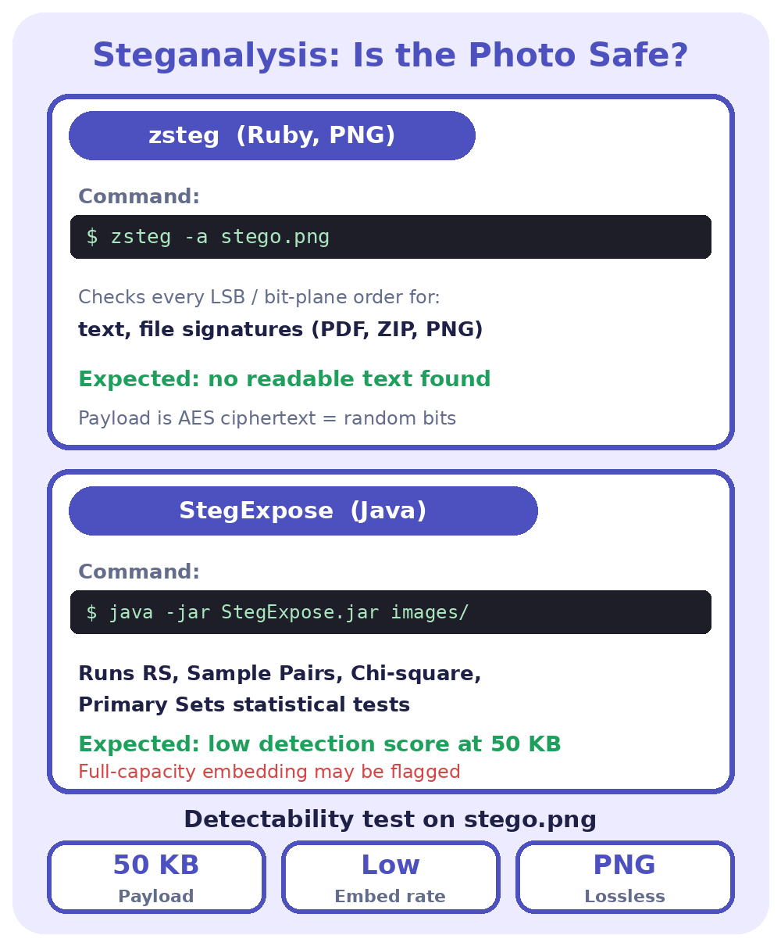
Security Testing: StegExpose and zsteg
Implementation:
Run zsteg on stego.png to look for hidden text or files
Run StegExpose (RS, Sample Pairs, Chi-square tests)
Repeat at low and high embedding rates
Expected Output (hospital example):
zsteg finds no readable text or file signature
StegExpose detection score stays low for a 50 KB payload
A higher embedding rate raises the score (known limit)
Tools: zsteg (Ruby), StegExpose (Java), Pillow, NumPy
In our example: Anita’s 50 KB report in a hospital photo is expected to pass both checks.

Slide 18
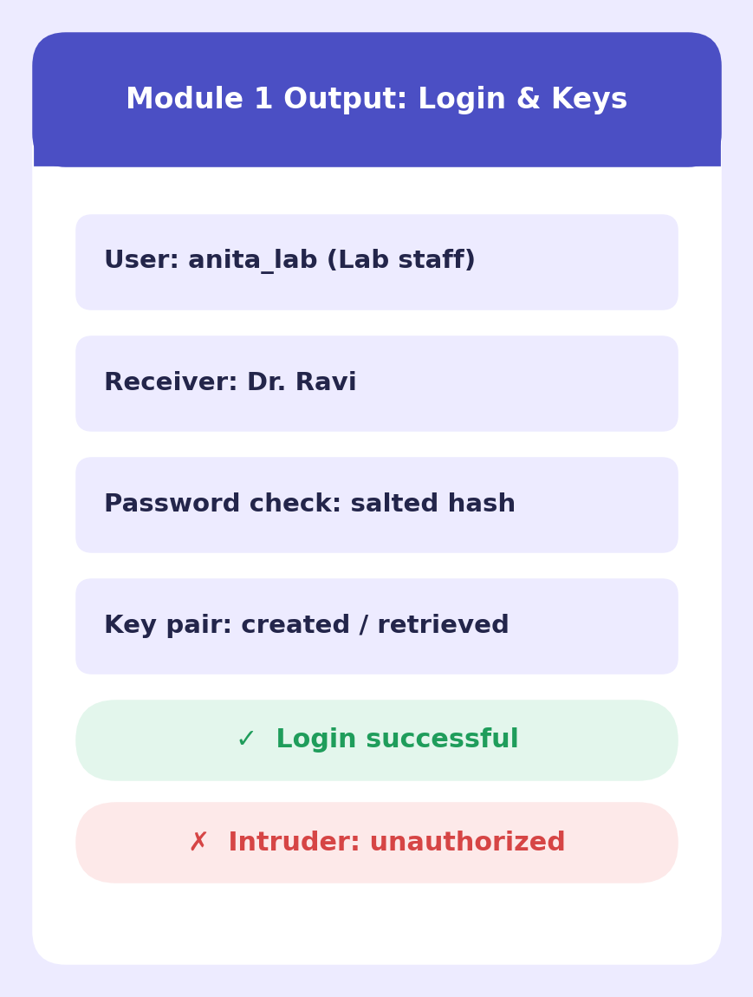
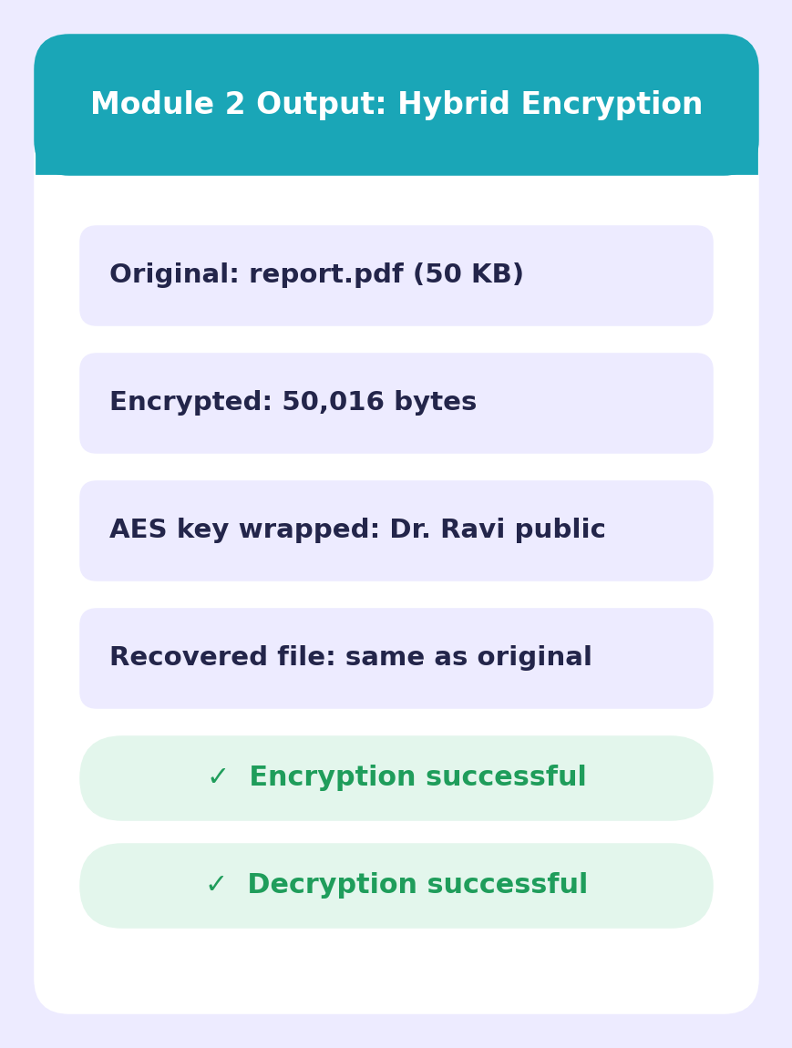
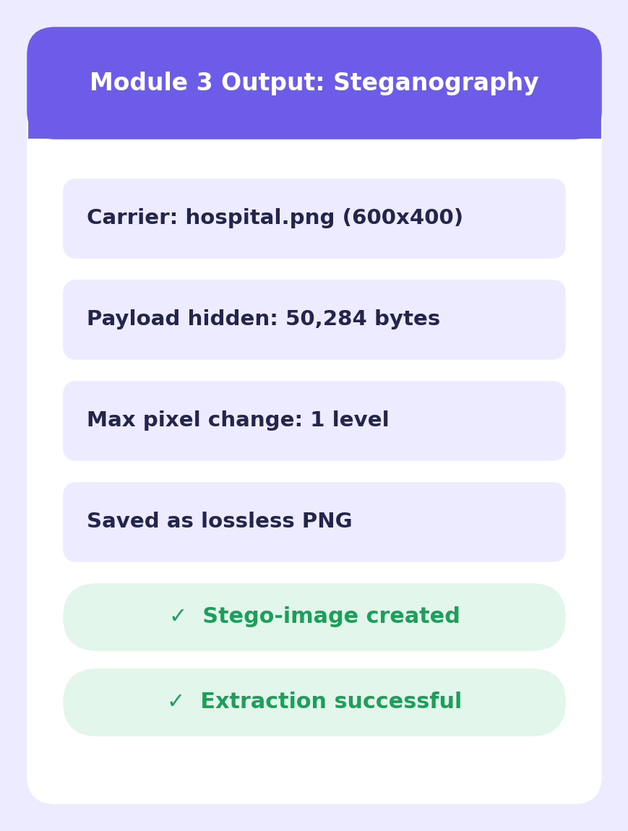
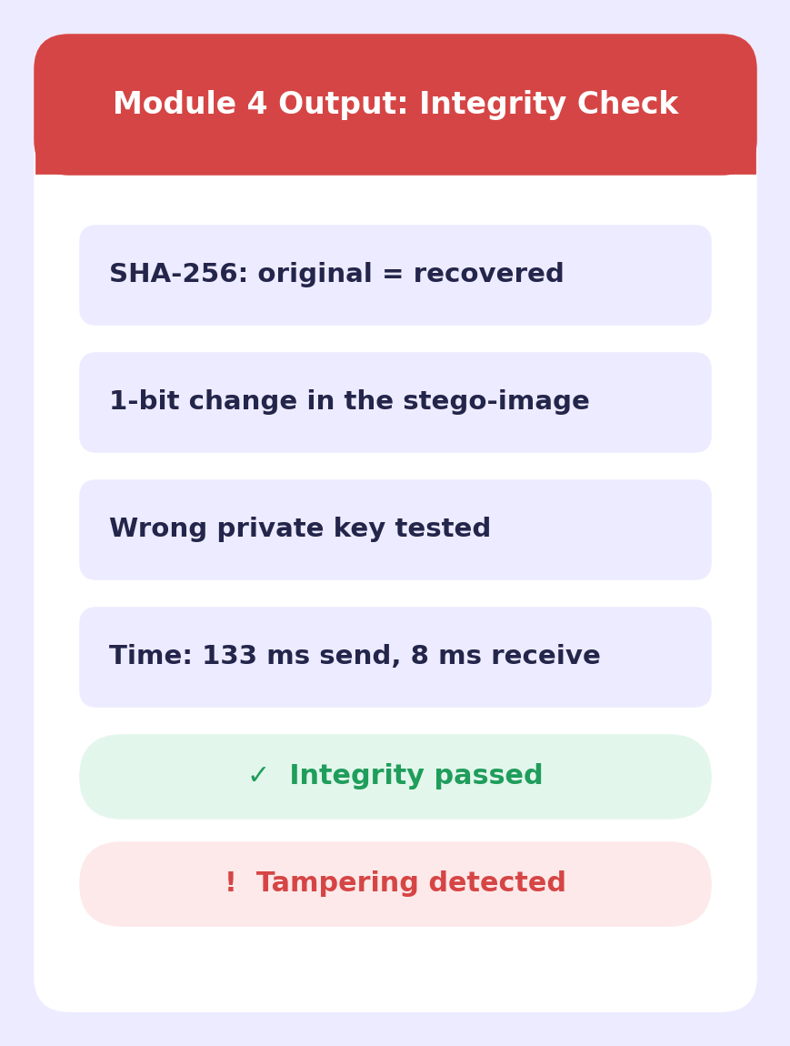
Output

Slide 19
FUTURE ENHANCEMENT
Add post-quantum ML-KEM so keys stay safe against future quantum computers.
Support audio and video carriers, not just PNG images.
Use adaptive steganography that is harder to detect.
Build a mobile app for secure file sharing on the go.
Add multi-factor authentication (OTP) at login.
Compress files before encryption to save space and time.

Slide 20
CONCLUSION
The system shares files safely by combining hybrid cryptography, steganography and integrity checks.
AES-256-GCM protects the file, while the receiver’s public key protects the AES key.
The encrypted file hides inside a PNG, so nobody notices a secret is being sent.
Any tampering or wrong key is caught immediately, so only the right person gets the file.
The result is three layers of defence: confidentiality, secrecy and integrity.

Slide 21
REFERENCES
M. Alanzy, R. Alomrani, B. Alqarni and S. Almutairi, “Image Steganography Using LSB and Hybrid Encryption Algorithms,” Applied Sciences, vol. 13, no. 21, p. 11771, 2023.
Tanu et al., “Hybrid Steganography: A Multi-Layered Framework for Hybrid Text and Image Concealment Enhanced by AES and LSB Techniques,” 16th International Conference on Security of Information and Networks (SIN), IEEE, 2023.
National Institute of Standards and Technology, “Module-Lattice-Based Key-Encapsulation Mechanism Standard,” FIPS 203, Aug. 2024.
Umm e Amara, “Using Cryptography and Steganography Techniques for Data Security,” MS Thesis, COMSATS University Islamabad, Lahore Campus, 2025.
Python Cryptographic Authority, “cryptography” library documentation (AES-GCM, RSA-OAEP), cryptography.io, accessed 2026.

Slide 22


