Slide 1
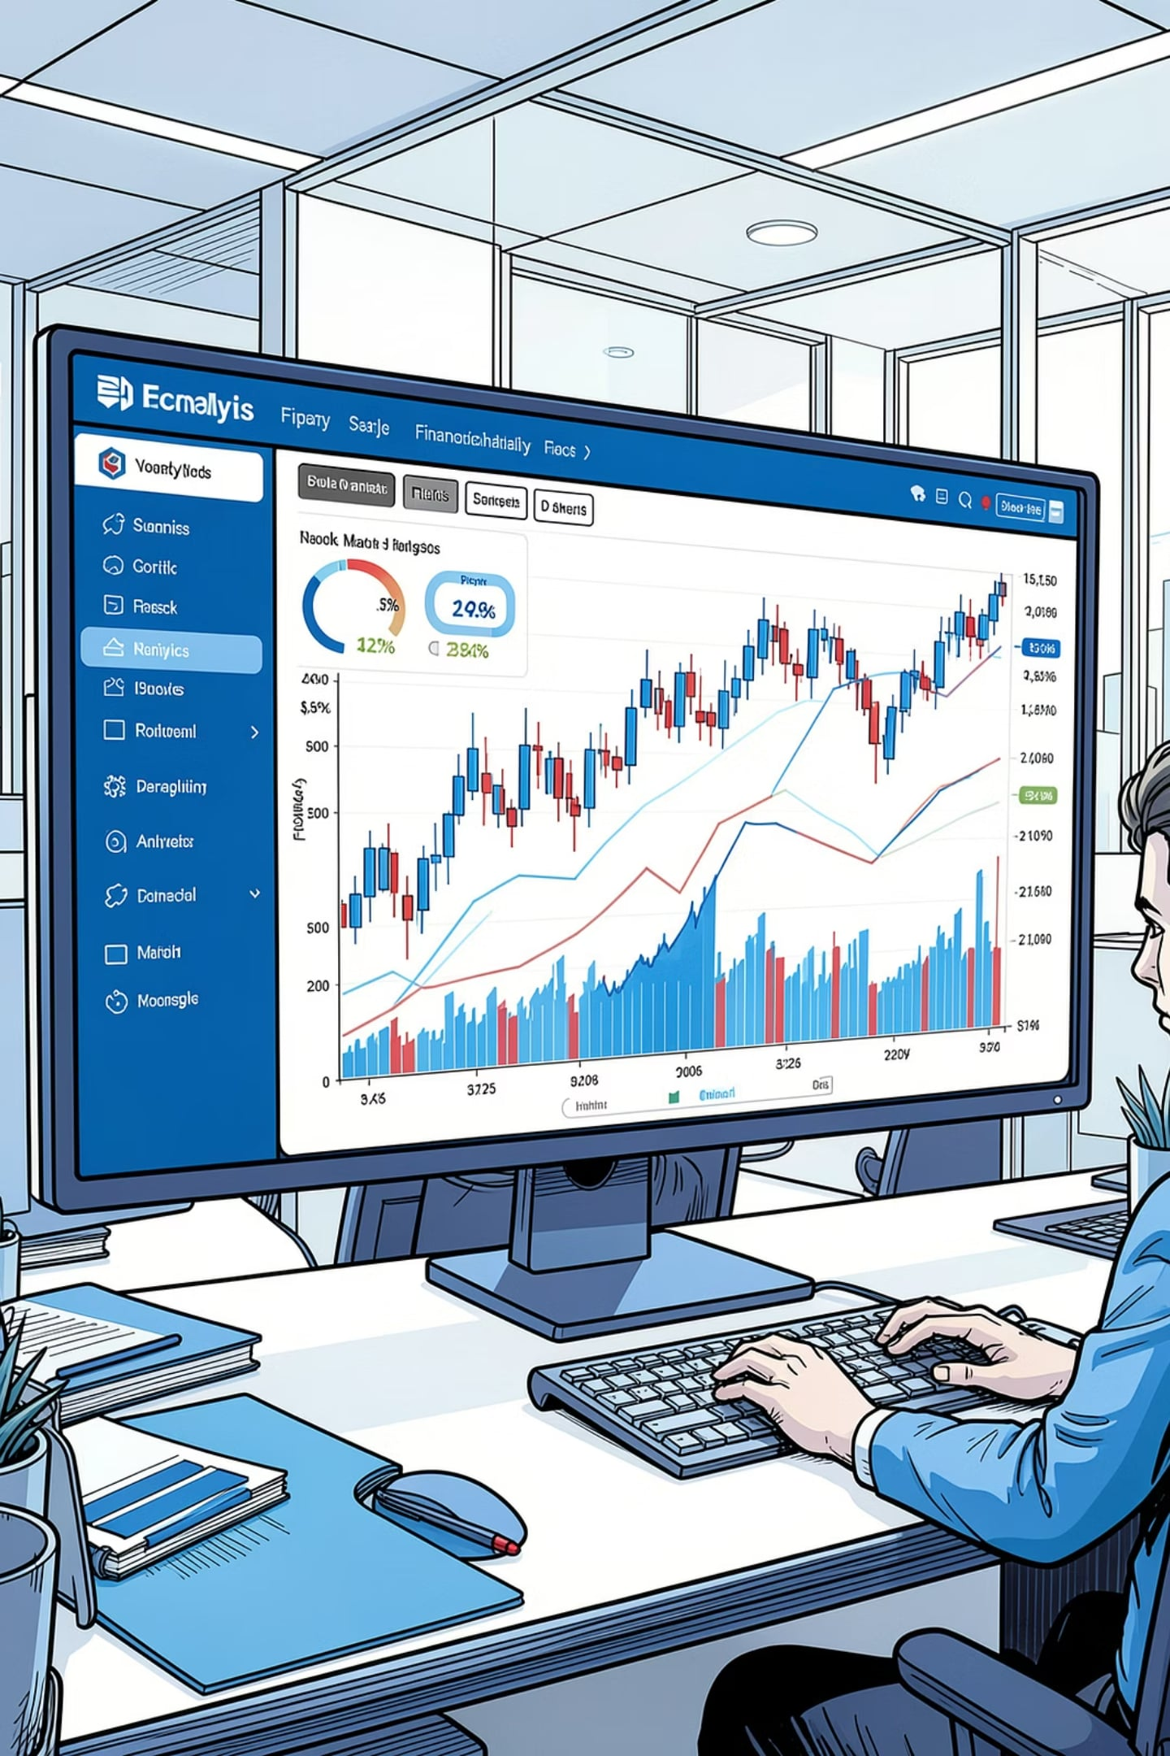
B.TECH CAPSTONE PROJECT
INFORMATION TECHNOLOGY
Bluestock Mutual Fund Analytics System
Presented by J. Lakshman Chowdary
B.Tech – Information Technology

Slide 2
Introduction
The Case for Data-Driven Investing
Mutual funds pool money from many investors to purchase a diversified portfolio of securities, offering a practical way to participate in financial markets without requiring deep expertise in individual stock selection.
1
2
3
What Are Mutual Funds?
Importance of Analysis
Need for Analytics
Pooled investment vehicles managed by professionals, offering diversification and accessibility to a broad range of investors.
Rigorous analysis is essential for evaluating fund performance, understanding risk exposure, and making informed investment decisions.
Data analytics transforms raw financial data into actionable insights, enabling smarter, evidence-based investment strategies.

Slide 3


Project Objectives
From Raw Data to Investor Insights
This capstone project aims to build a comprehensive analytics system that automates data processing and delivers actionable financial intelligence through interactive visualizations.
Dashboard & Insights
Analytics & Metrics
Build an interactive Power BI dashboard to generate meaningful investor insights and recommendations.
ETL Pipeline & Storage
Perform exploratory data analysis and calculate key financial metrics including Sharpe Ratio, Beta, VaR, and CVaR.
Build an automated ETL pipeline to clean and preprocess financial datasets, storing data efficiently in SQLite.

Slide 4

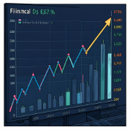
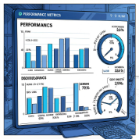
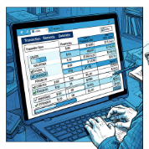
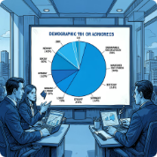
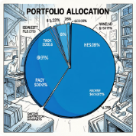
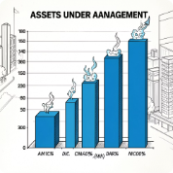
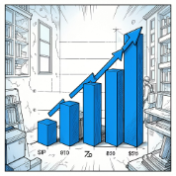
Dataset Description
Eight Core Financial Datasets
The system integrates eight structured CSV datasets covering fund metadata, performance history, investor profiles, and portfolio composition.
fund_master.csv
nav_history.csv
scheme_performance.csv
investor_transactions.csv
Master list of all mutual fund schemes with metadata.
Net Asset Value history tracking fund performance over time.
Scheme-level performance metrics and returns data.
Detailed records of investor buy and sell transactions.
investor_demographics.csv
portfolio_holdings.csv
aum.csv
sip_inflows.csv
Assets Under Management figures across funds and dates.
Systematic Investment Plan inflow data over time.
Investor profile data including age, income, and region.
Asset-level holdings within each mutual fund portfolio.

Slide 5
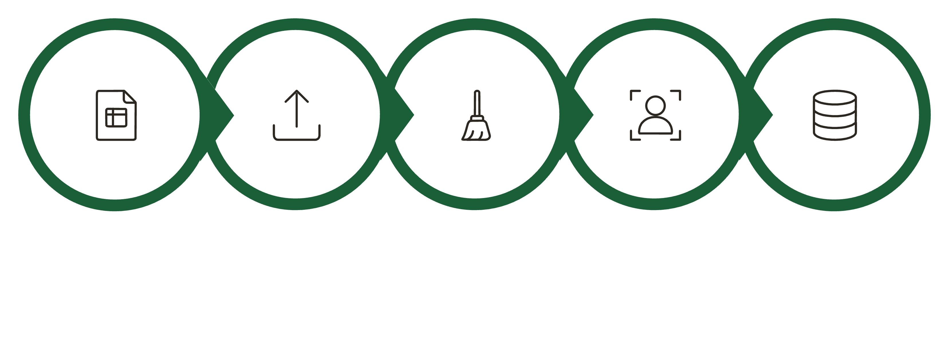
ETL Pipeline
Automated Data Processing Flow
The ETL pipeline transforms raw CSV files into a structured analytics-ready database, leveraging Python, Pandas, SQLite, SQL, and Power BI at each stage.
Raw CSV
Ingestion
Cleaning
Processed
SQLite
Each stage is automated through Python scripts, ensuring reproducibility and data quality from ingestion to visualization.

Slide 6
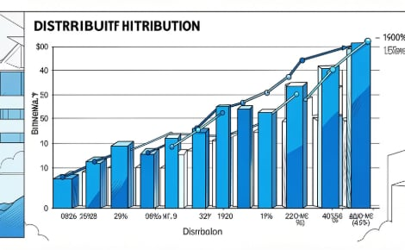
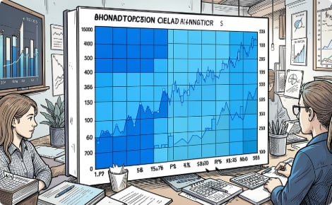
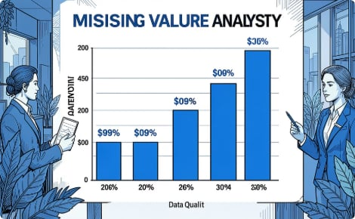
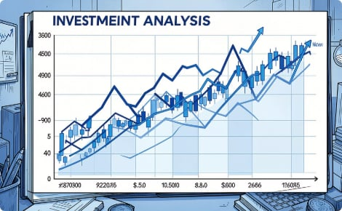

Exploratory Data Analysis
Uncovering Patterns in Financial Data
Distribution Plot
Correlation Heatmap
Missing Value Analysis
Investment Analysis
Visualizing the spread and skewness of fund returns across schemes.
Identifying strong relationships among performance variables.
Detecting and addressing gaps in the dataset for quality improvement.
Recognizing distinct investment patterns across investor segments.
Data quality improved significantly after cleaning. Investment patterns were identified, and strong relationships among performance variables were confirmed.

Slide 7
Performance Analytics
Key Financial Risk & Return Metrics
The system computes six critical performance metrics to evaluate risk-adjusted returns, volatility, and downside risk for each fund scheme.
CAGR
Sharpe Ratio
Measures the compound annual growth rate of fund investments over a specified period.
Evaluates risk-adjusted returns by measuring excess return per unit of volatility.
Beta
Historical VaR
Quantifies a fund's sensitivity to market movements relative to its benchmark index.
Estimates the maximum potential loss over a given time horizon at a confidence level.
Conditional VaR (CVaR)
Rolling Sharpe Ratio
Assesses the expected loss in the tail beyond the VaR threshold for extreme risk.
Tracks risk-adjusted performance dynamically over a rolling time window.

Slide 8
Power BI Dashboard
Interactive Business Intelligence Layer
The Power BI dashboard delivers four interactive views with KPI cards, interactive slicers, charts, tables, and drill-down analysis capabilities for comprehensive investor intelligence.
Executive Overview
Fund Performance
High-level KPIs and summary metrics for decision-makers.
Detailed scheme-level returns and comparative analytics.
Investor Analysis
Risk Analytics
Investor demographics, behavior, and transaction patterns.
VaR, CVaR, Beta, and Sharpe Ratio visualizations.

Slide 9
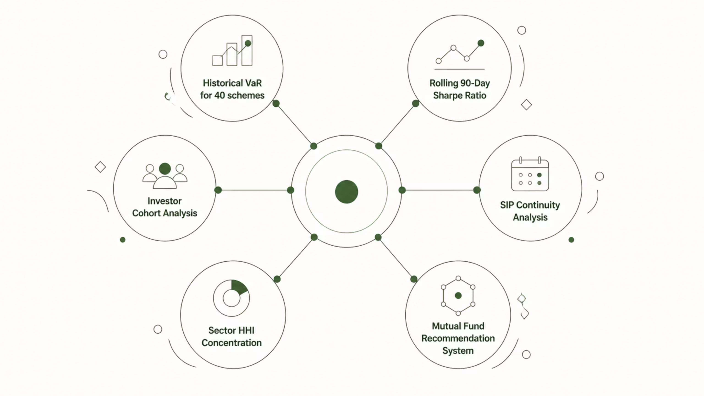
Advanced Analytics
Deep-Dive Investment Intelligence
Beyond standard metrics, the system performs six advanced analytical studies to uncover deeper investment patterns and generate fund recommendations.

Slide 10
Key Findings & Conclusion
Insights, Outcomes, and Future Scope
Higher Sharpe Ratio, Better Returns
Risk Detection
Funds with higher Sharpe Ratios consistently generated better risk-adjusted returns for investors.
Historical VaR successfully identified higher-risk funds, enabling proactive risk management.
SIP & Cohort Insights
Diversification Measurement
SIP continuity analysis detected irregular investors, while cohort analysis revealed meaningful investment trends.
Sector HHI effectively measured portfolio diversification across fund schemes.
Project Achievements
Future Scope
Successful ETL pipeline implementation, comprehensive financial analytics, interactive Power BI dashboard, and advanced analytics delivering meaningful investment insights — demonstrating practical application of Python, SQL, and Power BI.
AI-powered Recommendation System
Live NAV Integration & Real-Time Tracking
Streamlit Web Application
Monte Carlo Simulation & Markowitz Optimization
Automated Email Reports
Thank You — Questions & Discussion

