Slide 1



VIRTUAL TEACHING
BATCH - 7
Faculty Guide Mr. A.Kathiresan
ABHIJITHA
LAKSHMANDEV
KIRAN
RAJARAJAN

Slide 2
Table of contents
01.
02.
03.
Introduction
Benefits
Working
04.
05.
Teaching
Our Project
Intro about hologram
Benefits of hologram
Working of hologram
Teaching in nowadays
Project on hologram

Slide 3

Whoa!
Let’s enter into the ppt...

Slide 4
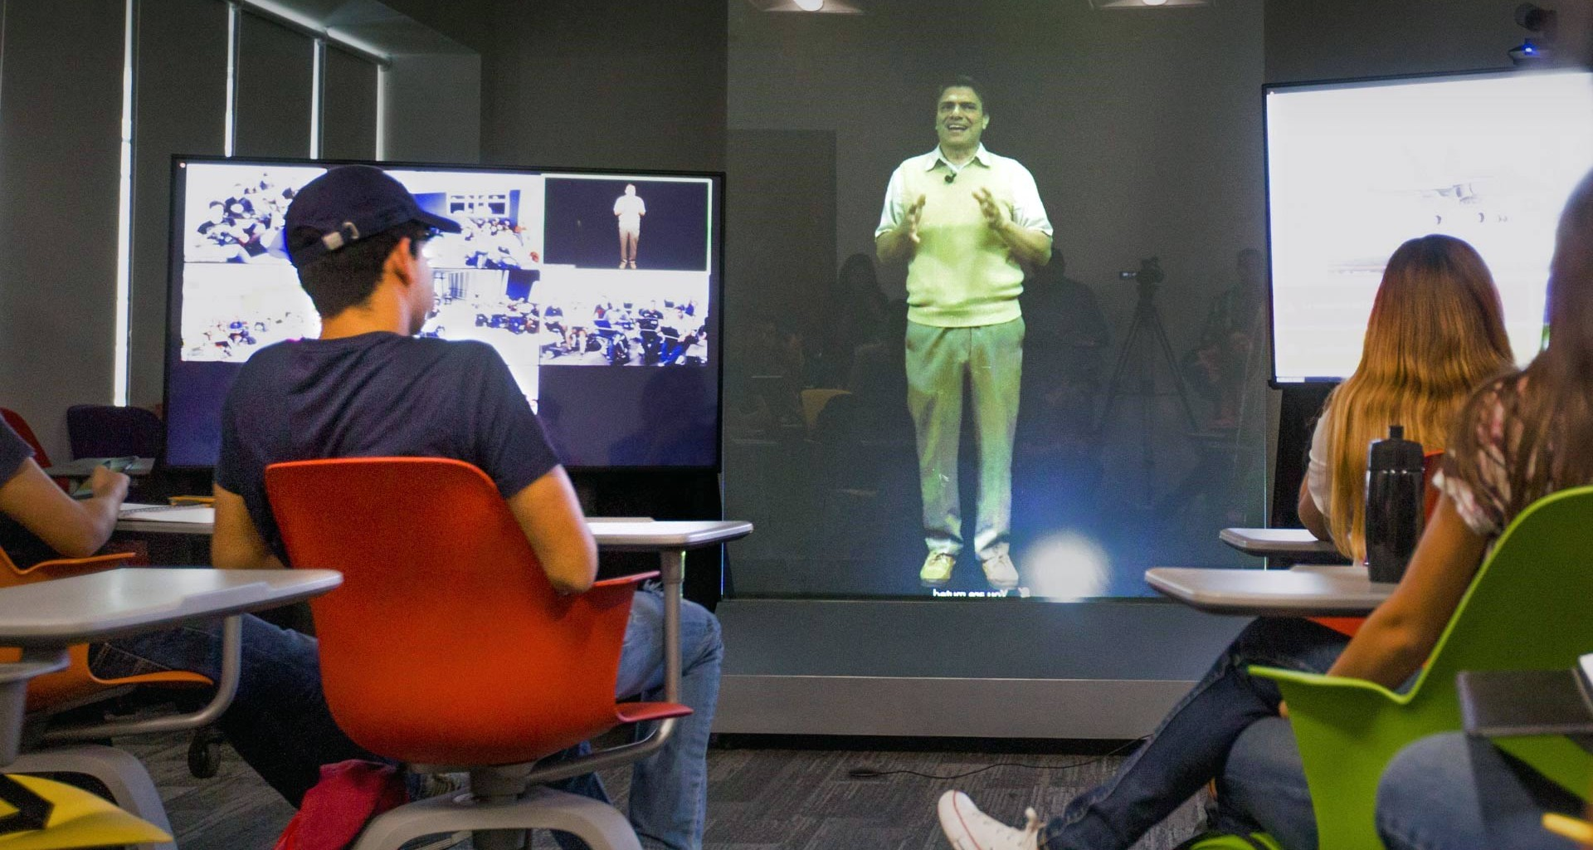
Objective
One of the most exciting applications of holograms is the improvement of the educational experience. In order to engage students more fully, interactive digital lessons will be used in schools. This combination of digital and real-world information is known as mixed reality.

Slide 5
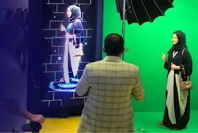
Tools for implementation
Hologram Projector
Audio System
Recorded video with green screen

Slide 6
01.
Introduction
Intro about hologram

Slide 7
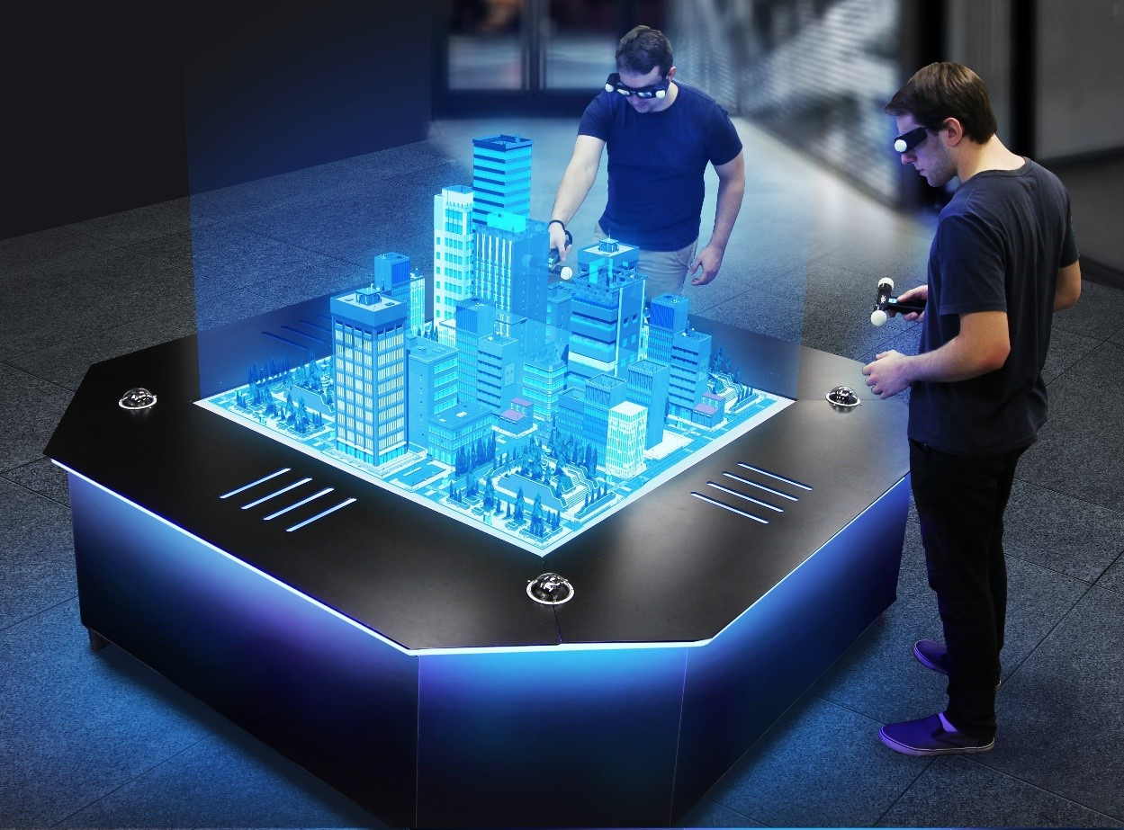
Introduction
Holograms are 3D images created by recording the interference pattern of laser beams on a photosensitive medium. They provide immersive and realistic visual experiences, appearing to float in space. Widely used in security, art, and entertainment, holography continues to evolve with advancements in technology, opening up new possibilities.

Slide 8
02.
Benefits
Benefits of hologram

Slide 9

Benefits of hologram
Holograms: Enhanced visualization, realistic immersion, anti-counterfeiting, interactivity, medical imaging, impactful advertising, data storage, AR/VR enhancement, and creative applications.

Slide 10
03.
Working
Working of hologram

Slide 11
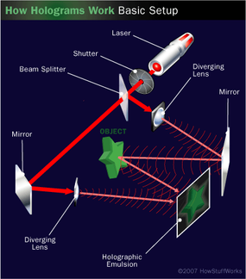
Working of hologram
Holograms work by splitting a laser beam into an object and a reference beam.
The object beam interacts with the object, creating an interference pattern when combined with the reference beam on a photosensitive medium.
Reconstructing the hologram with coherent light displays a 3D image that changes with perspective.

Slide 12
04.
Teaching
Teaching in nowadays

Slide 13

Teaching in nowadays
Present teaching includes blended learning models, remote learning with technology integration, flexible environments, project-based and inquiry-based learning, social-emotional learning, data-driven instruction, culturally responsive practices, and ongoing professional development to meet the diverse needs of students in a rapidly changing educational landscape.

Slide 14
Project

Slide 15
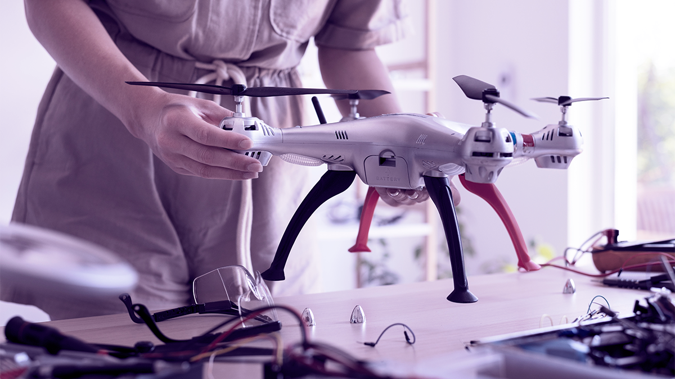
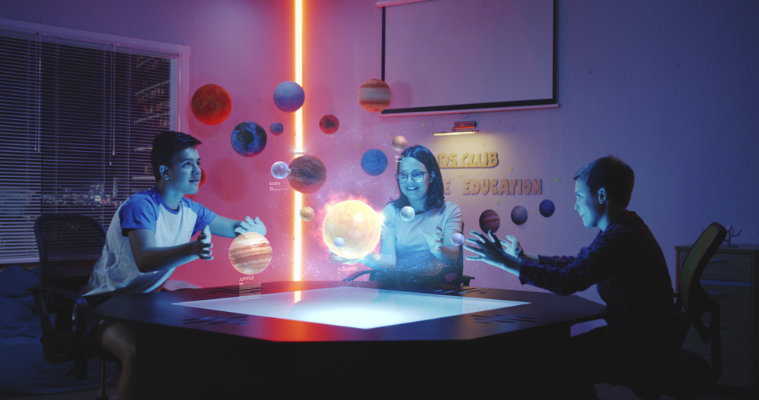
With the hologramic technology

Slide 16
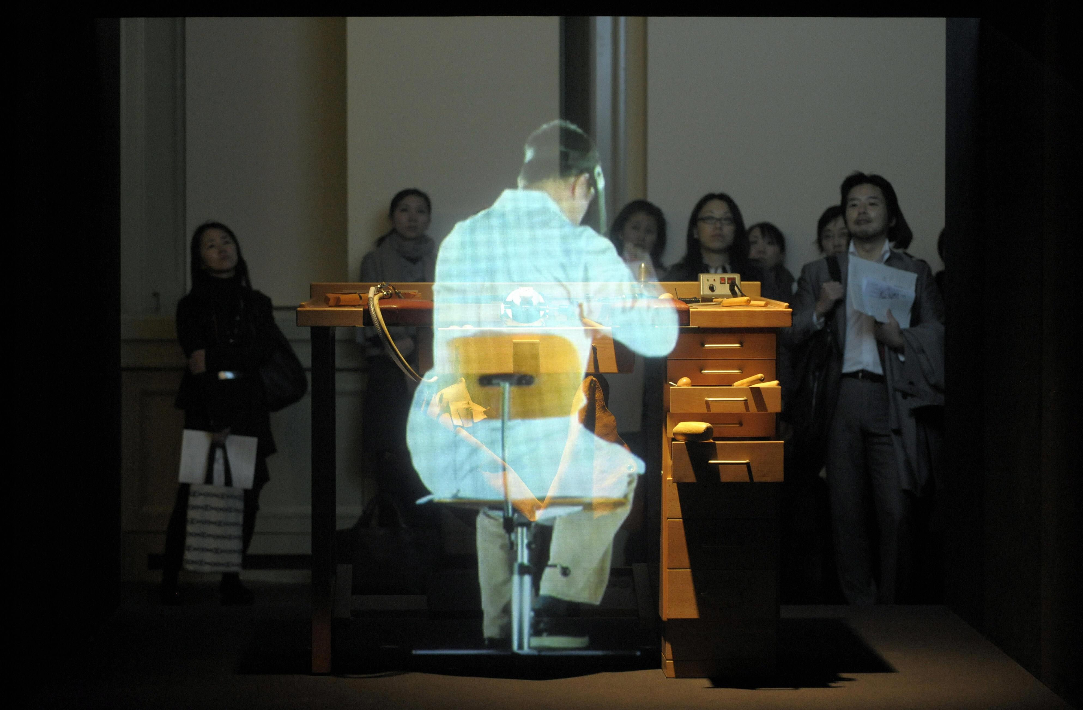
Hologram teaching
Hologram teaching utilizes holographic technology to project interactive and immersive visualizations in the classroom, enhancing student engagement and understanding of complex concepts through dynamic and 3D representations. Implementation may vary due to technological limitations and resource availability.

Slide 17
Pros and Cons
Engaging and Interactive Learning
Improved Retention
Collaborative Learning
Real-World Simulations
Inclusive Education
Cost and Accessibility
Technological Limitations
Content Availability and Quality
Learning Curve
Limited Interactivity

Slide 18
Base paper
https://www.engpaper.com/3d-holographic-ieee-paper.html
https://online-journals.org/index.php/i-joe/article/view/27371/10457
https://www.researchgate.net/publication/357057759_EduGram_Education_Development_Based_on_Hologram_Technology

Slide 19
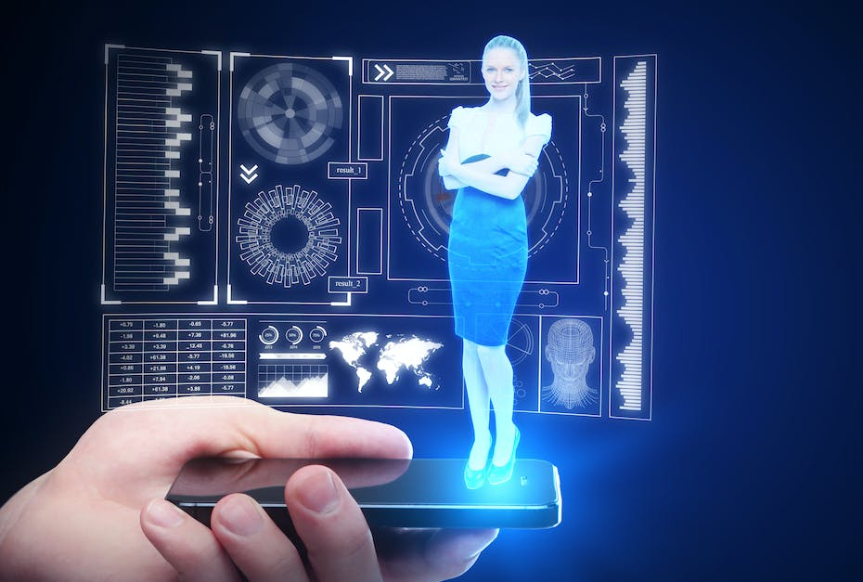


Slide 20
Thank You

