Slide 1

BIG DATA ANALYSIS
PSG POLYTECHNIC COLLEGE
K.ABHIJITHA [21DI01]
J.ARISUDAN [21DI03]
VK.LAKSHMANDEV [21DI15]

Slide 2
Table of Contents
01
02
03
04
05
BIGDATA
3V’S
MAPREDUCE
MARKET OF BIG DATA
FUTURE SCOPE

Slide 3
INTRODUCTION
Big data is a term that describes the large volume of data.
It is a complex data, it should be freely accusable.
big data contains high volume, high velocity and high variety.
Example :
Net banking
Online shopping
Social media

Slide 4
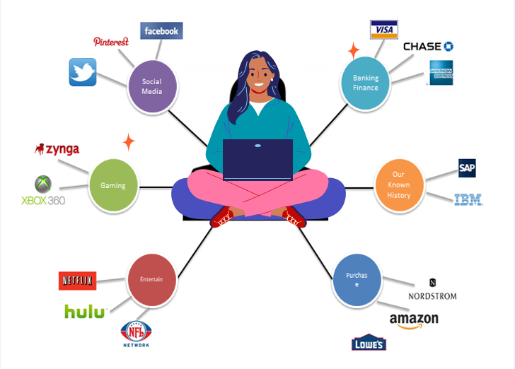
A SINGLE VIEW TO THE CUSTOMER

Slide 5
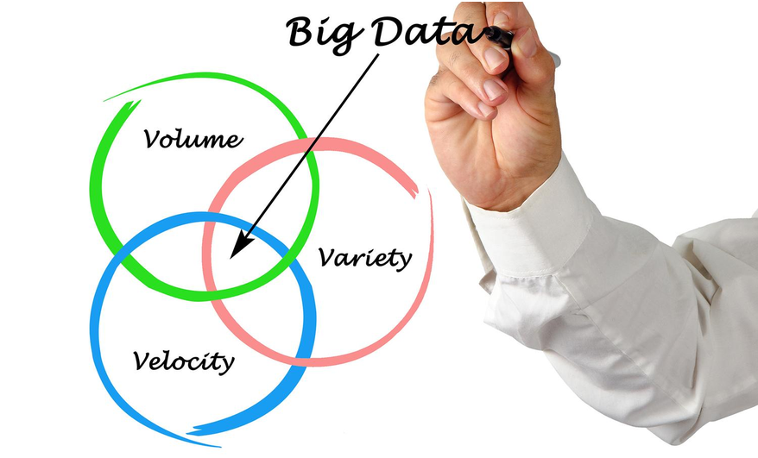

Slide 6
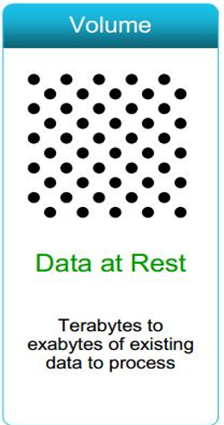
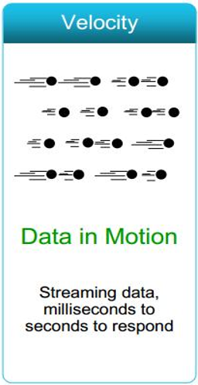
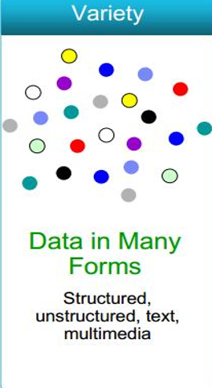

Slide 7
STRUCTURE OF BIGDATA
BIG DATA
Semi structure
Unstructured
Structure

Slide 8
TYPES OF TOOLS USED IN BIGDATA
Where processing is hosted?
Distributed server/cloud(eg:Amazon EC2)
Where data is stored?
Distributed storage(eg:Amazon S3)
What is the programming model?
Distributed processing(eg:mapreduce)
How data is stored & indexed?
High preformation schema (eg:MongoDB)
What operation are performed on data?
Analytic

Slide 9
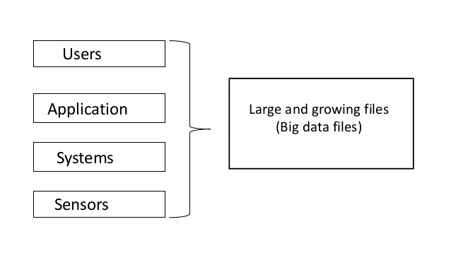
BIG DATA SOURCE
Big data sources are repositories of large volumes of data. Using business intelligence applications like Logi Info, users can quickly connect to and derive value from these sources.

Slide 10
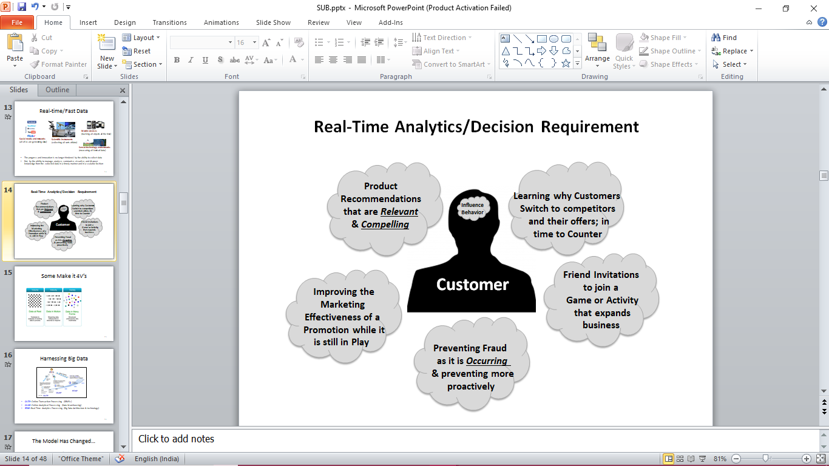
REAL-TIME ANALYTICS

Slide 11
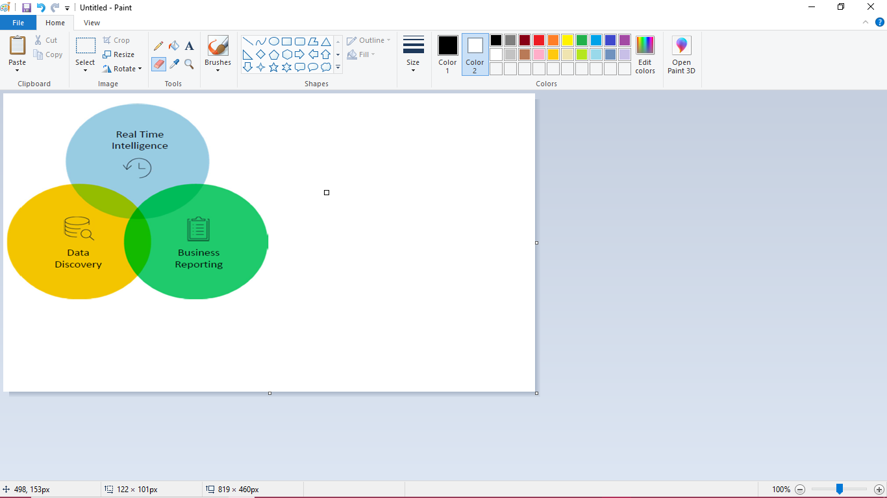
BIG DATA ANALYTICS USE CASES

Slide 12
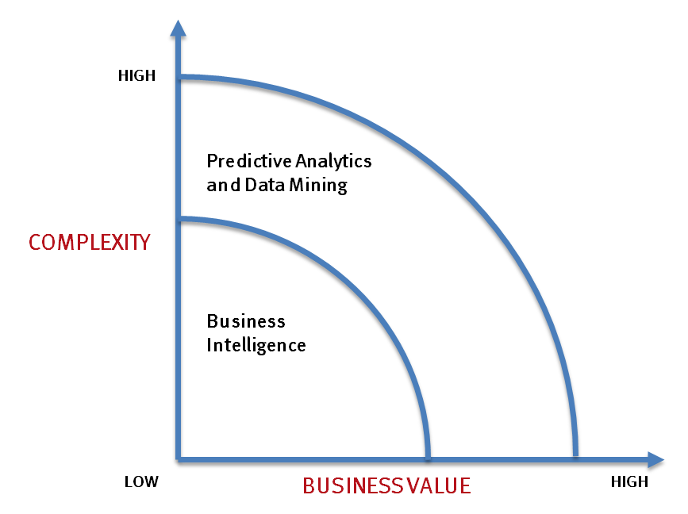
WHAT’S DRIVING BIG DATA
- Optimizations and predictive analytics
- Complex statistical analysis
- All types of data, and many sources
- Very large datasets
- More of a real-time
- Ad-hoc querying and reporting
- Data mining techniques
- Structured data, typical sources
- Small to mid-size datasets
12

Slide 13
OVERVIEW OF MAPREDUCE
Map reduce has two important task, they are:
1. map
It contains a set of data it converts an other set of data
2. Reduce
it will take a set of data & maps the data into smaller tuples.
User
Server
DB

Slide 14
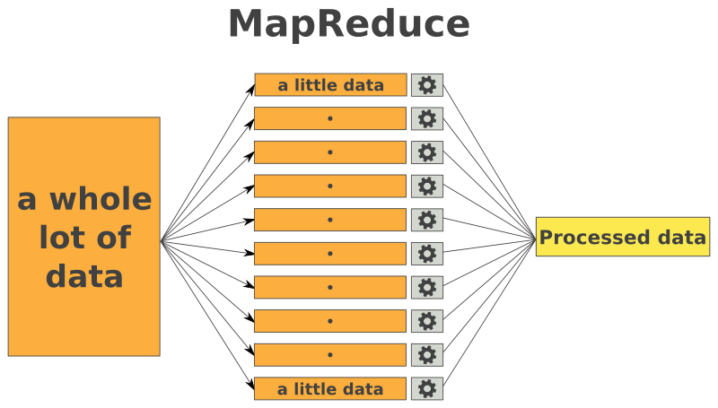
WORKING OF MAP REDUCE

Slide 15

HADOOP BIG DATA
Hadoop is an Apache open source framework written in the language on Java.
It is distributed storage model.
It is parallel CPU processing.
It is low cost, scalability and stores the processed data is speed.
It is designed on single server to compute and store process of 1000 machines.

Slide 16
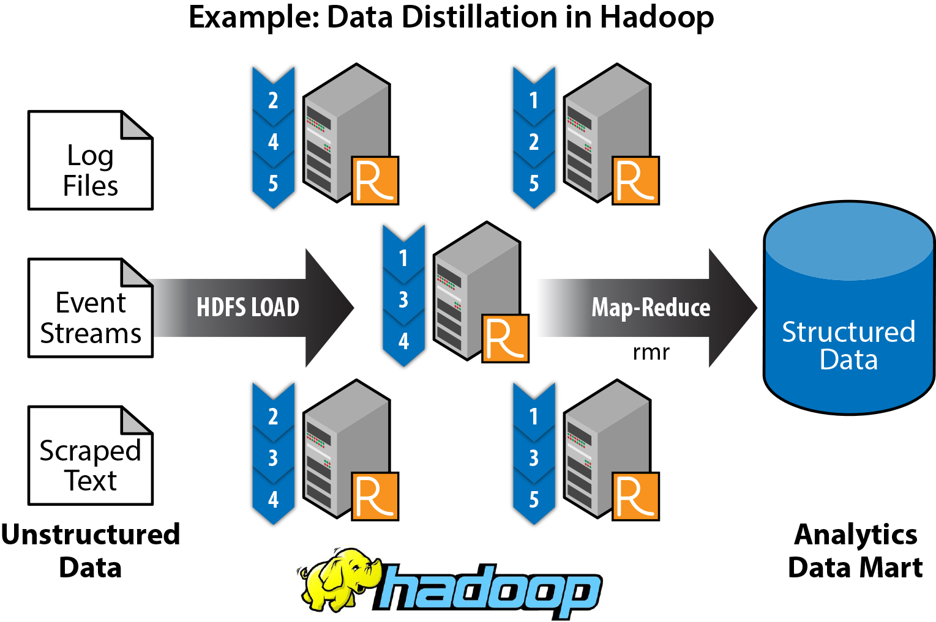
HDFS
HDFS-Hadoop Distributed File System
HDFS is the large set of data which process and store the data.

Slide 17
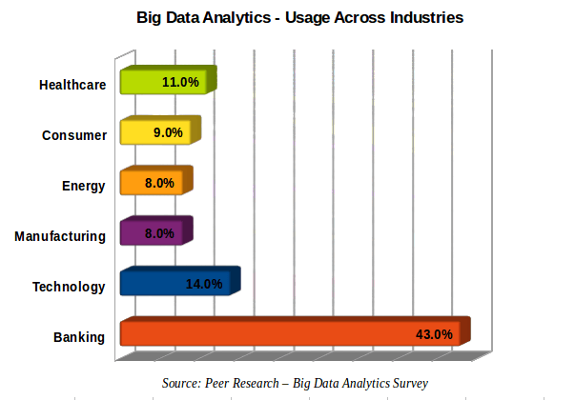
MARKET OF BIG DATA

Slide 18
MARKET OF BIG DATA
11%
14%
43%
Health care
Technology
Banking

Slide 19
LIMITATION OF HADOOP
Secure of data
Slow processing of speed
No caching
Not easy to use
No real time data processing
Support for only batch processing only

Slide 20
GOOGLE’S APPENGINE VS AMAZON’S EC2
Google
Amazon
Google App Engine abstracts infrastructure complexities, enabling developers to focus on code, and seamlessly integrates with Google Cloud Services like Big Query and Dataflow for streamlined big data development.
Offers greater customization and control over infrastructure, making it suitable for custom big data configurations, and leverages a broad ecosystem of AWS big data services such as Amazon EMR and Amazon Redshift for versatile big data processing and analytics.

Slide 21
ADVANTAGES OF BIG DATA
Cost Savings
Reduced Time to deployment
New Product Development
Understand the market conditions
Control online reputation

Slide 22

FUTURE SCOPE
Big data is influencing the IT industry like few technologies or trends have done so before. If analyzed effectively, massive information caches can help companies improve their decision-making and compete on another level. However, managing big data is a difficult endeavor, according to a recent report by Microsoft.

Slide 23
REFERENCE
Hadoop: The Definitive Guide, Tom White, O’Reilly
https://en.wikipedia.org/wiki/Big_data
https://www.oracle.com/in/big-data/guide/what-is-big-data.html

Slide 24

Thank You
K.ABHIJITHA [21DI01]
J.ARISUDAN [21DI03]
VK.LAKSHMANDEV [21DI15]

