Slide 1
PROJECT PROPOSAL
Augmented Horizon of Exploring New Realities in Education

Slide 2
TABLE OF CONTENTS
01
02
03
ABOUT THE PROJECT
WORKING
PROJECT GOALS
04
05
STAFF VS STUDENTS
PROJECT STAGES

Slide 3




OUR TEAM
J.ARISUDAN
S.GAUTHAM SIDDHARTH
21DI03
D.VIVIN
21DI31
21DI07
K.ABHIJITHA
21DI01
VK.LAKSHMANDEV
21DI15
V.SRI MUTHU KANNAN
21DI25

Slide 4

INTRODUCTION
Augmented Reality (AR) in education integrates digital content with the real-world environment, offering interactive and personalized learning experiences, fostering engagement and collaboration among students.

Slide 5
ABOUT THE PROJECT
Integrate AR for personalized learning.
Boost engagement with interactive AR in education.
Foster collaboration through AR projects for teamwork and knowledge sharing.

Slide 6
THIS IS HOW IT WORKS
Unity in AR creates interactive and immersive experiences by seamlessly integrating digital content with the real world, enhancing user engagement.

Slide 7
PROJECT GOALS
Enhanced Learning Experiences
Continuous Improvement
Technology Proficiency
Measurable Outcomes
Implement AR for enhanced and immersive learning experiences
Continuously improve AR content based on feedback from educators and students
Equip students with technological skills by integrating AR, preparing them for a digitally advanced future.
Establish measurable metrics to assess and achieve positive educational outcomes

Slide 8

STAFF VS STUDENTS
STAFF
STUDENT’S
Staff implement AR in education through planning, training, content creation, implementation, and continuous improvement, ensuring a seamless integration for enhanced learning experiences.
Students engage dynamically with AR, collaborating, providing feedback, and developing independent learning skills, fostering a personalized and adaptive educational experience..

Slide 9
IN THE FUTURE
The future of AR in education entails revolutionizing learning through immersive simulations and personalized content, fostering dynamic, collaborative, and engaging educational environments.

Slide 10
SYSTEM REQUIREMENT
Unity:
1. Operating System: Windows 7 (64-bit) or macOS 10.12 or later.
2. Graphics: DirectX 11 support or equivalent.
3. RAM: At least 8 GB.
Blender:
1. Operating System: Windows 8 or 10, macOS 10.12 or later, or a compatible Linux distribution.
2. Graphics: OpenGL 3.3 support.
3. RAM: A graphics card with at least 4 GB of RAM for optimal performance.

Slide 11
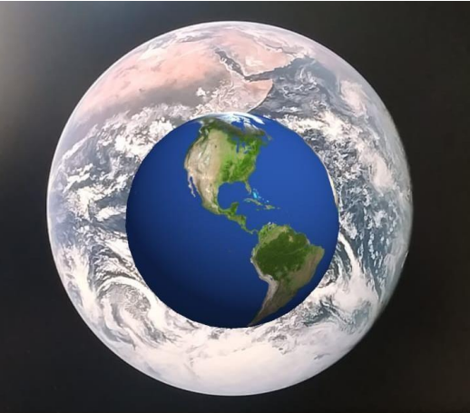
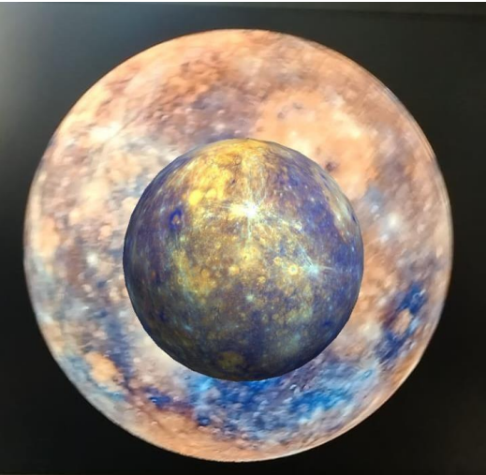
OUTPUTS

Slide 12
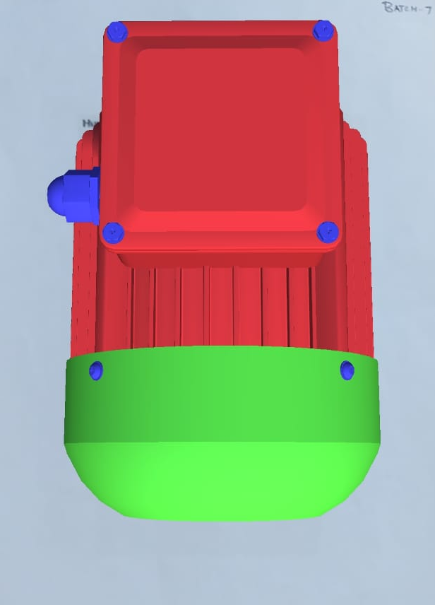
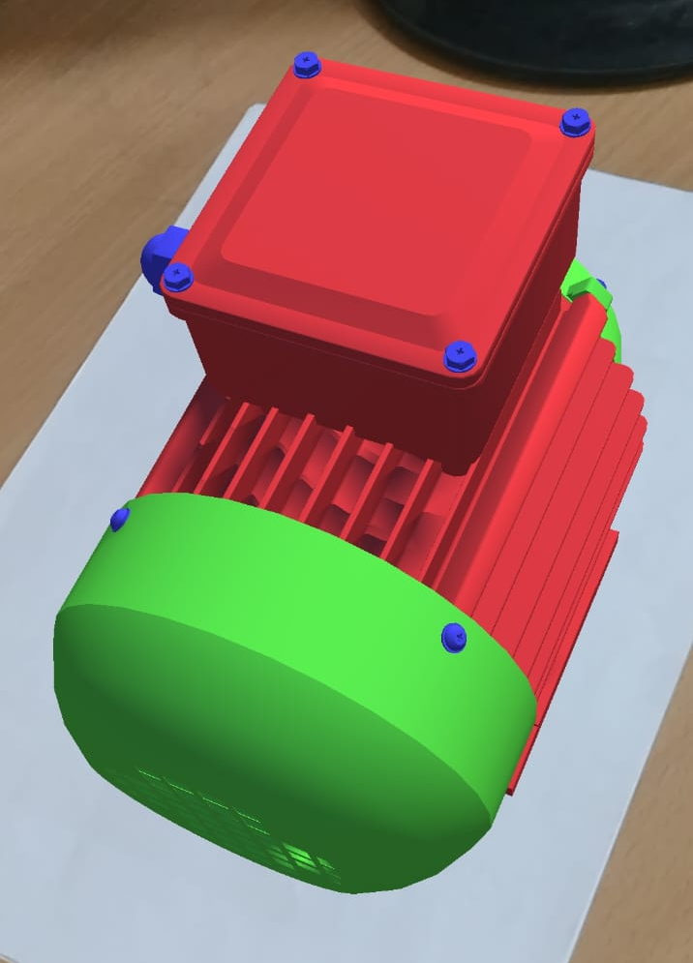
OUTPUTS

Slide 13
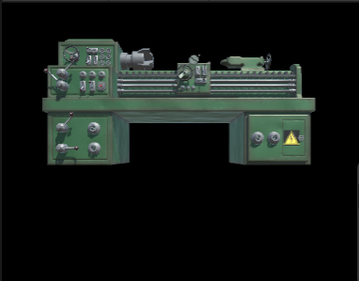
OUTPUTS

Slide 14

THANK
YOU!!!!!
K.ABHIJITHA [21DI01]
J.ARISUDAN [21DI03]
S.GAUTHAM SIDDHARTH [21DI07]
VK.LAKSHMANDEV [21DI15]
V.SRI MUTHU KANNAN [21DI25]

