Slide 1
Augmented Horizons: Exploring New Realities in Education
Faculty Guide: Mr A.Kathiresan
BATCH - 7
Abhijitha
Kiran
Lakshmandev
Rajarajan

Slide 2
TABLE OF CONTENTS
1.
4.
2.
5.
3.
6.
INTRODUCTION
TOOLS FOR IMPLEMENTATION
EXISTING SYSTEM
BASE PAPER
WORKING OF AR
IMAGES

Slide 3

INTRODUCTION
Augmented reality (AR) is a technology that superimposes a computer-generated image on a user's view of the real world, thus providing a composite view. AR can be used in education to enhance learning by making it more immersive and interactive. AR has many benefits for education, including visualization, engagement, personalization, collaboration, and assessment. AR can be used in education in many different ways, including science and math, history and geography, language learning, art and design, and business and engineering. The use of AR in education is still in its early stages, but it has the potential to revolutionize the way we learn.

Slide 4
EXISTING SYSTEM
Waze: This AR navigation app shows drivers real-time traffic information and directions.
Pokémon Go: This game uses AR to allow players to catch Pokémon in the real world.
Augmedix: This app allows doctors to see a patient's medical records and images in AR.
AR City: This app allows students to explore a virtual city and learn about different aspects of urban planning.

Slide 5
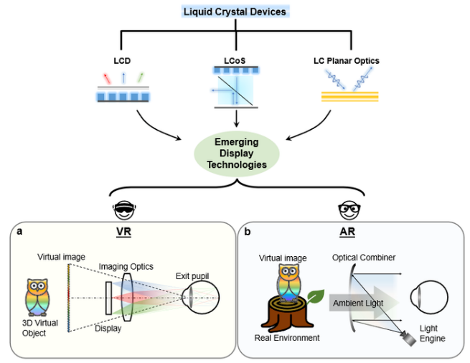
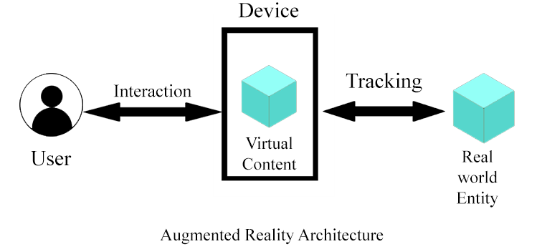
WORKING OF A AR

Slide 6
TOOLS FOR IMPLEMENTATION
UNITY
ANDROID APPLICATION
AR FOUNDATION
AR CORE

Slide 7
BASE PAPERS
https://www.researchgate.net/publication/281336331_A_Review_of_Research_on_Augmented_Reality_in_Education_Advantages_and_Applications
https://ieeexplore.ieee.org/document/8726192
https://www.ijraset.com/research-paper/augmented-reality-in-education
https://www.sciencedirect.com/science/article/pii/S1877042812023907

Slide 8


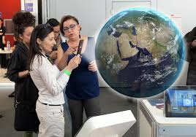
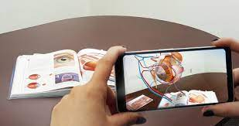
IMAGES

Slide 9
THANK YOU

