Slide 1


MACHINE LEARNING INTERNSHIP
PROJECT NAME:
AUTO ENCODER
NAME : N. Lakshman
REDG NO : Y20CS119
RVR & JC College of Engineering
B Tech 3rd year
Computer science Department

Slide 2
abstraction
The concept of auto encoder was originally proposed by Le Cun in 1987, early works on auto encoder were used for dimensionality reduction or feature learning. Recently, with the popularity of deep learning research, auto encoder has been brought to the forefront of generative modeling.
Requirements engineering is the first phase in software development life cycle and it also plays one of the most important and critical roles. Requirement document mainly contains both functional requirements and non-functional requirements. Non-functional requirements are significant to describe the properties and constraints of the system. Early identification of Non-functional requirement has direct impact on the system architecture and initial design decision.

Slide 3
Introduction:
Autoencoder is an unsupervised artificial neural network that learns how to efficiently compress and encode data then learns how to reconstruct the data back from the reduced encoded representation to a representation that is as close to the original input as possible.
Autoencoder, by design, reduces data dimensions by learning how to ignore the noise in the data.
An autoencoder consists of 3 components: encoder, code and decoder. The encoder compresses the input and produces the code, the decoder then reconstructs the input only using this code.

Slide 4
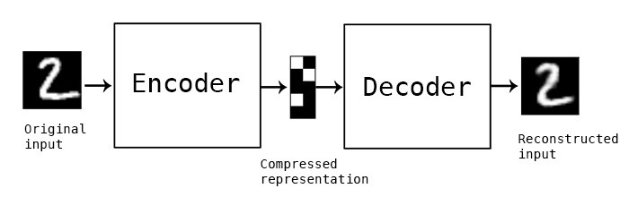
Autoencoders were first introduced in the 1980s by Hinton and the PDP group (Rumelhart et al., 1986) to address the problem of “backpropagation without a teacher”, by using the input data as the teacher.

Slide 5
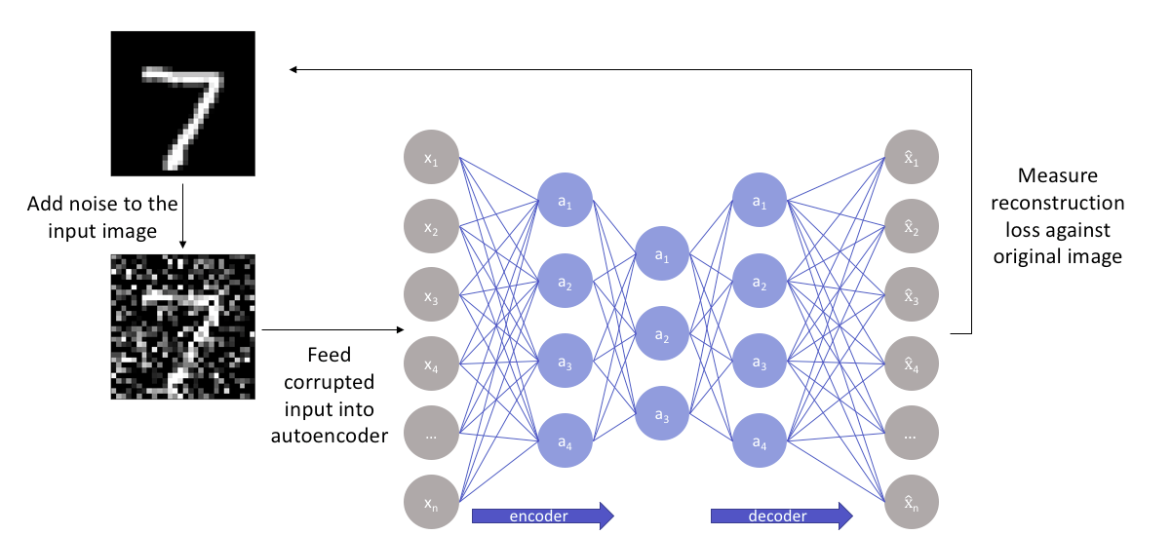
Sample Model to understand how the reconstruction of loss against the original Image

Slide 6
Autoencoder Components:
Autoencoders consists of 4 main parts:
1- Encoder: In which the model learns how to reduce the input dimensions and compress the input data into an encoded representation.
2- Bottleneck: which is the layer that contains the compressed representation of the input data. This is the lowest possible dimensions of the input data.
3- Decoder: In which the model learns how to reconstruct the data from the encoded representation to be as close to the original input as possible.
4- Reconstruction Loss: This is the method that measures measure how well the decoder is performing and how close the output is to the original input.
The training then involves using back propagation in order to minimize the network’s reconstruction loss.

Slide 7
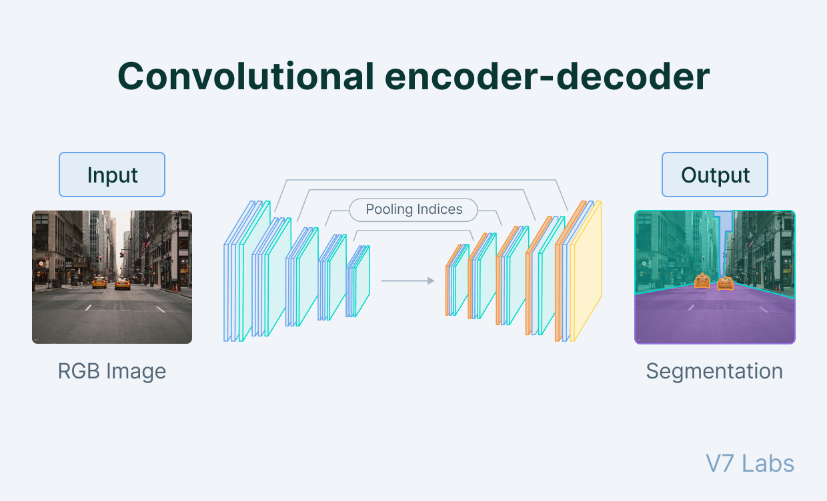

Slide 8
The relationship between the Encoder, Bottleneck, and Decoder:
Encoder
The encoder is a set of convolutional blocks followed by pooling modules that compress the input to the model into a compact section called the bottleneck.
The bottleneck is followed by the decoder that consists of a series of upsampling modules to bring the compressed feature back into the form of an image. In case of simple autoencoders, the output is expected to be the same as the input with reduced noise.
However, for variational autoencoders it is a completely new image, formed with information the model has been provided as input.
Bottleneck
The most important part of the neural network, and ironically the smallest one, is the bottleneck. The bottleneck exists to restrict the flow of information to the decoder from the encoder, thus,allowing only the most vital information to pass through.
Since the bottleneck is designed in such a way that the maximum information possessed by an image is captured in it, we can say that the bottleneck helps us form a knowledge-representation of the input.

Slide 9
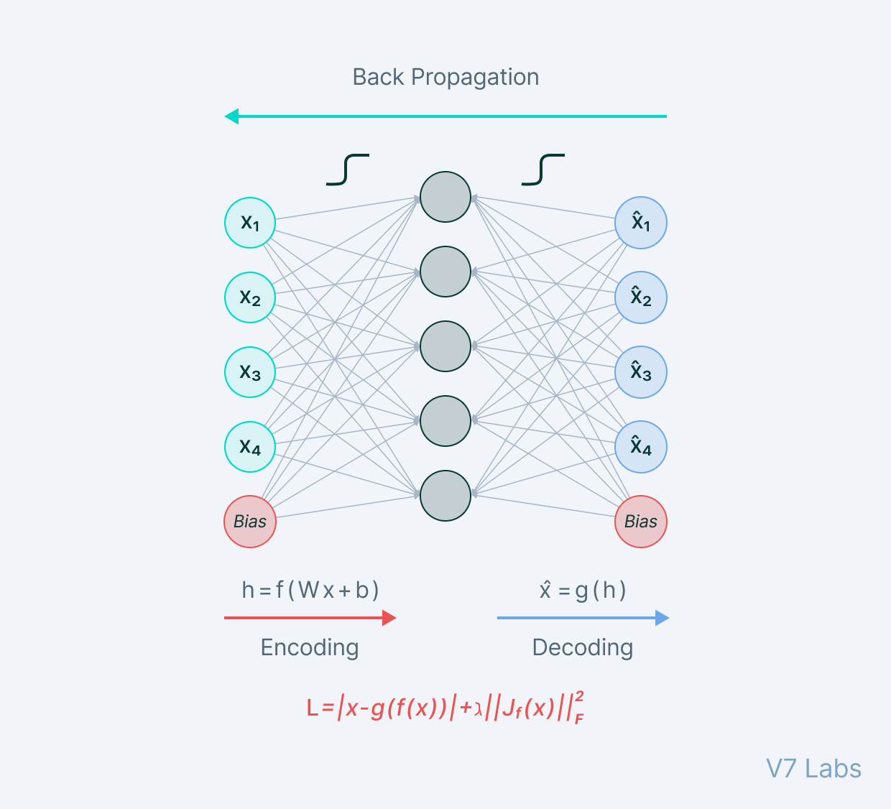
A bottleneck as a compressed representation of the input further prevents the neural network from memorising the input and overfitting on the data.
As a rule of thumb, remember this: The smaller the bottleneck, the lower the risk of overfitting.
However—
Very small bottlenecks would restrict the amount of information storable, which increases the chances of important information slipping out through the pooling layers of the encoder.
Decoder
Finally, the decoder is a set of upsampling and convolutional blocks that reconstructs the bottleneck's output.
Since the input to the decoder is a compressed knowledge representation, the decoder serves as a “decompressor” and builds back the image from its latent attributes.

Slide 10
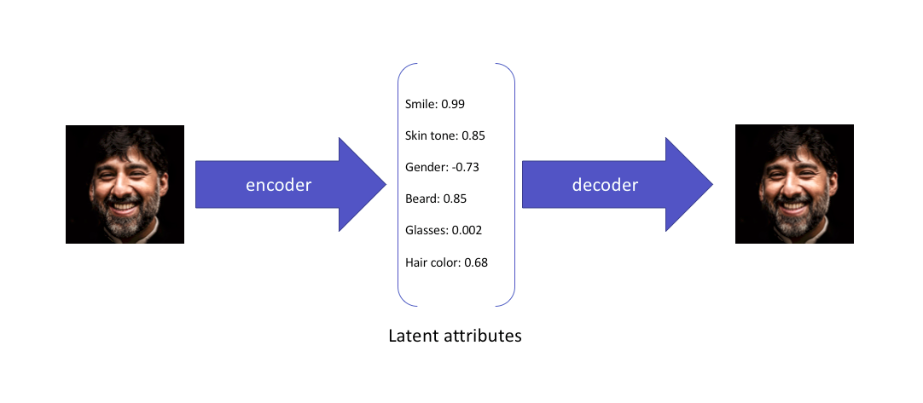
Sample Pictorial Representation of Working of Encoder and Decoder Model:

Slide 11
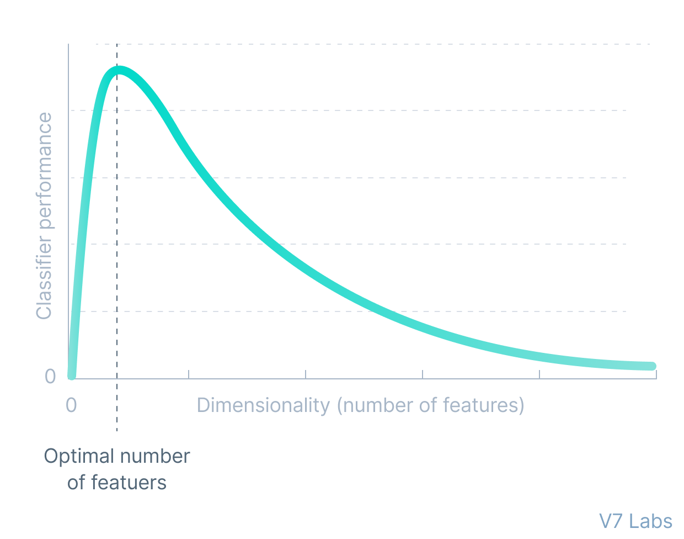
The primary use of autoencoders like such is the generation of the latent space or the bottleneck, which forms a compressed substitute of the input data and can be easily decompressed back with the help of the network when needed.
This form of compression in the data can be modeled as a form of dimensionality reduction.

Slide 12
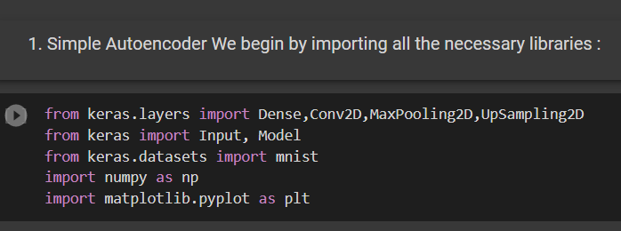
Libraries and Technologies used in this project:
We use libraries like tensor flow and tensor flow dataset to extract out data set from it, math and numpy to do operation on array like to represent of size of matrix of image and we use keras from tensorflow to preprocessing the images .
We use technology like CNN (convolutional neural network) and CGI techniques(our data set is consist of computer generated images).and finally we used DATA AUGMENTATION technique also.

Slide 13
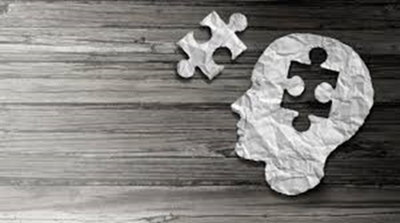
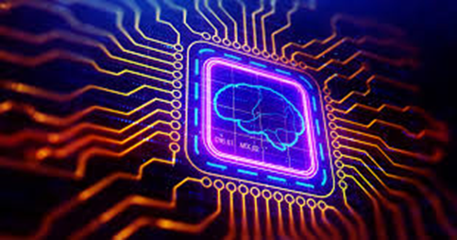
Problem Background:
The aim of an auto encoder is to learn a lower-dimensional representation (encoding) for a higher-dimensional data, typically for dimensionality reduction, by training the network to capture the most important parts of the input image.
The Primary objective is to build a deep learning model which can identify the blur images in the given data set. Here the accuracy, precision and overall performance can be in the category as follows.
The secondary objective is simply to learn about Simple Auto Encoder, Deep CNN Auto Encoder and De noising Auto Encoder.

Slide 14
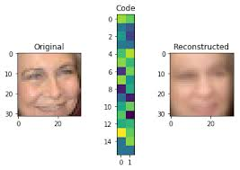
OBJECTIVES:
Import data from Tensor Flow
Import blur images from dataset
Testing data and Training Data
Images from web source

Slide 15
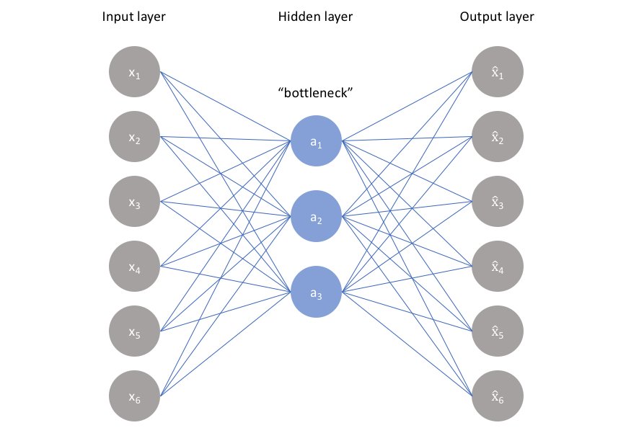
ARCHITECTURE:
A convolutional neural network (CNN) is a network architecture for deep learning that learns directly from data. CNNs are particularly useful for finding patterns in images to recognize objects, classes, and categories. They can also be quite effective for classifying audio, time-series, and signal data.

Slide 16
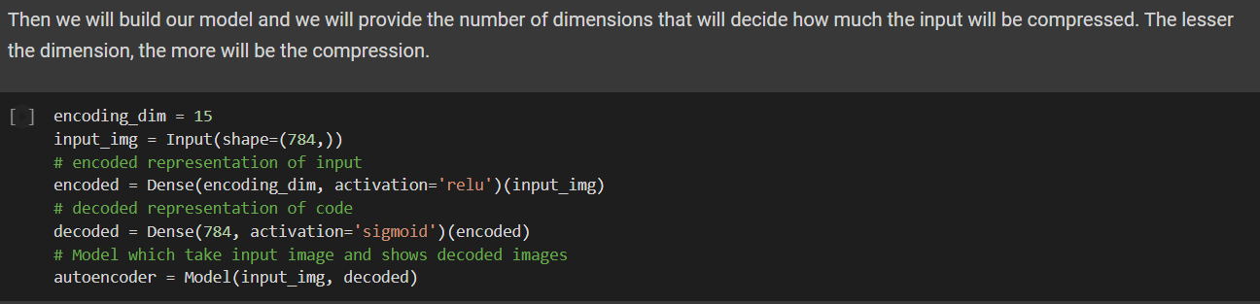
Source Code for project:

Slide 17
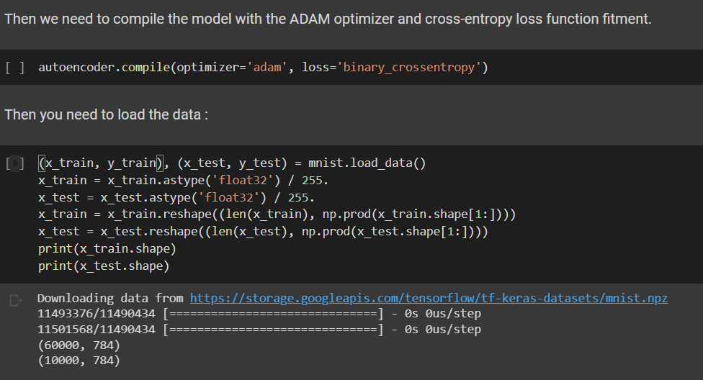
Now to Load Data:

Slide 18
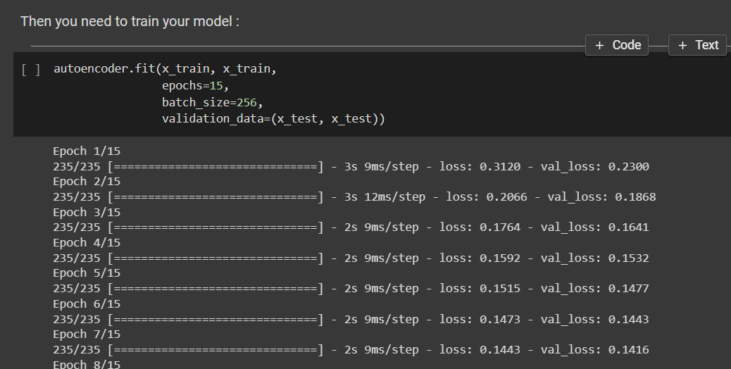
Next to train data:

Slide 19
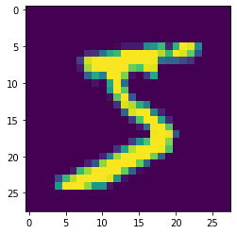
If you want to see how the data is actually, you can use the following line of code :
plt.imshow(x_train[0].reshape(28,28))

Slide 20
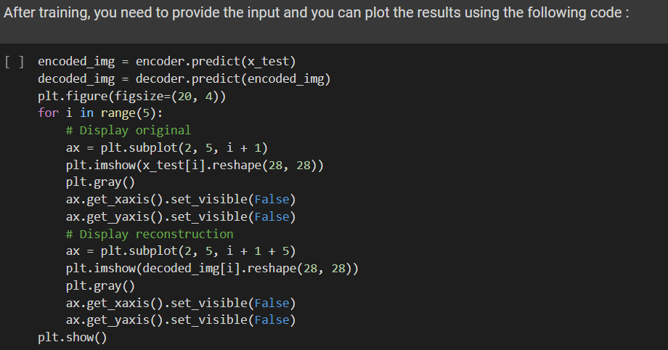

Slide 21
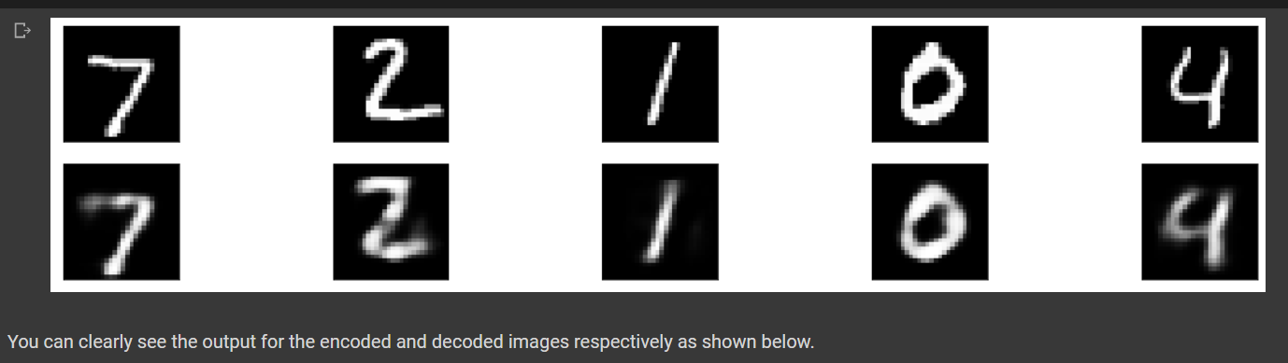
Output:
We can also do it by other two methods called Deep CNN Auto Encoder and another approach is De noising Auto Encoder. So these also having same approach either.

Slide 22
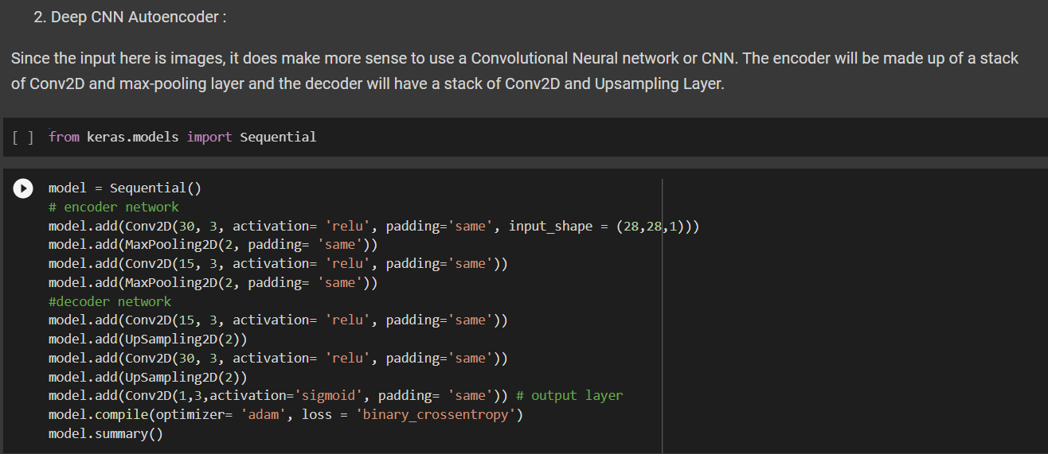
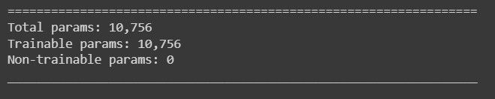

Slide 23
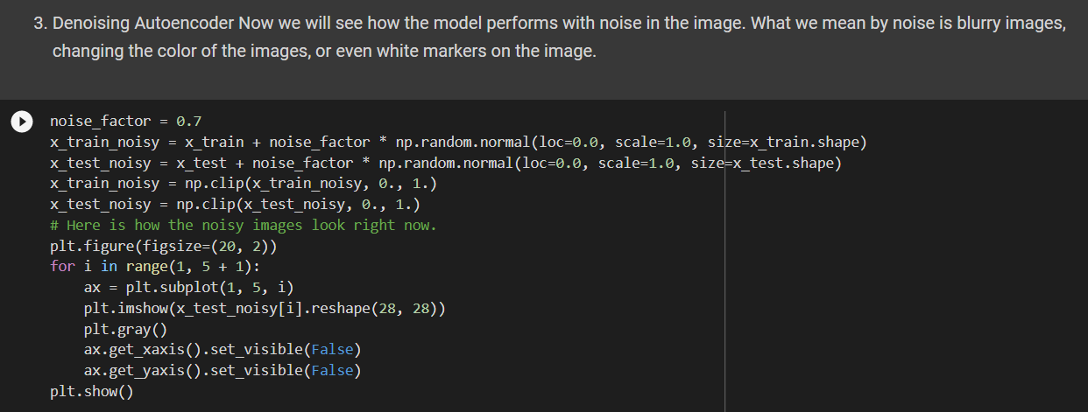
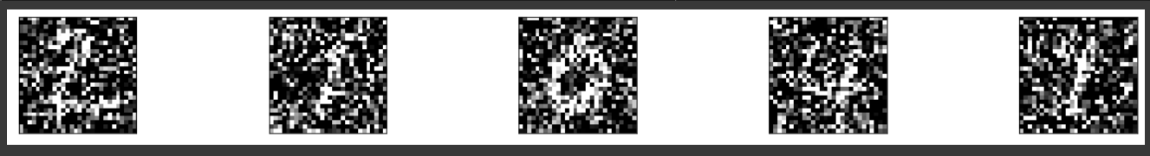

Slide 24
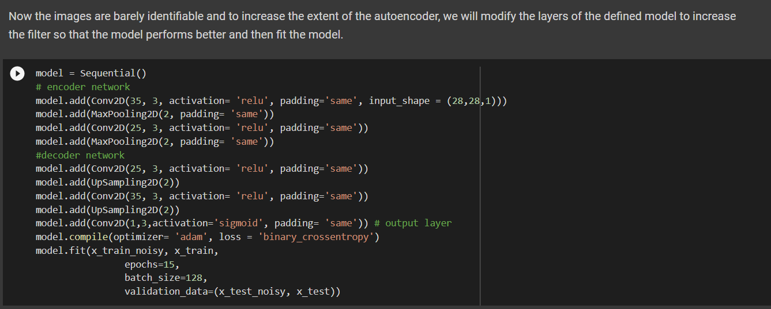
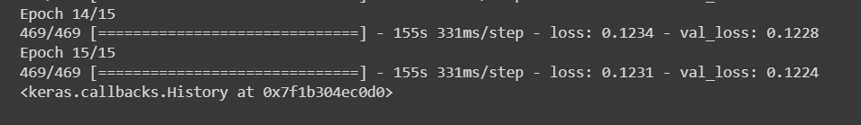

Slide 25
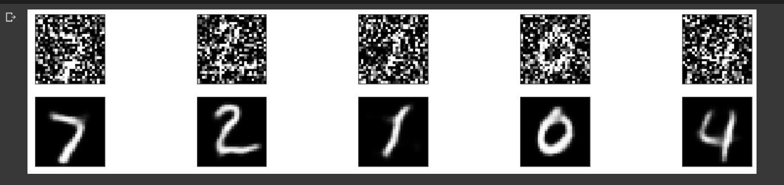
We have gone through the structure of how autoencoders work and worked with 3 types of autoencoders. There are multiple uses for autoencoders like dimensionality reduction image compression, recommendations system for movies and songs and more. The performance of the model can be increased by training it for more epochs or also by increasing the dimension of our network.

Slide 26
CONCLUSION:
we've been introduced to autoencoders, which are neural networks that compress input data into low-dimensional codes in order to efficiently perform structural transformations such as denoising and colorization. We've laid the foundations to the more advanced topics of GANs and VAEs, that we will introduce in later chapters, while still exploring how autoencoders can utilize Keras. We've demonstrated how to implement an autoencoder from two building block models, both encoder and decoder. We've also learned how the extraction of a hidden structure of input distribution is one of the common tasks in AI.
Once the latent code has been uncovered, there are many structural operations that can be performed on the original input distribution. In order to gain a better understanding of the input distribution, the hidden structure in the form of the latent vector can be visualized using low-level embedding similar to what we did in this project or through more sophisticated...

Slide 27
Thank you

