Slide 1
An improved Id3 algorithm for clinical data classification
-Data Mining
119003228 N.L.Veerendra
119003080 K.Gangadhar
119003107 P.Rohith Surya
Smt. Kamakshi.S

Slide 2
Paper:
Yang, Shuo, Jing-Zhi Guo, and Jun-Wei Jin. "An improved Id3 algorithm for medical data classification." Computers & Electrical Engineering 65 (2018): 474-487.
Url:
https://www.sciencedirect.com/science/article/pii/S004579061732517X

Slide 3
Objective
To improve the Id3 algorithm overcomes multi-value bias problem when selecting test/split attributes and to solve the issue of numeric attribute discretization.

Slide 4
Introduction:
Improved Id3 algorithm for disease prediction
Features:
balance function for test attribute selection.
numeric attribute discretization strategy.
rule-based method for classified representation.

Slide 5
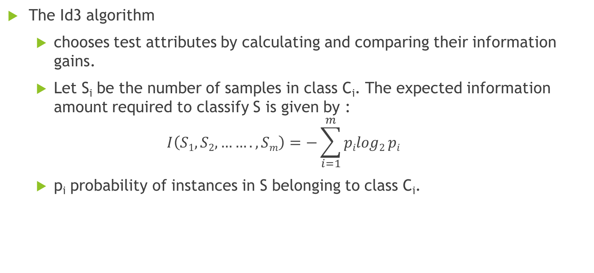
Basic principles of Id3
The Id3 algorithm
chooses test attributes by calculating and comparing their information gains.
Let S_{i} be the number of samples in class C_{i}. The expected information amount required to classify S is given by :
$$I\left(S1,S2,…….,Sm\right)=−\sum_{i=1}^{m}{pilog2}pi$$
p_{i} probability of instances in S belonging to class C_{i}.

Slide 6
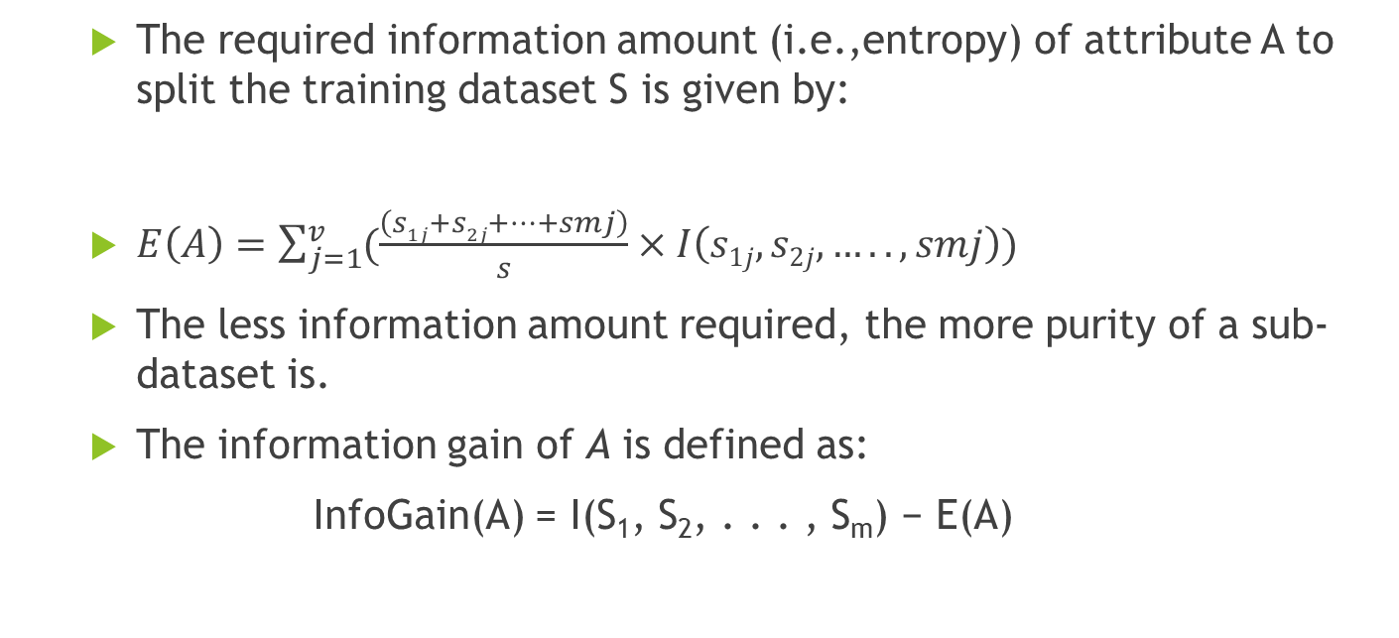
Basic principles of Id3
The required information amount (i.e.,entropy) of attribute A to split the training dataset S is given by:
$E\left(A\right)=\sum_{j=1}^{v}{(\frac{\left(s1j+s2j+…+smj\right)}{s}×I\left(s1j,s2j,…..,smj\right))}$
The less information amount required, the more purity of a sub-dataset is.
The information gain of A is defined as:
InfoGain(A) = I(S₁, S₂, . . . , S_{m}) − E(A)

Slide 7
Problems of classical Id3 algorithm
Bias on multi-variated attributes
The more different attribute values, the larger information gains.
Helplessness with numeric attributes
Clasical ID3 algorithm works only on nominal data.
if the default filter of NumericToNominal in WEKA is used to discretize the attributes, the performance of Id3 algorithm degrades dramatically.

Slide 8
Problems of classical Id3 algorithm
Loosing relations among attributes
uses a tree structure to represent a classifier model which is hard to interpret and understand.
the tree representation is neither an optimal method for storage nor a good way for interpretation.(takes more memory and uses recursive calls to traverse the tree)

Slide 9
Improvements on ID3
Balance Function
Discretization of numeric attributes
Rule representation of classifier model

Slide 10
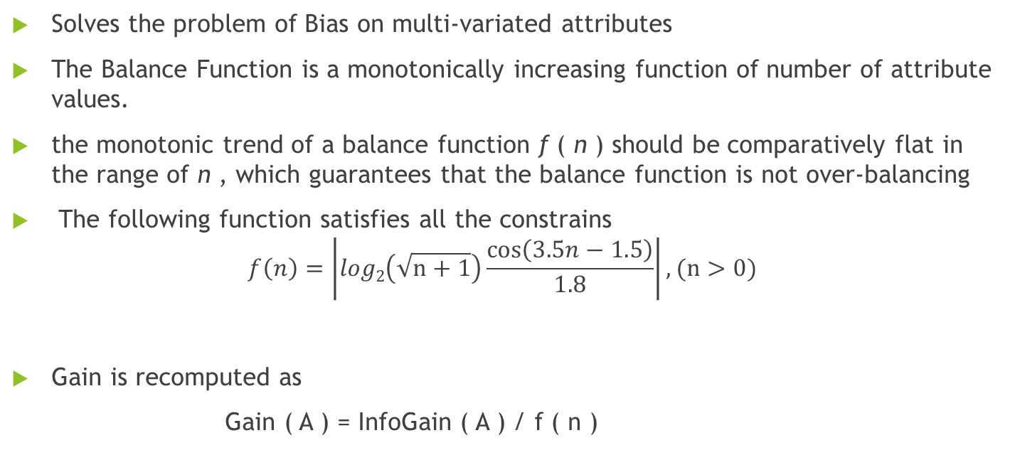
Balance Function
Solves the problem of Bias on multi-variated attributes
The Balance Function is a monotonically increasing function of number of attribute values.
the monotonic trend of a balance function f ( n ) should be comparatively flat in the range of n , which guarantees that the balance function is not over-balancing
The following function satisfies all the constrains
$$f\left(n\right)=\left|log2\left(\sqrt{n+1}\right)\frac{\cos\left(3.5n−1.5\right)}{1.8}\right|, (n>0)$$
Gain is recomputed as
Gain ( A ) = InfoGain ( A ) / f ( n )

Slide 11
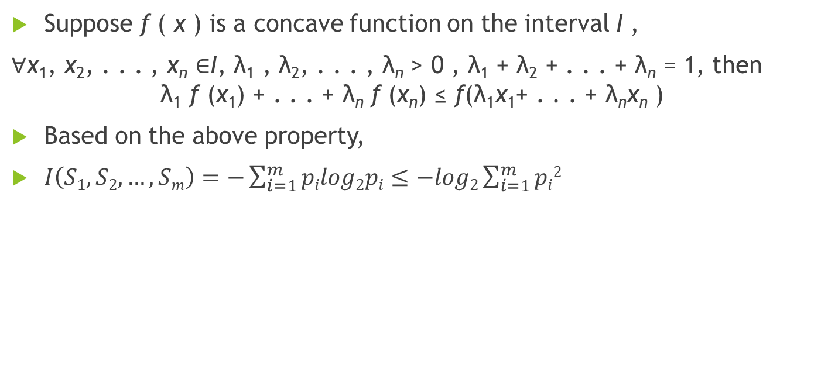
Discretization of numeric attributes
Suppose f ( x ) is a concave function on the interval I ,
$\text{∀}\text{x}\text{1}\text{, }\text{x}\text{2}\text{, . . . , }\text{x}\text{n} \text{∈}\text{I}\text{, }\text{λ}\text{1}\text{ , }\text{λ}\text{2}\text{, . . . , }\text{λ}\text{n} \text{> 0 , }\text{λ}\text{1}\text{ + }\text{λ}\text{2}\text{ + . . . + }\text{λ}\text{n} \text{= 1}$, then
$$\text{λ}\text{1} \text{f} \text{(}\text{x}\text{1}\text{) + . . . + }\text{λ}\text{n} \text{f} \text{(}\text{x}\text{n}\text{) ≤ }\text{f}\text{(}\text{λ}\text{1}\text{x}\text{1}\text{+ . . . + }\text{λ}\text{n}\text{x}\text{n} \text{) }$$
Based on the above property,
$I\left(S1,S2,…,Sm\right)=−\sum_{i=1}^{m}{pilog2pi≤−log2\sum_{i=1}^{m}{pi2}}$

Slide 12
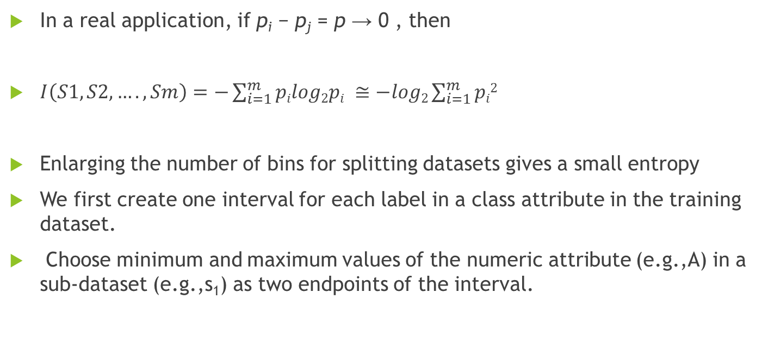
Discretization of numeric attributes
In a real application, if p_{i} − p_{j} = p → 0 , then
$I\left(S1,S2,….,Sm\right)=−\sum_{i=1}^{m}{pilog2pi ≅−log2\sum_{i=1}^{m}{pi2}}$
Enlarging the number of bins for splitting datasets gives a small entropy
We first create one interval for each label in a class attribute in the training dataset.
Choose minimum and maximum values of the numeric attribute (e.g.,A) in a sub-dataset (e.g.,s₁) as two endpoints of the interval.

Slide 13
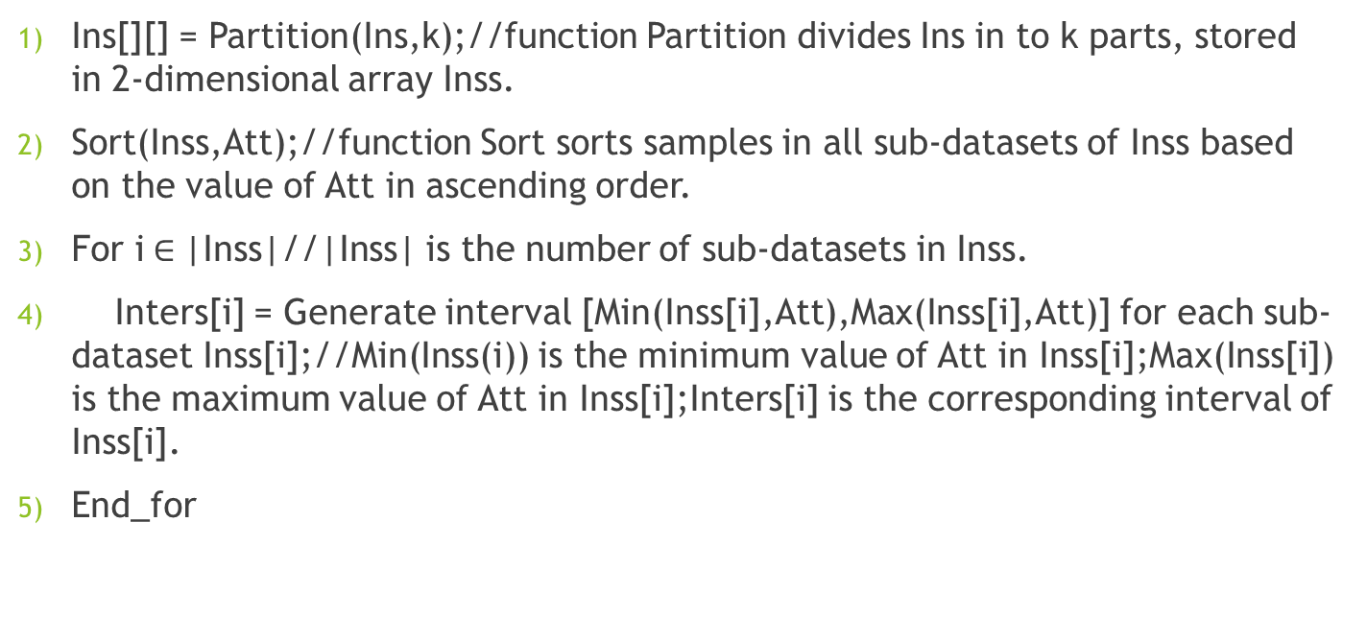
Algorithm to discretize a numeric attributes
Discretize(Ins,Att,k):Ins-training dataset; Att – a numeric attribute; k-the number of different labels in a class attribute.
Input: Att,Ins,k
Output: Intervals of Att
Ins[][] = Partition(Ins,k);//function Partition divides Ins in to k parts, stored in 2-dimensional array Inss.
Sort(Inss,Att);//function Sort sorts samples in all sub-datasets of Inss based on the value of Att in ascending order.
For i$∈$|Inss|//|Inss| is the number of sub-datasets in Inss.
Inters[i] = Generate interval [Min(Inss[i],Att),Max(Inss[i],Att)] for each sub-dataset Inss[i];//Min(Inss(i)) is the minimum value of Att in Inss[i];Max(Inss[i]) is the maximum value of Att in Inss[i];Inters[i] is the corresponding interval of Inss[i].
End_for

Slide 14
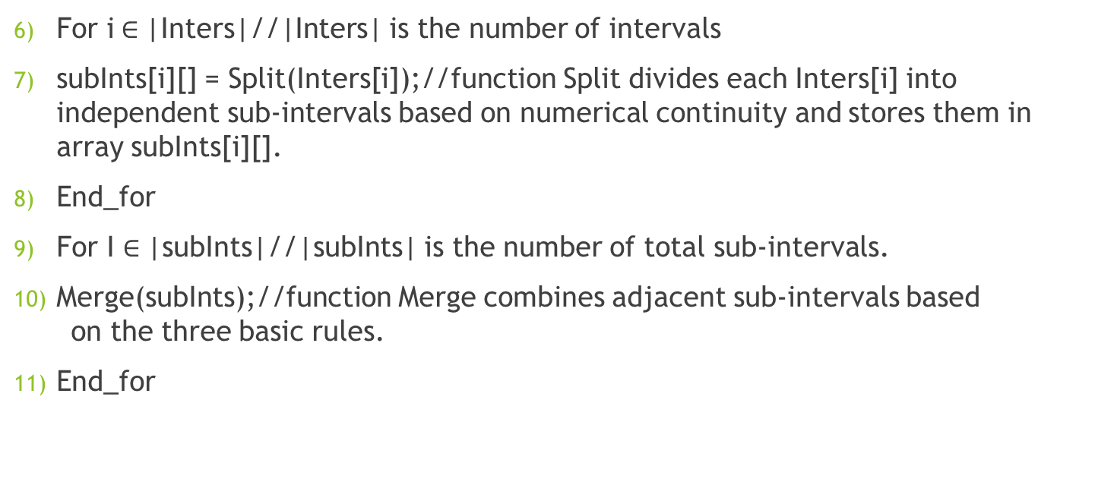
Algorithm to discretize a numeric attributes
For i$∈$|Inters|//|Inters| is the number of intervals
subInts[i][] = Split(Inters[i]);//function Split divides each Inters[i] into independent sub-intervals based on numerical continuity and stores them in array subInts[i][].
End_for
For I $∈$|subInts|//|subInts| is the number of total sub-intervals.
Merge(subInts);//function Merge combines adjacent sub-intervals based on the three basic rules.
End_for

Slide 15
Improved Id3 algorithm
Id3_improved algorithm: Generate_Decision_tree( S , attribute list). S is a training dataset.
Input: training dataset; numeric class attribute is discretized before constructing a classifier model.
Output: a rule-based classifier model.
Create a node M
If all instances in a sub-dataset are in the same class (e.g. C), execute (3)
Return M as a leaf node and mark it with class C
If attribute list is empty, then execute (5)
Return M as a leaf node and mark it with the majority class in the dataset
If attribute list is not empty, then select an attribute with the greatest InfoGain/f(n) from the attribute list as a test attribute
Mark the node M as the test attribute
(8) If it is a numeric attribute, discretize it based on the class attribute values; Then execute (9)

Slide 16
Improved Id3 algorithm
For each value a i of the test attribute (e.g., A)
Regard A = a i as a testing condition and generate a corresponding branch from the node M
Let S i be the sub-dataset when A = a i
If S i is empty, then execute (13)
Add a leaf node and mark it with the majority class in the dataset
Else mark it with the return value of Generate_Decision_tree( S i , {new attribute list|{attribute list} −A })
Return rule-based decision list.

Slide 17
Rule representation of classifier model
TransformTreeToRules approach generates rule-based classifier models
representing rules as “IF...THEN ... ”.
Conjunction of all attribute-value pairs in the path constructs the IF part of the rule, while the class label in a leaf is the THEN part

Slide 18
Data Sets used
Acute inflammations data set: Diagnosing of the acute inflammation of the urinary bladder and acute hephritis. Instances: 120 attributes: 6
Wisconsin breast cancer data set: Obtained from University of Wisconsin Hospitals. Instances: 699 attributes: 10
Lung cancer data set: Instances: 32 attributes: 56
Mammographic mass data set: The data set used to predict the severity (benign or malignant) of a mammographic mass lesion. Instances: 961 attributes: 6
Statlog (Heart) data set: Instances: 270 attributes: 13

Slide 19
Data Sets used for this Project
All the data sets are publicly available at: [UCI archive](https://archive.ics.uci.edu/ml/)
1.Acute inflammations
2. breast cancer (Wisconsin)
3. lung cancer
4. mammographic mass
5. statlog (Heart)

Slide 20
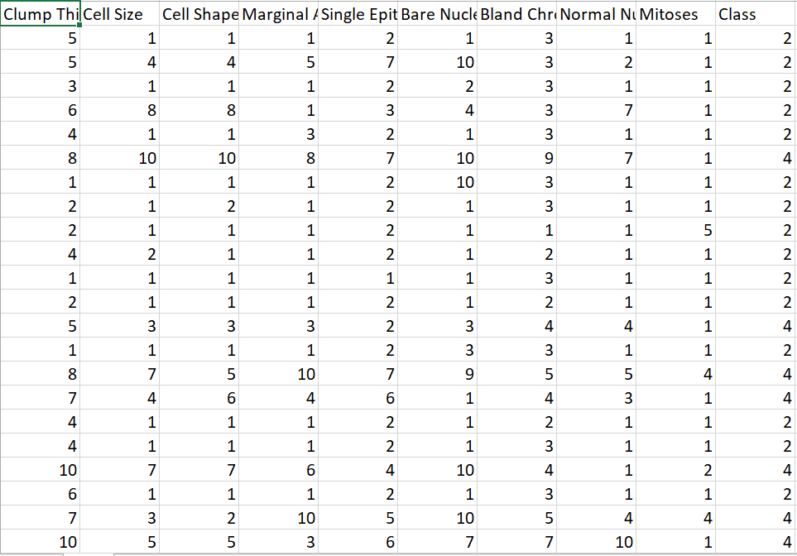
Data Set Before Discretization

Slide 21
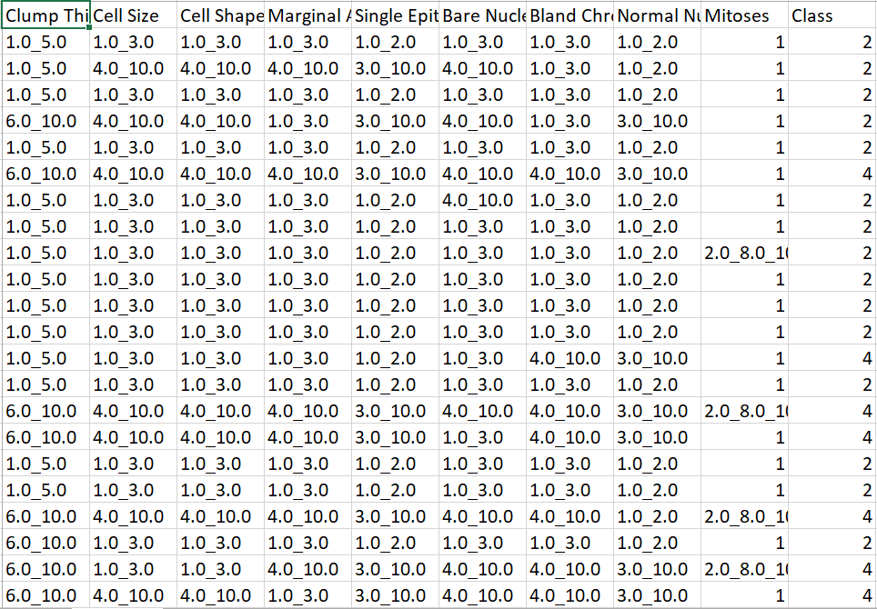
After Discretization

Slide 22
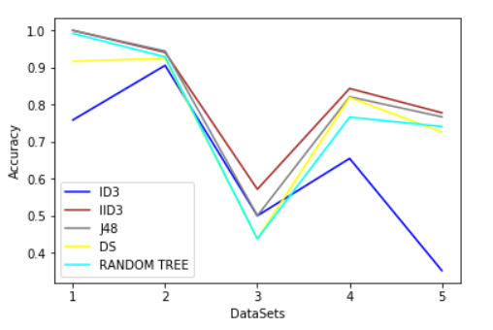
Algorithms- Accuracy

