Slide 1

Capstone Project ONLINE SHOPPING- DIGITAL STORE
DEVELOPED BY
Manikanta Reddy Kovvuri
Darsi Venkata Guru Pavan
Atmakuru Harshini
Chappagadda Srilakshmi
Bhupathiraju Venkat Sairaju
Manda Divya

Slide 2
Table of contents
Introduction
Aim of project
Objective
System requirements
Technologies Used
Project Modules
Admin/Retailer characteristics
User characteristics
Problem statement
Scope
Project Screenshots

Slide 3
INTRODUCTION
Shopping is one of the essential part of our daily life. We are using different types of shops to buy different kind of things everyday.
Online shopping is the process whereby consumers directly buy goods or services from a seller in real-time, without an intermediary service, over the internet.
Digital store is a online shopping service which provides easy shopping facility and easy selling facility to the merchants of all categories.

Slide 4
Aim of project
From the business perspective, customers usually find the products more attractive, on websites, as they get all the details available there.
The aim of this application is to provide a quick and easy use interfaces for all users.
The primary goal of e-commerce is to reach maximum customers at the right time to increase sales and profitability of the business.

Slide 5
objective
The main objective of this website is to bring the people, whole market just in one click and the good quality products at the reasonable price which they can afford.
Another objective is to achieve maximum numbers of visitors and customers traffic over the website so that maximum amount of profit can be provided to the customer as well as site owner .

Slide 6
System Requirements
Software
Hardware
JDK 1.8
Mongo DB
Eclipse IDE
Visual Studio Code
Disk space:1GB or above
RAM : 2GB or above

Slide 7
TECHNOLOGIES USED
Spring boot
Angular 8
CSS3
HTML5
JPA
Mongo DB

Slide 8
ADMIN & RETAILER Modules
ADMIN
RETAILER
Login to view retailers list.
Add retailer
Remove retailer
Login to view products list.
Add products
Delete products
Update products

Slide 9
USER Modules
USER
Register & Login to view products
View profile
Add to cart
Add to compare/Wishlist
Payment

Slide 10
PROBLEM STATEMENT
Application to be developed is an E-Commerce Web Application. Application will implement all of the CRUD operations on database with strict constriction to DRY principle. The goal of our application is to provide a quick and easy to use interfaces for all users.
The product will provide platform for several individuals and companies to sell their products.

Slide 11
scope
This website will provide a better shopping experience, interactive and easy interface so that buying process takes place smoothly.
Good quality products can be bought easily and at very reasonable price and that is can be performed by just some clicks and basic knowledge of internet.

Slide 12
PROJECT SCREENSHOTS

Slide 13
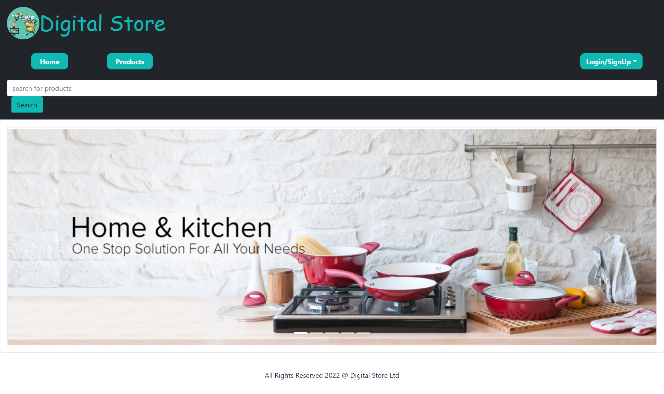
Home Page

Slide 14
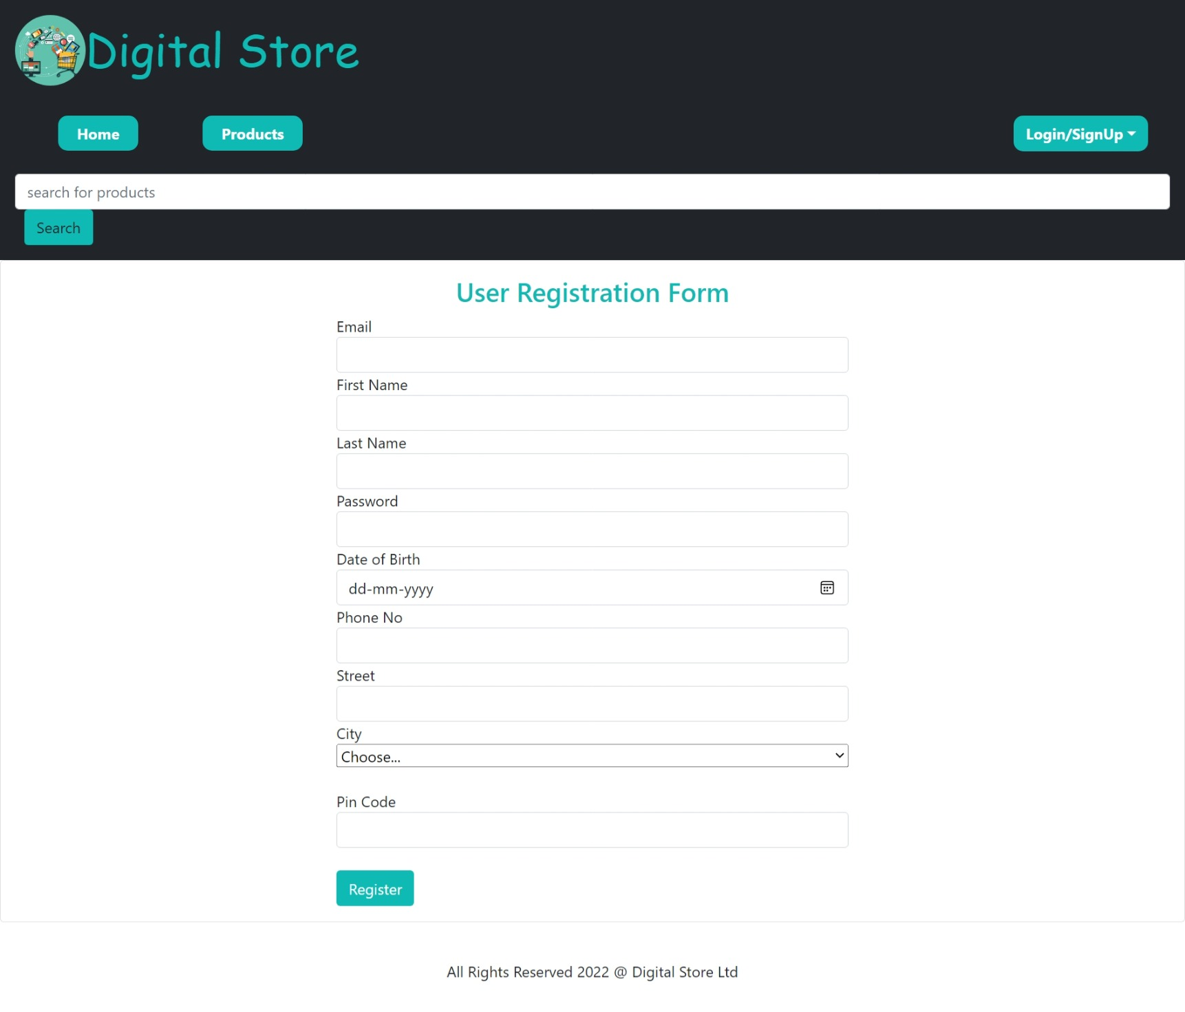
User Registration

Slide 15
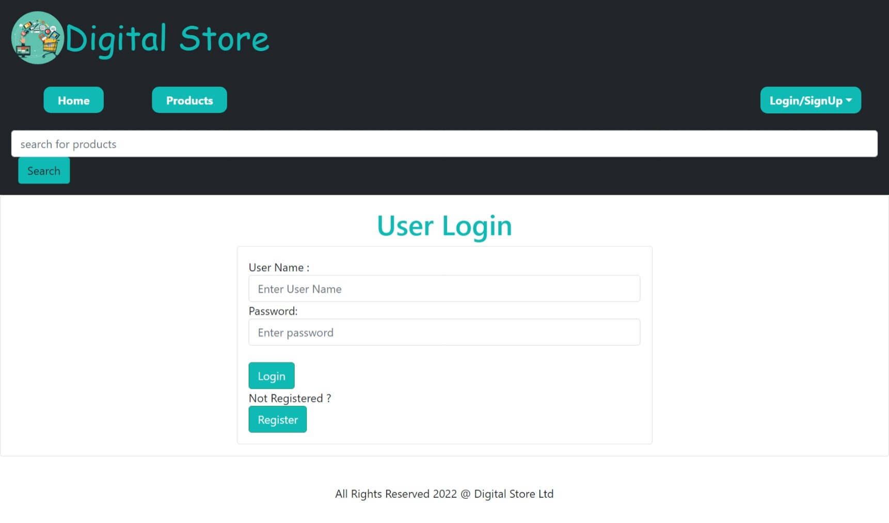
User Login

Slide 16
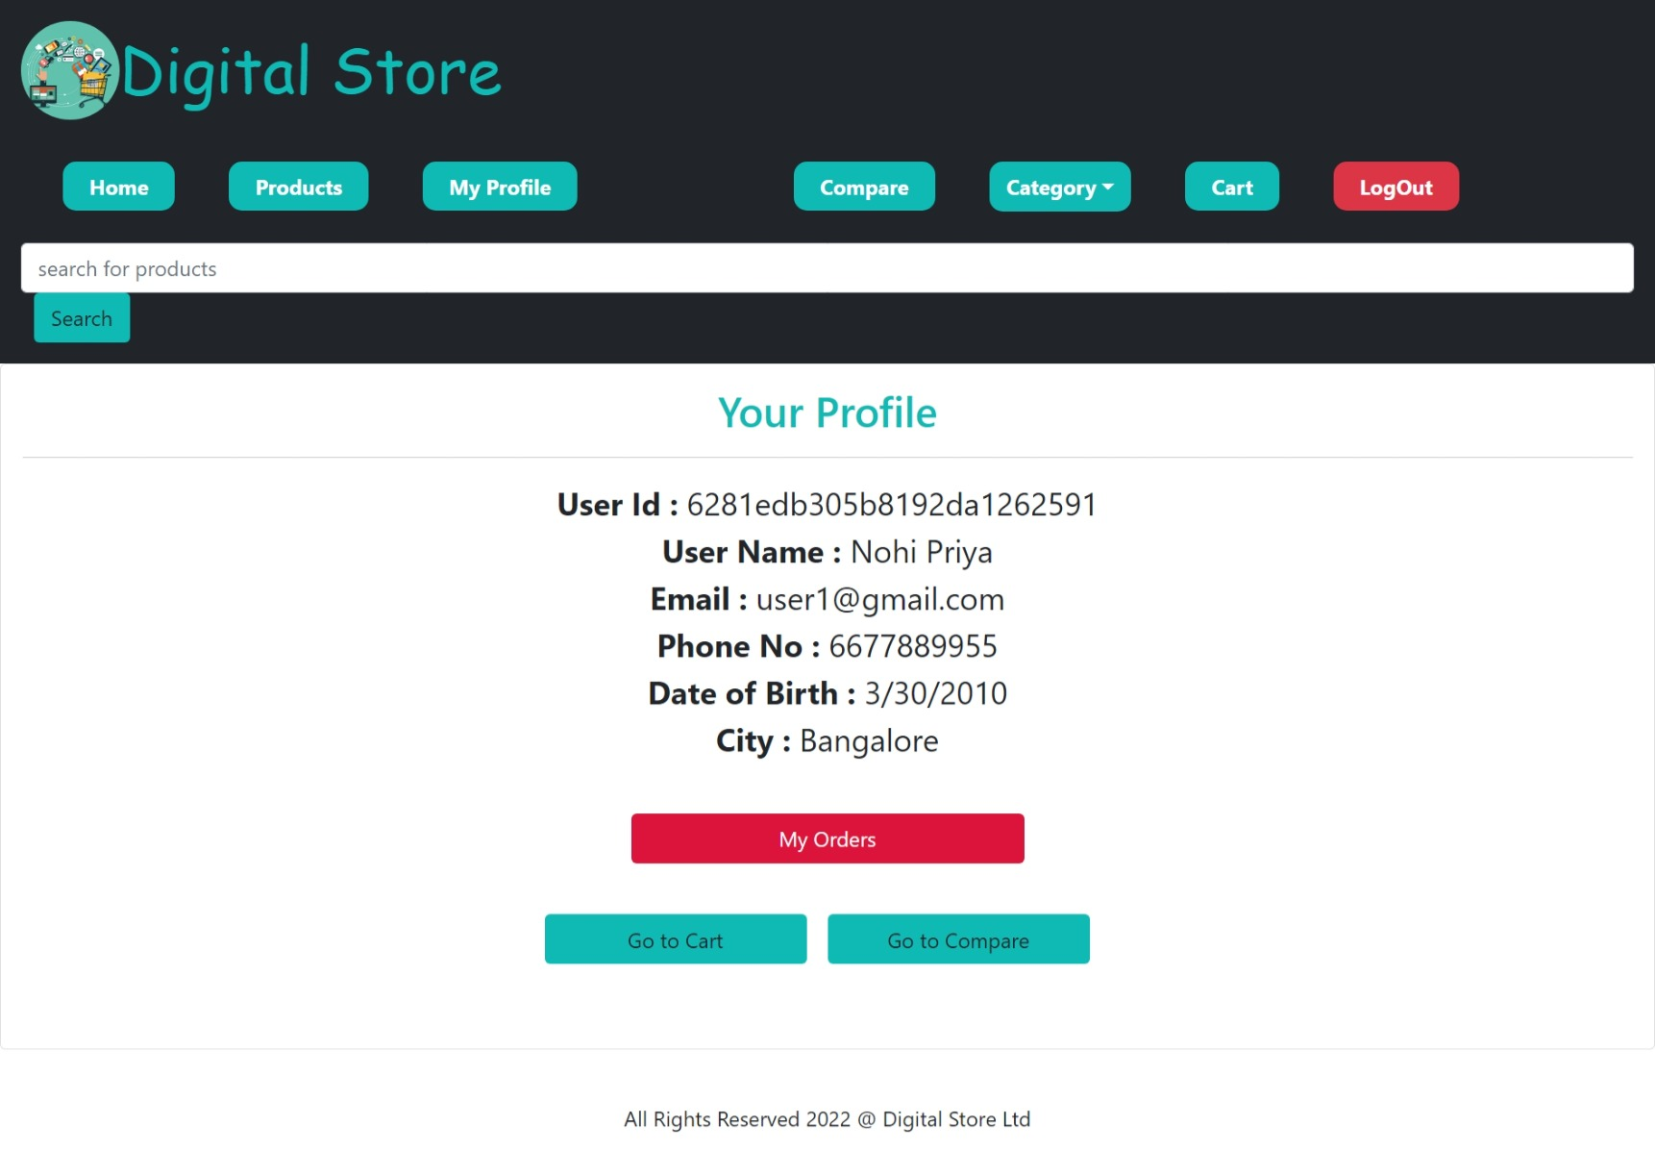
USER PROFILE

Slide 17
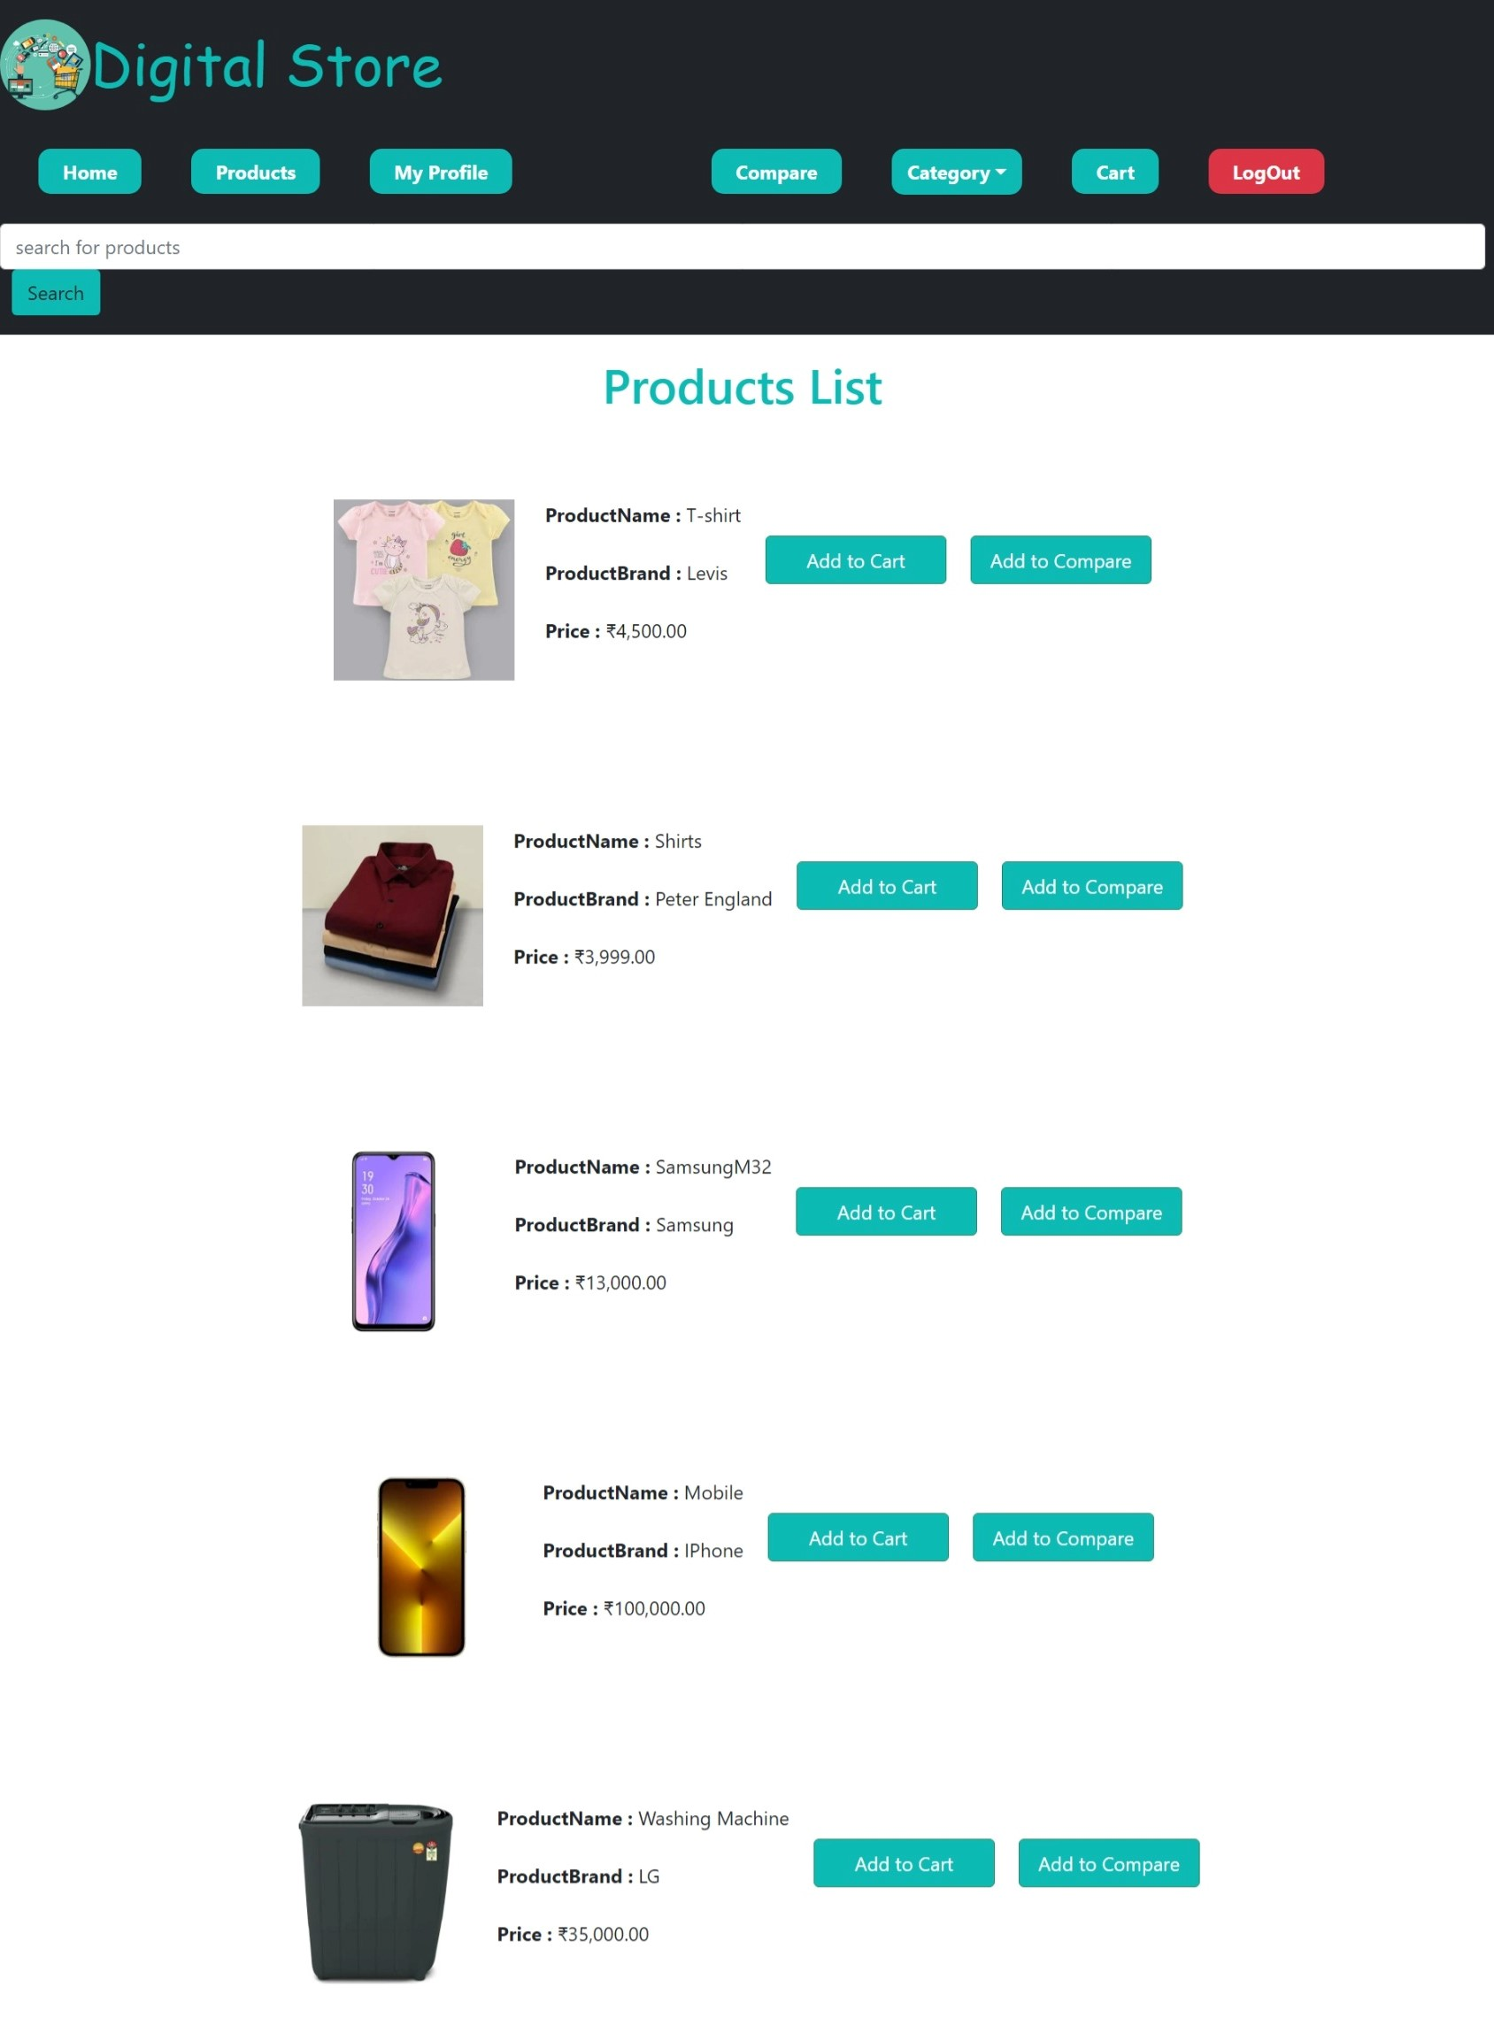
Products List

Slide 18
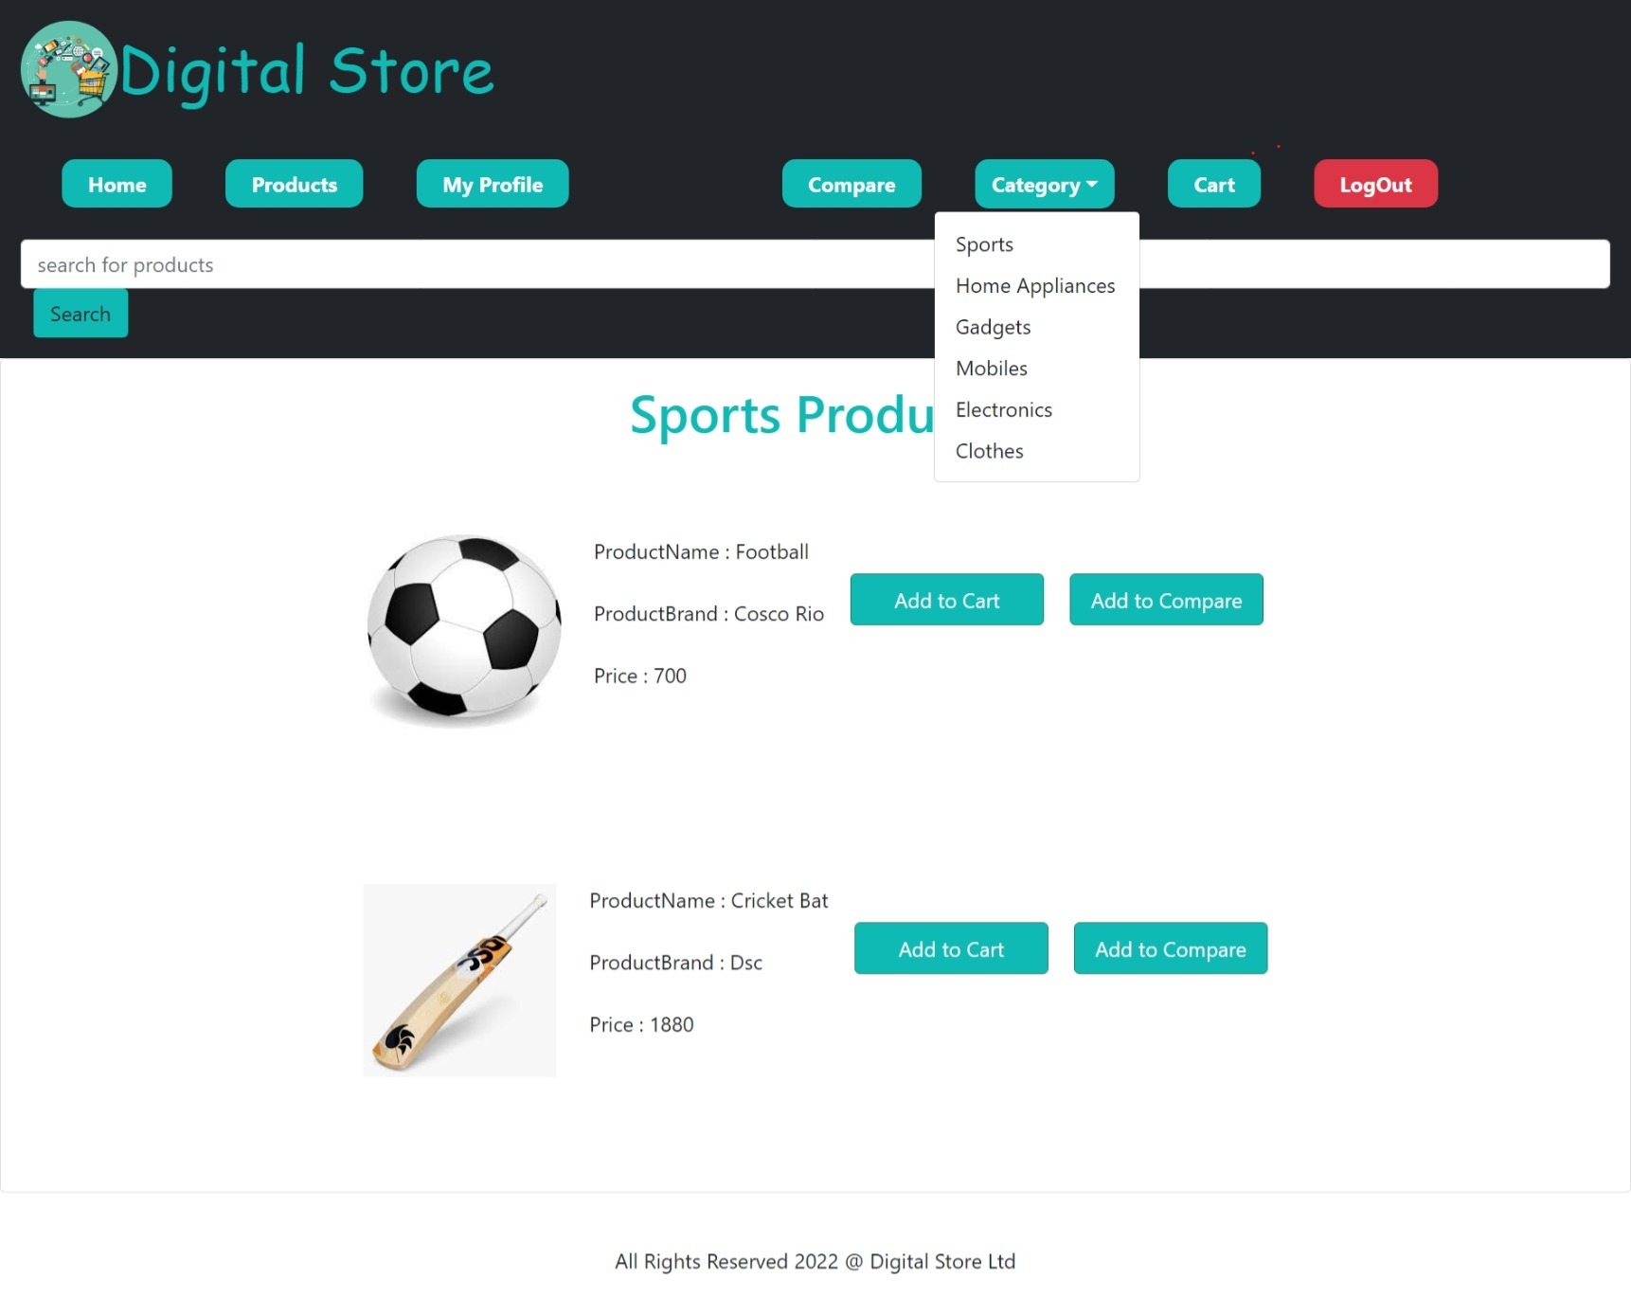
Category Of Products

Slide 19
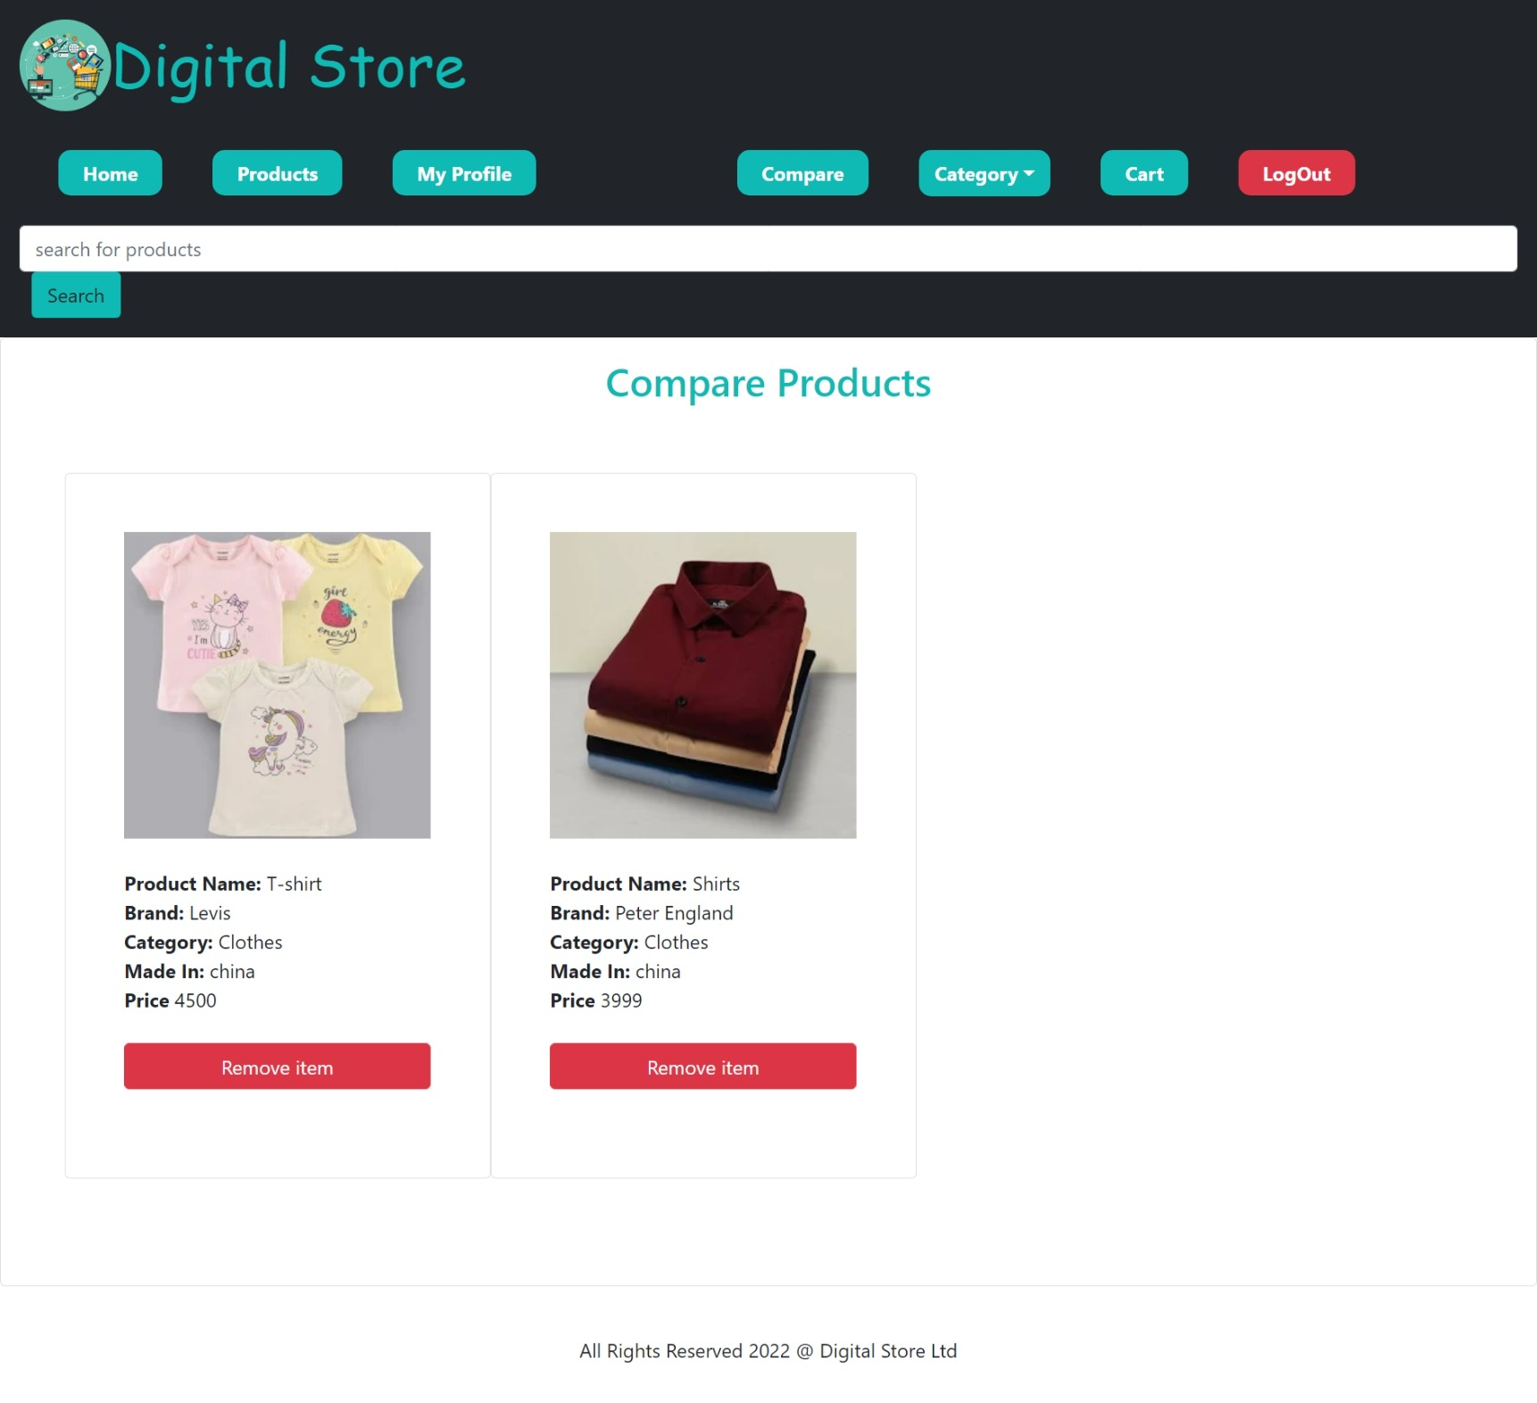
Compare Products

Slide 20
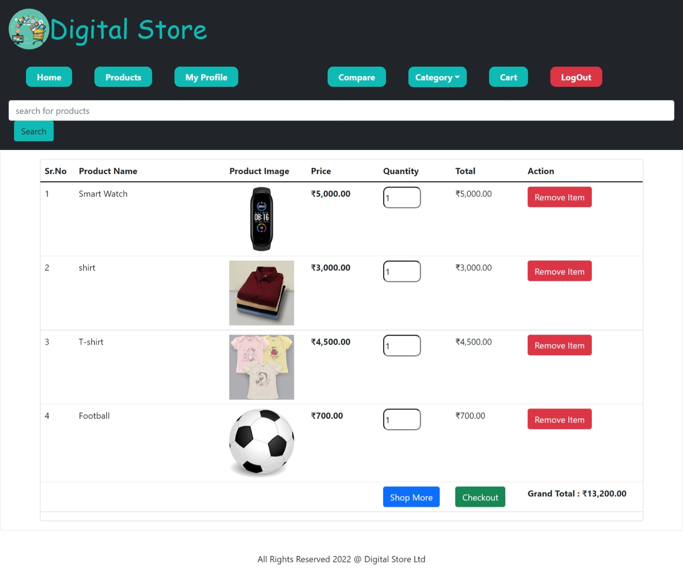
User Cart

Slide 21
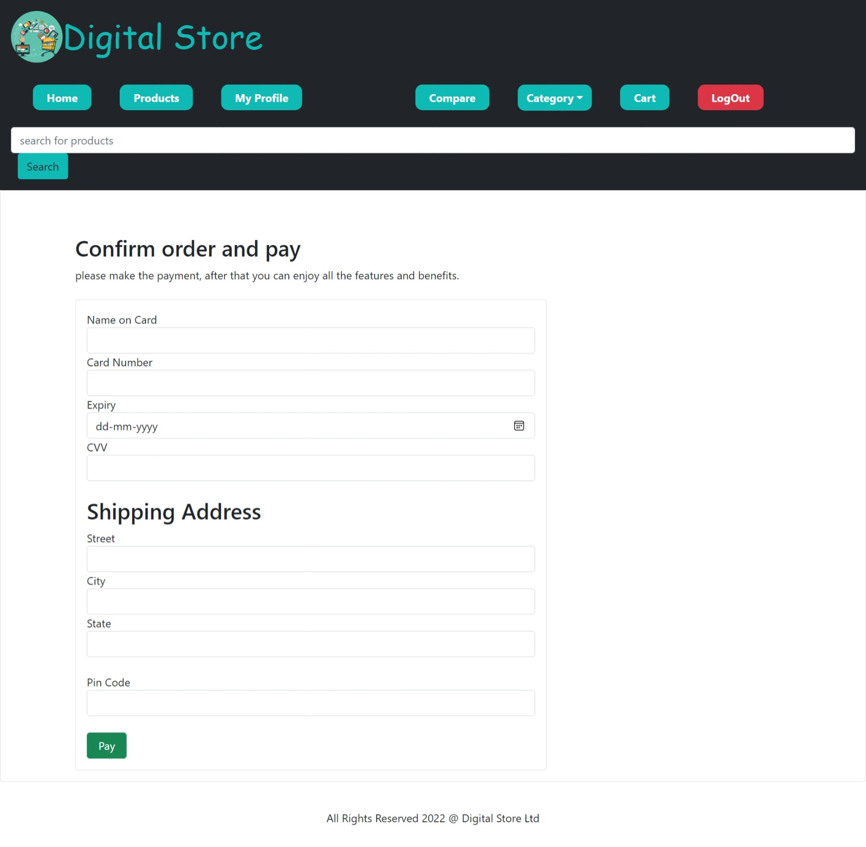
Payment Page

Slide 22
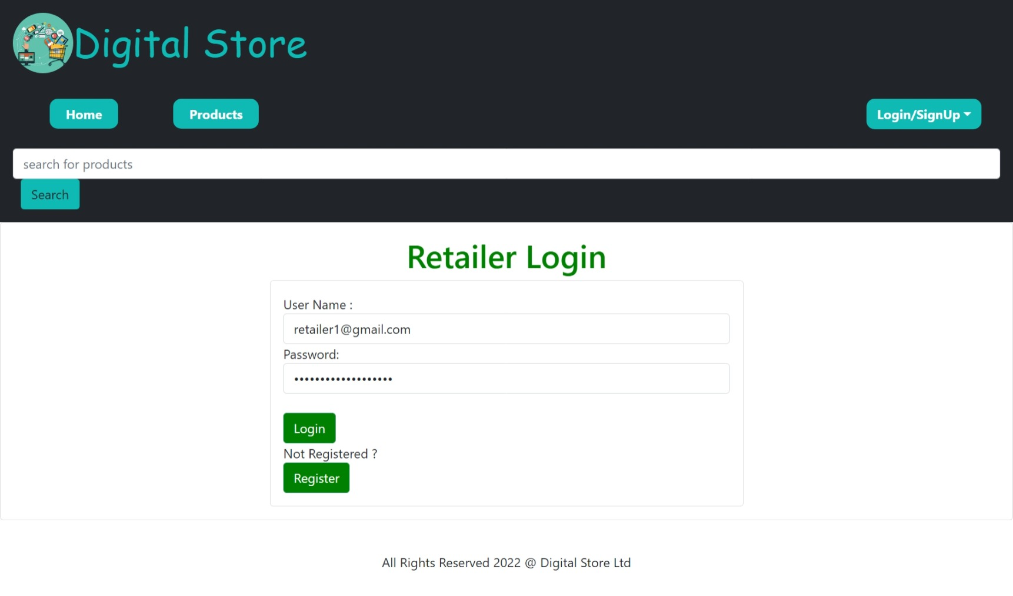
Retailer’s Login Page

Slide 23
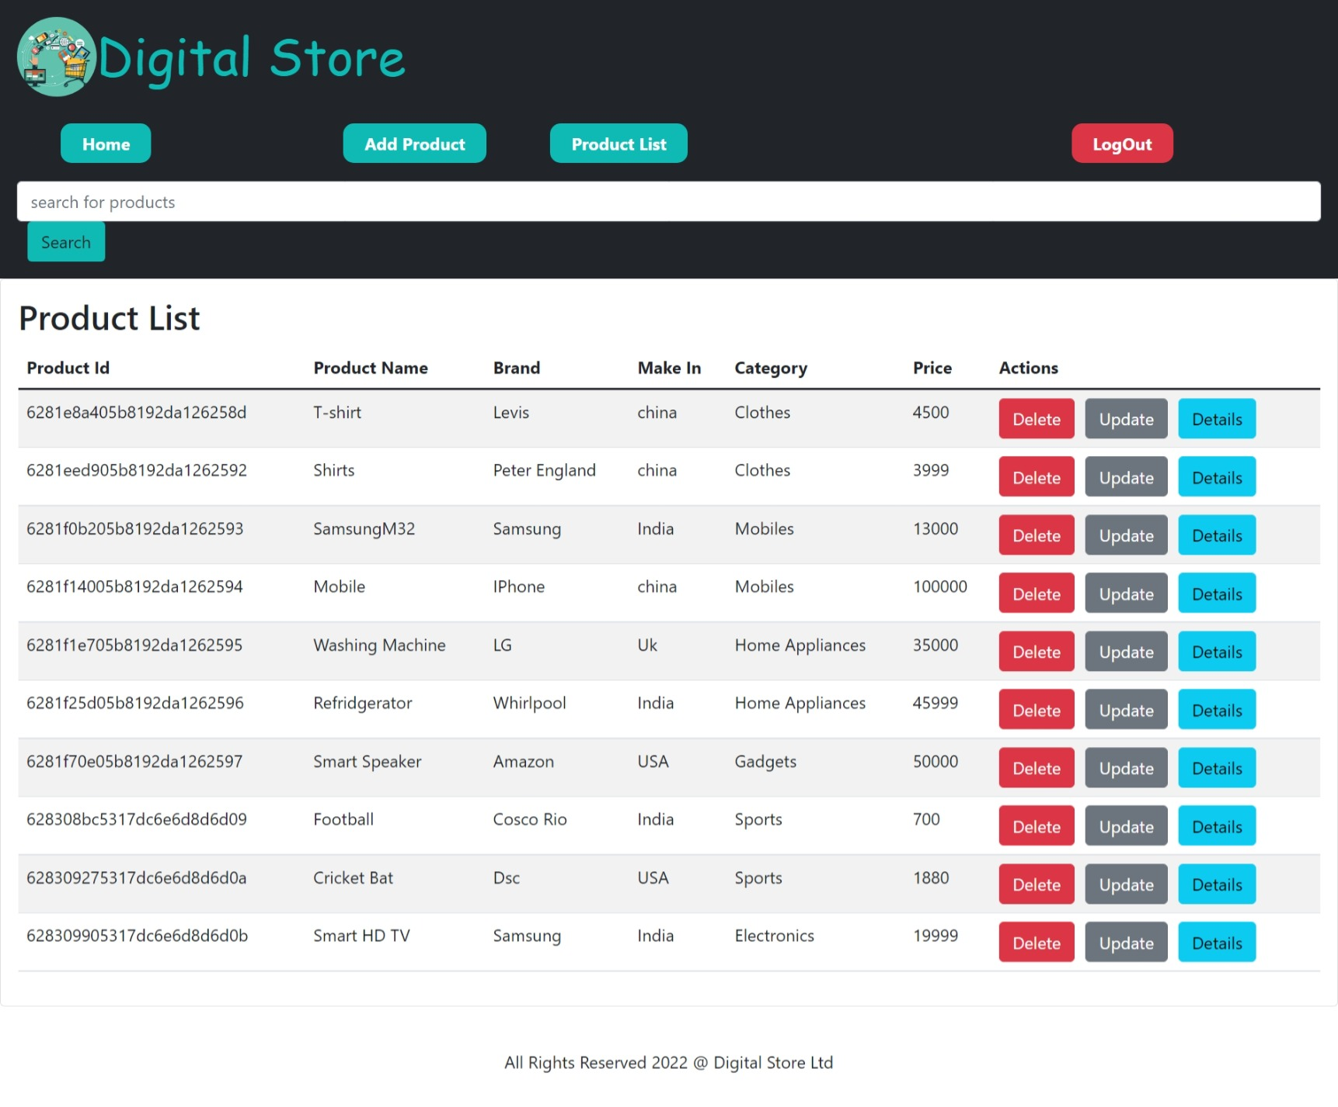
Retailer’s Product List

Slide 24
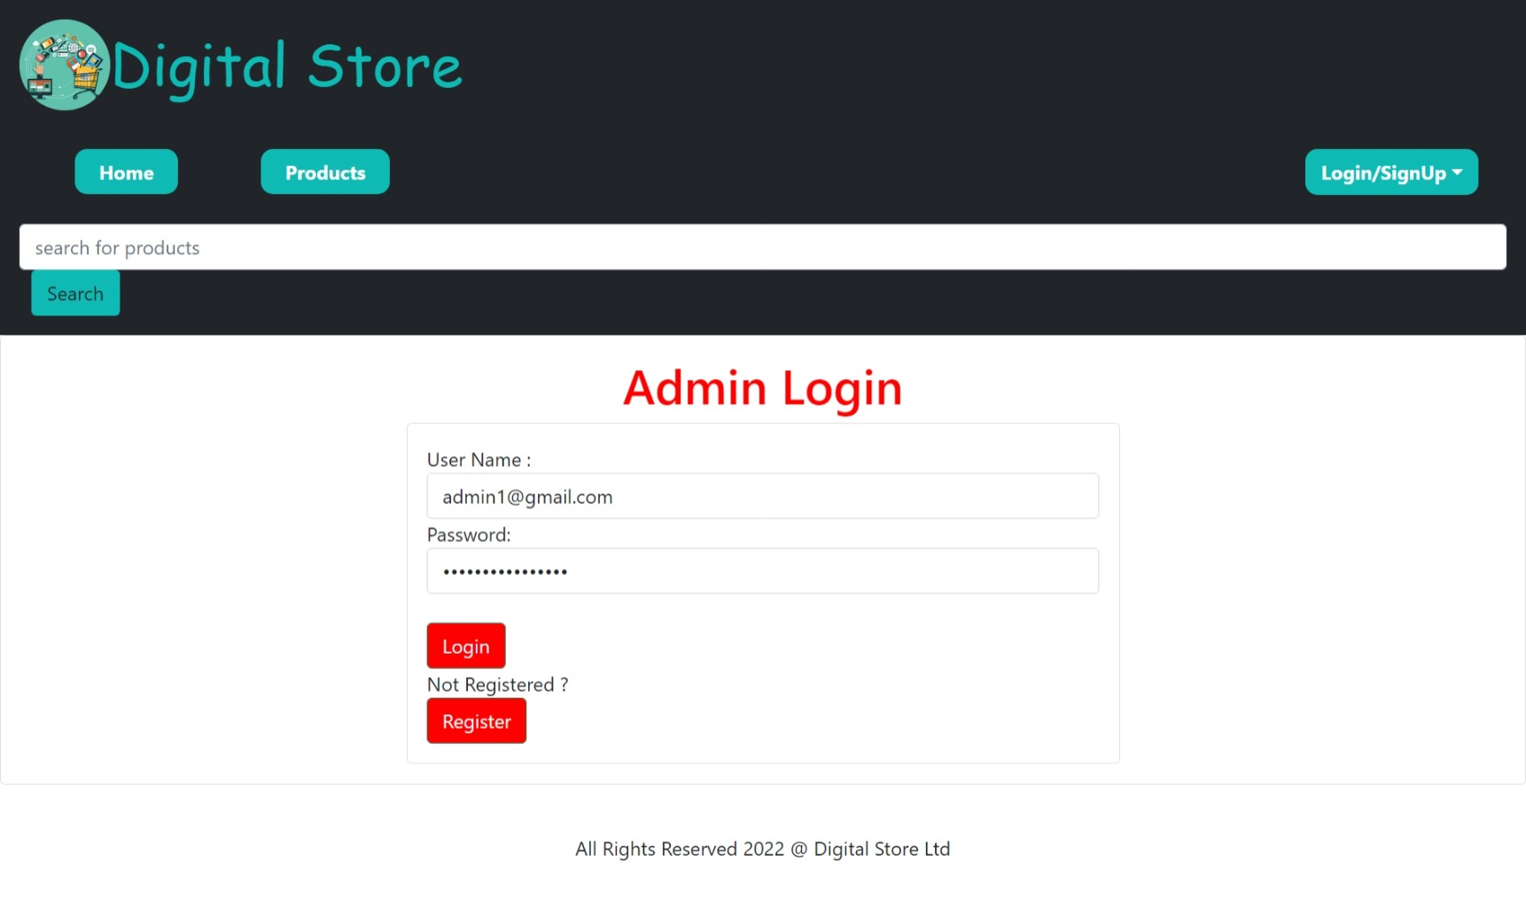
Admin’s Login Page

Slide 25
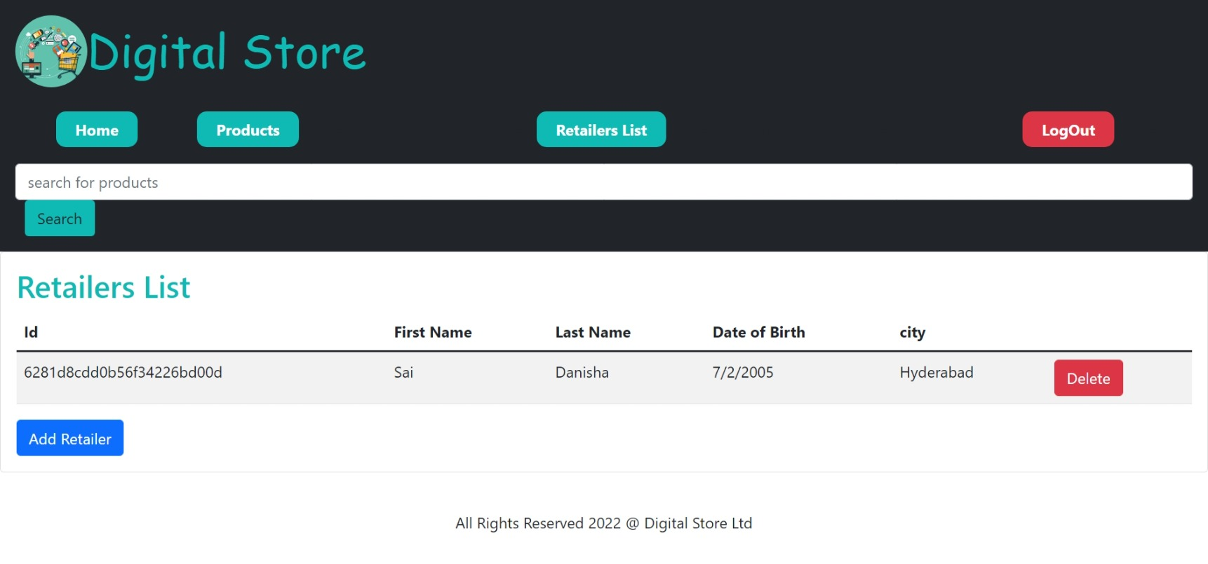
Retailers List

Slide 26
THANK YOU

