Slide 1
IOT based air quality monitoring

Slide 2

Introduction : In this world With increasing concerns about air pollution and its impact on human health and the environment, it's more important than ever to have accurate and real-time data on air quality. And that's where IoT-based air quality monitoring systems come in.

Slide 3
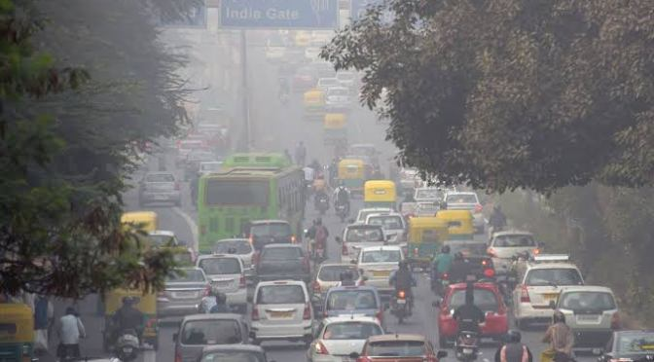
Problem statement : The problem statement is about Increase the number of vehicles hascaused an increase in the pollution level. This increase is affecting nature in many ways. The government wishes to monitor the air pollution index in your city such that they can take action accordingly.

Slide 4

What is an IoT-based air quality monitoring system?
An IoT-based air quality monitoring system is a network of sensors that collect data on various pollutants in the air, such as carbon monoxide, nitrogen dioxide, and particulate matter. These sensors are connected to the internet, allowing for real-time data collection and remote monitoring.

Slide 5
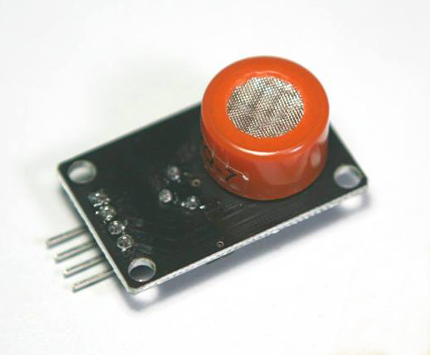
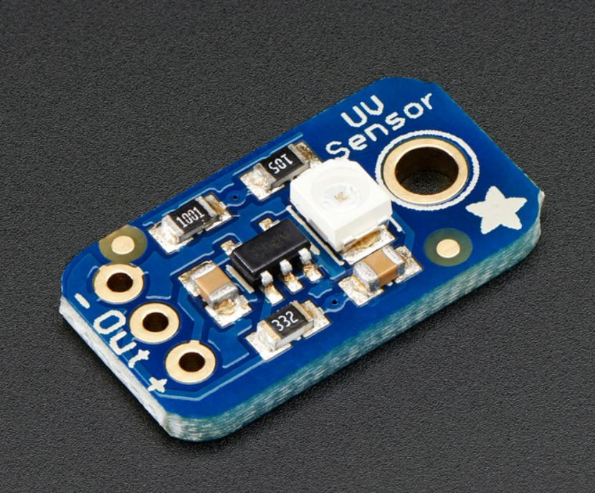
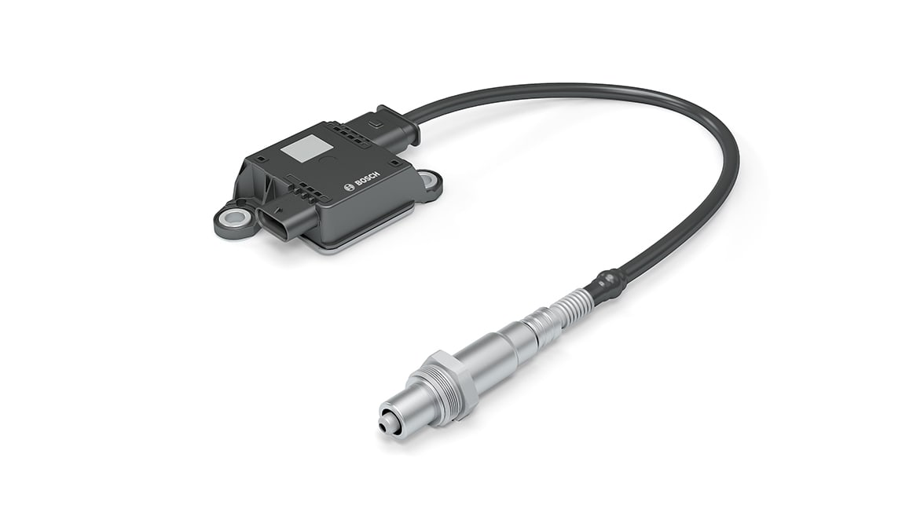
Sensors to be used : • particular matter sensors • carbon monoxide sensors • meteorological sensors • Ionization chambers

Slide 6
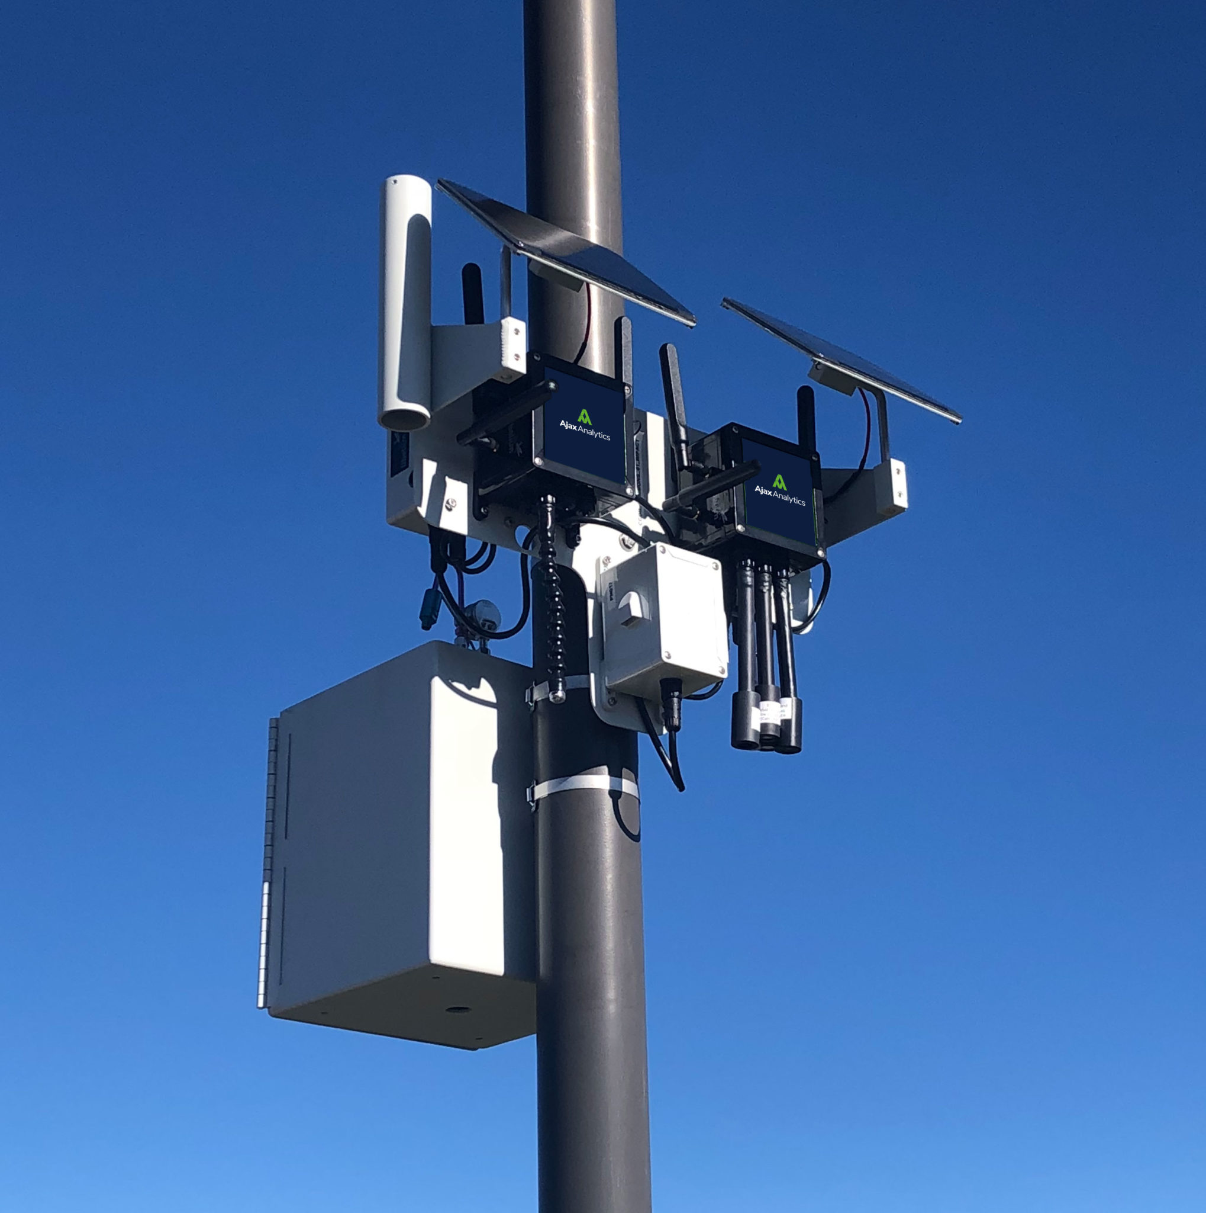
Benefits of an IoT-based air quality monitoring system : One of the key benefits of using an IoT-based air quality monitoring system is improved air quality. By collecting real-time data on air pollutants, these systems can help identify sources of pollution and take action to reduce emissions. This can lead to cleaner air and a healthier environment for everyone. Another benefit is reduced health risks.

Slide 7
In conclusion, an IoT-based air quality monitoring system is a crucial tool in protecting our health and environment. By providing real-time data collection, remote monitoring, and data analysis, it enables us to make informed decisions about our air quality. With the increasing concerns over air pollution, it is vital that we take action towards improving air quality, and an IoT-based air quality monitoring system can help us achieve this goal.
conclusion

