Slide 1
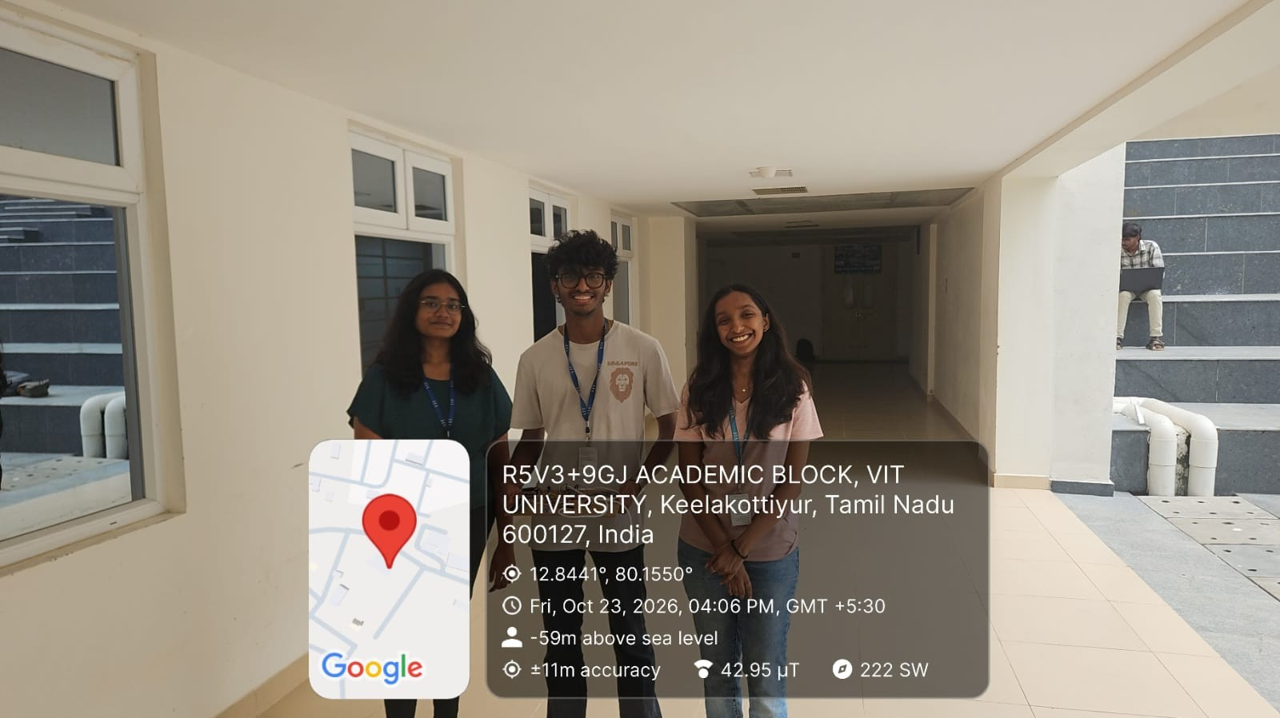
DA3 — EMBEDDED SYSTEMS PROJECT REVIEW 3
  Project Title – RAKSHA-NET: IMU-based fall detection with a Random Forest classifier, BLE room identification and SMS alerting
  Institution – Vellore Institute of Technology, Chennai
  Course – Embedded Systems
  Assessment – DA3, Review 3: Prototype Validation
  Registration Numbers – 23BAI1288, 24BCE1712, 24BCE1857
  Team Members – Disha Parasu, Lakshmanan Parthasarathy SP, Nethra Sri R S
  Faculty Guide – Dr Suhasini S
Geotagged team photograph, Academic Block, VIT Chennai (23 Oct 2026)

Slide 2
INTRODUCTION AND PROBLEM
1. Background
  Falls and injury: falls are the second leading cause of unintentional injury deaths worldwide after road injuries. WHO estimates about 842 000 fall deaths in 2023, and about 71% of them were adults aged 60 and over [1].
  Getting help: a person who lives alone may not be able to reach a phone after a fall. Wearable fall detectors try to send the alert automatically [2].
2. Problem Statement
  Detection: recognise a probable fall from body-motion data (accelerometer and gyroscope), without cameras.
  False alarms: one unusual reading should not send an SMS, and the wearer should be able to cancel an alert.
  Location: tell the caregiver which room the person is in, using low-cost BLE beacons.
  Reach: alert caregivers by SMS, so any phone works and no app or internet is needed on their side.
3. Scope of this prototype
  Bench prototype on one board. The ESP32-S3 handles sensing, BLE scanning, LCD, buzzer, GSM and SD logging. The Random Forest runs on a laptop connected over USB serial.
~842 000
fall deaths worldwide in 2023 [1]
2nd
leading cause of unintentional injury deaths [1]
~71%
of fatal falls were adults aged 60+ [1]

Slide 3
OBJECTIVES AND PROPOSED SOLUTION
1. Objectives
  Stream 6-axis IMU readings from the ESP32-S3 to a laptop in real time.
  Train a classifier that separates normal (straight) data from fall data.
  Alert only after repeated fall predictions, with a local cancel button.
  Identify the room with BLE beacons and include it in the SMS.
  Log alert and GSM events on a MicroSD card; show status on an LCD and a dashboard.
2. Proposed Solution
Subsystem | How RAKSHA-NET implements it
Inertial motion sensing | MPU6500 on I2C: 3-axis accelerometer (±2 g) and gyroscope (±250 dps), read in every loop of the firmware.
Machine learning | Random Forest (200 trees) on 8 features in predict_live.py on the laptop; result returned as a PRED command.
BLE room localization | ESP32-S3 scans for 3 named beacons; the strongest one above −95 dBm is taken as the current room.
Emergency notification | Buzzer and LCD countdown, 12 s to cancel with the button, then SMS to 2 numbers through the SIM800L.
Monitoring and logging | 16×2 LCD pages, CSV logs on MicroSD (alert events, GSM replies), laptop terminal and web dashboard.

Slide 4
OVERALL SYSTEM ARCHITECTURE
MPU6500 IMU
±2 g, ±250 dps
I2C, GPIO8/9, 0x68
ESP32-S3 controller
(YD-ESP32-S3 board)
loop(): read MPU6500, print sensor line and MLDATA, update LCD page, handle PRED commands, run the alert window
beaconScanTask on core 0: 3 s BLE scan, nearest beacon ≥ −95 dBm
I2C, GPIO8/9
16×2 I2C LCD
address 0x27; room, readings, alerts
BLE room beacons ×3
ROOM_Bedroom, ROOM_Hallroom, ROOM_Washroom
BLE advertising (RSSI)
GPIO21
Buzzer
toggles every 300 ms in alert
Cancel push button
GPIO14, INPUT_PULLUP
digital input
SPI, GPIO10–13
MicroSD module
ai_fall_log.csv, gsm_log.csv
USB serial 115200: MLDATA up, PRED,<status>,<conf> down
UART1
Laptop (edge computer)
predict_live.py: features + Random Forest
run_dashboard.py: web dashboard
SIM800L GSM
UART1 (TX GPIO17, RX GPIO18), AT text mode
Caregiver phones (2)
SMS: room, RSSI, AI confidence

Slide 5
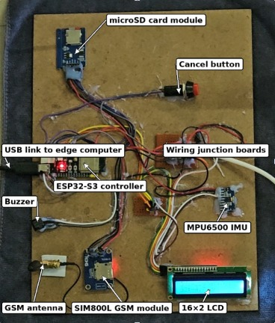
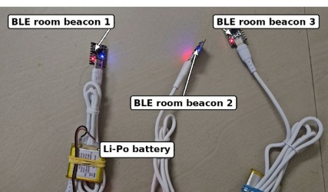
HARDWARE COMPONENTS AND PROTOTYPE
Build
  Modules fixed on a hardboard base with wiring junction boards.
  ESP32-S3 powered over the USB link to the laptop (same cable carries serial data).
  Beacons are separate small boards, powered by Li-Po battery or USB.
BLE room beacons 1–3 (one on Li-Po battery)
Component | Role in the prototype
ESP32-S3 (YD-ESP32-S3) | Controller, BLE scanner, USB serial link
MPU6500 IMU | Acceleration and angular rate
SIM800L GSM module + antenna | Emergency SMS
16×2 I2C LCD | Room, readings, alert countdown
Buzzer / push button | Audible alert / cancel during 12 s window
MicroSD card module | CSV logs of alerts and GSM replies
BLE beacon boards ×3 | Room identification (Bedroom, Hallroom, Washroom)
Assembled prototype on board (labelled)

Slide 6
CIRCUIT DESIGN AND CONNECTIONS
Module | Interface | ESP32-S3 pins | Settings in firmware
MPU6500 IMU | I2C | SDA GPIO8, SCL GPIO9 | Address 0x68; ±2 g (16384 LSB/g); ±250 dps (131 LSB/dps); VCC 3.3 V
16×2 LCD (I2C backpack) | I2C (shared bus) | SDA GPIO8, SCL GPIO9 | Address 0x27; one page per loop (1000 ms)
MicroSD card module | SPI | CS 10, MOSI 11, MISO 12, SCK 13 | /ai_fall_log.csv, /gsm_log.csv (append)
SIM800L EVB | UART1 | RX1 GPIO18 ← GSM TX TX1 GPIO17 → GSM RX | Baud auto-detect: 9600, 115200, 57600, 38400, 19200, 4800; ATE0, AT+CMGF=1
Cancel push button | Digital input | GPIO14 to GND | INPUT_PULLUP, pressed = LOW
Buzzer | Digital output | GPIO21 | On/off every 300 ms during the 12 s window
Laptop | USB serial | USB port | 115200 baud; MLDATA out, PRED commands in
BLE beacons ×3 | BLE (on-chip radio) | – | Active scan 3 s, interval 100, window 90; min RSSI −95 dBm
Pins and settings taken from falldeetectml.ino. The SIM800L currently runs from the board supply; a separate supply for it is planned.

Slide 7
SOFTWARE ARCHITECTURE
ESP32-S3 firmware (falldeetectml.ino)
USB serial, 115200 baud
Laptop, Python 3
setup()
LCD, SD card, GSM (baud detect, text mode), MPU6500, start beacon task
collect_data.py
parses MLDATA, adds acc_mag, gyro_mag and label → fall_dataset.csv
ACC X: … g | GYRO X: … dps | Room: <name> RSSI: <n>
loop() every ~1 s
readMPU6500() → logSensorData(): text line + MLDATA → LCD page
MLDATA,ax,ay,az,gx,gy,gz
train_random_forest.py
75/25 split, RandomForest(200) → fall_random_forest.joblib
waitWithAlertHandling()
handlePredictionCommand(), handleFallAlert(): buzzer, button, 12 s window
PRED,FALL | NORMAL | CHECK,<confidence>
predict_live.py
parse_ml_line() → predict + predict_proba → 3-sample confirmation → board_command()
beaconScanTask (core 0)
BLE scan → setCurrentRoom() under a critical section
Room and RSSI reach the laptop only through the text line; the classifier uses MLDATA only.
run_dashboard.py
same prediction logic; owns the port; browser UI, event log, recordings
sendConfirmedFallAlert()
SMS to 2 numbers → saveGSMLog(); logFallEvent() → SD
Only one program may hold the COM port: predict_live.py or the dashboard, with Arduino Serial Monitor closed.

Slide 8
DATASET COLLECTION AND PREPARATION
1. Collection (collect_data.py)
  Command: python collect_data.py --port COM6 --label straight (or --label fall).
  Procedure: each run reads the serial port for 240 s by default; a beep every 60 s asks the wearer to face or move front, right, back and left. Recorded with one human volunteer and a teddy bear wearing the prototype.
  Per row: ax, ay, az (g), gx, gy, gz (dps), acc_mag, gyro_mag and the run label.
2. Dataset (fall_dataset.csv)
  Size: 1425 rows, 8 features, 2 labels: straight 855, fall 570.
  Copy file: straight_fall_dataset - Copy.csv equals the first 855 straight rows; not used separately.
3. Preparation
  Rows with missing values dropped (none present); no scaling, since tree models do not need it.
  Stratified 75/25 split with random_state 42.
  Every row of a run gets the run's label, so the fall class also includes rows before and after each fall.
Split | straight | fall | Total
Training (75%) | 641 | 427 | 1068
Test (25%) | 214 | 143 | 357
Total | 855 | 570 | 1425

Slide 9
MACHINE LEARNING MODEL
1. Input features (8)
  ax, ay, az (g) and gx, gy, gz (dps) from one MLDATA line.
  acc_mag = √(ax² + ay² + az²), gyro_mag = √(gx² + gy² + gz²).
2. Prediction and confidence
  Each sample is classified on its own; output class fall or straight.
  Confidence = highest class probability from predict_proba (average over the 200 trees). It is not the model accuracy.
3. Fall confirmation (predict_live.py)
  fall with confidence ≥ 0.70 adds 1 to fall_count; any other result resets it.
  fall_count ≥ 3 → PRED,FALL,<conf> sent at once. straight → PRED,NORMAL. Otherwise PRED,CHECK.
  Other commands are sent at most once per 1.0 s.
  Samples with acc_mag < 0.20 g and gyro_mag ≤ 0.5 dps are ignored; no data for 3 s → PRED,CHECK,0.00.
4. Random Forest settings (verified from the saved model)
Parameter | Value
Estimator | RandomForestClassifier (scikit-learn 1.8.0)
n_estimators | 200
criterion | gini
max_features | sqrt (3 of 8 features per split)
max_depth | None (deepest tree: 16 levels)
min_samples_leaf | 1
bootstrap | True
class_weight | balanced
random_state | 42
Training rows | 1068 (test rows: 357)

Slide 10
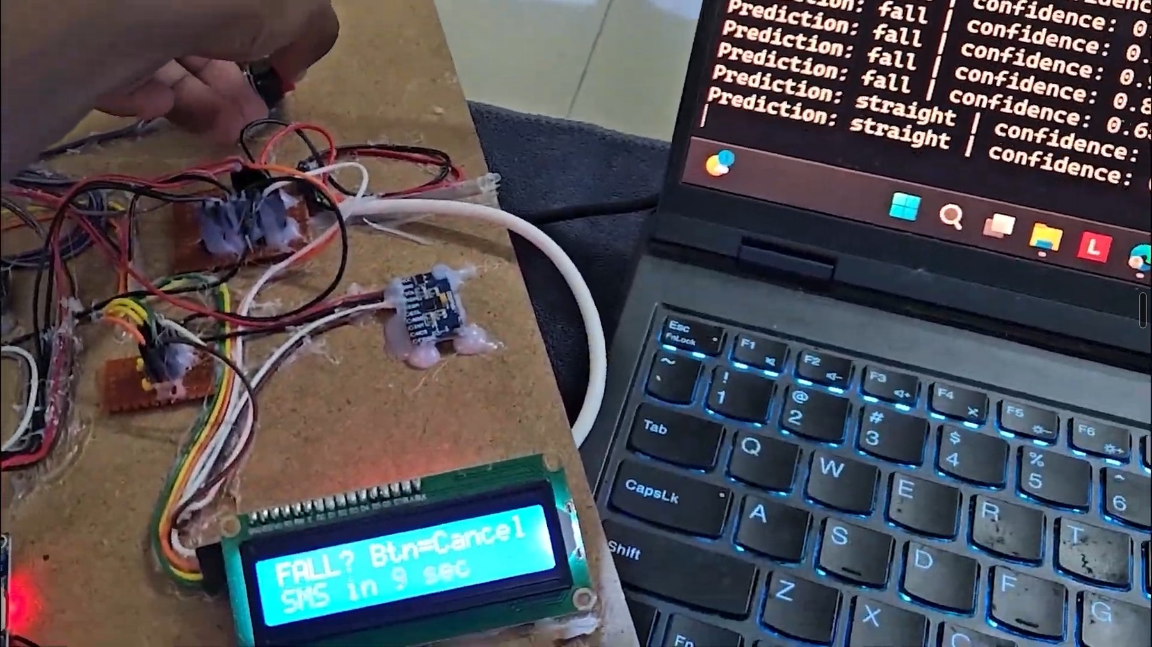
FALL DETECTION AND ALERT WORKFLOW
1. Sensor acquisition
MPU6500 read once per loop (~1 s); MLDATA line over USB
2. Feature extraction
parse_ml_line(): 6 values + acc_mag, gyro_mag
3. Classification
Random Forest: class and confidence
4. Confirmation
3 consecutive fall results with conf ≥ 0.70 → PRED,FALL
5. Hardware alert
Buzzer toggles every 300 ms; LCD "FALL? Btn=Cancel"
6. Cancel countdown
12 s window; button press cancels and is logged
7. Notification attempt
SMS to 2 numbers with room, RSSI, confidence
Laptop (Python)
ESP32-S3 firmware
Details from the firmware
  While an alert is active, repeated PRED,FALL commands are ignored until a non-fall command arrives.
  Button pressed in the window: buzzer off, FALL_CANCELLED_BUTTON written to ai_fall_log.csv, no SMS.
  No press: SMS "RAKSHA-NET FALL ALERT. Room: …, RSSI: …, AI confidence: …" to both numbers, if GSM was ready at boot.
  A send counts as successful when the modem reply contains +CMGS and OK. This shows the modem accepted it, not that the phone received it.
  Each reply is saved in gsm_log.csv; a failed reply is shown on the LCD for 4 s.
Hardware run: LCD countdown with predict_live.py fall predictions

Slide 11
SENSOR GRAPH OUTPUTS
  Straight rows (815–854): az 0.93–0.96 g, ax 0.16–0.24 g, ay ≤ 0.08 g; gyro values stay within a few dps. The steady gyro offsets (gx ≈ −2.5, gz ≈ −5 dps) are sensor bias; the firmware does no calibration.
  Fall rows (855–904): ay rises to 0.3–0.6 g and az drops to about 0.7–0.8 g as the board tilts; gx swings between −52 and +65 dps during the movement.
  Note: the dataset stores no timestamps, so the x-axis is the row order. Plotted values are the recorded rows, unmodified.

Slide 12
MACHINE LEARNING PERFORMANCE
Saved model on the held-out test split (357 rows)
Actual \ Predicted | fall | straight
fall (143) | 136 | 7
straight (214) | 4 | 210
Class | Precision | Recall | F1-score | Support
fall | 97.1% | 95.1% | 96.1% | 143
straight | 96.8% | 98.1% | 97.4% | 214
Accuracy | 96.9% (346 of 357 rows)
Check beyond the random split | Result
5-fold stratified cross-validation | 96.6% ± 1.7% accuracy; fall F1 0.957
Later recordings (train first 75% of each class, test last 25%) | 85.1% accuracy; every held-out fall detected (recall 1.000)
Confirmation rule on held-out upright rows | False alert episodes: 17 (k = 1), 2 (k = 3), 0 (k = 5)
  Errors: 7 falls called straight, 4 straights called fall.
  Features: az (30.0%) and ax (18.9%) lead: orientation separates the classes more than rotation rate.
  Why the extra checks: neighbouring rows of one run land in both sets of a random split, so later recordings give a fairer test.

Slide 13
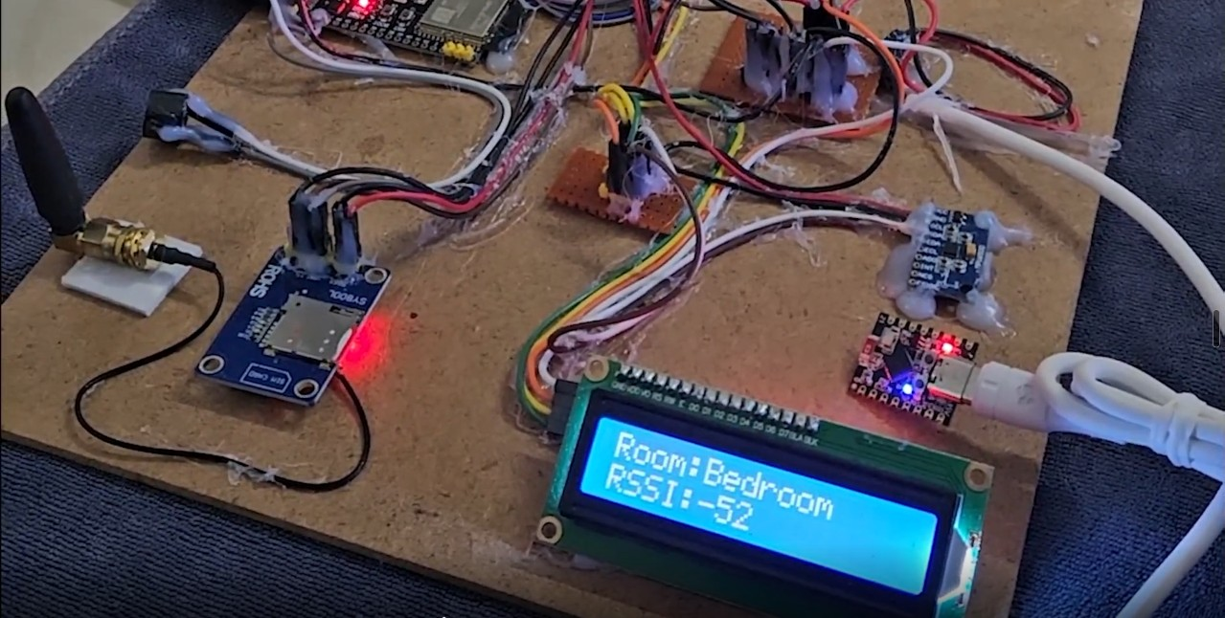
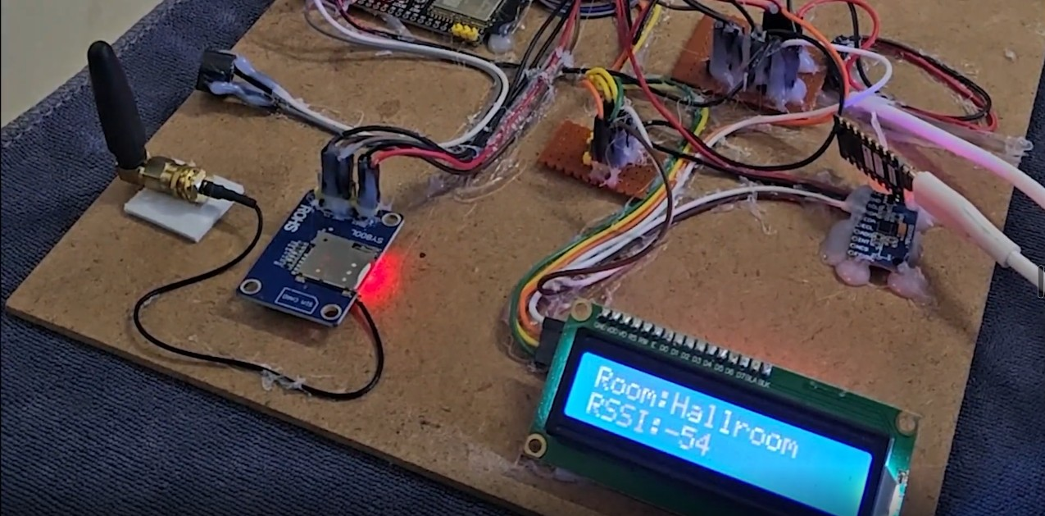
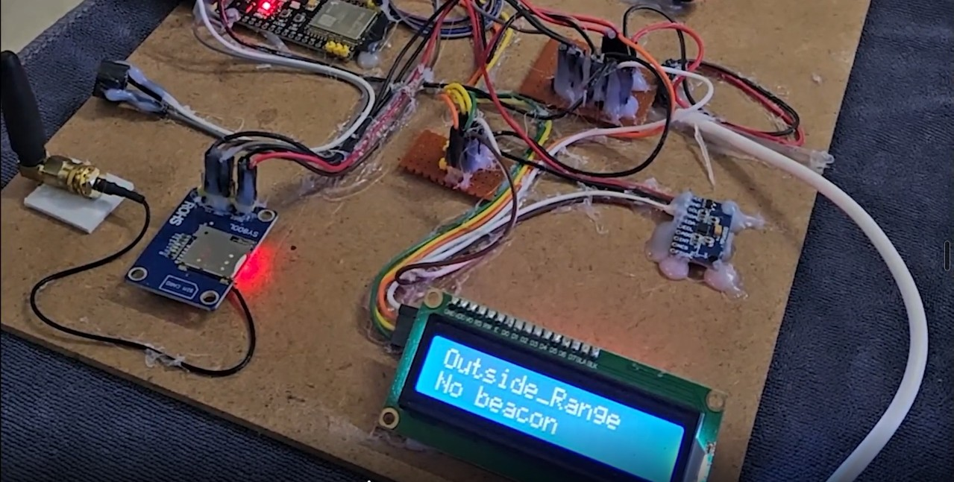
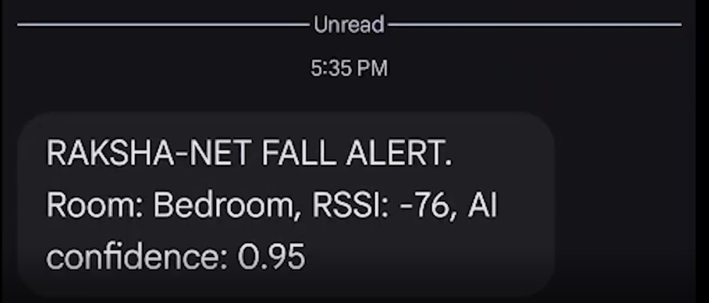
BLE ROOM LOCALIZATION
1. Method
  Three beacon boards advertise the names ROOM_Bedroom, ROOM_Hallroom and ROOM_Washroom.
  beaconScanTask runs on core 0: active scan for 3 s, then a 0.5 s pause. Only names in this list are accepted.
  The strongest beacon with RSSI ≥ −95 dBm becomes the current room; if none, the room is Outside_Range.
  Room and RSSI appear on the LCD, in every sensor line on serial and in the alert SMS.
2. What it can and cannot tell
  Room-level identification only: the nearest beacon, not x-y coordinates or distance.
  RSSI changes with walls, body position and beacon placement, so near a doorway the room can switch.
3. Observed output
  LCD: Bedroom −52 dBm, Hallroom −54 dBm, and Outside_Range when no beacon is in range.
  Washroom logged at −48 to −59 dBm in ai_fall_log.csv; the alert SMS carries the room (Bedroom, −76 dBm).
Room: Bedroom, −52 dBm
Room: Hallroom, −54 dBm
Outside_Range: no beacon above −95 dBm
Alert SMS with room and RSSI

Slide 14
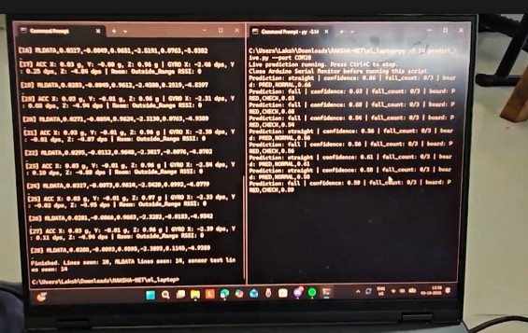
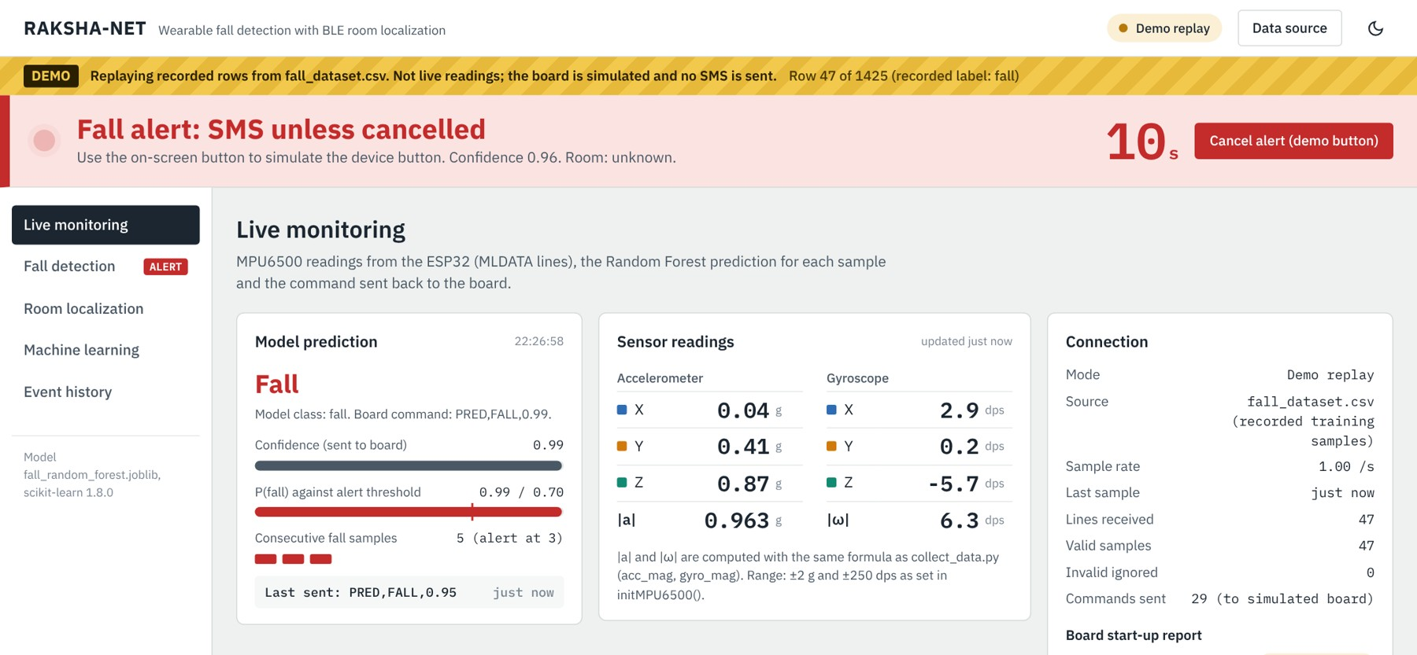
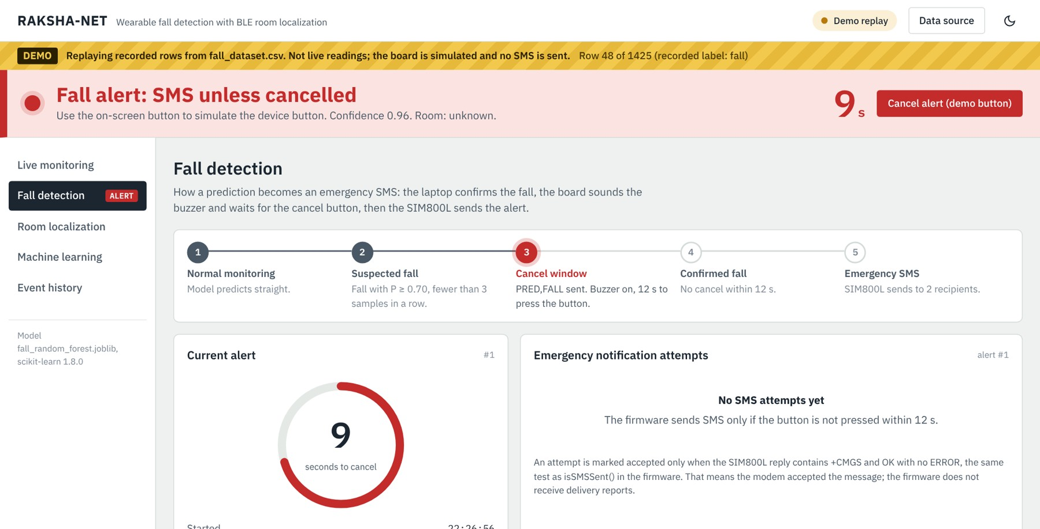
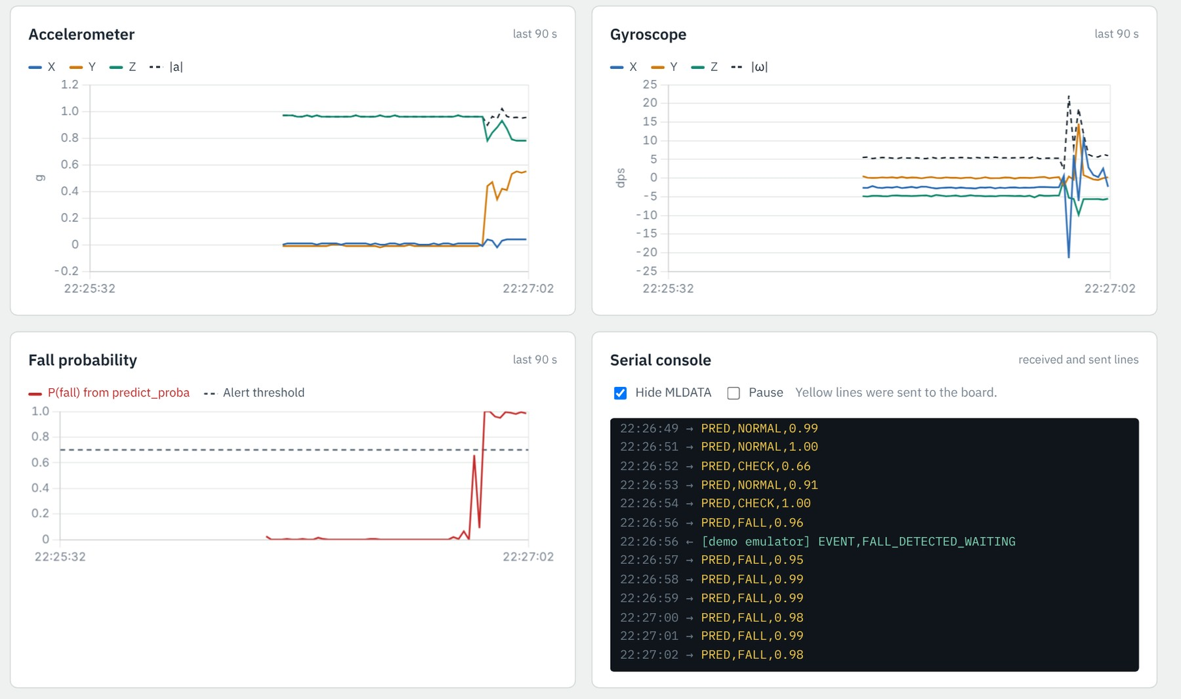
WORKING PROTOTYPE AND DASHBOARD
Hardware run: serial_debug.py (left) and predict_live.py (right) with class, confidence, fall_count, command
Dashboard, Live monitoring: readings, prediction, fall counter and alert band
Dashboard, Fall detection: alert stages and 12 s cancel countdown
Dashboard: accelerometer, gyroscope and P(fall) charts with serial console
Dashboard screenshots taken in demo replay mode (recorded fall_dataset.csv rows, board simulated, no SMS). The same pages show live data when the laptop is connected to the ESP32.

Slide 15
TESTING AND VALIDATION
Function tested | Evidence | Result
MPU6500 readings over serial | serial_debug.py output: ACC/GYRO and MLDATA lines | Validated and passed
Live ML classification | predict_live.py output with class, confidence and PRED command | Validated and passed
Model on held-out data | 357-row test split, per sample: 96.9% accuracy | Validated and passed
Fall confirmation and LCD countdown | LCD "FALL? Btn=Cancel, SMS in 9 sec" after consecutive fall predictions | Validated and passed
GSM alert SMS | SMS received: Room Bedroom, RSSI −76, AI confidence 0.95 | Validated and passed
Second SMS recipient | Alert received on the second number (team hardware test) | Validated and passed
BLE room identification | LCD: Bedroom −52, Hallroom −54, Outside_Range; Washroom −48 to −59 dBm in ai_fall_log.csv | Validated and passed
Cancel button and buzzer | Button press stops buzzer and SMS within the 12 s window (team hardware test) | Validated and passed
MicroSD logging | ai_fall_log.csv: over 100 alert entries; gsm_log.csv: +CMGS 40–42 with OK | Validated and passed
Serial link over long runs | Continuous USB serial during hardware runs (team hardware test) | Validated and passed
Repeated fall trials | Held-out falls all detected; false episodes 17 → 2 (k = 3) → 0 (k = 5) | Validated and passed
Dashboard software | 20 automated tests; same PRED bytes as predict_live.py; demo replay | Validated and passed
Power consumption | Not measured | Not tested

Slide 16
CHALLENGES AND IMPROVEMENTS
Challenge | Effect | What we changed (in the code)
MLDATA was printed with every log message | Classifier received repeated or all-zero samples as new data | MLDATA now printed only after a real IMU read (logSensorData)
Single-sample false triggers | Any odd reading could start an alert | 3 consecutive fall results with confidence ≥ 0.70, plus a 12 s cancel window
Invalid readings or stopped stream | Wrong predictions when the sensor is not read | Samples below 0.20 g ignored; PRED,CHECK,0.00 after 3 s without data
SIM800L baud rate not fixed | No AT response at the expected speed | Auto-detect over 6 baud rates; LCD shows "GSM Error, Check SIM/PWR"
SMS wait blocked the loop for the full timeout | Slow alerts | readGSMUntil() returns on OK or ERROR; failure reply shown on LCD and logged
BLE scanning is slow (3 s) | Main loop and LCD would stall | Scan runs as a FreeRTOS task on core 0; room data guarded by a critical section
Added for Review 3
  Monitoring dashboard: live serial view, fall stages, room, ML results, event log and CSV export; demo replay when hardware is absent.
  Verification: automated tests confirm the dashboard sends the same commands as predict_live.py.
  Firmware option: event-reporting patch that prints alert and SMS status on serial (compiled, not yet flashed).

Slide 17
CONCLUSION AND FUTURE SCOPE
1. Conclusion
  Built a working bench prototype: the ESP32-S3 streams MPU6500 data, the laptop classifies each sample and the board raises a buzzer and LCD alert with a 12 s cancel window.
  All functional tests passed in hardware runs: live predictions, LCD countdown, cancel button, room detection, SMS to both numbers and SD logging.
  Random Forest: 96.9% on the random test split, 96.6% in 5-fold cross-validation; every fall caught on later recordings.
2. Limitations
  Data from one volunteer and a teddy bear only.
  Single samples at about 1 Hz, ±2 g range.
  Inference on the laptop over USB; SIM800L on the board supply.
  Power consumption not measured; room-level location only.
3. Future Scope
  Sample at 50 Hz or more and classify short windows.
  Extend the accelerometer range beyond ±2 g; remove the gyroscope offset at start-up.
  Run a smaller forest on the ESP32-S3; give the SIM800L its own supply.
  Collect event-labelled data from several wearers; check room accuracy in all rooms.
MPU6500 sensing + Random Forest classification + BLE room identification + SMS after a 12 s cancel window

Slide 18
REFERENCES AND SUPPORTING LINKS
[1] World Health Organization, "Falls," Fact sheet, 21 Oct. 2026. who.int/news-room/fact-sheets/detail/falls
[2] R. Igual, C. Medrano and I. Plaza, "Challenges, issues and trends in fall detection systems," BioMedical Engineering OnLine, vol. 12, art. 66, 2013, doi:10.1186/1475-925X-12-66
[3] L. Breiman, "Random Forests," Machine Learning, vol. 45, no. 1, pp. 5–32, 2001, doi:10.1023/A:1010933404324
[4] F. Pedregosa et al., "Scikit-learn: Machine Learning in Python," Journal of Machine Learning Research, vol. 12, pp. 2825–2830, 2011.
[5] TDK InvenSense, MPU-6500 Product Specification.
[6] SIMCom Wireless Solutions, SIM800 Series AT Command Manual.
[7] Espressif Systems, ESP32-S3 Series Datasheet.
Supporting links
Item | Link
GitHub repository | https://github.com/LakshmananParthasarathySubbiah/RAKSHA-NET
Demonstration video | https://drive.google.com/file/d/1NSicNeXJ_TEGcQyVMQZT8Lcgb-owuh-1/view
Dashboard (online demo replay) | https://raksha-net-da3-vitc.vercel.app
IEEE project report | https://docs.google.com/document/d/1tkphE-E_hh2wXWzOzW7m_2iI8aC8j3y8QR7x9MrlkrM
References and proofs document | https://docs.google.com/document/d/1VNs3Jc9mYc-b4mMi58AH8aHW2Y_WUNgGyTsJXDkRRuY

