Slide 1
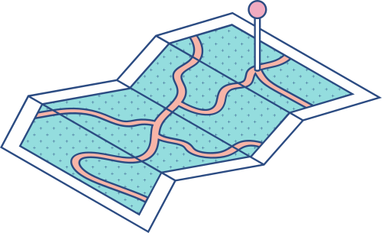





ORGANIZATION - WEBCHIRPY
Project 1
Manual Calculator
Presented by - M Lakshmi Dharshini

Slide 2



Agenda
KEY TOPICS DISCUSSED IN THIS PRESENTATION
Project Overview Problem Statement Solution Methodology Key features Results and achievement Challenges faced

Slide 3

Project Overview
The main goal of the project is to create a manual calculator using Python & GUI. The hurdle in this project is to bring float numbers and when to execute “error” statement

Slide 4
Problem statement
1
2
3
4
5
TO BRING FLOAT VALUES
TO EXECUTE ERROR STATEMENT
TO PLACE THE BUTTONS IN CALC IN ORDER
TO ALIGN THE BUTTONS IN WIDGET
TO SIMPLIFY THE ARITHMETIC OPERATIONS USING PYTHON CODE

Slide 5
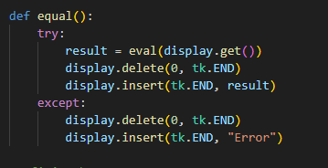
SOLUTION & CHALLENGES FACED
TO EVALUATE THE FLOAT VALUES
TO SIMPLIFY THE ARITHMETIC OPERATIONS USING PYTHON CODE
In this code I have used “eval” function to evaluate the values that is entered in the calculator. This function minimizes the number of code and it performs all the arithmetic functions as well as it can provide me with float values too.

Slide 6
SOLUTION & CHALLENGES FACED
TO EXECUTE THE ERROR STATEMENT
I used try and except method for “error” display instead of “if & else” to avoid nestled conditions and easier way.

Slide 7
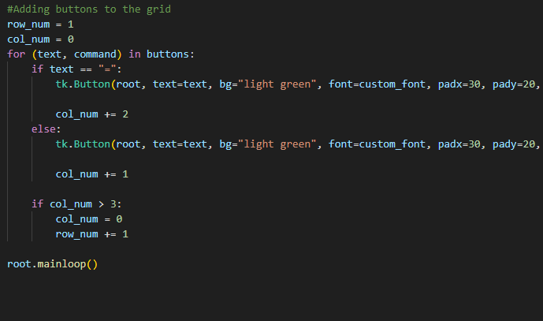
SOLUTION & CHALLENGES FACED
TO PLACE THE BUTTONS IN ORDER
Learned the technique of using multiple “if” “else” command to place under the “for” command to loop.

Slide 8
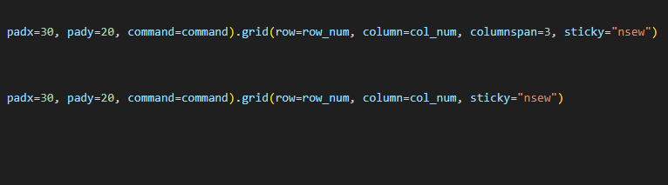
SOLUTION & CHALLENGES FACED
TO ALIGN THE BUTTONS IN WIDGET
Aligning the buttons to the calculator was the biggest challenge I faced that’s when I came across padding of buttons and center aligning of the buttons with “sticky” command. This command will allow the buttons to automatically center align to the calculator’s width.

Slide 9


Methodology & Key Features
For loop and nestled “if” conditions to align the buttons
Lambda to call the functions and minimize the number of codes
“Eval” function to do all the arithmetic functions
“try & Except” function to evaluate the value or result “error” if unusual values are input
Tkinter library commands to customize the look of the calculator

Slide 10
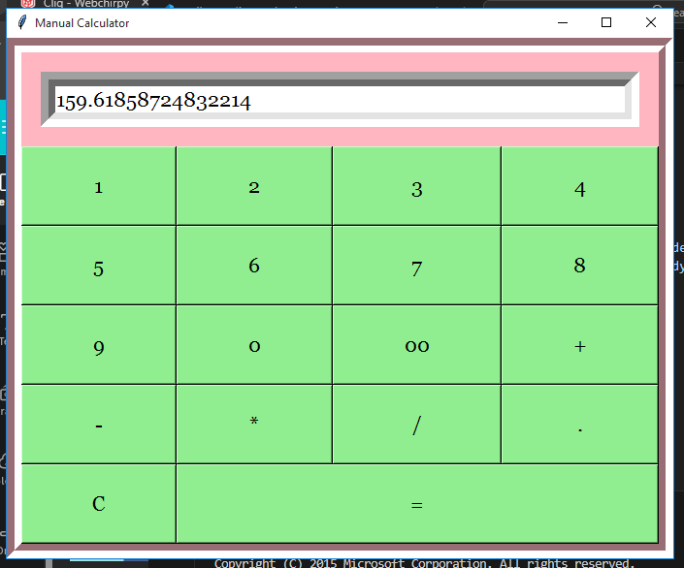

RESULT

