Slide 1
FAKE NEWS DETECTION USING MACHINE LEARNING
A presentation by:
M. Lakshmi Gowri

Slide 2

Abstract
Introduction
Major Problem
Our solution
Technology Used
Explanation
Conclusion

Slide 3
Introduction
Fake news has been around for decades and is not a new concept.
However, the social media page has aggravated the generation and circulation of fake news many folds.
Fake news can be simply explained as a piece of article which is usually written for economic, personal or political gains.
In recent years, the reliability of information has emerged a crucial issue of modern society.

Slide 4
Major Problem
The main objective is to generate a model that can discriminate between “fake” and “true” news articles when it is trained with a certain data set.
The increase of fake news on social media and internet is deceiving people to an extent which needs to be stopped.
Fake news websites may found in Ukraine, United states of America, Germany, china and lots of other countries.
Hence, Fake news is a global issue as well as global challenge.

Slide 5
Our Solution
Our goal is to develop a reliable model that classifies a given news article as either fake or true.
Here, Data Cleaning and Preparation, Basic data exploration, Modelling, Preparing the data.
Used on different algorithms like Logistic Regression, Decision tree Classifier, Random Forest Classifier.
We find accuracy in different algorithms and take the highest accuracy model to our project.

Slide 6
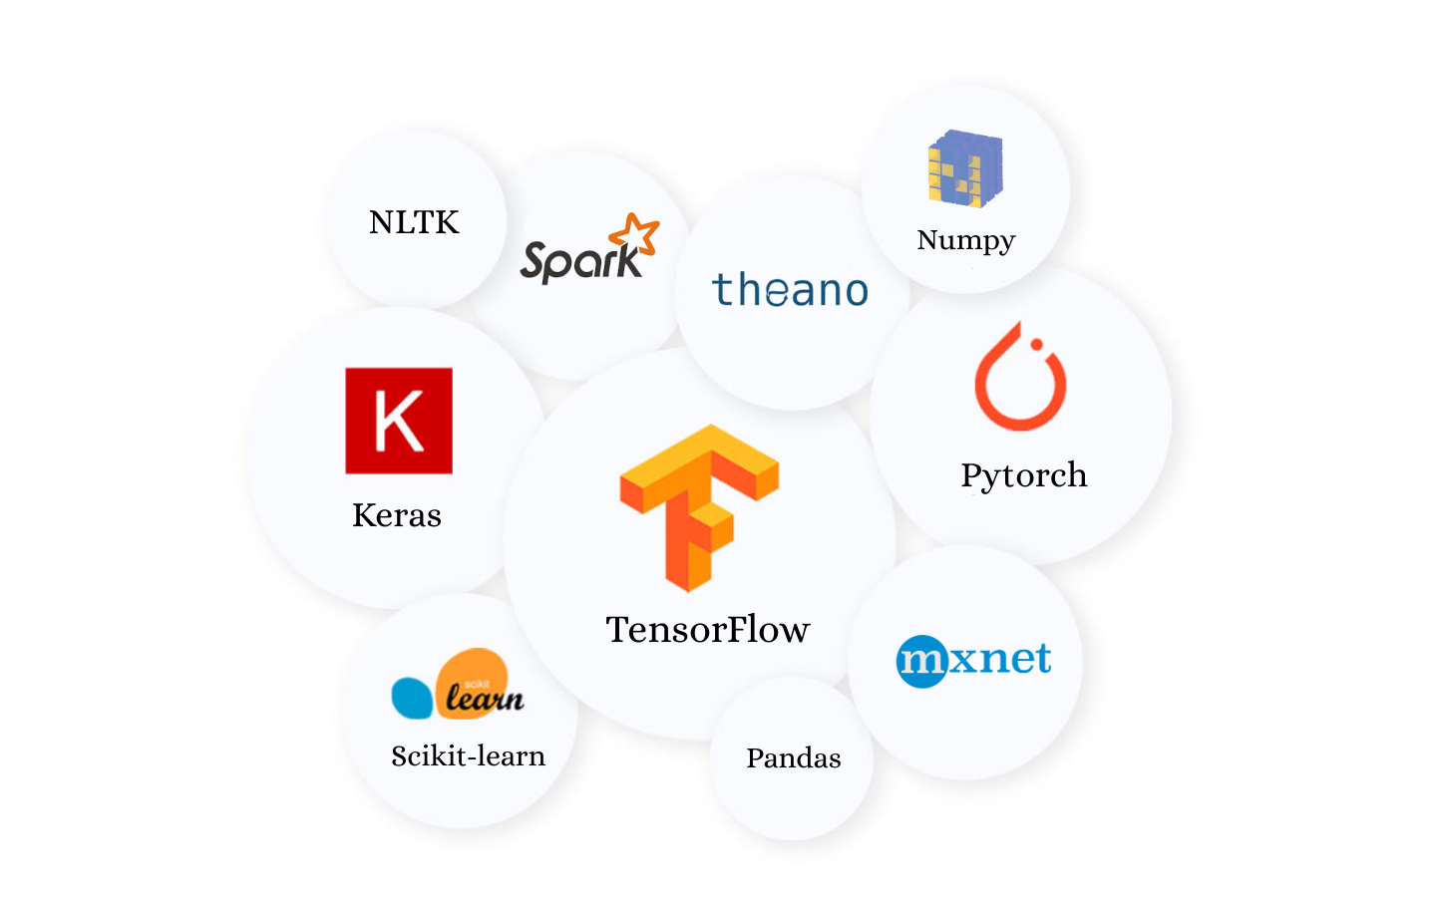
Technology Stack Used
Software’s : Anaconda Navigator, Jupyter notebook.
Libraries : Python,
Pandas,
NumPy,
word cloud,
sklearn,
nltk…etc.,

Slide 7
Explanation
I choose this project because these days people can’t find which is fake and which is real.
I have chosen the dataset from the Kaggle site, here is link: https://www.kaggle.com/clmentbisaillon/fake-and-real-news-dataset
After loading data into jupyter notebook, I performed some operations to clean the data.
After data cleaning, we understand the characteristics of the data and we try to model it.
To model, we use word cloud in the project.

Slide 8

(cont.….)
WORD CLOUD : the more a specific word appears in a source of textual data(ex: blog, database, speech), the bigger and bolder it appears in the word cloud, the more often its mentioned within a given text and the more important it is.
Word Cloud is also known as Tag cloud or Text clouds.
They help business users compare and contrast two different pieces of text to find the wording similarities between the two.

Slide 9
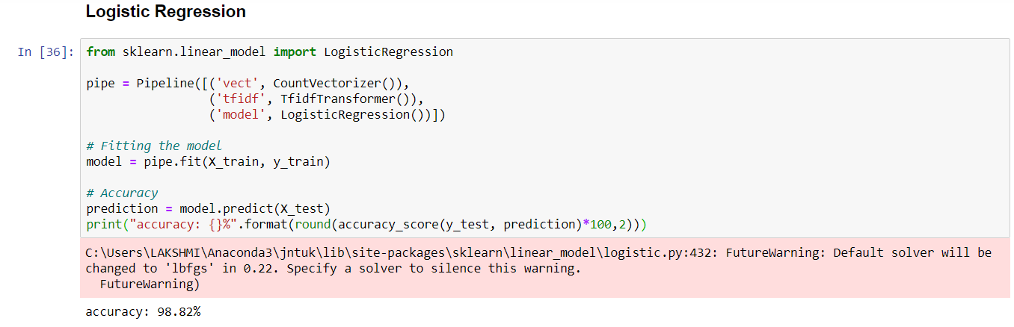
(cont.….)
To Model the data, I Used different ways

Slide 10
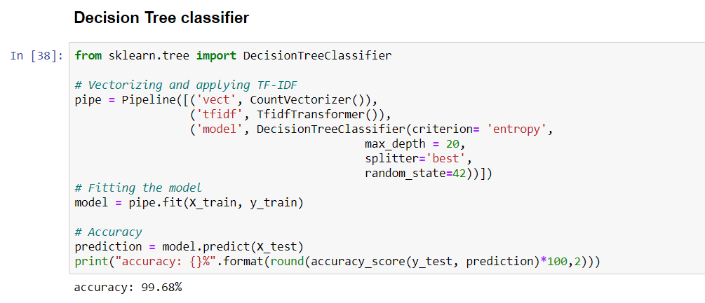
(cont.….)

Slide 11
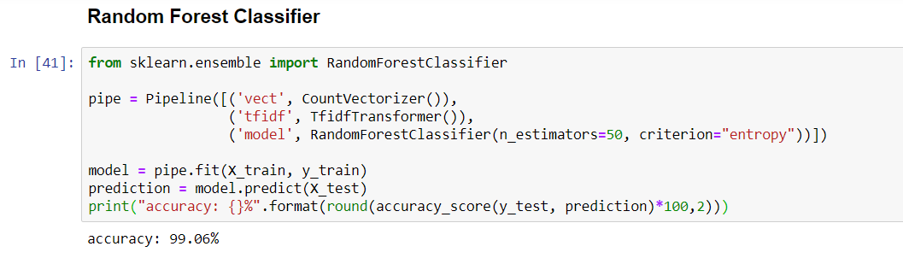
(cont.….)

Slide 12
(cont.….)
In all the above algorithms, the highest accuracy(99.68) is found in the decision tree classifier.
And after Random forest Classifier algorithm shows high accuracy(99.06).
When we test the data, we may come to know whether our model is correct or not.
We can check by giving news articles, blogs, speeches as input.

Slide 13
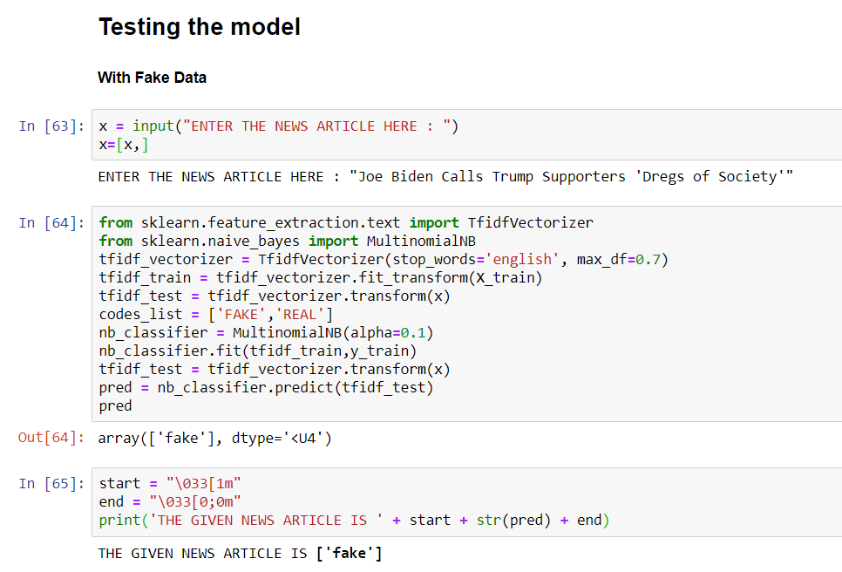

Slide 14
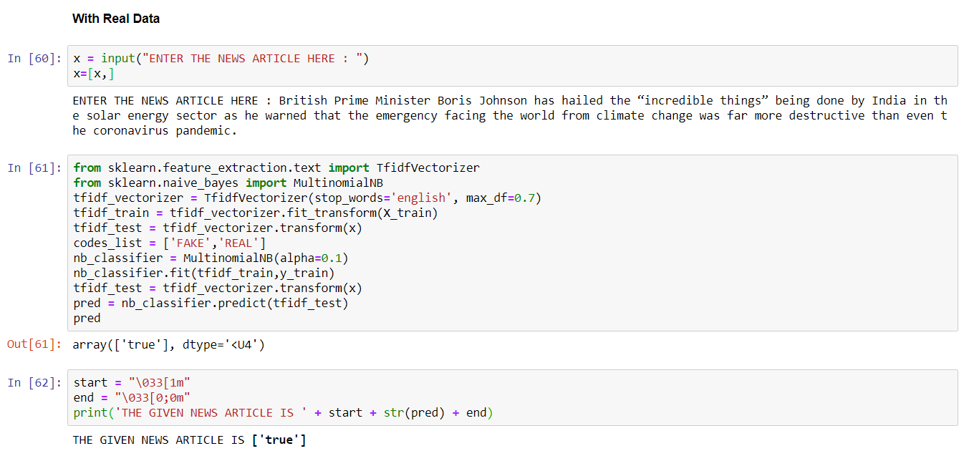

Slide 15
Conclusion
In the 21st century, the majority of the tasks are to done online.
Newspapers who were earlier preferred as hard-copies are now being substituted by applications like Facebook, twitter and news articles to be read online.
We can detect the fake news by this and stop encouraging it.
Hence, we can classify the online news into real or fake by using Machine learning algorithms.

Slide 16


