Slide 1
Employee Data Analysis using Excel
Lakshmi R
312218616
B.Com (general)
J.N.N Arts and Science Women's College
STUDENT NAME:
REGISTER NO:
DEPARTMENT:
COLLEGE

Slide 2
PROJECT TITLE
Employee Performance Analysis using Excel

Slide 3


AGENDA
Problem Statement
Project Overview
End Users
Our Solution and Proposition
Dataset Description
Modelling Approach
Results and Discussion
Conclusion
3/21/2024 Annual Review

Slide 4

PROBLEM STATEMENT
1. "How can we identify the key drivers of high employee performance and develop targeted training programs to enhance those skills?" 2. "What is the relationship between employee engagement and performance, and how can we improve both?" 3. "How can we use data to predict which employees are at risk of leaving the company and develop retention strategies?"

Slide 5

PROJECT OVERVIEW
•OBJECTIVE:
To analyze and evaluate employee performance data to identify trends, strengths, and weaknesses
SCOPE:
Collect and analyze employee performance data from various sources (e.g., HR systems, performance reviews, sales data)

Slide 6

WHO ARE THE END USERS?
1.HR Managers 2.Line Managers 3.Senior leadership
4.Employees
5.Talent management teams
6.Training and development teams

Slide 7

OUR SOLUTION AND ITS VALUE PROPOSITION
SOLUTION:
Employee Performance Analytics Platform (EPAP)
VALUE PROPORTION: • Data-Driven Insights:EPAP provides accurate and timely performance data, enabling managers to make informed decisions.
• Improved Productivity:Identify high-performing employees and areas for improvement, optimizing resource.

Slide 8
Dataset Description
Description: This dataset contains information on employee performance, including demographic data, job information, performance metrics, and feedback.

Slide 9

THE "WOW" IN OUR SOLUTION
The FORMULA used for finding the performance level of employee.
=IFS(Z8>=5,"VERY HIGH",Z8>=4,"HIGH"Z8>=3,"MEDIUM",Z8>=2,"LOW",Z8>=1,"VERY LOW")
3/21/2024 Annual Review
9

Slide 10
MODELLING
1. Regression Models: Predict continuous outcomes (e.g., sales performance) based on demographic and performance variables. 2. Classification Models: Predict categorical outcomes (e.g., high/low performer) based on demographic and performance variables. 3. Clustering Models: Group employees with similar performance characteristics. 4. Decision Trees: Visualize relationships between variables and predict performance outcomes.
10

Slide 11
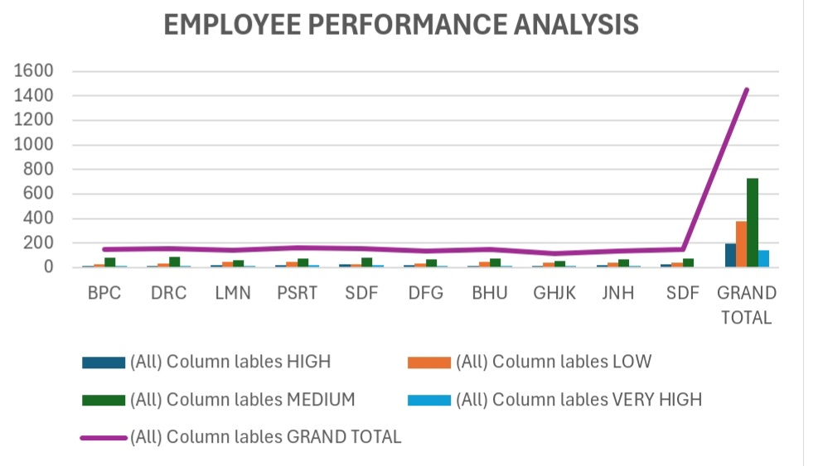
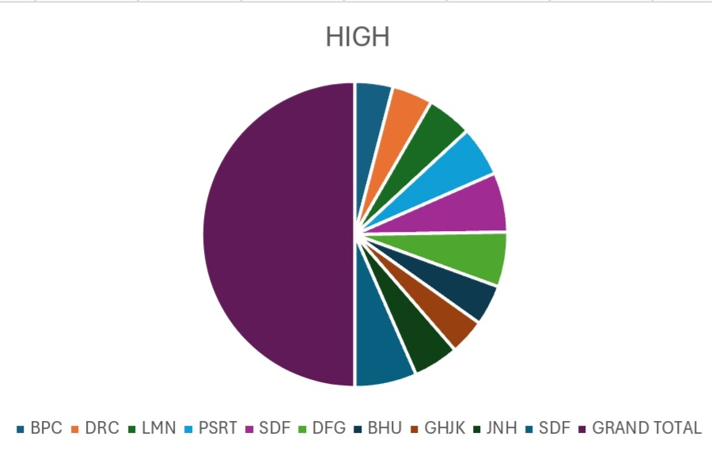
RESULTS
11

Slide 12
conclusion
The employee performance analysis has provided valuable insights into the relationships between demographic, performance, and developmental factors. The findings suggest that: ● High-performing employees tend to have longer tenure, higher job satisfaction, and more frequent training and development opportunities. ● Performance metrics such as sales numbers and customer satisfaction scores are strong predictors of overall performance ratings.

