Slide 1



MarineMesh Performance Report (Mar 10-12, 2024)
Prepared for: P-Koncepts Management 2 & 3
MarineMesh Stakeholders

Slide 2
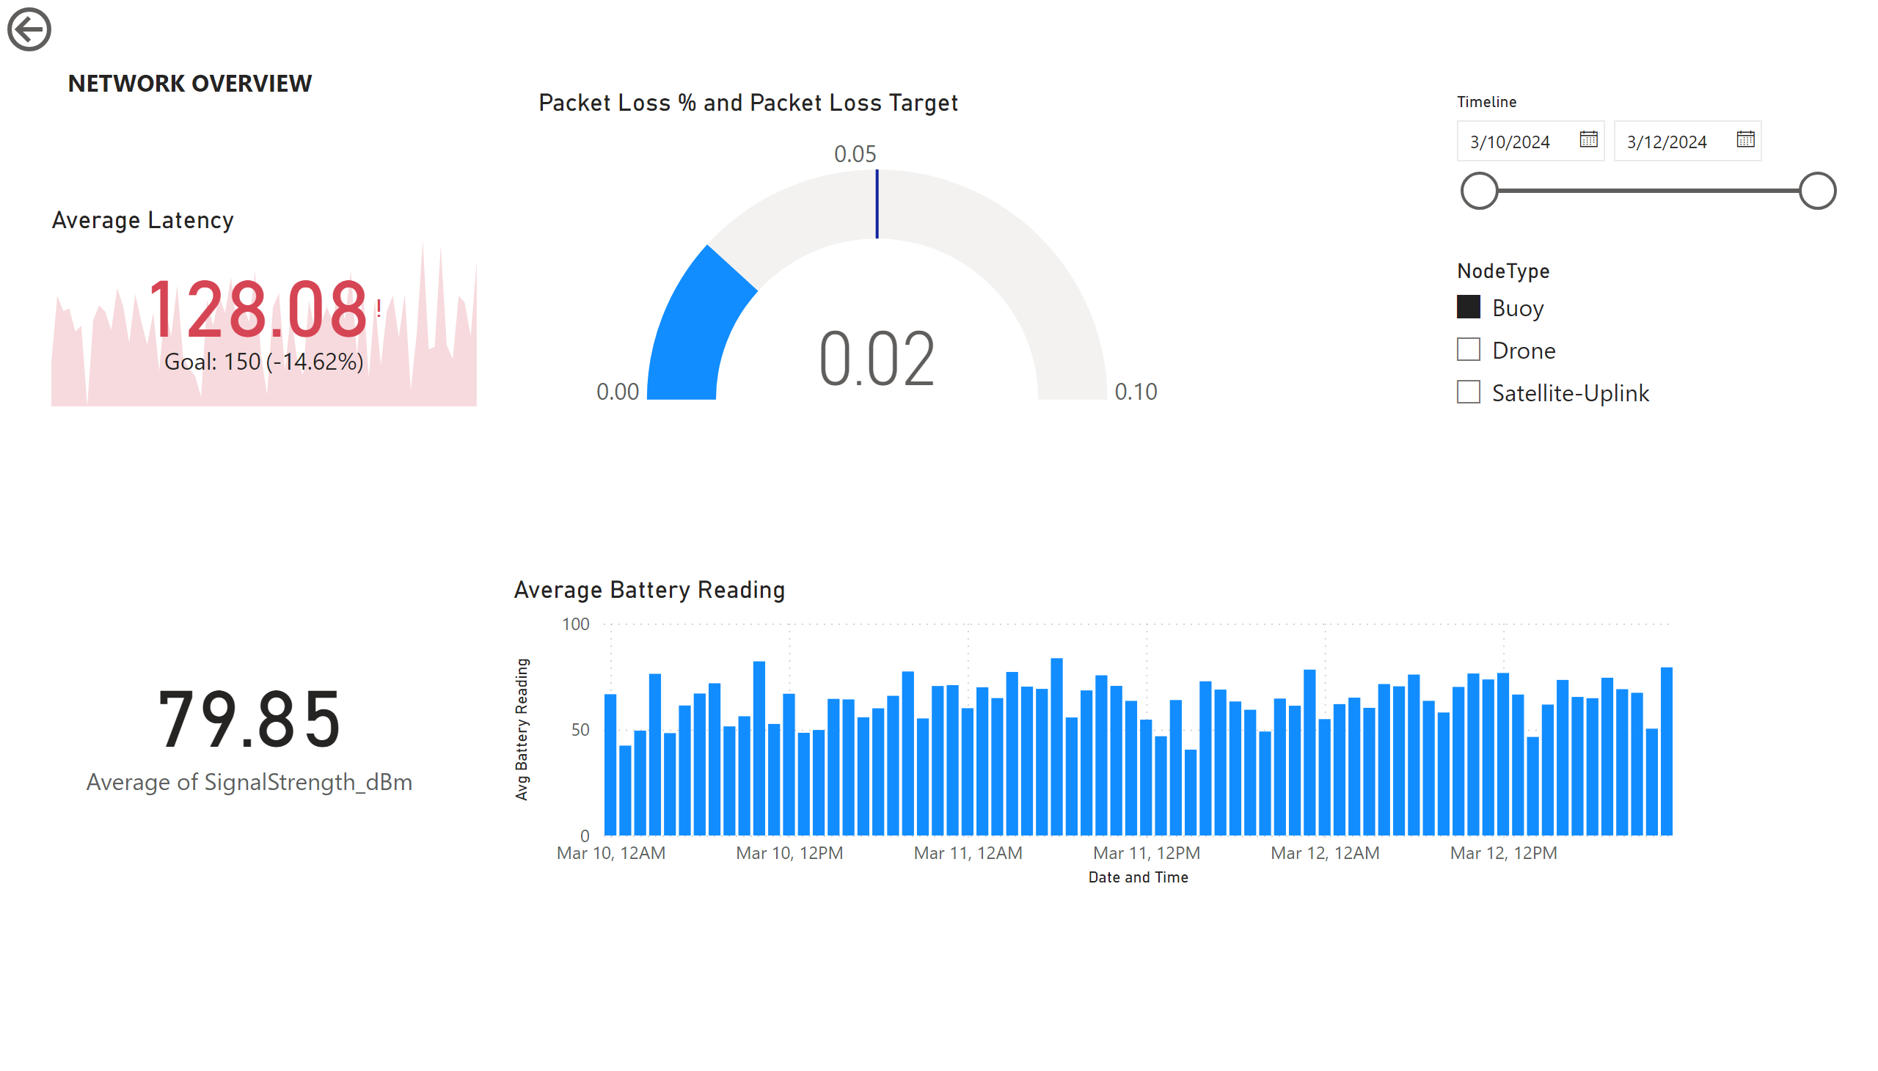
Network Overview
Notes:
card
No alt text provided
actionButton
No alt text provided
gauge
No alt text provided
Average Battery Reading
No alt text provided
slicer
No alt text provided
slicer
No alt text provided
textbox
No alt text provided
Average Latency
No alt text provided

Slide 3
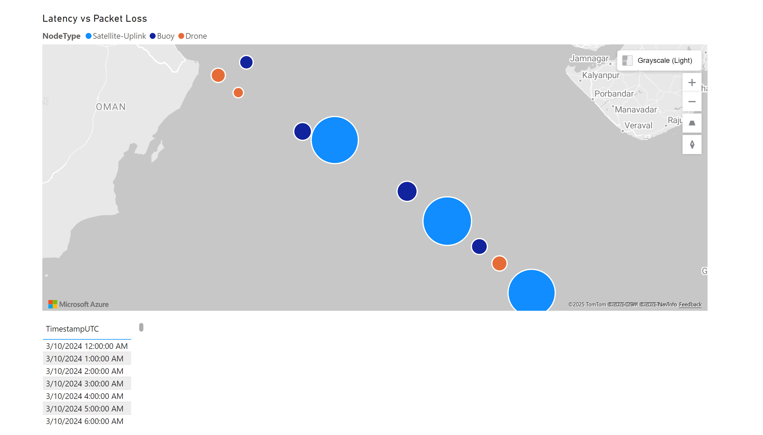
Geo-Nodes Map
Notes:
Latency vs Packet Loss
No alt text provided
tableEx
No alt text provided

Slide 4
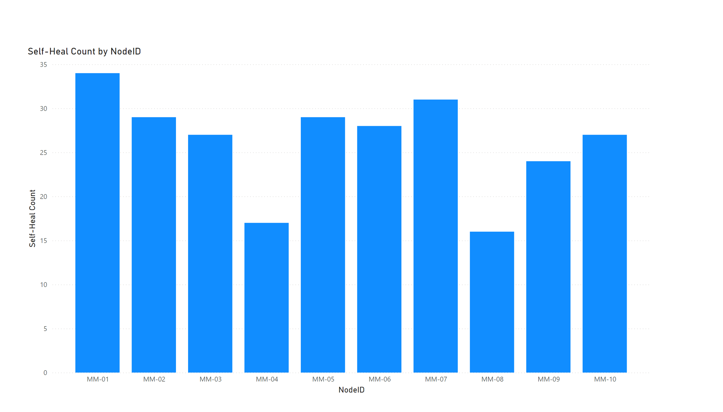
Self Healing Analytics
Notes:
columnChart
No alt text provided

Slide 5
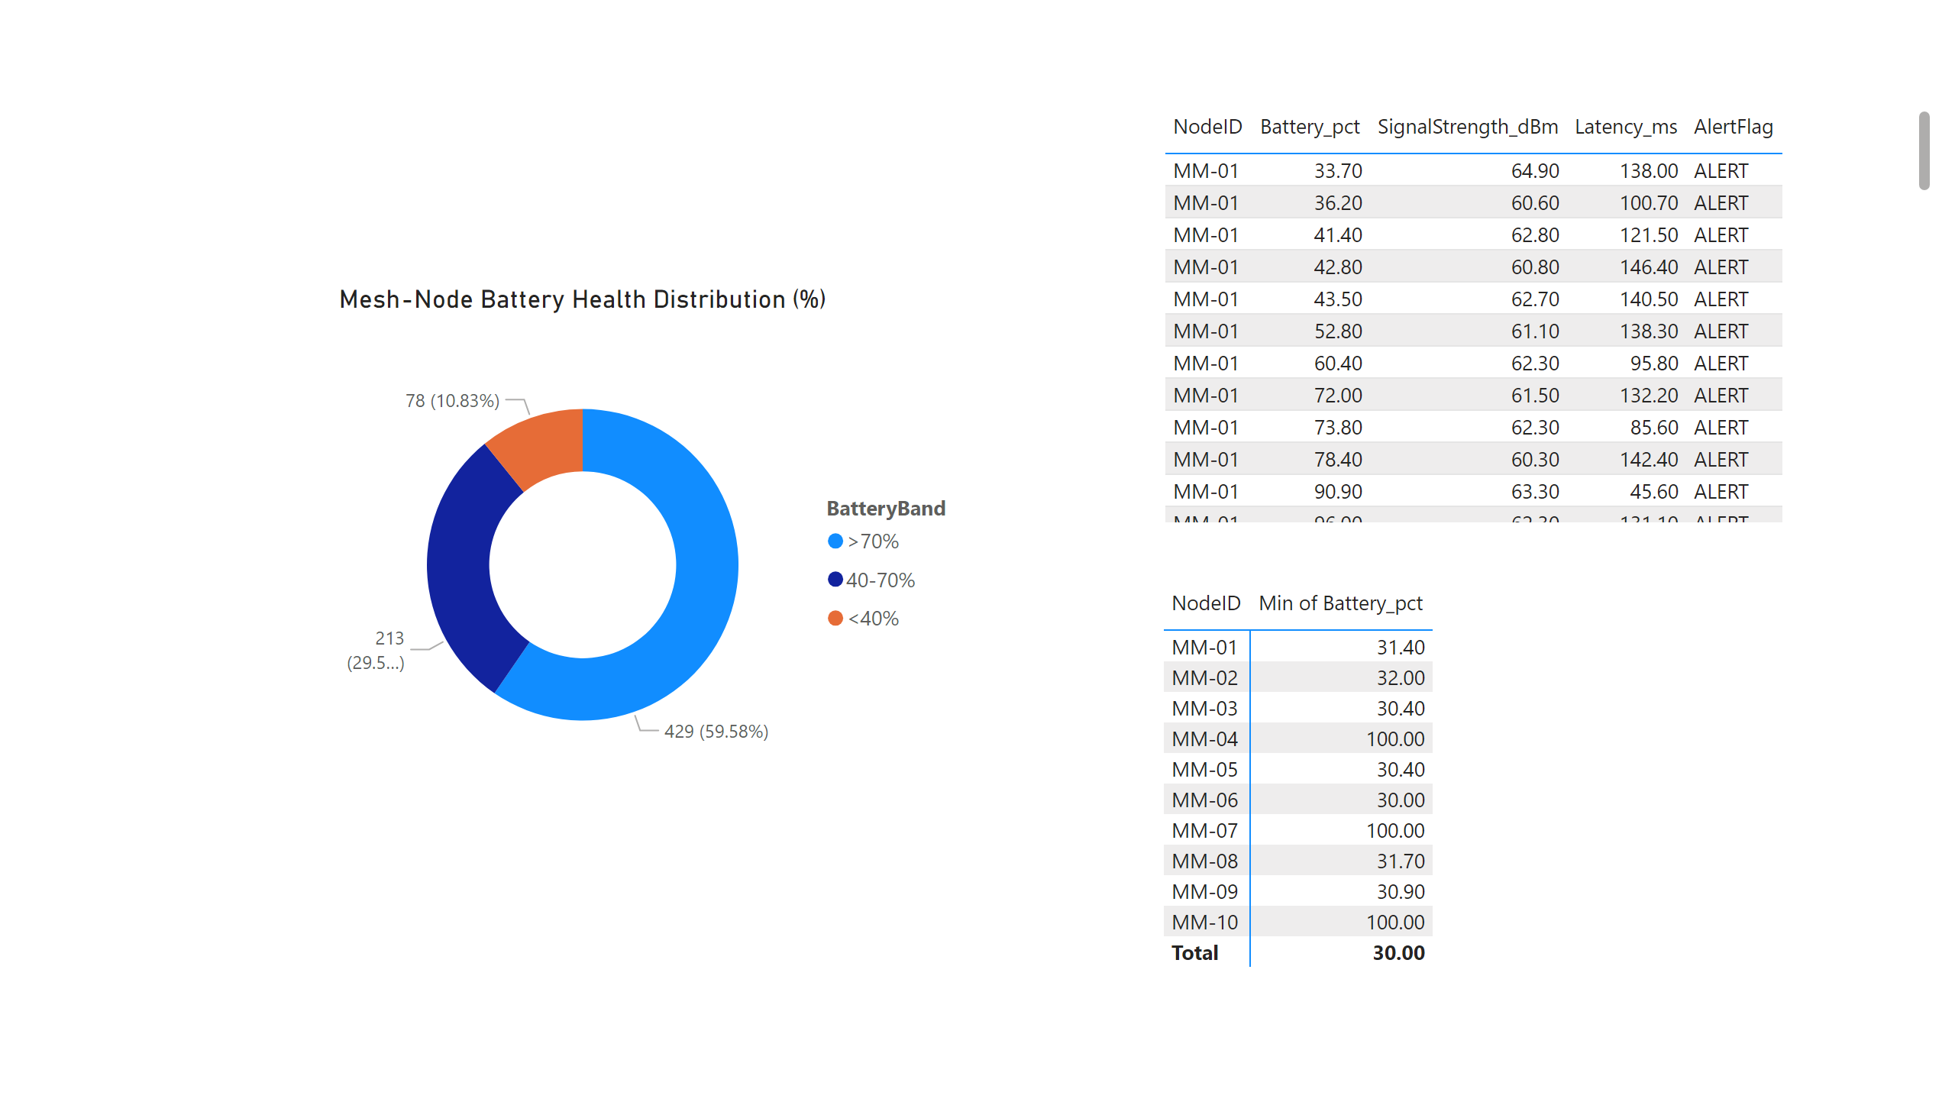
Alerts
Notes:
tableEx
No alt text provided
pivotTable
No alt text provided
Mesh-Node Battery Health Distribution (%)
No alt text provided

Slide 6
Summary
MarineMind Mesh – 10-12 Mar 2024
The network held 98 % uptime with average latency 112 ms.
Only 9 % of traffic periods breached the 5 % packet-loss limit.
Node MM-04 saw the one notable event: latency spike to 340 ms and signal dip to 66 dBm; the mesh’s self-heal recovered the packets in under 3 h.
Power status: 82 % of devices remain above 40 % battery; MM-04 and MM-07 flagged for recharge.
Next actions
Replace solar pack on MM-04 within 5 days.
Review nightly satellite congestion (23:00-02:00 UTC).

