Slide 1

A Regression-Based Study – Revealing How Flooring Affects Price Per Square Foot
Presented by : Lakshmi sravani

Slide 2


Introduction – The Homebuyer's Dilemma
Introduce the problem: Homebuyers often overlook interior details like flooring, focusing more on location or size.
But can floor covering type impact house value?
Goal: Help buyers understand how different floor types influence price per square foot.

Slide 3
Dataset Overview
About the Dataset:
Real estate sales data for residential properties, with each row representing a single house. Includes features like square footage, bathrooms, garage, HOA fees, and more.
The data was pre-cleaned to handle missing values and outliers.
Key Feature – floor_covering:
Indicates the type(s) of flooring in each house, including single or multiple types like Hardwood, Tile, Carpet, etc.
Many entries list combined floor types, requiring preprocessing for accurate analysis.
Target Variable – price_per_sqft:
Calculated as sold_price / sqrt_ft to enable fair comparisons across homes of different sizes this Reflects how floor types influence what buyers are willing to pay per square foot.

Slide 4
Data Cleaning - Floor Covering
Handling Missing Values:
Filled missing values in the floor_covering column with the most common flooring type to retain consistency.
Managing Multiple Floor Types:
Many homes had multiple flooring types listed as comma-separated values (e.g., "Hardwood, Tile“ ).
These entries were split into lists for proper analysis.
Standardization:
Extra spaces and inconsistencies were cleaned.
The result: a structured and analyzable format that supports one-hot encoding.

Slide 5
One-Hot Encoding Floor Types
Why One-Hot Encoding?
Since many homes have multiple floor types, we needed a way to represent each type individually for analysis.
How It Was Done:
Converted the floor_covering lists into binary columns—one for each common floor type (e.g., Hardwood, Tile, etc.).
Used a threshold of 10 listings to filter out rare floor types and reduce noise.
Purpose:
This allowed each floor type to be treated as a separate predictor in the regression model.

Slide 6
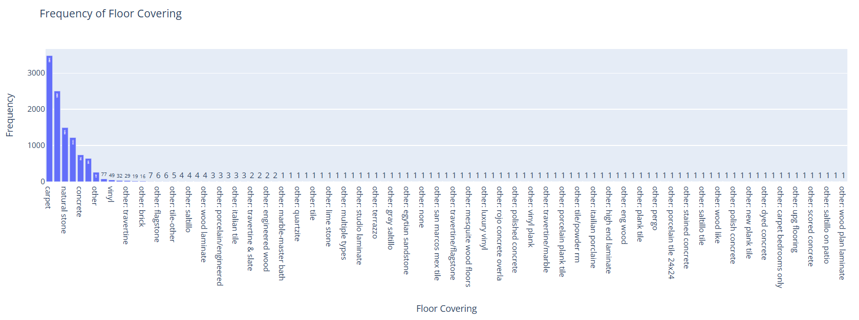
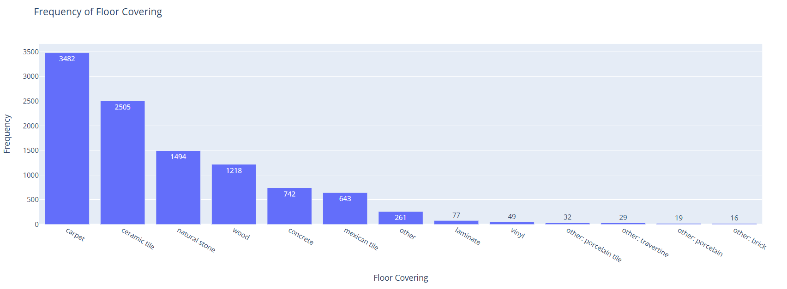
Feature selection

Slide 7
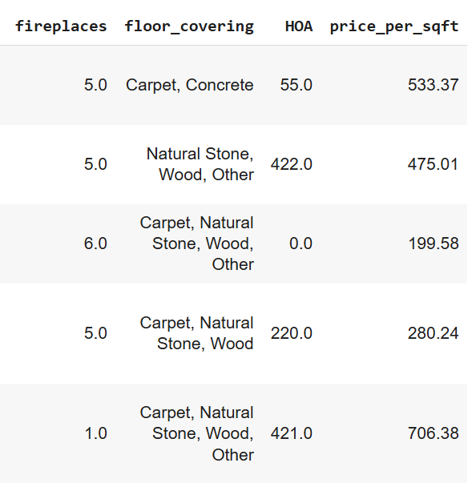
Feature Engineering – Price Per Sqft
New Metric Creation
Introduced a new feature called price_per_sqft = sold_price / sqrt_ft.
Why It Matters:
This metric normalizes property prices based on home size, enabling fair value comparison between small and large houses.
Use in Model:
Set price_per_sqft as the target variable for our regression model to evaluate how flooring impacts value per square foot.

Slide 8

Modeling Approach
Model Used:
Applied Multivariate Linear Regression to predict price_per_sqft.
Features Selected:
Used the one-hot encoded floor covering types as input features.
After one-hot encoding the floor covering, I got binary values, which alone didn’t yield good model performance. So, I added more features to my model like lot_acres and taxes to improve it.
Objective:
To Predict the Price of square foot based on the floor covering.

Slide 9
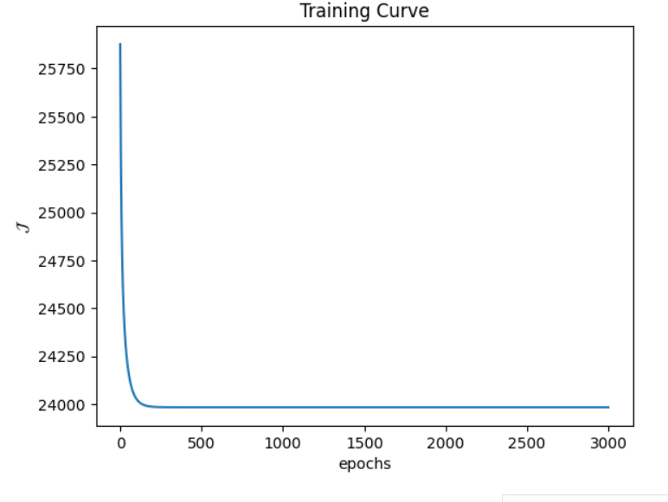
Results
Insights
Most Frequency - 3482 –carpet
Total Combinations – 289 – most repeat combination( Carpet, Ceramic tile-1229)
Among 289 combination, 166 combination repeating only one
R2 value – 0.01

Slide 10

Real-World Use Case
For Buyers: Know which floor types indicate higher quality or resale value.
For Sellers: Invest in higher-value floorings before listing.
Example Scenario: “Choosing between two similar houses—one with hardwood, the other with laminate? Our model helps make a smarter choice.”

Slide 11

Conclusion & Future Work
Recap: Floor covering plays a subtle but measurable role in home value.
Multivariate regression can demystify what makes a home worth more.
Future Ideas:
Include more interior features.
Try non-linear models (like Random Forest).

Slide 12


Thank you

